Slide 1
Longitudinal beam observations of ions in the SPS
T. Argyropoulos
Measurements: H, Bartosik, T. Bohl, A. Lasheen, G. Papotti, E. Shaposhnikova
LIU-SPS BD WG 20/11/2018

Slide 2
Outline
Preliminary analysis of bunch measurements for two different cycles.
During the setting up of the 75 ns LHC beam
14-11-2018 (not analysed yet)
15-11-2018
During an LHC filling
15-11-2018 Fill 7446

Slide 3
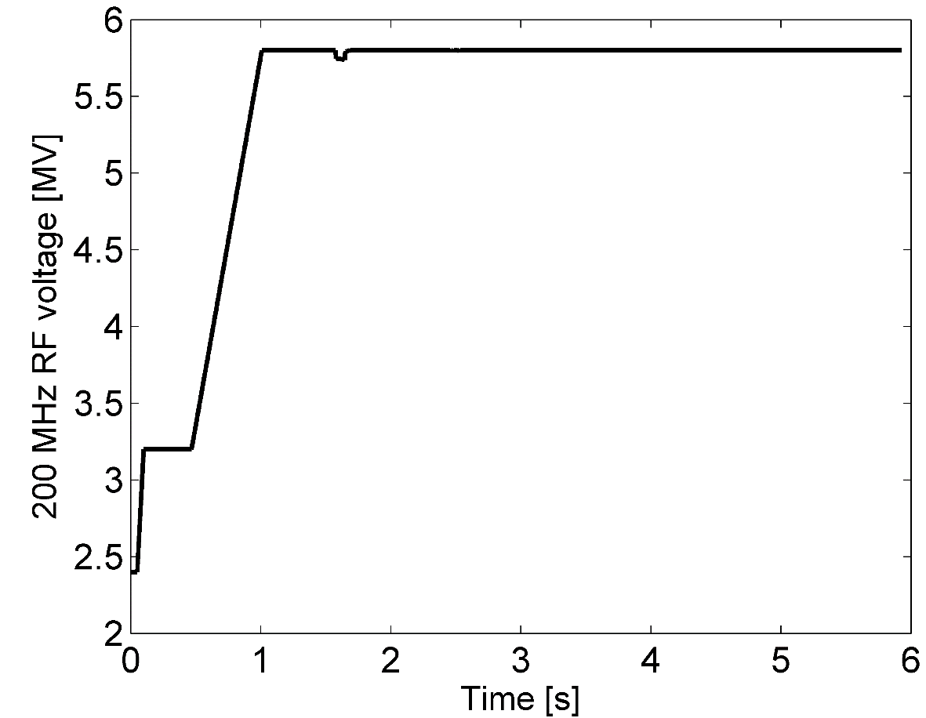
1 batch (3 bunches) optimization
LHC requests beam with 75 ns bunch spacing → Thomas, Giulia set-up the beam (Elena, Alex on the 14th )
Measurements of short cycle: 1 injection of 3 bunches spaced by 75ns
200 MHz RF voltage program
Linear increase at the start of ramp until 5.8MV. → constant later on.
Decreasing the RF voltage after transition worse for stability and losses.
Similar if is decreased before
Transition crossing

Slide 4
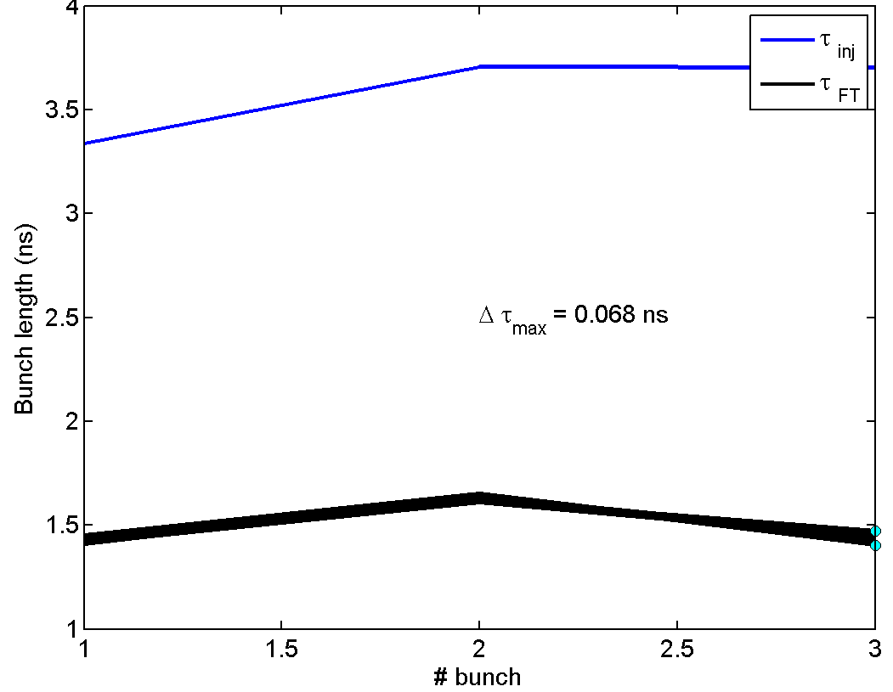
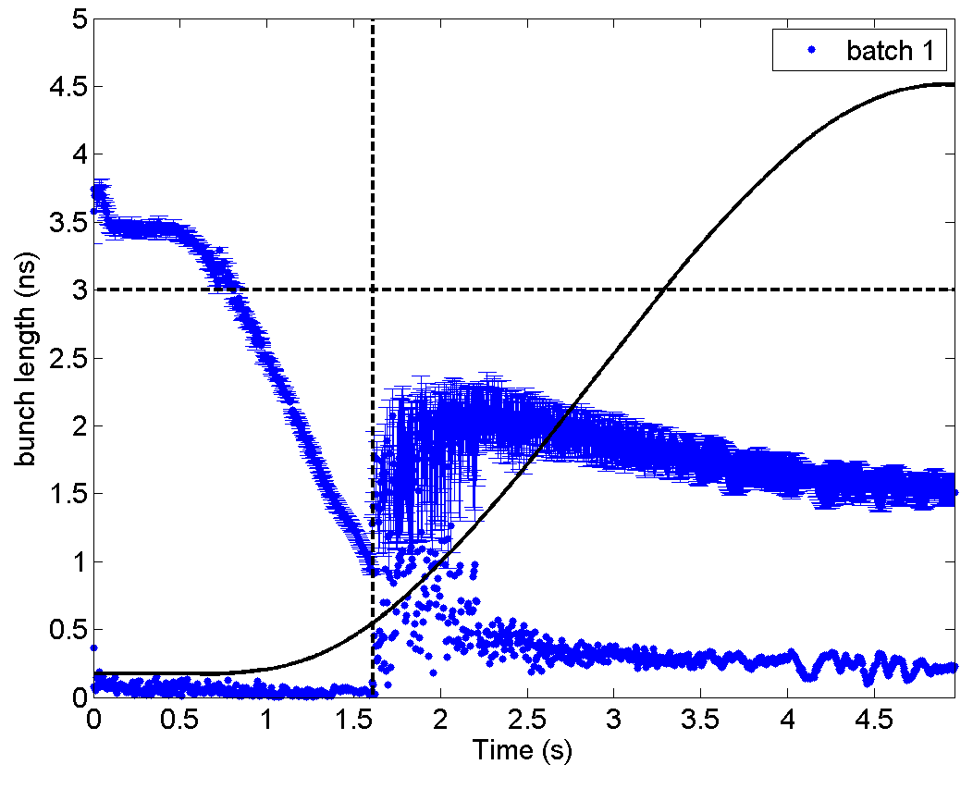
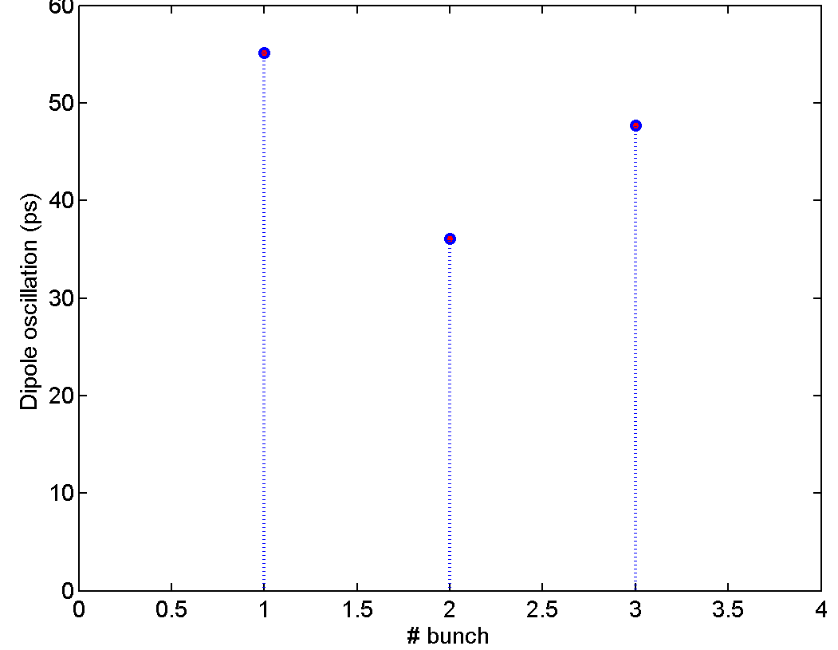
1 batch (3 bunches) optimization
Example in the beginning
Stable → accepted by BQM

Slide 5
1 batch (3 bunches) optimization
Example in the beginning
No optimisation of the transition timing yet → bunches blow-up after transition → more stable at flat top
But this is not controlled → can be more often unstable.

Slide 6
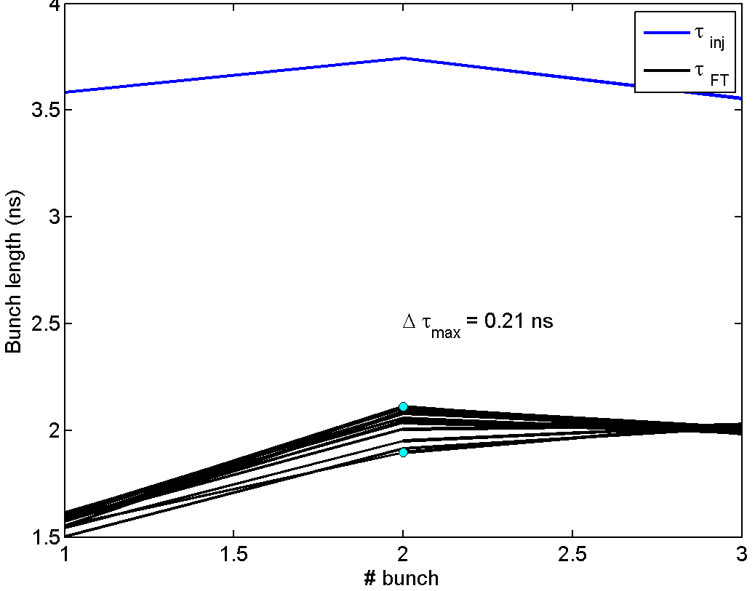
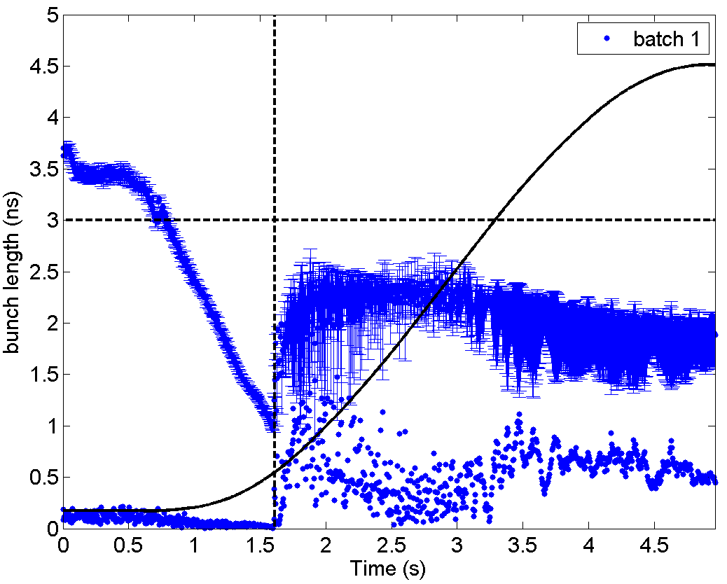
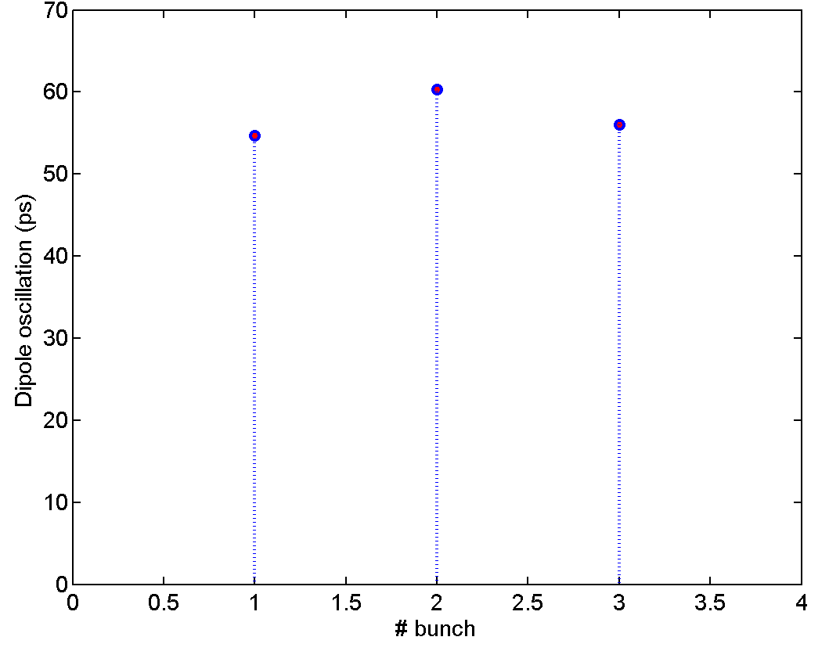
1 batch (3 bunches) optimization
Example 2 in the beginning
Still acceptable by BQM

Slide 7
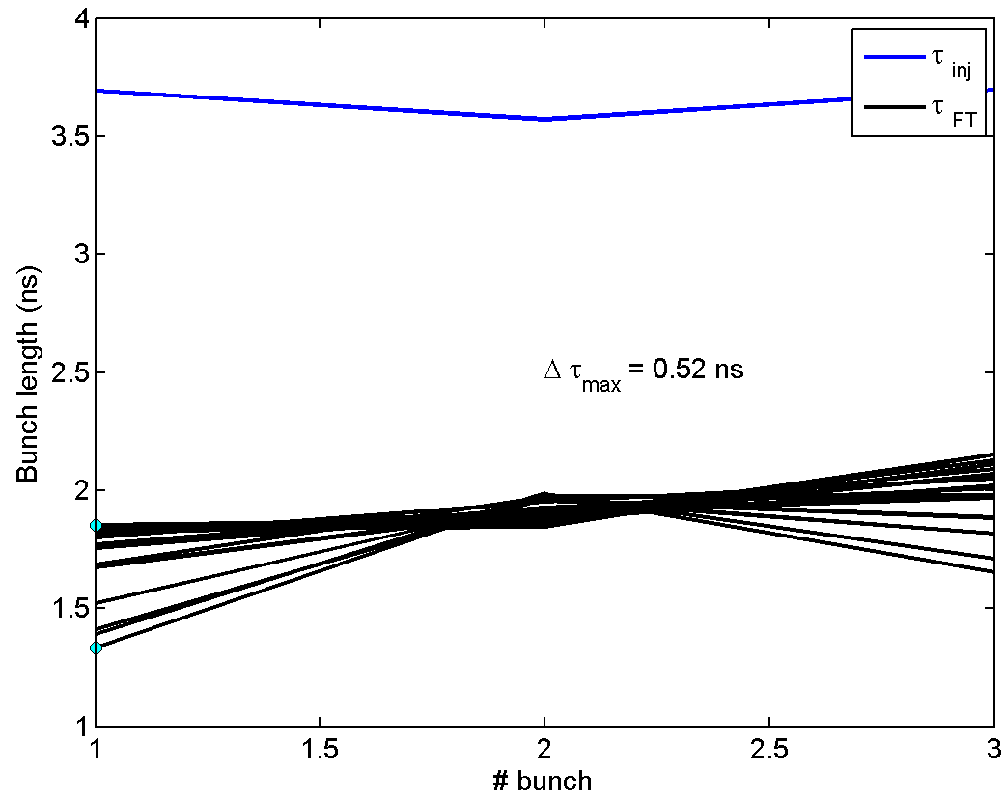
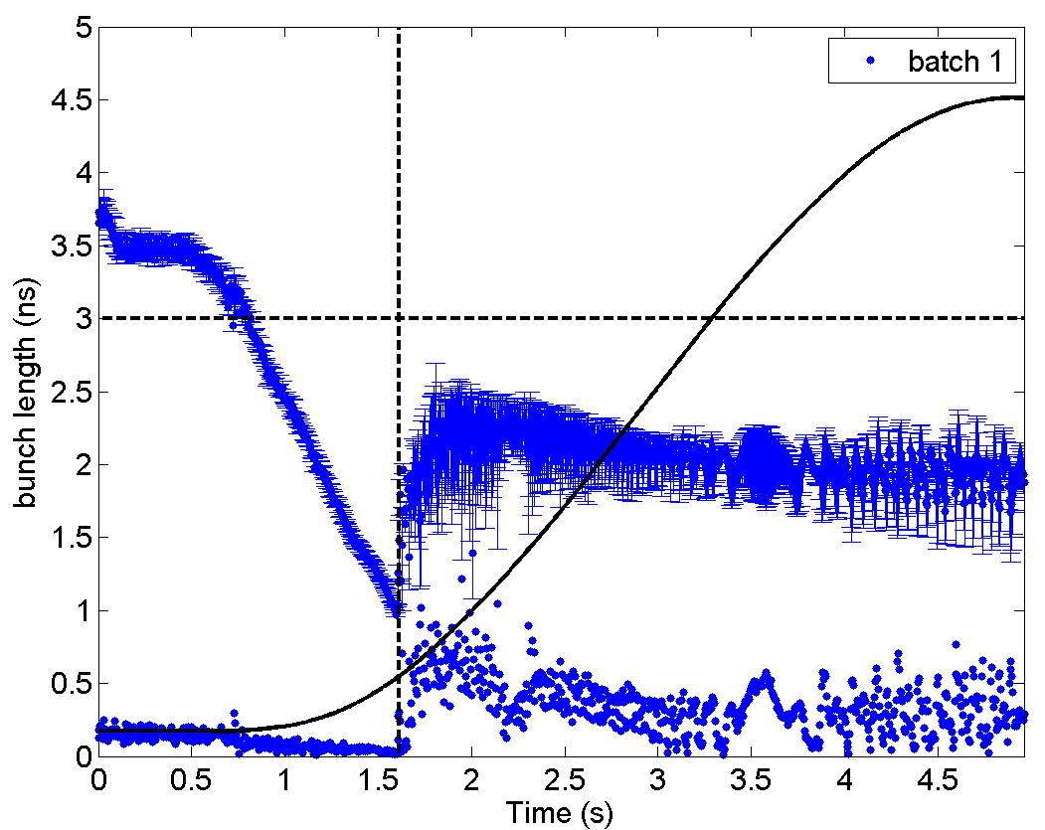
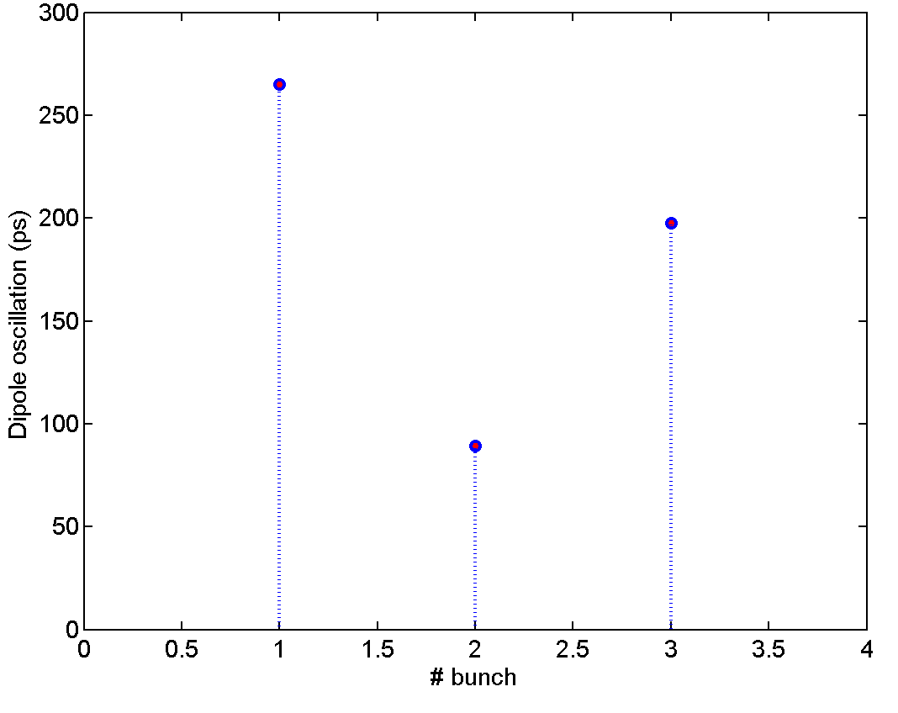
1 batch (3 bunches) optimization
Example 3 in the beginning
Not acceptable by BQM

Slide 8
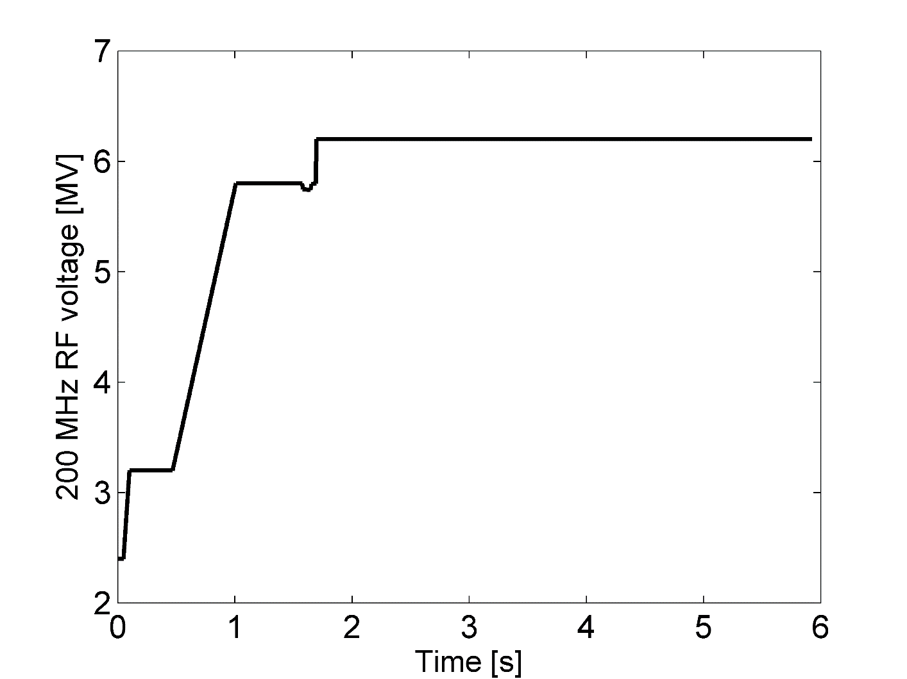
1 batch (3 bunches) optimization
No improvement from trimming on the Radial steering and also trimming down the RF voltage.
Small improvement by increasing the voltage after transition (limit at 6.2MV at the moment!)

Slide 9
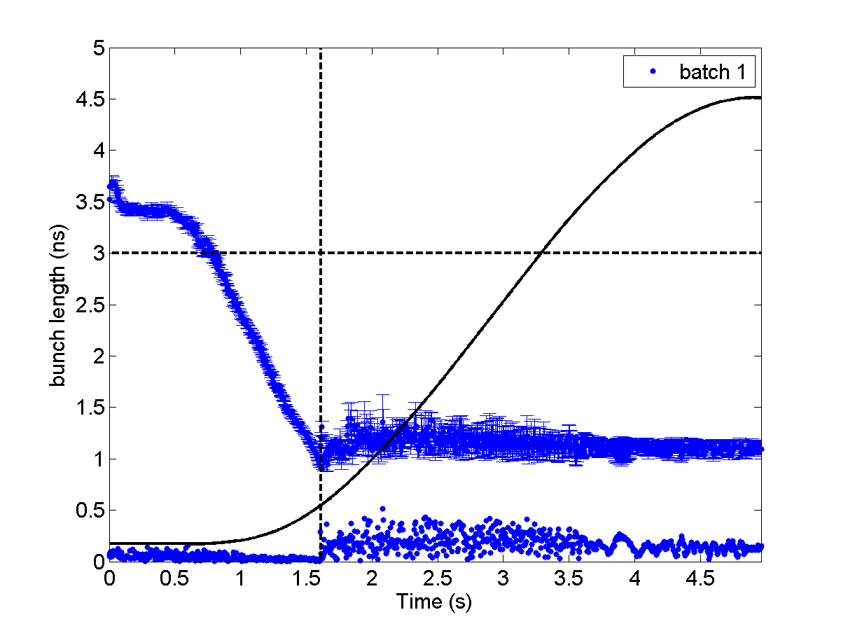
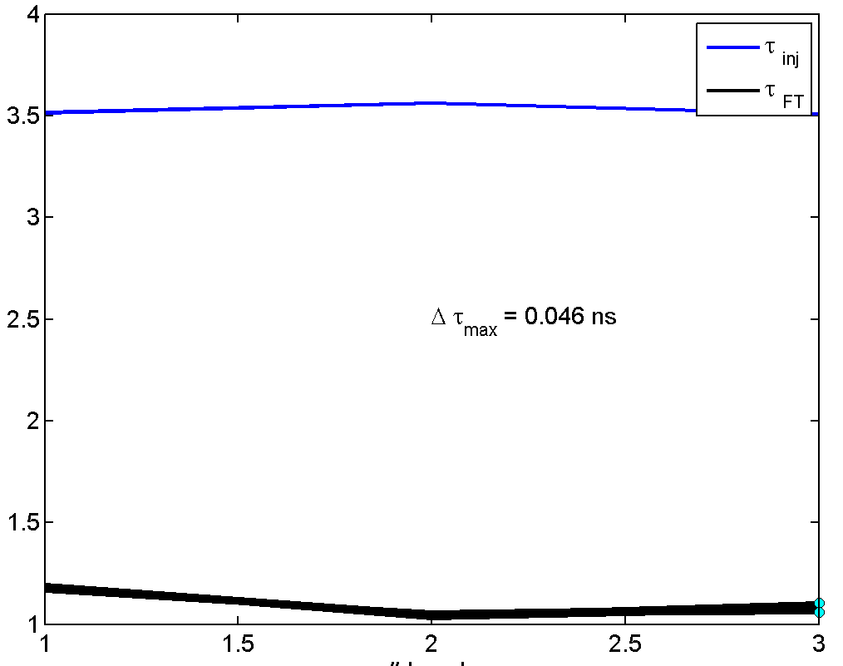
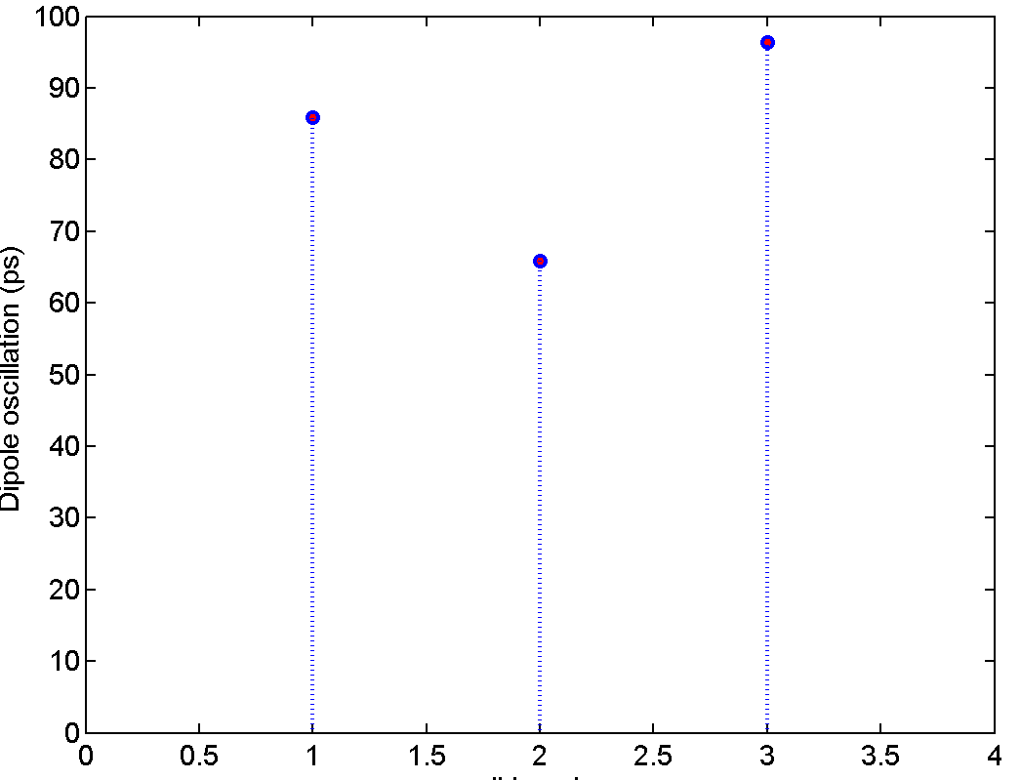
1 batch (3 bunches) optimization
Adjusting the timing of the transition (~5ms) helped both stability and losses.

Slide 10
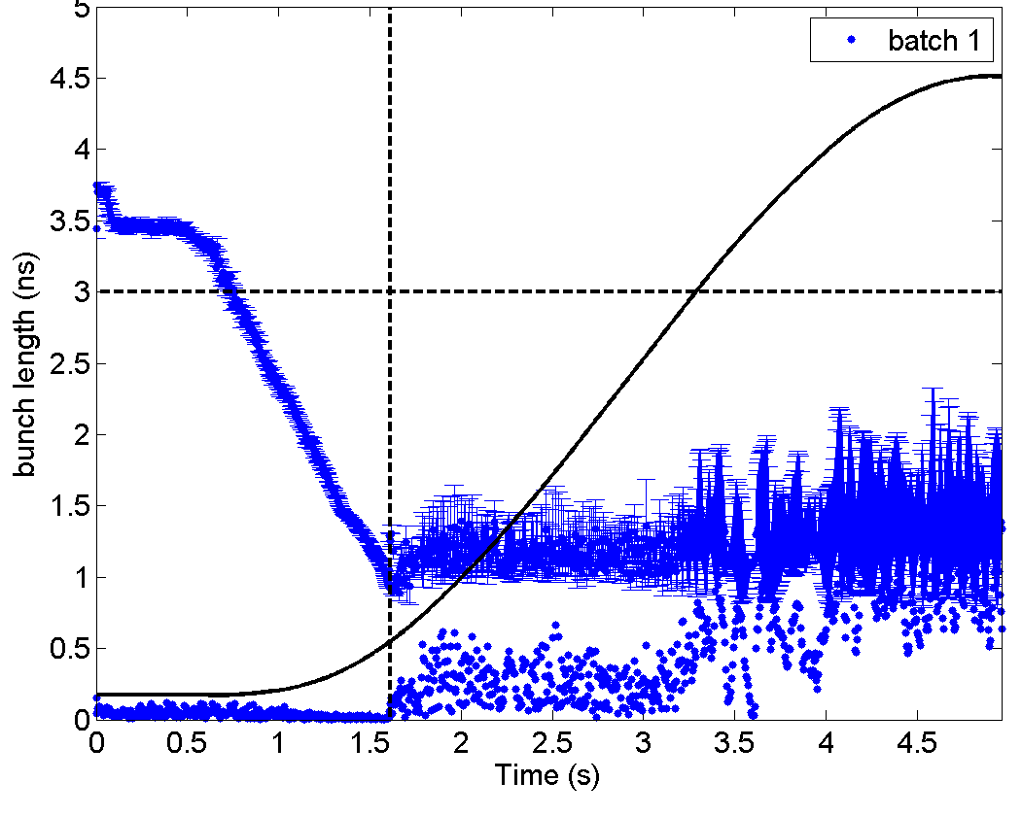
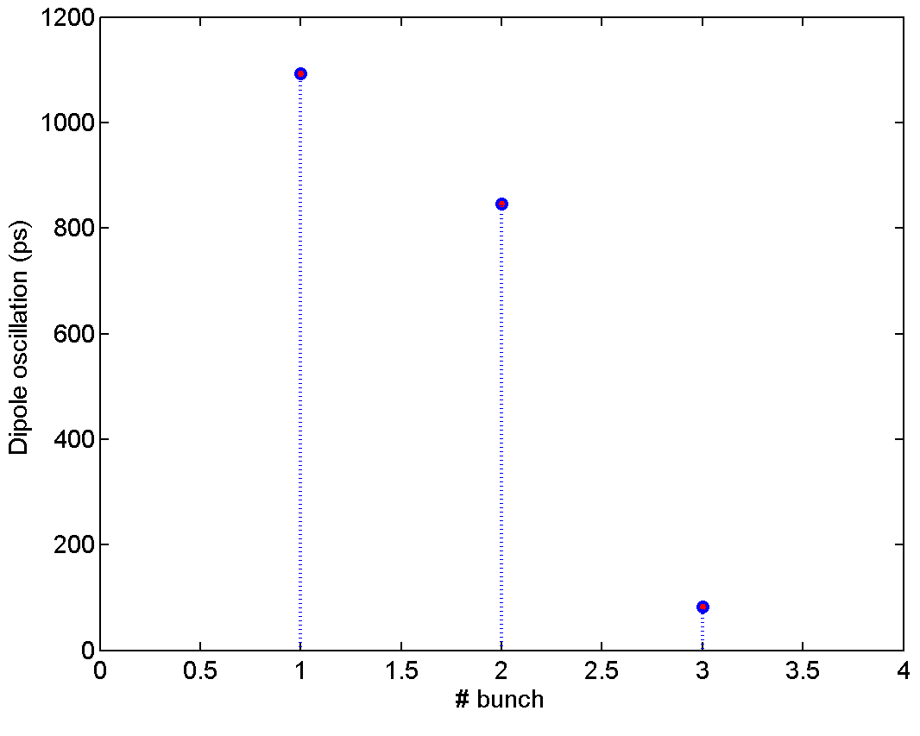
1 batch (3 bunches) optimization
More stable bunches at extraction (from BQM)
But due to the smaller blow-up after transition uncontrolled blow-up is observed (~300 GeV/c slip-stacking energy!)
Small offset in the transition timing can help by blowing up the bunch

Slide 11
1 batch (3 bunches) optimization
Quick attempt to switch on the controlled emittance blow-up
Higher amplitude (>100) of the noise spectrum was worse.
Lower amplitude did not show much effect.
Few changes of Scaling and margins did not also show any improvement
CEBU is difficult in ions (single RF) and needs a lot of time for setting up → Thomas has tried many times in the past without success.

Slide 12
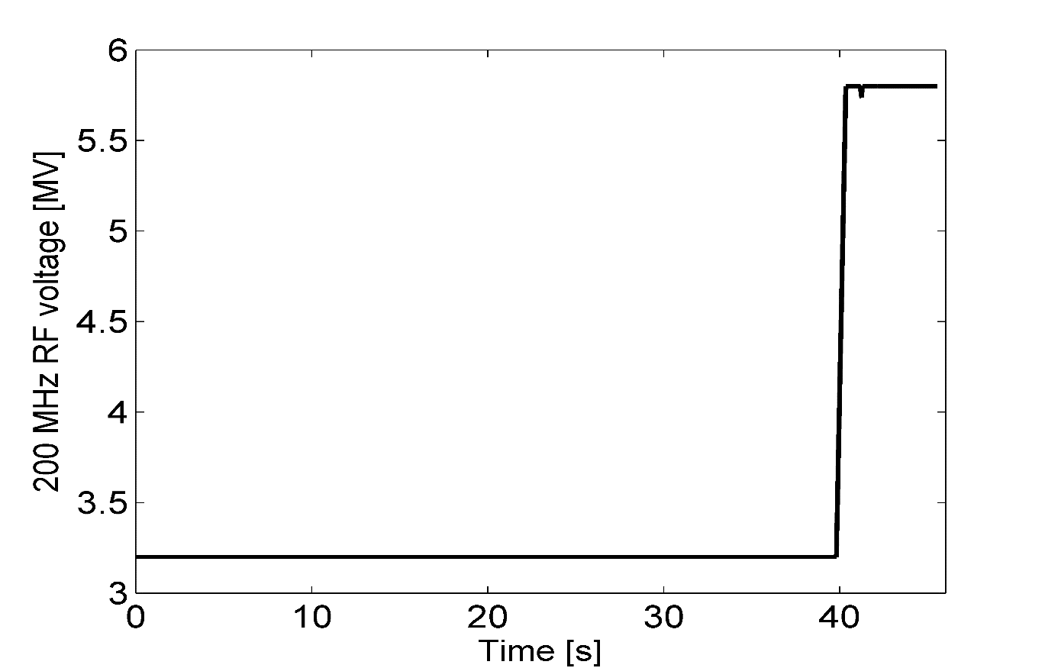
LHC filling 7446
Measurements of bunch profiles during LHC filling:
SPS batch: 9 PS batches of 4 bunches spaced by 100 ns
Not every cycle was recorded due to acquisition set-up (slow data transfer from the scope)
Smooth filling not many cycles by BQM

Slide 13
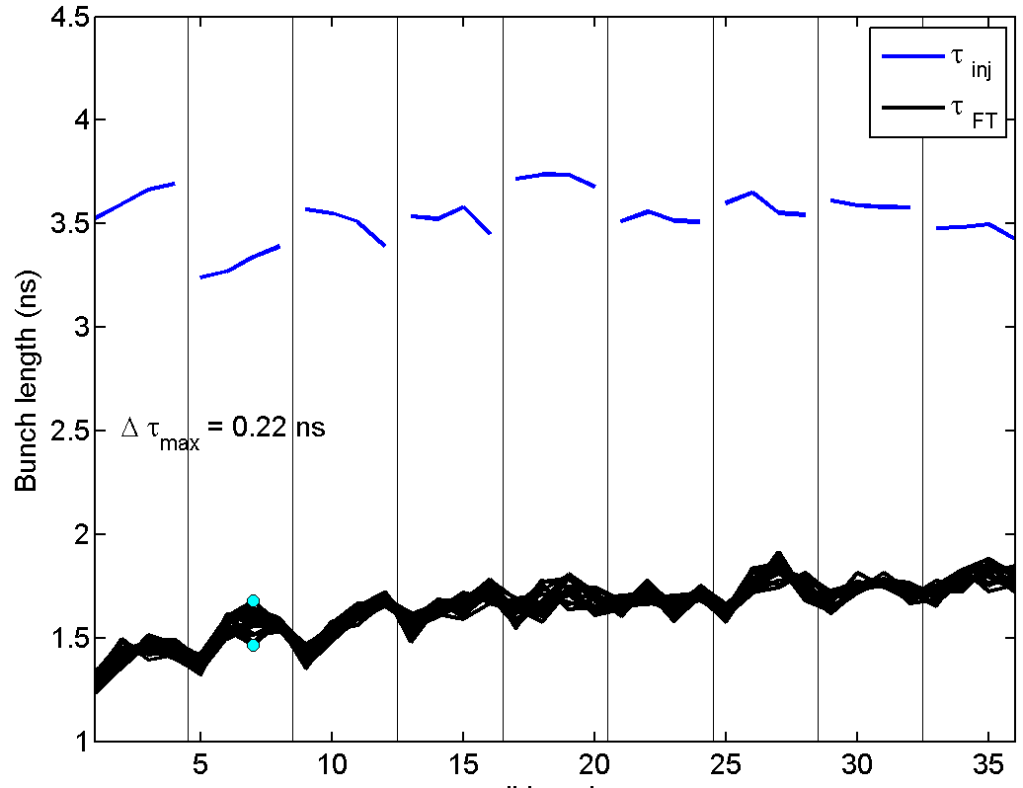
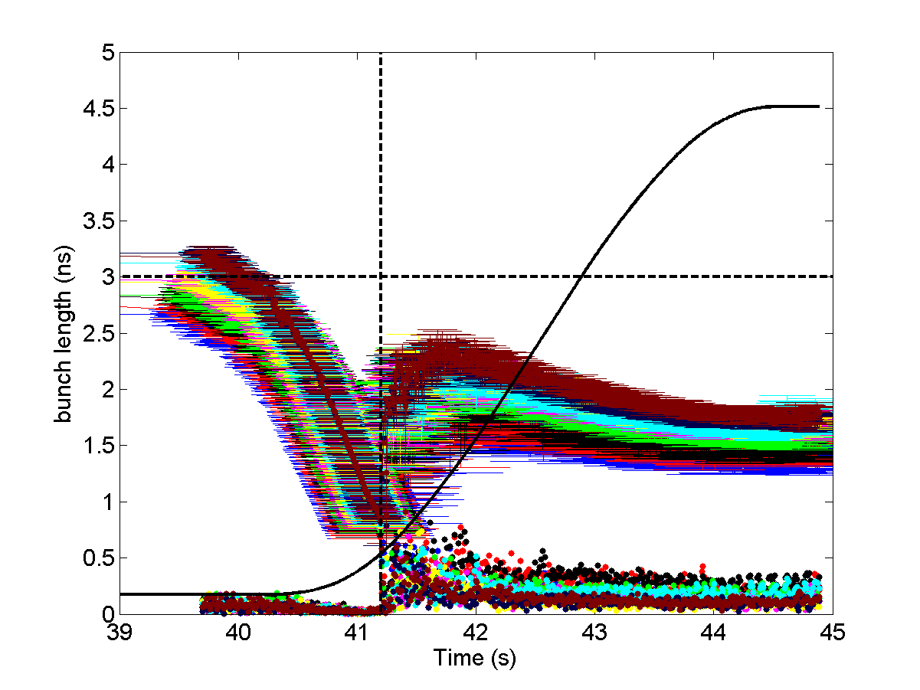
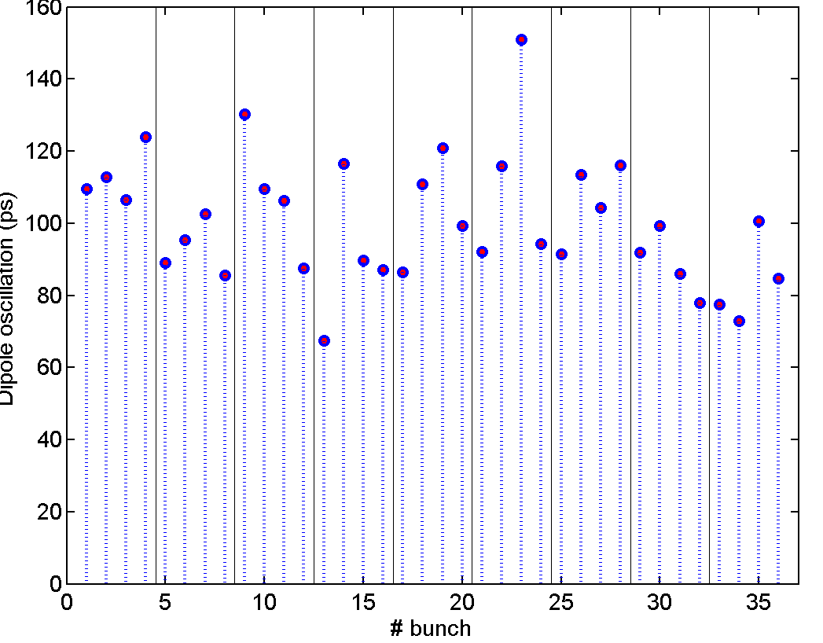
LHC filling 7446
Example of a good cycle

Slide 14
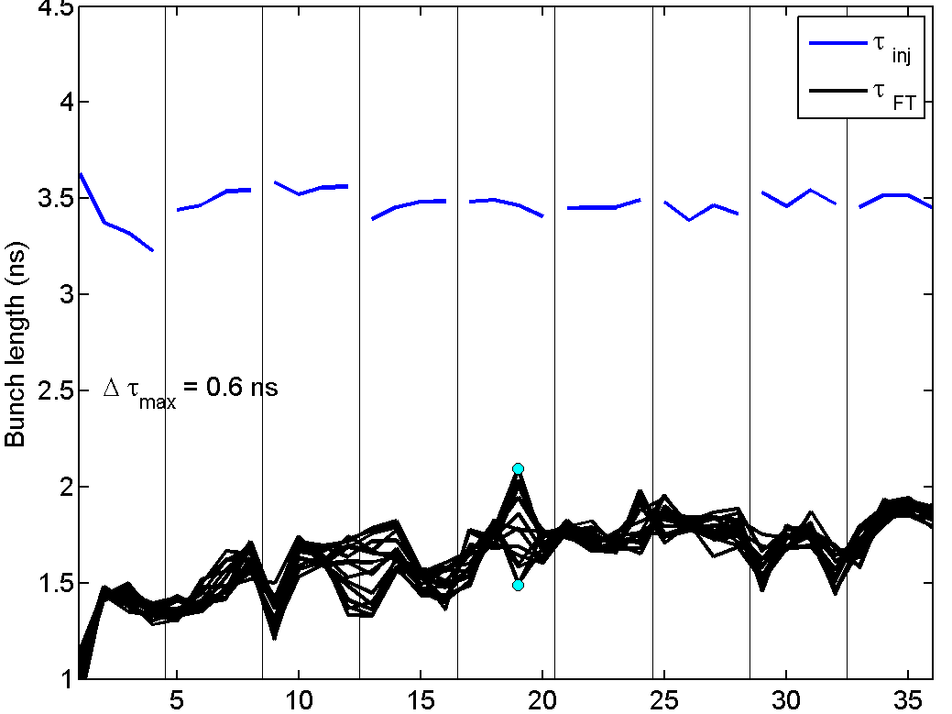
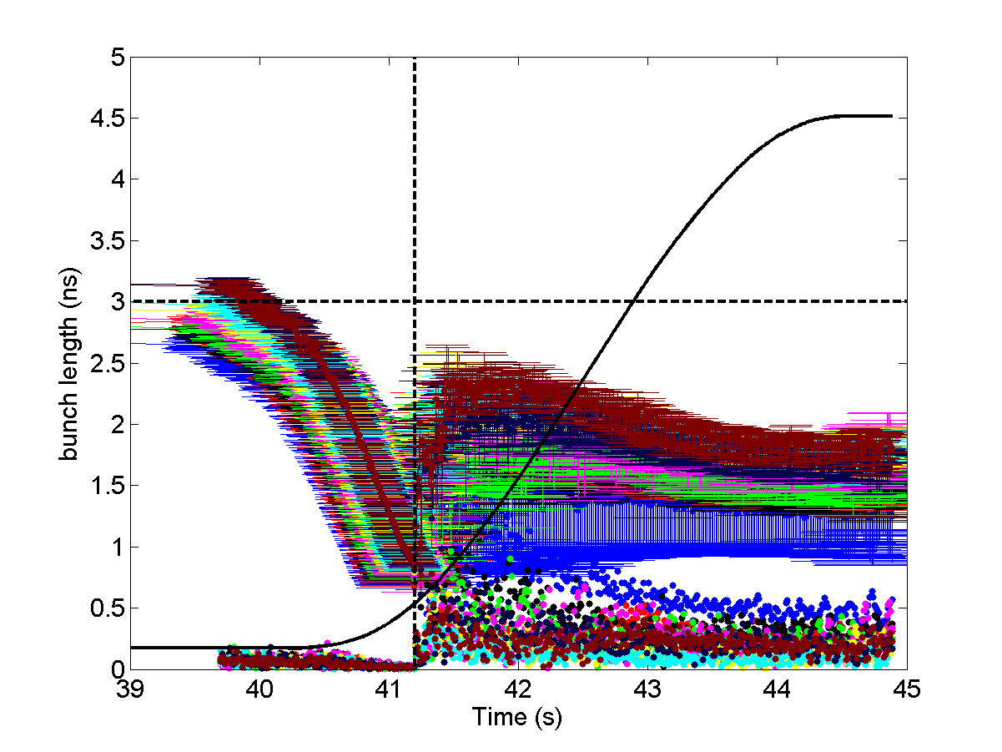
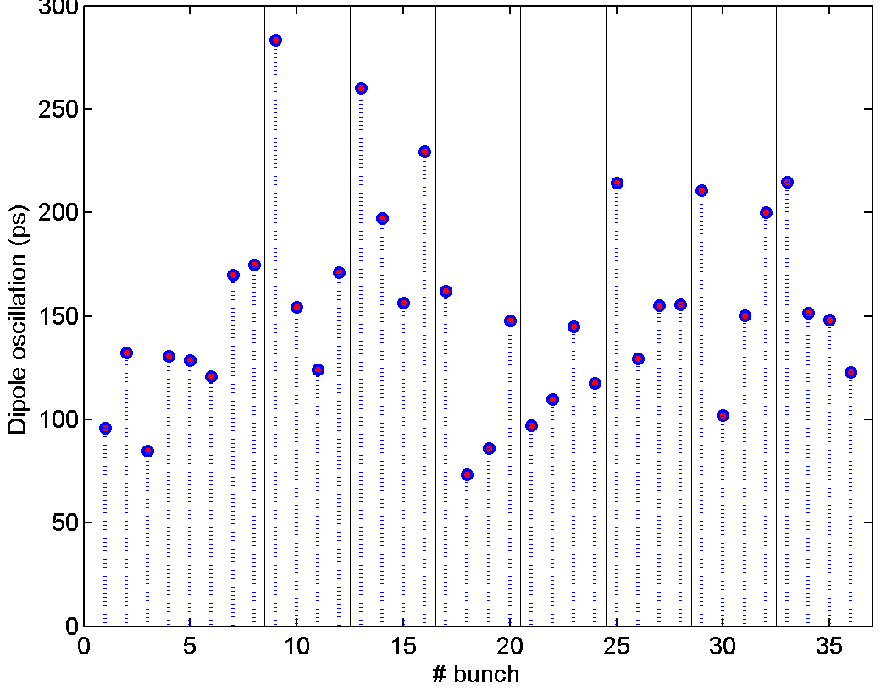
LHC filling 7446
Example of a bad cycle

Slide 15
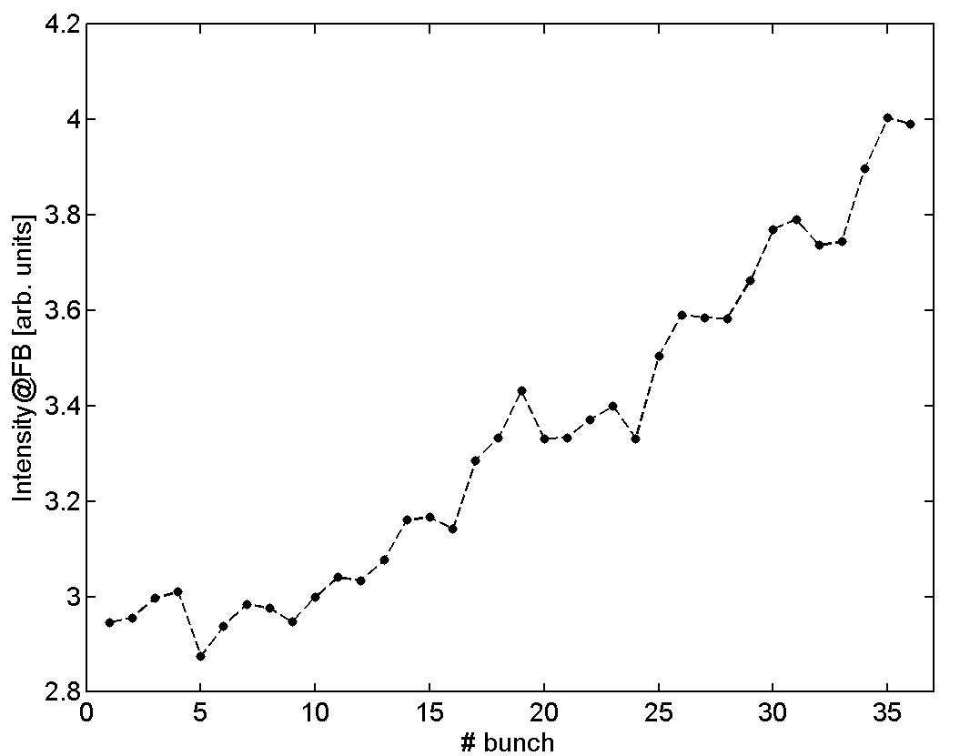
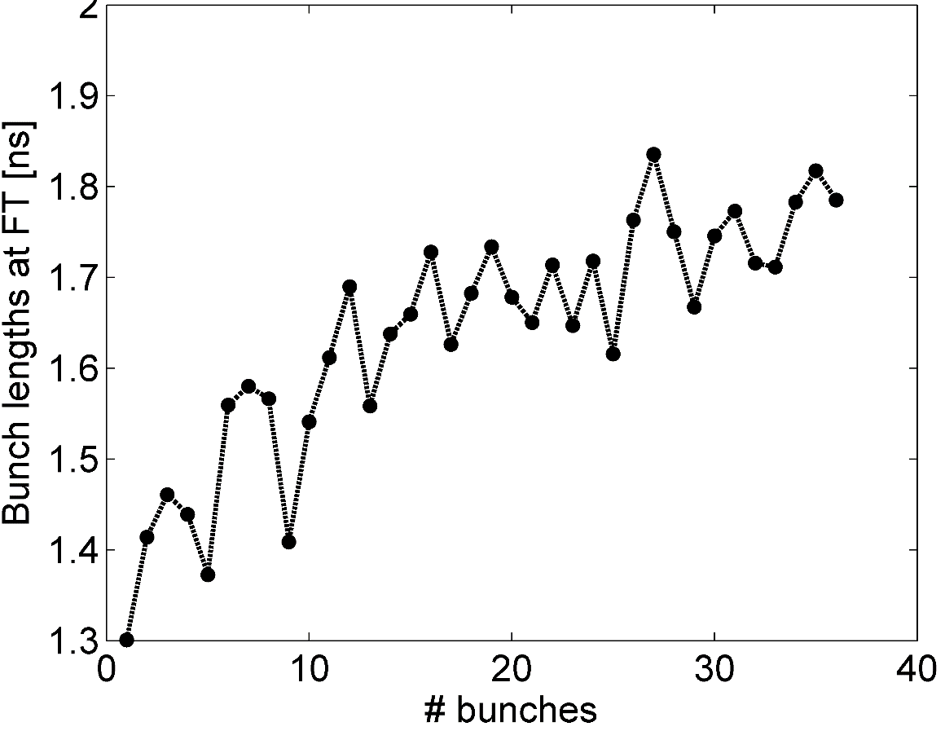
LHC filling 7446
Big spread in intensity and bunch length distributions along the batch as in the past.

Slide 16
Summary
Not trivial to optimise the ion cycles!!
After hours spent by Thomas and Giulia beams are good for extraction.
Voltage program optimisation not possible for the moment due to power limitations.
Means for improving beam stability in proton beams (800 MHz RF system, CEBU) not used!!
Switching on the 800 MHz is necessary for higher intensities → easier aslo to set-up CEBU
Next steps
Still ongoing analysis (meas@14-11-2018,bunch by bunch analysis, correlate with BCT intensities, …)
More measures:
LHC fillings
Slip-stacking cycle

