Slide 1
Online bunch length measurement for SPS OP
LIU SPS-BD WG, 2018-11-20
G. Papotti (RF-BR), F. Follin (OP-SPS)
acks: T. Bohl (RF-BR), M. Jaussi (RF-CS)

Slide 2
introduction
from LIU SPS-BD WG on 2017-12-14:
H. Bartosik: “The most important is to be able to measure the bunch length bunch by bunch along the batch.”
correction from 2018-11-15: add “along the cycle”
ideas:
reuse hardware installed for OP in CCR
reuse SPS BQM algorithms
get the new system done during the YETS
operational as of April 2018
bbb bunch length measurement along the cycle available in the CCC

Slide 3
outline
design ideas
hardware
FESA class
many GUI screenshots
future developments

Slide 4
main design ideas
OP mode (main functionality)
one measurement of one turn, every x ms
data analysis and transfer at every acquisition
x: typ 200 ms; HB 20 ms
20 ms clamped by GUI; maybe somewhat faster is feasible
logged in Timber (extract without fundamental filter!)
MD mode
one measurement of many turns, once in the cycle, one transfer per cycle
GUI to orchestrate all settings and their coherence
LTIMs, number of acquisitions in FESA, VTU settings, …
stored in LSA
GuruSettings, with proper value generators
non-PPM Calibration Factors, derived wrt BQM SPS

Slide 5
hardware
Acqiris card installed since years in CCR for OP long. observations
not much used recently
removed it from Oasis database on 18-19 Dec 2017
wrote dedicated FESA class
later moved to BA3 Faraday Cage, seized CCC PicoScope signal
a better signal than to the CCR
signal amplitude remains at the limit for p+ probes and ions

Slide 6
FESA class
“ABWLM”: A for RF, Beam, Wideband, Longitudinal, Measurement
keep it simple: call it “Bunch length measurement”, like the GUI in the CCM
RTAs:
prepare first acquisition, at start of cycle
retrieve data, analyse, prepare for next acquisition if necessary
publish results in 2 separate properties
latest acquisition only (used for logging)
aggregate all results once per cycle (used by GUI)

Slide 7
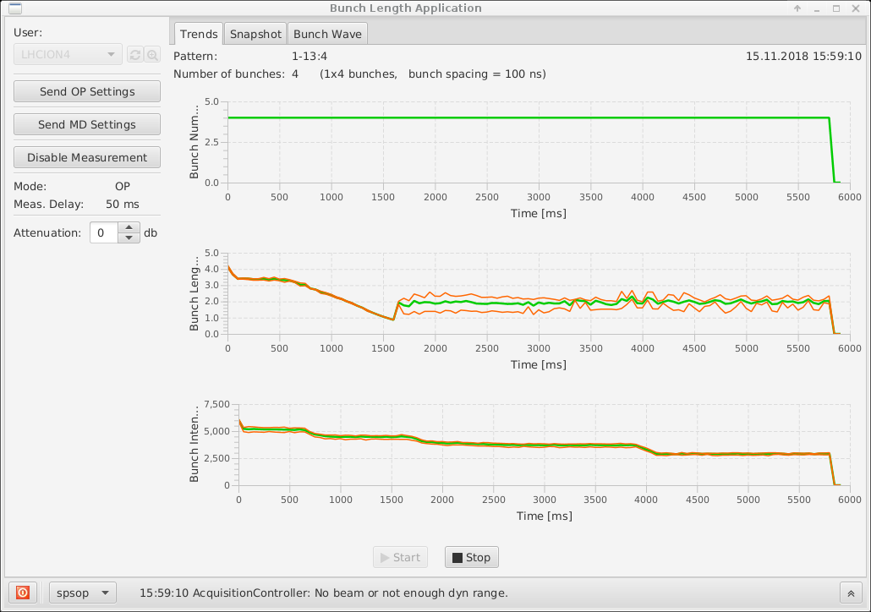
GUI
user selection
config settings and readout
PPM attenuator
suggestion: stop acquisition for changing settings
console messages
choice of view for results

Slide 8
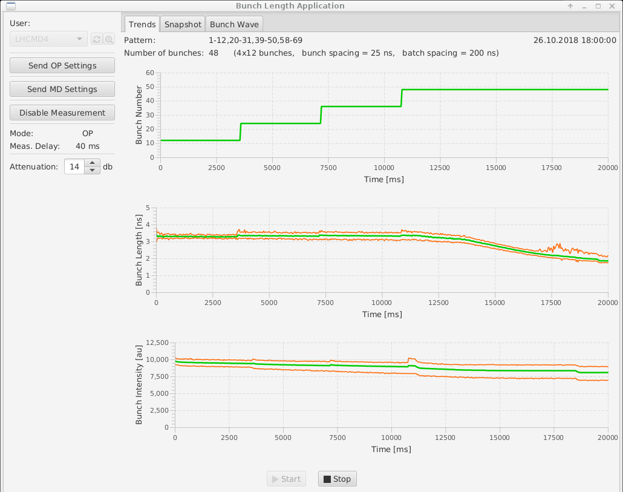
GUI: Trends display
bunch number and pattern
bunch length
min-mean-max
bunch intensity [a.u.]
min-mean-max
bbb peak available but not displayed by GUI

Slide 9
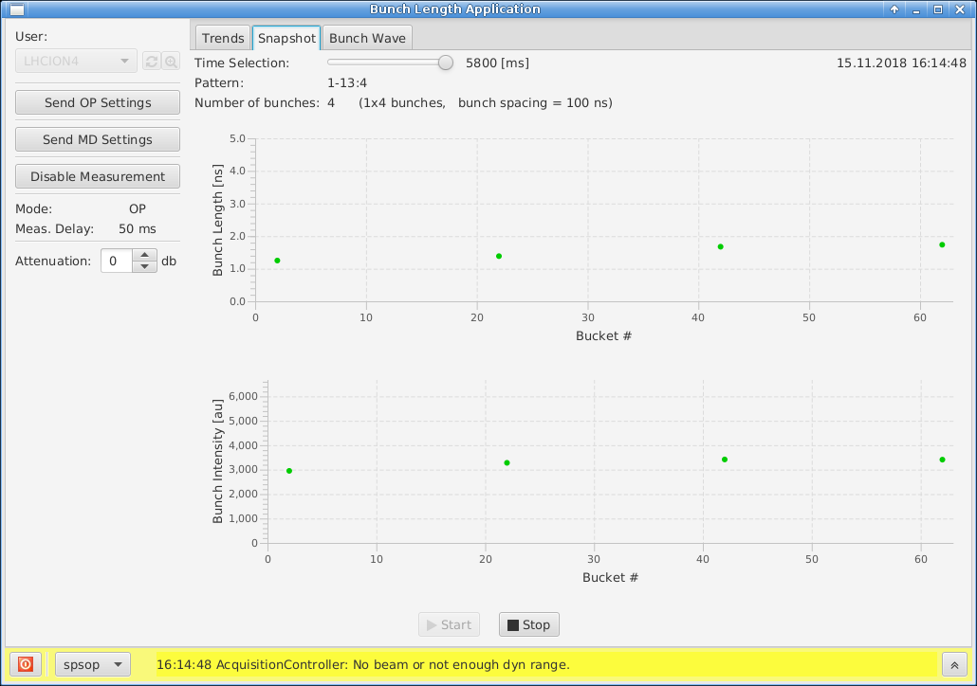
GUI: Snapshot display
RT evolution of bunch length and intensity
particularly appreciated during many MDs
can use Time Selection slider to replay evolution
GUI also reconstructs pattern
used also for wire scanners setup

Slide 10
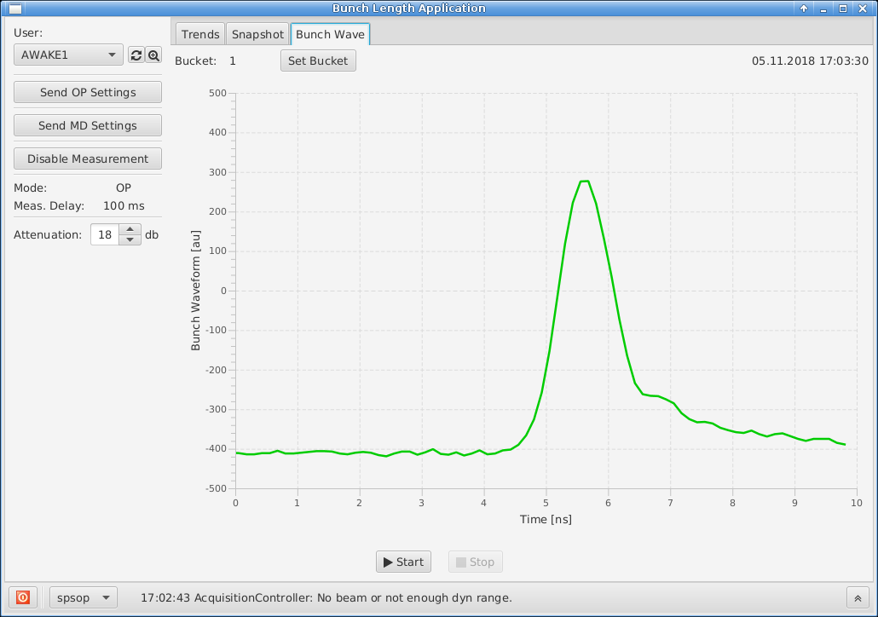
GUI: Bunch Wave display
RT bunch profile display
can select one bunch at a time (stop acquisition first)
useful to check if acquisition saturates
if saturation: no results

Slide 11
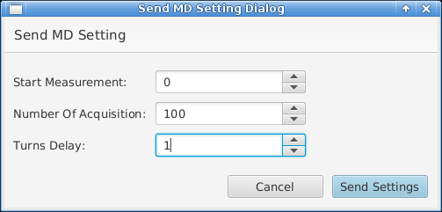
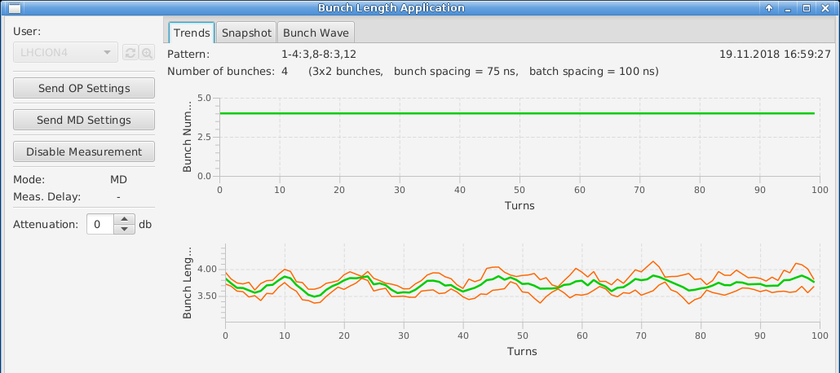
GUI: MD mode
e.g. AWK bunch rotation setup
suggestion: always cross-check the settings sent (JavaFX!)
apologies
for the ugly screenshots!

Slide 12
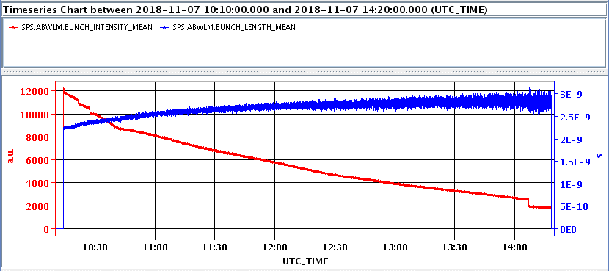
measurement in coast
suggestion: set one measurement every 500-1000 ms

Slide 13
work ahead
hardware:
during LS2: fibre optics transmission
sometime after restart: change ADC
software: include tomography for the SPS
some work started by S. Albright, discussions ongoing across machines
every machine wants a tomoscope!
support common efforts
ABWLM+GUI the perfect user for such common tomo-code
piggyback on C++ code development, perfect synergy
ready to use MD mode of acquisition
GUI smart way to get LSA settings
Notes:
from LSA: voltage program and harmonic, energy
from user: phase,

