Slide 1
Latest update on the wideband feedback system
K. Li, J. Komppula, G. Kotzian, T. Levens, W. Hofle
Acknowledgements: S. Albright, H. Bartosik, M. Beck, A. Lasheen, M. Schenk
LIU-SPS Beam Dynamics Meeting
20. November 2018

Slide 2
This year’s activities
Installation and tests of slotline kicker
Beam stabilization using one stripline and one slotline kicker
Reconfiguration of existing exponential stripline as horizontal kicker – tests in high intensity MDs

Slide 3
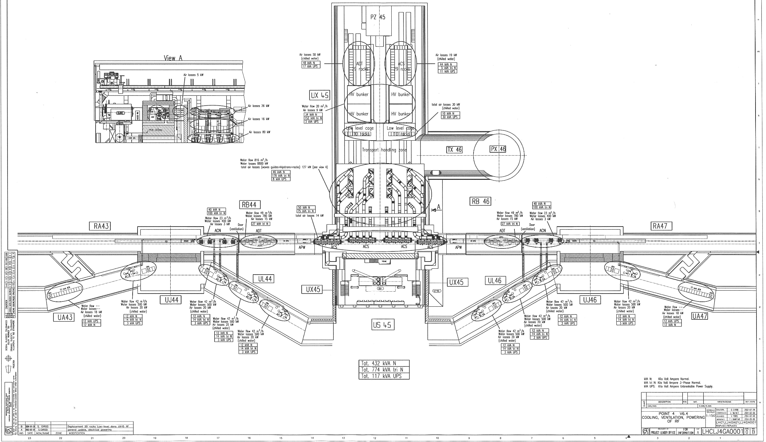
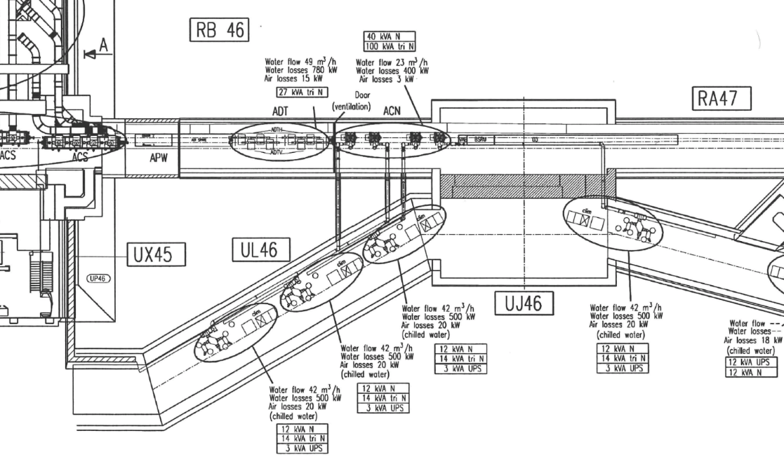
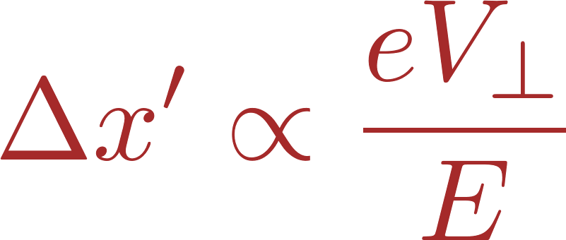
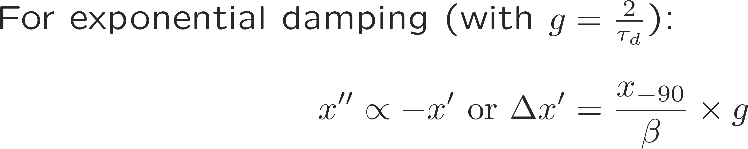
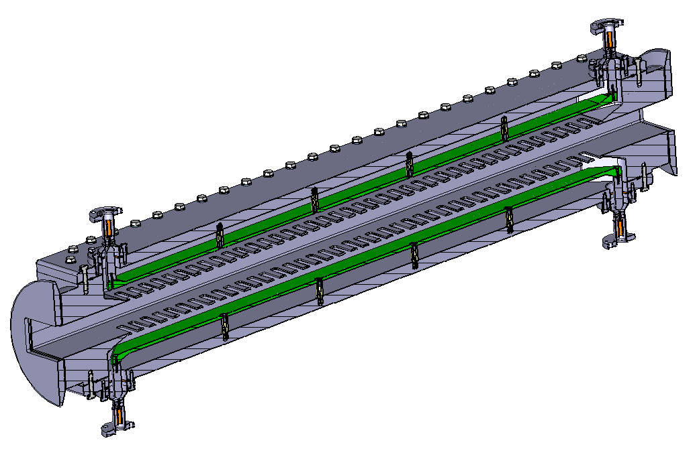
The slotline kicker
Some space (~ 5m at each side of the ADT) was already foreseen for a possible damper upgrade
Stripline – 10 cm
Slotline – 1 m
+- 5 m on each side
J. Cesaratto et al.:
SPS Wideband Transverse Feedback Kicker: Design Report,
CERN-ACC-NOTE-2013-0047
LHC, point 4
3D rendering courtesy of M. Wendt

Slide 4
The slotline kicker
Some space (~ 5m at each side of the ADT) was already foreseen for a possible damper upgrade
Stripline – 10 cm
Slotline – 1 m
+- 5 m on each side
Much larger kick strength at high frequencies
Increased bandwidth was demonstrated in excitation experiments during summer MDs
J. Cesaratto et al.:
SPS Wideband Transverse Feedback Kicker: Design Report,
CERN-ACC-NOTE-2013-0047
3D rendering courtesy of M. Wendt
LHC, point 4

Slide 5
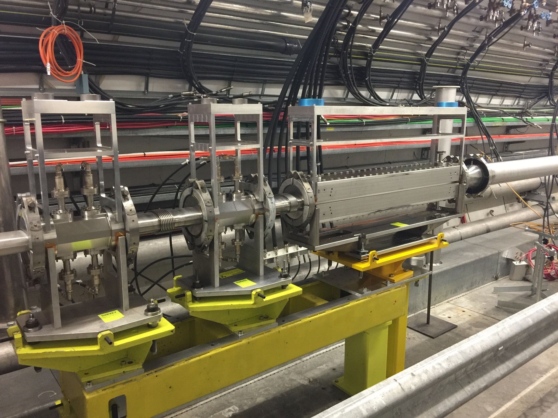
The slotline kicker
1 strimpline
2 x 250 W
Some space (~ 5m at each side of the ADT) was already foreseen for a possible damper upgrade
1 x slotline kicker
Powered @ 2 x 250 W
LHC, point 4

Slide 6
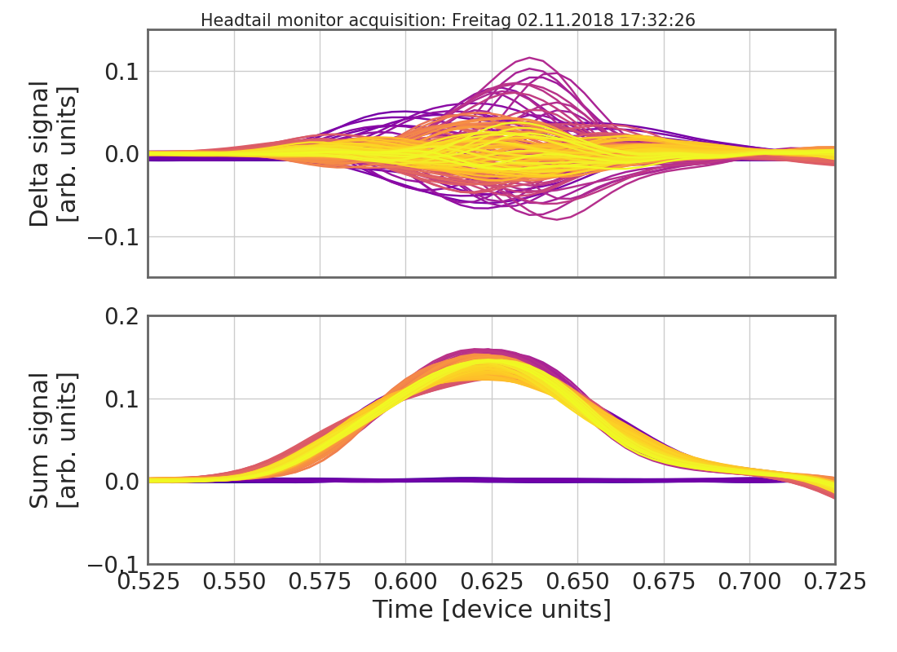
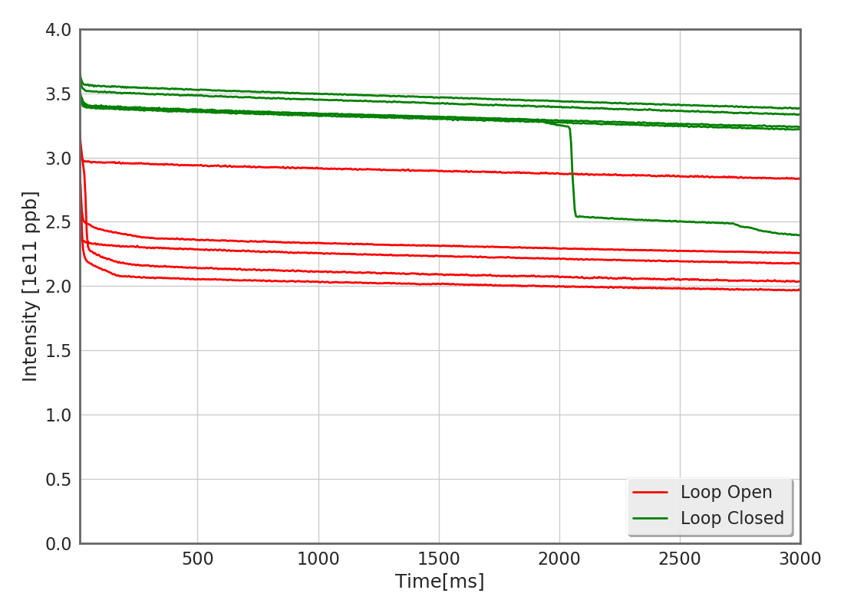
Beam stabilization using the slotline kicker
Injection of high intensity single bunches beyond the Q22 TMCI threshold around 3.0 – 3.5e11 ppb
200 MHz voltage at 2.5MV; 800 MHz active
Chromaticity set close to zero @ Q’/Q = 0.05
Beam setup for TMCI signature accompanied by fast losses
Once stable unstable conditions were reached, different configuration for the wideband feedback were tested:
  Wideband feedback in open/closed loop
  Wideband feedback in conjunction as well as without the transverse damper

Slide 7
Beam stabilization using the slotline kicker
Injection of high intensity single bunches beyond the Q22 TMCI threshold around 3.0 – 3.5e11 ppb
200 MHz voltage at 2.5MV; 800 MHz active
Chromaticity set close to zero @ Q’/Q = 0.05
Observations
The wideband feedback was able to stabilize against the instability making possible the injection of bunches with intensities well beyond 3e11 ppb.
The wideband feedback was able to stabilize against this instability also in absence of the transverse damper! This is still to be understood…
  Impact of the slotline kicker?
  Less injection oscillations that would saturate the WBFB?
Beam setup for TMCI signature accompanied by fast losses
Once stable unstable conditions were reached, different configuration for the wideband feedback were tested:
  Wideband feedback in open/closed loop
  Wideband feedback in conjunction as well as without the transverse damper

Slide 8
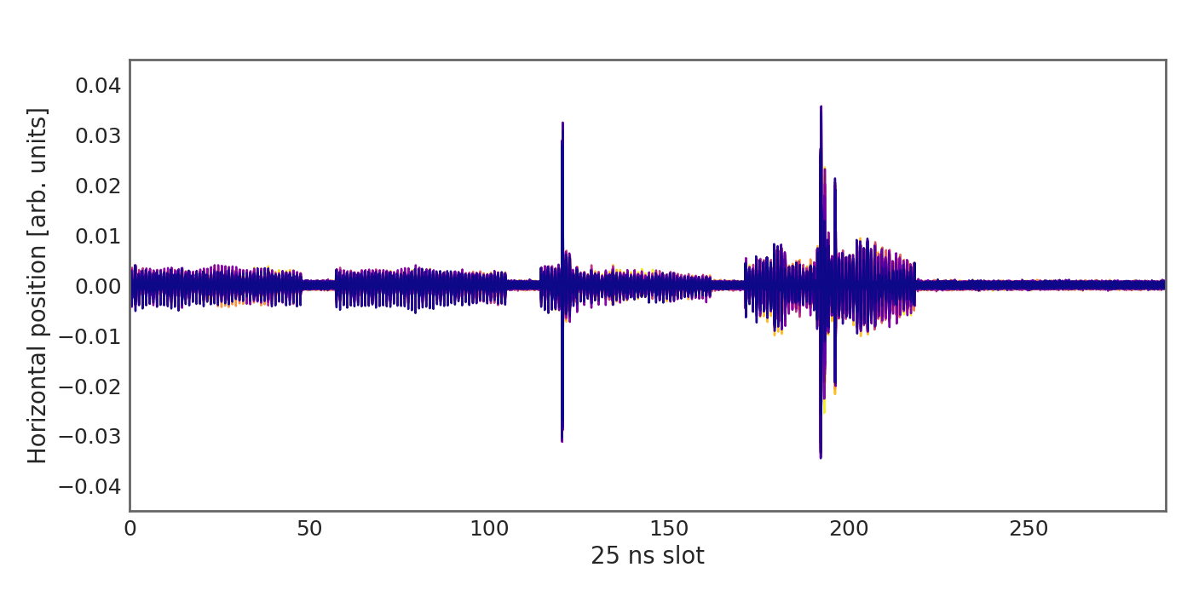
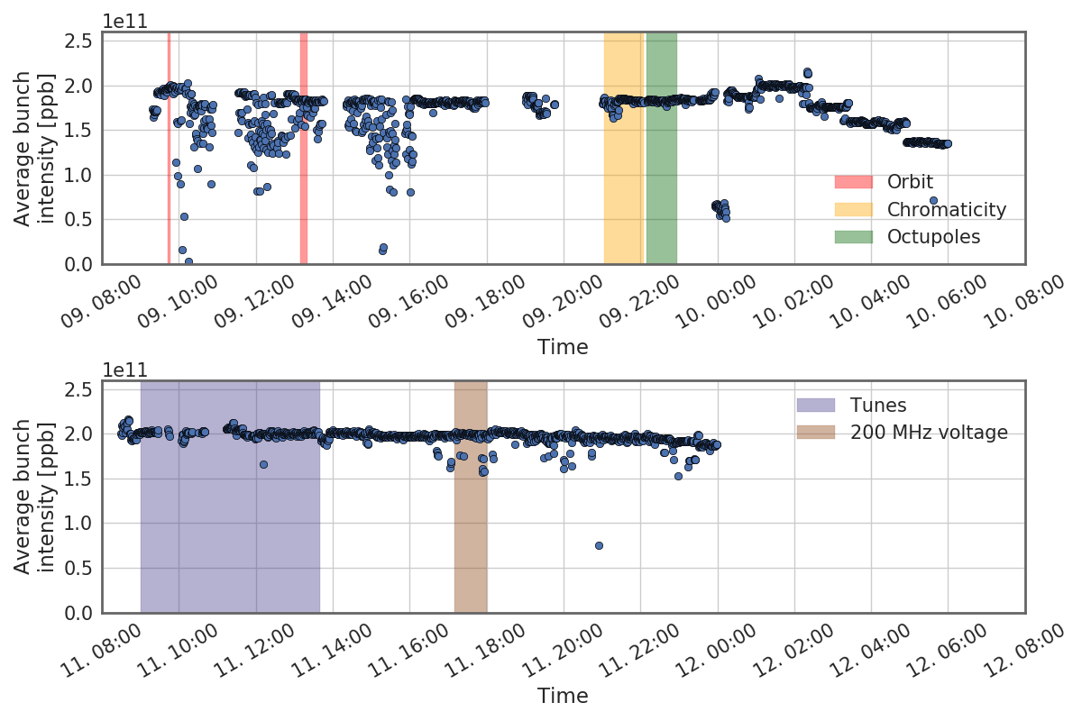
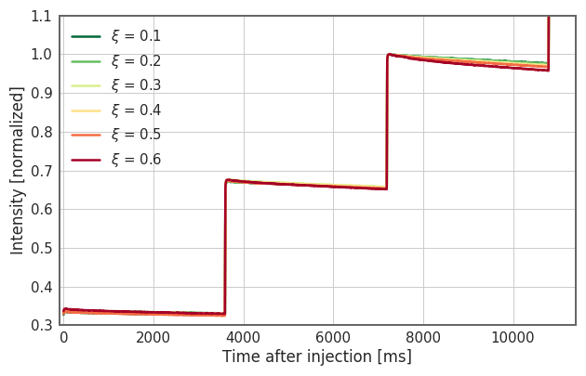
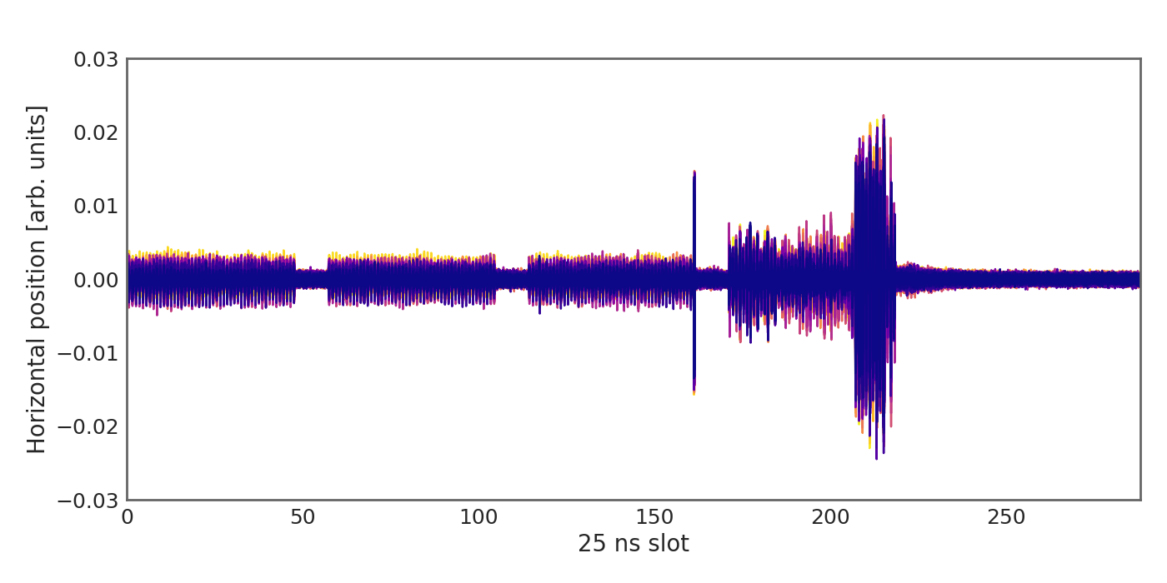
Observations during the 2017 high intensity run
Horizontal instability
Investigation beam stability and incoherent losses as a function of chromaticity for high intensity beams.
BCMS beam – 4 x 48 bunches

Slide 9
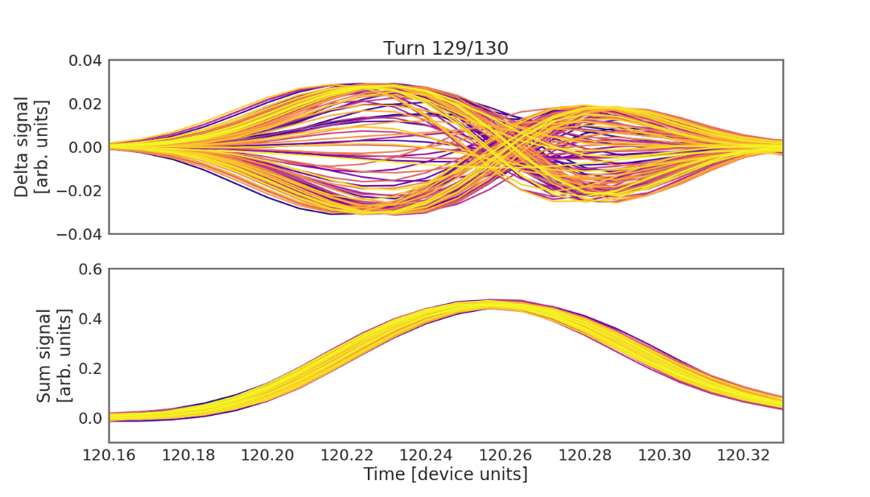
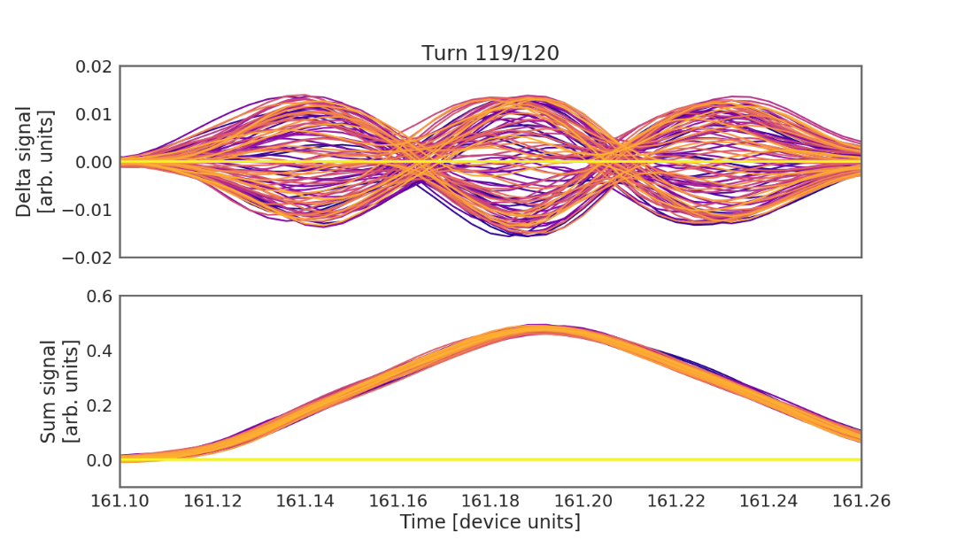
Observations during the 2017 high intensity run
Horizontal instability
Investigation beam stability and incoherent losses as a function of chromaticity for high intensity beams.
BCMS beam – 4 x 48 bunches
Clearly, a wideband feedback system could extend the operational parameter space for working also at low chromaticities. The present system works exclusively in the vertical plane, however.

Slide 10
High intensity horizontal instability
A reconfigured exponential stripline (normally used as pickup) had been used in the past as a kicker in the vertical plane to test the capabilities of the feedback box.
The stripline has bandwidth limited to maximum 200 MHz making it very hard to exert any kick strength to the beam.
The kicker could be used in the past on low intensity beams to a limited extent for grow-damp measurements – this was to demonstrate the DSP and diagnostics capabilities of the box.
The kicker had never successfully been used to mitigate instabilities. This is not a surprise as it had already been shown in simulations that a bandwidth of <200 MHz is insufficient to mitigate single bunch instabilities.

Slide 11
High intensity horizontal instability
Tests performed (on a very limited number of cycles)
Closed loop on 4th batch
Standard WBFB filters
  Gain scan
Test of shorter 3-tap filters
  Gains scan
  Fine delay scan at max gain
  Positive vs. negative feedback
A reconfigured exponential stripline (normally used as pickup) had been used in the past as a kicker in the vertical plane to test the capabilities of the feedback box.
The stripline has bandwidth limited to maximum 200 MHz making it very hard to exert any kick strength to the beam.
The kicker could be used in the past on low intensity beams to a limited extent for grow-damp measurements – this was to demonstrate the DSP and diagnostics capabilities of the box.
The kicker had never successfully been used to mitigate instabilities. This is not a surprise as it had already been shown in simulations that a bandwidth of <200 MHz is insufficient to mitigate single bunch instabilities.

Slide 12
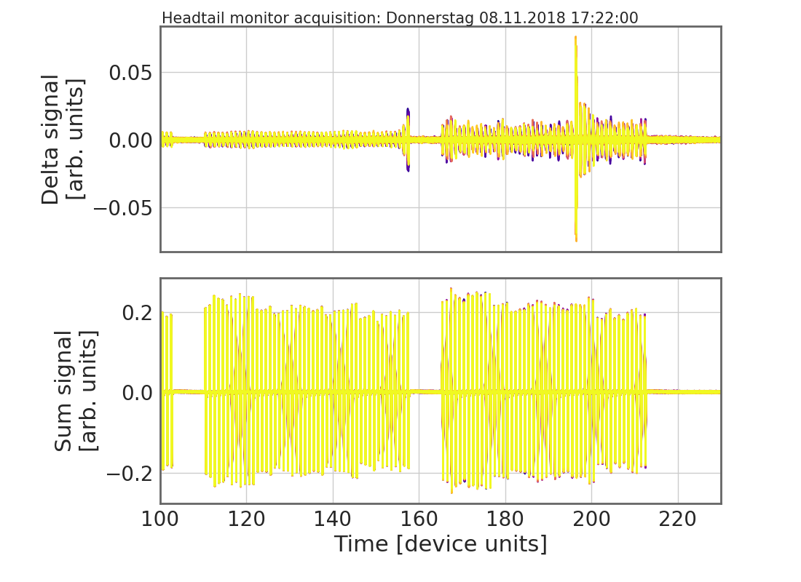
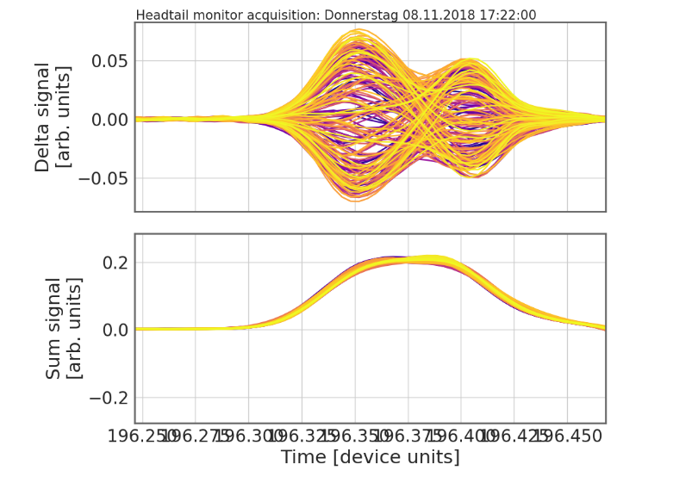
High intensity horizontal instability
Tests performed (on a very limited number of cycles)
Closed loop on 4th batch
Standard WBFB filters
  Gain scan
Test of shorter 3-tap filters
  Gains scan
  Fine delay scan at max gain
  Positive vs. negative feedback
A reconfigured exponential stripline (normally used as pickup) had been used in the past as a kicker in the vertical plane to test the capabilities of the feedback box.
The stripline has bandwidth limited to maximum 200 MHz making it very hard to exert any kick strength to the beam.
The kicker could be used in the past on low intensity beams to a limited extent for grow-damp measurements – this was to demonstrate the DSP and diagnostics capabilities of the box.
The kicker had never successfully been used to mitigate instabilities. This is not a surprise as it had already been shown in simulations that a bandwidth of <200 MHz is insufficient to mitigate single bunch instabilities.

Slide 13
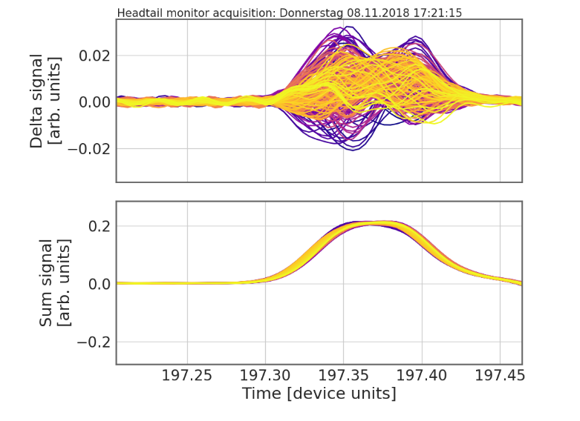
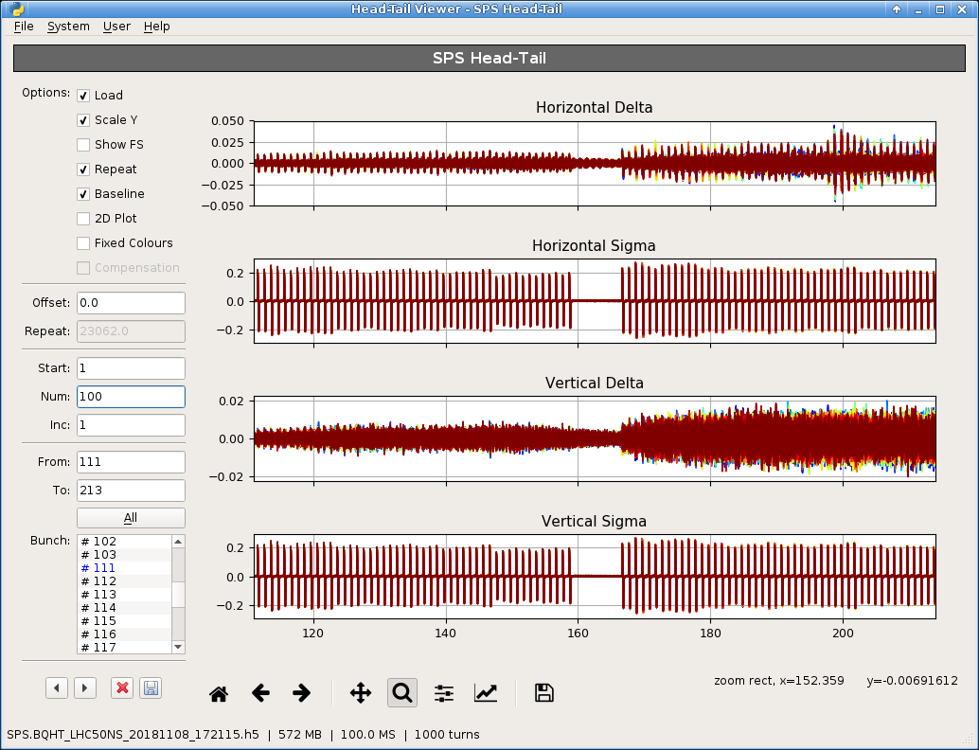
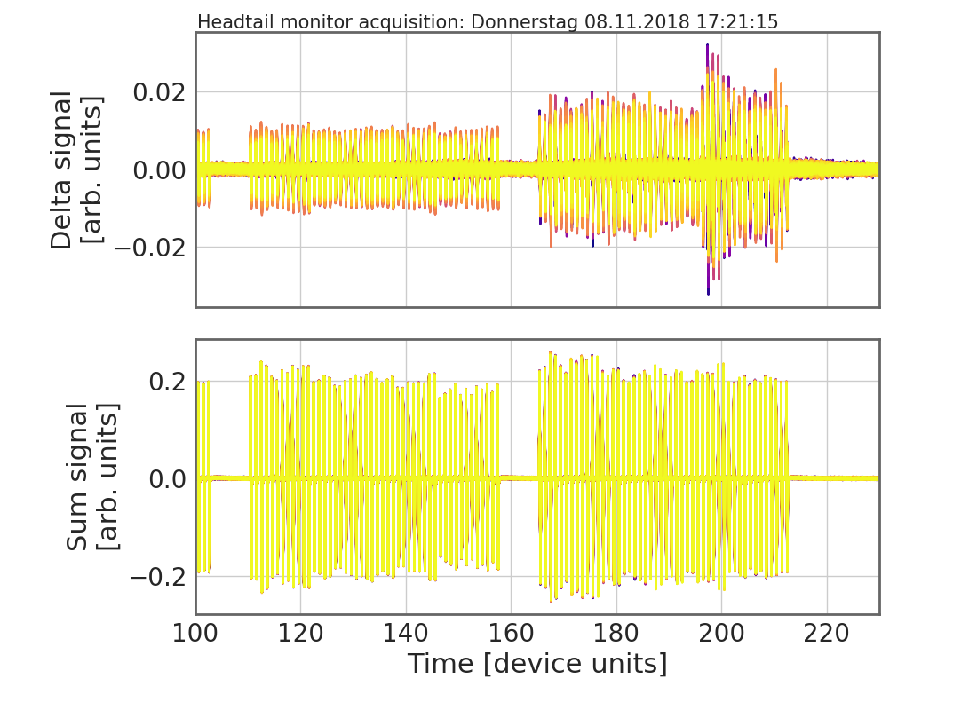
High intensity horizontal instability
Tests performed (on a very limited number of cycles)
Closed loop on 4th batch
Standard WBFB filters
  Gain scan
Test of shorter 3-tap filters
  Gains scan
  Fine delay scan at max gain
  Positive vs. negative feedback
A reconfigured exponential stripline (normally used as pickup) had been used in the past as a kicker in the vertical plane to test the capabilities of the feedback box.
The stripline has bandwidth limited to maximum 200 MHz making it very hard to exert any kick strength to the beam.
The kicker could be used in the past on low intensity beams to a limited extent for grow-damp measurements – this was to demonstrate the DSP and diagnostics capabilities of the box.
The kicker had never successfully been used to mitigate instabilities. This is not a surprise as it had already been shown in simulations that a bandwidth of <200 MHz is insufficient to mitigate single bunch instabilities.

Slide 14
High intensity horizontal instability
Tests performed (on a very limited number of cycles)
Closed loop on 4th batch
Standard WBFB filters
  Gain scan
Test of shorter 3-tap filters
  Gains scan
  Fine delay scan at max gain
  Positive vs. negative feedback
→ The test were not very conclusive – stable instability mitigation was not observed anyhow.
A reconfigured exponential stripline (normally used as pickup) had been used in the past as a kicker in the vertical plane to test the capabilities of the feedback box.
The stripline has bandwidth limited to maximum 200 MHz making it very hard to exert any kick strength to the beam.
The kicker could be used in the past on low intensity beams to a limited extent for grow-damp measurements – this was to demonstrate the DSP and diagnostics capabilities of the box.
The kicker had never successfully been used to mitigate instabilities. This is not a surprise as it had already been shown in simulations that a bandwidth of <200 MHz is insufficient to mitigate single bunch instabilities.

Slide 15
Conclusions
Slotline kicker
  The slotline kicker has been successfully installed, tested and commissioned
  The slotline kicker shows a significant increase in bandwidth reach and opens up new possibilities in what can be reached inboth excitations and damping of instar-bunch motion.
Single bunch instabilities
  Mitigation of fast instabilities at injection has been demonstrated for bunches of intensities up to 3.5e11 ppb. The wideband feedback system has been used with one stripline and one slotline kicker.
  Mitigation of instabilities was possible using the wideband feedback system alone, even in absence of the transverse damper.
Horizontal coupled bunch instability
  The wideband feedback system was used with a single exponential stripline kicker bandwidth limited at 200 MHz.
  Reproducible mitigation of the horizontal instability could not be demonstrated despite trying various different configurations.

Slide 17
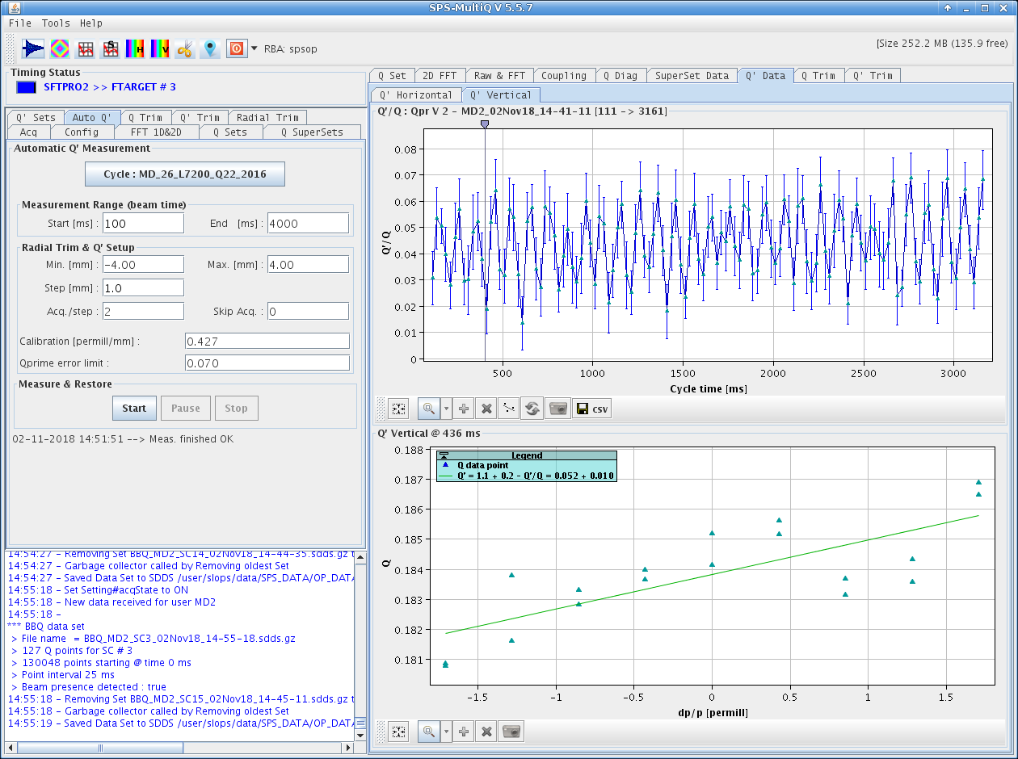
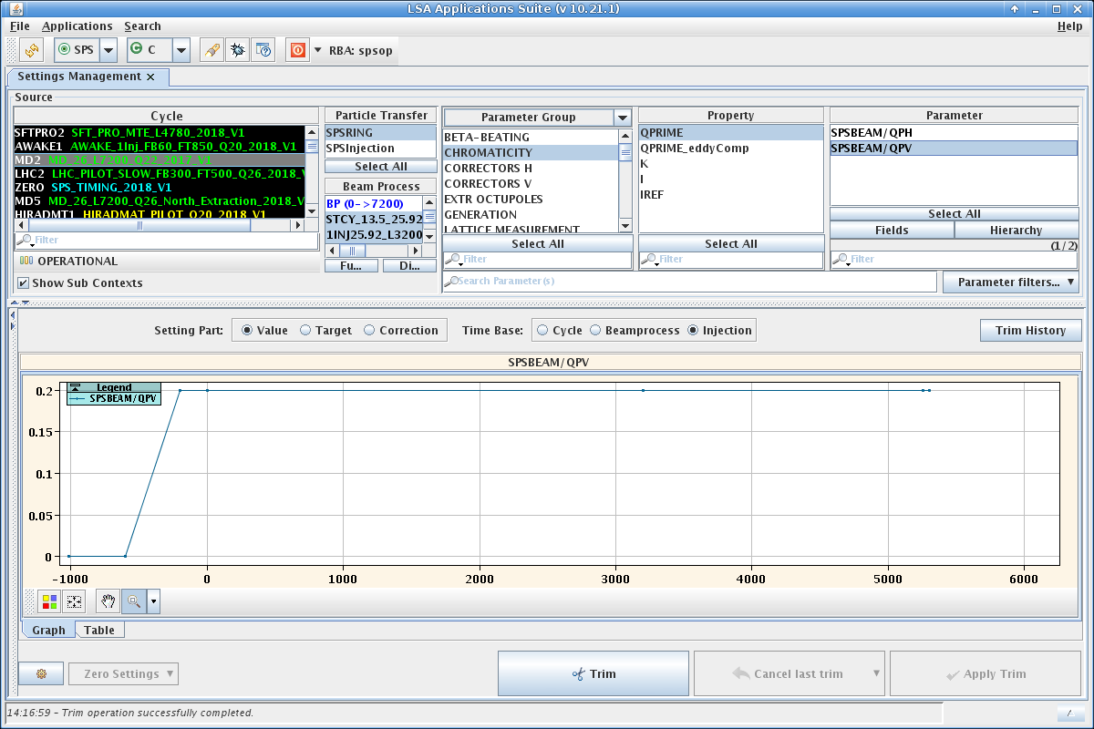
Beam stabilization using the slotline kicker
Injection of high intensity single bunches beyond TMCI threshold
200 MHz voltage at 2.5MV; 800 MHz on
Chromaticity set close to zero @ Q’/Q = 0.05

Slide 18
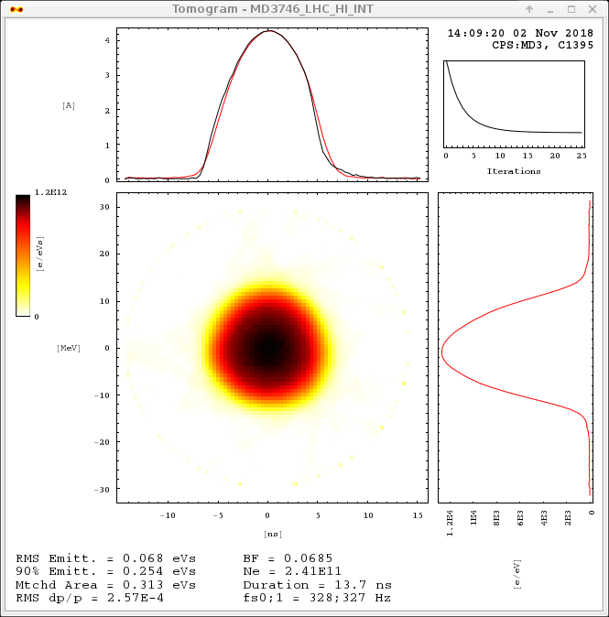

Slide 19
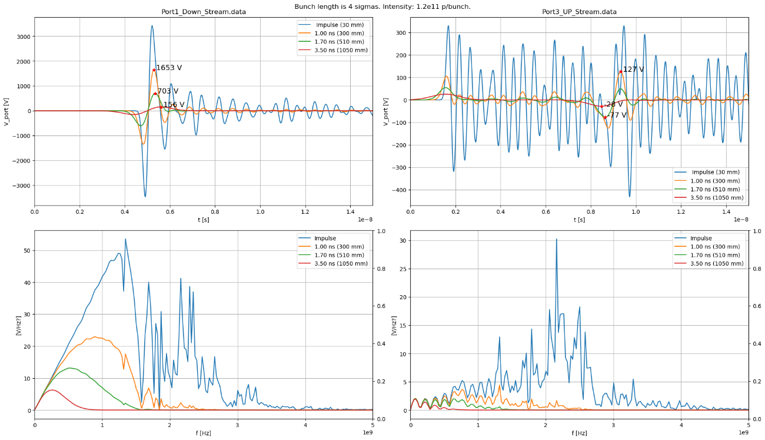
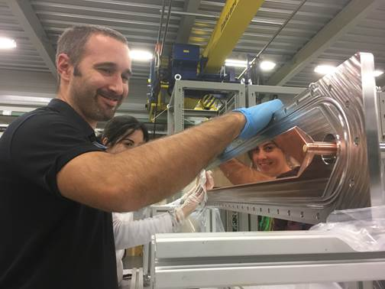
Outlook – using the slotline kicker
A. Farricker
Some space (~ 5m at each side of the ADT) was already foreseen for a possible damper upgrade
Fabrication and installation ready. Lab/tunnel measurements look promising and match well with the simulations. 50 Ohm matching is very good.
Slotline signals were also being looked at during the crab cavity MDs; data from this is being analysed by Rama.
LHC, point 4

