Slide 1
Simulations of instabilities during ramp s
6th of March 2018
LIU-SPS Beam Dynamics Working Group
J. Repond
Acknowledgements: E. Shaposhnikova, T. Bohl, A. Lasheen, M. Schwarz, G. Papotti, S. Albright, H. Bartosik, SPS, PS, PSB OP teams, MD coordinators, BLonD dev. team.

Slide 2
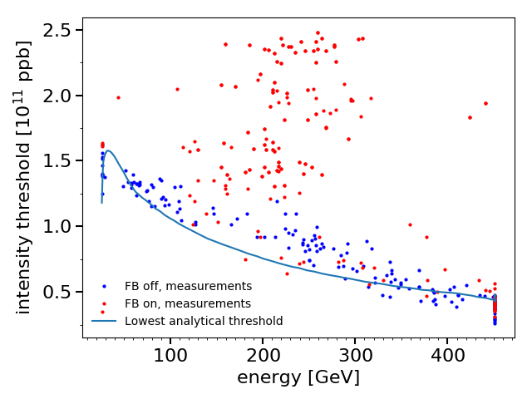
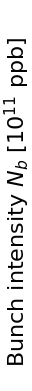

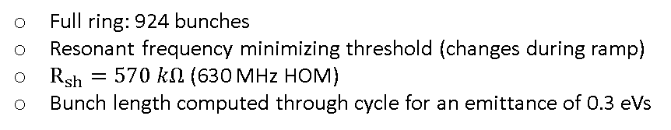
Stability threshold during ramp: 12 bunches
Instability threshold with 12 bunches during ramp
Energy dependence 1RF, FB on/off
Threshold is minimum on flat top
No energy dependence of threshold when feedback is on
Higher threshold with FB on → 200 MHz impedance dominant during acceleration?
Feedback more efficient at low energy?
Threshold weakly affected by LD → can be neglected in simulation (*)
Analytical threshold comparable
Flat bottom instability observed for small bunch length and $N_{b}≈1.4×{10}^{11}$
Assumptions for analytical threshold
Full ring: 924 bunches
Resonant frequency minimizing threshold (changes during ramp)
$R_{sh}=570 kΩ$ (630 MHz HOM)
Bunch length computed through cycle for an emittance of 0.3 eVs
(*) LIU-SPS BD WG, J. Repond, Measurements of beam instabilities during ramp with FB off, 14th of September

Slide 3
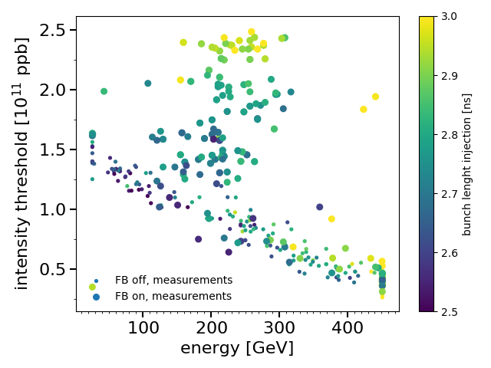
Stability threshold for 12 bunches
Injected bunch length
Instability threshold with 12 bunches during ramp
Energy dependence 1RF, FB on/off
Increasing bunch length
Average injected bunch length: 2.75 ns → smaller bunch length due to phase-loop (*)
Bunch length after capture increases with intensity → possible reason of no energy dependence
(*) LIU-SPS BD WG, J. Repond, Measured instability thresholds during ramp, 17th of August

Slide 4
Questions to answer in simulations
Can we identify why the threshold is not energy dependent when feedback is on?
  Feedback more efficient at low energy?
  200 MHz impedance dominant during acceleration?
  Bunch length variation with intensity?
Can we reproduce stability threshold during cycle in simulation?
  Impedance model benchmarking
  Identify the driving source(s) of instability
Can we reproduce the flat bottom instability?
  Bunch distribution + 10 sec flat bottom
How threshold obtained on flat top compares with ramp simulations?

Slide 5
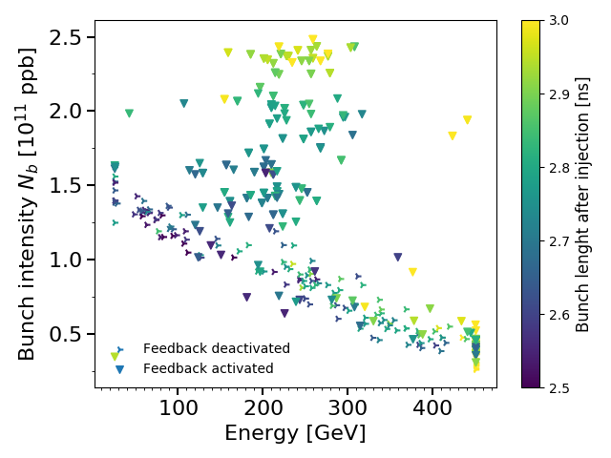
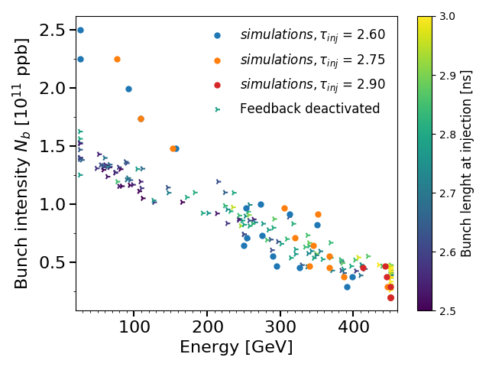
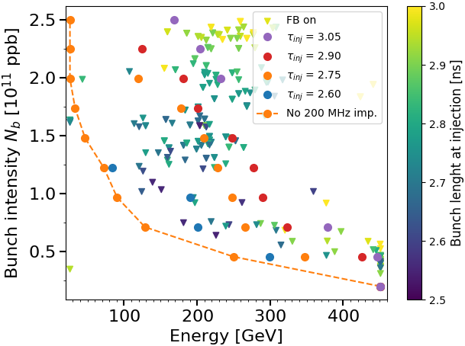
Stability treshold during ramp
12 bunches: simulations vs measurements
Simulations of different bunch length, feedback off
Simulations of different bunch length, feedback on
Bunch distribution in simulations is matched on flat bottom according to bunch length
End of ramp and flat top well reproduced in simulation with correct bunch length
Difficulties to reproduce flat bottom instability
  Short flat bottom in simulation (1s)
  Bunch rotation in PS before extraction (s-shape)
  → Ongoing study
Simulations more unstable if 200 MHz impedance removed
  Bunch-to-bunch synchrotron frequency variations improves stability (*)
Steady-state formula of impedance reduction from feedback gives reasonable agreement
  → Increasing bunch length with intensity removes the energy dependence
(*) E. Vogel, T. Bohl, rf amplitude modulation to suppress longitudinal coupled bunch instabilities in the CERN SPS, PRSTAB, vol. 8, p. 102801, 2005

Slide 6
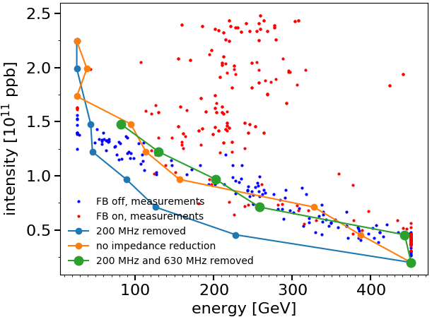
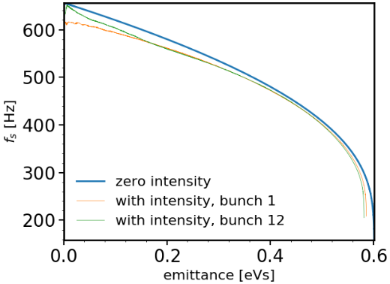
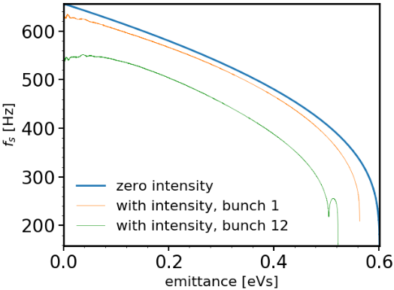

Lower stability without 200 MHz impedance?
Instability threshold with 12 bunches during ramp
Simulations with injected bunch length 2.75 ns
Synchrotron frequency
First and last bunch, $N_{b}=2×10^{11}$ ppb
Beam more sensitive to 630 MHz HOM when 200 MHz impedance removed
200 MHz removed
No impedance reduction
→ Bunch to bunch synchrotron frequency shift improves stability (*). Effect of the frequency variation equivalent to removing the 630 MHz HOM in simulation.
(*) E. Vogel, T. Bohl, rf amplitude modulation to suppress longitudinal coupled bunch instabilities in the CERN SPS, PRSTAB, vol. 8, p. 102801, 2005

Slide 7
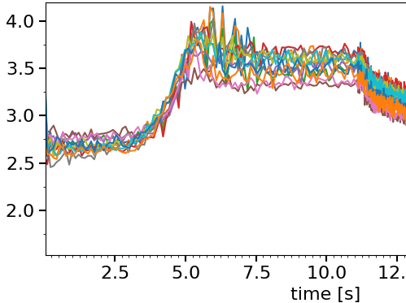
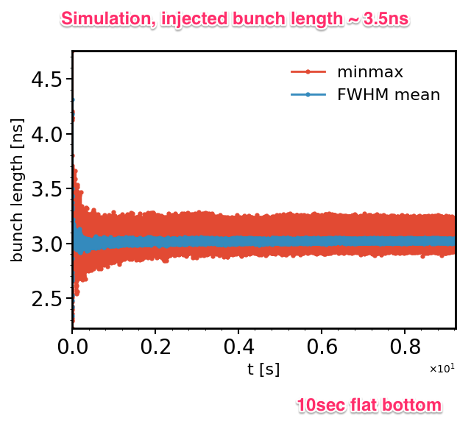
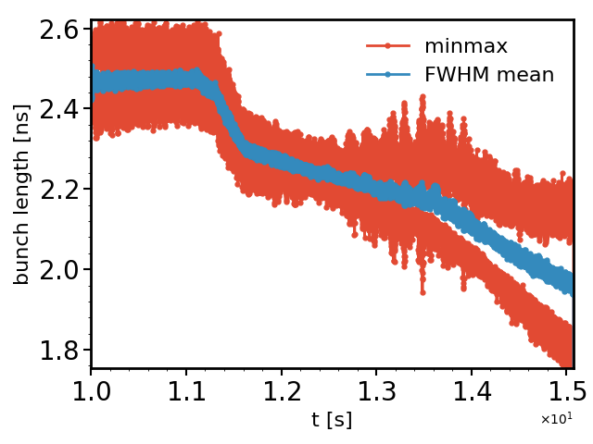

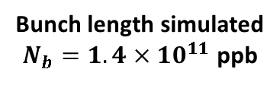
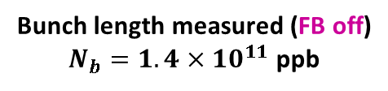
Instability at flat bottom
Bunch length measured (FB off)
$N_{b}=1.4×{10}^{11}$ ppb
Bunch length simulated
$N_{b}=1.4×{10}^{11}$ ppb
Bunch length [ns]
10 sec flat bottom
Realistic bunch distribution simulated in PS
Injected bunch length 3.3 ns
Bunch length after filamentation: 2.7 ns
Instability after 4 sec. flat bottom
Injected bunch length 3.4 ns
Bunch length after filamentation: 3 ns
Stable during 10 sec. flat bottom
Difficulties to reproduce flat bottom instability → Smaller bunch after filamentation due to phase-loop
Instability observed if smaller bunches injected (blow-up on flat bottom)
First simulations with phase-loop show no difference (gain must be calibrated)
1sec flat bottom
$N_{b}=1.8×{10}^{11}$ ppb

Slide 8
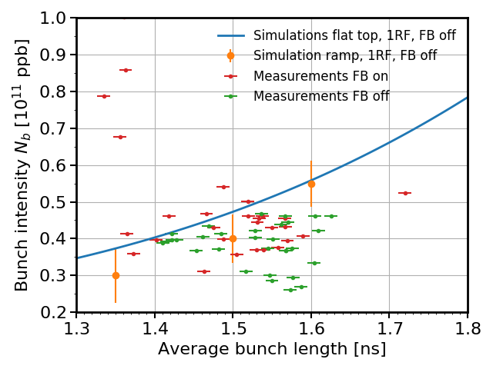
Stability threshold at flat top.
Comparison between ramp simulations and measurements
7 MV in 200 MHz RF system, 12 bunches, feedback off
Measurements of unstable beam during ramp cannot be compared here
no information about bunch length at flat top
Stable beam
Bunch distribution in simulation is matched at flat top
  → Bunch distribution after ramp can differ from matched at flat top
Measured threshold at flat top is compared with simulations
→ Measurements of stable beams and simulations (FT and ramp) are in good agreement with feedback off

Slide 9
Conclusion and future work
Good agreement between simulations and measurements at the end of the cycle and flat top (FB off)
No energy dependence of threshold (FB on) explained by
  Feedback impedance reduction
  Bunch length increasing with intensity
Bunch-to-bunch synchrotron frequency variations from uncompensated beam-loading improve stability
  accurate model of feedback needed in simulation
Difficulties to reproduce flat bottom instability
  Smaller bunch after filamentation due to phase-loop (gain need calibration)
  Injected bunch distribution affects losses and distribution after filamentation

Slide 10

THANK YOU FOR YOUR ATTENTION!

Slide 11
Backup slides

Slide 12
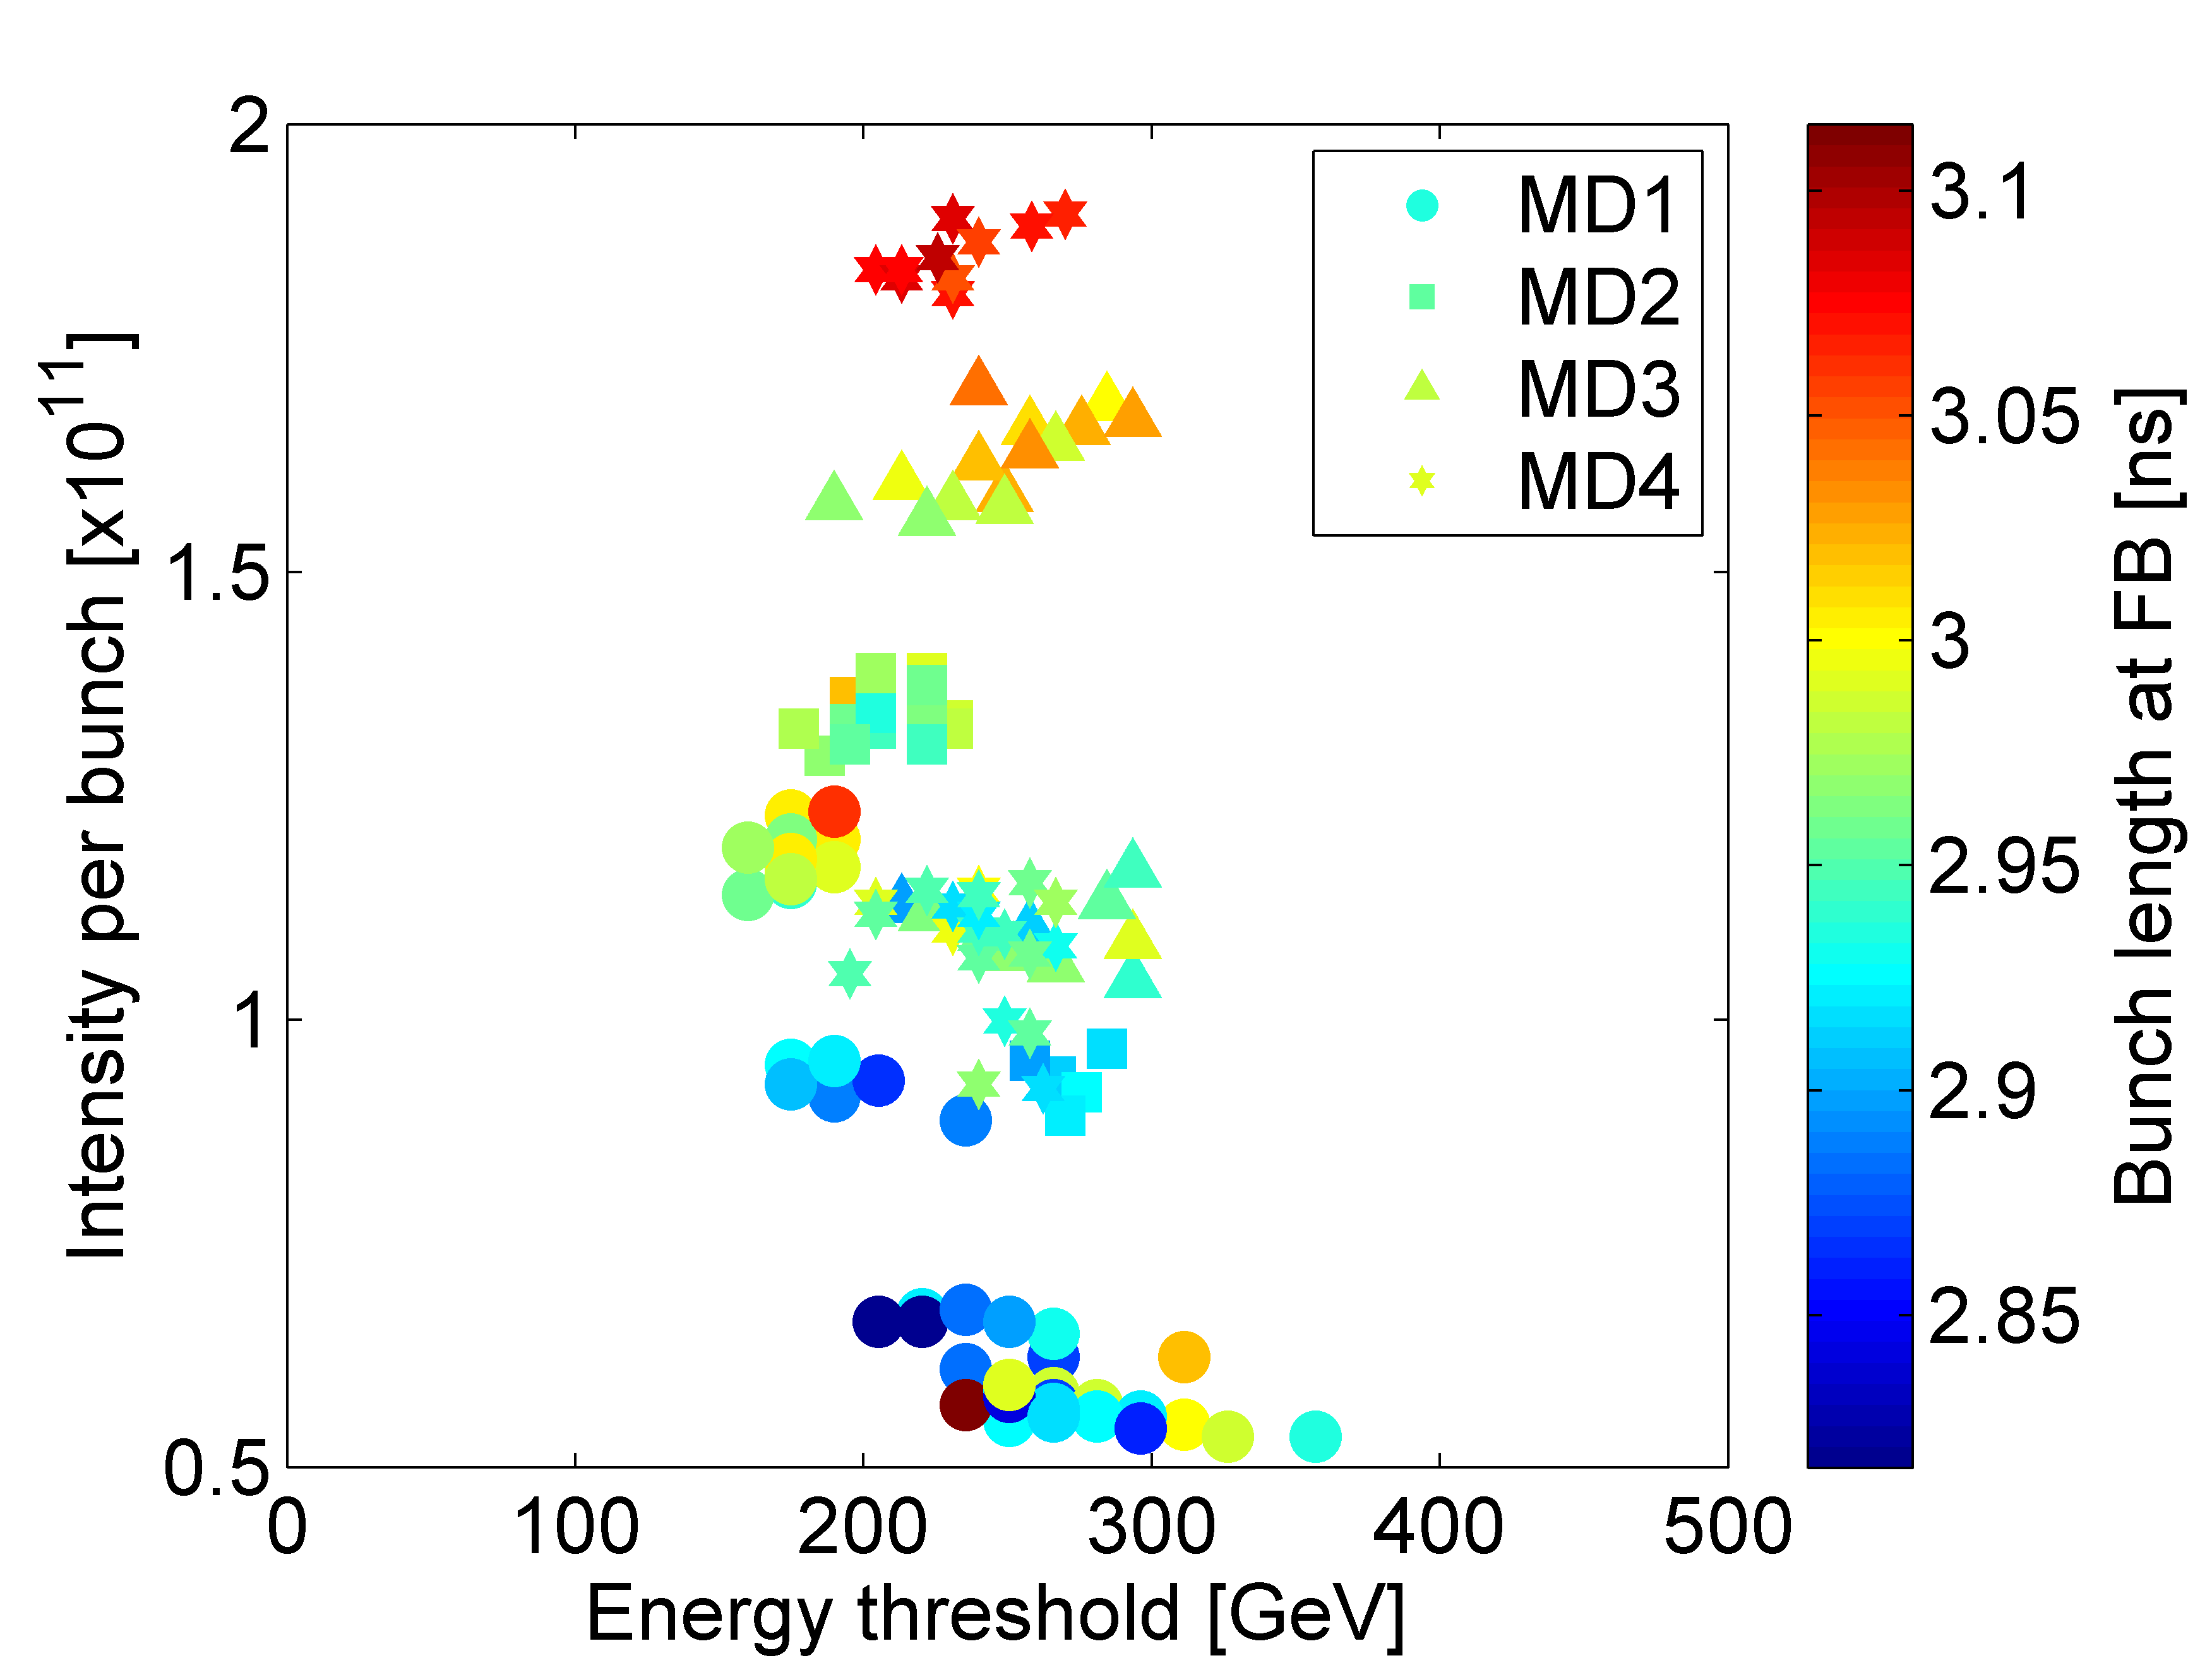
Instability threshold with 12 bunches
Courtesy: T. Argyropoulos

Slide 13
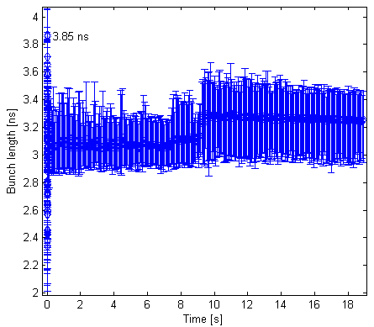
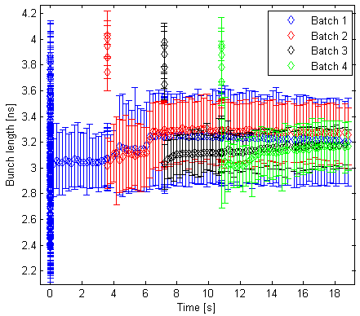
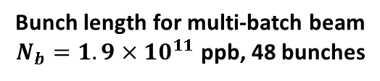
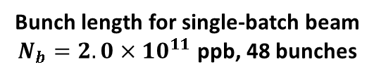
Flat bottom instability observed during high intensity run
Bunch length for single-batch beam
$N_{b}=2.0×{10}^{11}$ ppb, 48 bunches
Bunch length for multi-batch beam
$N_{b}=1.9×{10}^{11}$ ppb, 48 bunches
Multi-batch instability
  → Injection of second batch drives the first one
Possible causes
  Power limitation (uncompensated beam loading)
  Uncaptured beam passing through the first batch
  Unexpected behavior of LLRF
Quality of the beam extracted from the PS was sufficiently good
Instability observed after filamentation
Centre of the batch more unstable
Uncontrolled emittance blow-up in the middle of the cycle
Search of instability source ongoing

Slide 14
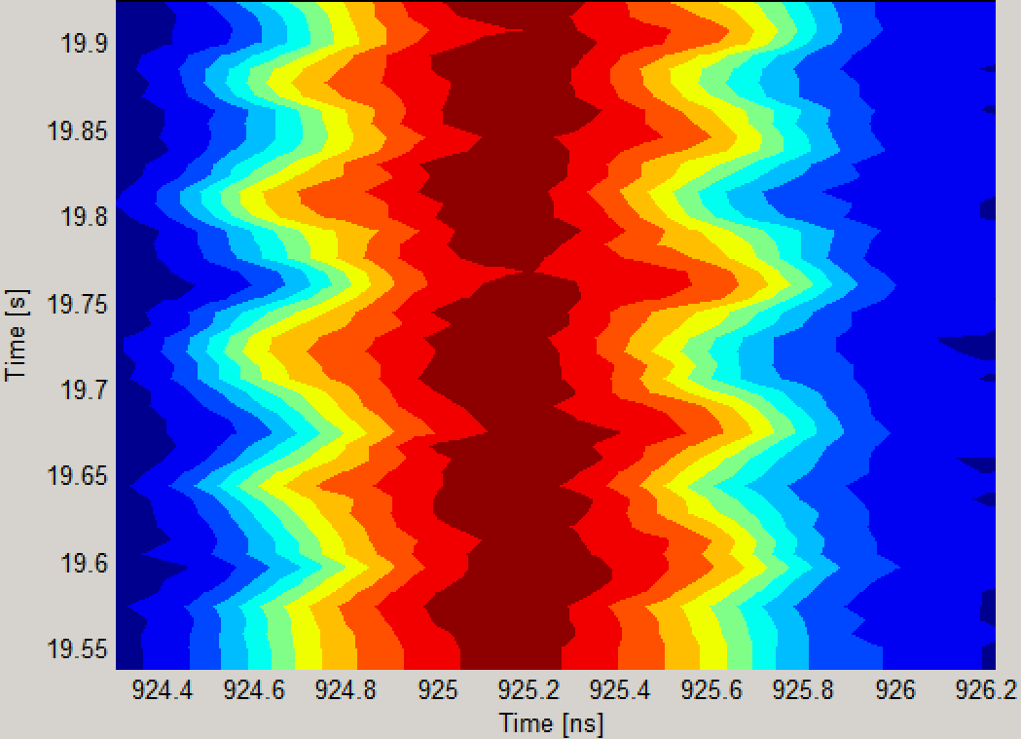
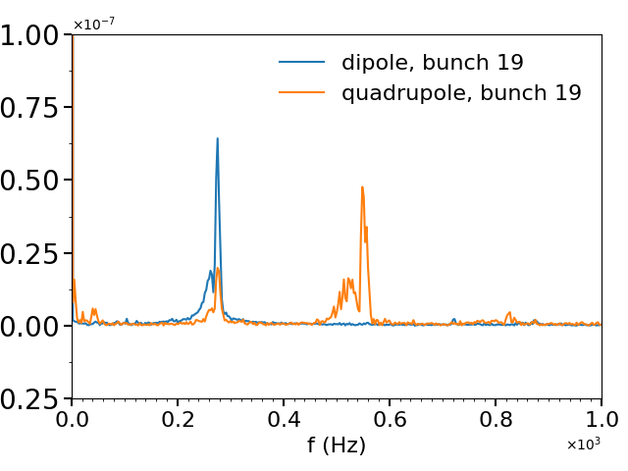
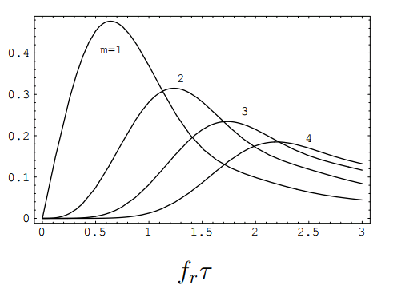

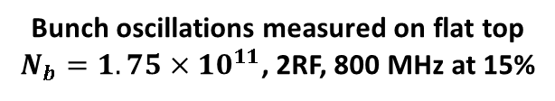
Coupled-bunch instability and
630 MHz HOM of the 200 MHz cavities
Growth rate of instability proportional to a form factor different for each mode
For given bunch distribution and resonant frequency the main growing modes can be predicted
Bunch oscillations measured on flat top
$N_{b}=1.75×{10}^{11}$, 2RF, 800 MHz at 15%
270 Hz
515-545 Hz
Form factor for SPS FT bunch distribution
for 630 MHz and 1.65 ns bunch length
Synchrotron frequency including intensity effects: $f_{so}=270$ Hz
Non-rigide dipole and quadrupole oscillations observed
Simulations on flat top agree well
  If 630 MHz removed, no oscillations
Courtesy: E. Shaposhnikova
→ On flat top 630 MHz HOM excites principally dipole and quadrupole modes
→ The instability source seems to be the 630 MHz HOM of the 200 MHz RF cavities

Slide 15
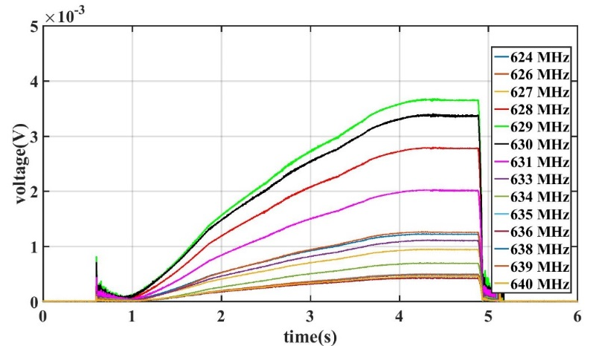
200 MHz RF cavity and 630 MHz HOM.
Voltage measurements
Voltage measurements on central loop cavity 2 and two different beams
Filter 1 MHz passband between 624-640 MHz
AWAKE cycle :15.12.2017
Before bunch rotation
SFTIons cycle :14.12.2017- during ramp
Courtesy: N. Nasresfahani
The beam excites clearly the 630 MHz passband in the cavity
The voltage measured is maximum for resonant frequency between 628 MHz – 630 MHz
  In agreement with the 630 MHz HOM model
New HOM couplers installed during the last YETS
  → New measurements scheduled to identify the efficiency of the HOM damping scheme

Slide 16
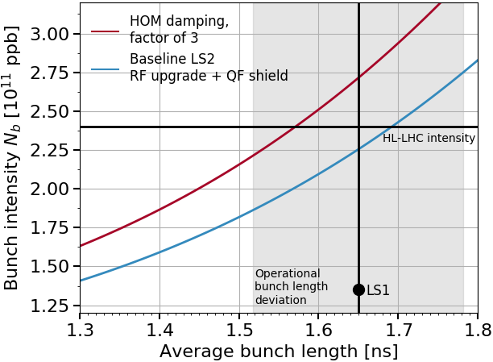
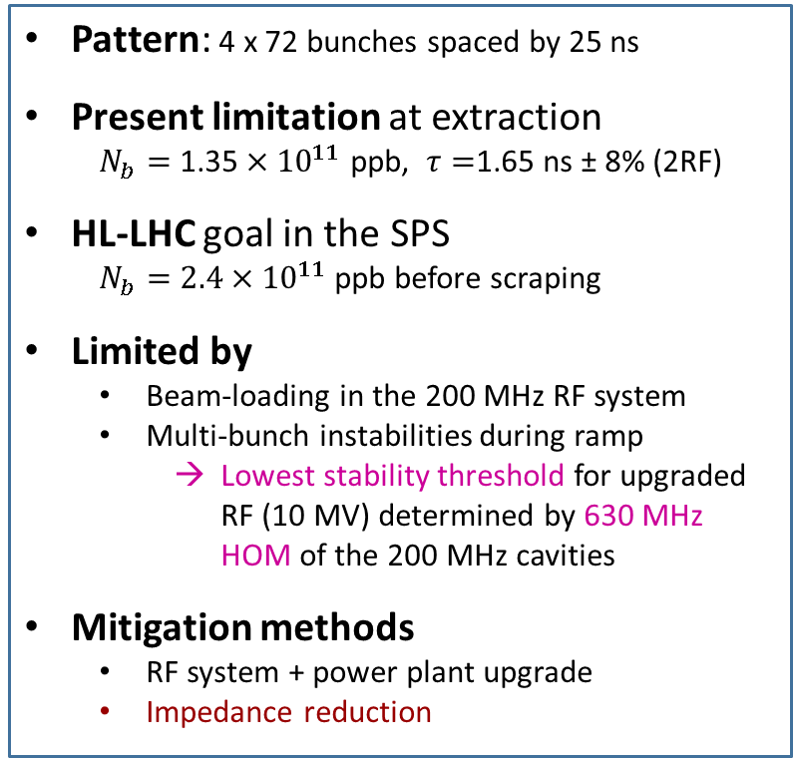
HL-LHC proton beam in the SPS.
Goal and limitations
Pattern: 4 x 72 bunches spaced by 25 ns
Present limitation at extraction
  $N_{b}=$ 1.35 $×{10}^{11}$ ppb, $τ=$1.65 ns ± 8% (2RF)
HL-LHC goal in the SPS
  $N_{b}=$ $2.4×{10}^{11}$ ppb before scraping
Limited by
  Beam-loading in the 200 MHz RF system
  Multi-bunch instabilities during ramp
    Lowest stability threshold for upgraded RF (10 MV) determined by 630 MHz HOM of the 200 MHz cavities
Mitigation methods
  RF system + power plant upgrade
  Impedance reduction
Instability threshold for 72 bunches at SPS flat top
10 MV at 200 MHz, 1MV at 800 MHz

