Slide 1
Measurements of the synchronous phase of the SPS
A. Farricker, A. Lasheen, M. Schwarz, E. Shaposhnikova
Acknowledgements:
G. Papotti, PS & SPS operators

Slide 2
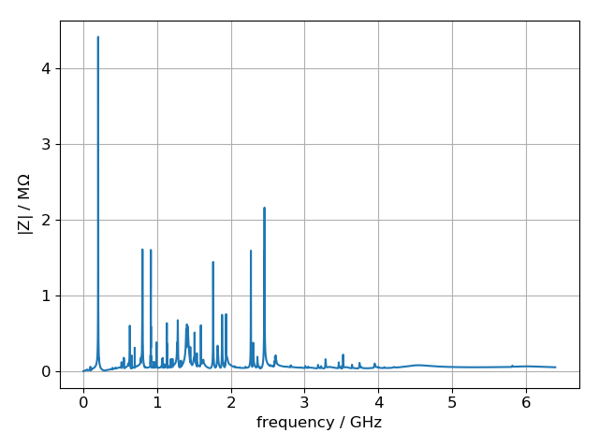
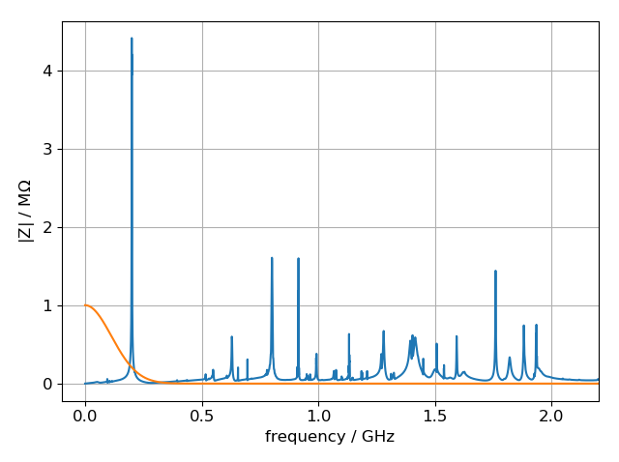
SPS impedance and synchronous phase
Resistive impedance leads to energy loss
The synchronous phase of the bunch shifts, to compensate for energy loss
Measurements of the synchronous phase can be used to test the SPS impedance model
First performed in 2003 [E. Shaposhnikova, EPAC 2004, WEPLT036]

Slide 3
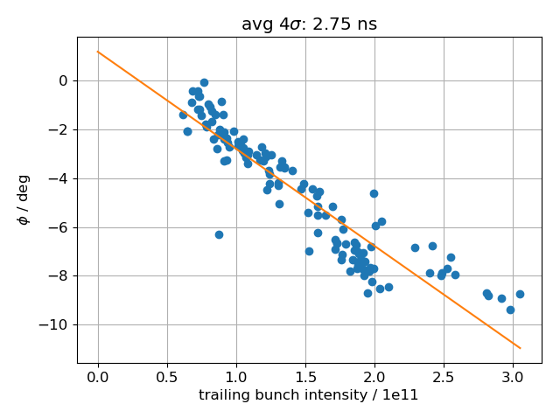
Energy loss
$\sin\left(φ_{s}\right)=\frac{U_{0}}{e V}≅φ_{s}$
Bunch: $U(N,σ)=eV φ_{s}(N,σ)$
For same bunch shape ($σ=const$):
$$U\left(N\right)=eV φ_{s}\left(N\right)≅eV \text{slope} N$$
Normalized energy loss per particle $\overline{U}$:
$$\overline{U}=U/{N/{10}^{10}}={10}^{10}eV \text{slope}$$
Energy lost by bunch: $U=e^{2}N^{2}\sum_{n}{κ_{n}}$ with loss factor $κ_{n}=\frac{ω_{0}}{π}\sum_{p=0}^{∞}{Re\left(Z_{n}\left(pω_{0}\right)\right)h(pω_{0})}$ for impedance $Z_{n}$
Normalized energy loss per particle $\overline{U}$: $\overline{U}=\frac{U}{N}\frac{1}{N/{10}^{10}}={10}^{10}e^{2}\sum_{n}{κ_{n}}$

Slide 4
Measurement of synchronous phase
To obtain reference phase, use leading bunch of (smaller) intensity as reference, with trailing bunch separated by ~1500ns
Obtain bunch position and shape by fitting to ‘binomial-μ’ distribution
Obtain relative phase by $∆φ=\frac{2π}{T_{RF}}\left({\text{pos}}_{1}−{\text{pos}}_{0}\right)\%T_{RF}$
For absolute phase, assume same distribution (i.e. bunch length) $φ_{1}=\frac{Δφ}{N_{1}−N_{0}}N_{1}$

Slide 5
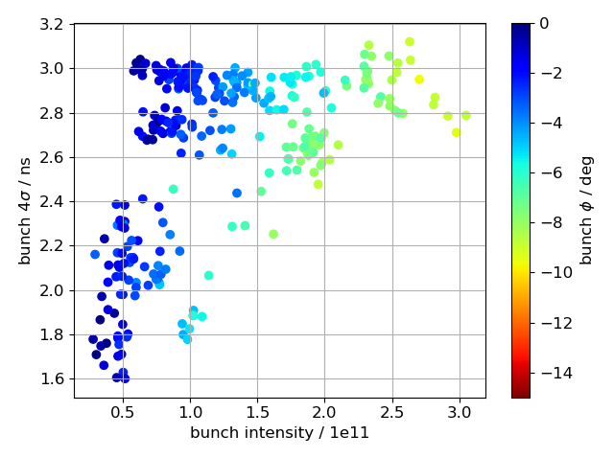
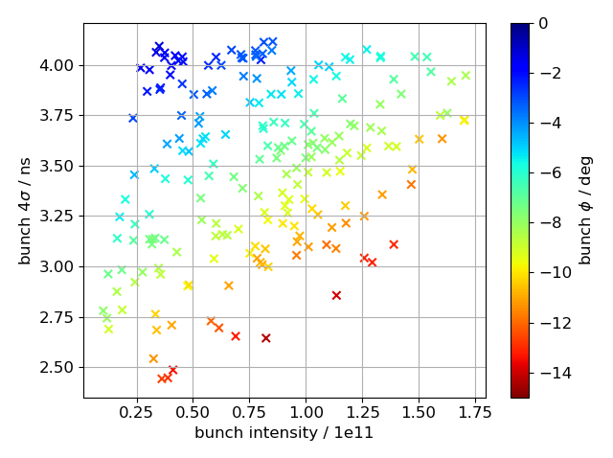
Measurement of synchronous phase: ‘scope’ and ‘ABWLM’
In 2018, three MDs where bunch parameters were adjusted manually and bunch profiles were acquired with the 40GS/s oscilloscope
One MD with scripted machine settings and automated profile acquisition with ‘ABWLM’ system
In both cases, bunches were captured in V₂₀₀=4.5MV and V₂₀₀=2.5MV after capture
‘scope’
ABWLM

Slide 6
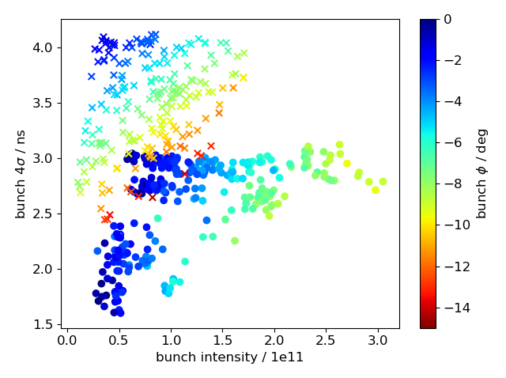
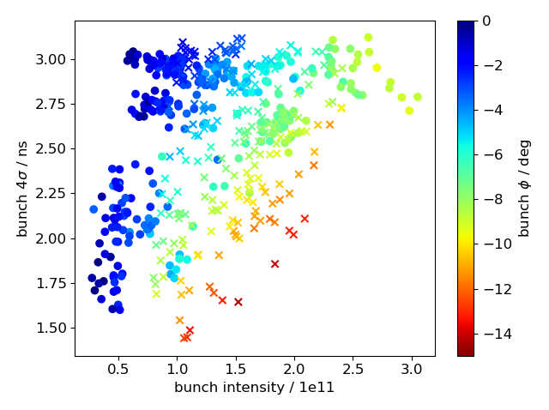
Measurement of synchronous phase: ‘scope’ and ‘ABWLM’
To compare both data sets, shift ‘ABLM’ set
‘ABWLM’ profile not corrected by transfer function
Shift by (0.7e11, -1.0ns)

Slide 7
Measured energy loss
Bin data with respect to bunch length between 1.5ns and 3ns
Obtain ‘slope’ from linear fit

Slide 8
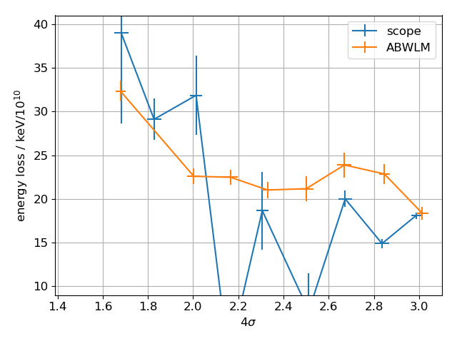
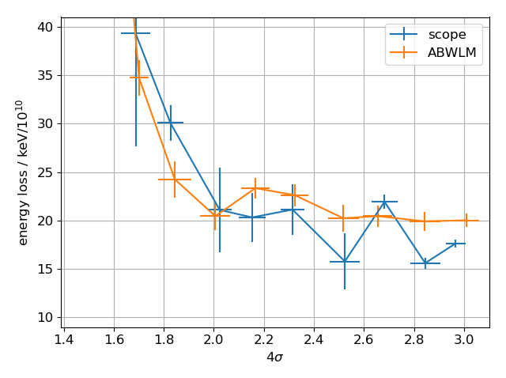
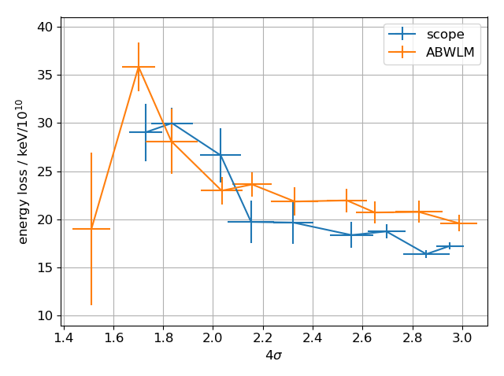
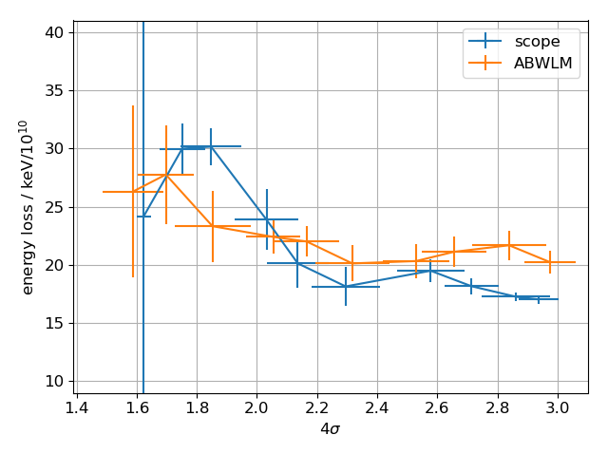
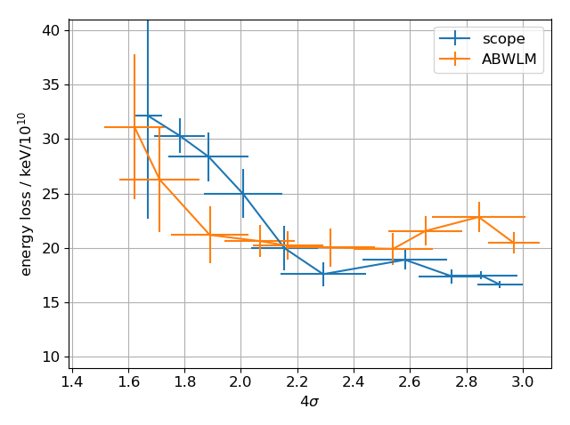
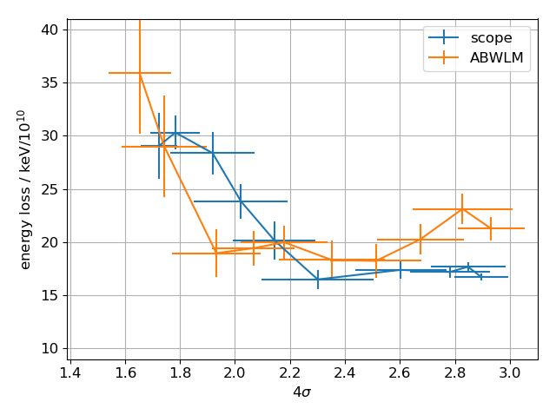
Measured energy loss
Bin data with respect to bunch length between 1.5ns and 3ns in X ps window
100ps
200ps
300ps
400ps
500ps
600ps

Slide 9
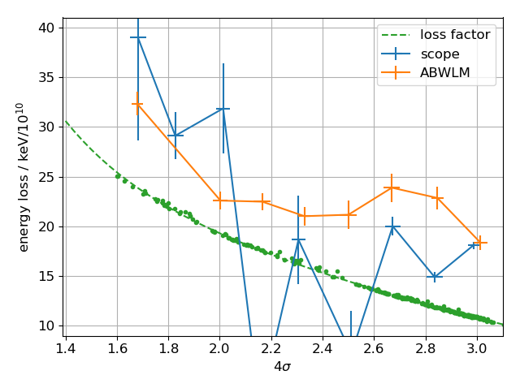
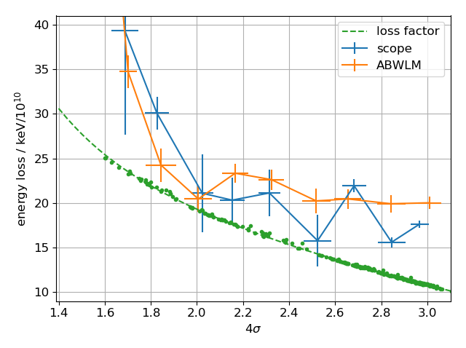
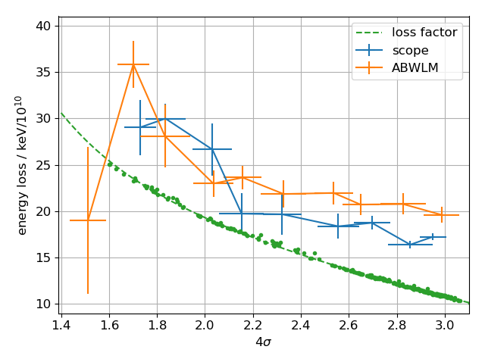
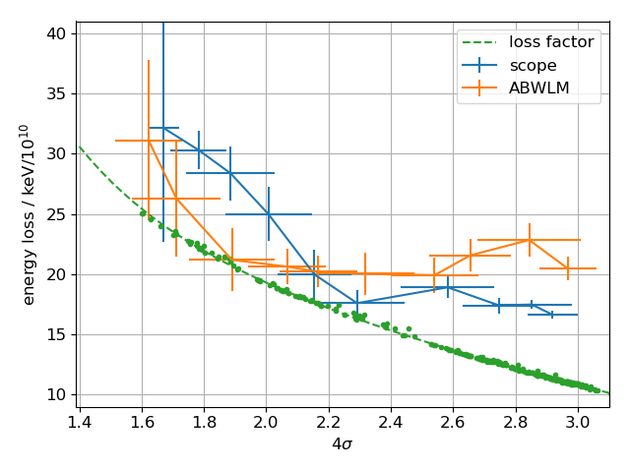
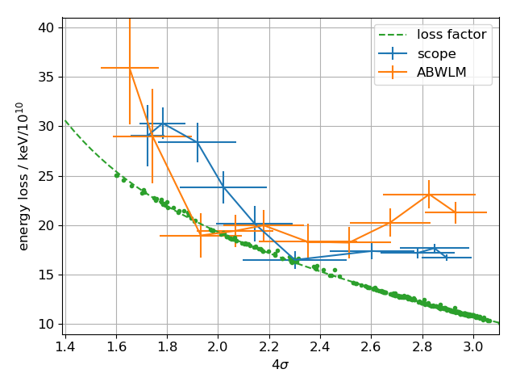
Comparison with impedance model
Bin data with respect to bunch length between 1.5ns and 3ns in X ps window
100ps
200ps
300ps
400ps
500ps
600ps

Slide 10
Comparison with impedance model
After shift of ABWLM data, they show the same tendency as the ‘scope’ data
Impedance model result
follows overall trend at small bunch length (<2.0ns)
does not display ‘plateau’ at larger bunch lengths
gives systematically smaller losses
500ps

Slide 11
Open questions / next steps
Difference in bunch lengths between ABWLM and ‘scope’ was observed before, but difference in intensities was not -> due to ABWLM profile not compensated by cable transfer function, which leads to a spurious tail and false intensity?
Why does impedance model not give ‘plateau’ at large bunch lengths?
Use BLonD simulations to generate matched binomial-μ distribution and obtain synchronous phase to compare with measurements and loss-factor calculation
Thank you for your attention!

