Slide 1
Longitudinal stability of LHC ions
T. Argyropoulos, H. Bartosik, T. Bohl, A. Lasheen, G. Papotti, M. Schwarz, E. Shaposhnikova
LIU-SPS BD WG 18/12/2018

Slide 2
Introduction
Momentum slip-stacking in the SPS is in the baseline for the ion beams to reach the HL-LHC requirements.
Two SPS batches of 100 ns bunch spacing will be interleaved at an intermediate energy plateau (300 GeV Z, well above transition crossing) reducing the bunch spacing to 50 ns.
A preliminary measurement campaign was initiated this year to get as much information about the beam parameters and stability to use during LS2 → more realistic beam simulations and better definition of the hardware specifications.
Measurements were dominated by beam instabilities and large emittance blow-up after transition crossing.

Slide 3
Outline
Measurements of the slip-stacking cycle.
LHC nominal cycle (4 bunches per PS batch).
Possible means of stabilizing the ion beams.

Slide 4
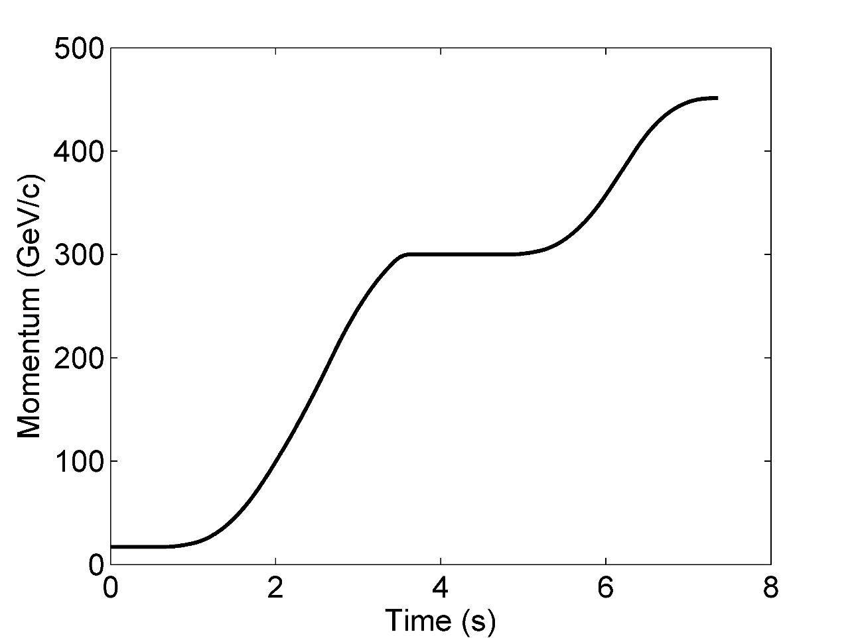
Slip-Stacking MDs
Measurements with one batch of 4 nominal ion bunches (~2.8E10 charges per bunch)
Adjustments during the MD of the 200 MHz voltage program, transition timing and radial beam displacement (more knobs are used in the initial set-up of the cycle by Thomas and Giulia)

Slide 5
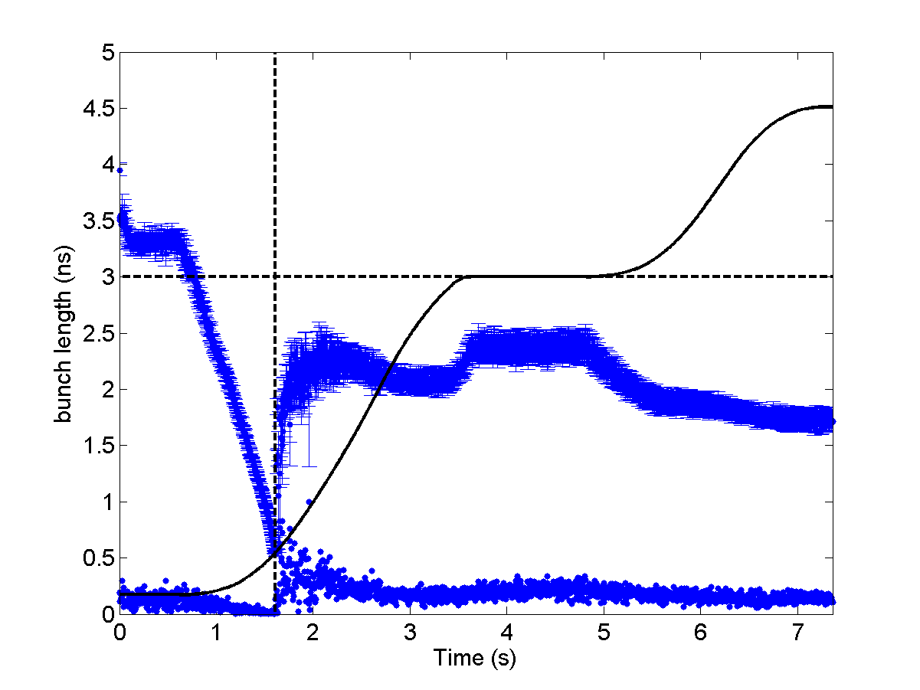
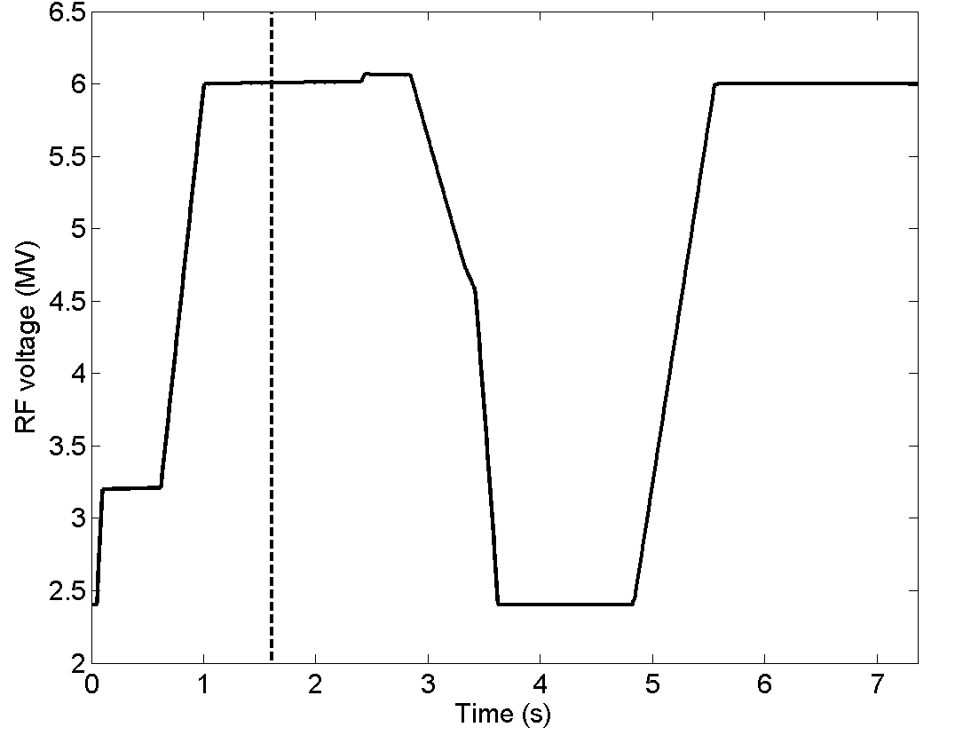
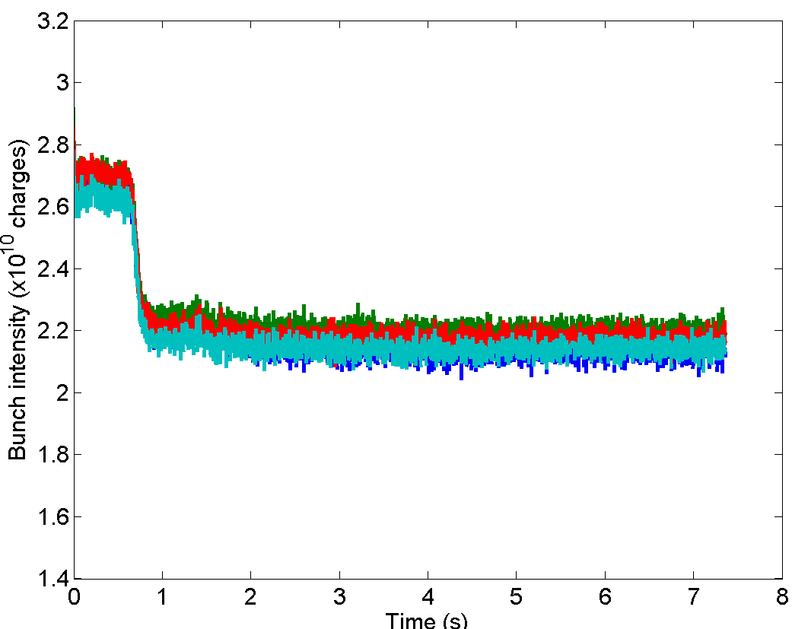
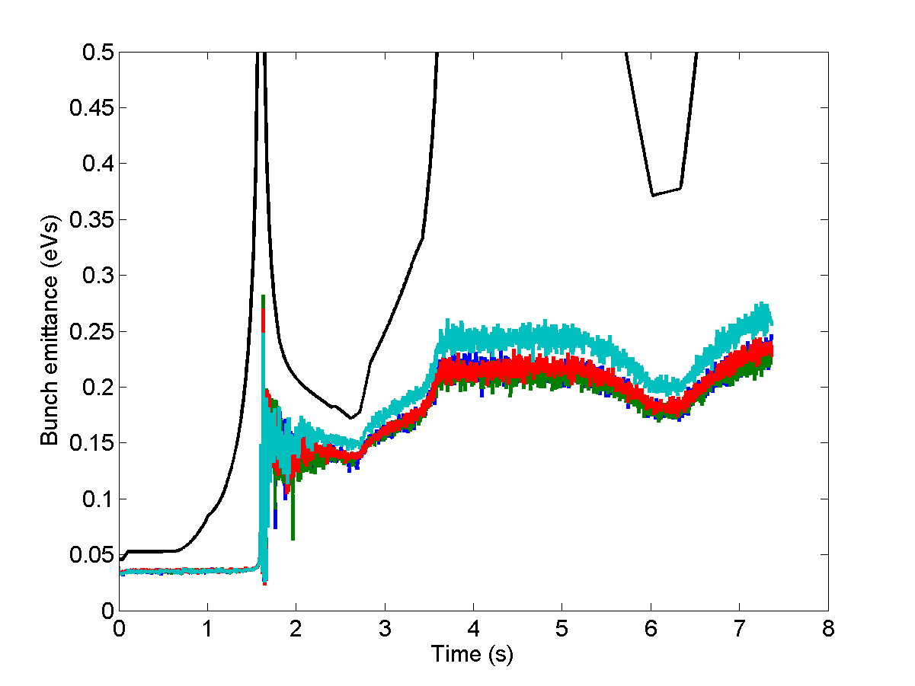
Slip-Stacking MDs – Voltage adjustments
Bunches blow-up after transition and then remain stable along the cycle
Large emittance at slip stacking plateau (~0.2-0.25 eVs proton eq. )
Losses ~ 20%
Not reproducible. There are cases with much bigger spread in bunch lengths

Slide 6
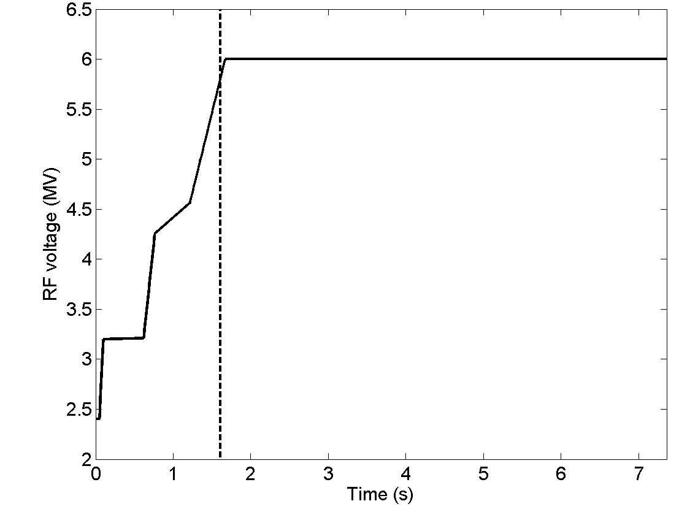
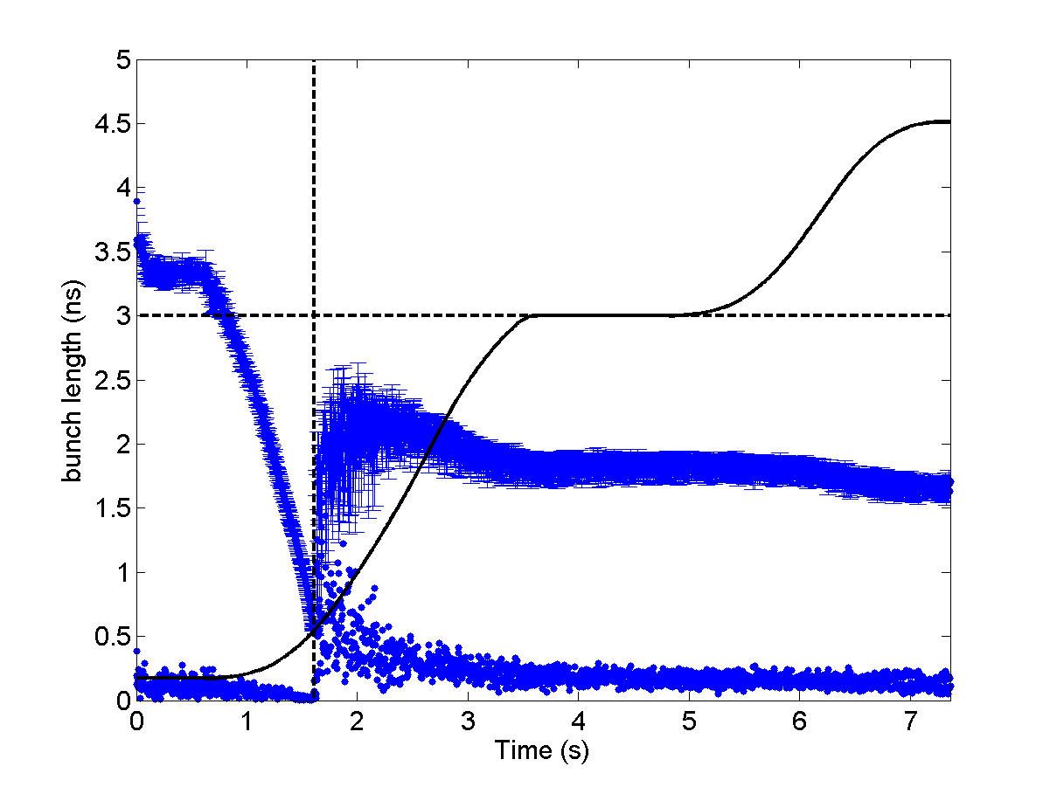
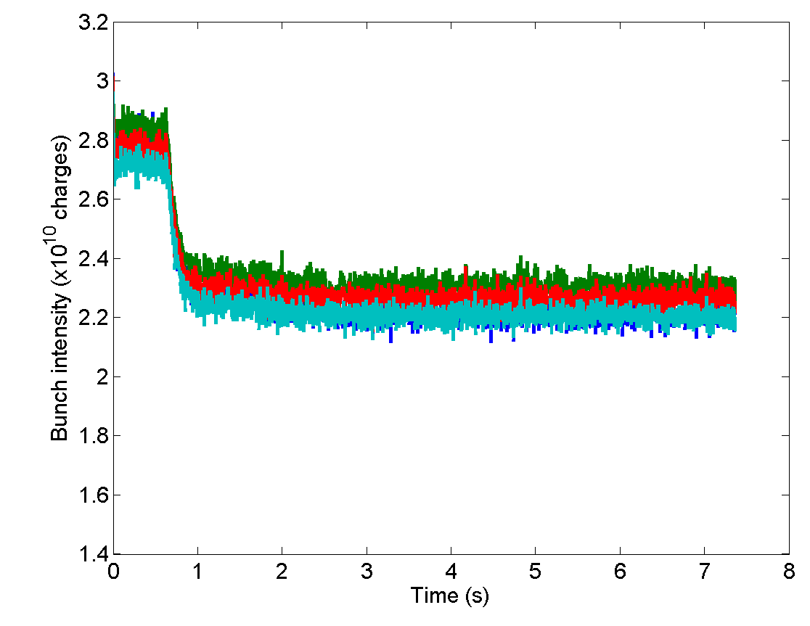
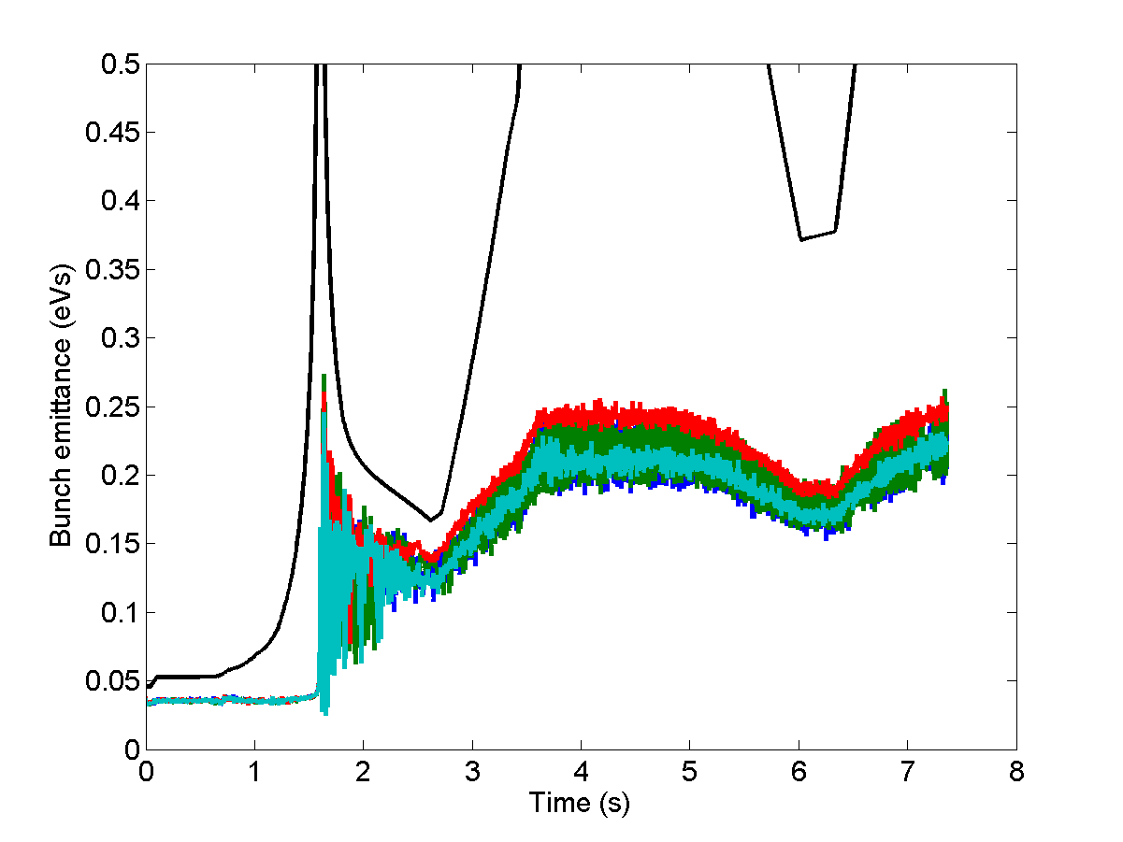
Slip-Stacking MDs – Voltage adjustments
Same comments as before:
Bunches blow-up after transition and then remain stable along the cycle
Large emittance at slip stacking plateau (~0.2-0.25 eVs proton eq. )
Losses ~ 20%
Not reproducible. There are cases with much bigger spread in bunch lengths

Slide 7
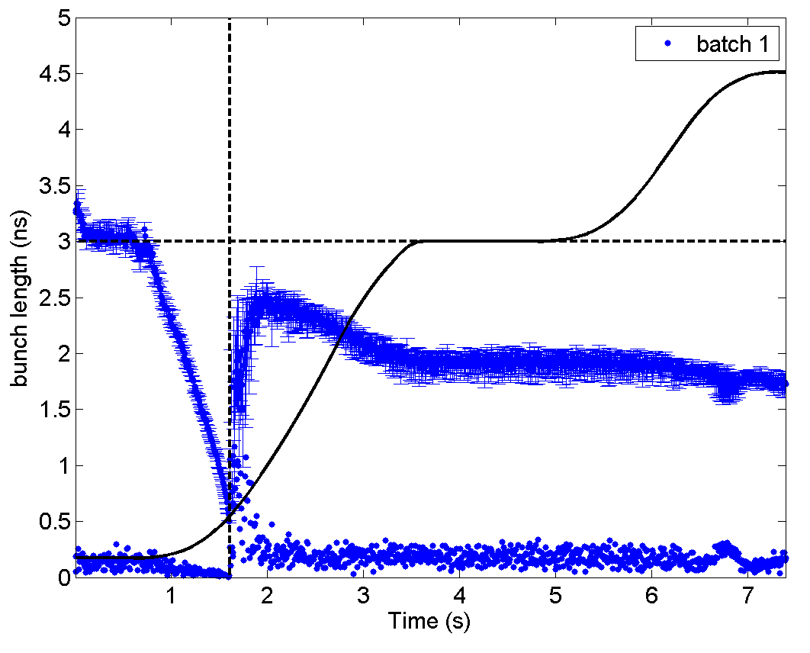
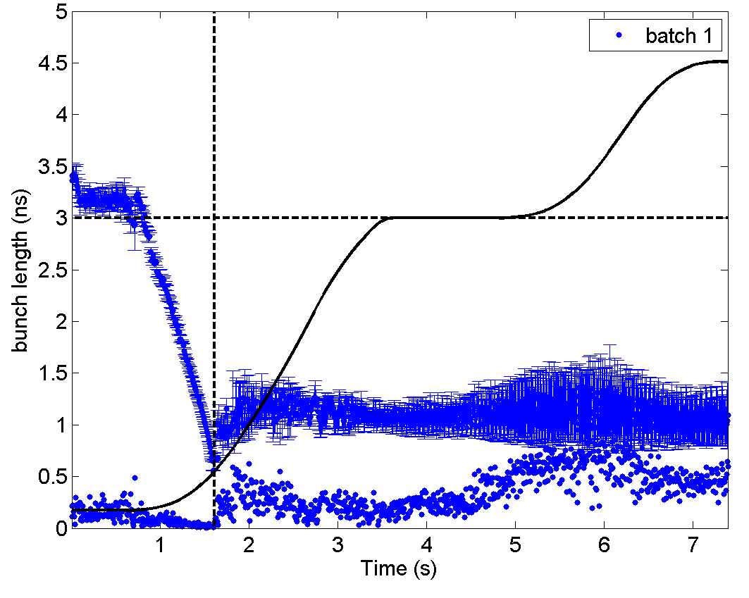
Slip-Stacking MDs – transition timing
Improving transition crossing leads to less blow-up but beam becomes unstable later:
instability is often starting at the plateau (due to reduction in the synchrotron frequency spread?)
Transition crossing adjusted
Not reproducible
Reproducible!

Slide 8
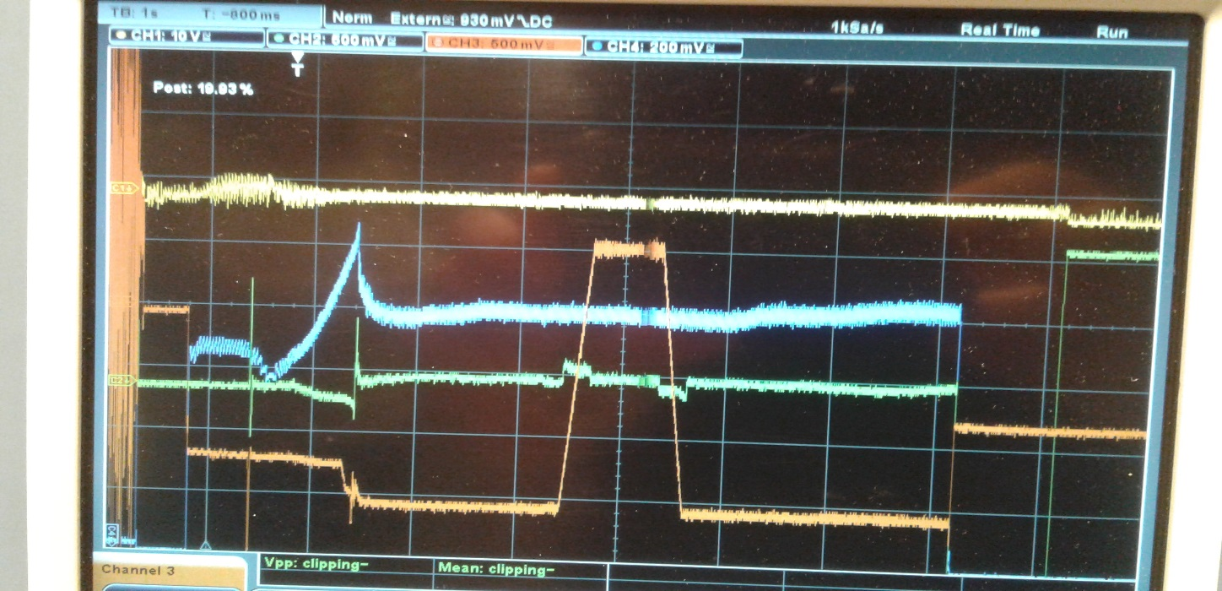
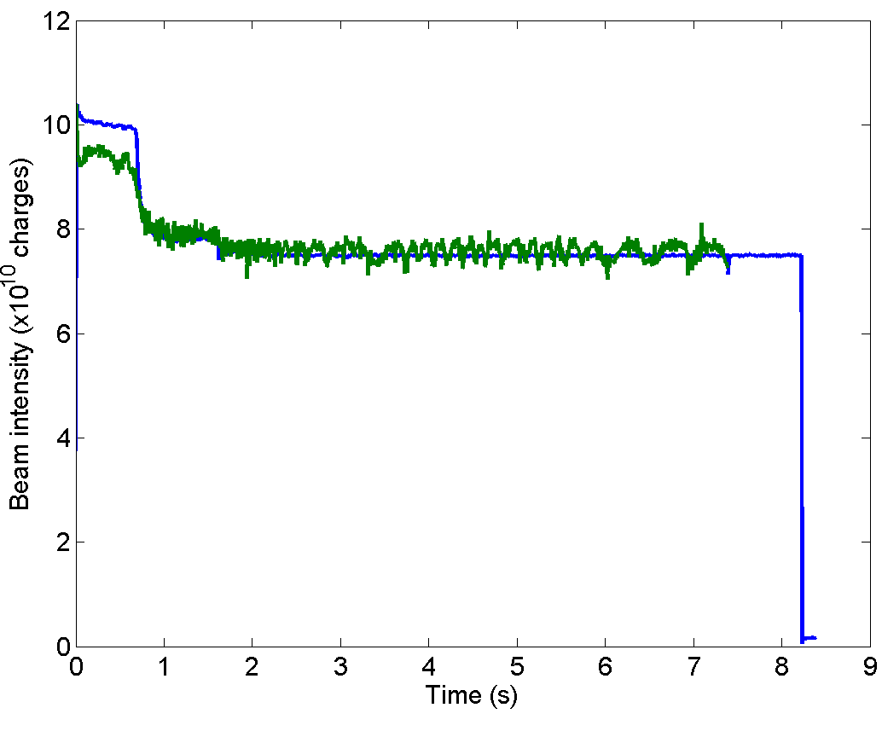
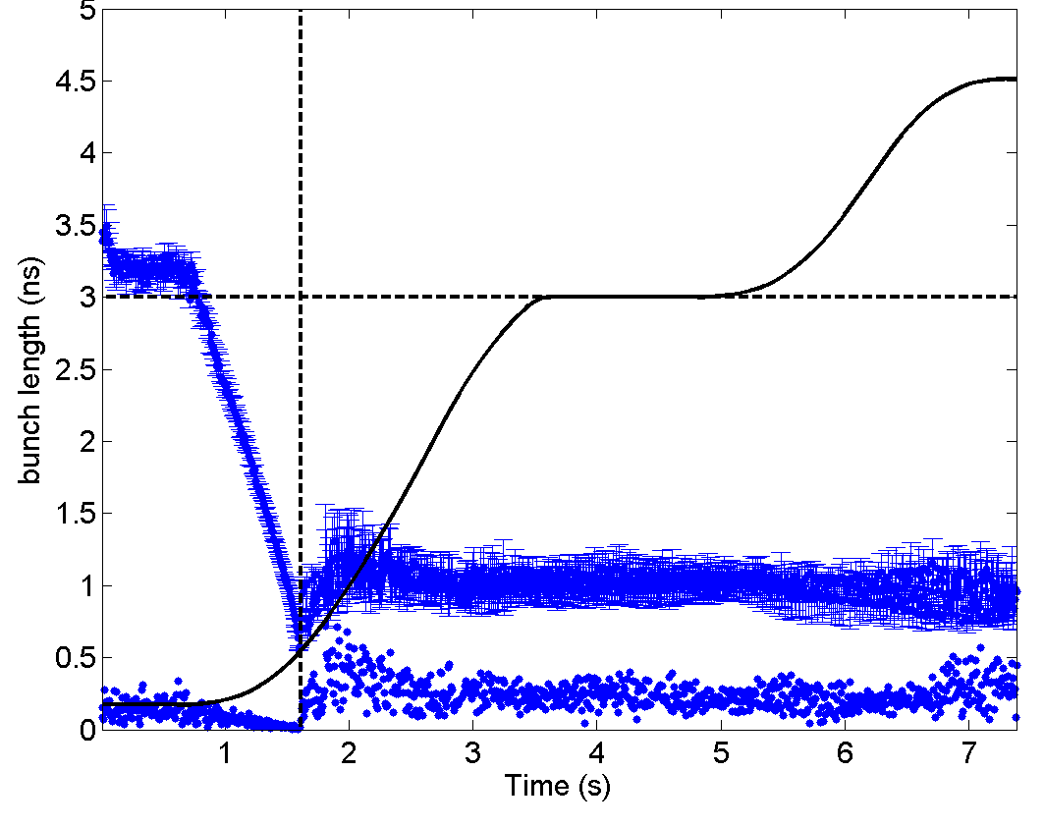
Slip-Stacking MDs – radial beam displacement
Radial beam displacement at the intermediate flat portion (~18 mm) didn’t lead to visible BCT losses!
→ Gives possibility to displace only one beam and simplify slip-stacking.
~18 mm displacement
DC BCT
Integration of bunch profiles

Slide 9
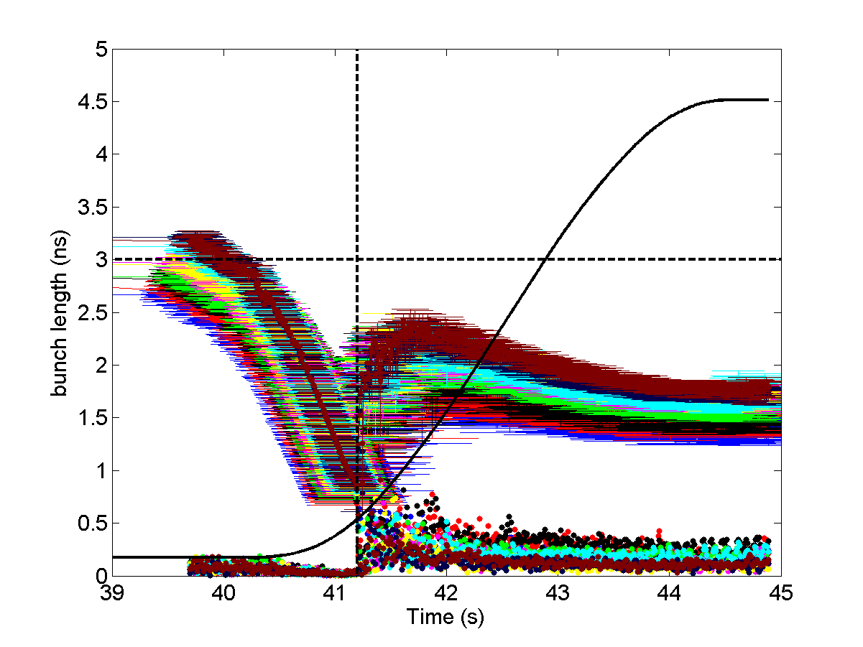
Nominal LHC cycle
Long flat bottom → significant reduction of intensity and bunch length along the SPS batch before ramp →
Big spread of beam parameters (bunch length and intensities).
The shortest (less intense) bunches can also become unstable later.
Uncontrolled blow-up during transition crossing → helps stability
but creates problems for the slip-stacking.
Improving transition crossing → smaller bunches which become
unstable!
Need to find mitigation measures for beam stabilisation before
and during slip-stacking

Slide 10
Possible means to stabilize the beam and future plans
800 MHz RF system was applied during one MD after deployment for ions
no effect on the beam was observed but
the relative phase was not specifically calibrated for ion operation
it can be used only after transition crossing (too late?)
if used during slip-stacking – need separate control of each cavity (as 200 MHz) – not available
Controlled emittance blow-up
it is very difficult in a single RF system due to small frequency spread
In double RF can be done only after transition crossing (too late?)
large bunch-by bunch variation in bunch length and then in synchrotron frequency shift
blow-up before transition crossing (smaller spread, stronger shift, big bucket area, …)
Better design of the slip-stacking cycle
Use of 6 bunches per PS batch
preliminary analysis shows very similar results
Feasibility of controlled blow-up needs to be studied during LS2 in simulations for realistic bunch-by-bunch particle distribution and SPS impedance model
before transition crossing in a single RF
after transition in double RF with phase noise or phase modulation of 800 MHz

