Slide 1
Update on loss studies
M. Schwarz
Acknowledgements:
A. Lasheen, J. Repond, E. Shaposhnikova, H. Bartosik, V. Kain, T. Bohl, G. Papotti,
H. Timko, P. Baudrenghien, P. Kramer, I. Karpov
SPS & PS operator team, BLonD dev team

Slide 2
Outline
Review of previous results
Simulations with
Different bunch distributions
Phase loop
Modulated intensity and bunch length
High intensity for present and future setup
First results of simulations with dynamic one-turn delay feedback

Slide 3
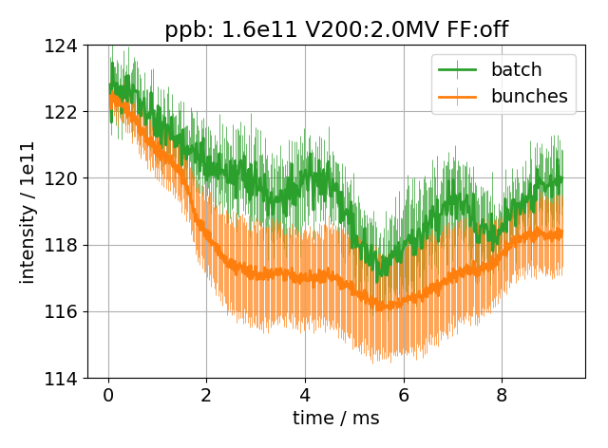
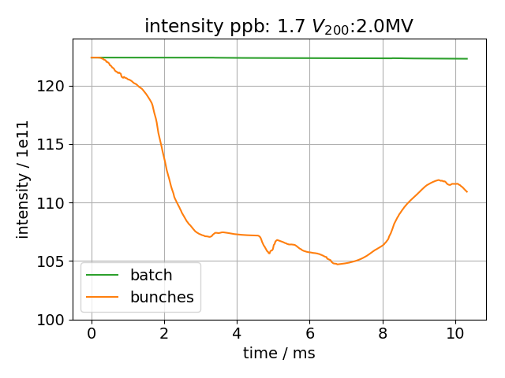
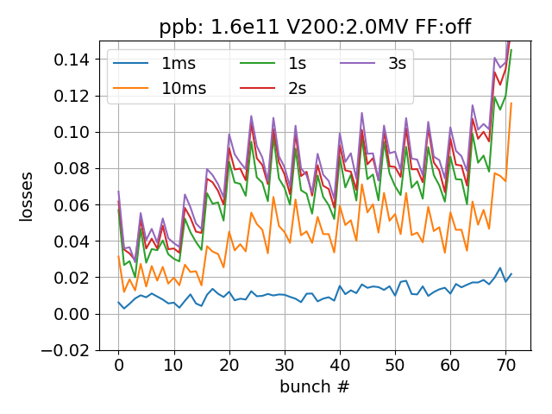
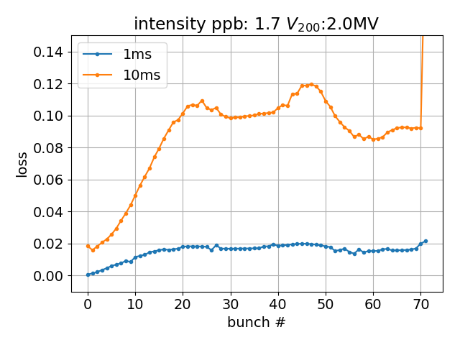
Measured and simulated losses: previous results
72 bunches (25ns spacing) and Q22 in both measurement and simulation
Measured and simulated intensity obtained by integrating profile +/-0.575 RF-buckets around bunch peak
Example with highest intensity (1.7e11ppb) in measurements and low V₂₀₀ voltage (2.0MV)
Measurement
Simulation
Shape and time scale agree very well!
Simulated losses to high compared to measurements: phase loop not included

Slide 4
Simulation parameters
Use different bunch distributions simulated in the PS (courtesy of A. Lasheen)
Out of the 4M macro-particles, randomly select 1M macro-particles for tracking in the SPS for each of the 72 bunches
Place bunches at center of bare RF-bucket
Use ‘impedance reduction’ to model one-turn delay feedback of 200 MHz TWC
Phase loop gain: 5e3 1/s; Radial loop gain: 5e9; PL averages over 12 bunches (hard edge)
Measurement setup
MD 17/11/14
72 bunches, Q22 optic
Vary intensity (here only show 1.7e11 ppb) and V₂₀₀ (from 2.0 MV up to 6.0 MV)
FF on/off (here only FF off)
Bunch parameters
Same methods used to analyze measured and simulated bunch profiles
Bunch intensity obtained by integrating profile +/-0.575 RF-buckets around bunch peak
Bunch length obtained from FWHM and converted to $4σ_{FWHM}=4 FWHM/2\sqrt{2 ln⁡(2)}$
Bunch position relative to bare RF-bucket spaced 25ns apart (1st bunch assumed to be at center of RF-bucket)
Bunch loss $l\left(t\right)=(intensity\left(0\right)−intensity\left(t\right))/intensity(0)$

Slide 5
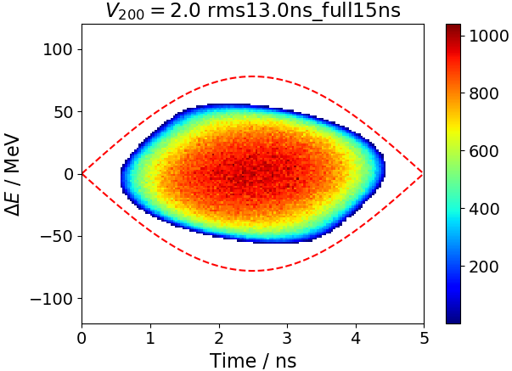
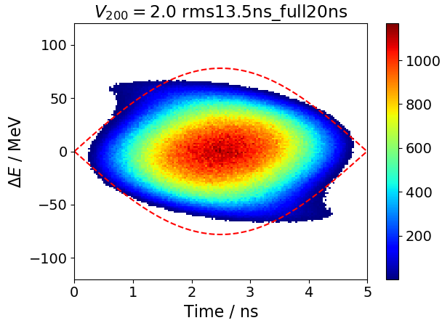
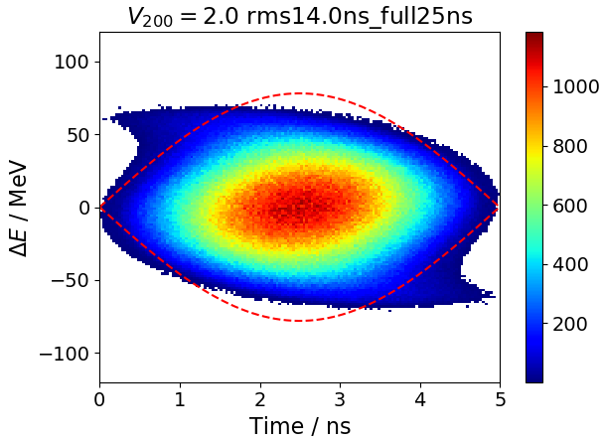
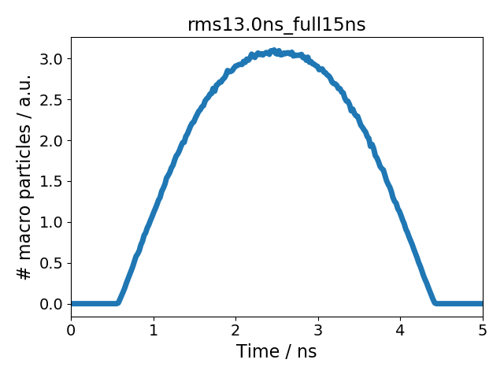
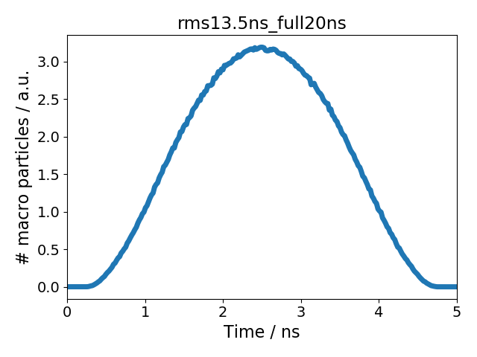
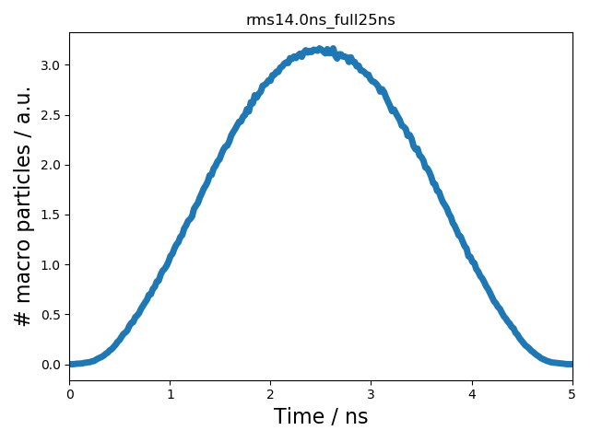
Simulated particle distributions used
Use different bunch distributions simulated in the PS (courtesy of A. Lasheen)
Out of the 4M macro-particles, randomly select 1M macro-particles for tracking in the SPS for each of the 72 bunches
Place bunches at center of bare RF-bucket
Use ‘impedance reduction’ method to simulate SPS one-turn delay feedback
Full SPS impedance model
Distribution 1
Distribution 2
Distribution 3

Slide 6
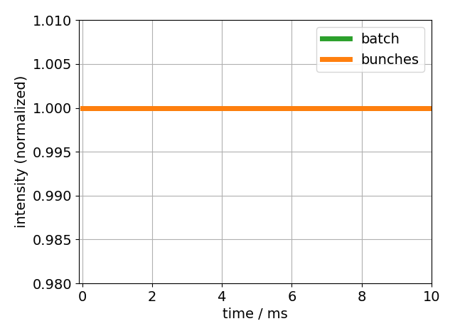
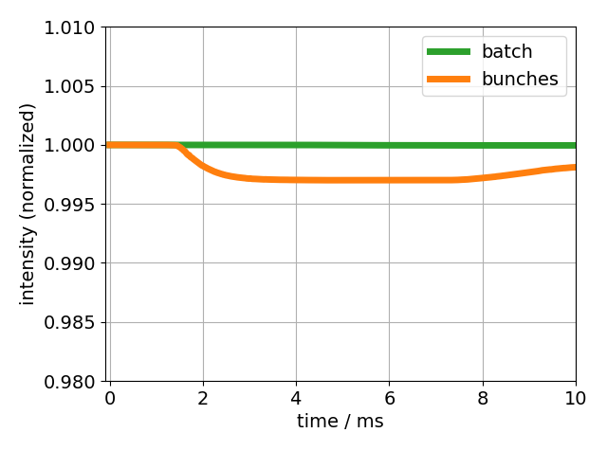
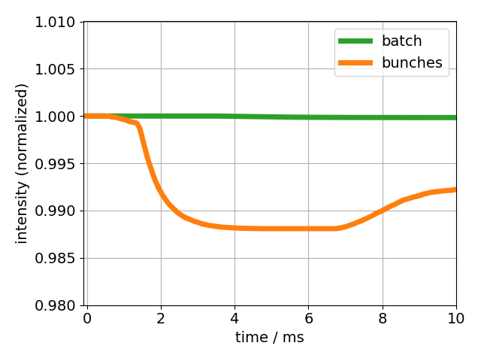
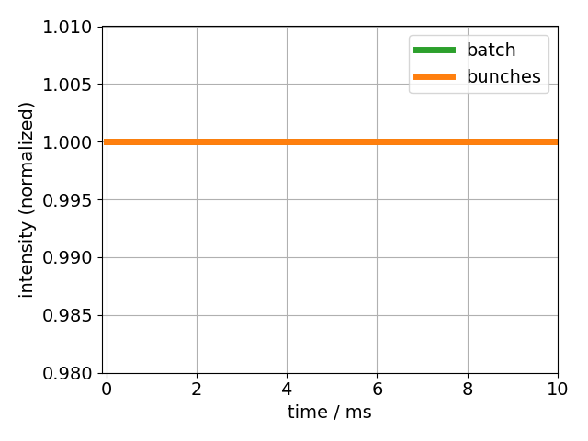
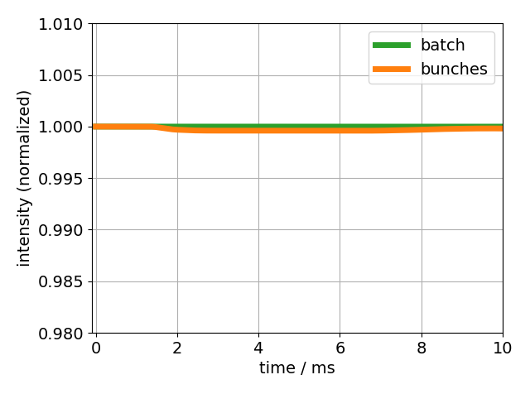
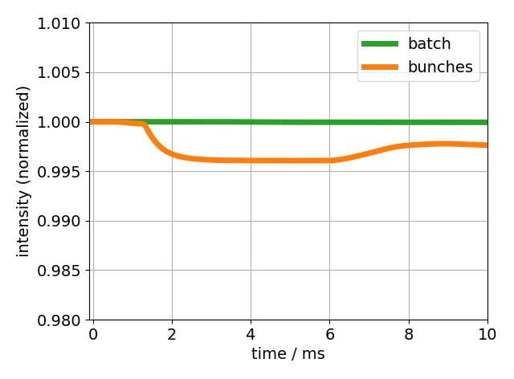
Simulated bunch intensity, no beam loading
0 bunch intensity -> losses due to overlap of bunch distribution with RF-bucket
Distribution 1
Distribution 2
Distribution 3
V₂₀₀ = 2.0 MV
0% losses
< 1% losses
~ 1% losses
V₂₀₀ = 3.5 MV
0% losses
~ 0% losses
< 1% losses

Slide 7
Simulations phase loop
1.7e11 ppb; V₂₀₀=2.0MV; distribution 2

Slide 8
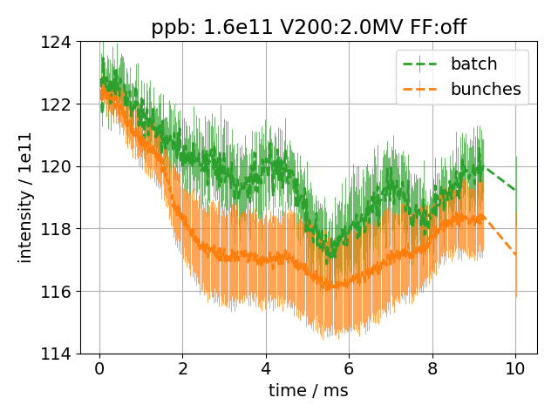
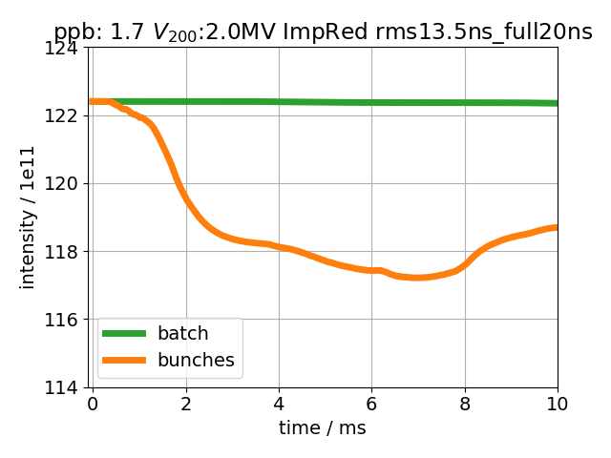
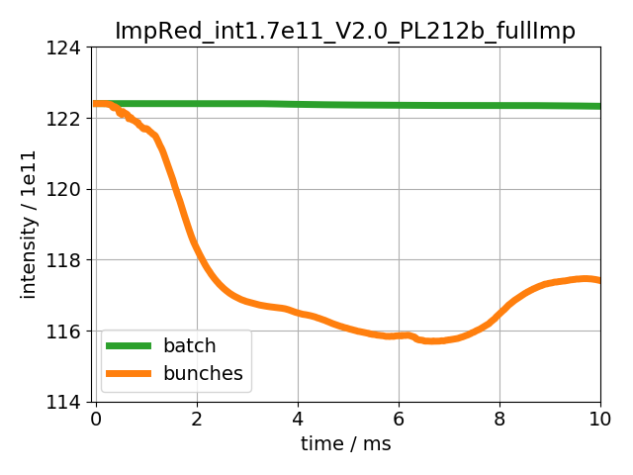
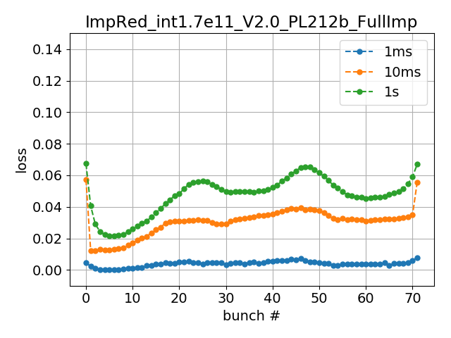
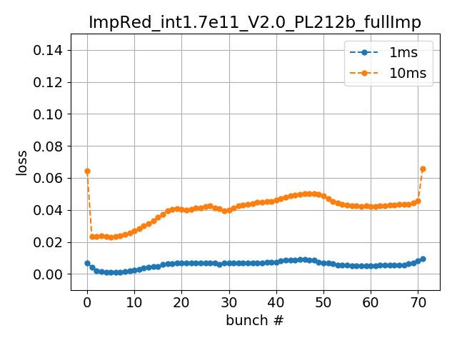
Simulations with different distributions vs measurements
1.7e11 ppb; V₂₀₀=2.0MV
Measurement
Distribution 2
Distribution 3
With phase loop, simulated and measured losses also in quantitative agreement
But notice modulation of losses in measurements (every 4th bunch = 10 MHz)

Slide 9
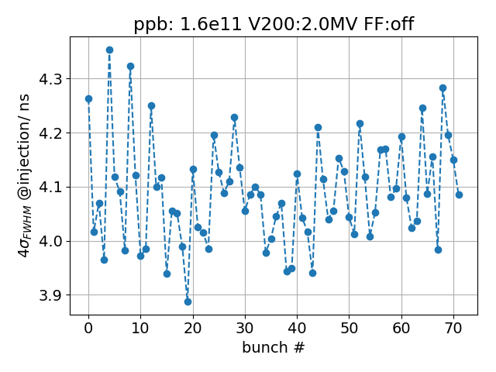
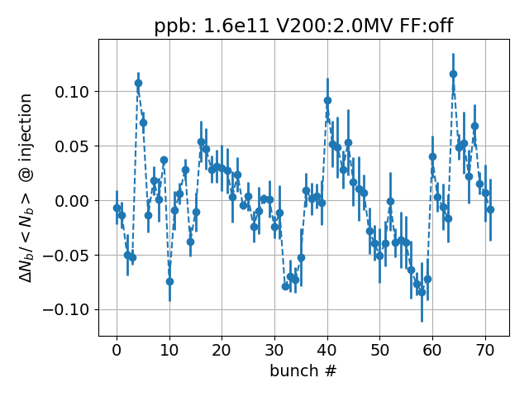
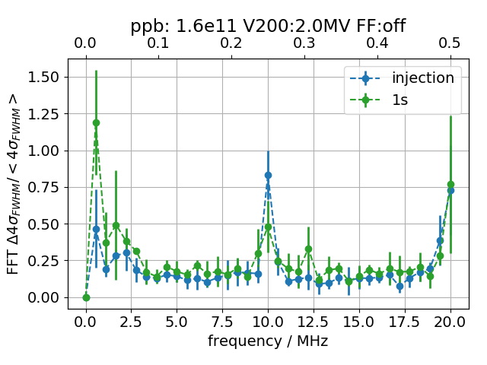
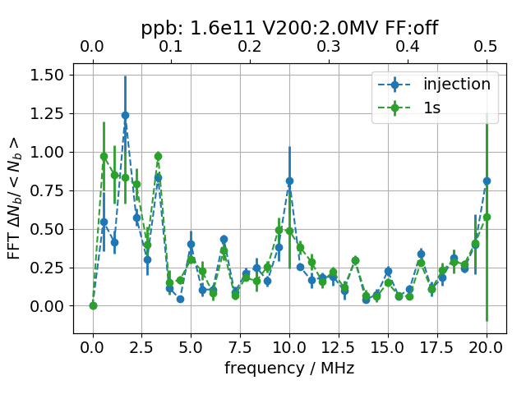
Investigate 10 MHz modulation
Both initial bunch length and intensity modulated with 10 MHz
To model this effect in simulations:
Modulate bunch intensity (# of macro-particles) with pattern [0.9, 0.97, 1.03, 1.1] every four bunches
Modulate bunch length by choosing distributions with 4σ_{FWHM} [4.25ns, 4.17ns, 4.09ns, 3.97ns]

Slide 10
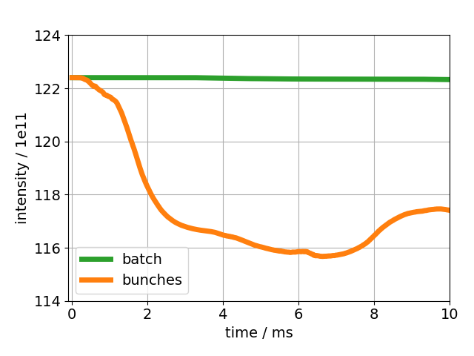
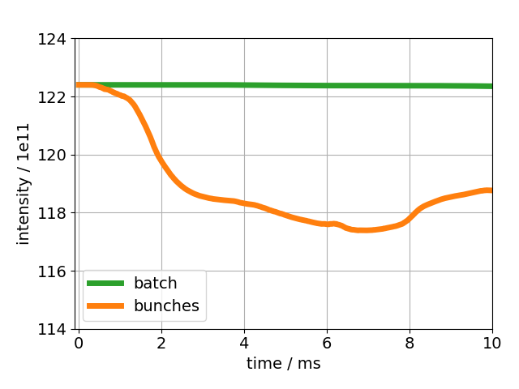
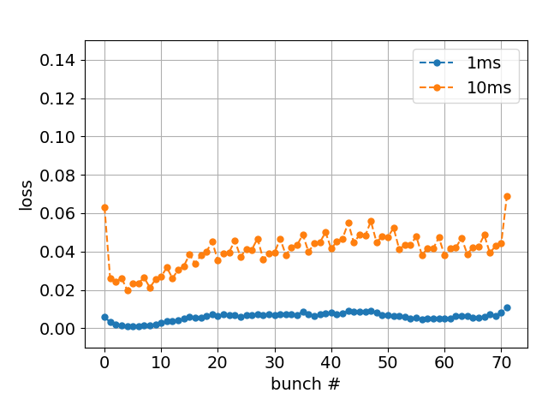
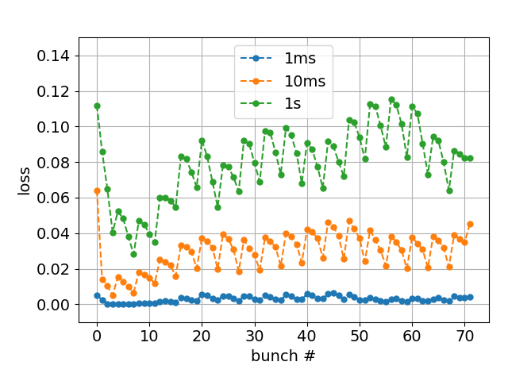
Simulations with different distributions vs measurements
1.7e11 ppb; V₂₀₀=2.0MV
Modulation of bunch intensity
(distribution 3)
Modulation of bunch length
(based on distribution 2)
Measurement
Modulation of bunch length leads to stronger loss modulation compared to intensity modulation
When modulating bunch lengths, losses decrease for last bunches!?

Slide 11
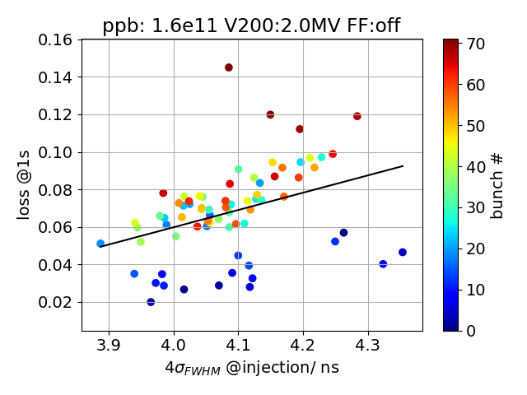
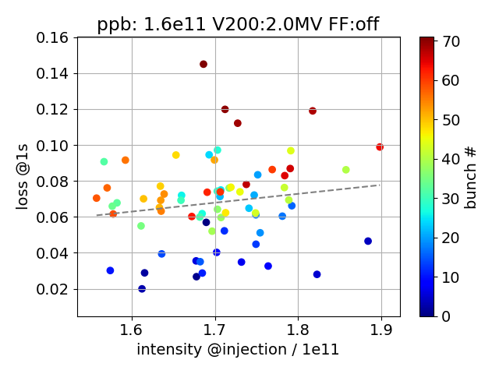
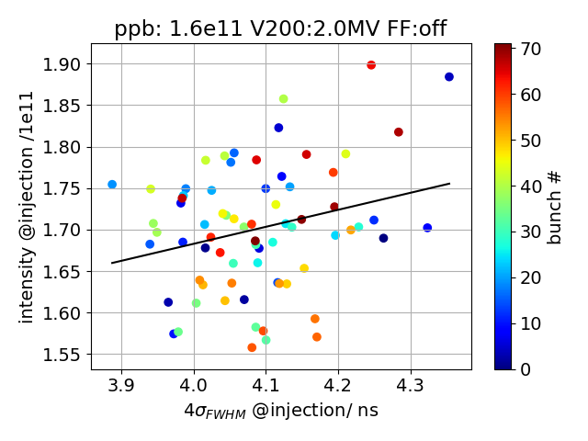
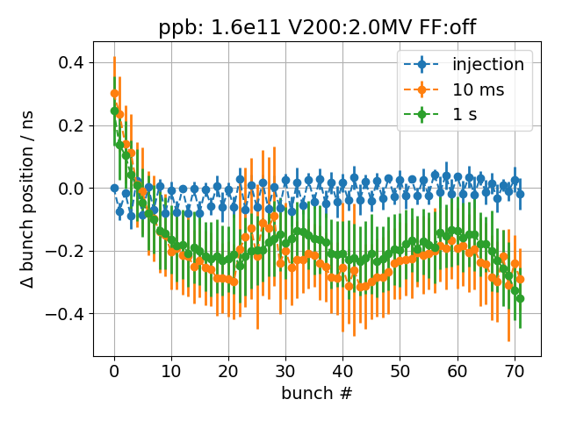
Correlations with losses
Loss after 1s correlated with injected bunch length, but no correlation with injected intensity
Bunch positions change -> reproduced in simulations?

Slide 12
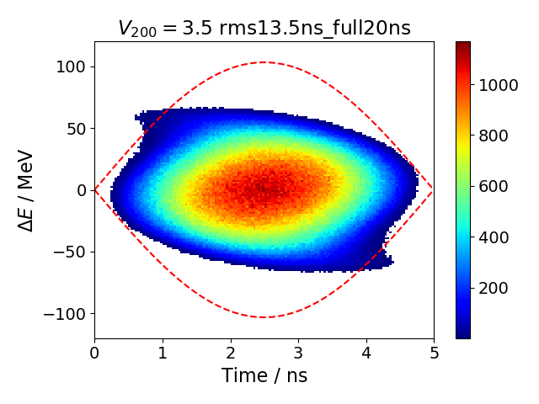
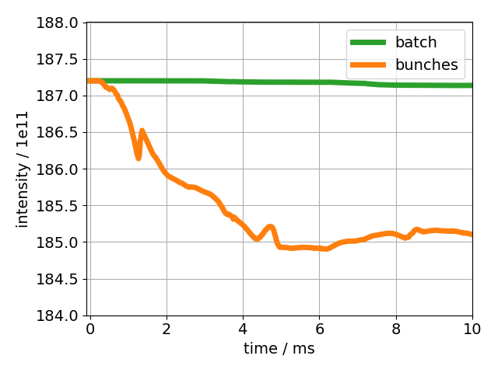
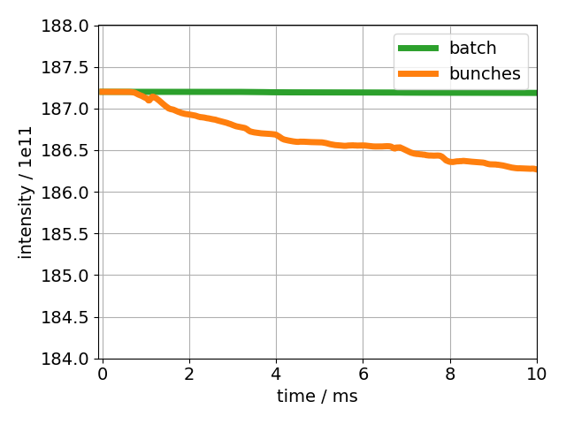
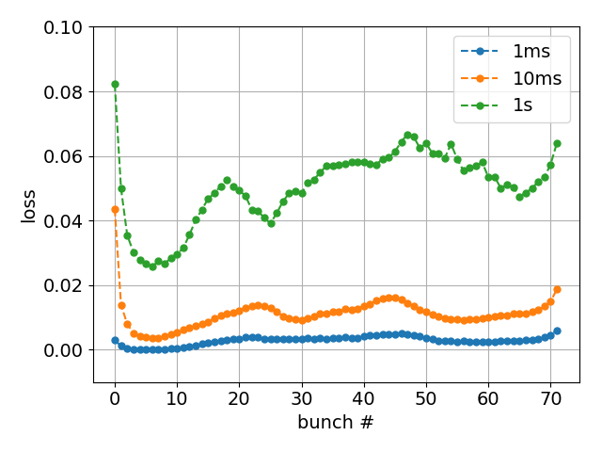
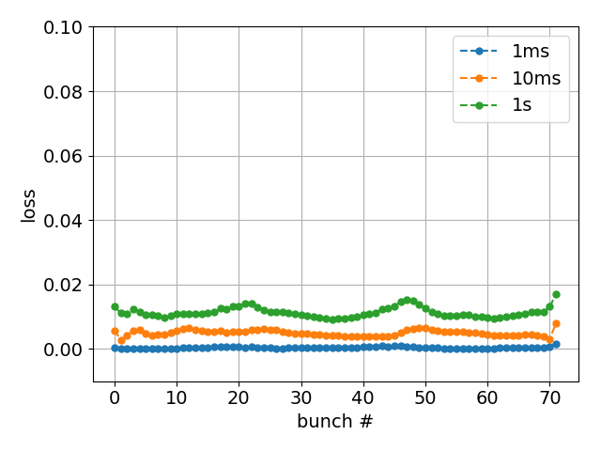
18/02/12
Simulated losses for high intensity
Simulation parameters present:
72 bunches, 2.6e11 ppb
V₂₀₀ = 3.5 MV
Feedback strength at -15 dB reduction
Phase loop averages over 12 bunches
Two 5-section and two 4-section cavities
Present SPS impedance model
Simulation parameters future:
72 bunches, 2.6e11 ppb
V₂₀₀ = 3.5 MV
Feedback strength at -26 dB reduction
Phase loop averages over all bunches
Two 4-section and four 3-section cavities
Future SPS impedance model
present
future

Slide 13
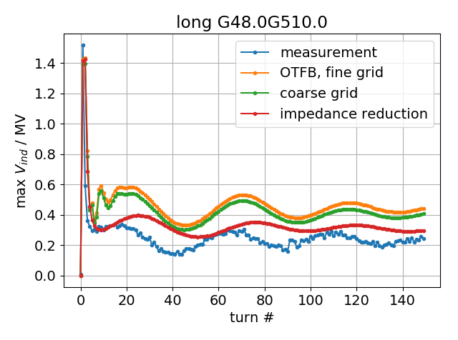
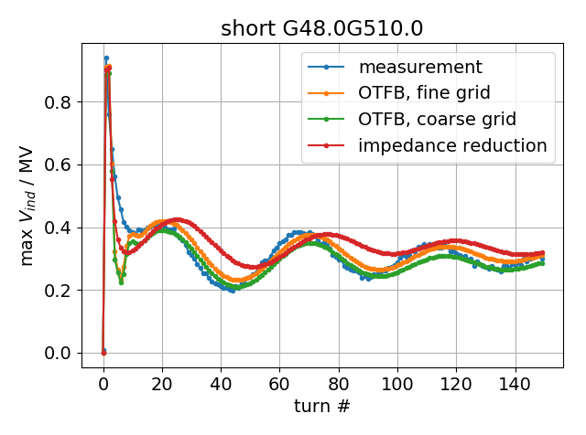
Motivation:
Previously, SPS OTFB modeled by ‘impedance reduction’, i.e. no dynamic implementation
Dynamic OTFB developed for BLonD (H. Timko)
Here, present first comparisons with measurements
First results with dynamic OTFB
Measurements:
48 bunches, 1.48e11 ppb
V₂₀₀ = 4.5 MV, Q22 optic
Simulation parameters:
48 bunches, 1M macro-particles per bunch
V₂₀₀ = 4.5 MV, Q22 optic
Present full SPS impedance model
Present ‘best settings’ (G_LLRF_4 = 8.0, G_LLRF_5 = 10.0)
Results:
Induced voltage in short TWC ‘undershoots’ around turn 10; asymptotic behavior represented well
For long TWC, OTFB does not reduce induced voltage enough!?

Slide 14
Summary
With inclusion of phase loop, simulated losses are also in quantitative agreement with measurements
Started to investigate influence of different initial distributions on losses
Assuming future parameters (improved PL, OTFB, SPS impedance), simulations for high intensity yield losses below 2% after 1s
First results of dynamic OTFB show good results for 4-section cavity, but not for 5-section cavity
Next steps
More 1s long simulations for different cases to study losses after 1s
Why losses for last bunches in simulations sometimes smaller?
Bunch positions
Further work on dynamic OTFB
Thank you for your attention!

Slide 15
Appendix

Slide 16
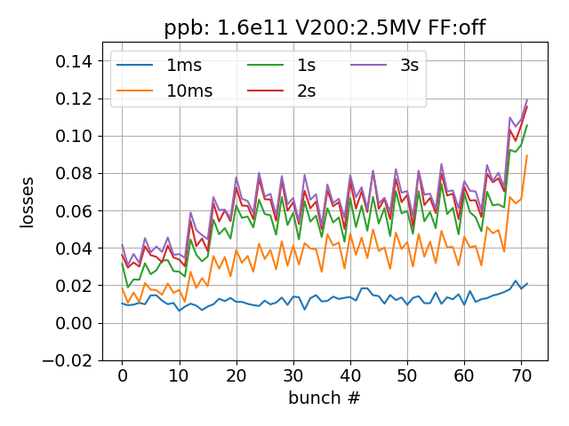
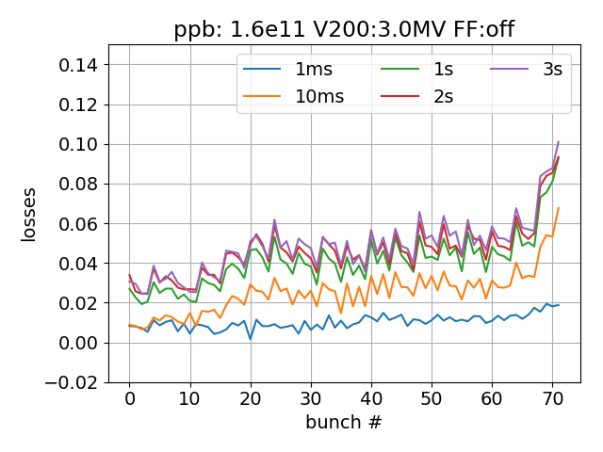
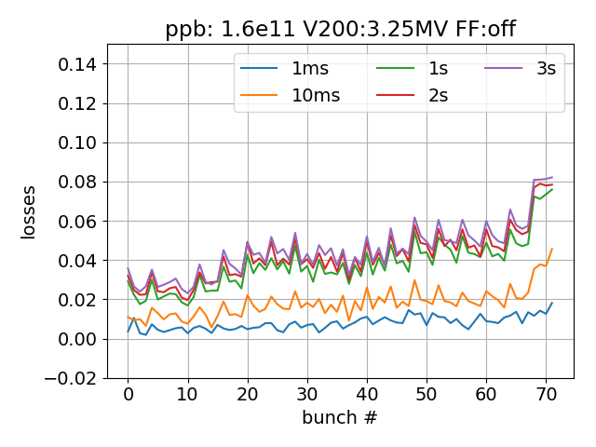
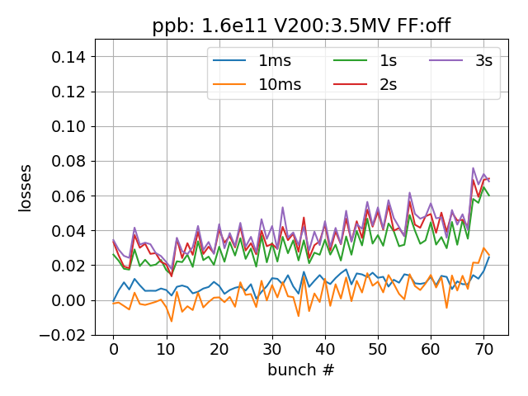
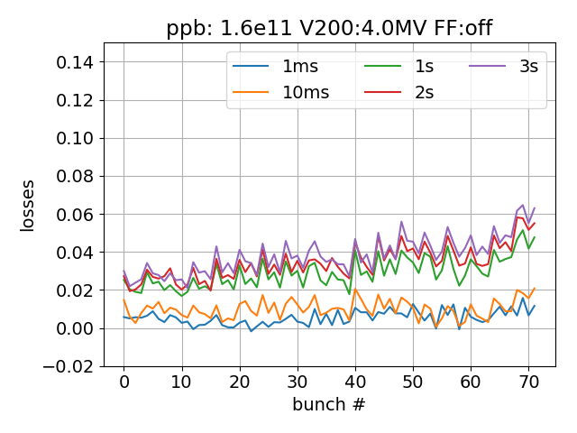
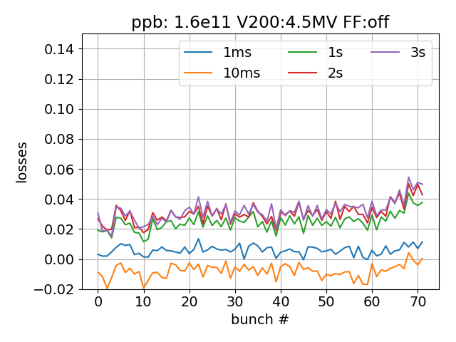
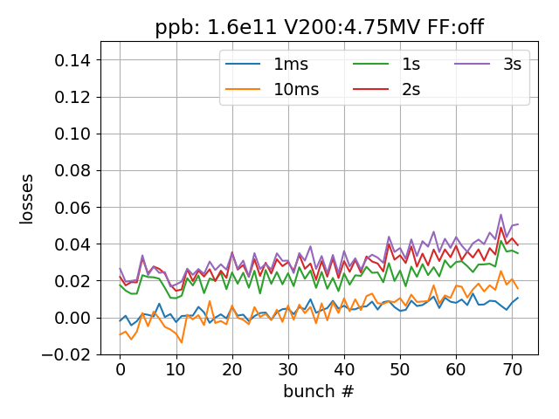
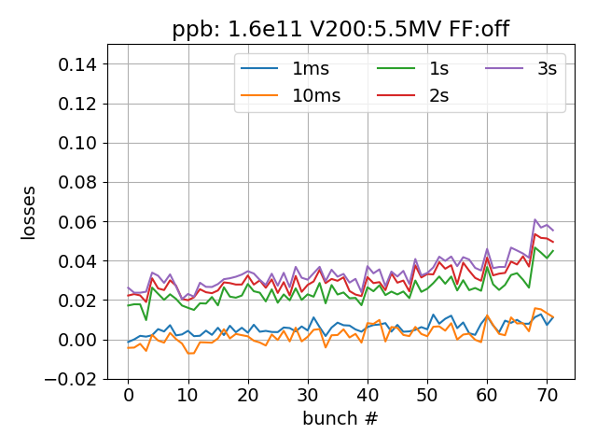
MD 17/11/14: 1.7e11 ppb bunch-by-bunch losses

Slide 17
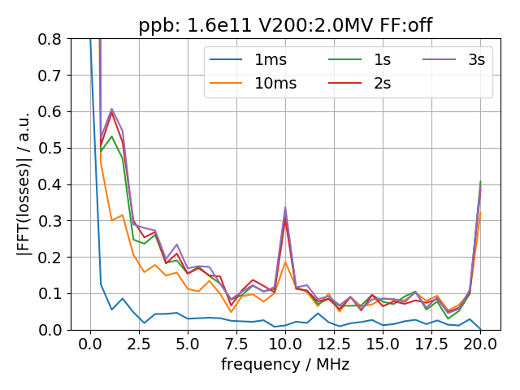
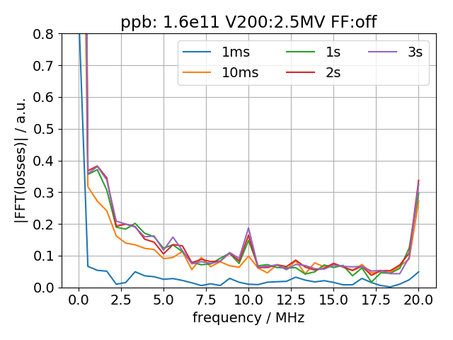
FFT bunch-by-bunch losses -> 10 MHz modulation

Slide 18
MD 17/11/14: 1.7e11 ppb FFT of relative 4σ_{FWHM}

Slide 19
MD 17/11/14: 1.7e11 ppb FFT of relative bunch intensity

Slide 20
MD 17/11/14: 1.7e11 ppb FFT of relative bunch intensity

Slide 21
MD 17/11/14: 1.7e11 ppb loss@1s VS injection bunch length

Slide 22
MD 17/11/14: 1.7e11 ppb loss@1s VS injection bunch intensity

