Slide 1
Effect of the 80 MHz impedance s 3rd of July 2018
LIU-SPS Beam Dynamics Working Group
J. Repond, E. Shaposhnikova
Acknowledgements: A. Farricker, R. Calaga, A. Lasheen, H. Damerau, G. Papotti, BLOND dev. team.

Slide 2
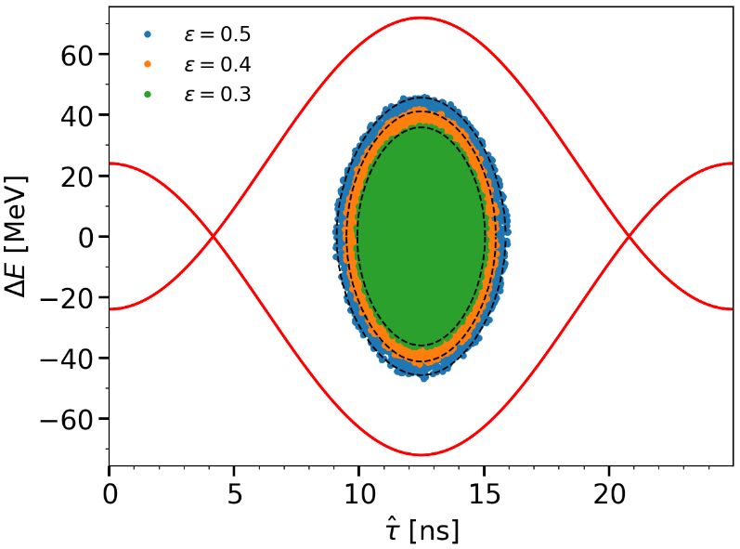
Bunch distribution and generation at PS flat top in 40 MHz and 80 MHz RF systems with $V_{40}=V_{80}=600$ kV
Liouville’s equation:
$\frac{dF}{dt}=0=∂_{t}F+\left\{F,H\right\} →\left\{F,H\right\}=0$for a stationary distribution
The stationary bunch distribution
is a function of the Hamiltonian
(SRF here but the same applies in multiple RFs)
with ratio of the phase-space ellipse axis:
For proton bunches, a binomial distribution with parameters $μ$ and $H_{0}$ fit usually the measurements
$$F\left(H\right)=F_{0}{\left(1−\frac{H}{H_{0}}\right)}^{μ}, H∈[0,H_{0}]$$
Phase space for the binomial distribution with $μ=0.5$
The binomial distribution is used to generate bunches on PS flat top ($V_{40}=V_{80}=600$ kV) for different exponents $μ$ and emittances $ε$

Slide 3
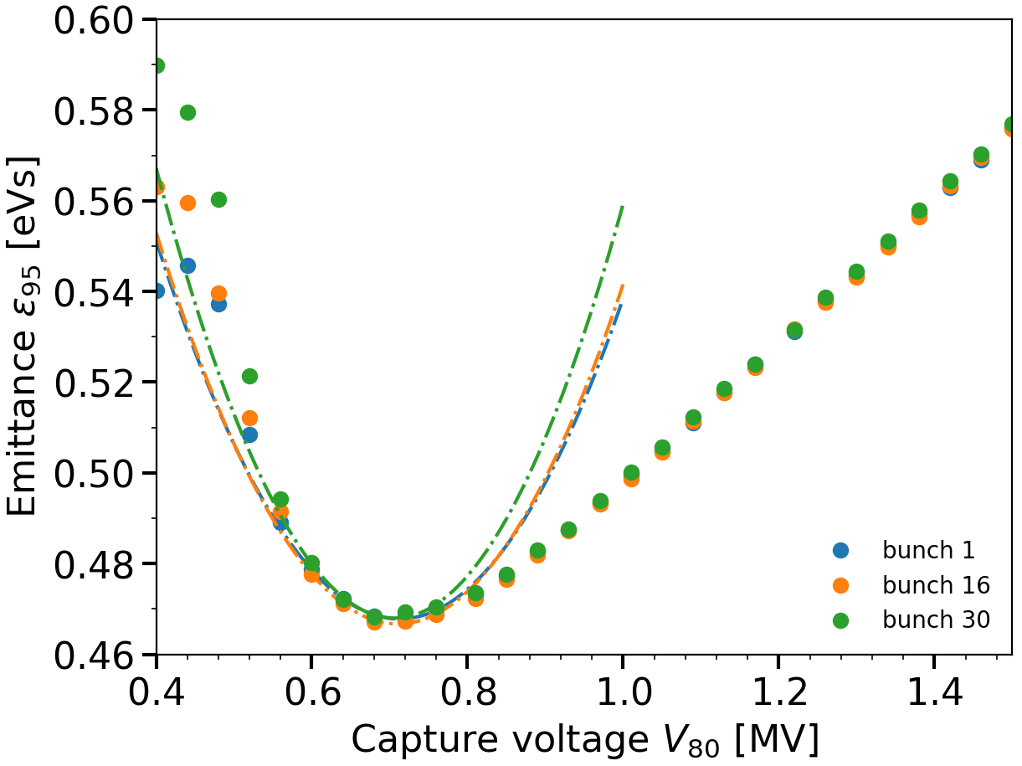
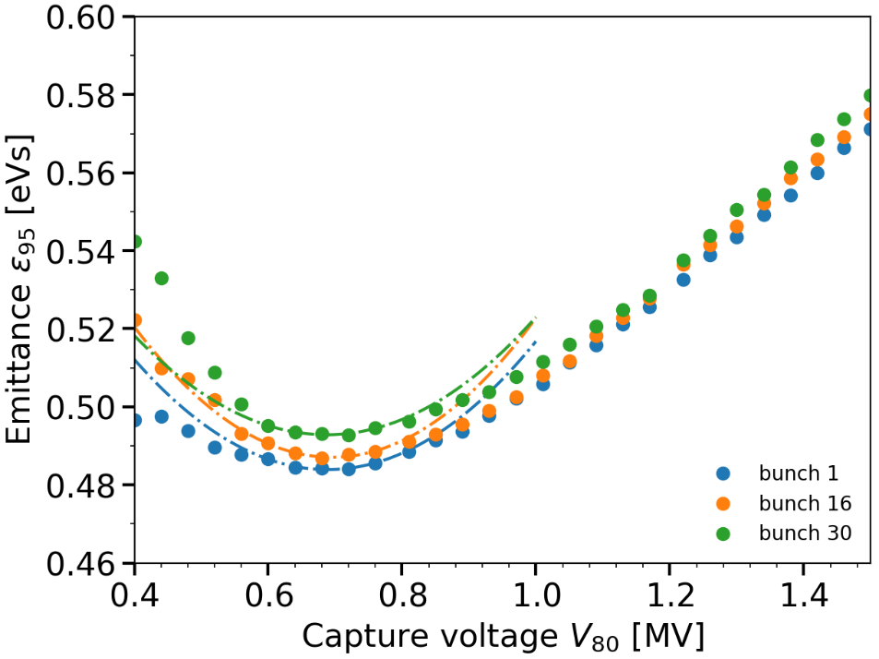
Uncontrolled emittance blow-up in SPS along the batch as a function of the capture 80 MHz voltage
Bunch distribution matched in PS for a given $μ$ and $ε$
Bunch intensity $N_{b}=2.4×{10}^{11}$ ppb
RF systems: 80 MHz + 200 MHz ($V_{200}=0.4×V_{80}$) + 800 MHz ($V_{800}=0.1×V_{200}$)
$φ_{200}=1.5π+φ_{80}$ (BSM) and $φ_{800}=π+φ_{200}$ (BSM)
$μ=0.5, ε∼0.5$ eVs
$μ=3.5, ε∼0.5$ eVs
→ Capture voltage $V_{80}=0.7$ MV to minimise the uncontrolled emittance blow-up

Slide 4
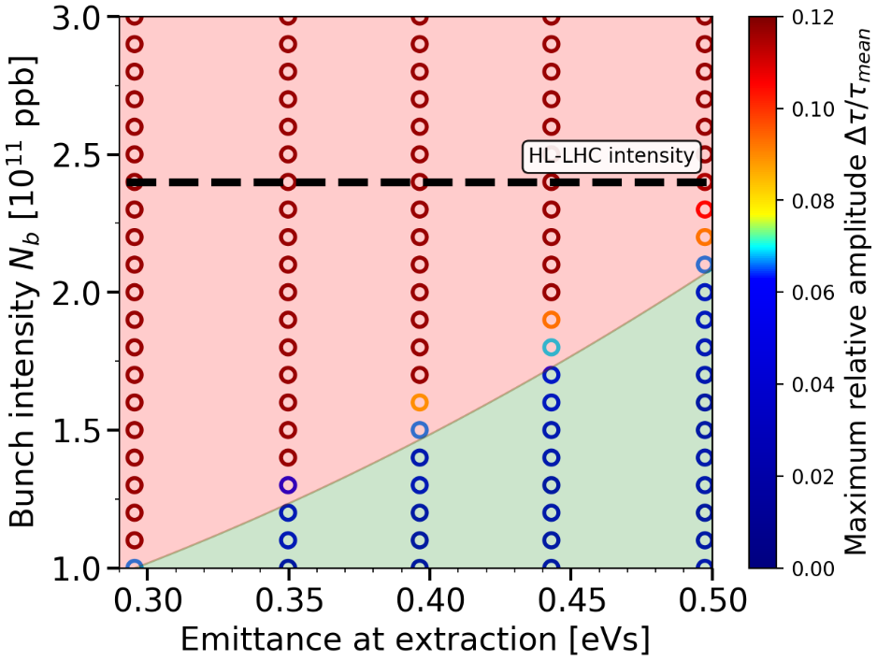
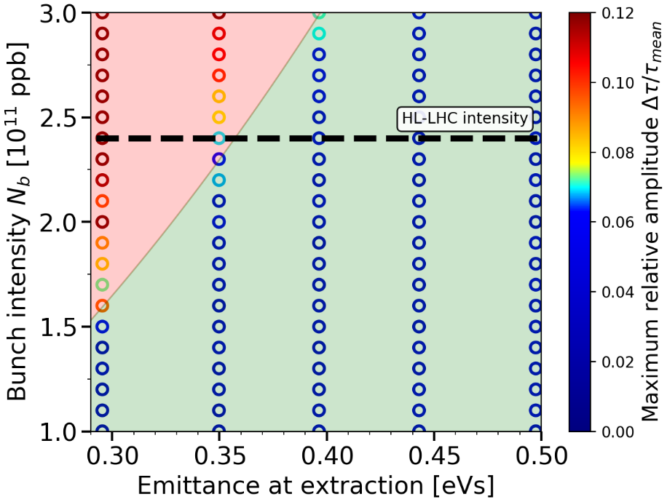
Intensity threshold at SPS FB in the 80 MHz RF system Trains of 48 bunches with binomial distributions matched in PS
Impedance model after LIU upgrades
Single 80 MHz RF system, $V_{80}=0.7$ MV
Bunch distribution with $μ=1.5$
Triple RF system 80 (0.7 MV) + 200 ($0.4×V_{80}$) + 800 ($0.1×V_{200}$) MHz,
Landau systems in BSM, bunch distribution with $μ=1.5$
Beam stability ~OK after LIU upgrades with the 200 MHz RF system in bunch-shortening mode
Little margins for 0.35 eVs emittance beams, the threshold decreases with larger $μ$ (possible issue depending on PS bunch quality)

Slide 5
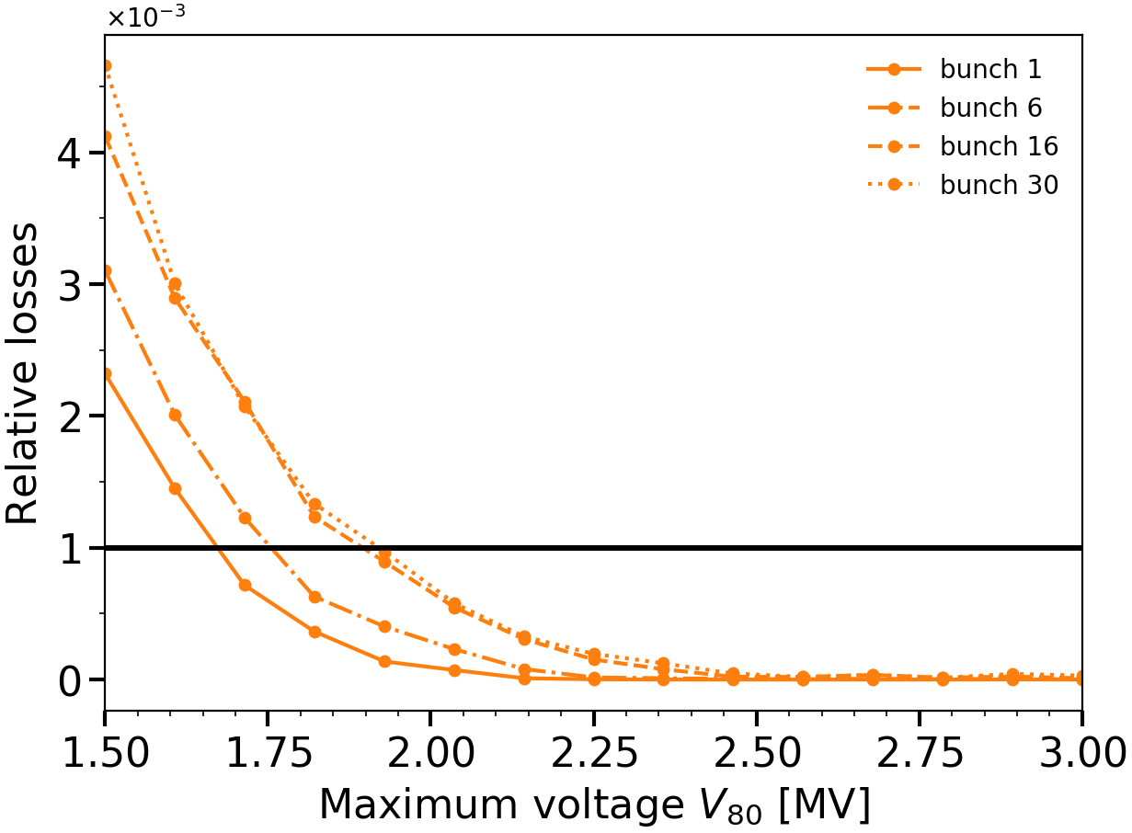
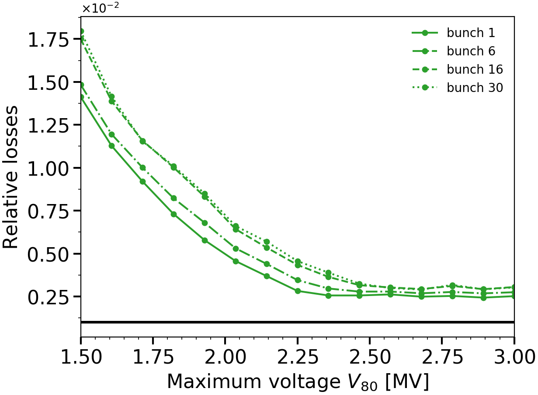
Creation of satellite bunches at transfer into 200 MHz Losses along the batch as a function of the maximum $V_{80}$
Bunch distribution matched in PS for a given $μ$ and $ε$
Bunch intensity $N_{b}=2.4×{10}^{11}$ ppb
RF systems: 80 MHz + 200 MHz ($V_{200}=0.4×V_{80}$) + 800 MHz ($V_{800}=0.1×V_{200}$)
Capture voltage $V_{80}=0.7$ MV, increased to its maximum value during rebucketing
$μ=1.5, ε∼0.5$ eVs
$μ=2.5, ε∼0.5$ eVs
Threshold for satellite population in LHC
Threshold for satellite population in LHC
→ Maximum voltage $V_{80}=2.5$ MV to minimise population of satellite bunches

Slide 6
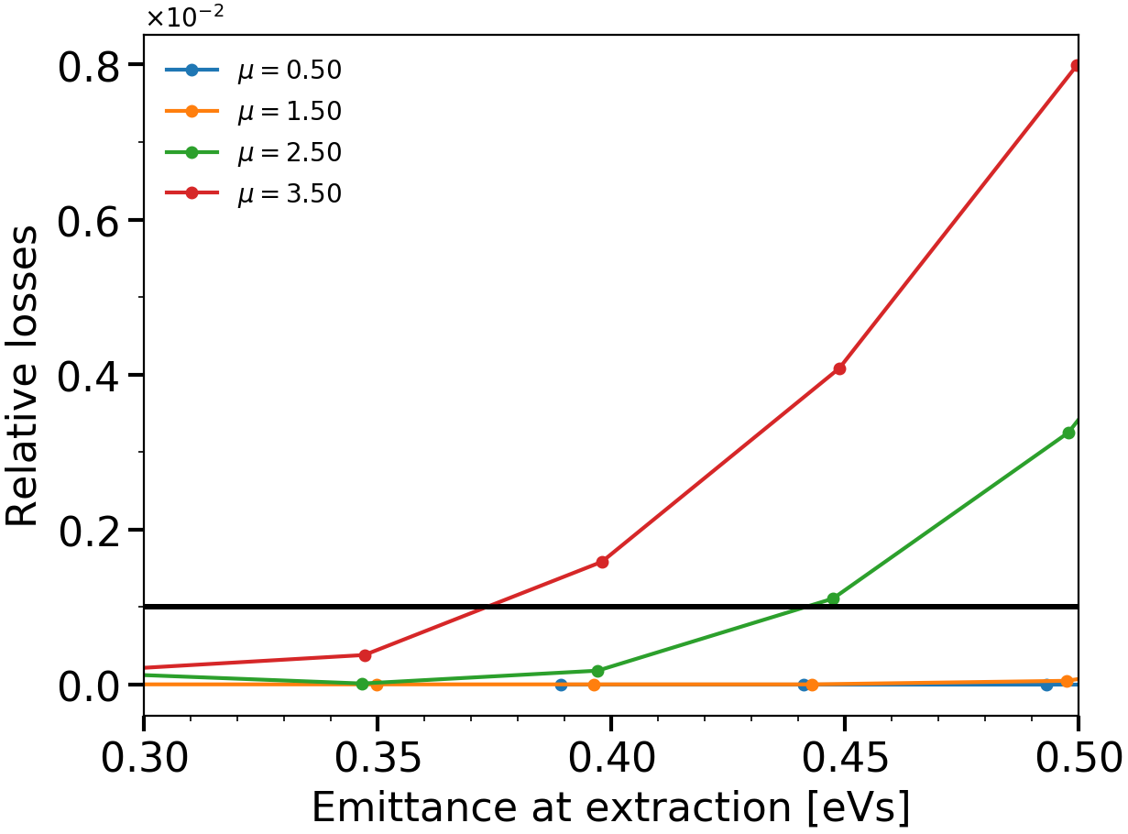
Creation of satellite bunches at transfer into 200 MHz as a function of emittance for different bunch distributions
Relative satellite population, maximum 80 MHz voltage $V_{80}=2.5$ MV
Threshold for satellite population in LHC
Feasibility of the scenario depends on bunch quality from PS (Bunches with large tails exceed the threshold for satellite population in the LHC)
Depending on the bunch distribution a smaller voltage could be used ($μ≤1.5$)

Slide 7
Potential issues with the 80 MHz
Acceleration of larger emittance bunches in 200 MHz (needed for beam stability in PS if no Landau system installed in PS)
SPS acceptance limited by available power and beam-loading
Lower beam stability due to lower harmonic number
→ 200 MHz as a Landau cavity, but
Residual $V_{200}$ difficult to control to a low level → 6 ns bunch length from the PS but not guaranteed
Instabilities recently observed on flat bottom not fully understood and the 800 MHz RF was not very helpful
Re-bucketing in the 200 MHz RF system
Potential reduction of losses only if related to bunch shape due to PS bunch rotation
Large 80 MHz voltage for re-bucketing in 200 MHz
Creation of satellite bunches if PS bunch has large tails → harmful for LHC
Impedance and beam-loading in the new RF system
Effect on beam stability during the rest of the cycle

Slide 8
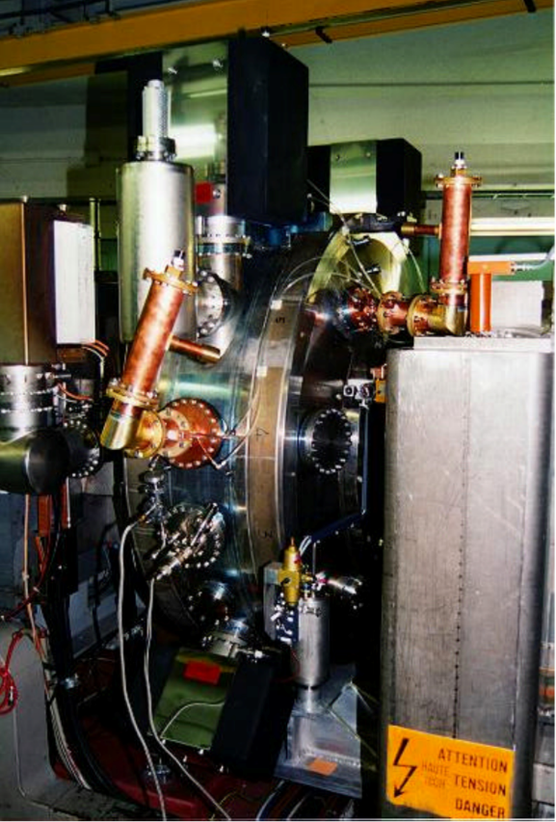
Characteristics of the new SPS capture RF system based on PS 80 MHz cavity model
New capture system in the SPS
80 MHz RF system
Maximum voltage of 2.5 MV (3 MV with spares)
Flat bottom only, narrow frequency range
→ Standing-wave cavity
80 MHz cavity in PS
300 kV per cavity on a length of ~1 m
There is a fast feedback system reducing the impedance of the accelerating band by ~40 dB
The impedance measured with beam is higher than assumed earlier (A. Lasheen), the new value is used in what follows
80 MHz cavity in PS tunnel
10 PS-type cavities needed in SPS (10 m)
Also 1-turn delay feedback in SPS, maybe less reduction achievable
Ref: CERN/PS 98-021 (RF)
/!\ Notice that cavities should be tuned to avoid Robinson’s instability in SPS

Slide 9
Possible locations of the 80 MHz RF system in the SPS
Sextan | Position | Free space [m] | Infos
LSS1 | 117 | 10 | Not ideal, beam injection region. Need confirmation from beam dump team
LSS3 | 314 | 12.5 | Next to the present RF system
LSS3 | 321 | 13 | Position of slotted line kicker (more space may be needed in future)
LSS4 | 416 | 10.5
LSS4 | 417 | 12.5 | Extraction line, bigger aperture needed
LSS4 | 421 | 12.5
LSS6 | 616 | 10 | Next to the crab cavities
LSS6 | 621 | 11
Credits: A. Farricker

Slide 10
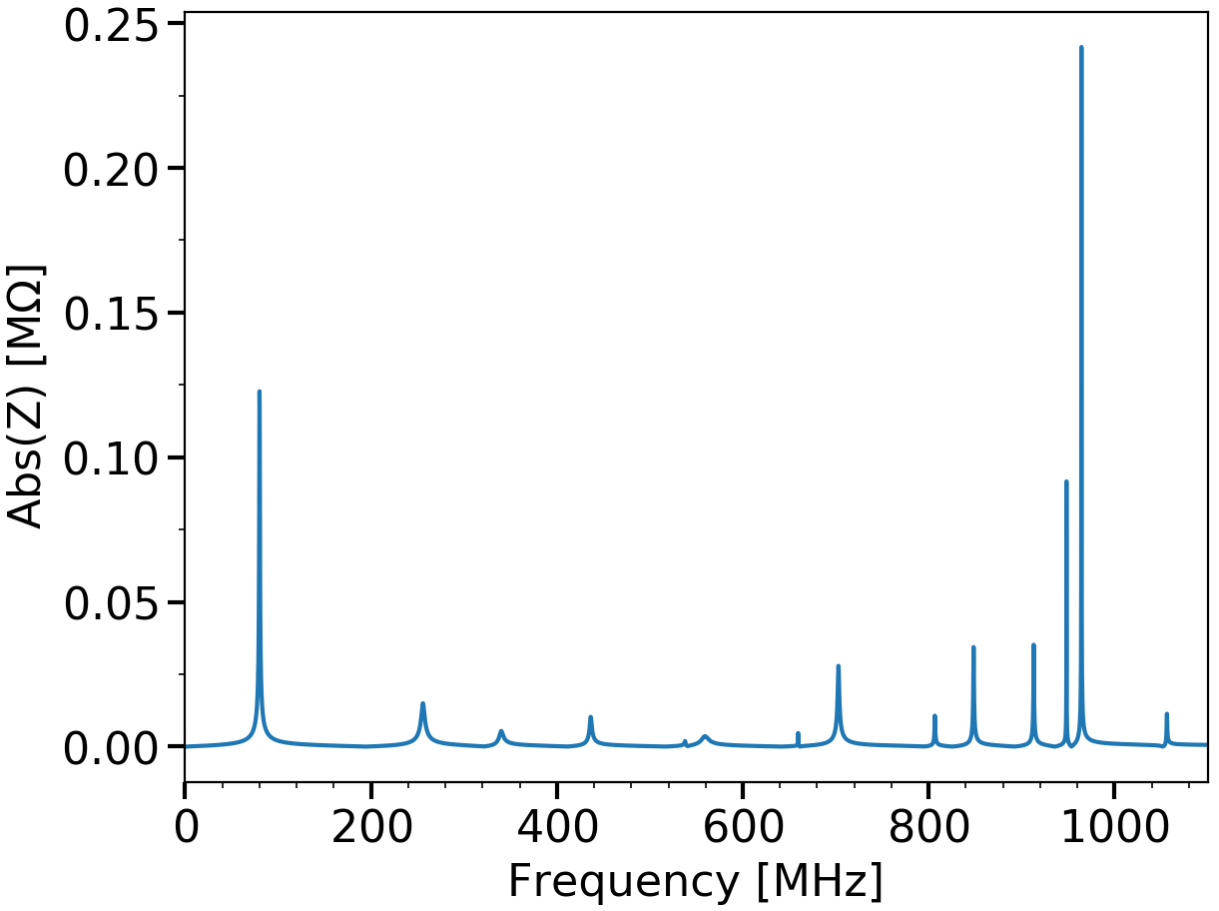
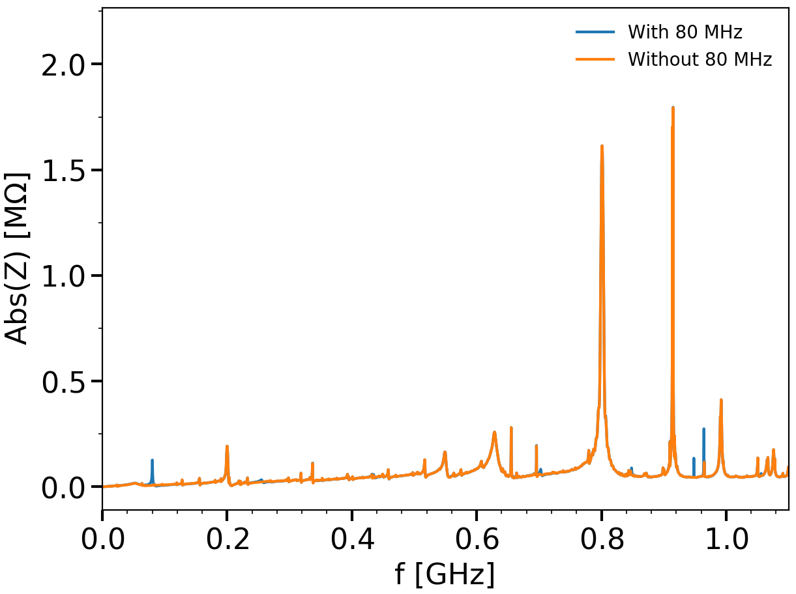
Impedance of the PS 80 MHz cavities in SPS
Longitudinal impedance of 10 PS 80 MHz cavities
with fast feedback (40 dB) and HOMs dampers
SPS longitudinal impedance model > LS2
Contribution of PS 80 MHz cavities
40 dB maybe difficult to achieve with 1-turn delay feedback
Preliminary analysis of SPS longitudinal beam stability at flat top (lowest threshold) with 80 MHz impedance:
No significant effect of HOMs on intensity threshold
Potential well distortion is increased due to beam-loading in the 80 MHz RF system
Spread in bunch length increased along the batch
Impact on other instabilities
What is the effect of a smaller feedback reduction in SPS?

Slide 11
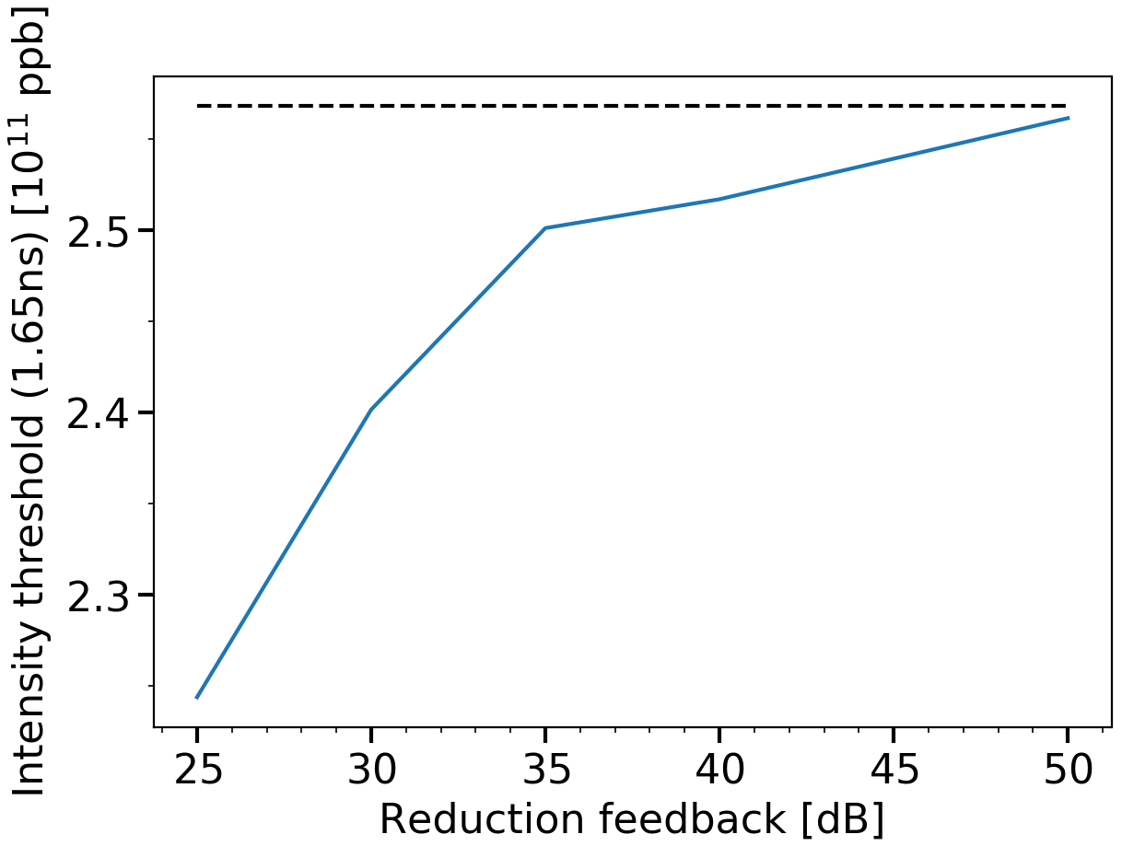
Effect of 80 MHz impedance on beam stability at SPS flat top as a function of feedback reduction
Intensity threshold at 1.65 ns bunch length
Threshold without 80 MHz impedance
Simulation parameters
Flat top simulations (2 s)
48 bunches matched, spaced by 25 ns
Double RF system (10 MV+ 1 MV)
Impedance model after LIU upgrades + fundamental mode of ten 80 MHz cavities
Feedback applied on 80 MHz shunt impedance
Intensity threshold decreased by ~5% with 35 dB,
more FB reduction may be difficult to achieve

Slide 12
Conclusion
Based on the PS 80 MHz cavity model, 10 m space is required in SPS
→ The best possible location is next to the present SPS RF system
The preliminary analysis shows an insignificant effect of the HOMs on beam stability at flat top
The beam-loading from the 80 MHz fundamental impedance decreases the intensity threshold on flat top
50 dB reduction recovers the intensity threshold at nominal bunch length without 80 MHz impedance
35 dB gives ~5% lower intensity threshold

Slide 13
THANK YOU FOR YOUR ATTENTION!

Slide 14
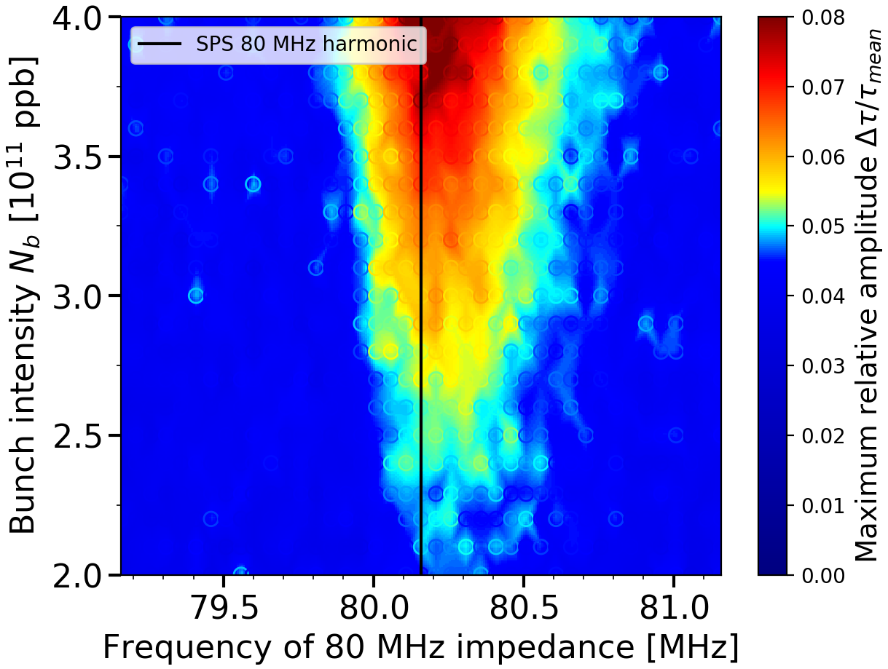
Bunch lengthening at flat top due to only fundamental 80 MHz impedance in the SPS (nothing else)
Relative bunch length spread in the batch
Matched bunches at SPS flat top for a length of 1.6 ns
80 MHz fundamental impedance only with 26 dB reduction

