Slide 1
Effects of FeedForward on flat-bottom losses
M. Schwarz
Acknowledgements:
H. Bartosik, T. Bohl, G. Papotti, E. Shaposhnikova, SPS operator team

Slide 2
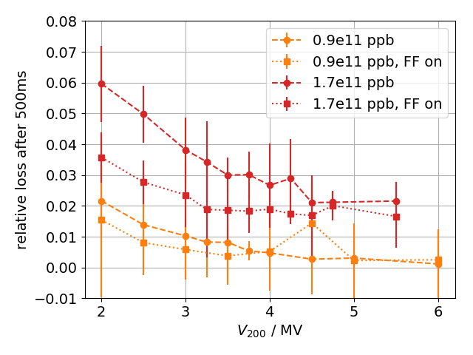
Scan FF on/off and Q-kick at 2s
Motivation:
Observed reduction of losses with FF on (MD 17/11/14) for short flat-bottom (2s)
But does FF help with losses along flat-bottom, or introduce RF-noise?
To test, measure losses along long flat-bottom with FF on/off and FF on only for 4s after injection
Remove uncaptured beam after 2s with Q-kick
Setup:
MD 17 May 2018: 48 bunches, 25ns spacing, BCMS Q20, Intensity 1.2e11 ppb
this was only operational cycle with long flat-bottom
Feedback: on (start time adjusted when FF was on/off at injection), FeedForward (FF): on/off, on only during first 4s Phase loop: on, long. damper: on
V₂₀₀ =4.5 MV, V₈₀₀ = 0.45 MV
Flat-bottom up to 19.2 s; then small ramp
About five to ten acquisitions per case, all quantities derived from bunch intensities

Slide 3
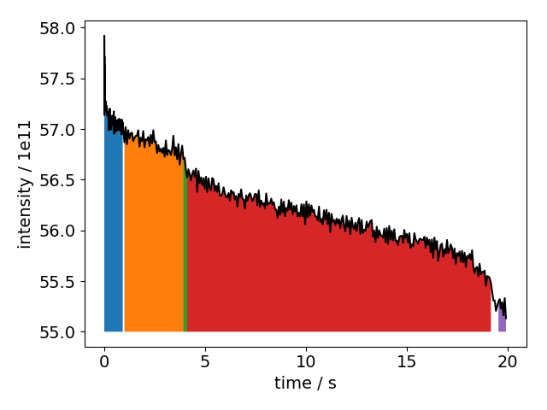
Bunch intensity along cycle
Compute relative loss and loss rate from bunch intensity
0s — 1s: ‘capture’ losses (blue), intensity not linear during first second
1s – 4s: orange
@4s: if FF is turned off, drop in intensity (green)
>4s—19.2s: remaining flat-bottom (red)
Ramp at 19.2s: intensity after ramp (purple)

Slide 4
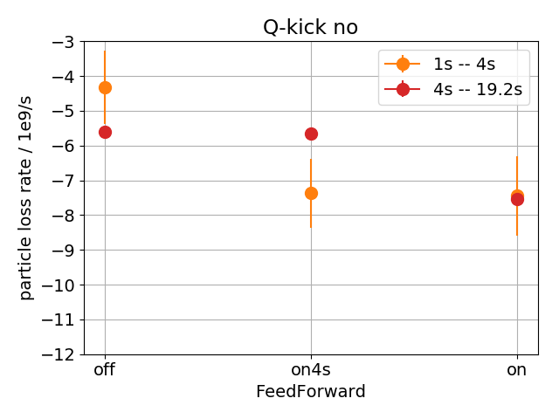
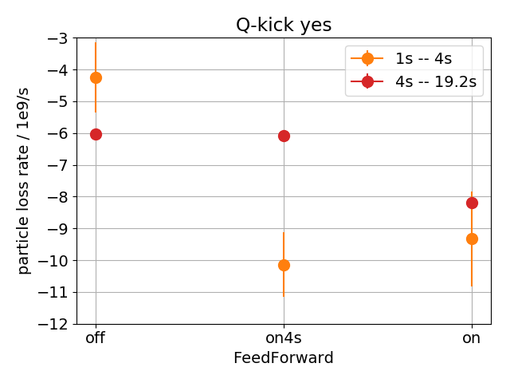
Loss rates along flat-bottom
loss rate is slope of line fitted to bunch intensities
removal of uncaptured beam with Q-kicker has no significant effect
loss rate during first four seconds (1s – 4s, orange) and remaining flat-bottom (4s — 19.2s, red)
loss rates during first 4s equal, if FF is on
but when FF is turned off after 4s, loss rate decreases to the value when FF is off
-> FF increases loss rate at flat-bottom

Slide 5
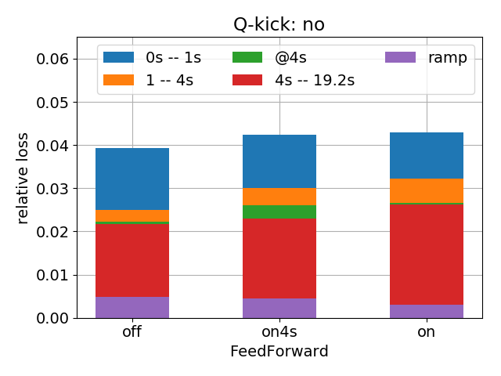
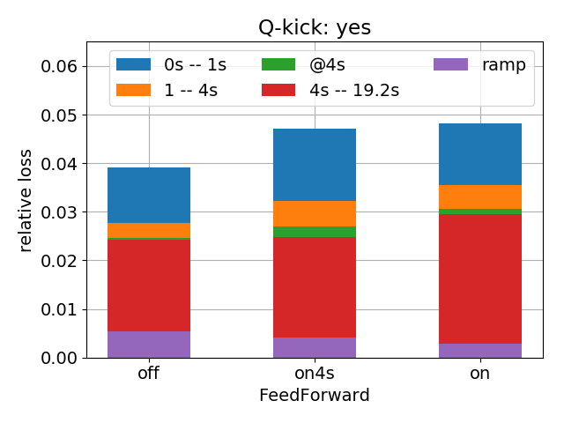
Loss along cycle
When FF is off, total losses are slightly lower
Whether FF is on along entire flat-bottom or just for 4s, losses up to 4s are similar (blue + orange)
Drop in intensity when FF is turned off at 4s (green)
Losses along flat-bottom smaller if FF is off (red)
But losses during ramp are larger if FF is off (purple)
Possible explanation:
When FF is on, particles at the edge of RF-bucket get driven out. But if FF is off, these particles get lost during ramp -> total losses equal

Slide 6
Summary
FeedForward does increase loss rate along flat-bottom, …
… but total losses after ramp remain the same
Next steps
No significant decrease of capture losses observed (contrary to previous MDs), but here Q20 BCMS beam with 48 bunches and nominal intensity (compared to 72 bunches in Q22 and 1.7e11 ppb) -> repeat at high intensity
Thank you for your attention!

Slide 7
Appendix

Slide 8
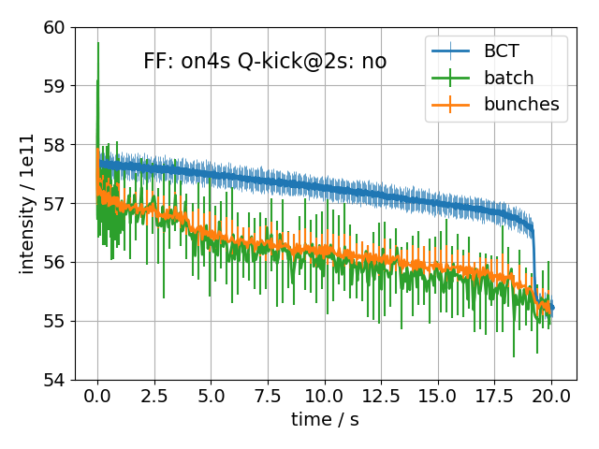
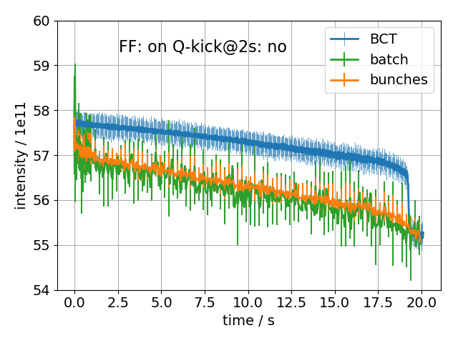
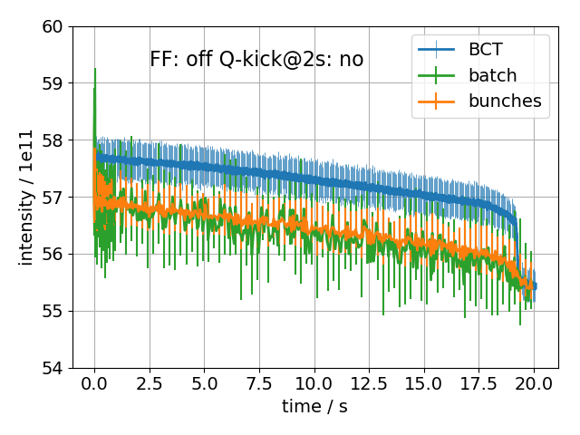
Scan FF without Q-kick
Remarks:
When FF is turned off at 4s, drop in bunch intensity

Slide 9
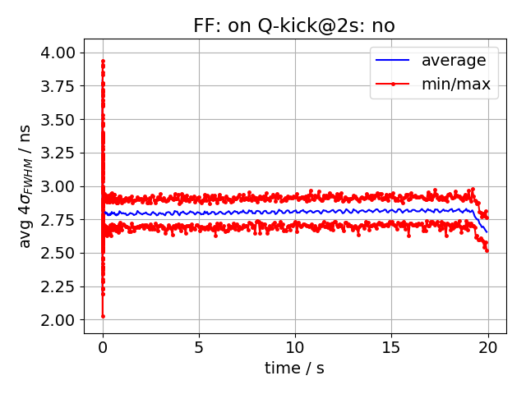
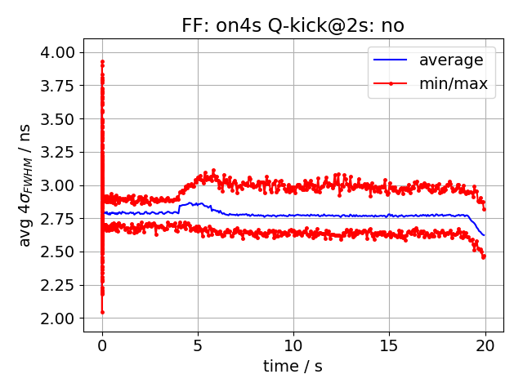
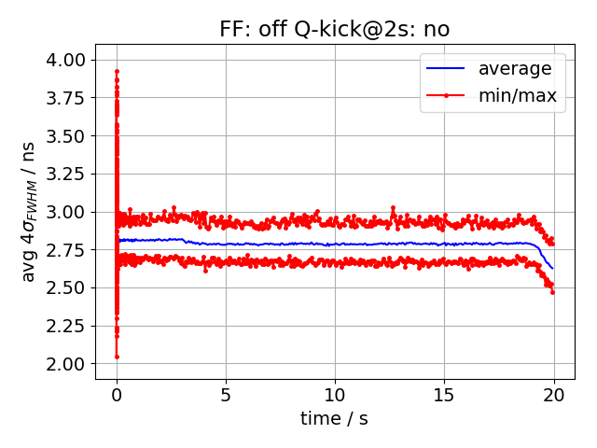
Average bunch length without Q-kick
Remarks:
When FF is on, oscillation of bunch length

Slide 10
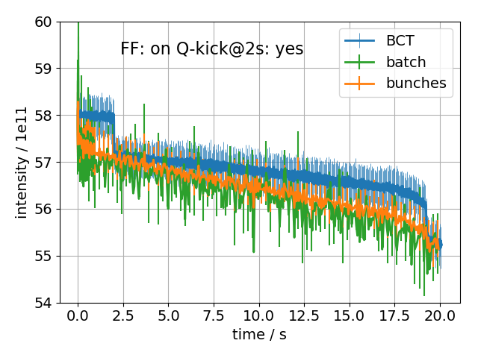
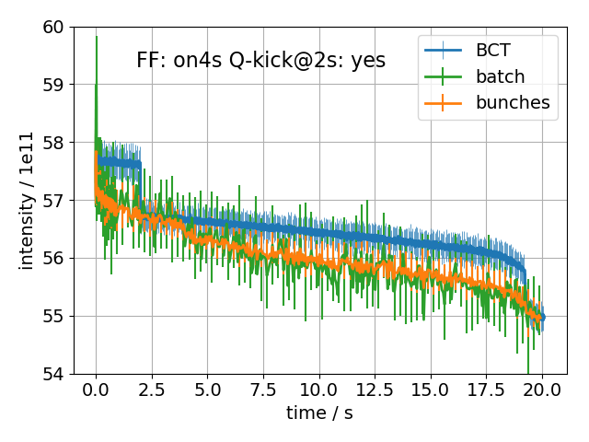
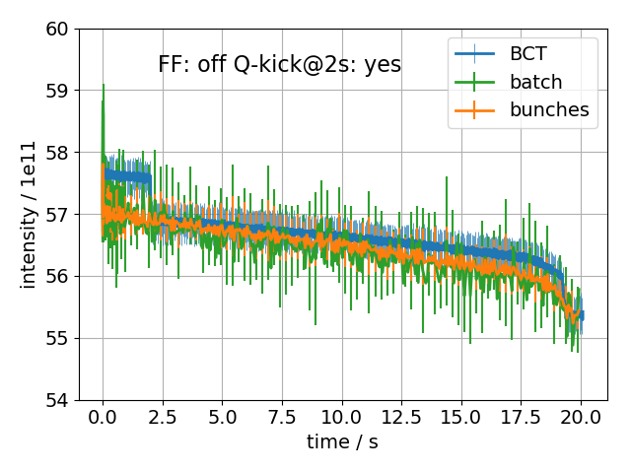
Scan FF with Q-kick @ 2s
Remarks:
When FF is turned off at 4s, drop in bunch intensity

Slide 11
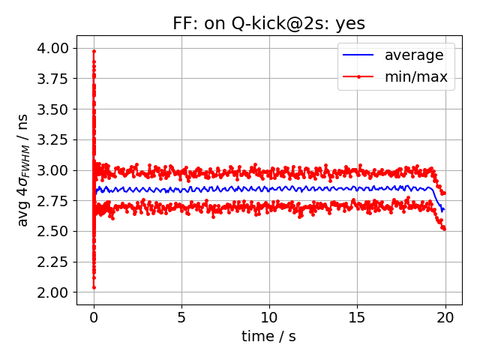
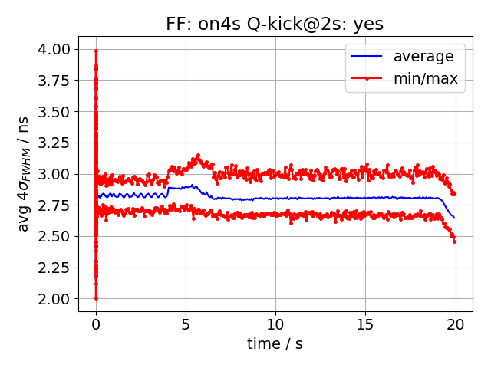
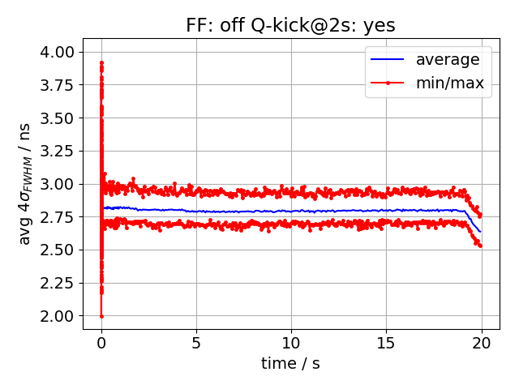
Scan FF with Q-kick @ 2s
Remarks:
When FF is on, oscillation of bunch length

Slide 12
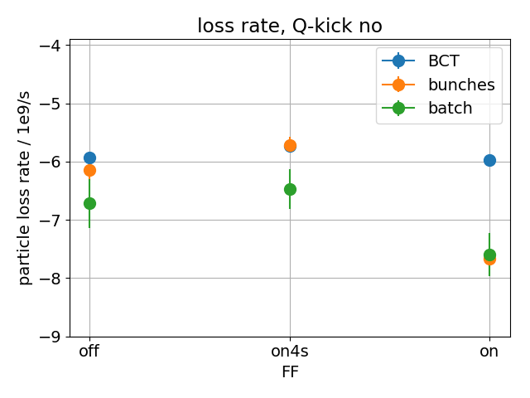
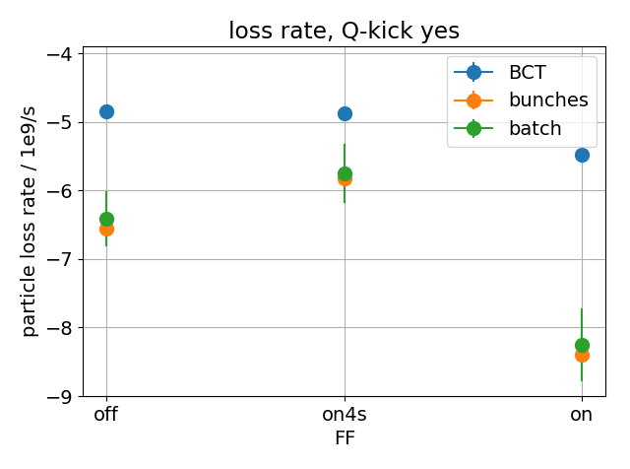
Loss rates along flat-bottom
Remarks:
loss rate is slope of line fitted to intensities
along the flat-bottom from 7s to 19.2s
When FF is on, bunches lose more!

