Slide 1
SPS Impedance Model Post LS2 Aaron Farricker Contributions from: M.Beck, T.Kaltenbacher, P.Kramer, N.Nasresfahani, J.Repond, J.Varela, C.Vollinger & Others

Slide 2
Outline
Overview of the Current Impedance Model
Changes to the Impedance Model During LS2
Current Estimated Instability Threshold

Slide 3
Current Model
SPS Longitudinal Impedance Model:
200 MHz and 800 MHz Cavities Accelerating Mode and HOMs
Vacuum Flanges
BPM’s, Wire Scanners and other BI equipment
Injection, Extraction, Tune and Dump Kickers
Sector Valves, Pumping Ports
Beam Scrapers
Electrostatic Septa
Feedback and Feedforward systems

Slide 4
200 MHz Cavity Upgrade (1/3)
Two-Five section and Two-Four section cavities becomes to Two-Four section and Four-Three Sections (18 Sections→20 Sections)
Feedback improved from 20 dB to 26dB reduction
Power upgrade to enable HL-LHC beams with 10 MV of RF acceleration
Covered in several ECR’s (ECR#1894326, ECR#1698074, ECR#1543111, ECR#1900971)
One of the major changes which affects beam dynamics is the 630 MHz HOM damping

Slide 5
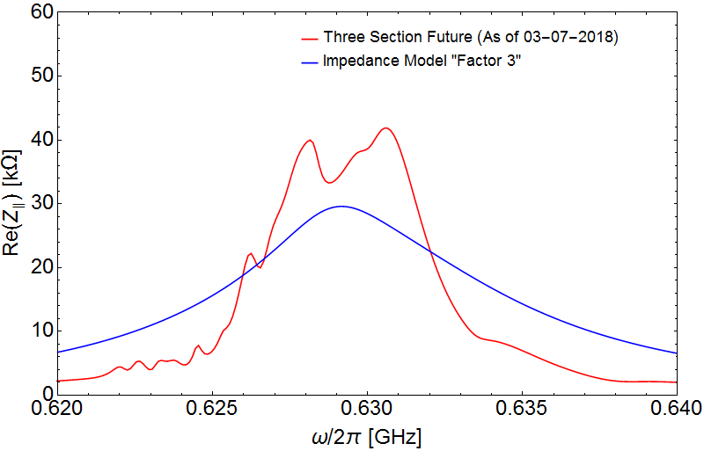
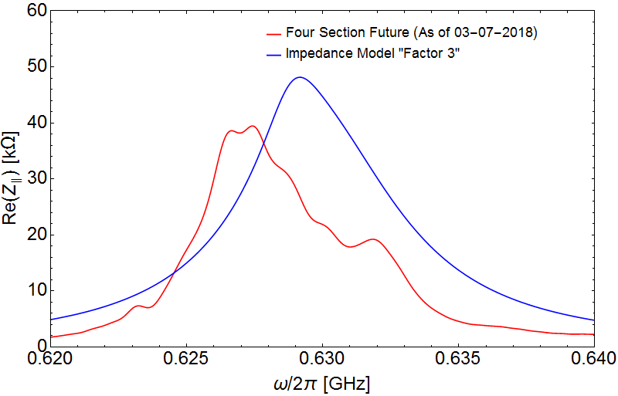
200 MHz Cavity Upgrade (2/3)
Three Section
Four Section
P.Kramer
N.Nasresfahani
Three section cavity simulation includes: 630 MHz coupler, FPC and perturbations at the pumping ports (No other Couplers)
Four section cavity simulation includes: new 630 MHz coupler, FPC and 940 MHz coupler (No 460 MHz Transverse Coupler)

Slide 6
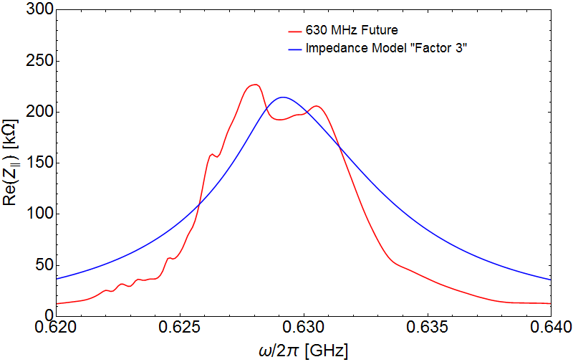
200 MHz Cavity Upgrade (3/3)
The overall picture looks promising as we are in the ball park of what is required from beam dynamics simulations
The final couplers need to be added in both sets of simulations to ensure the most accurate representation (could increase or decrease the impedance)
Measurements in the tunnel are ongoing on the four section cavities to provide support for the simulations
Ideally the final simulations should be benchmarked with another code

Slide 7
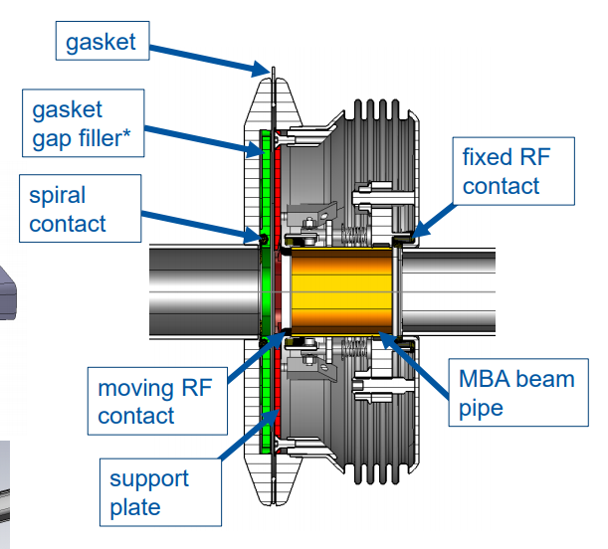
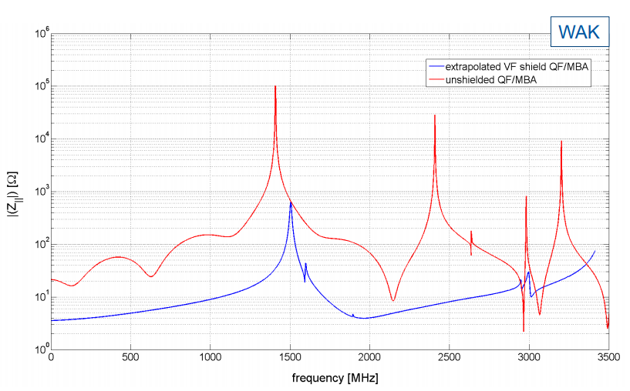
Flange Shielding
ECR#1968756
IWG#5 T.Kaltenbacher, C.Vollinger
CERN­-ACC­-2014-­0099
84 MBA four convolution bellows shielded
26 QF four convolution bellows shielded
131 QF flange fillers
13 MBA flange fillers
31 BPH->QF flanges shielded
This leave two unshielded BPH->QF/QFA locations
These will be put into separate ECR’s as the fall outside the SSS’s
Hopefully there will be no unshielded BPH locations

Slide 8
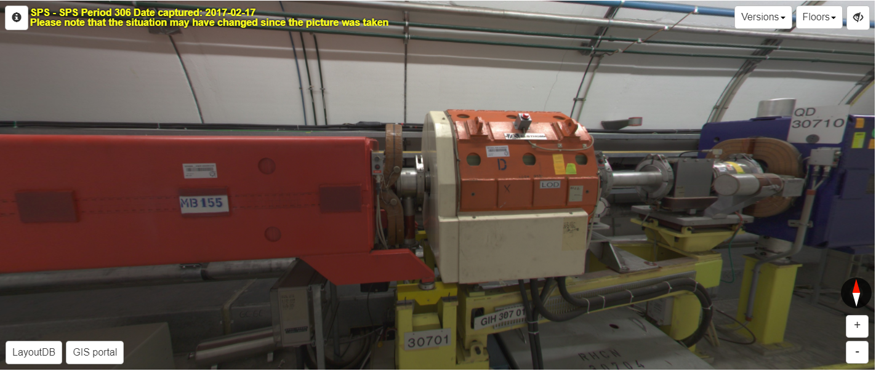
Pumping Port Shielding
ECR#1968756
Most pumping ports in the SPS were shielded in earlier campaigns (EPAC 2002 WEPRI082)
25 which are not equipped with shields are present
15 will be shielded in the course of the shielding of the VF (All nest to LOD/LOF magnets)
The remaining ten are of different types the impedance of which needs investigating
Removal of the redundant BCTDC.11601 will add another but shielding of it will be requested

Slide 9
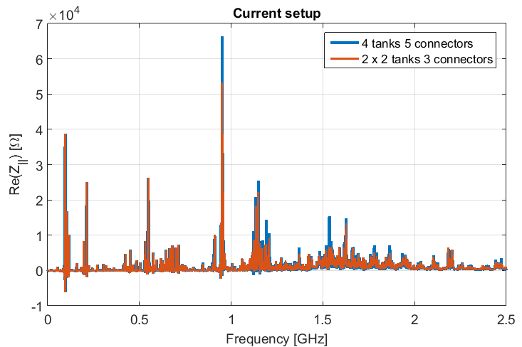
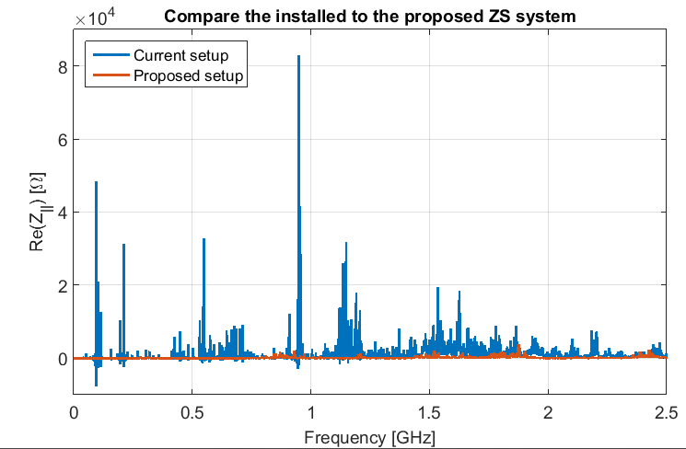
ZS Upgrade
IWG#11 M.Beck
Modification of the interconnects using a racetrack profile reduces the impedance significantly
Pumping ports are relocated under the ZS tanks themselves
An RF screen is added to reduce the beam coupling to the large tank volume of the ZS
Overall impedance drops by an order of magnitude and shifts to higher frequency
Needs to migrate to the impedance model

Slide 10
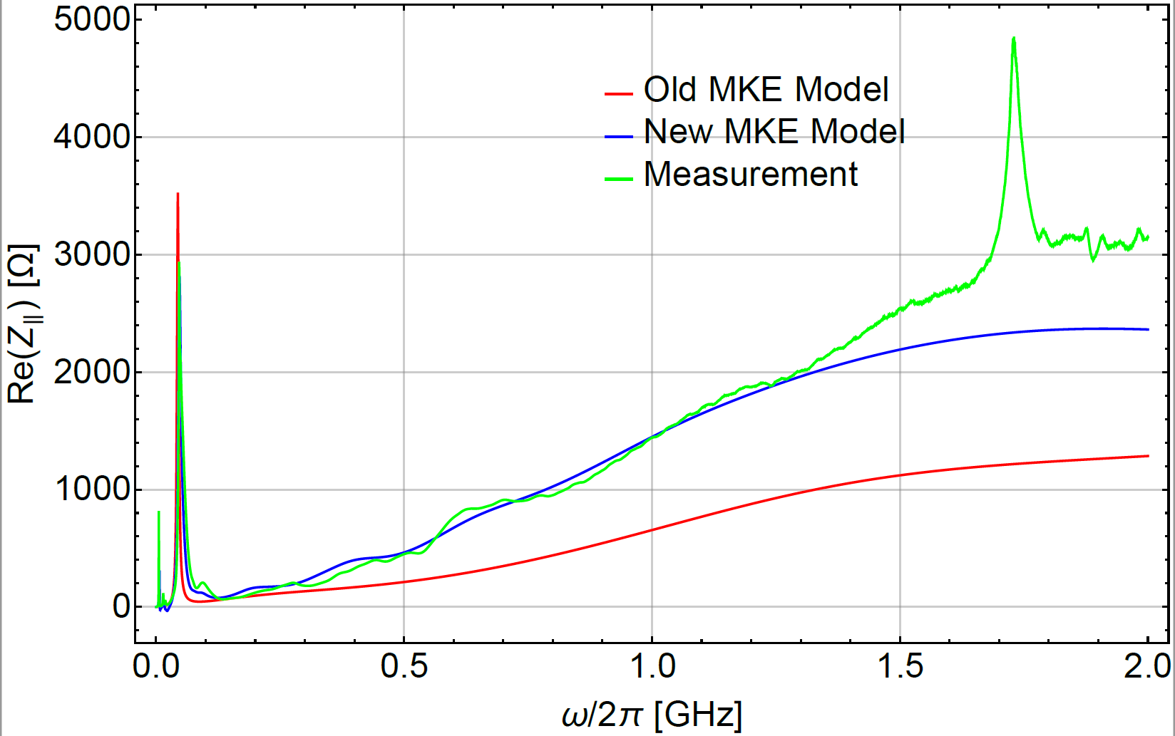
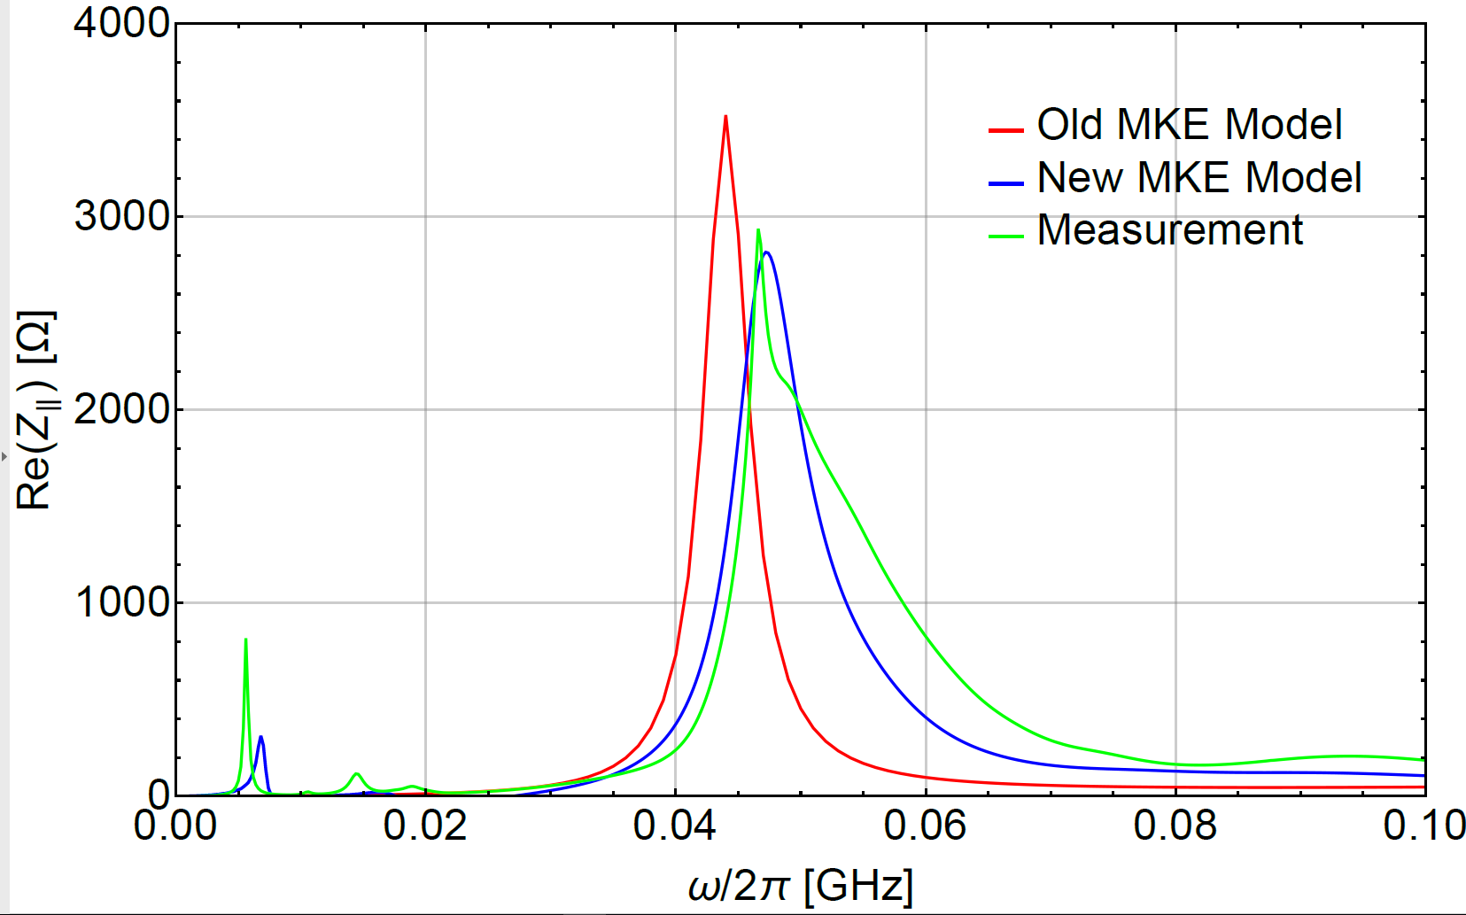
MKE Kicker Changes (Note this is an updated model not additional Kicker)
IWG#17 M.Beck, A.Farricker
MKE model updated with corrected serigraphy geometry
Modelling of the serigraphy is changed from PEC to thin panel material
This results in an almost doubling of the longitudinal impedance
This has been benchmarked with coaxial wire measurements
It is also consistent with previous measurements by Kroyer, Casper & Gaxiola

Slide 11
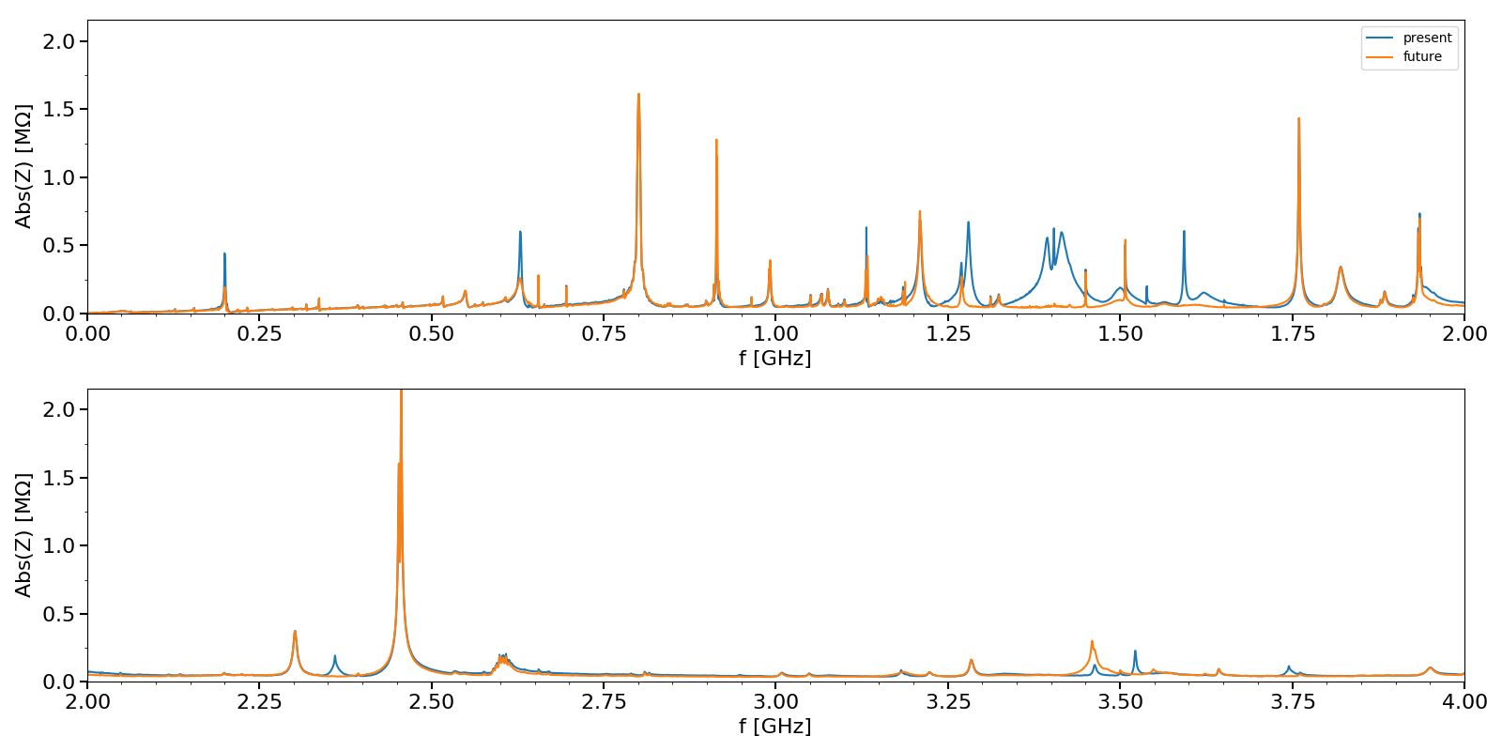
Resulting Impedance Spectra
BPH-QF
Shielding
MBA/QF Flange Shielding
630 MHz HOM reduction
200 MHz feedback

Slide 12
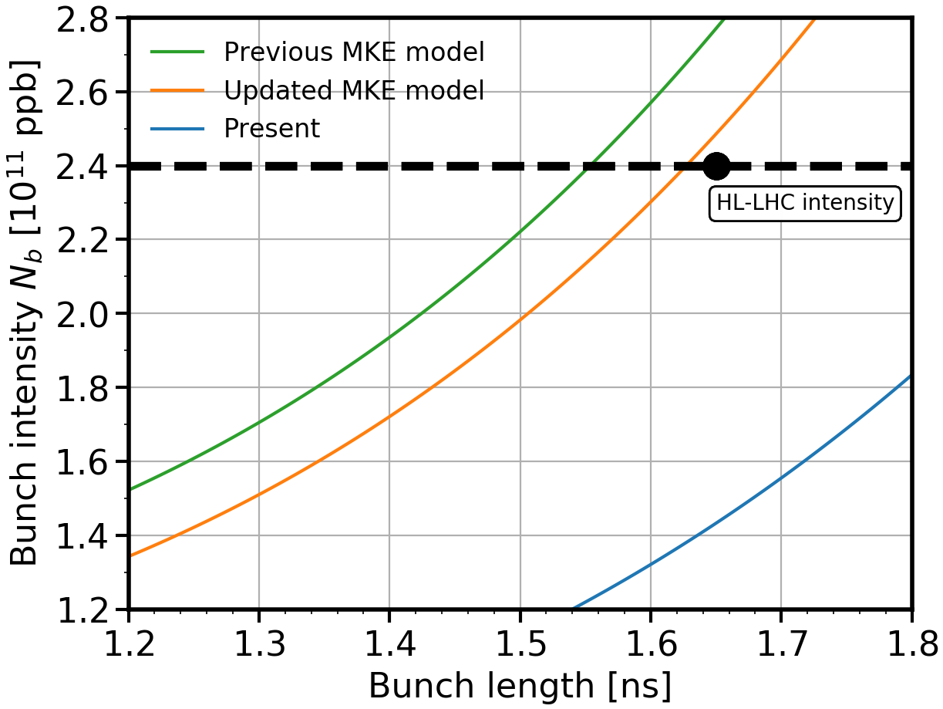
Current Threshold Estimation
Current beam dynamics simulations suggest that the HL-LHC goal is possible when the upgrades are implemented
The margin is relatively small and work to identify other sources of impedance is ongoing
In addition to this the impedance of LSS1 & LSS5 is being optimized due to the relocation of the beam dump
Bench marking of the impedance model with beam measurements is also being carried out

