Slide 1
Capture losses in the SPS s
6th of April 2017
J. Repond

Slide 2
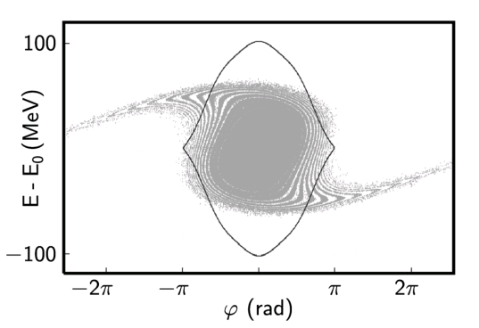
What we do know
Non-linearities in PS rotation -> S-shape in phase space distribution [*]
Losses are longitudinal:
  Using a kicker to clean the beam gap, uncaptured
  beam observed
E-cloud effect is not the main cause (more losses in 8b4e)
Losses on FB are larger with the 800 MHz RF system ON
Beam-loading not fully compensated by LLRF (transient, a few ms)
Among all the LLRF loops (PL, FF, LD, FB), the feedback had the strongest effect
tune kicker
Courtesy H. Bartosik
[*] Ref: H. Timko et al.,Phys. Rev. ST Accel. Beams 16 (2013) no.5, 051004.

Slide 3
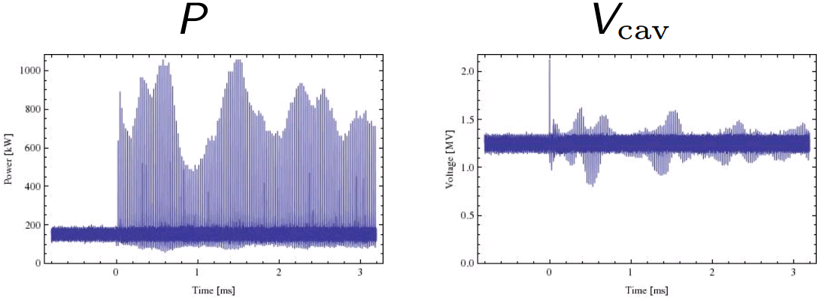
What we do not know
Effect of 800 MHz on uncaptured beam losses at flat bottom:
  Spectrum of uncaptured beam has higher amplitudes above the 800 MHz harmonic with 800 MHz ON [*]
Effect of beam loading:
  Voltage seen by beam during transient
  How long the transient lasts
  Effect of the LLRF during transient
How it will change after LS2
  New LLRF could help, but…
Courtesy H. Bartosik
Courtesy T. Bohl, power requirement at injection and flat bottom (5 Section TWC)
[*] Ref: E. Shaposhnikova, CERN LHC Project Note 338

Slide 4
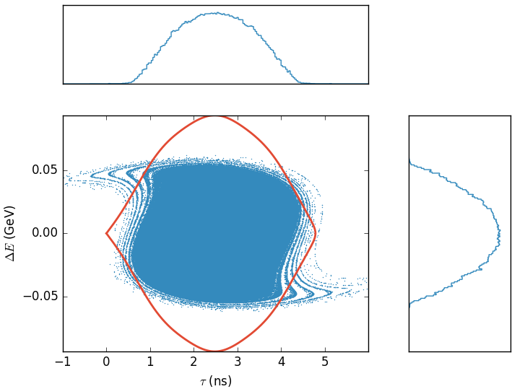
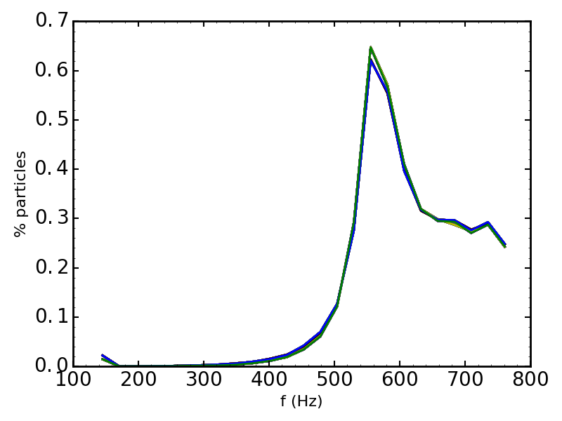
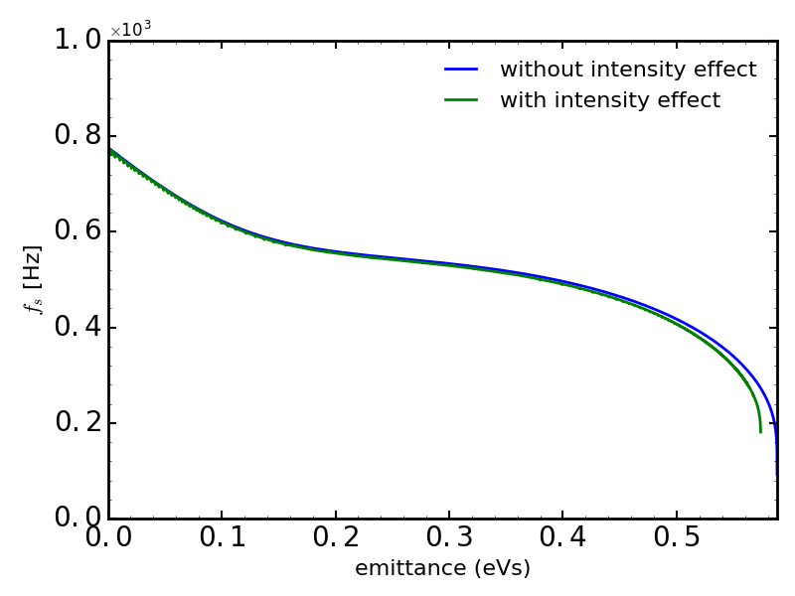
Realistic bunch after PS rotation
Simulation in the SPS for LHC-type beam
  72 bunches spaced by 25 ns
  Flat bottom in 2RF: 4.5MV + 0.45MV
  Bunches injected to the center of RF bucket (but no PL, no FF)
Realistic phase space distribution
  PS simulation of measured profile in PS before splitting (H. Timko, A. Lasheen)
  Splitting + rotation in PS without intensity effects

Slide 5
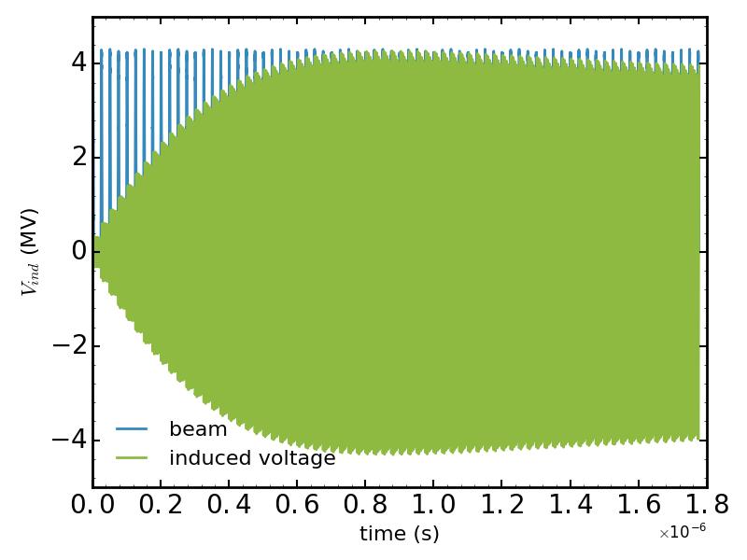
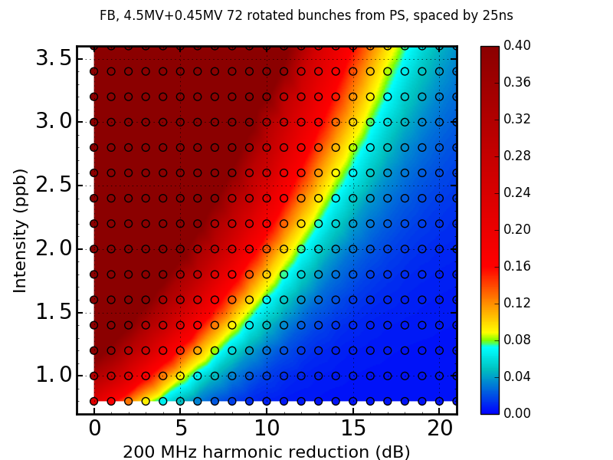
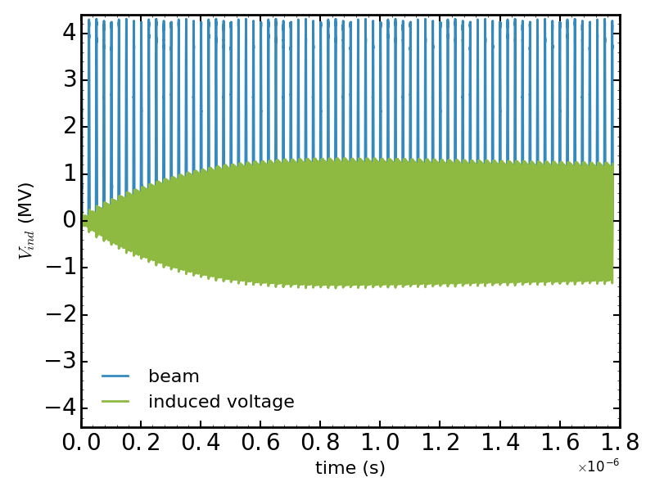
Flat bottom: impedance seen by the beam
Beam loading compensation at injection by feedback is not perfect:
  Impedance reduction weaker (than 20 dB in stationary state)
  Scan was performed to estimate feedback (fixed) reduction giving ~8% losses
0 dB
10 dB
DRF

Slide 6
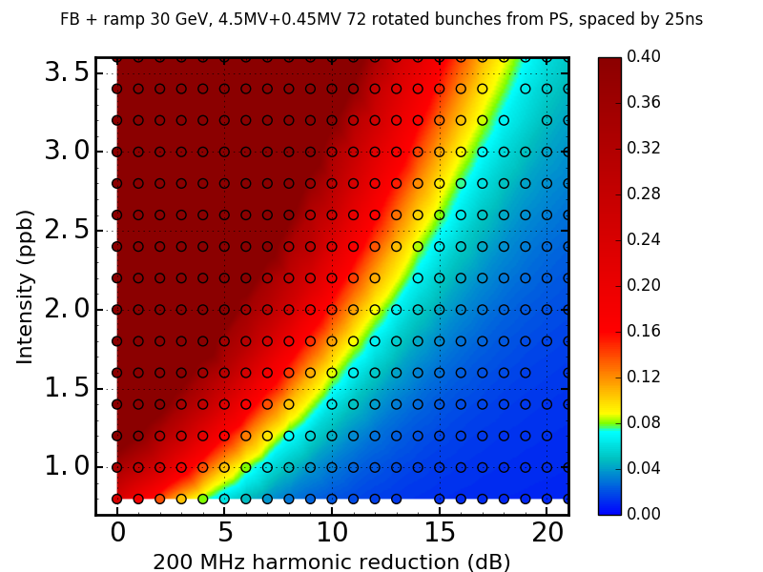
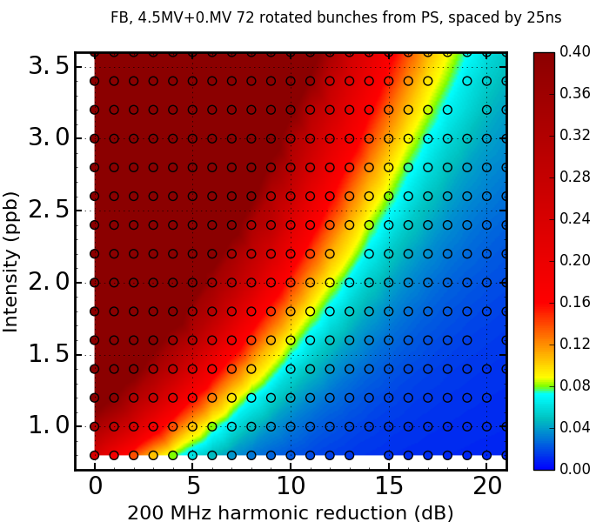

Flat bottom: 1RF/2RF + ramp to 30 GeV
Flat Bottom
RAMP 30 GeV
2RF
1RF

Slide 7
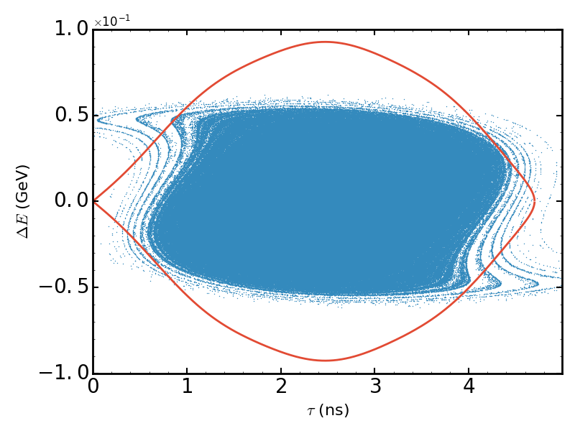
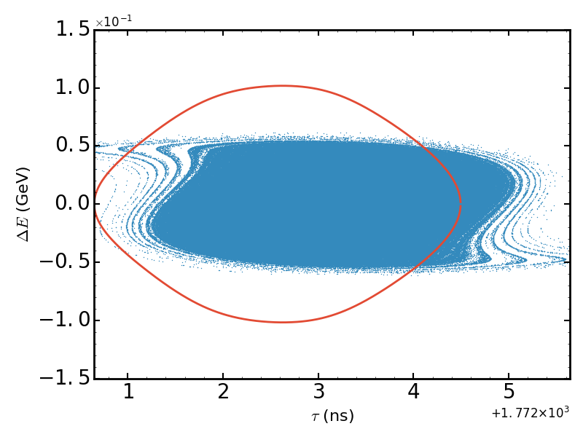
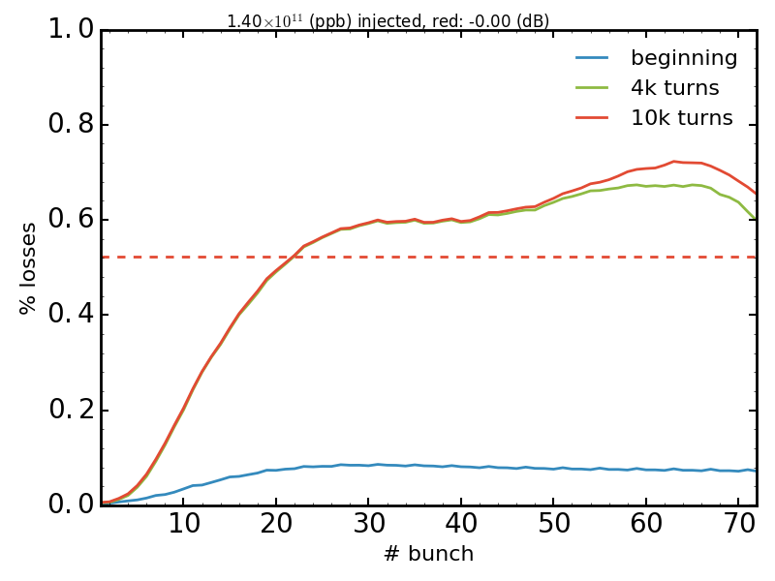

Injection: closer look
$I=1.4×{10}^{11}$ (ppb), no feedback
Accelerating bucket due to energy loss
Displacement along the batch due to beam-loading
What is the minimum transient time for losses?
Losses for all bunches centered (not realistic)?
bunch 1
bunch 72
$I=1.4×{10}^{11}$ (ppb), no feedback
relative losses

Slide 8
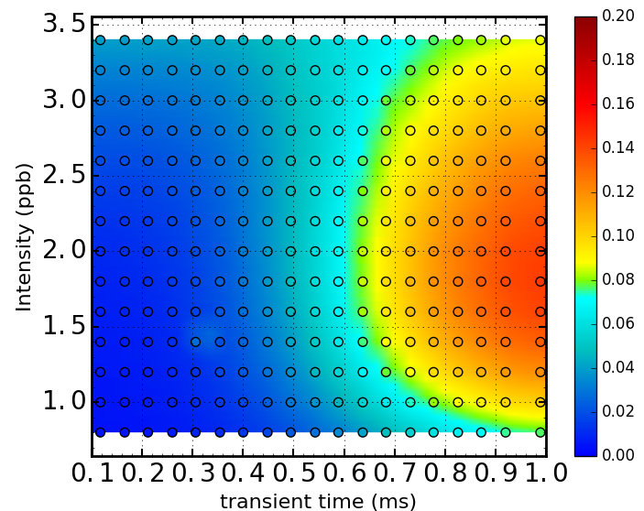
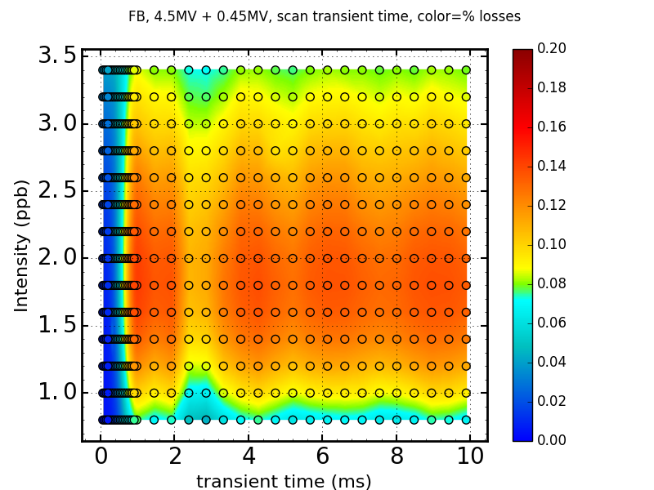
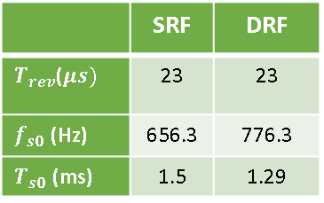
Transients: time scale
For each intensity:
  Use reduction needed for ~ 8% losses from previous simulations
  Apply this reduction only during some transient time
  Filamentation with 20 dB reduction
→ Transient time scale: ~ 1ms
→ Half a synchrotron period sufficient to reproduce the losses!
 | SRF | DRF
$T_{rev}$($μs)$ | 23 | 23
$f_{s0}$ (Hz) | 656.3 | 776.3
$T_{s0}$ (ms) | 1.5 | 1.29

Slide 9

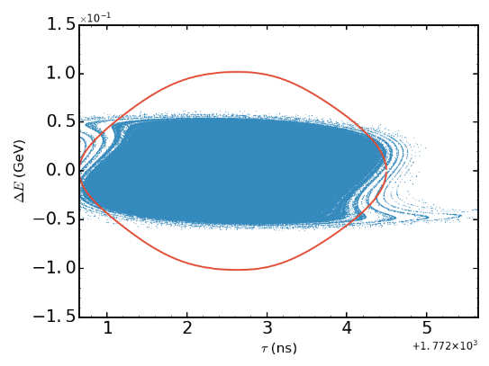
Bunch repositioning
Due to beam-loading, bunches at the batch end are not centered
LLRF phase loop recenters them using a 12 bunches signal
Maximum effect estimated by centering every bunch manually
$I=1.4×{10}^{11}$ (ppb), no feedback

Slide 10
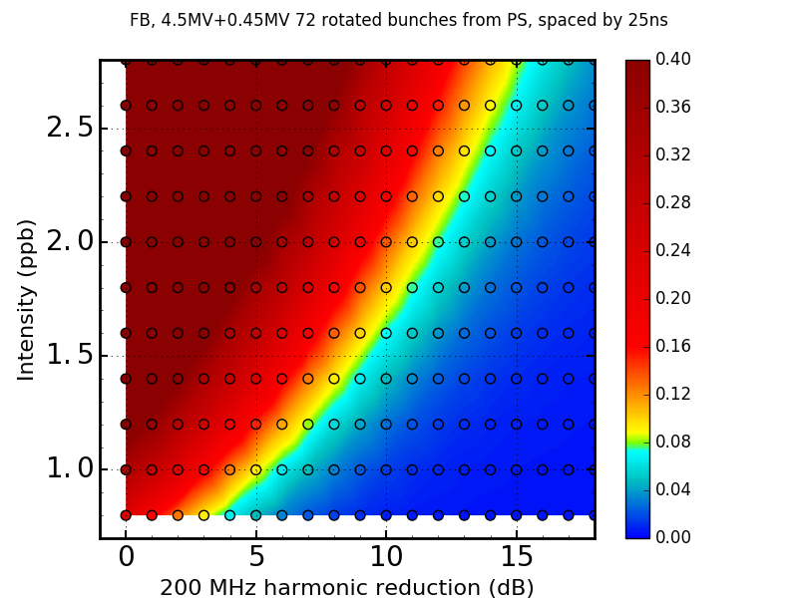
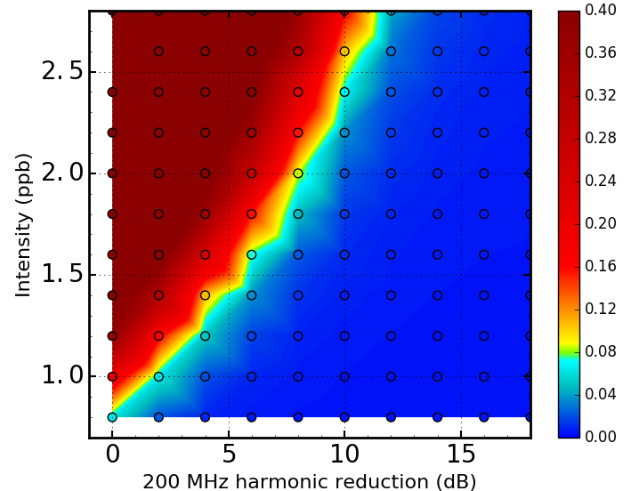
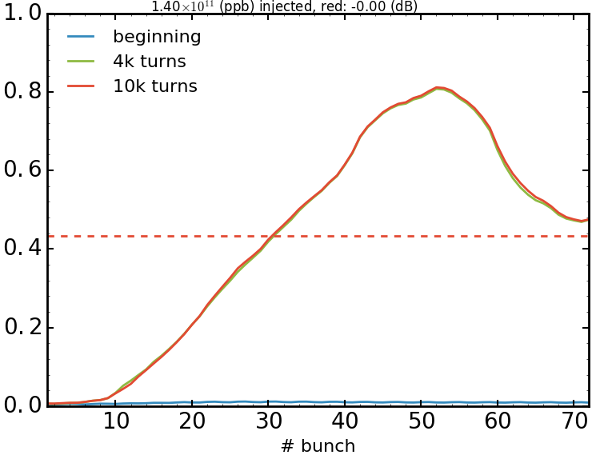

Bunch repositioning: comparison
Displacement from Beam-loading
Manual repositioning
$I=1.4×{10}^{11}$ (ppb), no feedback
$I=1.4×{10}^{11}$ (ppb), no feedback
relative losses
relative losses

Slide 11
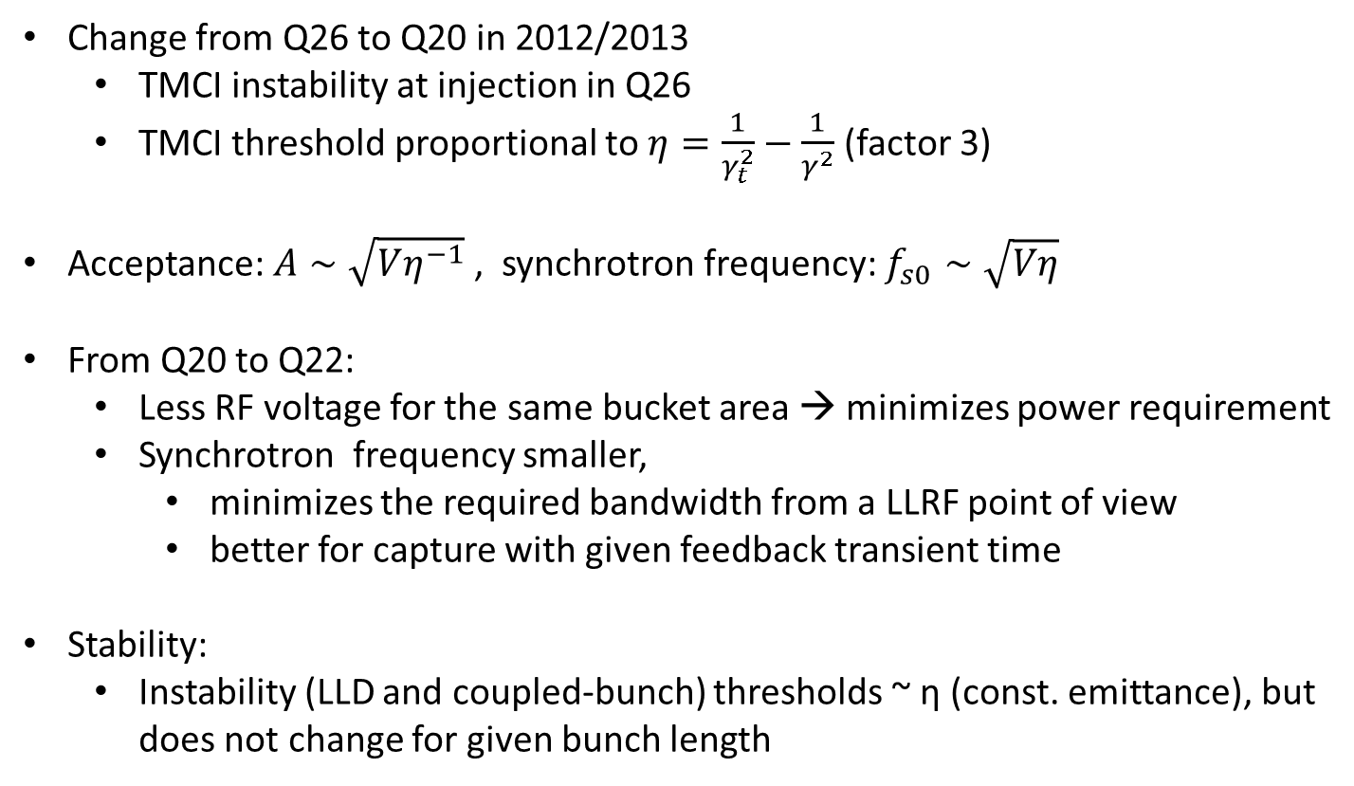
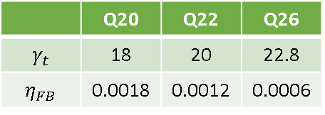
Q22 optics
 | Q20 | Q22 | Q26
$$γ_{t}$$ | 18 | 20 | 22.8
$$η_{FB}$$ | 0.0018 | 0.0012 | 0.0006
Change from Q26 to Q20 in 2012/2013
  TMCI instability at injection in Q26
  TMCI threshold proportional to $η=\frac{1}{γ_{t}^{2}}−\frac{1}{γ^{2}}$ (factor 3)
Acceptance: $A∼\sqrt{Vη^{−1}}$, synchrotron frequency: $f_{s0}∼\sqrt{Vη}$
From Q20 to Q22:
  Less RF voltage for the same bucket area → minimizes power requirement
  Synchrotron frequency smaller,
    minimizes the required bandwidth from a LLRF point of view
    better for capture with given feedback transient time
Stability:
  Instability (LLD and coupled-bunch) thresholds ~ η (const. emittance), but does not change for given bunch length

Slide 12
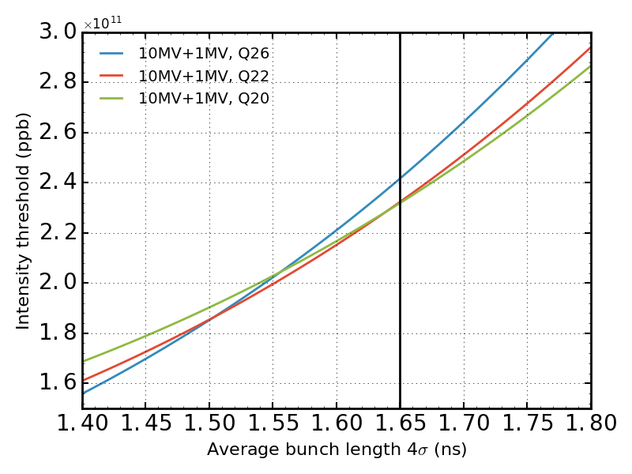

Q22 optics: flat top stability threshold
Same RF voltage: Q20 has the smallest bucket and Q26 the largest one
Increasing $\frac{δp}{p}$
Better for microwave-type instability?
Q20/Q22 equivalent at nominal bunch length

Slide 13
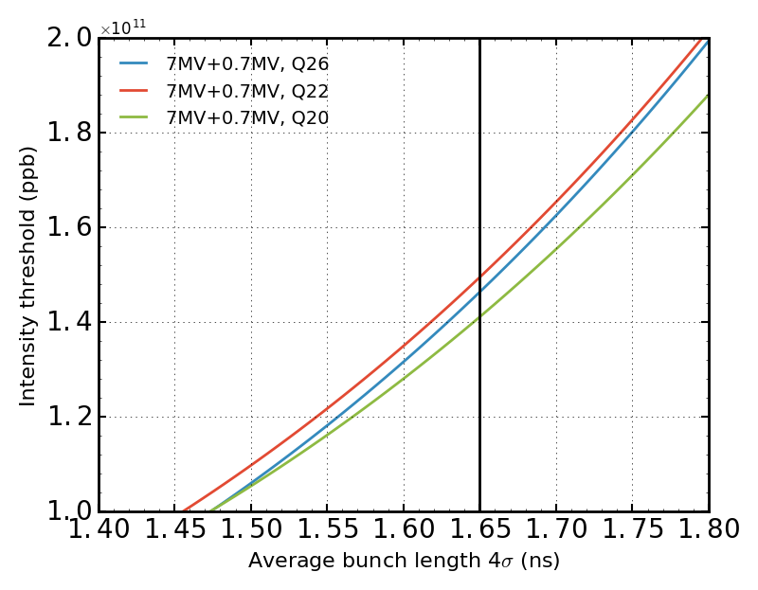
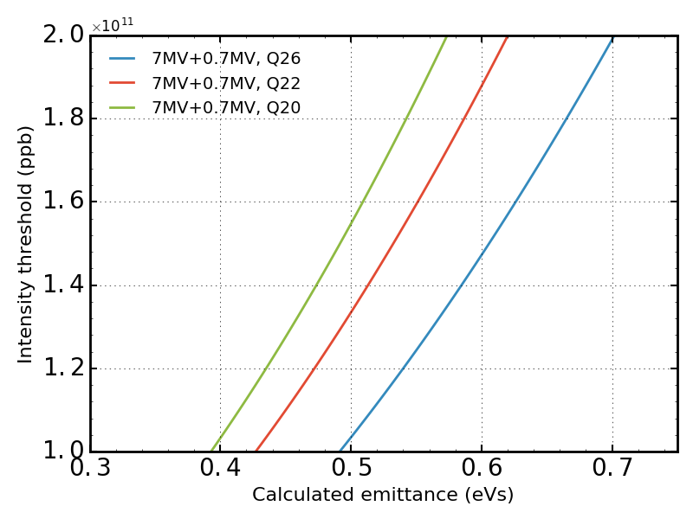
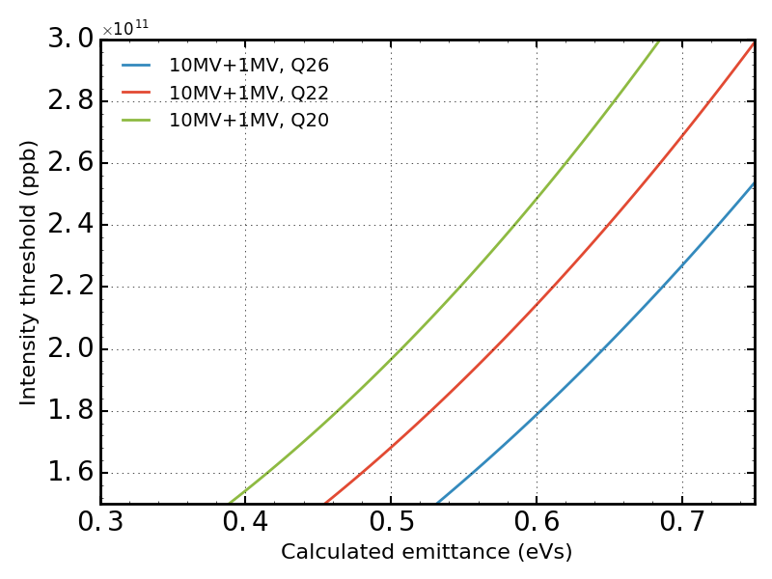
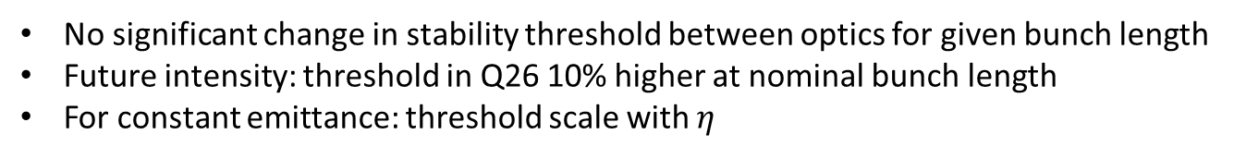
Q22 optics: flat top stability threshold
No significant change in stability threshold between optics for given bunch length
Future intensity: threshold in Q26 10% higher at nominal bunch length
For constant emittance: threshold scale with $η$
present
future

Slide 14
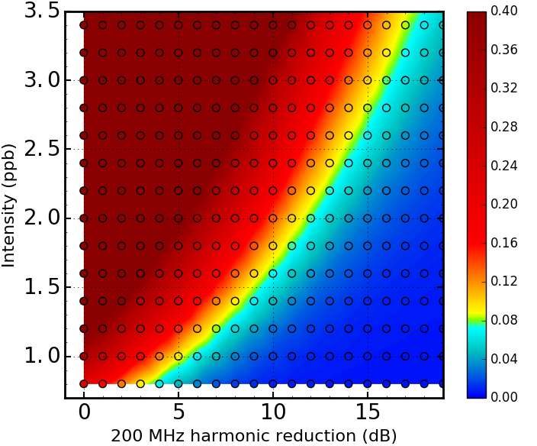
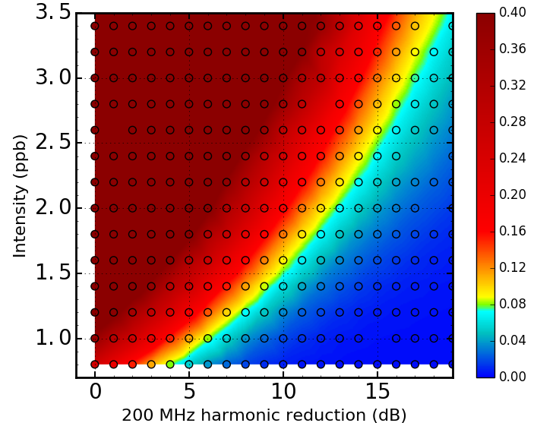
Q22: Loss comparison with Q20, same RF voltage
Bucket larger in Q22 by 10% , does it help for losses?
→ No visible improvement. Too small increase in bucket size?
→ Larger emittance after filamentation → more voltage during ramp
Q20
Q22

Slide 15
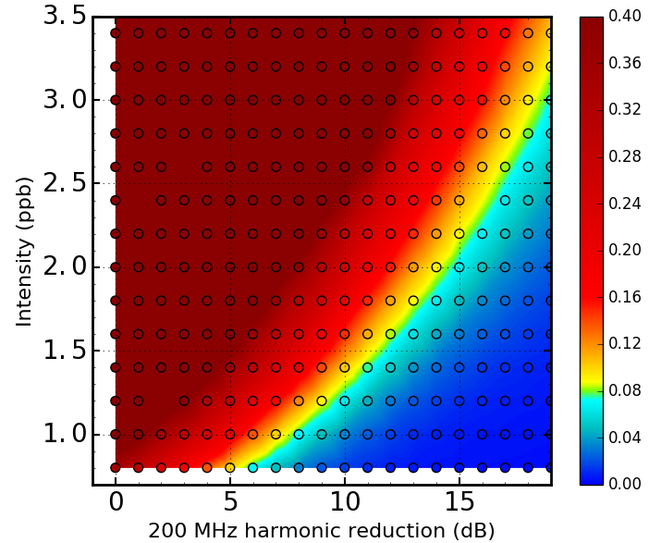
Q22: Loss comparison with Q20, same RF acceptance
Same bucket area but smaller synchrotron frequency in Q22
→ Higher losses in Q22. Induced voltage does not depend on the optics, less voltage in Q22 but same induced voltage
Q20
Q22

Slide 16
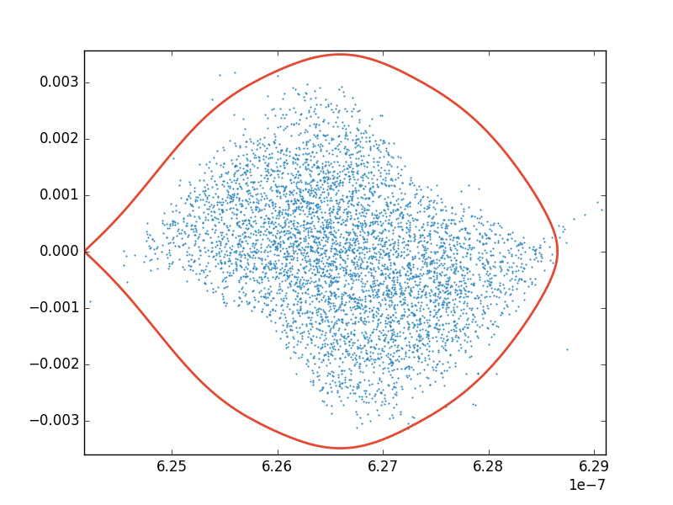
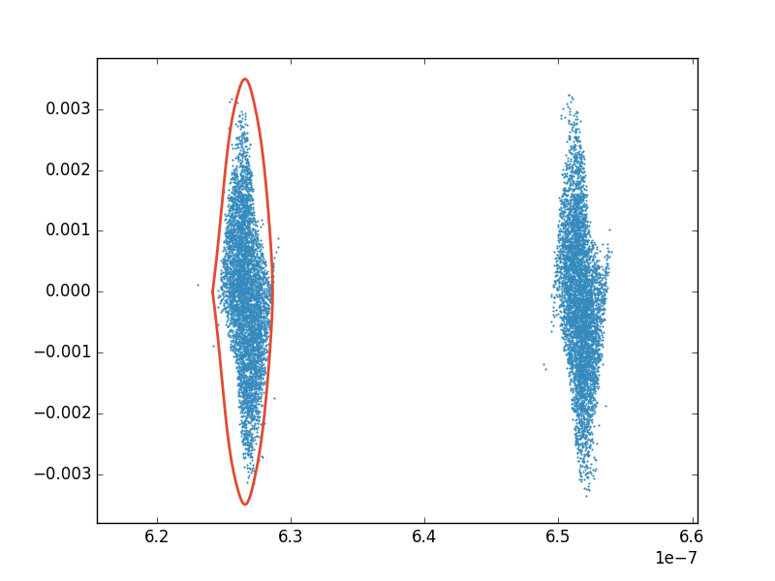
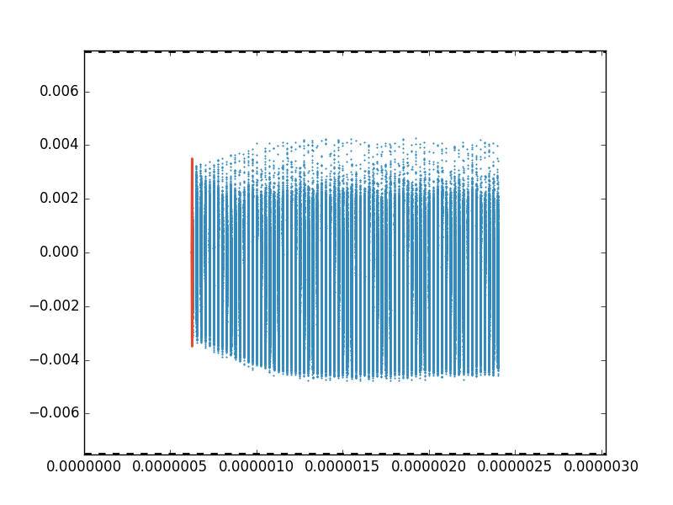
Uncaptured beam: numerically demanding
Difficult to simulate accurately:
  More macroparticles required to sample the uncaptured beam
  Multi-bunch collective effects important (losses increase along the batch) → 72 bunches necessary in simulation
  Slicing of the full ring is not feasible
  Time scale ~ 10 s to observe ~1% difference in loss rate (800 MHz ON/OFF) → long simulations
Momentum aperture
Momentum aperture

Slide 17
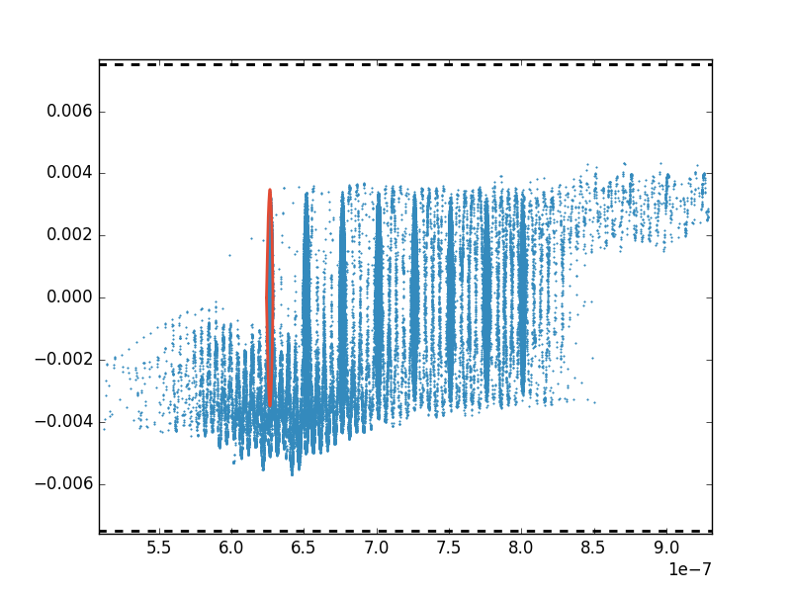
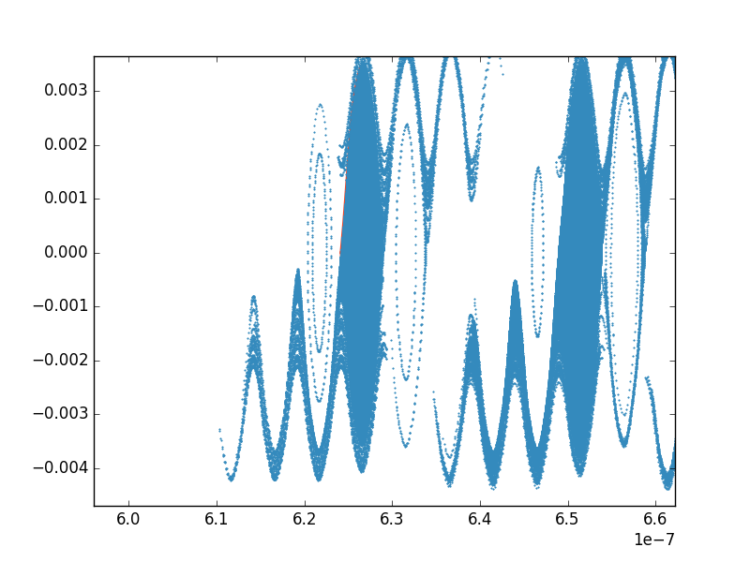
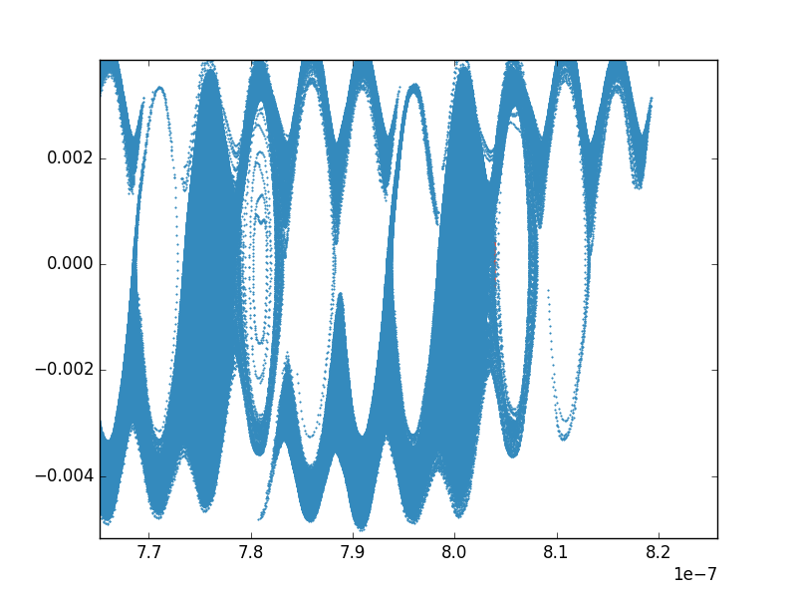


Uncaptured beam: very preliminary results
8 bunches to start with
High intensity, no impedance reduction
Lost particles move mainly to the head of the batch
Next steps:
  72 bunches
  Loss rate with/wo 800 MHz
  Ramp or momentum aperture
$$\frac{δp}{p}$$
Momentum aperture
s
Momentum aperture
$$τ$$
Head
Tail

Slide 18
Conclusion and future work
Assuming weaker impedance reduction (but constant) from feedback:
  Impedance requirement to explain losses
  ½ synchrotron period sufficient to obtain losses
Q22 optics (larger bucket for same voltage) will not help for capture losses
Uncaptured beam: energy loss are reproduced, ongoing study, more demanding computationally

Slide 19
Conclusion and future work
Possible mitigations:
  Rotation optimization in PS (A. Lasheen)
    Use additional 40 MHz
    Optimize rotation timing and RF program
  RF capture system in the SPS (80-120 MHz)
    1MV required but voltage in 200 MHz RF cavities of the same order
    Recapture in 200 MHz bucket could be complicated
    Ongoing study
  Obtain requirements for the future LLRF
    Study necessary to understand reaction during transient
  Optimize the beginning of the ramp to minimize losses at acceleration.

Slide 20
Thank you for your attention.
Acknowledgements
  Thank to E. Shaposhnikova for the support and countless fruitful discussions
  Thank to A. Lasheen without whom this study would have been a lot more difficult
  Thank to H. Bartosik for his previous studies and the help with the momentum aperture
  Thank to T. Bohl concerning the RF measurements
  Thank to the BLonD team for constant developments and improvements of the code

Slide 21
Backup slides

Slide 22
Cleaning of un-captured beam with Q-kicker
BCMS beam on special MD cycle (6 bp flat bottom + ramp to 28 GeV/c plateau)
  48 bunches, ~1.35e11 p/b injected, 4 ns bunch length at injection
  Vertical tune kicker on empty part of circumference for cleaning un-captured beam
  Flat bottom losses enhanced with 800 MHz (V=1/10 of 200 MHz), no impact on total transmission
  3.5% losses due to uncaptured beam, 2% losses at start of acceleration, 1% at 28 GeV/c
enhanced
loss rate
same loss rate
loss rate like 800 MHz OFF
tune kicker
tune kicker
same total transmission
Courtesy H. Bartosik

Slide 23
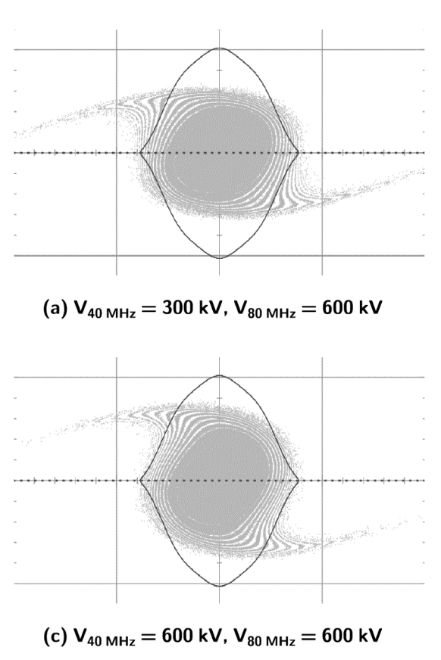
Additional 40 MHz cavity at PS extraction
LHC25ns operational beam with 72 bunches (MD cycle with ramp to 28 GeV/c)
  Transmission improved by 2% (= loss reduction by almost 40%) when using additional 40 MHz cavity for optimized bunch rotation in PS (optimal settings of Helga&Heiko)
  Additional 40 MHz cavity became operational during second half of 2016
1x40 MHz
total losses until 28 GeV
flat bottom losses
~ 2%
2x40 MHz
operational
settings
gap of additional 40 MHz
open (no voltage)
both 40 MHz
active
Courtesy H. Bartosik

Slide 24
Effect of RF loops on losses
Courtesy H. Bartosik
LHC 25ns standard beam on MD cycle with ramp to 28 GeV/c
  72bunches, ~1.33e11 p/b injected, 4.1 ns bunch length at injection
  Strong losses observed when feedback switched OFF
  Minor impact of other LLRF settings (apart from certain damper gain settings)

Slide 25
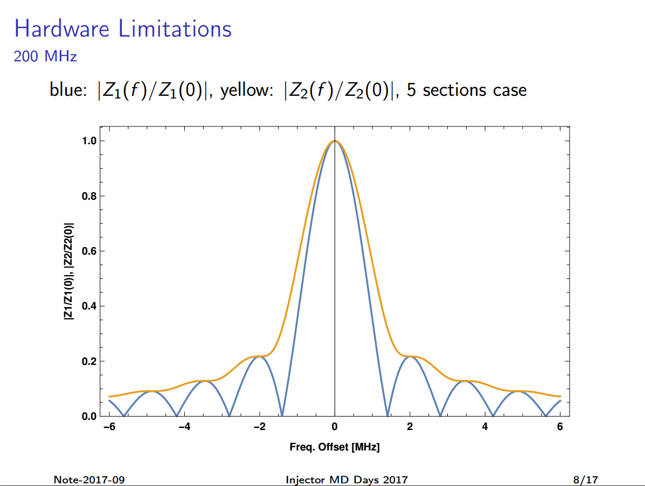
Courtesy T. Bohl

