Slide 1
Possible Modifications of The 630 MHz HOM Damping
Nasrin Esfahani
LIU-SPS BD WG – 6 April 2017

Slide 2
Outline
Introduction
628 MHz related modes
Tuning possibilities
Explanation of the tuning characteristics
Damping possibilities
Conclusions

Slide 3
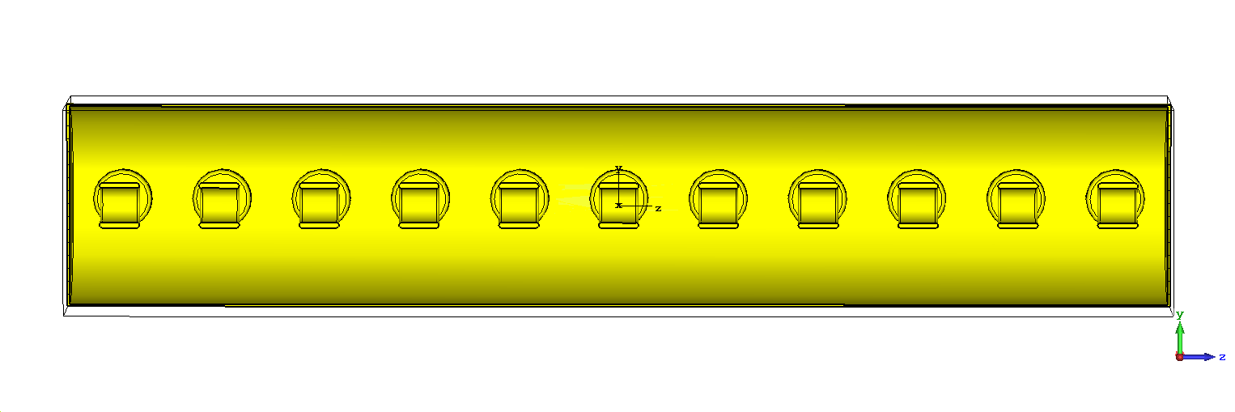
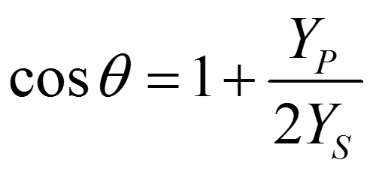
Introduction
Single cell Results
Dispersion Diagram:

Slide 4
Results from equivalent circuit modelling
Δϕ

Slide 5
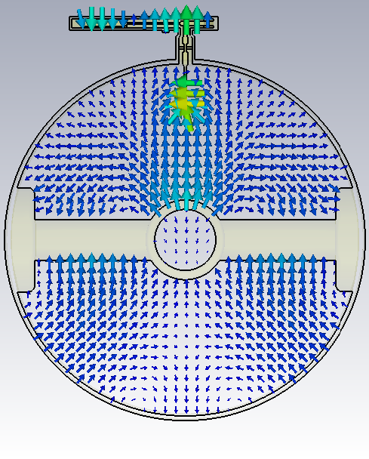
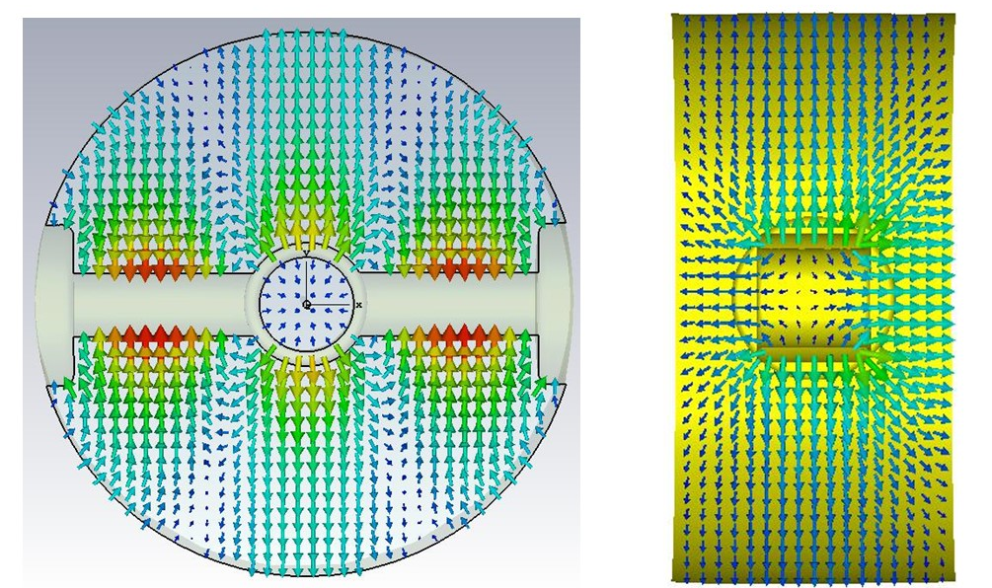
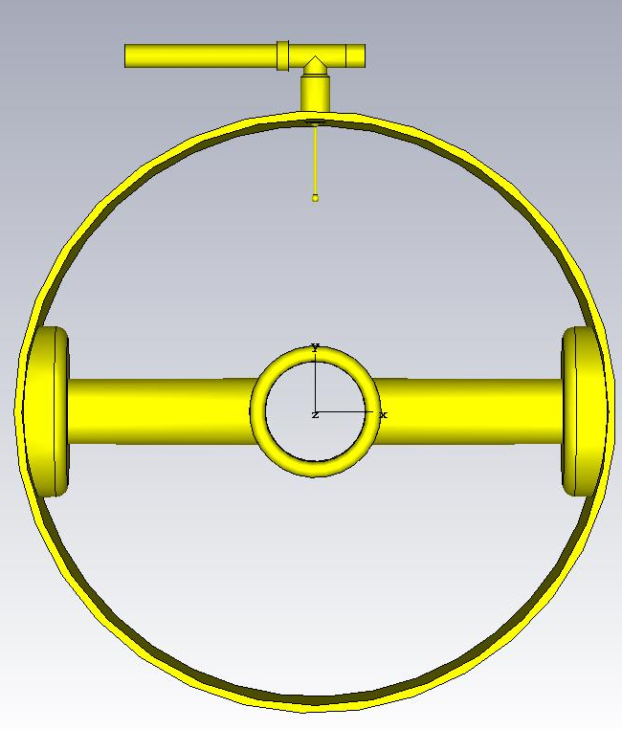
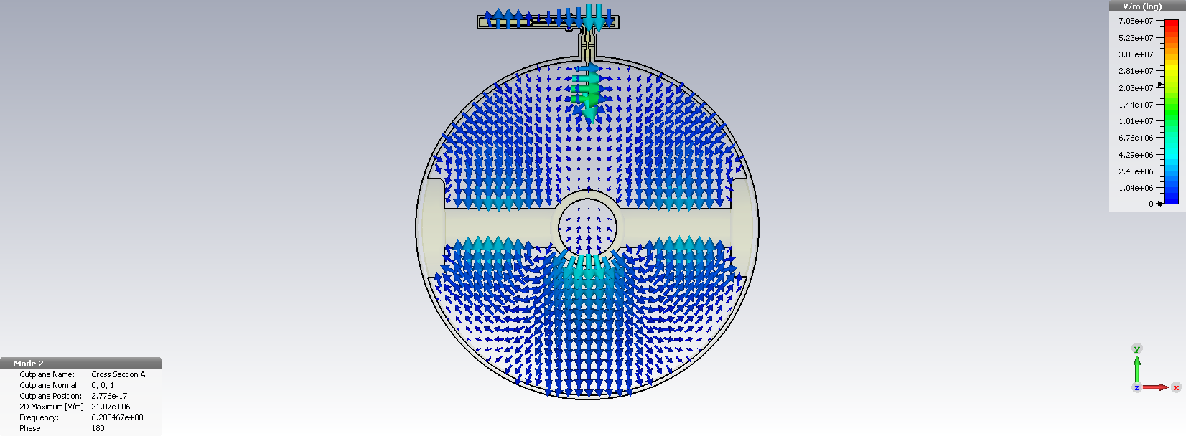
Tuning and damping possibilities
624.4 MHz
628.8 MHz
628 MHz mode without the presence of HOM

Slide 6
Tuning and damping possibilities (1)
|ΔF | =2 MHz

Slide 7
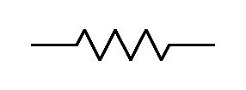
Tuning and damping possibilities (2)
1
R
1
1
1
2
R
2
2
2

Slide 8
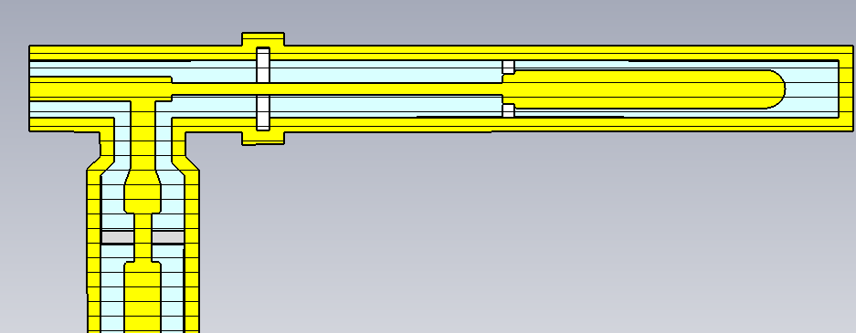
Existing coupler
50Ω Load
Zin
Ref. “On The 628 MHz Coupler” and “Results From Single-Cell Simulations” in SPS 200 MHz TWC HOMs meeting

Slide 9
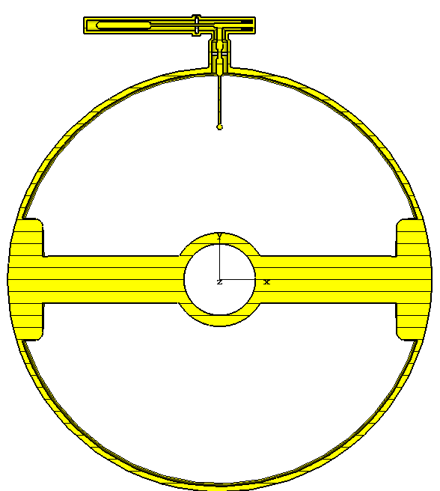
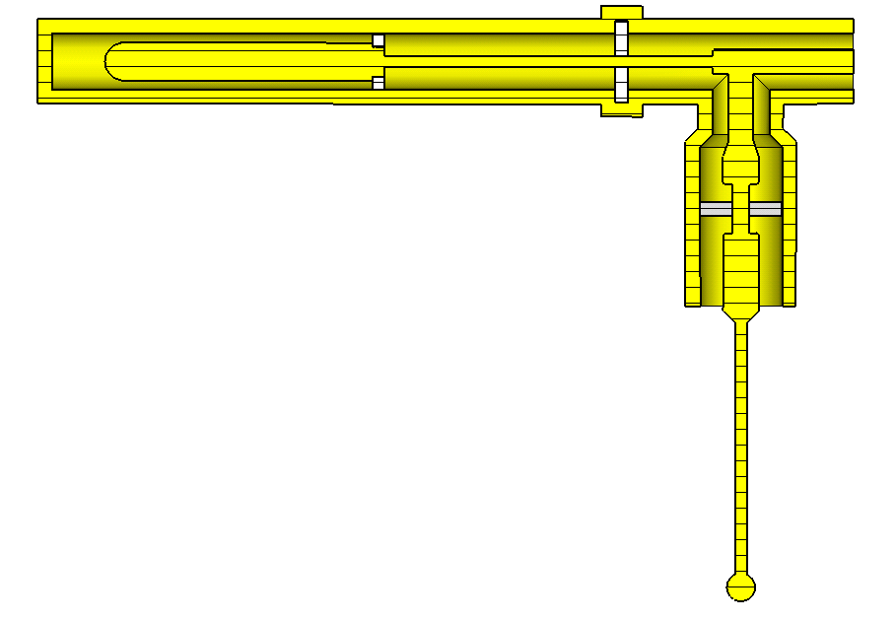
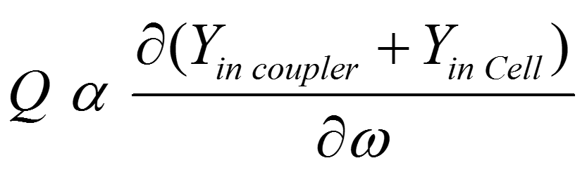
Modifying the existing coupler
Yin_Cavity
1. Reducing the load
2. Omitting the filtering part
Frequency selective part
Load
Yin_Couppler
(a)
(b)
Two times Q reduction

Slide 10
Conclusions
Changing the probe length provides |ΔF | =2 MHz
|ΔF | can be at the expense of Q
Two times Q reduction by 1. using a 17 Ω load and 2. omitting the filtering part

