Slide 1
200MHz cavities HOM impact on transverse stability
D.Amorim
Thanks to N.Biancacci, K.Li, E.Métral, B.Salvant
LIU-SPS beam dynamic WG meeting
02/03/2017

Slide 2
Outline
Introduction
Stability simulations results for the SPS impedance model in presence of a transverse resonator
Sensitivity to the resonator parameters
Conclusion and next steps

Slide 3
Outline
Introduction
Stability simulations results for the SPS impedance model in presence of a transverse resonator
Sensitivity to the resonator parameters
Conclusion and next steps

Slide 4
Introduction
Need to reduce the 620MHz longitudinal HOM
Doing so might modify the 940MHz transverse HOM
We want to assess the transverse stability margin if this mode grows when optimizing the 620MHz HOM
Method: stability simulations and analytical considerations on the sensitivity to resonator parameters

Slide 5
Outline
Introduction
Stability simulations results for the SPS impedance model in presence of a transverse resonator
Sensitivity to the resonator parameters
Conclusion and next steps

Slide 6
Stability simulations parameters
SPS impedance model (without 200MHz cavities) + transverse resonator
Resonator parameters
$f_{res}=938.5 MHz$, Q=1000 (E. Shaposhnikova, SL-Note 96-49 RF)
Scan in shunt impedance: ${10}^{8}≤R_{s} ≤ {10}^{12} Ω/m$
Growth rates obtained with DELPHI
Vertical plane
924 bunches (25ns spacing)
Single bunch intensity ${10}^{11}ppb$
Zero chromaticity, no damper (conservative parameters)
Notes:
Put Delphi params in appendix

Slide 7
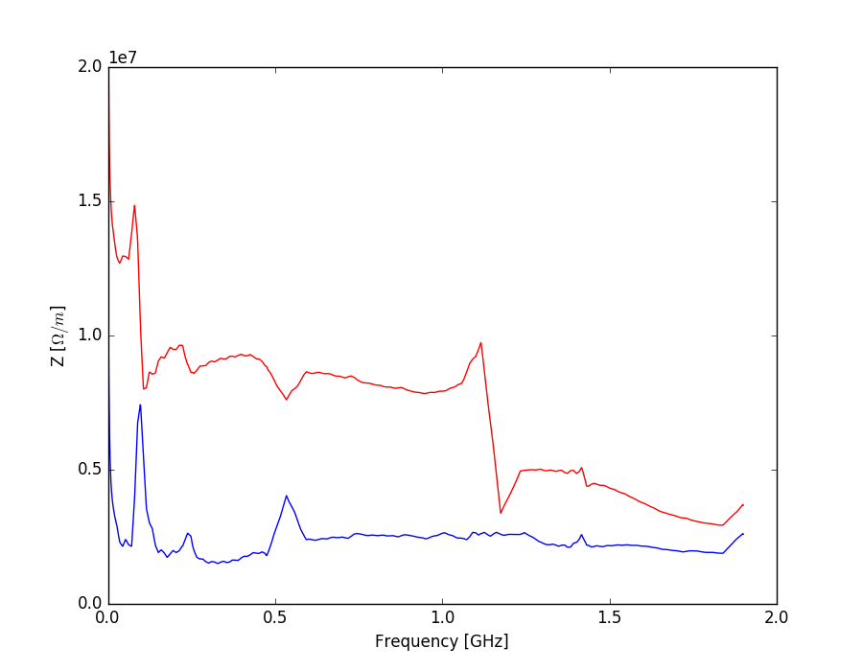
Stability simulations parameters
Impedance model (without 200MHz cavities) + Resonator
Resonator parameters
$f_{res}=938.5 MHz$, Q=1000
Scan in shunt impedance: ${10}^{8}≤R_{s} ≤ {10}^{12} Ω/m$
Growth rates obtained with DELPHI
Single bunch intensity ${10}^{11}ppb$
924 bunches (25ns spacing)
Zero chromaticity, no damper
Impedance model without resonator
Re(Z)
Im(Z)

Slide 8
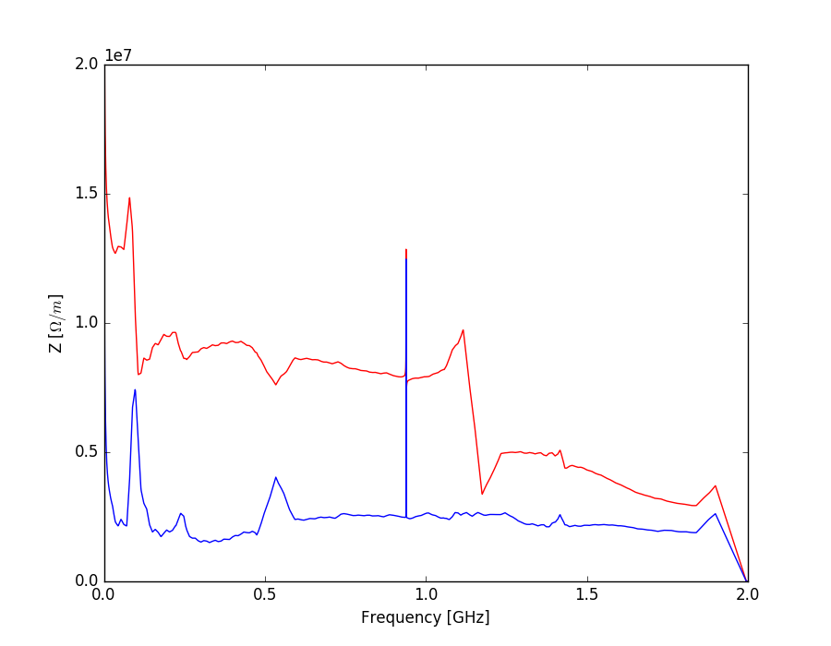
Stability simulations parameters
Impedance model (without 200MHz cavities) + Resonator
Resonator parameters
$f_{res}=938.5 MHz$, Q=1000
Scan in shunt impedance: ${10}^{8}≤R_{s} ≤ {10}^{12} Ω/m$
Growth rates obtained with DELPHI
Single bunch intensity ${10}^{11}ppb$
924 bunches (25ns spacing)
Zero chromaticity, no damper
$$R_{s}=10MΩ/m$$
$f_{res}=938.5 MHz$
Q=1000
Re(Z)
Im(Z)
Notes:
Redo plot with Re on front

Slide 9
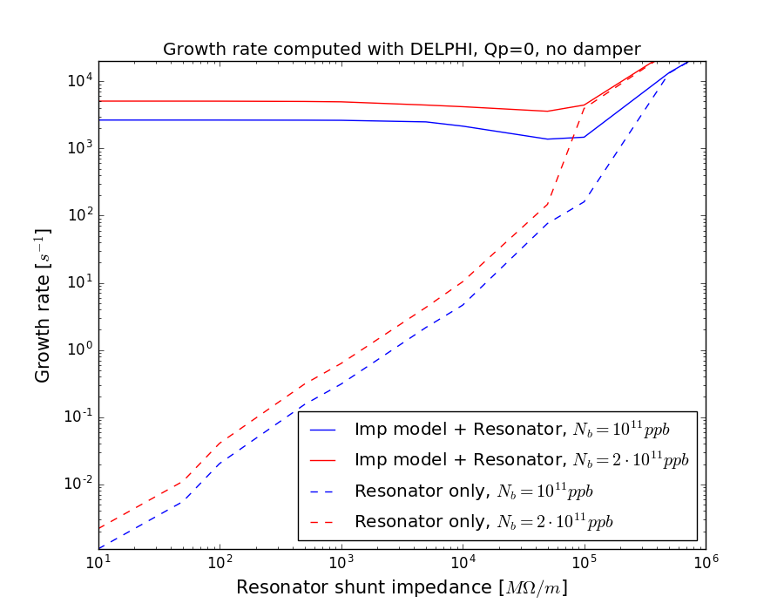
Stability simulations results
For $f_{res}=938.5 MHz$ and Q=1000 the effect of the resonator starts to be seen at $10 GΩ/m≤R_{s}$

Slide 10
Outline
Introduction
Stability simulations results for the SPS impedance model in presence of a transverse resonator
Sensitivity to the resonator parameters
Conclusion and next steps

Slide 11
Sacherer formula
Sacherer formula allows for an approximate calculation of rise time and frequency shift:
${Δω}_{m}=j\frac{1}{\left|m\right|+1}∙\frac{e^{2}βN_{b}}{4πm_{0}γQ_{y0}cτ_{b}}{\left(Z_{eff}\right)}_{m}$
With the effective impedance ${\left(Z_{eff}\right)}_{m}=\frac{\sum_{p}{Z\left(ω_{p}\right)h_{m} (ω_{p})}}{\sum_{p}{h(ω_{p})}}$
$h_{m}$ is the power spectrum
The growth rate $GR$ (in s⁻¹) is proportional to the real part of the transverse impedance
Notes:
Explain h
Put the resonator impedance picture

Slide 12
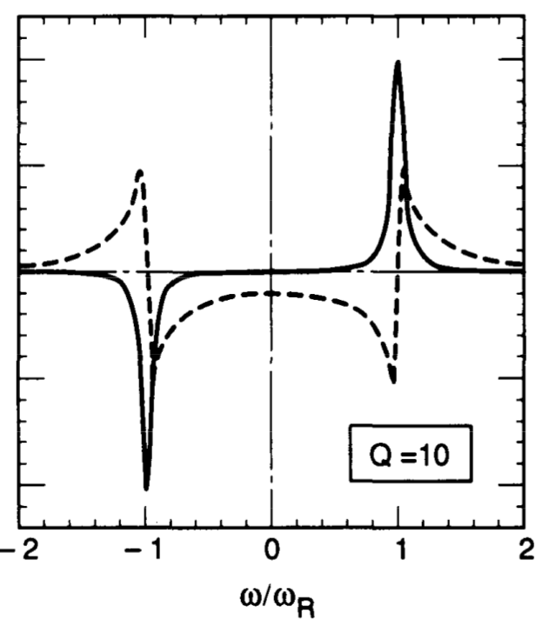
Sacherer formula
Sacherer formula allows for an approximate calculation of rise time and frequency shift:
${Δω}_{m}=j\frac{1}{\left|m\right|+1}∙\frac{e^{2}βN_{b}}{4πm_{0}γQ_{y0}cτ_{b}}{\left(Z_{eff}\right)}_{m}$
With the effective impedance ${\left(Z_{eff}\right)}_{m}=\frac{\sum_{p}{Z\left(ω_{p}\right)h_{m} (ω_{p})}}{\sum_{p}{h(ω_{p})}}$
$h_{m}$ is the power spectrum
The growth rate $GR$ (in s⁻¹) is proportional to the real part of the transverse impedance
Negative frequencies increase the growth rate (instability)
Positive frequencies decrease the growth rate (damping)
A.W. Chao
Notes:
Explain h
Put the resonator impedance picture

Slide 13
Sacherer formula
The impedance is sampled every $ω_{p}=(pM+n+Q_{y0})ω_{0}$
$$Mω_{0}$$
$$ω$$
$$pM$$
$$(p+1)M$$
M: Number of bunches
$$p∈ ℤ$$
Coupled bunch mode number: $n∈ ⟦0, M−1⟧$
Revolution frequency $f_{0}=\frac{ω_{0}}{2π}$
Notes:
Explain h

Slide 14
Sacherer formula
The impedance is sampled every $ω_{p}=(pM+n+Q_{y0})ω_{0}$
$$Mω_{0}$$
$$ω$$
$$pM$$
$$(p+1)M$$
Notes:
Explain h

Slide 15
Sacherer formula
The impedance is sampled every $ω_{p}=(pM+n+Q_{y0})ω_{0}$
$$ω_{0}$$
$$ω$$
$$pM$$
$$(p+1)M$$
Notes:
Explain h

Slide 16
Sacherer formula
The impedance is sampled every $ω_{p}=(pM+n+Q_{y0})ω_{0}$
$$ω_{0}$$
$$ω_{0}$$
$$ω$$
$$−(p+1)M$$
$$−pM$$
$$pM$$
$$(p+1)M$$
Notes:
Explain h

Slide 17
Sacherer formula
The impedance is sampled every $ω_{p}=(pM+n+Q_{y0})ω_{0}$
$$ω$$
$$−(p+1)M$$
$$−pM$$
$$pM$$
$$(p+1)M$$
Notes:
Explain h

Slide 18
Sacherer formula
The impedance is sampled every $ω_{p}=(pM+n+Q_{y0})ω_{0}$
$$ω$$
$$−(p+1)M$$
$$−pM$$
$$pM$$
$$(p+1)M$$
Notes:
Explain h

Slide 19
Sacherer formula
The impedance is sampled every $ω_{p}=(pM+n+Q_{y0})ω_{0}$
$$ω$$
$$−(p+1)M$$
$$−pM$$
$$pM$$
$$(p+1)M$$
Notes:
Explain h

Slide 20
Sacherer formula
The impedance is sampled every $ω_{p}=(pM+n+Q_{y0})ω_{0}$
$$ω$$
$$−(p+1)M$$
$$−pM$$
$$pM$$
$$(p+1)M$$
Notes:
Explain h

Slide 21
Sacherer formula
The impedance is sampled every $ω_{p}=(pM+n+Q_{y0})ω_{0}$
$$ω$$
$$−(p+1)M$$
$$−pM$$
$$pM$$
$$(p+1)M$$
Notes:
Explain h

Slide 22
Sacherer formula
The impedance is sampled every $ω_{p}=(pM+n+Q_{y0})ω_{0}$
$$ω$$
$$−(p+1)M$$
$$−pM$$
$$pM$$
$$(p+1)M$$
Notes:
Explain h

Slide 23
Sacherer formula
The impedance is sampled every $ω_{p}=(pM+n+Q_{y0})ω_{0}$
$$ω$$
$$pM$$
$$(p+1)M$$
Each couple of lines (negative and positive) is spaced by $2\left\{Q_{y0}\right\}⋅f_{0}$ (16KHz in this case)
Notes:
Explain h

Slide 24
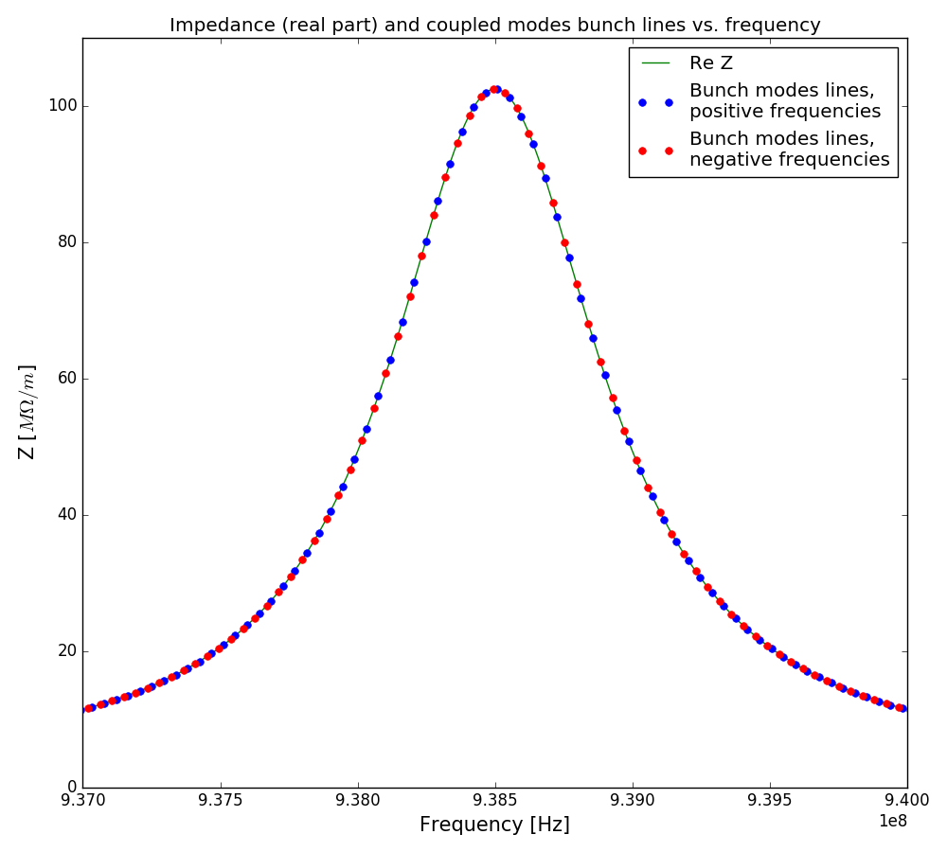
Resonator bandwidth > revolution frequency
Resonator impedance (line)
Coupled bunches modes lines (dots)
Positive and negative lines almost compensate
$$f_{res}=938.5MHz$$
$$R_{s}=100MΩ/m$$
$$Q=1000$$
Resonator bandwidth
$$Δf={f_{res}}/Q=938.5kHz$$
Here $Δf≫ f_{0}$, multiple coupled bunch lines are covered by the resonance

Slide 25
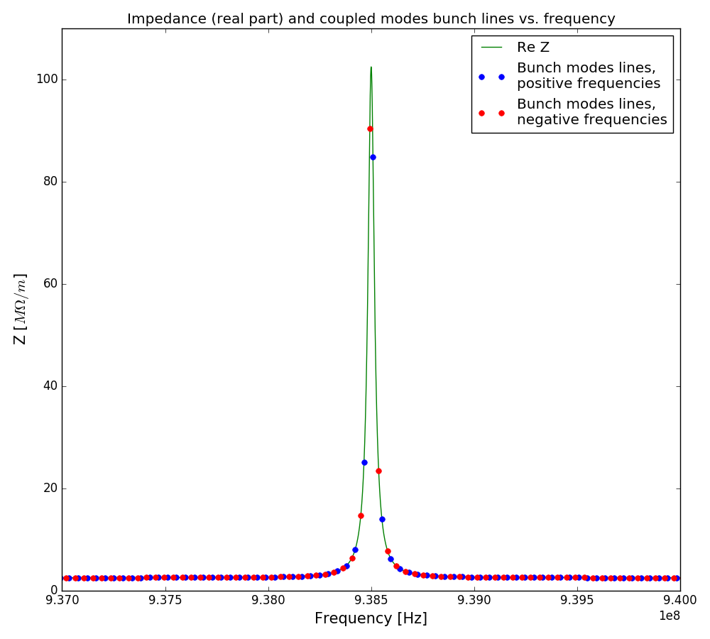
Resonator bandwidth < revolution frequency
Resonator impedance (line)
Coupled bunches modes lines (dots)
$$f_{res}=938.5MHz$$
$$R_{s}=100MΩ/m$$
$$Q=25000$$
Resonator bandwidth
$$Δf={f_{res}}/Q=37.5kHz$$
Here $Δf≲ f_{0}$, two coupled bunch lines are covered by the resonance and have almost the same amplitude
Notes:
Here: compenstae

Slide 26
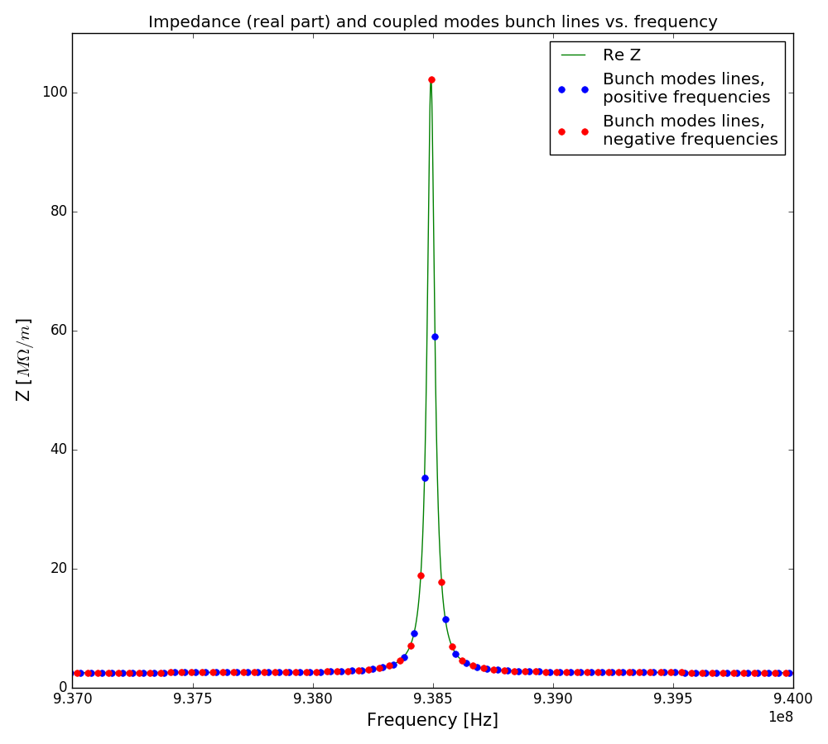
Resonator bandwidth < revolution frequency
Resonator impedance (line)
Coupled bunches modes lines (dots)
The resonance frequency is shifted by $−0.18∙f_{0}=−7.8kHz$
$$f_{res}=938.492MHz$$
$$R_{s}=100MΩ/m$$
$$Q=25000$$
Resonator bandwidth
$$Δf={f_{res}}/Q=37.5kHz$$
Here one coupled bunch line falls on top of the resonance
Notes:
Here: no compendsation

Slide 27
Summary of the two cases
Depending on the resonator bandwidth $Δf={f_{res}}/Q$
If $Δf≫ f_{0}$ the resonance covers multiple coupled bunch lines
Most of the growth rate given by the negative lines is compensated by the damping provided by the positive lines
If $Δf≲ f_{0}$ the resonance can:
Cover two lines, both having the same amplitude: the growth rate is compensated by the damping
Cover two lines, one having a larger amplitude: the growth rate can become much larger than the damping: an instability may rise

Slide 28
Conclusion
First studies show (for $f_{res}=938.5 MHz$, $Q=1000$) no impact until $10 GΩ/m≤R_{s}$
Qualitative analysis show that $Q\sim 1000$ ($Δf≫ f_{0}$) shouldn’t impact transverse stability
But higher $Q$ ($Q\sim 20000$ , $Δf≤ f_{0}$) might drive an instability, with a sensibility on the resonance frequency
Next steps
Check the corresponding single bunch stability margins (effect of $R_{s}/Q$)
Run the simulations for 4620 bunches (5ns)
Increased total intensity should lead to higher growth rates
Same qualitative behavior w.r.t. Q expected as line spacing is $f_{0}$
Study in more detail the coupled-bunch instability as a function of resonator parameters
Implement realistic HOM with values from impedance simulations

Slide 29
References
E. Shaposhnikova, Resonant impedances in the SPS, SL-Note 96-49 RF
N. Biancacci, Impact of transverse HOM on beam stability in the HL-LHC, 10/12/2014
R.J. Lauckner and T.P.R Linnecar, The transverse coupled bunch mode instability at 940MHz in the SPS, 03/09/1980
K.Y.Ng, Coupling Impedances and Beam Instabilities in Accelerator Rings, 2015

Slide 30
Stability simulations results
Nb=2e11 Baseline value: 5000 s⁻¹
Nb=1e11 Baseline value: 2600 s⁻¹
Growth rate linear with beam intensity, shunt impedance threshold is not changed
Notes:
Put reso param

Slide 31
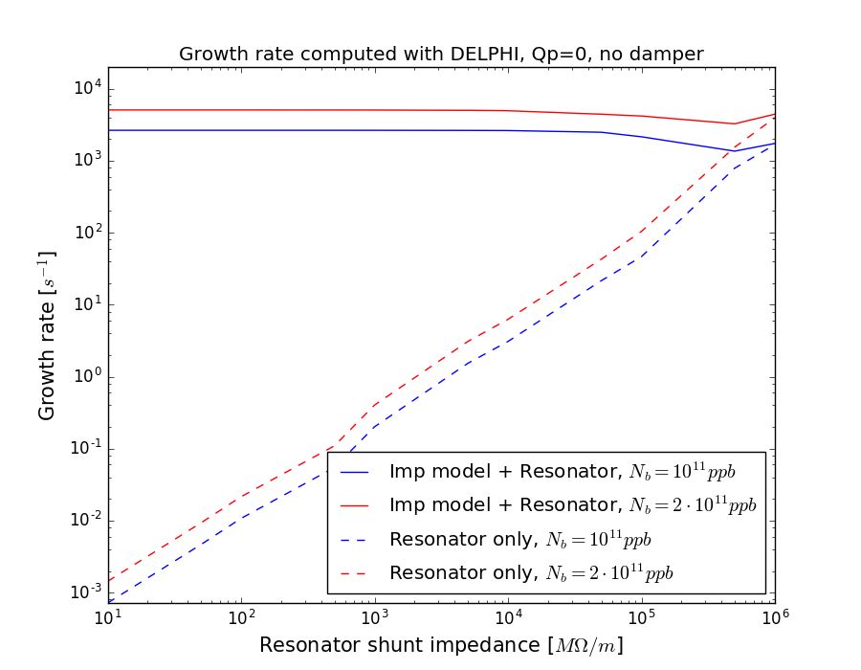
Stability simulations results
Nb=2e11 Baseline value: 5000 s⁻¹
Nb=1e11 Baseline value: 2600 s⁻¹
For ($f_{res}=938.5 MHz$, Q=10000) the effect of the resonator starts to be seen at $100 GΩ/m≤R_{s}$

Slide 32
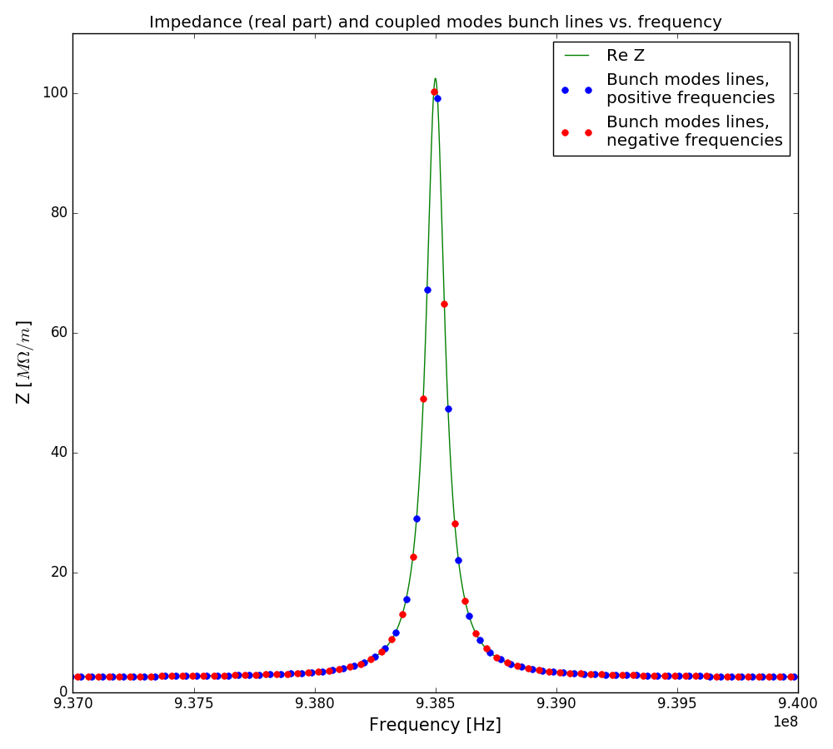
Theory considerations
Resonator impedance (line)
Coupled bunches modes lines (dots)
$$f_{res}=938.5MHz$$
$$R_{s}=10MΩ/m$$
$$Q=10000$$
Resonator bandwidth
$$Δf={f_{res}}/Q=938.5kHz$$

