Slide 1
Beam stability after LS2 and 630 MHz HOM s 2nd of March 2017
J. Repond, E. Shaposhnikova

Slide 2
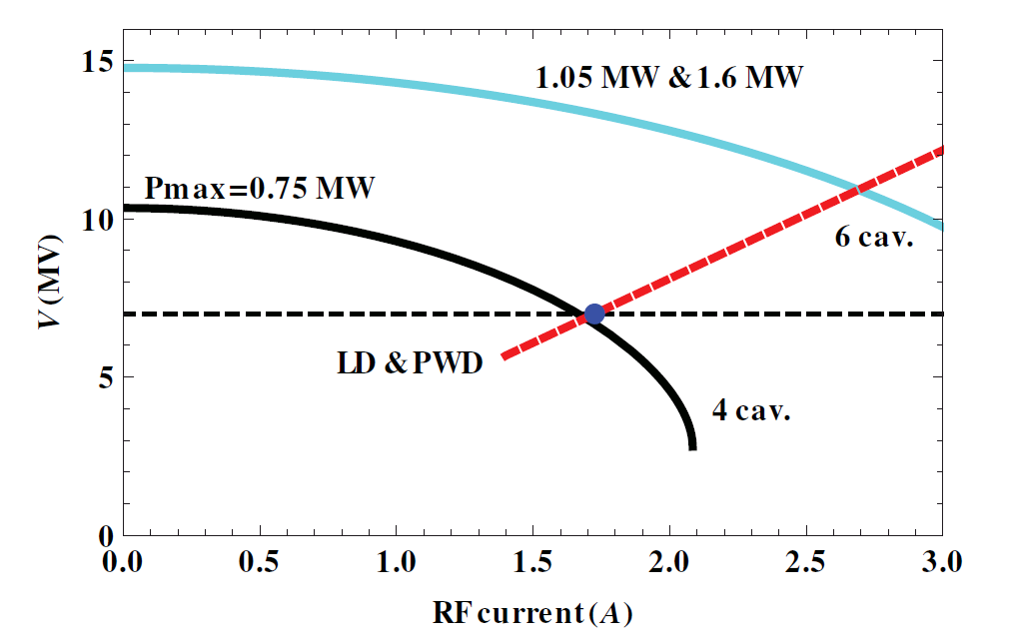
SPS 200 MHz RF system
Upgrade of the SPS 200 MHz RF system during the LS2:
RF power plants upgrade.
Present: 2x4 + 2x5 sections → Future: 2x4 + 4x3 sections.
More power available.
Shorter cavity length minimizes the impedance.
Tuning of the main harmonic probably required for the new 2 sections.
Impact on beam stability of a possible tuning (spreading/shifting) of the HOMs has been studied.
10 MV assumed in simulations
$1.75$ A → $1.35×{10}^{11}$ ppb.
$2.7$ A → $2.1×{10}^{11}$ ppb.
Ref: IPAC2016, MOPOY058

Slide 3
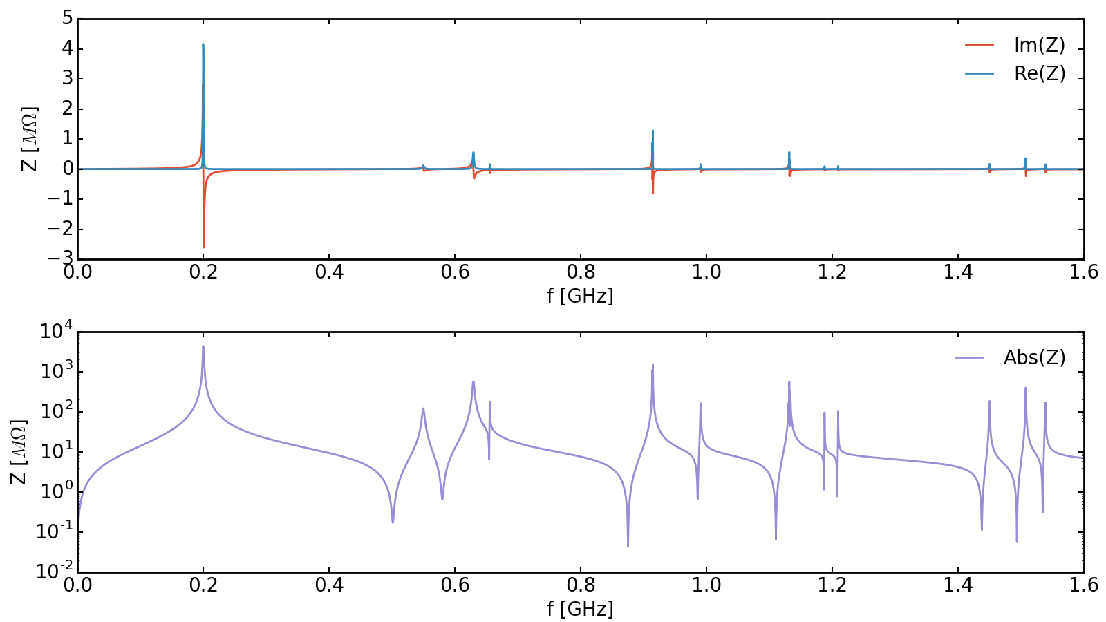
SPS 200 MHz TWC spectrum
The 630 MHz HOM has been identified to be the critical one for stability.
Actual damping already efficient, another factor 2-3 seems to be difficult to achieve.
Spreading of HOM peaks from 6 cavities in frequency is equivalent to damping.
Simulations:
630 MHz HOM from each cavity can be moved independently.
HL-HLC beam (72 bunches spaced by 25ns) on Flat Top (FT).
DRF: 10 MV + 1 MV, LIU baseline impedance model.
630 MHz
914 MHz
1133 MHz
1507 MHz

Slide 4
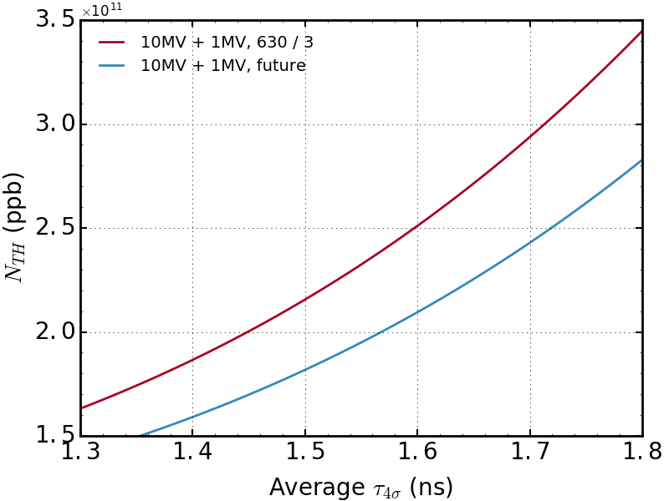
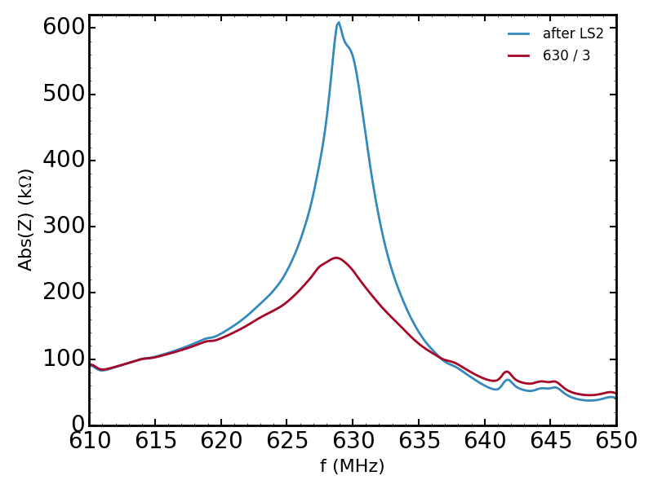
Damping of 630 MHz HOM
Nominal bunch length (1.65 ns):
Damping by a factor 3 (R/Q = const) improves stability threshold by 25%.
$$1.65 ns 4σ_{FWHM}$$
HL-LHC

Slide 5
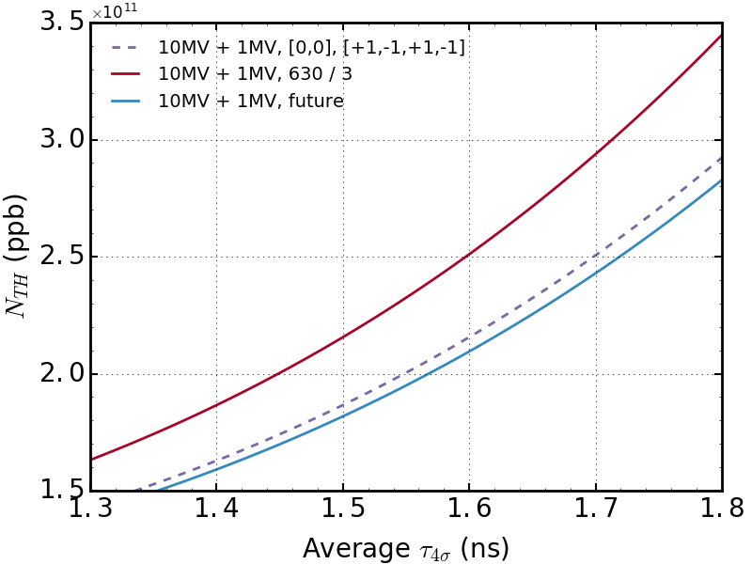
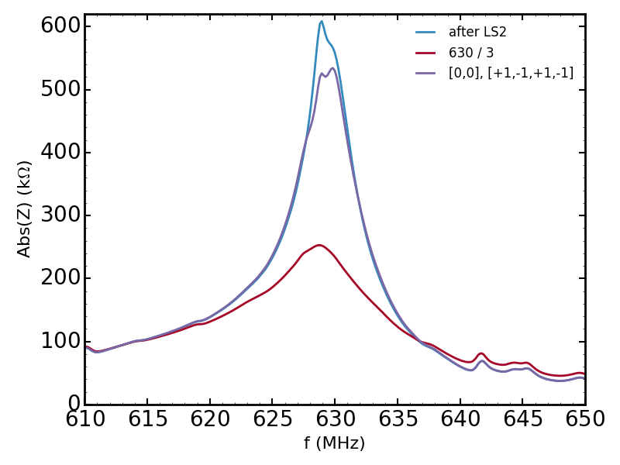
Spreading 630 MHz HOMs in 3 s. cavities
For nominal bunch length (1.65 ns)
Spreading the new 3 sections cavities by +/- 1 MHz, improves stability threshold by 1%.
2x4sec.
4x3sec.
2x4sec.
4x3sec.

Slide 6
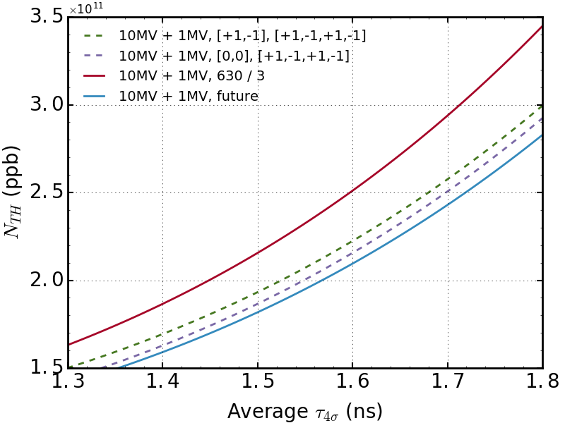
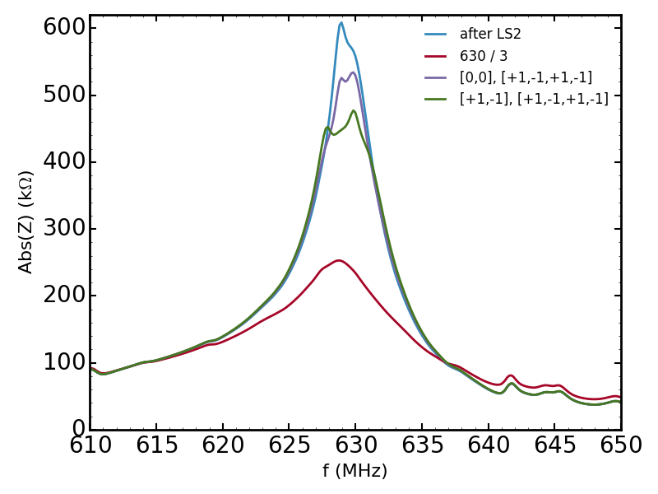
Spreading 630 MHz HOMs in all cavities
Nominal bunch length (1.65 ns).
Adding also a +/- 1 MHz spread to the 4 sections, improves stability threshold by 2%.

Slide 7
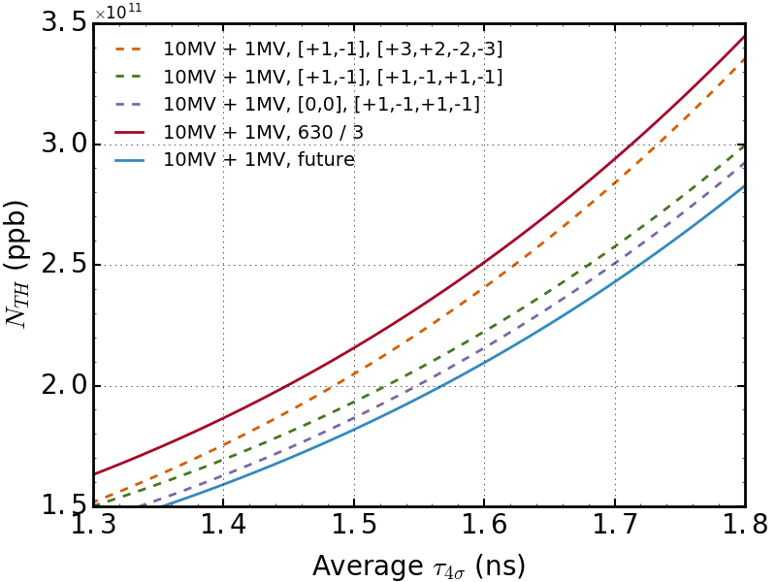
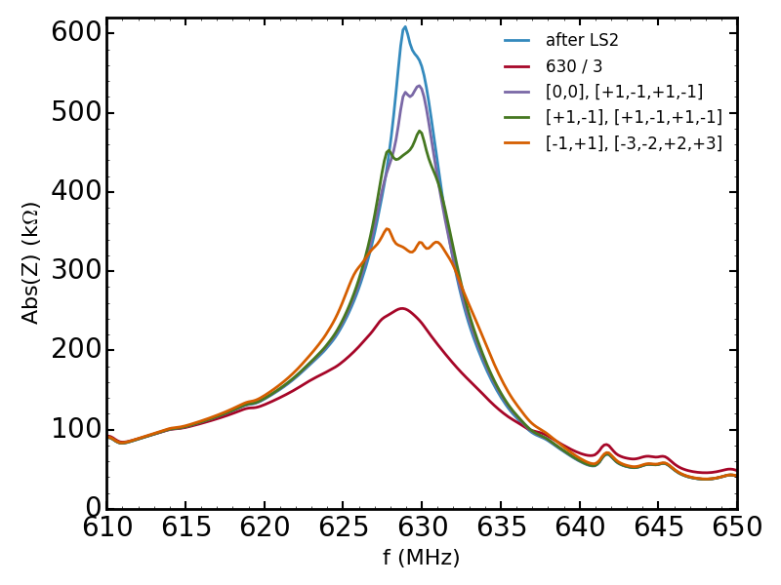
Larger spreading of 630 MHz HOMs
Nominal bunch length (1.65 ns)
More (up to 3 MHz) spread in the 3 sections, improves stability threshold by 20%.

Slide 8
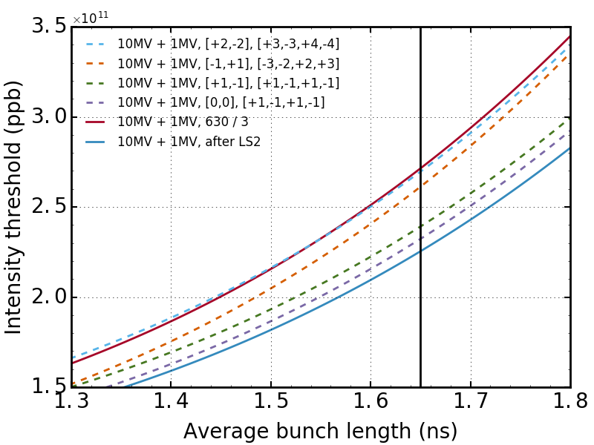
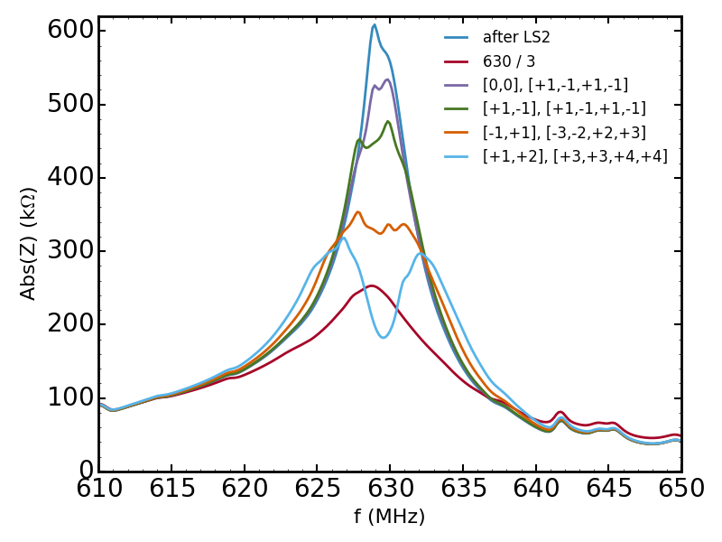
Larger spreading of 630 MHz HOMs
Nominal bunch length (1.65 ns).
Larger spread in both direction (up to 4 MHz)→ damping by factor 3 recovered.

Slide 9
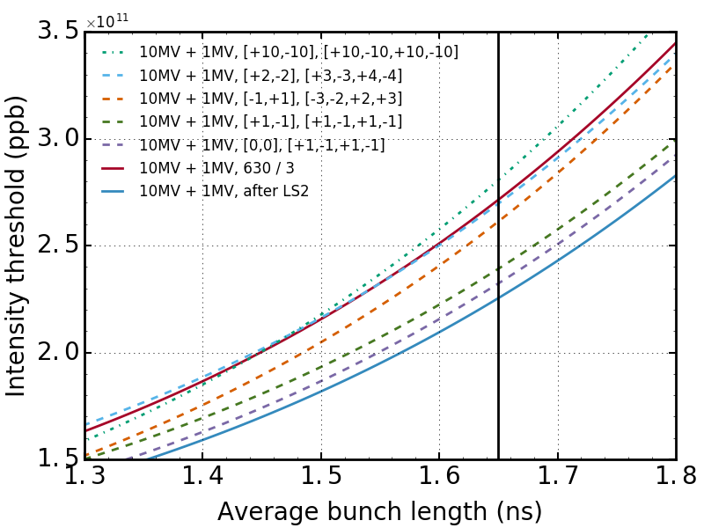
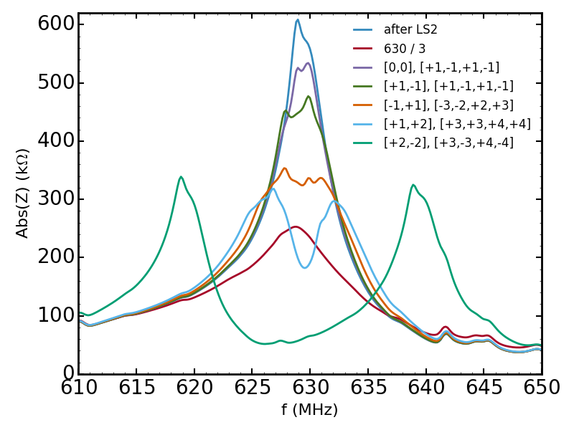
Even more spreading of 630 MHz HOMs
If more extreme values are used (+/- 10 MHz) → larger effect than damping by a factor 3.

Slide 10
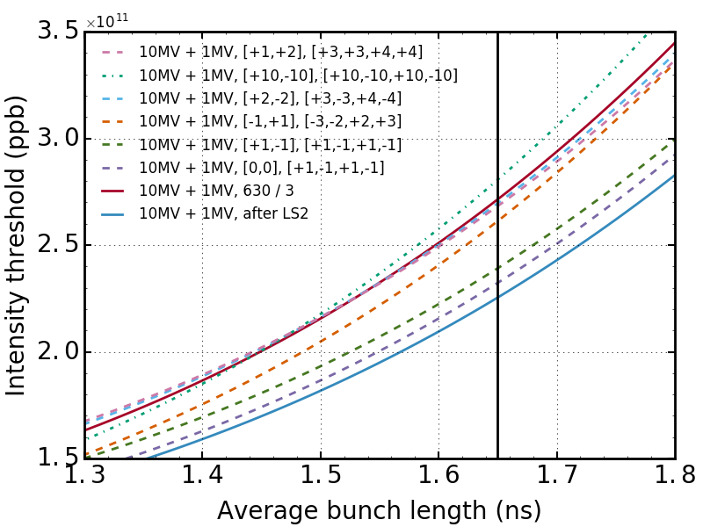
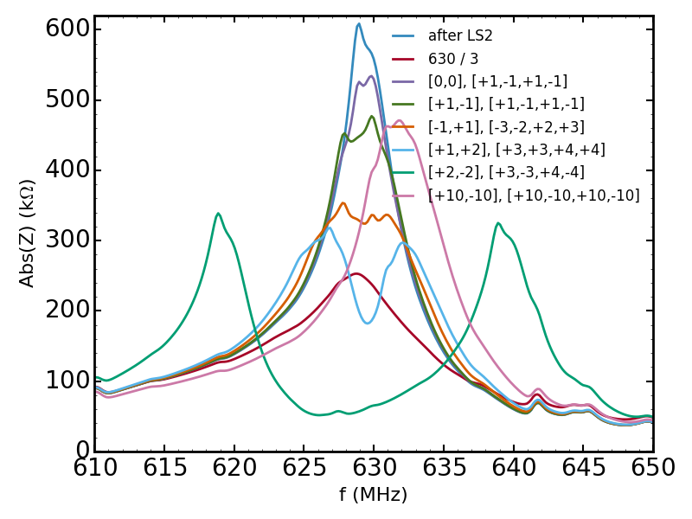
Shifting and spreading of 630 MHz HOMs
Nominal bunch length (1.65 ns).
Spread in positive direction only (see label) → damping by factor 3 recovered.

Slide 11
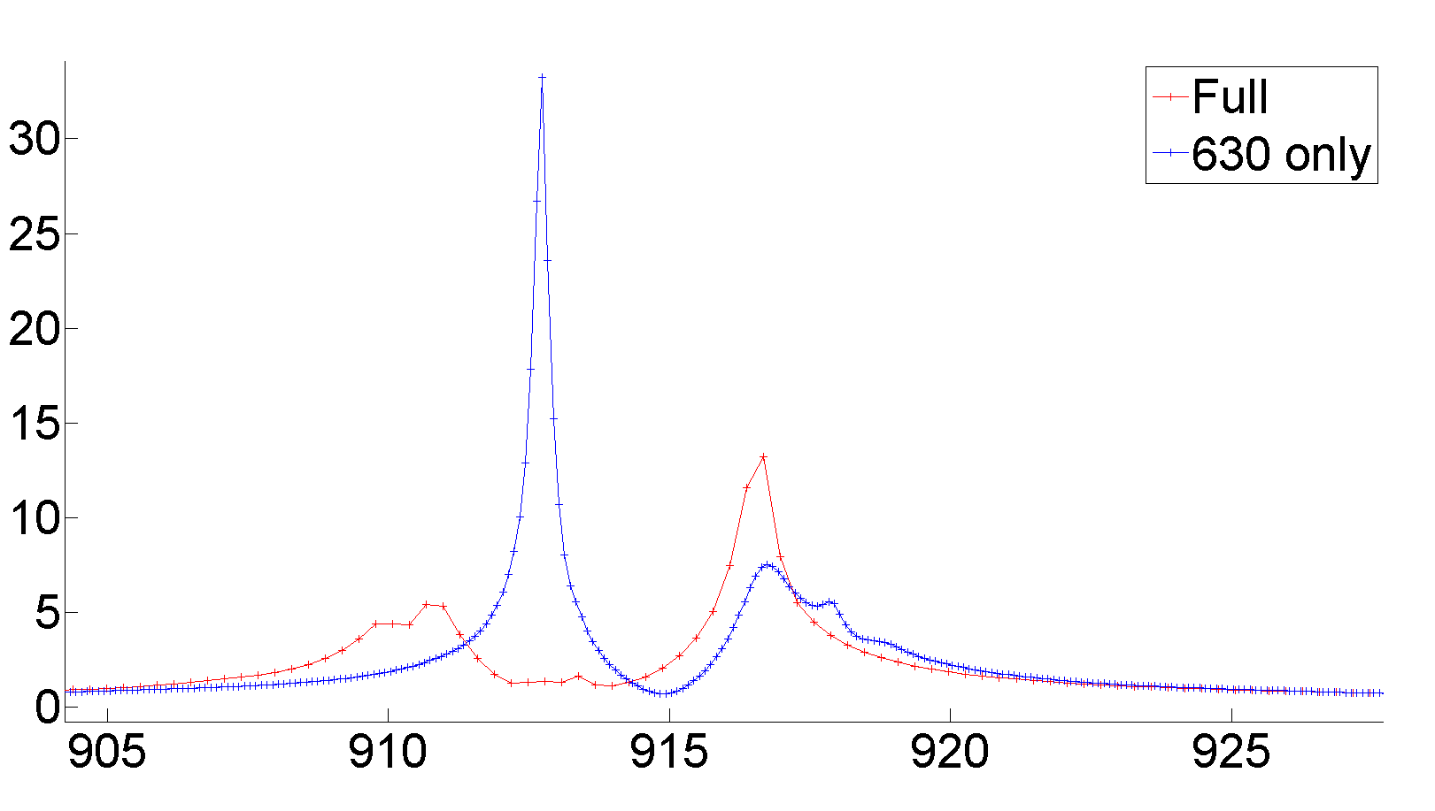
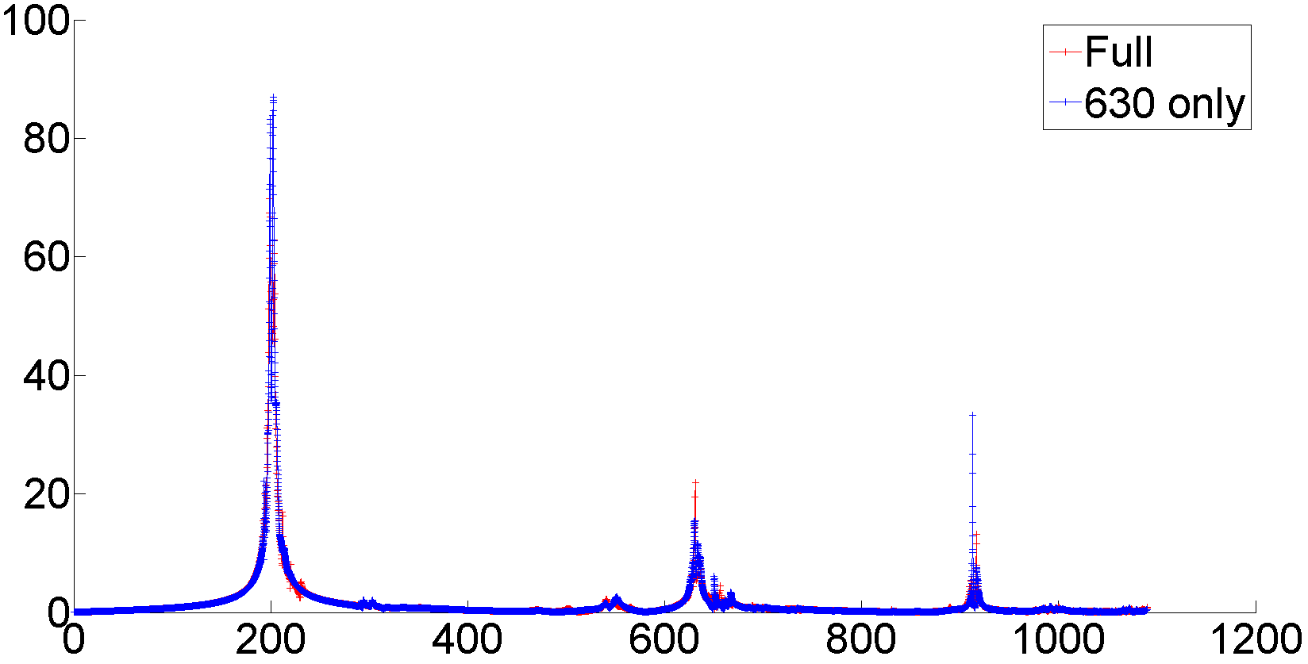
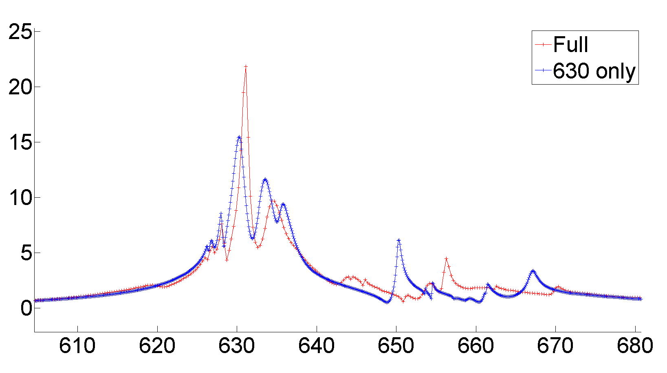
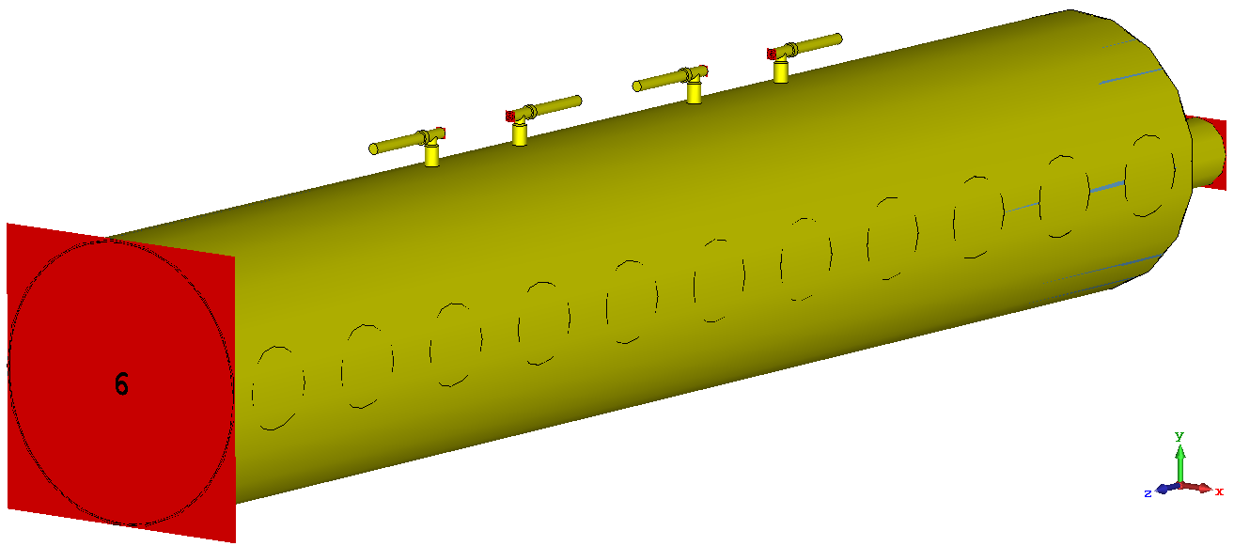
Effect of 938 MHz transverse HOM coupler
CST simulations show an enhancement of longitudinal HOM impedances due to installation of the transverse 938 MHz HOM coupler.
914 MHz is modified by a factor 6.6 and 630 MHz by 0.68 (keeping R/Q constant).
938 MHz OFF
938 MHz ON
938 MHz OFF
938 MHz ON
SINGLE SECTION
Courtesy T. Roggen

Slide 12
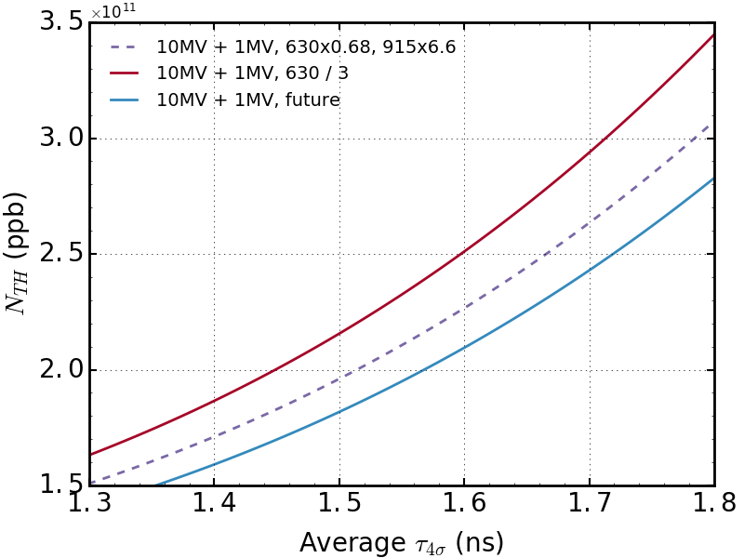
Effect of 938 MHz HOM transverse coupler
Removing the load on the 938 MHz transverse coupler increases the longitudinal stability threshold by almost 10%.

Slide 13
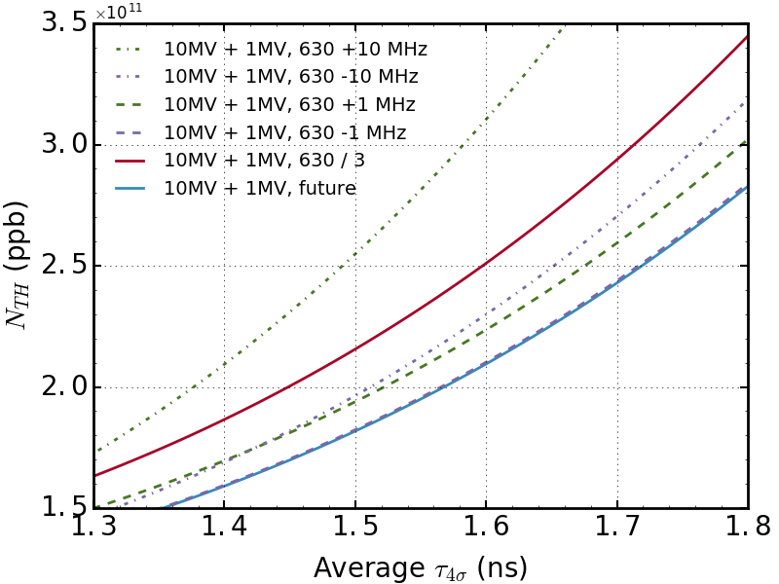
Shifting of 630 MHz HOM
From spreading simulations → positive frequency shift seems more favorable.
Possibility of shifting 630 MHz peak as a whole has been studied.
-1 MHz: same stability.
+1 MHz: 7% improvement in stability threshold.
-10 MHz: 11% improvement in stability threshold.
+10 MHz: 50% improvement in stability threshold.
$f_{res}=630$ MHz seems to be the worst case?

Slide 14
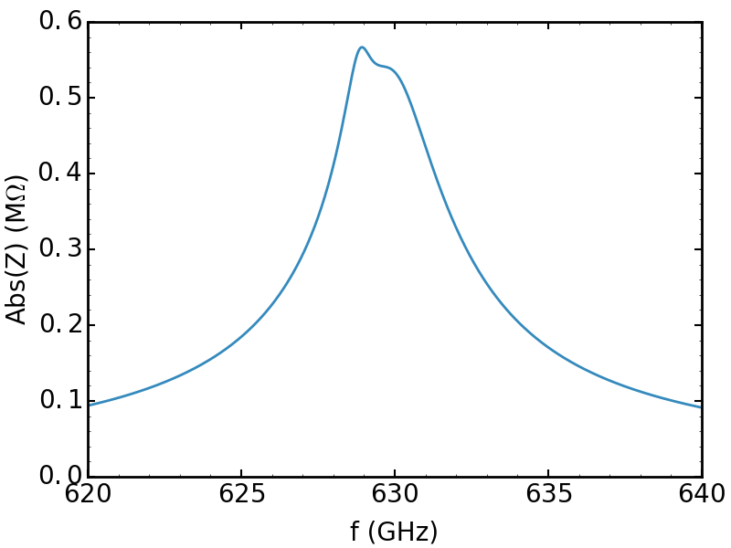
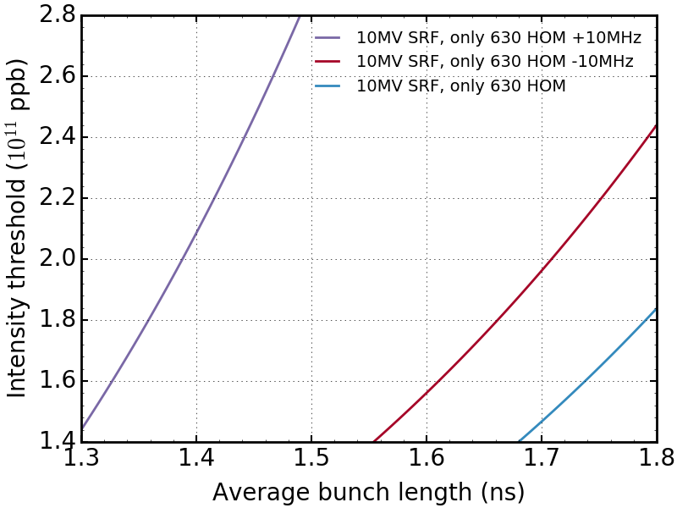
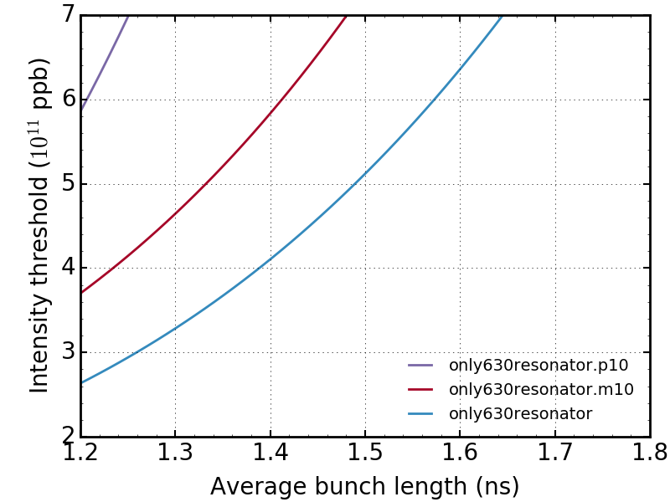
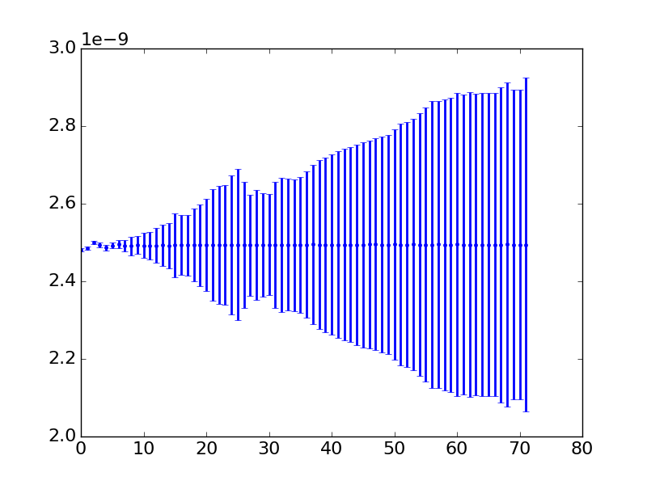
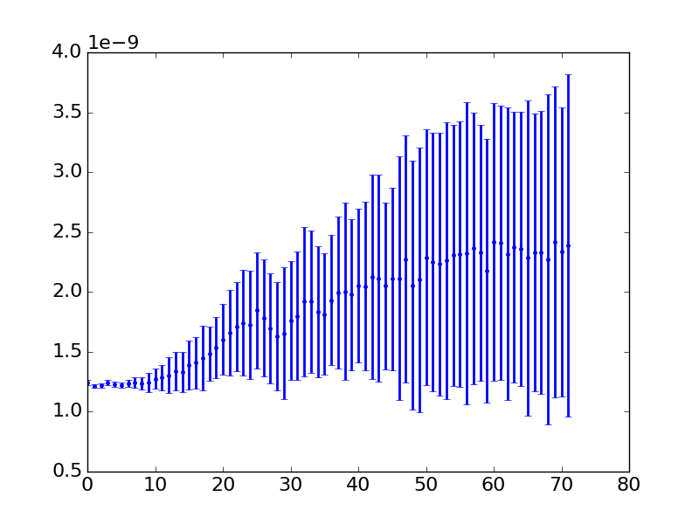
Shifting of 630 MHz HOM (alone)
Narrow down the problem to the impedance contribution around 630 MHz only.
=> Same behavior as for full impedance model in single and double RF.
=> Coupled bunch instability.
+/- 10 MHz
SRF
Bunch position (s)
Bunch length (s)
DRF
# bunch
# bunch

Slide 15
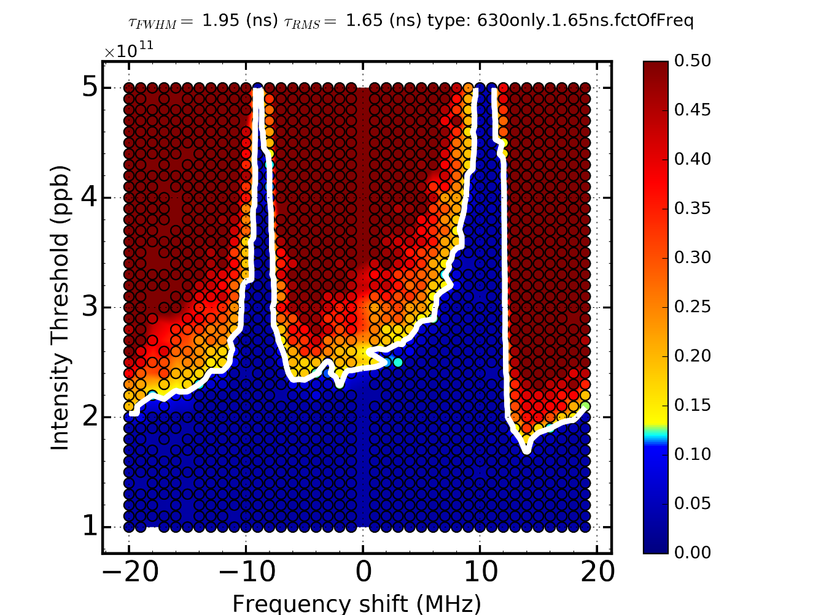
Shifting of 630 MHz HOM (alone)
Colorbar: $max(\frac{τ_{max}−τ_{min}}{τ_{mean}})$
4 sections
fr (GHz) | 0.6289 | 0.6299
Rsh (kOhm) | 40 | 110
Q | 700 | 250
3 sections
fr (GHz) | 0.6289 | 0.6299
Rsh (kOhm) | 24 | 66
Q | 420 | 150
630 MHz
SRF

Slide 16
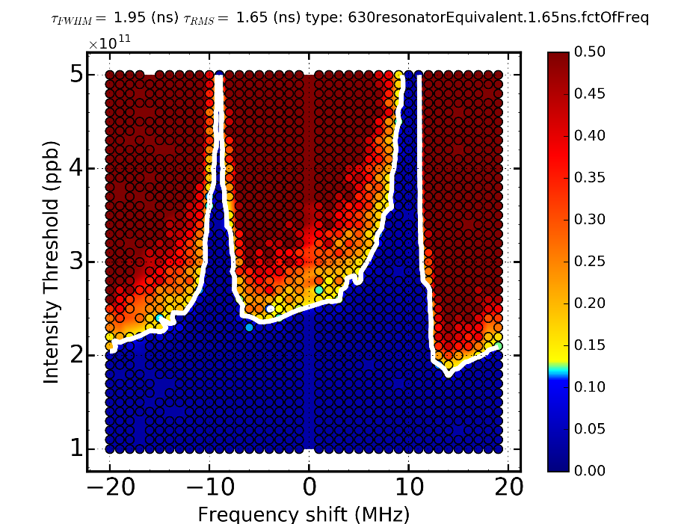
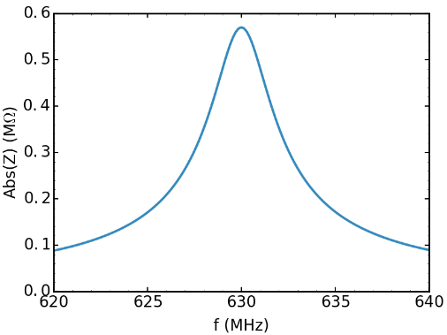
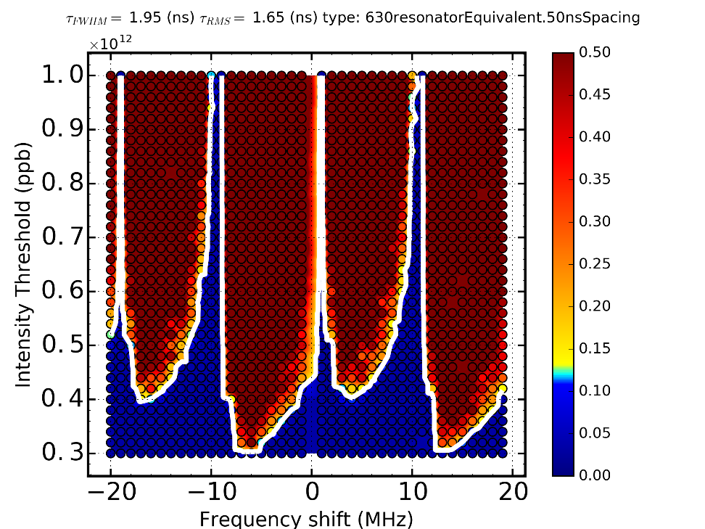
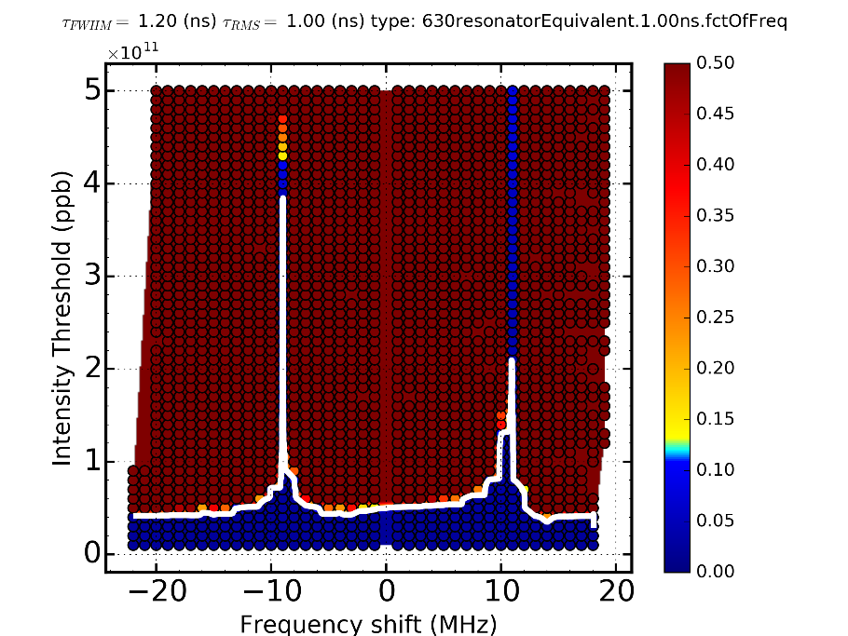
Shifting of 630 MHz HOM (alone): different bunch spacings in 1 RF
Only one resonator
fr (GHz) | 0.630
Rsh (kOhm) | 570
Q | 200
50 ns spacing
25 ns spacing
SRF

Slide 17
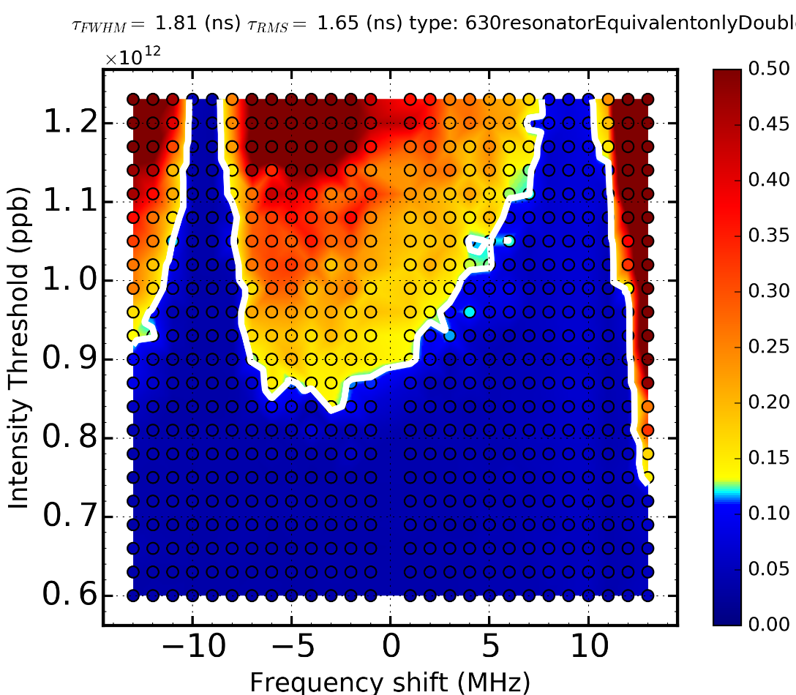
Shifting of 630 MHz HOM (alone): double RF
25 ns spacing
Only one resonator
fr (GHz) | 0.630
Rsh (kOhm) | 570
Q | 200
DRF

Slide 18
Single-macroparticle model
This behavior appears already for a simple «one macroparticle per bunch» model.
…
$$φ_{0}$$
$$φ_{1}$$
$$φ_{2}$$
$$τ$$
$$Δτ_{0}$$
$$Δτ_{1}$$
$$Δτ=Δτ_{0}+Δτ_{1}$$
$$τ_{bb}$$
If only two bunches are coupled, equation of motion for $φ_{1}$:
$$\ddot{φ_{1}}+Ω_{0}φ_{1}=\frac{ηNe}{E_{s}T_{0}}W_{//}\left(τ_{bb}+Δτ\right)=\frac{ηNe}{E_{s}T_{0}}{(W}_{//}\left(τ_{bb}\right)+{W′}_{//}\left(τ_{bb}\right)Δτ+O(Δτ^{2}))$$
Contributes to potential well distortion not multi-bunch dynamics.

Slide 19
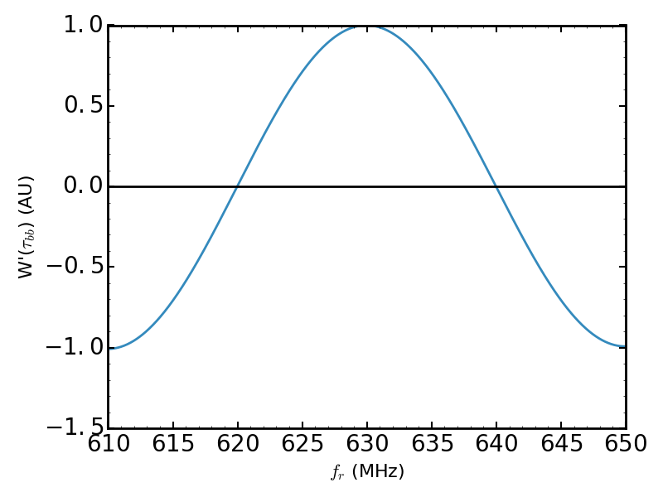
Single-macroparticle model
For a single resonator with $f_{r}, R, Q$, the wake and its derivative can be written:
$$W_{//}\left(τ\right)=2αRe^{−ατ}(\cos{\overline{ω}τ−\frac{α}{\overline{ω}}}\sin{\overline{ω}τ),}$$
${\overline{ω}}^{2}=ω_{r}^{2}(1−\frac{1}{4Q^{2}})$,
$$α=\frac{ω_{r}}{2Q}$$
$$\frac{{W^{′}}_{//}\left(τ\right)}{2α^{2}R}=−e^{−ατ}\sqrt{2^{2}+{\left(\frac{\overline{ω}}{α}−\frac{α}{\overline{ω} }\right)}^{2}}\sin\left(\overline{ω}τ+Δθ\right),$$
$$sin Δθ=\frac{2}{\sqrt{2^{2}+{\left(\frac{\overline{ω}}{α}−\frac{α}{\overline{ω} }\right)}^{2}}}≈\frac{1}{Q}$$
Perfect cancellation when $\sin\left(\overline{ω}τ+Δθ\right)=0$.
$$f_{r}τ_{bb}=\frac{k−\frac{1}{πQ}}{2\sqrt{1−\frac{1}{4Q^{2}}}}, k=1,2,3…$$
$τ_{bb}=25$ ns
With
$f_{r}≈k×20$ MHz
$Q=200$

Slide 20
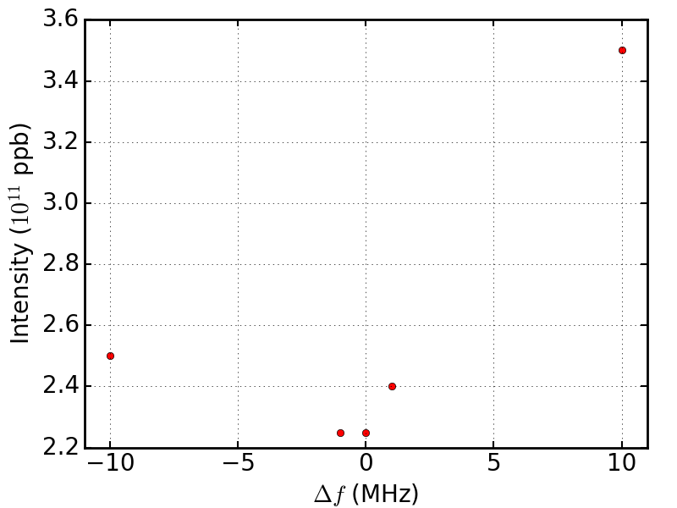
Conclusion and future work
This simple model predicts no instability every 20 MHz and a maximum effect of the wakefield in between, but symmetrically.
This behavior is also observed with complete SPS impedance model (post LS2) and long bunches
Ongoing study to understand the threshold asymmetry and possible cure for the instability.
Take into account multi-bunch interactions.
Take into account bunch distribution.
1.65 ns bunch length

Slide 21
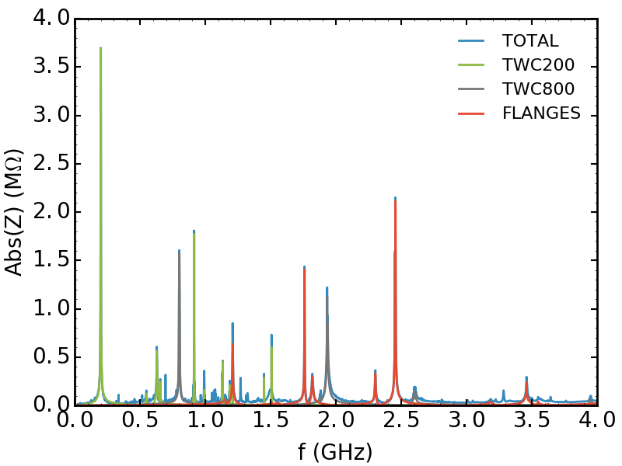
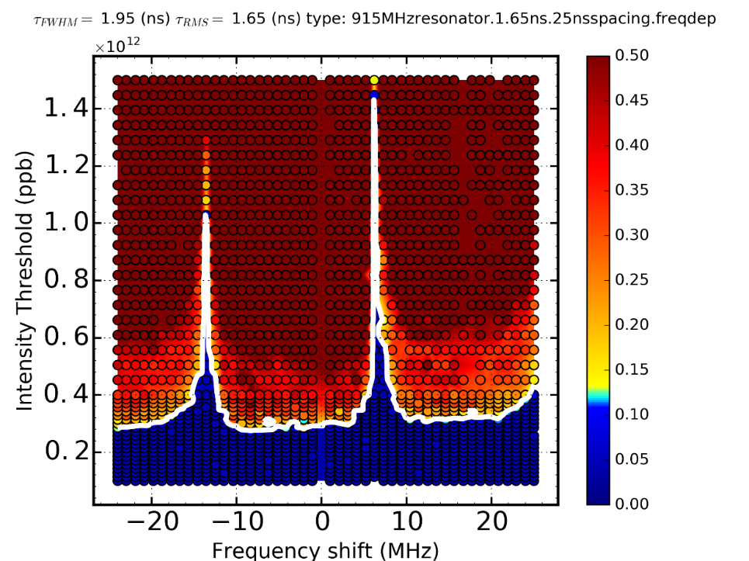
Conclusion and future work
Still valid at higher frequency?
Raise a new question about the impedance model:
Following the prediction: 1.51 GHz is less favorable than 1.52 GHz.
How accurate are the resonant frequencies from measurements and wakefield/eigenmode simulations?
Above which frequency the microwave instability dominates?
Fr (GHz) | 0.915
Rs (kOhm) | 570
Q | 200
25ns spacing, SRF

Slide 22
Conclusion and future work
Spreading of 630 MHz HOM:
Larger spread gives better stability.
Move to positive value is more favorable.
Possible to recover the damping by a factor 3 with a few MHz spread.
Removing 938 MHz transverse coupler:
Increases the stability threshold by 10%.
Shift the peaks as a whole:
Zero growth rate every 20 MHz.
Single-macroparticle model exhibits this behavior.
Study ongoing to explain the asymmetry.
Accuracy of high resonant frequencies should be assess.
Study threshold for microwave instability.

Slide 23
Thank you for your attention.
Acknowledgements
Thank to R. Calaga to have suggested this study.
Thank to the BLonD team for countless fruitful discussions along with constant developments and improvements of the BLonD code.

Slide 24
Backup slides

Slide 25
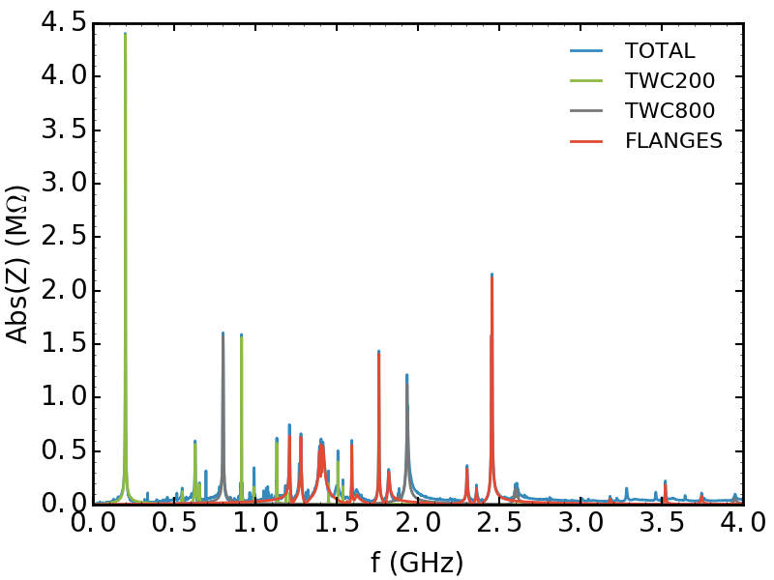
SPS IMPEDANCE MODEL
PRESENT
FUTURE

Slide 26
TWC 200 MHz impedance
Two 4 tank 200 MHz Cavities
Two 5 tank 200 MHz Cavities
fr [GHz] | Rsh [kOhm] | Q | R/Q [Ohm]
0.1997 | 850 | 450 | 1888. 9
0.2003 | 2060 | 400 | 5150
0.201 | 850 | 425 | 2000
0.6289 | 80 | 700 | 114.3
0.6299 | 220 | 250 | 880
0.914 | 770 | 5000 | 154
0.9148 | 772 | 5000 | 154.4
1.1319 | 132 | 4000 | 33
1.1331 | 156 | 5000 | 31.2
1.1335 | 160 | 5000 | 32
1.5073 | 174 | 8000 | 21.75
1.5076 | 236 | 8000 | 29.5
fr [GHz] | Rsh [kOhm] | Q | R/Q [Ohm]
0.1999 | 600 | 600 | 1000
0.2 | 2400 | 370 | 6486.5
0.2006 | 2200 | 600 | 3666.7
0.6291 | 260 | 300 | 866.7
0.6299 | 140 | 500 | 280
0.9142 | 940 | 4500 | 208.9
0.9148 | 720 | 4500 | 160
1.1317 | 520 | 4000 | 130
1.1332 | 196 | 4500 | 43.6
1.5074 | 240 | 7000 | 34.3
1.5078 | 184 | 7000 | 26.3

Slide 27
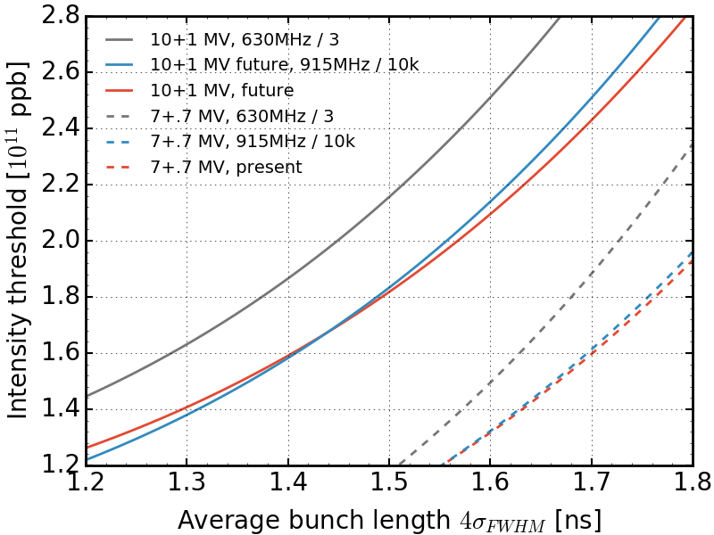
TWC 200 MHz HOMs

Slide 28
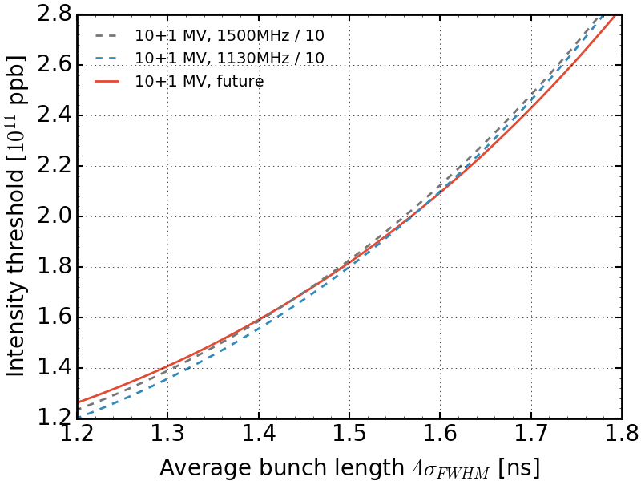
TWC 200 MHz HOMs
Effects of higher HOM negligible

