Slide 1
Status of Vacuum Flange Shielding/
Comparison of RF-shielding Designs
Christine Vollinger, Thomas Kaltenbacher

Slide 2
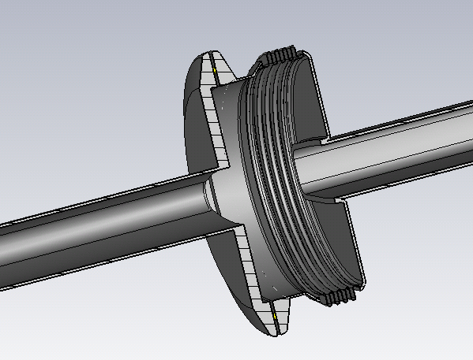
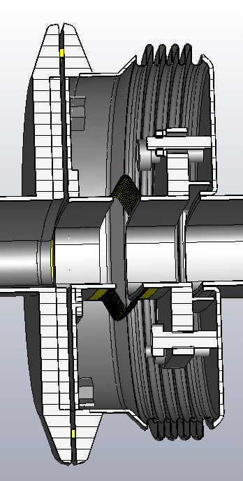
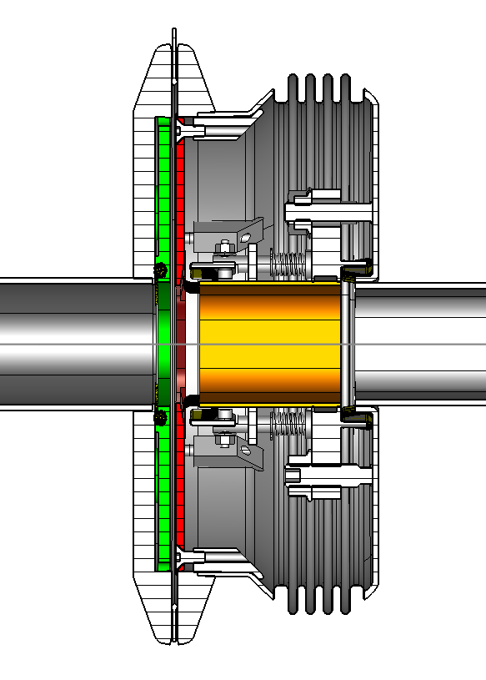
RF-shielding Designs – Recall (1/3)
Unshielded VF
Two shielding designs proposed by TE/VSC:
“double-tube shield”;
“interpolated shield design” → ECR 1709280, currently deployed in EYETS16/17.
gasket
Double-tube shield
Interpolated shield design
gasket
gap filler
fixed RF contact
gap filler
spiral contact
fixed RF contact
Both designs “suffer” from the gasket gap that is not closed.
spiral contact
Fixed RF fingers
MBA beam pipe
MBA beam pipe
moving RF contact
support plate
support plate

Slide 3
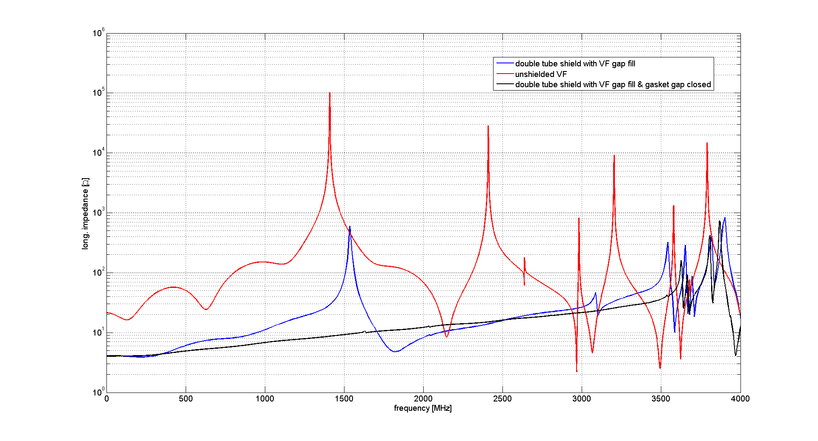
RF-shielding Designs – Recall (2/3)
Both designs “suffer” from the gasket gap that is not closed and causes the remaining resonance at about 1.5 GHz (+/- about 150 MHz).
Results with gasket gap closed.

Slide 4
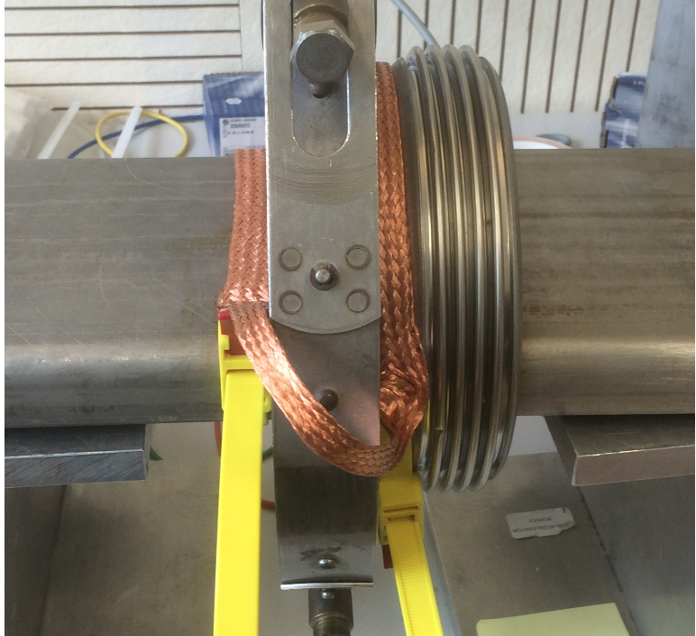
RF-shielding Designs – Recall (3/3)
Both designs show similar behavior for beam impedance, however, the double tube shield is considered to be mechanically more robust.
Only reason why the “interpolated design” is used for EYETS instead of the “double-tube” design was its faster availability, (double tube design availability not even to the level of production drawings);
Since the successful test of the soft-clamps in the SPS → electrical separation is no longer required!
Alternatively, we suggest a “braided” RF-shield;
this should be in team work with TE/VSC (comments/suggestions are welcome & required)!

Slide 5
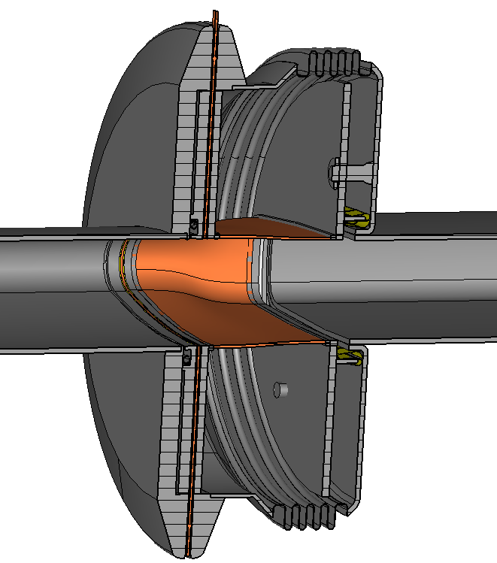
Braided RF-shield for QF/MBA VF
Allows to overcome the shortcomings of the other designs:
  Mechanically robust due to full connection on both ends,
  (!) even if beam pipe shape changes, e.g. QF/MBA VF;
  Closed gasket gap with blank seal equipped with RF-contacts and beam pipe shaped opening.
  Smooth transition between cross-sectional changes with metal braid.
[N. Ogiwara et al., IPAC’13, Shanghai, THPFI014]

Slide 6
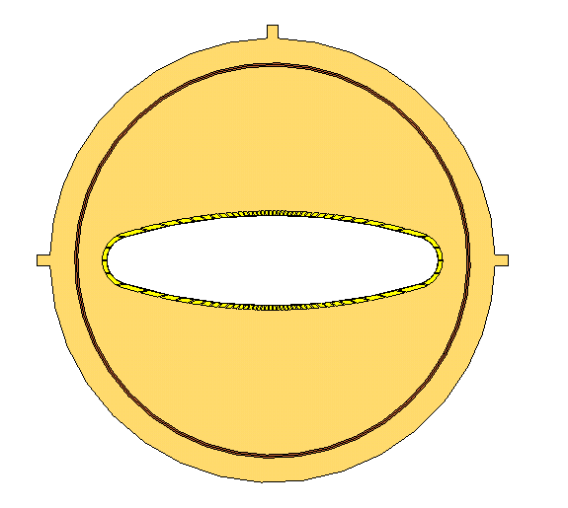
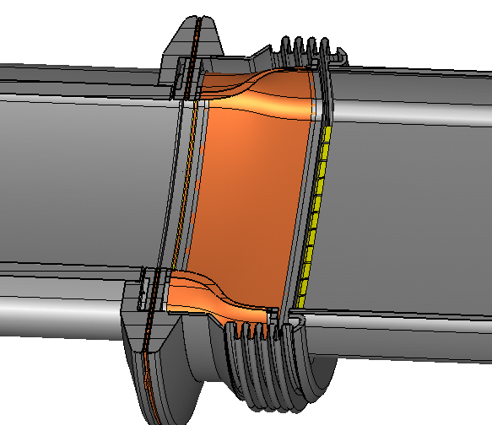
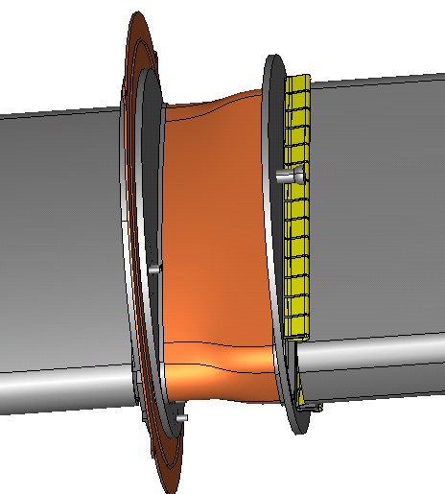
Braided RF-shield for QF/MBA Shield
Fixed RF fingers
Filled gasket with beam-pipe shaped opening and RF-fingers
Flexible but full connected braid for shielding taking “any” shape
AND
allows longitudinal and transverse displacements.
Seen at: Y. Li and X. Liu, presentation as USPAS 2015

Slide 7
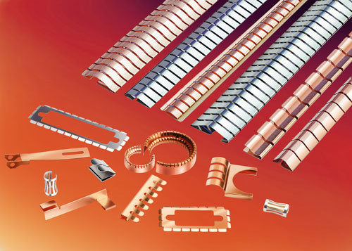
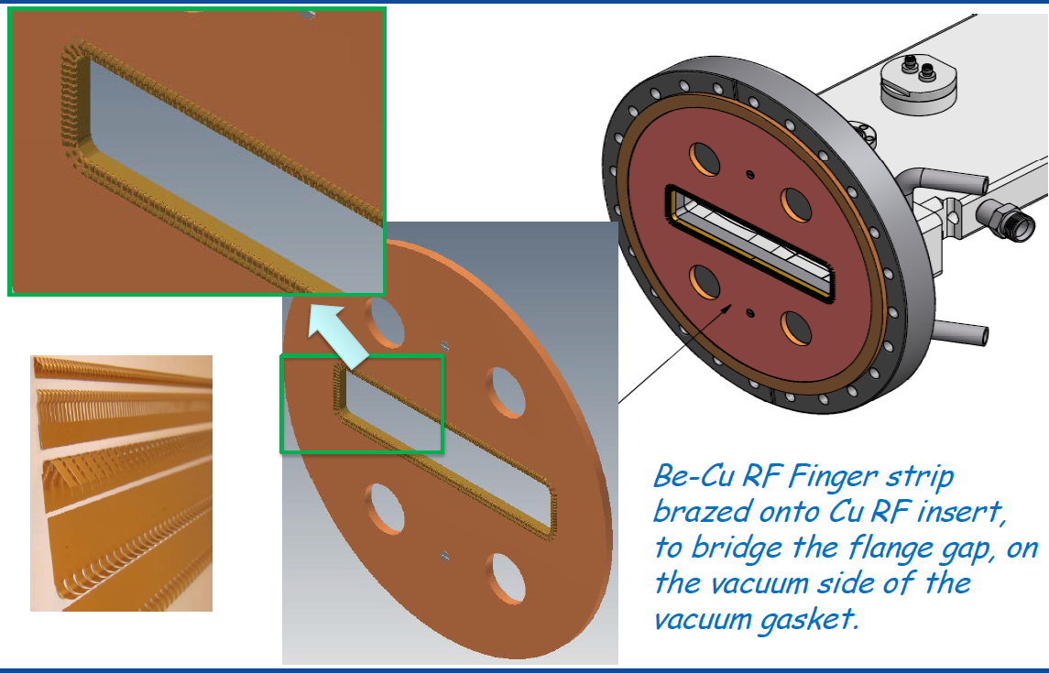
Solution for the Vacuum Gasket
Example of industry-available
RF-spring contacts.
Seen at: Y. Li and X. Liu, presentation as USPAS 2015

Slide 8
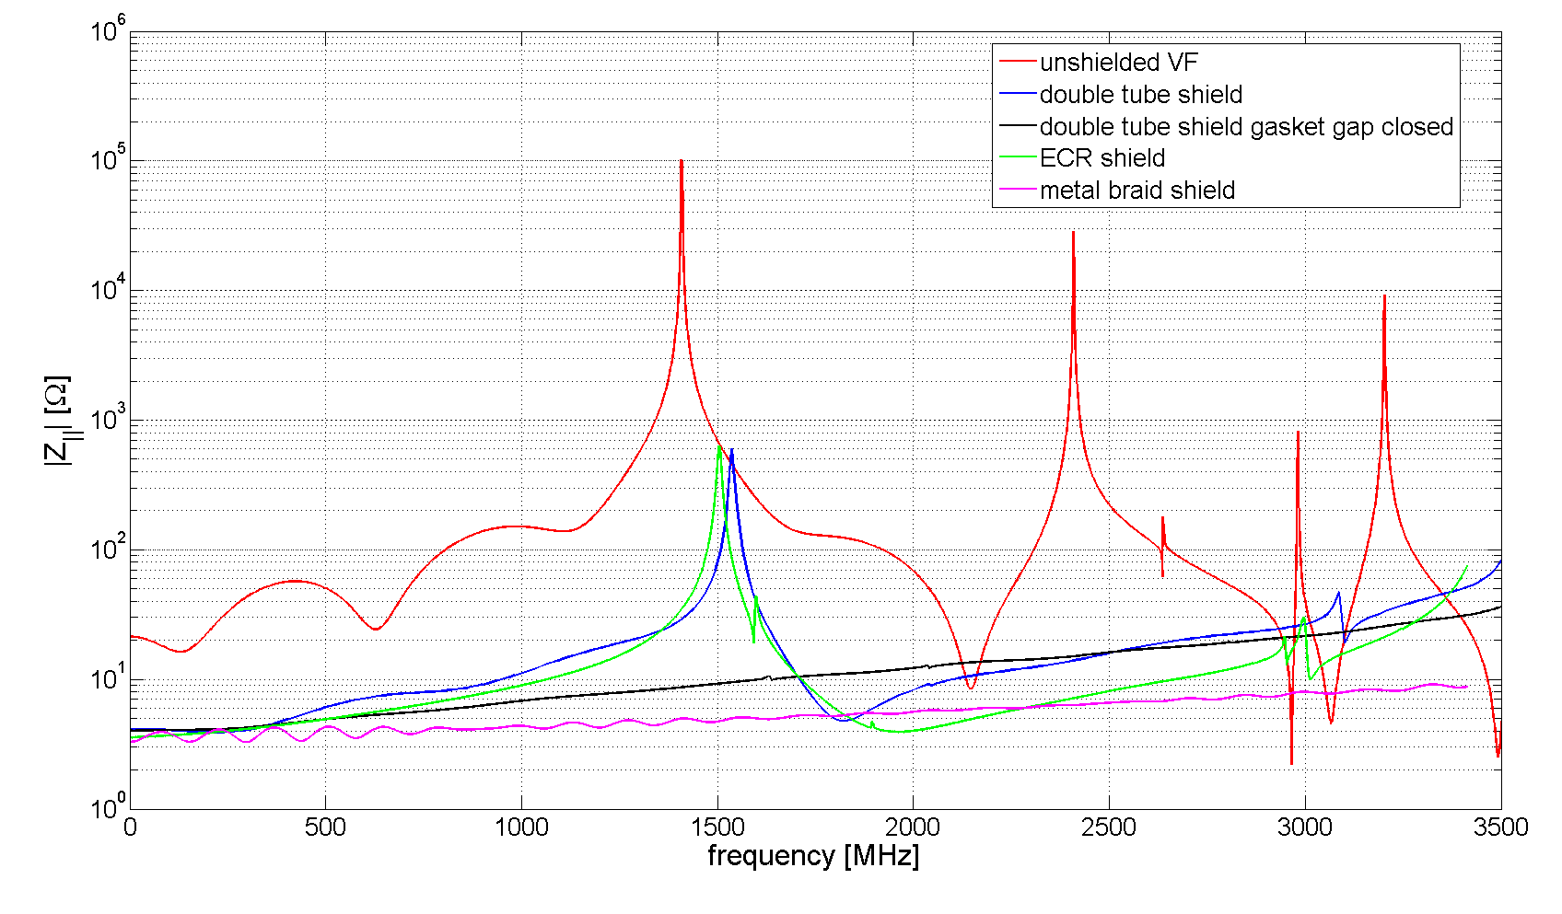
Comparison of Simulated Longitudinal Beam Impedance

Slide 9
Conclusion
Braided shield design was proposed and shows a mechanically robust solution;
Impedance performance is excellent;
Solution was found for gasket gap filler;
We suggest a prototype production that can be measured and evaluated as learning curve (team effort with TE/VSC required).
Many thanks for your attention!

