Slide 1
Preliminary results from the high intensity run --- Observations, longitudinal plan s 19th of October 2017
J. Repond
Acknowledgement: E. Shaposhnikova, T. Bohl, A. Lasheen, G. Papotti, H. Bartosik, H. Damerau, P. Kramer, A. Farricker, OP crew

Slide 2
MD Parameters
9th and 11th of October
No acceleration, 25 GeV
48 bunches: BCMS and 25 ns standard beam
Single and double RF
Low Level RF: PL on, LD on, FB on, FF off
Goals (longitudinal):
Study a beam close to the HL-LHC intensity
Observe behavior of the losses
Stability study

Slide 3
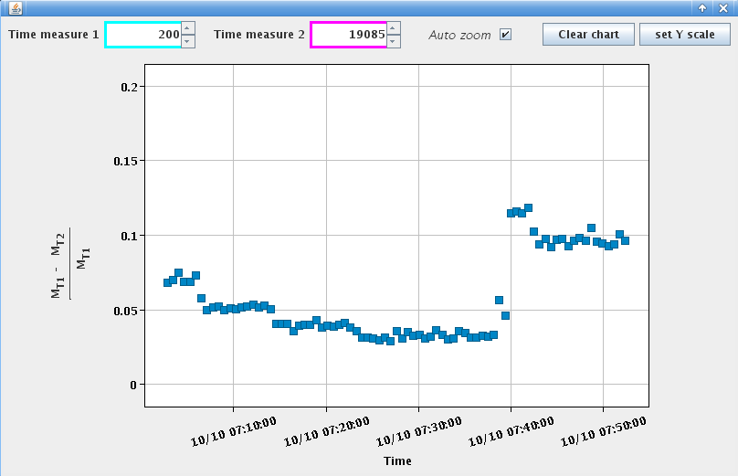
25 ns versus BCMS beam – Losses
Total transmission better with BCMS beam (smaller transverse emittance)
Conditions:
Switch from BCMS to standard beam
Feedback: on
Longitudinal damper: on
Feedforward: off
Single RF
Intensity:
$1.4−1.9×{10}^{11}$ ppb
→ Limitation of momentum aperture

Slide 4
Single-batch – Instability on flat bottom
Average bunch length
Unstable from
very beginning
Emittance
blow-up
Bunch position (middle of batch)
Injected beam,
Intensity:
$2.0×{10}^{11}$ ppb
Injection looks fine
Center of the batch more unstable

Slide 5
Multi-batch – Instability on flat bottom
Observations:
Batch center more unstable
Dipole oscillations
Injection of second batch drives the first one
Bunch 3
Bunch 33
Bunch 39

Slide 6
Multi-batch – Instability on flat bottom
Observations:
Batch center more unstable
Dipole oscillations
Quadrupole oscillations
Injection of second batch drives the first one
Bunch 3
Bunch 33
Bunch 39

Slide 7
Multi-batch – Instability on flat bottom
Observations:
Batch center more unstable
Dipole oscillations
Quadrupole oscillations
Oscillations in stable phase when new batch injected
This is observed for nominal LHC beam as well
Injection of second batch drives the first one
~500ms later

Slide 8
Multi-batch – Instability on flat bottom
Possible causes:
Power limitation (uncompensated beam loading)
Uncaptured beam passing through the first batch
Unexpected behavior of LLRF?
Injection of second batch drives the first one
Courtesy: T. Bohl
~500ms later

Slide 9
Multi-batch – Effect of 800 MHz voltage
$$V_{800}=0.1×V_{200}$$
$$V_{800}=0.15×V_{200}$$
$$V_{800}=0.2×V_{200}$$
Losses?
Landau cavity inefficient on flat bottom, bunches too long
Intensity ~ $1.95×{10}^{11}$
Before injection of third batch
Injected first batch
Hole in the batch?

Slide 10
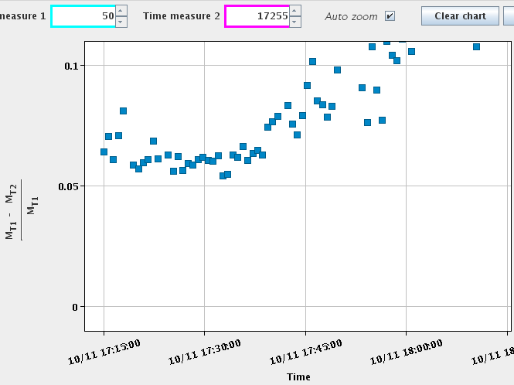
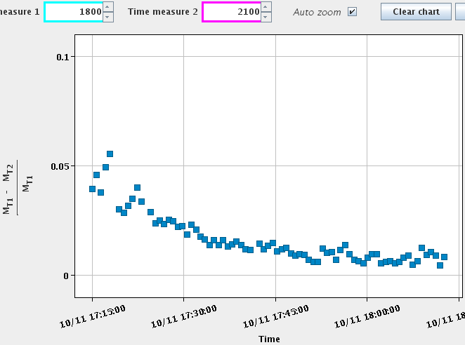
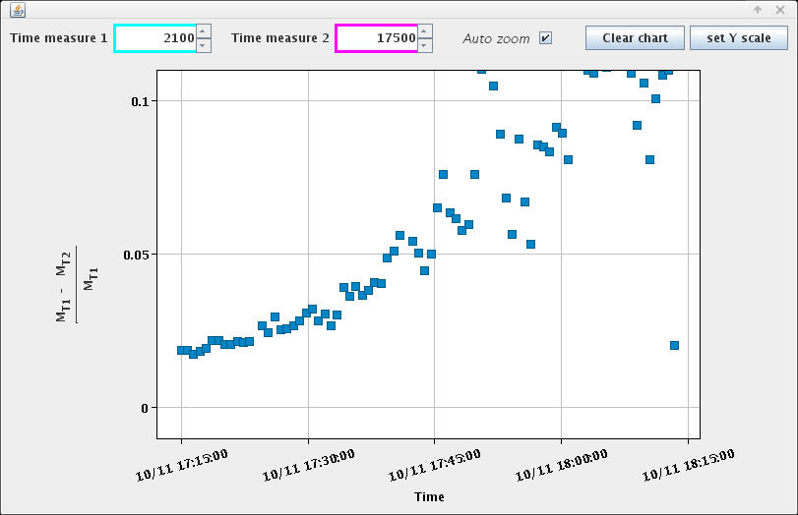
Losses – 1RF, 200 MHz voltage scan
BCMS beam, 48 bunches
Intensity ~ $2.0×{10}^{11}$ ppb
Conditions:
Total losses
Feedback: on
Longitudinal damper: on
Feedforward: off
Constant voltage on flat bottom
/!\ Change in cavities partition
Observations:
3.5 MV
4.5 MV
5.5 MV
6.5 MV
3 MV
4 MV
5 MV
6 MV
7 MV
Best transmission for 4.5-5 MV, overall losses ~ 6-7% (no ramp!)
Increasing bucket area decreases uncaptured beam
Limitation of bunch shape?
Larger voltage increases losses on flat bottom
→ Momentum aperture limitation?
Uncaptured beam
Flat bottom losses

Slide 11
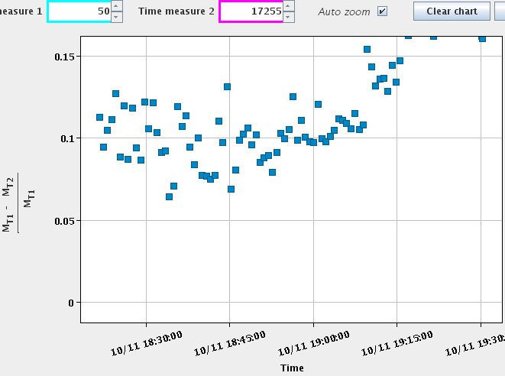
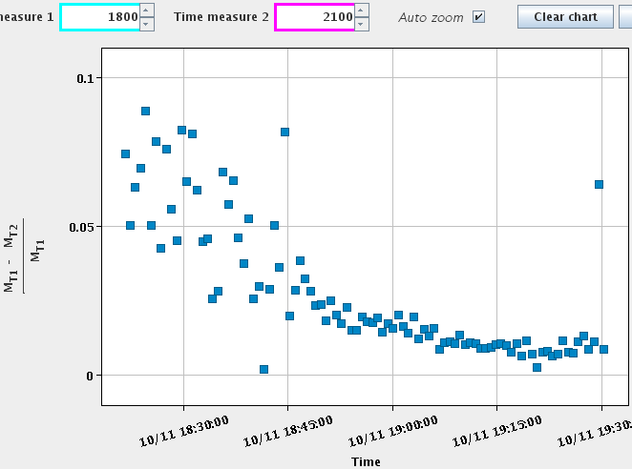
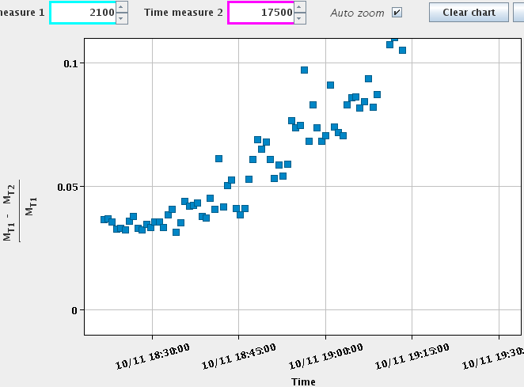
Losses – 2RF, 200 MHz voltage scan
$$V_{800}=0.1×V_{200}$$
BCMS beam, 48 bunches
Intensity ~ $2.0×{10}^{11}$ ppb
Conditions:
Total losses
Feedback on
Longitudinal damper on
Feedforward off
Constant voltage on flat bottom
3.5 MV
4.5 MV
5.5 MV
6.5 MV
3 MV
4 MV
5 MV
6 MV
7 MV
Observations:
Uncaptured beam
Transmission not improved by 800 MHz
No effect of 800 MHz on uncaptured beam
Overall losses higher, ~ 10% (but more scattered)
Flat bottom losses

Slide 12
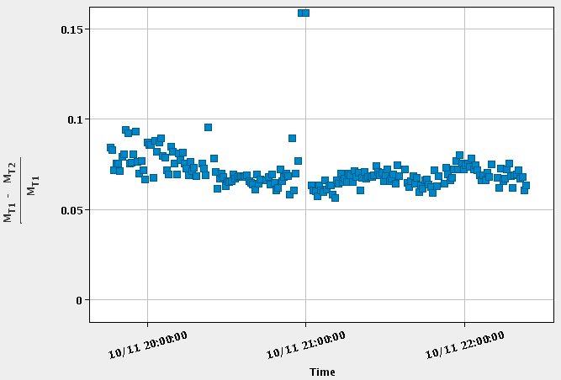
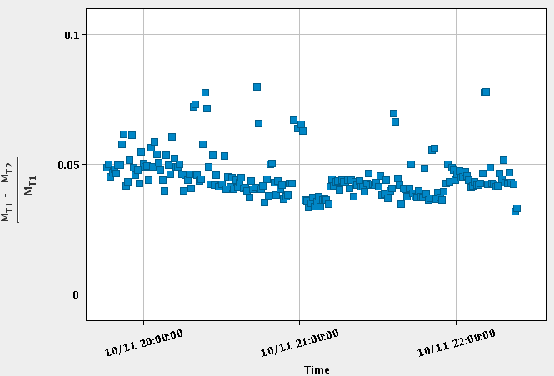
Losses – 800 MHz phase scan
Tilt observed with operational phase of 800 MHz
Total losses
Best transmission for $φ_{800}≈−108°$
Flat bottom losses
Exact bunch shortening mode is not the more stable working point
$Δφ_{800}=45°$ (from operational one) seems better for stability.

Slide 13
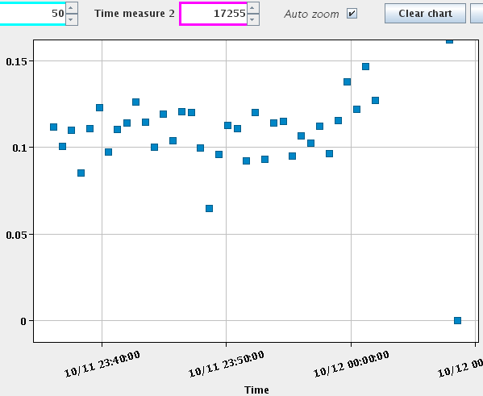
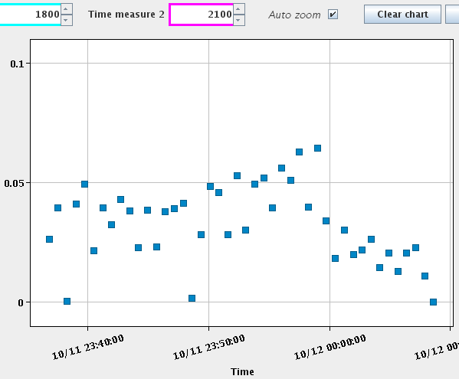
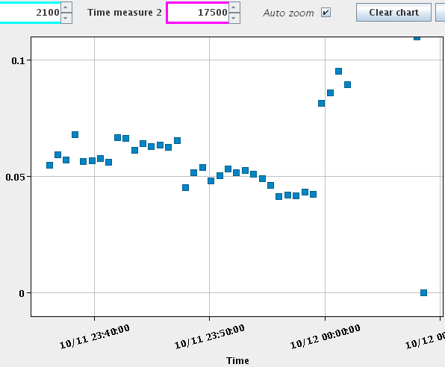
Losses – 2RF, 200 MHz voltage scan with optimal $φ_{800}$
$$V_{800}=0.1×V_{200}$$
25 ns beam 48 bunches
Intensity ~ $2.0×{10}^{11}$ ppb
Conditions:
Total losses
Feedback on
Longitudinal damper on
Feedforward off
Constant voltage on flat bottom
4.5 MV
5 MV
4 MV
3 MV
6 MV
7 MV
Observations:
Uncaptured beam
Transmissions similar to BCMS with 2RF
→ More points would be needed due to the big scattering observed
Uncaptured beam decreases with higher voltage
Flat bottom losses decreases with voltage
Flat bottom losses

Slide 14
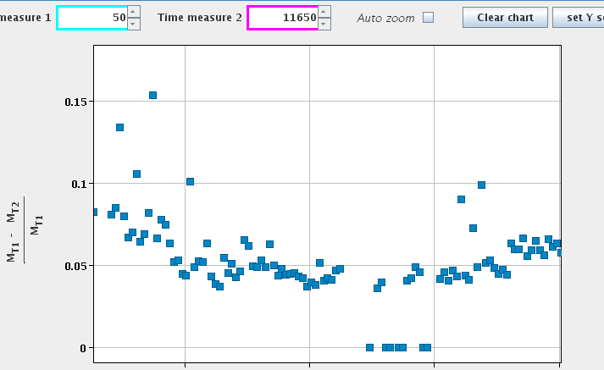
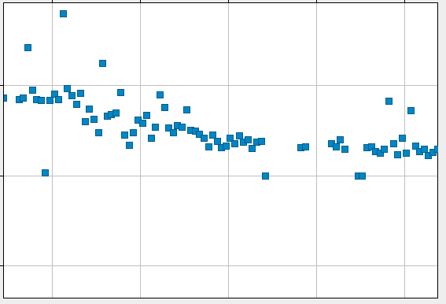
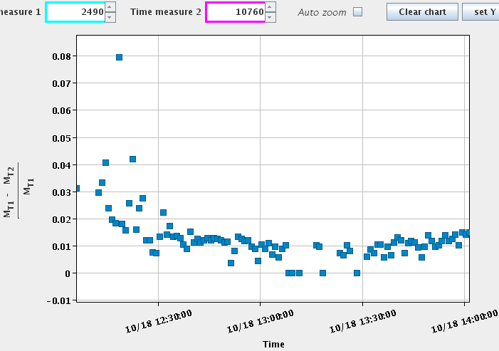
Q20 vs Q22 MD – Q22 1RF, 200 MHz voltage scan
BCMS beam, 48 bunches, Q22
Intensity ~ $1.35×{10}^{11}$ ppb
Total losses (ramp)
Conditions:
Feedback on
Longitudinal damper on
Feedforward off
Constant voltage on flat bottom
Single RF
5%
Uncaptured beam
0%
2.5 MV
2 MV
3.5 MV
4.5 MV
5.5 MV
3 MV
4 MV
5 MV
6 MV
Observations:
Best transmission $V_{200}=4$ MV (scaling from Q20 for same bucket area gives 3.6 MV)
Flat bottom losses

Slide 15
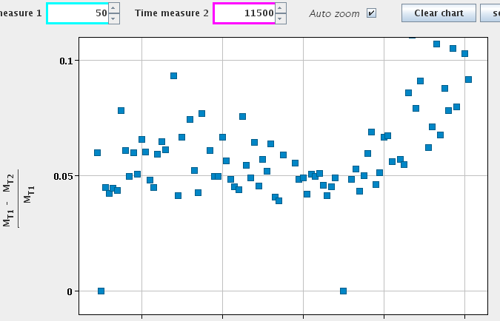
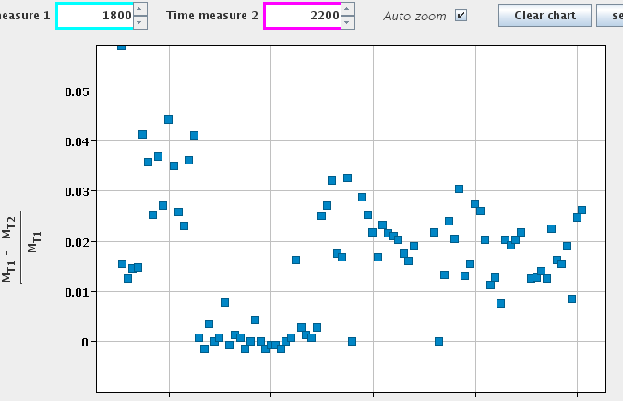
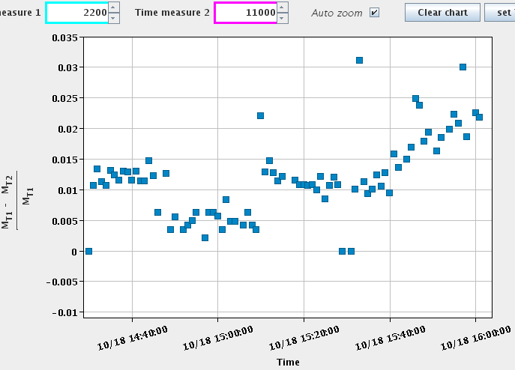
Q20 vs Q22 MD – Q20 1RF, 200 MHz voltage scan
BCMS beam, 48 bunches, Q20
Intensity ~ $1.35×{10}^{11}$ ppb
Total losses (ramp)
Conditions:
3 MV
3.5 MV
4.5 MV
6 MV
4 MV
5 MV
7 MV
Feedback on
Longitudinal damper on
Feedforward off
Constant voltage on flat bottom
Single RF
Power limitation observed
No tune kicker
Uncaptured beam
Observations:
Single RF, best transmission $V_{200}=4.5$ MV
Flat bottom losses

Slide 16
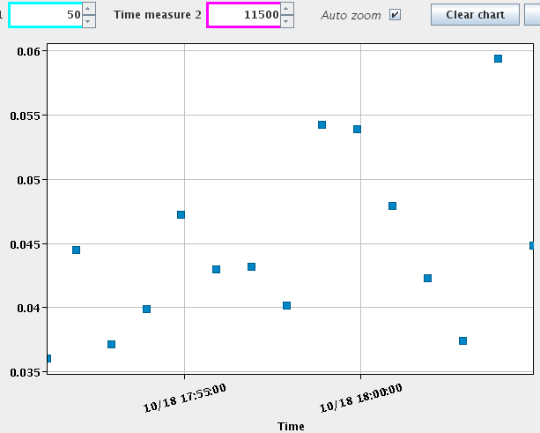
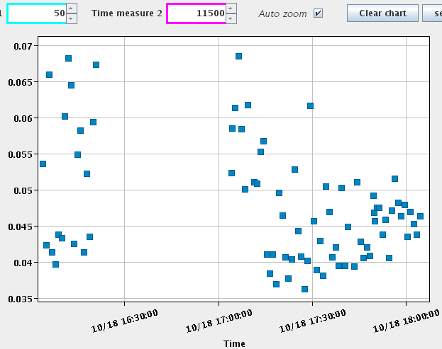
Q20 vs Q22 MD – total transmission, FF,LD,2RF
BCMS beam, Q20
V200 = 4.5MV
Intensity ~ $1.35×{10}^{11}$ ppb
BCMS beam, Q22
V200 = 4.0MV
Intensity ~ $1.35×{10}^{11}$ ppb
2RF, FF off, LD off
1RF, FF off, LD off
1RF, FF off, LD off
2RF, FF off, LD on
1RF, FF off, LD on
2RF, FF off, LD on
1RF, FF on, LD on
2RF, FF off, LD on
/!\ change in
voltage partition
2RF, FF off,
LD on,
PL shifted
2RF, FF off, LD on
→ Not enough statistics
LD improves transmission by 30%
No effect of FF on losses was observed

Slide 17
Conclusion and future work
Losses
1RF: Losses smaller with BCMS beam
2RF: Similar transmission but big scattering between points
Limitation in momentum aperture along flat bottom
Losses at capture certainly due to bunch shape
Instability
Single-batch: Instability observed on flat bottom for $2×{10}^{11}$ ppb (1.6 looks stable but to be confirmed)
Multi-batch: Coupling between batches, emittance blow-up
Possible causes: LLRF, uncapture beam or power limitation
Second RF not efficient to stabilise on flat bottom
Simulations needed to understand the cause of instability

Slide 18
Thank you for your attention

Slide 19
Backup slides

Slide 20
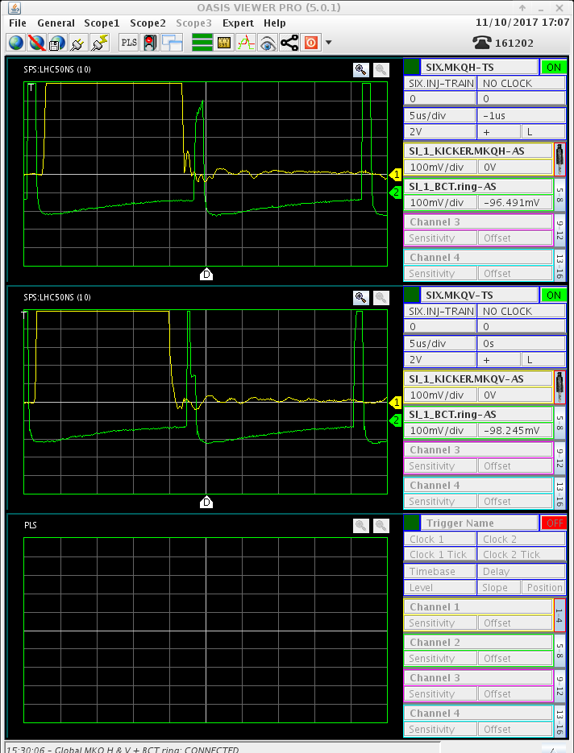
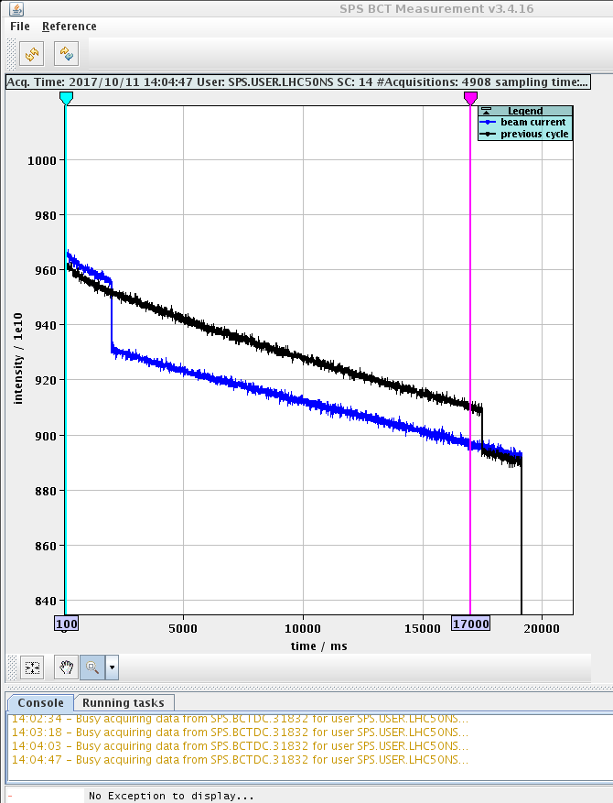
Tune kick

