Slide 1
Future instability thresholds in simulations with beam loading limitation s 17th of August 2017
J. Repond
Acknowledgement: E. Shaposhnikova

Slide 2
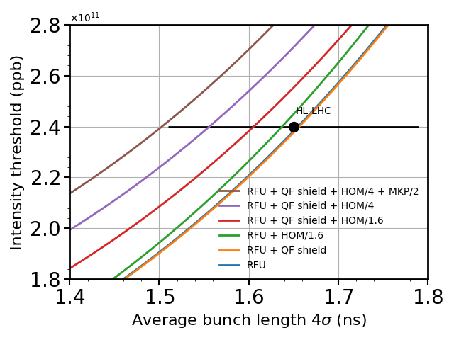
Instability threshold – Previous results
FT simulations: 72b, 25 ns spacing, 2RF: 10MV at 200 MHz, 1MV at 800 MHz
→ Voltage constant with intensity.
→ In reality beam loading reduces the available voltage.
→ Less voltage for high intensity.
RFU = RF upgrade

Slide 3
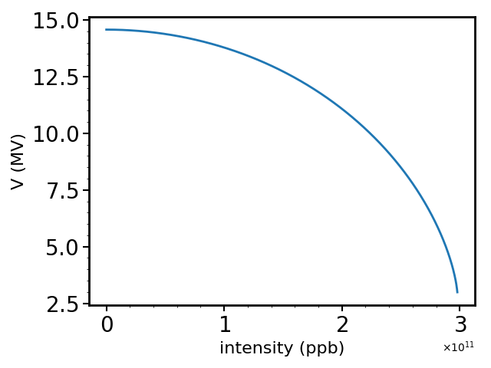
SPS 200 MHz RF system – Power limitation
Limited power available:
if no acceleration and zero $η,$ $P=\frac{V^{2}}{RL^{2}}+{\frac{RL^{2}}{64}I}_{RF}^{2}$, L = cavity length, $R=27.1\frac{kΩ}{m^{2}}$.
Below $2.25×{10}^{11}$ppb: V > 10 MV, above: V < 10 MV.
→ Instability threshold flatter.
→ Larger bunch length will not be as stable as predicted previously.
After RF upgrade
4 sections: 1.6 MW
3 sections: 1.0 MW
$I\left(10MV\right)≈2.25×{10}^{11}$ppb

Slide 4
Simulations scenarios – Post-LS2
Impedance:
QF flange in SSS will be shielded with RF fingers.
HOM damping by factor 1.6 is feasible, factor 3 initial baseline.
Latest results (today): factor 3.3 feasible
Effect of QD shielding simulated but negligible.
Effect of 800 MHz voltage increase simulated (10% of $V_{200}$ if not specified).
Different number of bunches considered (48, 72, 80).
Two different time: 0.5s FT (operation) and 2s (threshold).

Slide 5
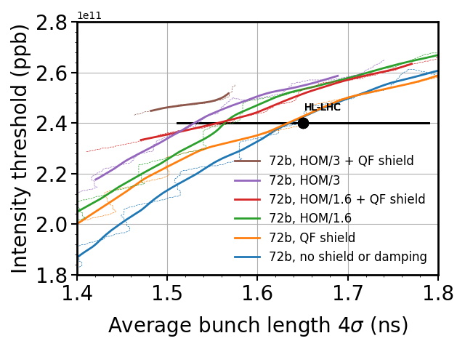
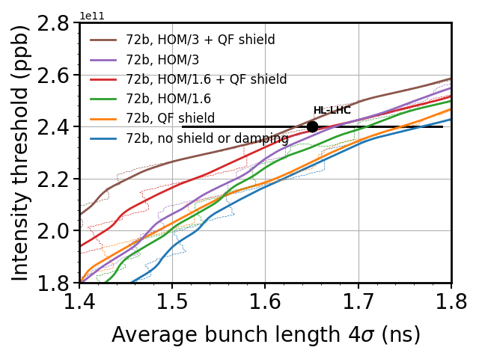
72b power limitation – HOMs damping, QF shielding
Running average on threshold. No fit in $τ^{4}$: voltage varies for each intensity.
Observations:
Threshold flatter at high intensity.
QF shield stabilizing for small bunch length (high freq. impedance > 1.4 GHz).
HOMs and QF threshold close to each other.
Their impedance must be reduced together.
Stable HL-LHC proton batch for nominal FT (0.5s) if HOM/3 + QF shield.
Feasible according to last results.
0.5s
2s

Slide 6
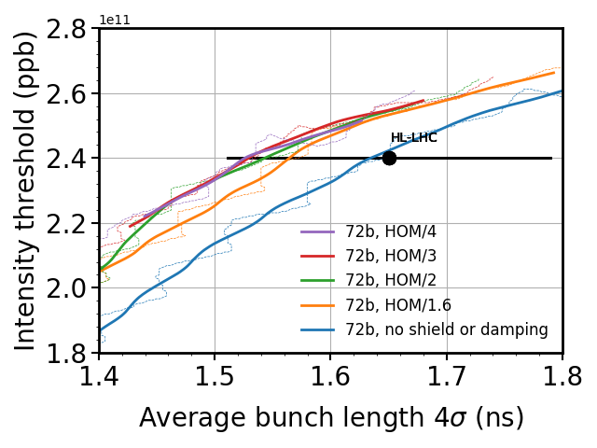
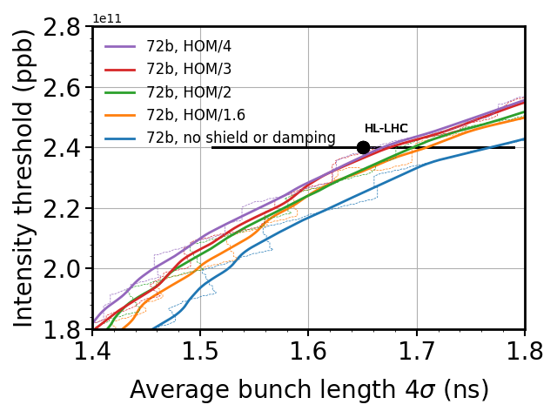
72b power limitation – Effect of HOMs damping
0.5s
2s
Damping of the HOMs until a factor 4 increases the instability threshold.

Slide 7
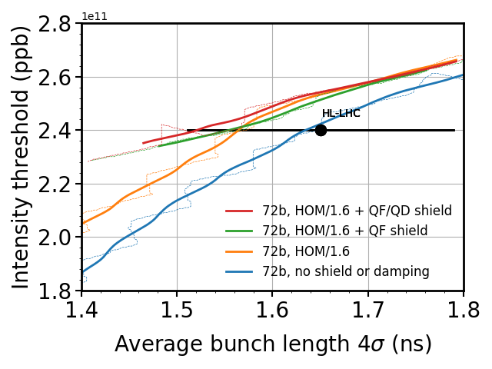
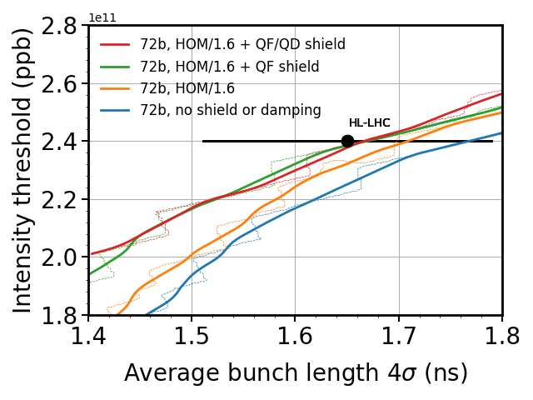
72b power limitation – HOM/1.6 + shield
0.5s
2s
HOM/1.6 + QF shield barely sufficient for the stability of the HL-LHC proton batch with $±8\%$ bunch length discrepancy around 1.65 ns.

Slide 8
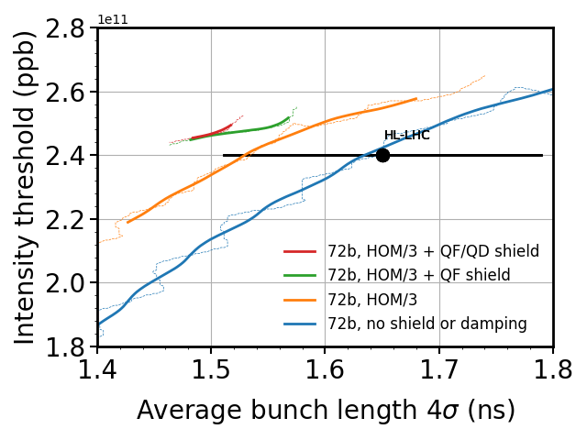
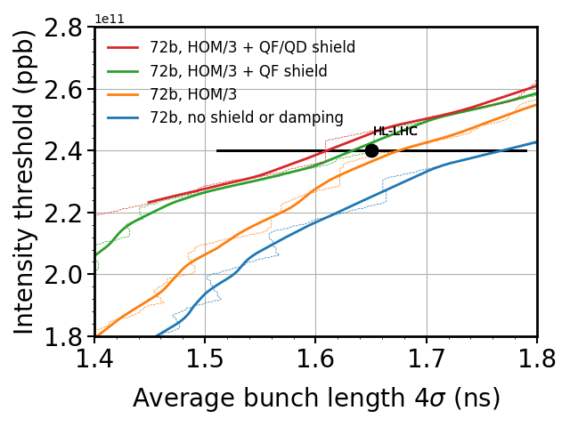
72b power limitation – HOM/3 + shield
0.5s
2s
Stable HL-LHC proton batch with $±8\%$ in bunch length around 1.65 ns for 0.5s FT, HOM/3 + QF shield.

Slide 9
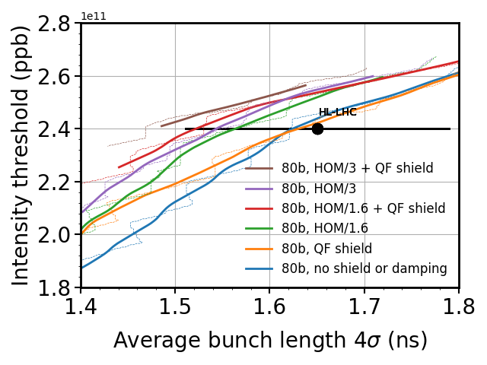
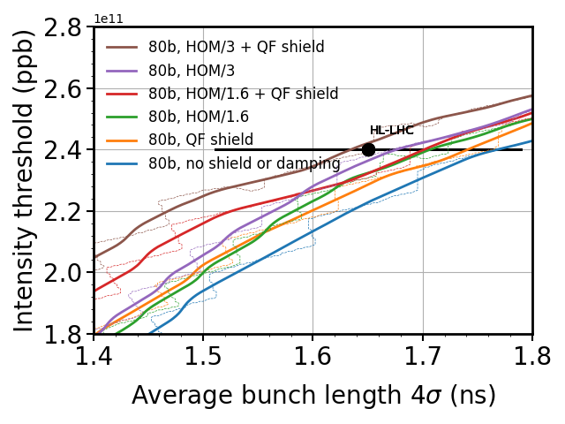
80b power limitation – HOMs damping, QF shielding
A batch of 80 bunches could be used to increase the luminosity in the LHC.
Threshold similar to 72 bunches.
0.5s
2s

Slide 10
80b power limitation – comparison with 72b
2s, 72b
2s, 80b
Instability threshold very similar between 72 and 80 bunches.

Slide 11
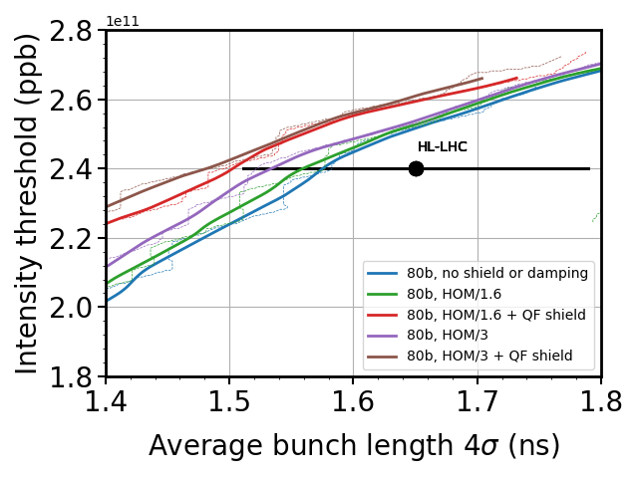
80b power limitation – 800 MHz voltage increase
$$\frac{V_{800}}{V_{200}}=0.15$$
$$\frac{V_{800}}{V_{200}}=0.1$$
2s, 80b
10% increase in stability threshold using 15% instead of 10% of $V_{200}$. Realistic value for future operation.

Slide 12
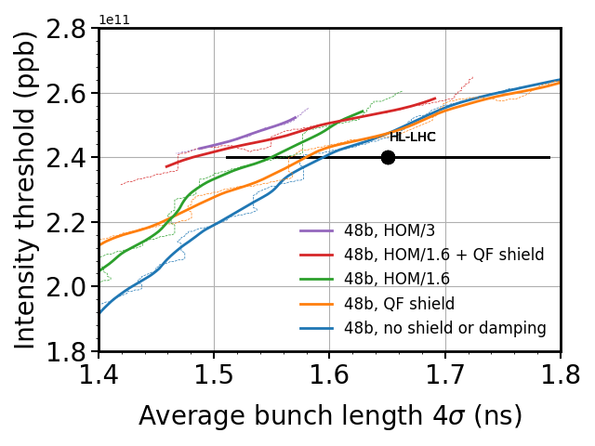
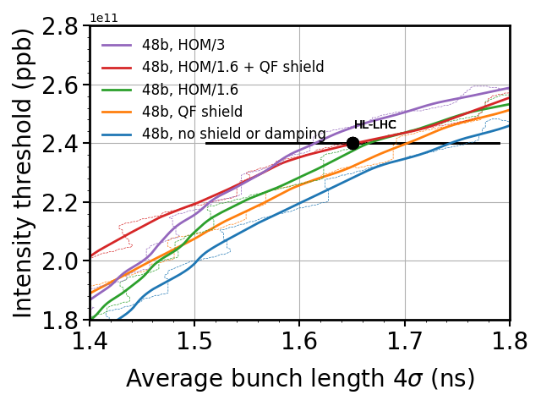
48b power limitation – HOMs damping, QF shielding
Instability threshold for BCMS beam.
0.5s
2s

Slide 13
48b power limitation – comparison with 72b
Only a few percent in intensity threshold between 72 and 48 bunches.
2s, 72b
2s, 48b

Slide 14
Conclusion and future work
Taking into account power limitation flattens the threshold.
Zero voltage above $3×{10}^{11}$ppb.
V < 10 MV for intensities larger than $2.25×{10}^{11}$ppb.
Instability threshold due to HOMs or QF impedance close.
→ Damping of HOMs AND shielding of QF necessary.
Instability threshold for 48/72/80 bunches close to each other (few %).
Negligible gain in stability threshold using BCMS beam.
Damping of HOMs by a factor 3 + QF shield insure the stability of the HL-LHC proton beam for the 0.5 s flat top.
More ongoing simulations:
Fixed $V_{800}$(1MV, 1.5MV)
Multibatch

Slide 15
Thank you for your attention.

Slide 16
Backup slides

