Slide 1
Measured instability thresholds during ramp s 17th of August 2017
J. Repond
Acknowledgement: A. Lasheen, E. Shaposhnikova

Slide 2
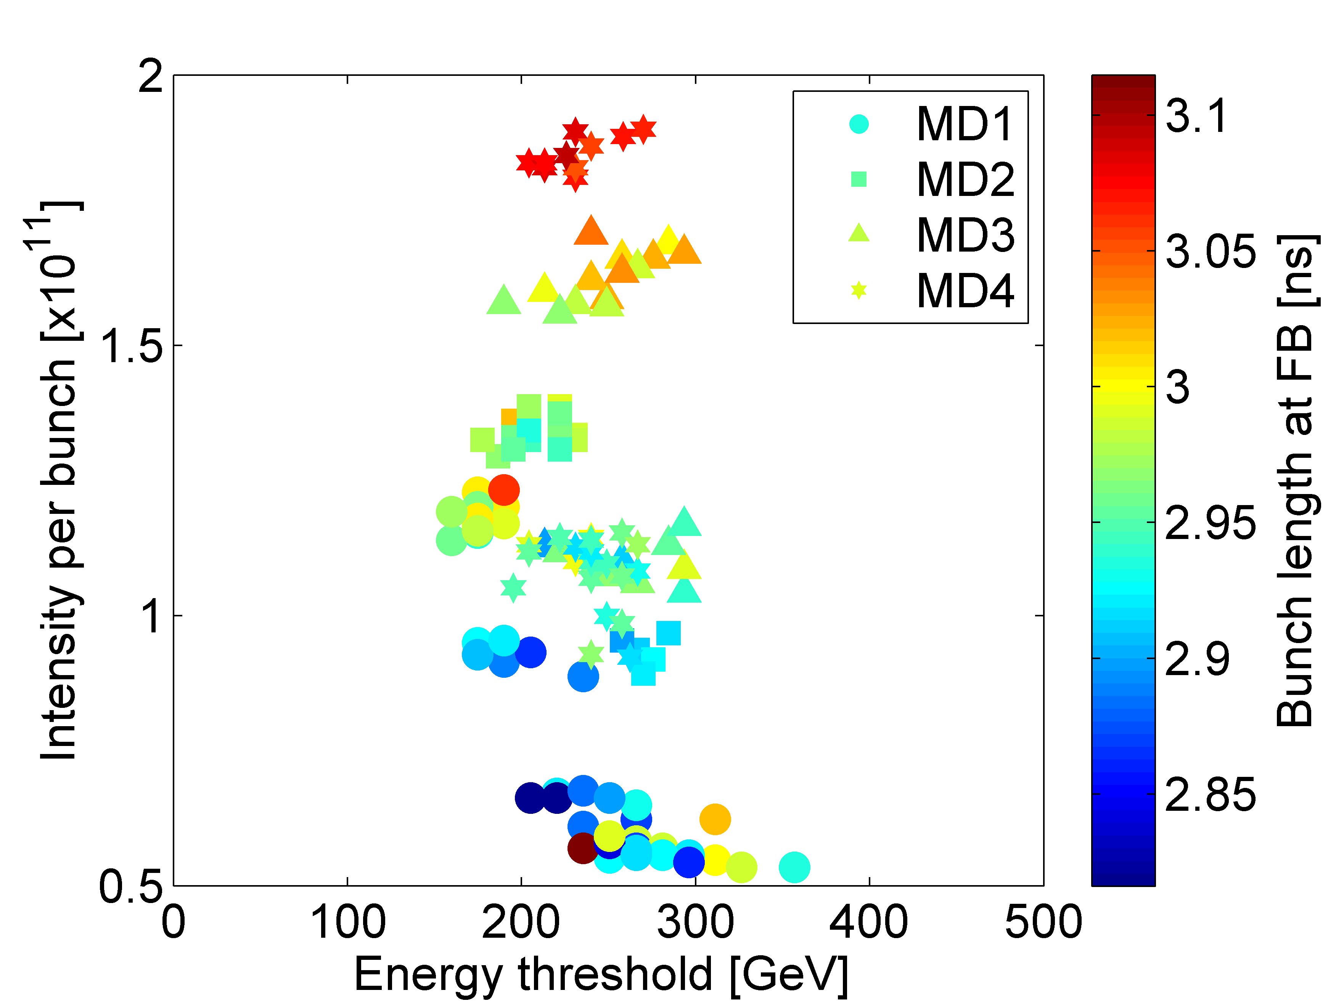
Instability threshold with 12 bunches
Courtesy: T. Argyropoulos

Slide 3
MD Parameters
Dedicated MD: 12th of July 2017
LHC 25ns nominal cycle (Q20)
Single RF
Low Level RF:
Phase loop: ON
Longitudinal damper: ON
Feedforward: OFF
Feedback: ON/OFF
Blow-up: OFF
Batch: 12/24 bunches
Nominal emittance, varying intensity
Goals:
Instability threshold in single RF for 12/24 bunches
Instability threshold in function of energy

Slide 4
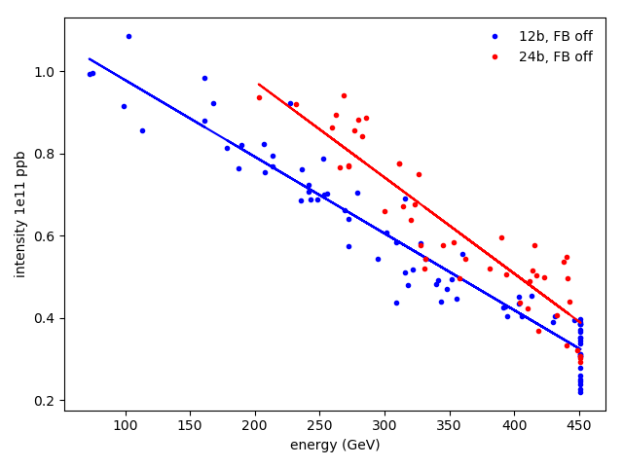
Instability Threshold 12/24 bunches, FB off
Instability threshold minimal at flat top.
24 bunches more stable during ramp?
Intensity threshold on flat top
$I_{th}^{12b}∼0.42×{10}^{11}$ppb, $\overline{τ}∼1.51$ ns
$I_{th}^{24b}∼0.31×{10}^{11}$ppb, $\overline{τ}∼2.18$ ns

Slide 5
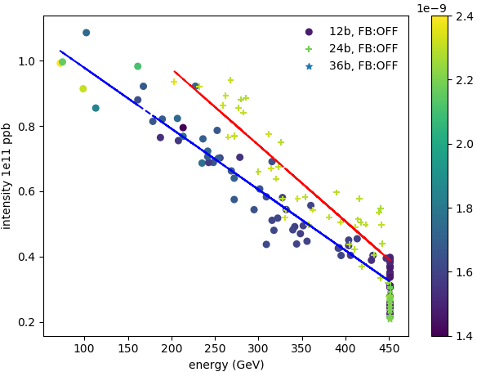
Instability Threshold 12/24 bunches, FB off
Instability threshold minimal at flat top.
Average bunch length
24 bunches more stable during ramp?
Intensity threshold on flat top
$I_{th}^{12b}∼0.42×{10}^{11}$ppb, $\overline{τ}∼1.51$ ns
$I_{th}^{24b}∼0.31×{10}^{11}$ppb, $\overline{τ}∼2.18$ ns
→ Batch of 24b more stable because larger bunch length.
→ Bunch length for 12 bunches smaller due to effect of phase loop.

Slide 6
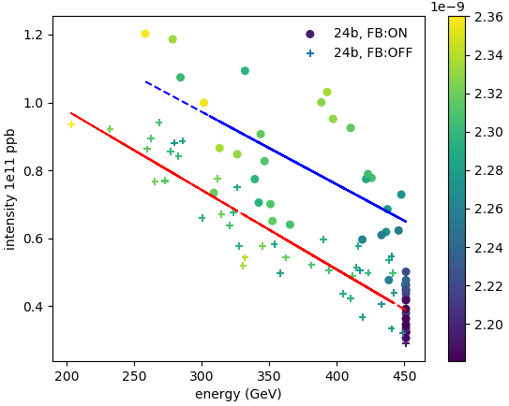
Effect of feedback – 24 bunches
Observation: Instability threshold higher with feedback on.
Average bunch length
Intensity threshold on flat top
$I_{th}^{FB}∼0.42×{10}^{11}$ppb, $\overline{τ}∼2.2$0 ns
$I_{th}^{NoFB}∼0.31×{10}^{11}$ppb, $\overline{τ}∼2.18$ns
200 MHz impedance dominates during acceleration? → Ongoing simulations

Slide 7
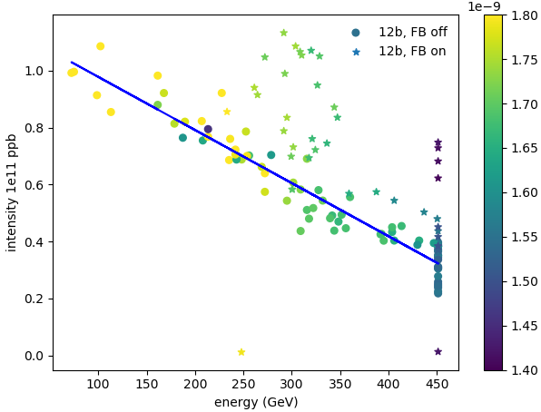
Effect of feedback – 12 bunches
Observation: Like with 24 bunches, higher instability threshold with feedback on.
Average bunch length
Intensity threshold on flat top
$I_{th}^{FB}∼075×{10}^{11}$ppb, $\overline{τ}∼1.42$ns
$I_{th}^{NoFB}∼0.42×{10}^{11}$ppb, $\overline{τ}∼1.51$ns
Measurements with FB on: sharp energy threshold w.r.t. intensity.
Similar to T. Argyropoulos measurements.

Slide 8
Conclusion and future work
Effect of phase loop non-negligeable.
Bunches smaller for a batch of 12 bunches.
Instability threshold higher for 24 bunches.
Instability threshold higher during acceleration with feedback on.
200 MHz impedance seems to dominates during ramp.
Ongoing simulations to confirm this hypothesis.
Dedicated MD next week:
Reproduce 12 bunches, feedback on.
36 bunches instability threshold.

Slide 9
Thank you for your attention.

Slide 10
Backup slides

Slide 11
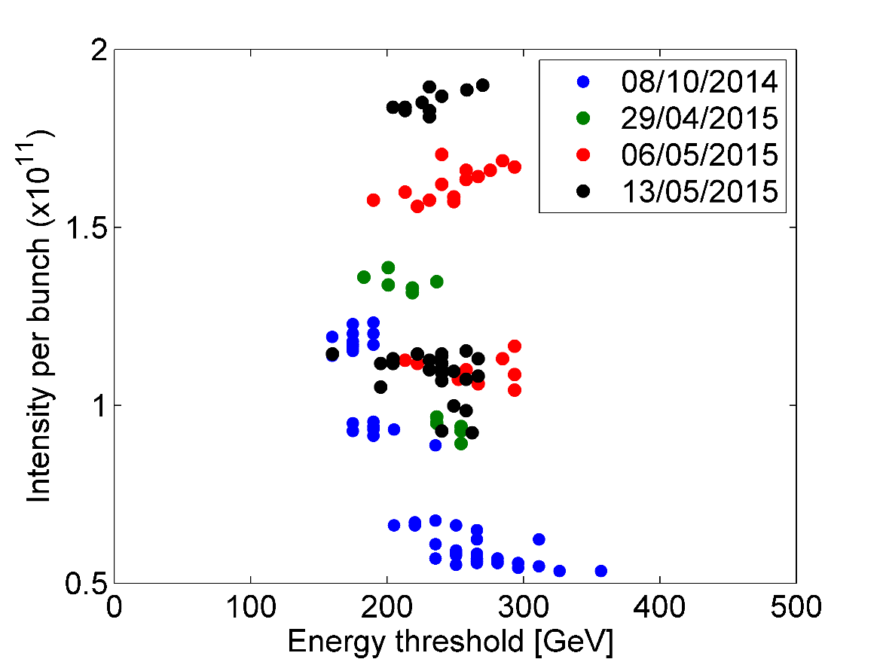
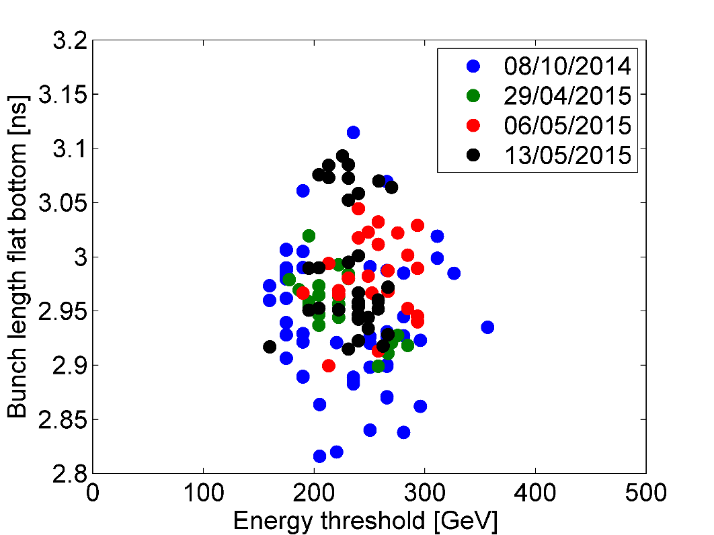
Instability threshold with 12 bunches
Sharp energy threshold with respect to bunch intensity
~6% scatter in bunch length
Courtesy: T. Argyropoulos

Slide 12
Instability threshold with 12 bunches
Courtesy: T. Argyropoulos

