Slide 1
SPS Impedance Model Review Aaron Farricker

Slide 2
Outline
A review of what is currently in the impedance model
What is missing from the model
Strategy for improving the Model
Strategy for improving the SPS impedance

Slide 3
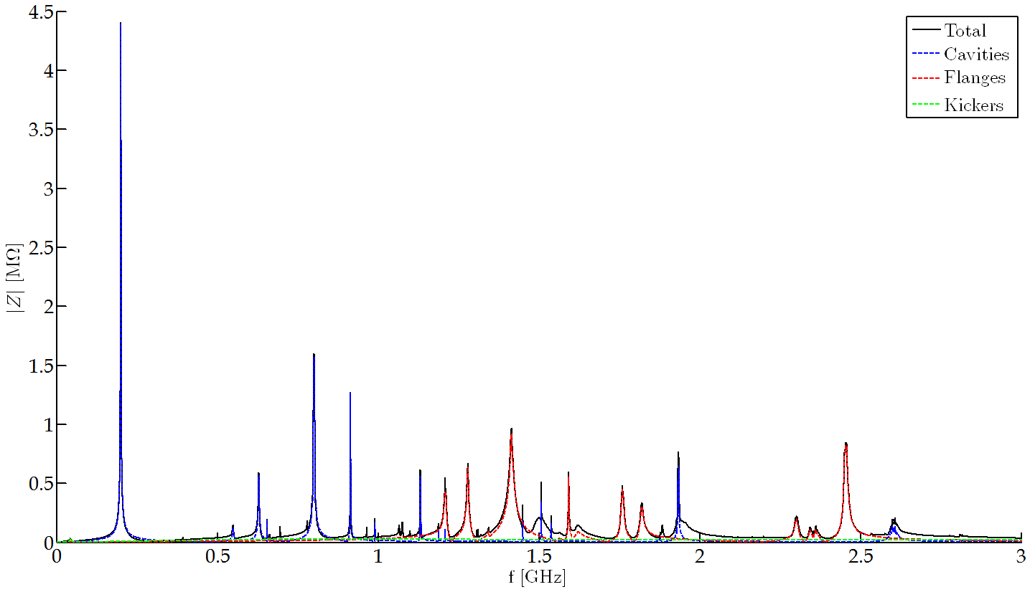
The Current Model
Generally the TW cavities dominate the Impedance particularly at low frequency
The flanges at high frequency
The Kickers provide a broadband impedance
The Current model is a combination of the work carried out by J.Varela and T.Kaltenbacher
Thomas’ work focused on vacuum flanges and the VVSA/B
Jose simulated the major contributors including: Cavities, Kickers and Flanges

Slide 4
What is Missing From the Model?
Currently there are around 900 components included in the model 600 of which are vacuum elements (Flanges and Ports)
Searching the vacuum report suggests there are 1,009 changes in cross-section this means there are significant numbers which may not be included
Beam measurements suggest missing impedance (3 kOhms) at 350 MHz with Q=10

Slide 5
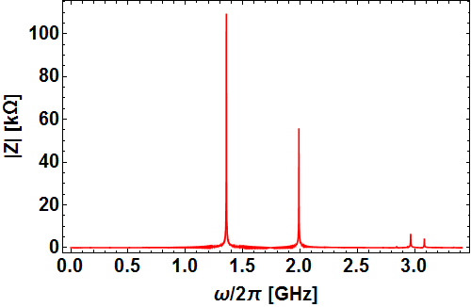
Improving and Expanding the Model
The bulk of the current model is based on J.Varela’s work
This is collated from presentations and data files in the Impedance model
As a result it is not straightforward to identify which elements are already included in the model
For example there are 83 QF-QF transitions via a ten-convolution bellow which doesn’t match with either source
Are some taken into account, all or non?

Slide 6
Improving and Expanding the Model
As the measurements and simulations disagree there is likely missing impedance at low frequency
F=350 MHz, Q=10, R/Q=3 kOhms
What can cause this?
Unlikely to be cause by a purely geometric shape which is unknown due to its wavelength
Therefore its likely to be something which contains material with high permittivity or a port which is unshielded
Such elements require identification and simulation.

Slide 7
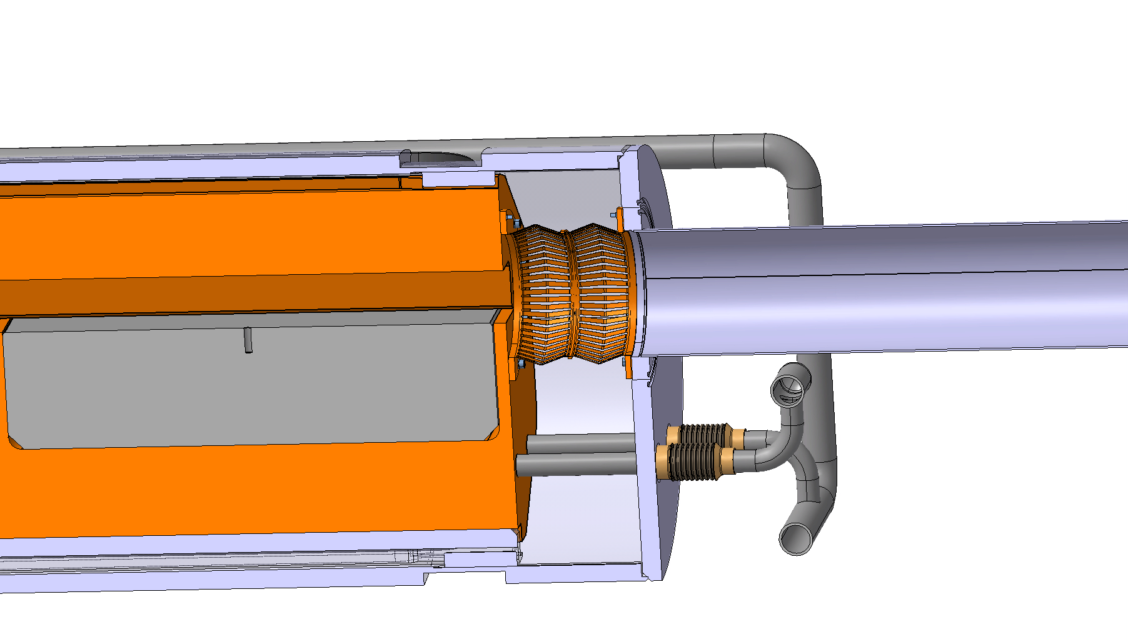
Analysis of New Equipment
M.Wendt et al. IPAC 2017
It is important to minimize the impedance of new equipment installed
Further it is also important to understand its behavior and include it in studies looking forward to the future upgrade
In addition it also presents the opportunity to reduce the impedance of the existing machine
TIDVG5

Slide 8
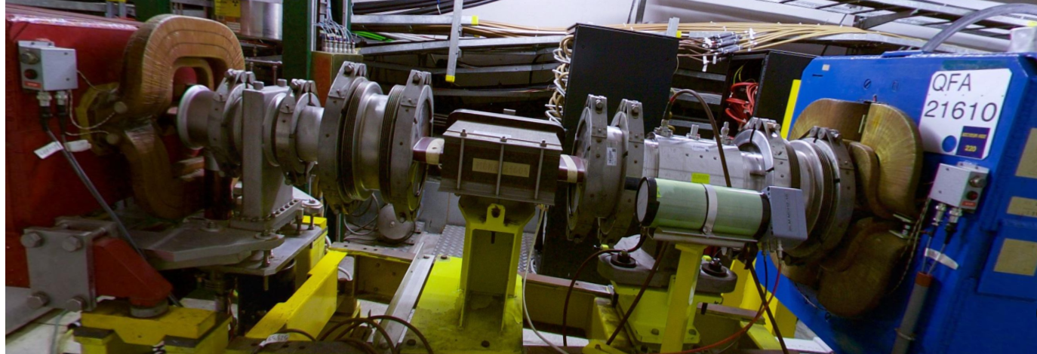
Impedance Reduction in the SPS
This section was identified by Thomas to be worth Investigating due to its complexity
Since then a beam diffusor has been suggested for this section
This grants us the opportunity to suggest and implement changes to the section which can reduce the existing beam impedance
Analysis of the current impedance and what may be possible to obtain are ongoing

Slide 9
Summary
The current state of the impedance model is being checked against past work and the vacuum report to identify inconsistencies and differences (I’m hoping to collate it all in a note)
Sources for missing low frequency impedance are under analysis to ensure consistency between simulation and measurement
Analysis of proposed and future components are being performed to minimize additional impedance
Further advantage is being taken to reduce the existing machine impedance where possible

