Slide 1
Recent capture loss studies
M. Schwarz
Acknowledgements:
J. Repond, P. Kramer, A. Lasheen, E. Shaposhnikova, H. Bartosik, T. Bohl, G. Papotti, SPS & PS operator team

Slide 2
Contents
First results on effects of PS post-acceleration in SPS
Comparison of losses in BCMS Q20 and Q22
Intensity and voltage scan in SPS

Slide 3
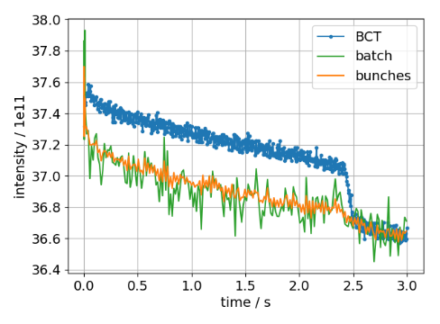
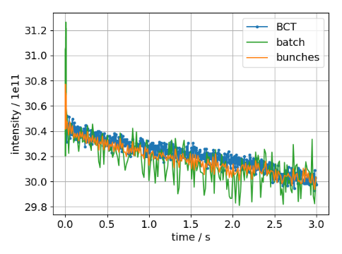
Post-acceleration and shaving
Use post-acceleration and shaving in PS to remove halo particles; observe losses in SPS
Settings:
36 bunches, 25ns spacing, 1.0e11 ppb (standard settings)
Ramp at 2.4s
Standard
Post-accl + shaving
No uncaptured beam with shaving!
MD 17/10/31

Slide 4
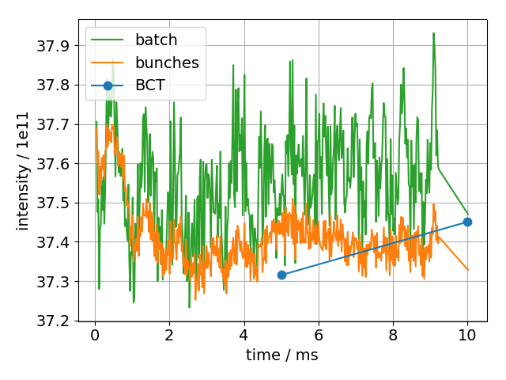
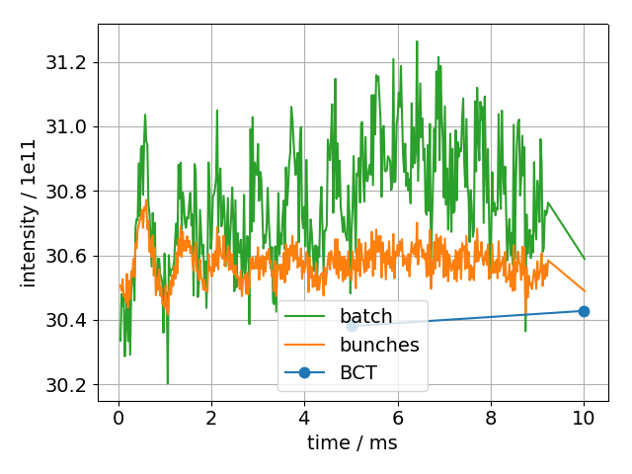
Beam profiles
Standard
Post-accl + shaving
no uncaptured beam
uncaptured beam

Slide 5
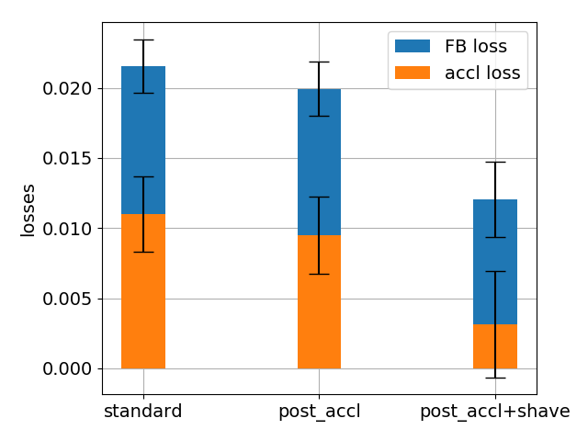
Loss analysis from BCT
Fit lines to BCT intensity from 50ms-2.4s and 2.5s-3s
About 1% losses at flat-bottom
With shaving, losses at
beginning of ramp compatible with 0% !
MD 17/10/31

Slide 6
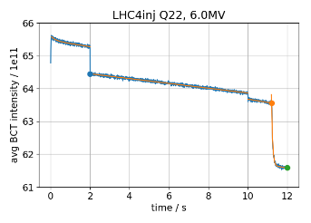
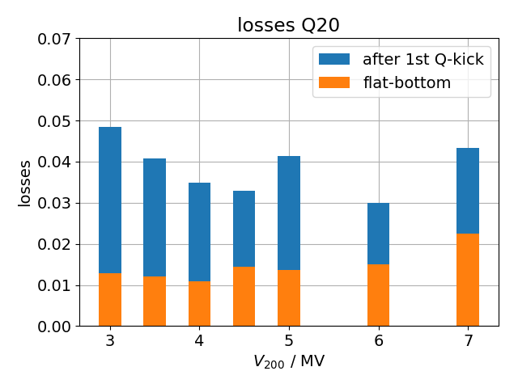
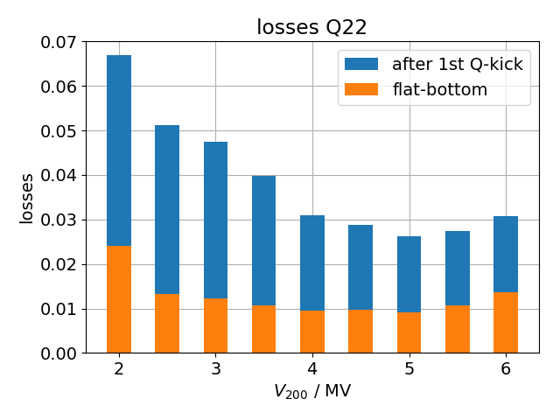
BCMS Q20 vs Q22
48 bunches, 1.35e11 ppb (Q22) 1.4e11 ppb (Q20)
800 MHz on; FB on; FF off; PL on; long. damper on
Larger momentum aperture in Q22 than Q20
Fit curves to BCT intensity
Compute $loss=(BCT\left(t_{0}\right)−BCT(t_{1}))/BCT(t_{0})$
few data
points
Q20: losses after first Q-kick decrease with V₂₀₀ -> more particles captured
Q20: losses along flat-bottom increase with V₂₀₀ -> particles scraped inside RF-bucket; less pronounced in Q22 due to larger momentum aperture
Total losses minimal at V₂₀₀=4.5MV(Q20) and V₂₀₀=5.0MV (Q22)
MD 17/10/18

Slide 7
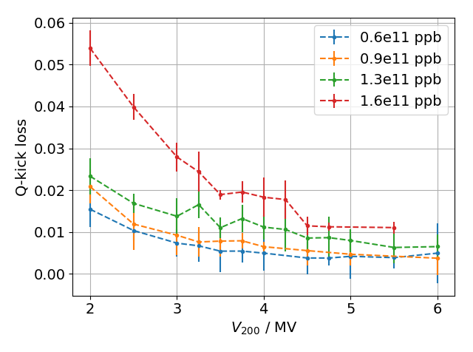
Scan intensity and induced voltage
Setup:
72 bunches, 25ns spacing, Q22, Intensity from 0.6e11 ppb up to 1.66e11 ppb
Feedback: on, Feedforward: on/off, Phase loop: on, long. damper: on
V₂₀₀ variable, 800 MHz cavity off
Aim: study if bunches injected from the PS change with intensity
Idea:
RF-bucket area scales as $a\sim \sqrt{V}$. Voltage seen by the beam given $V=V_{RF}−V_{ind}$, where induced voltage $V_{ind}$ depends in bunch intensity and bunch shape.
with increasing RF-bucket area $a$capture losses $l_{capt}$ decrease ( $l_{capt}\sim 1/a\sim 1/\sqrt{V−V_{ind}}$ ) and should level off, once all beam is captured
IF bunch shapes from the PS were independent of intensity, $V_{ind}$ depends only on intensity and for different intensities capture losses $l_{capt}$ would just be shifted horizontally
Estimate capture losses by comparing BCT intensity(*) before / after Q-kick at 2s
Observed vertical offset with intensity
(*) Keep in mind that these also contain losses from bunches along the flat-bottom!

Slide 8
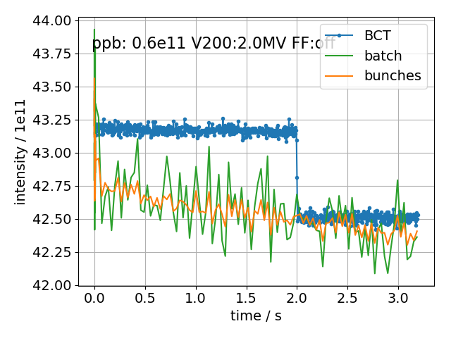
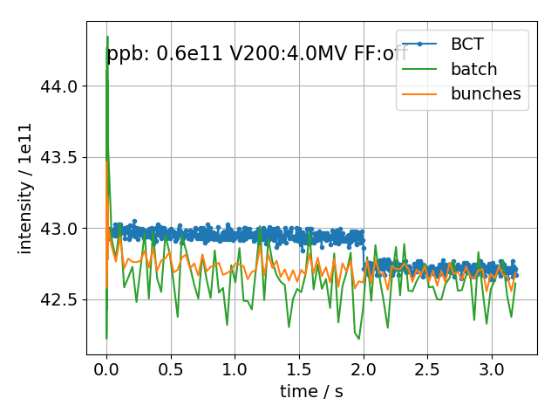
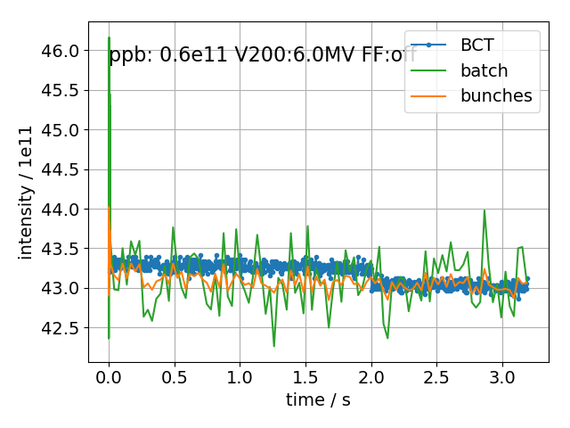
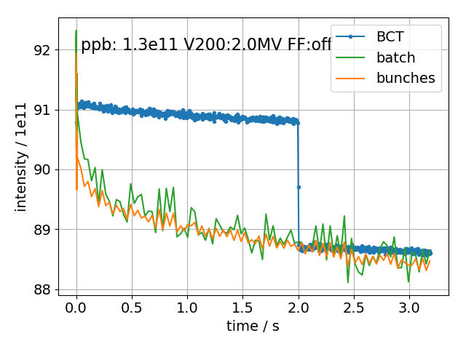
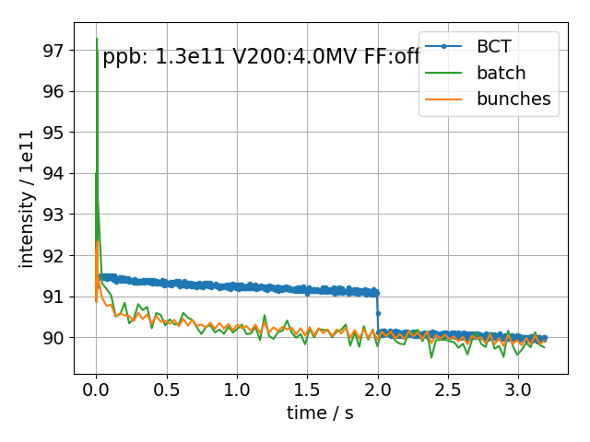
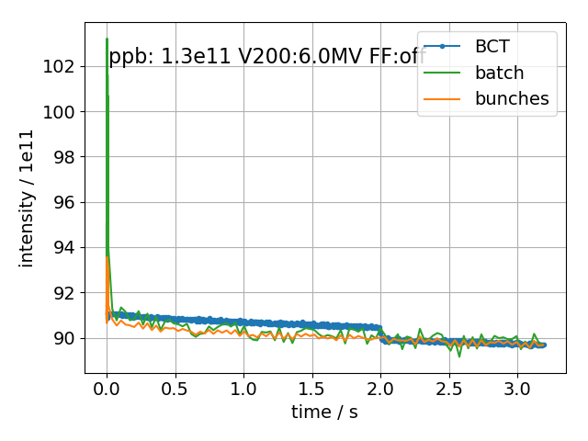
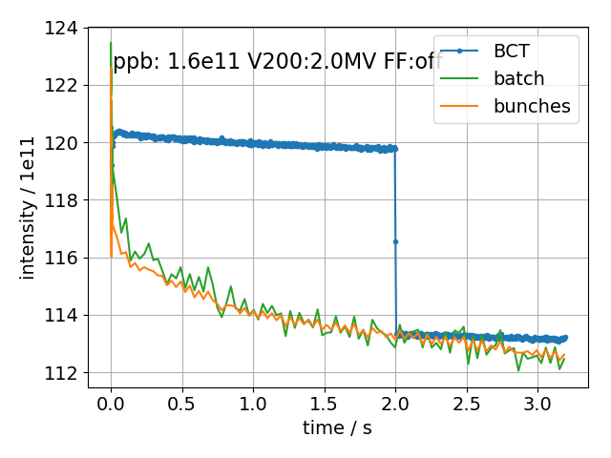
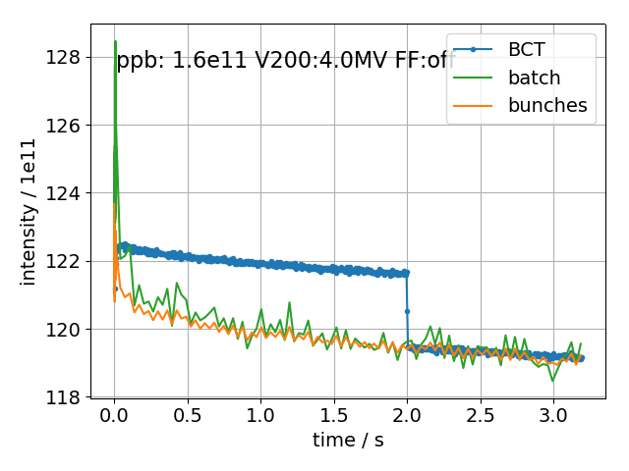
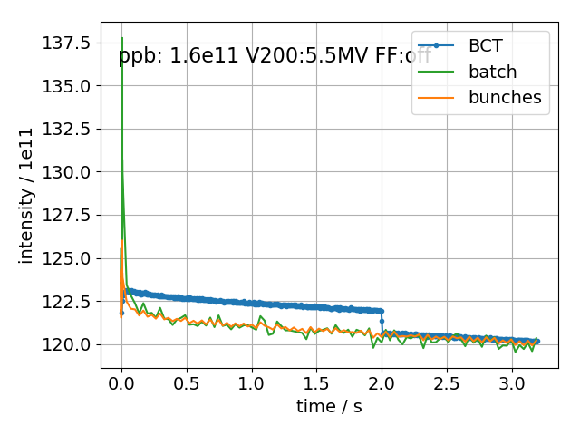
Intensity, summary

Slide 9
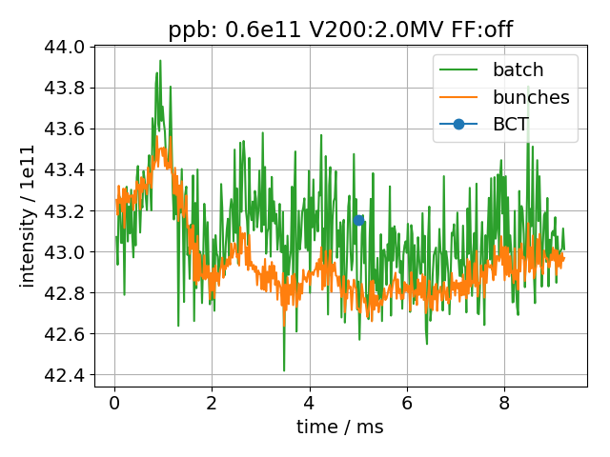
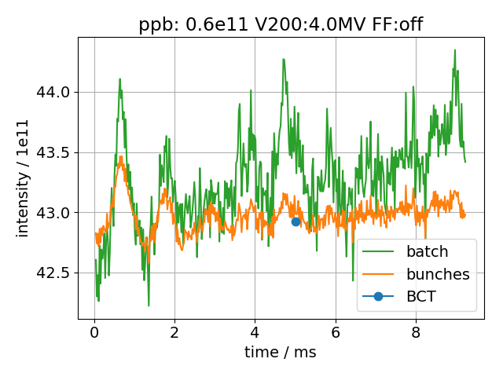
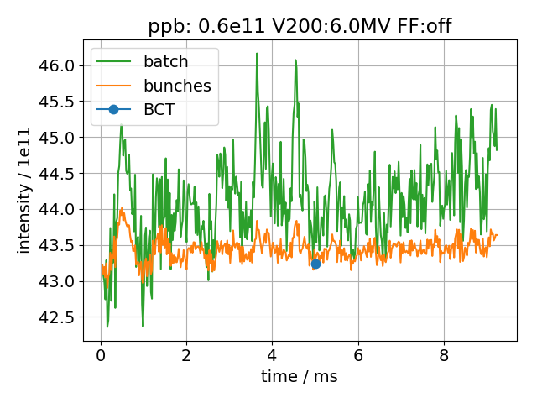
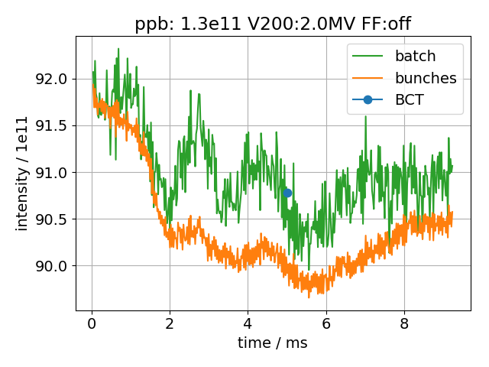
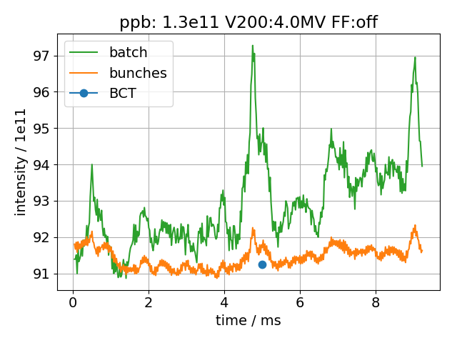
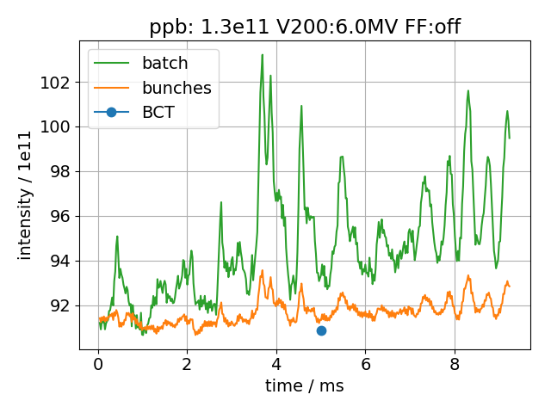
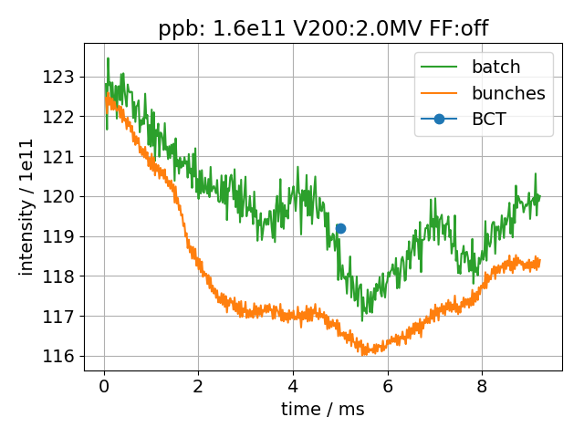
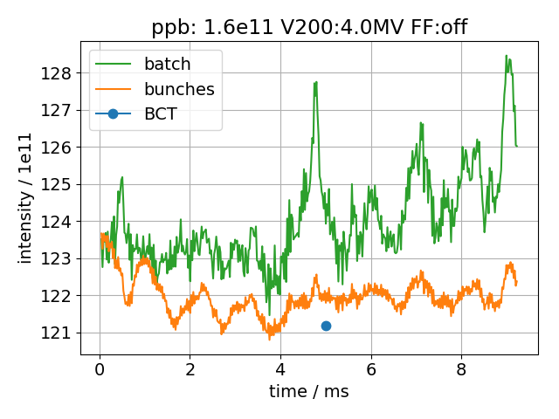
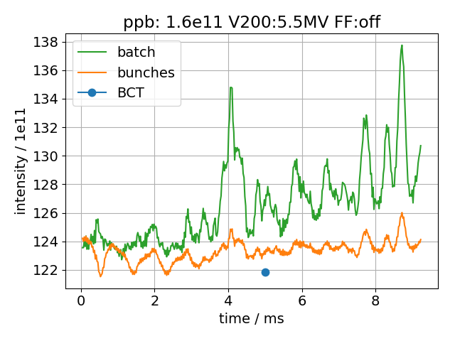
Capture losses, summary

Slide 10
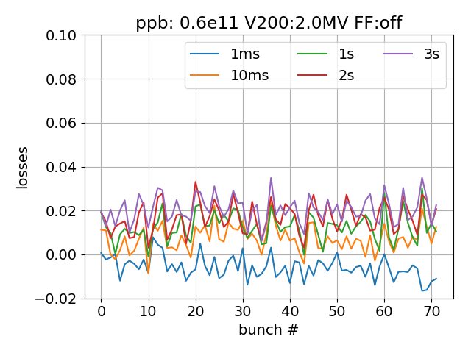
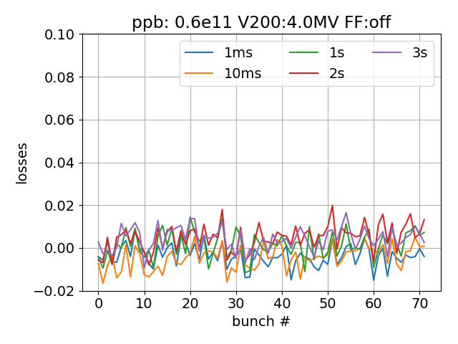
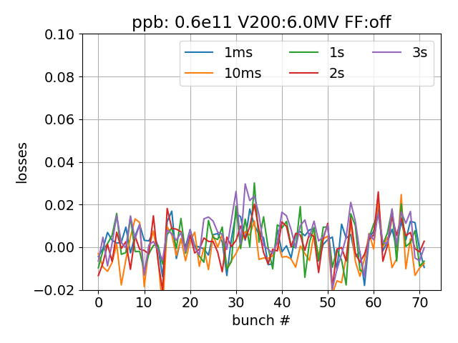
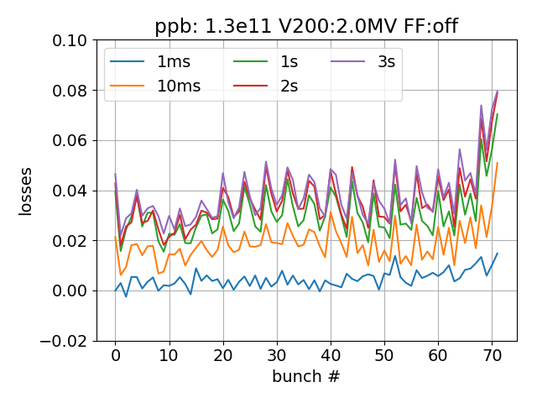
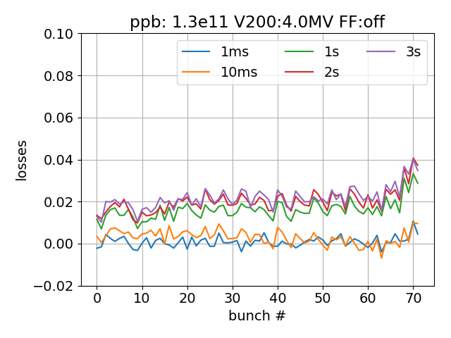
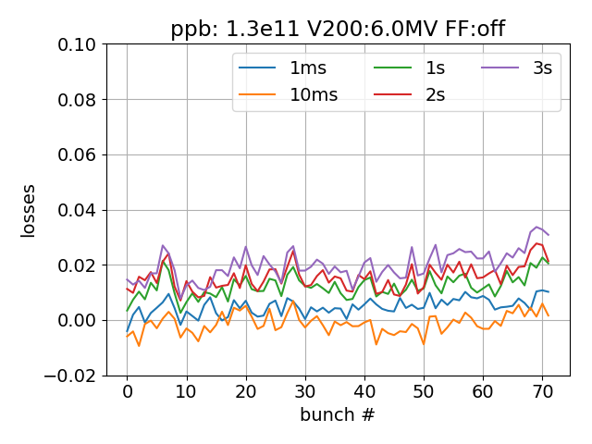
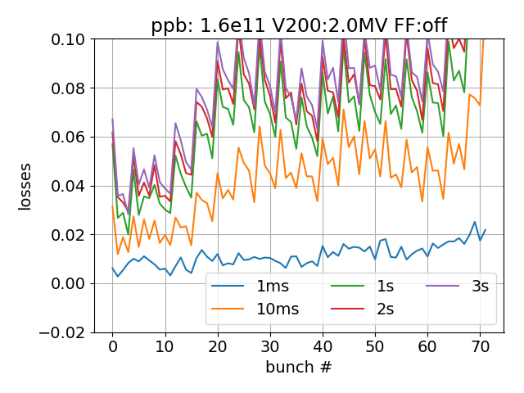
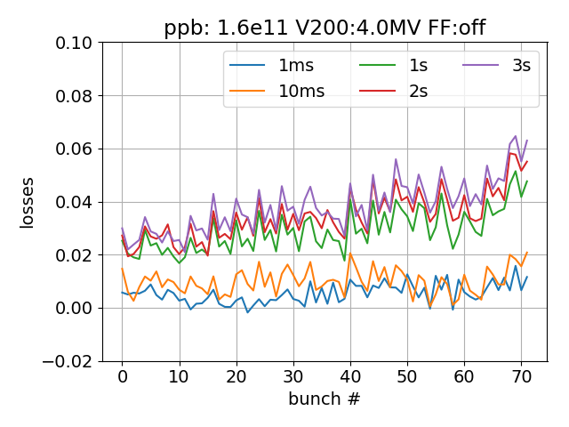
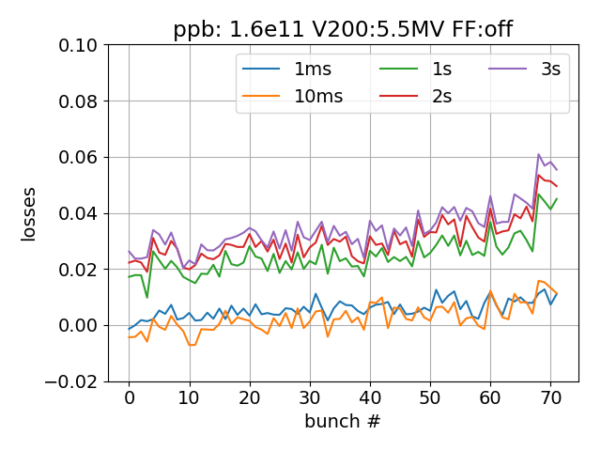
Loss patterns, summary

Slide 11
Summary & next steps
First results of post-acceleration and shaving in the PS show no capture losses in the SPS (at the cost of low intensity)
Flat-bottom losses from momentum aperture limitations reduced in BCMS Q22 compared to Q20
Bunches coming from PS change with intensity
Further data analysis for intensity and voltage scan:
Analyze data with Feedforward on
Obtain capture losses from bunch intensity in the first 10ms
Analyze data of measured voltage
Simulations:
Started BLonD simulations with 72 bunches with halo from PS and ‘impedance reduction’ version of feedback system; but results don’t make sense yet…
Thank you for your attention!

Slide 12
Appendix

Slide 13
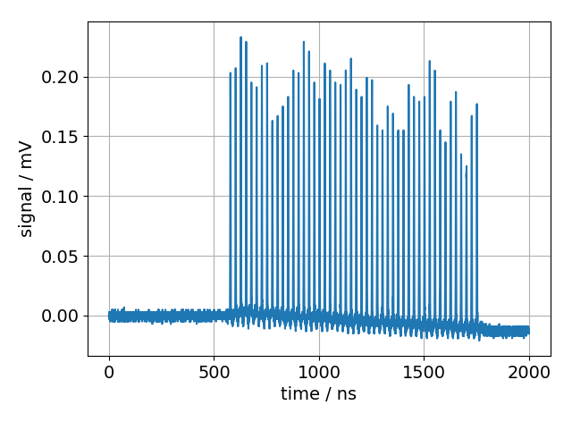
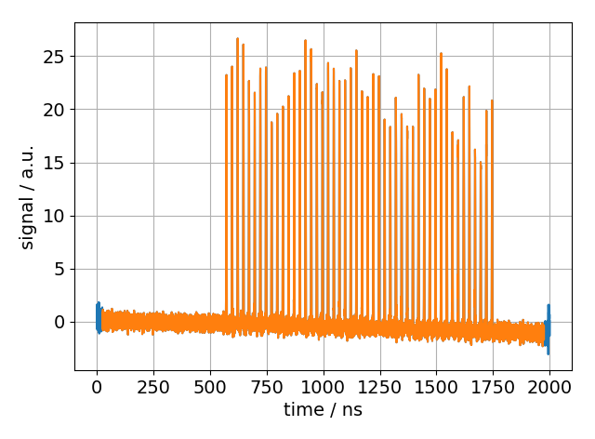
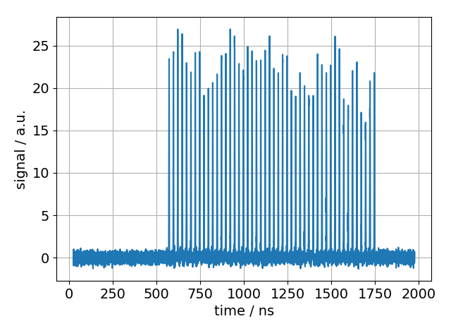
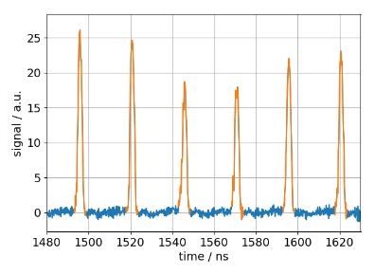
Profile analysis
Raw data
Apply transfer-
function
correction
Ignore boundary points
Remove baseline
detect
bunches

Slide 14
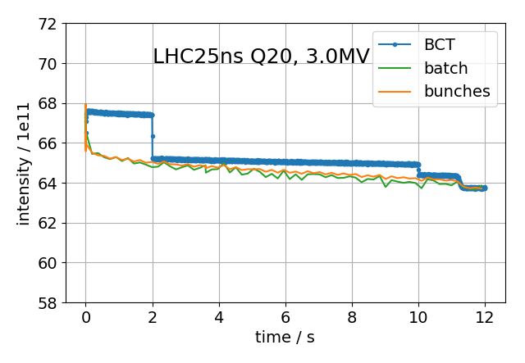
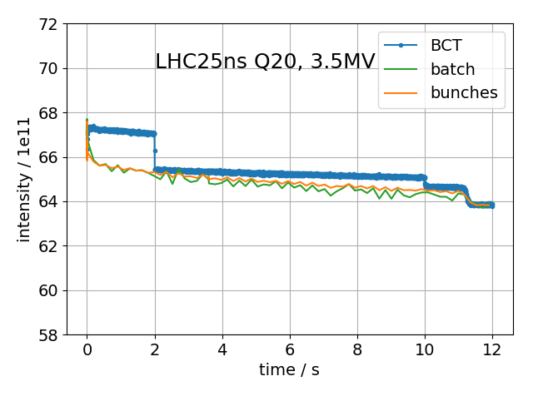
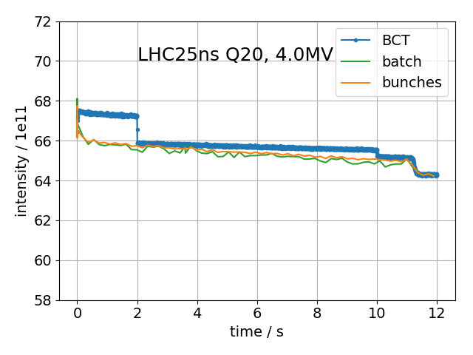
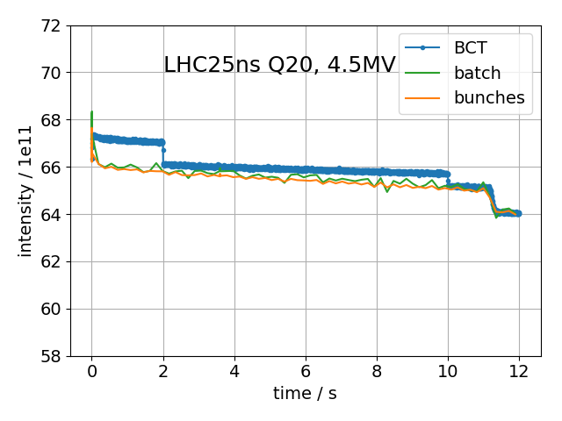
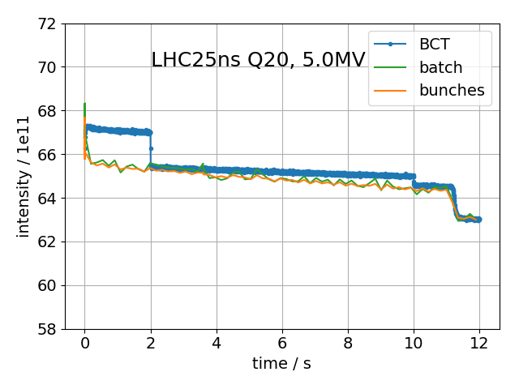
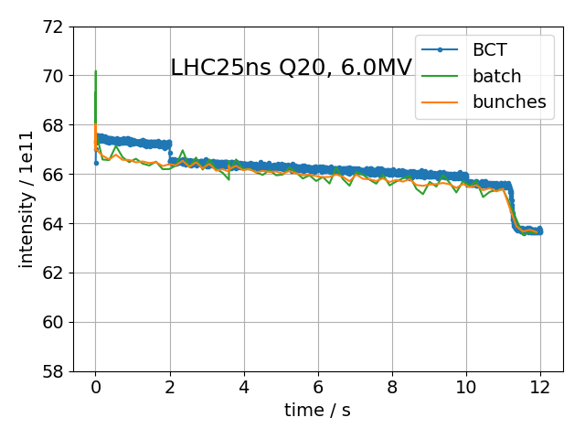
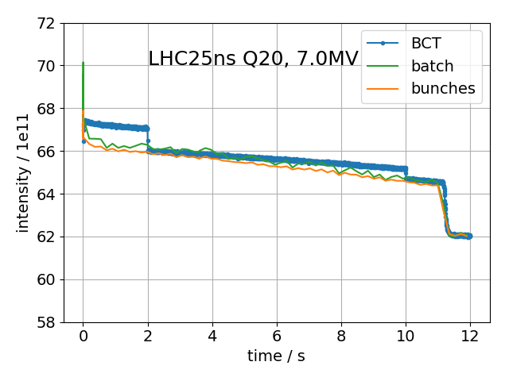
BCMS Q20

Slide 15
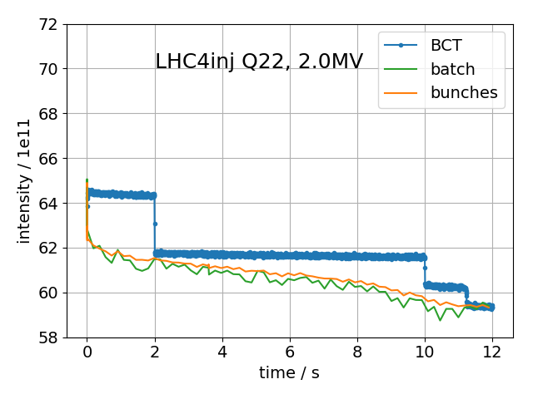
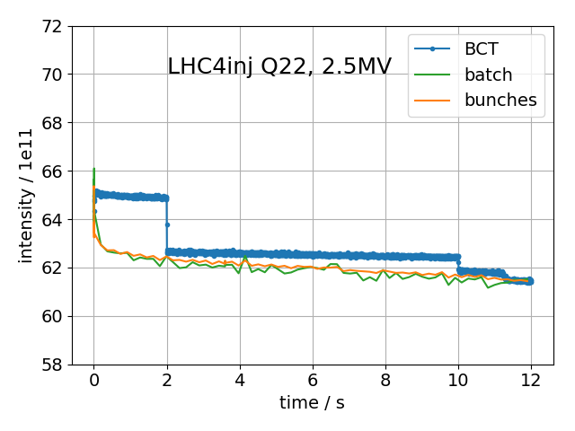
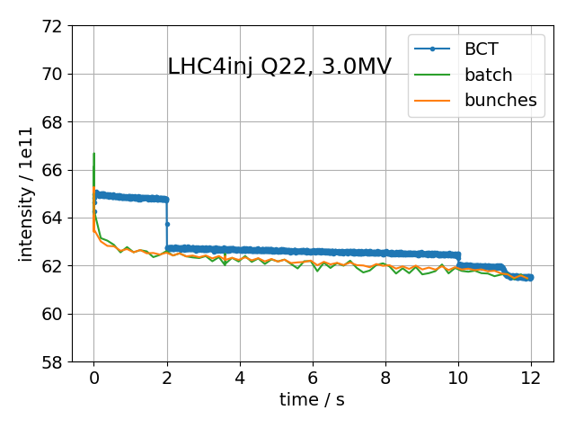
BCMS Q22

