Slide 1
Instability mode studies s 16th of November 2017
LIU-SPS Beam Dynamics Working Group
J. Repond
Acknowledgements: E. Shaposhnikova, T. Bohl, A. Lasheen, M. Schwarz, G. Papotti, H. Bartosik, OP crew.

Slide 2
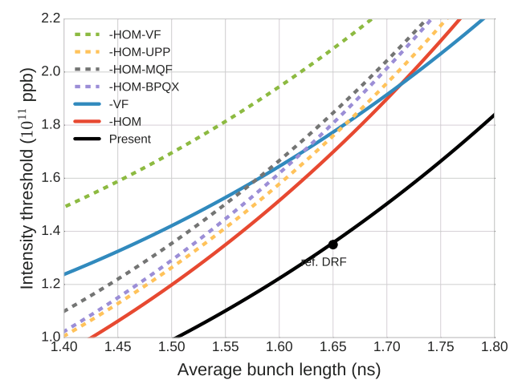
630 MHz HOM and stability threshold
What has been presented until now
Stability threshold
450 GeV, 72 bunches, 7 MV + 0.7 MV
The 630 MHz HOM has the lowest stability threshold for upgraded RF (10 MV) but for 7 MV it is «in competition» with vacuum flanges
Coupled-bunch instability caused by 630 MHz HOM has typical wake decay time of ~ 4 bunches
Threshold minimal on flat top
Courtesy: A. Lasheen
Old simulations with probably obsolete impedance model, new simulations still running
Can we identify instability source in measurements?

Slide 3
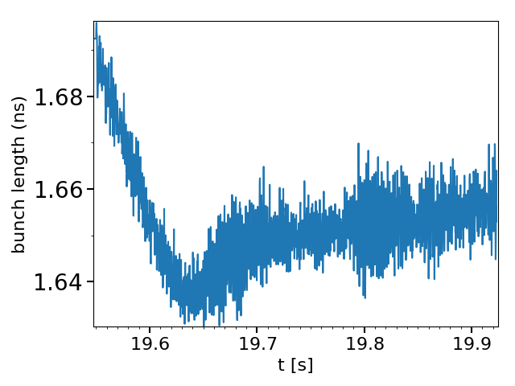
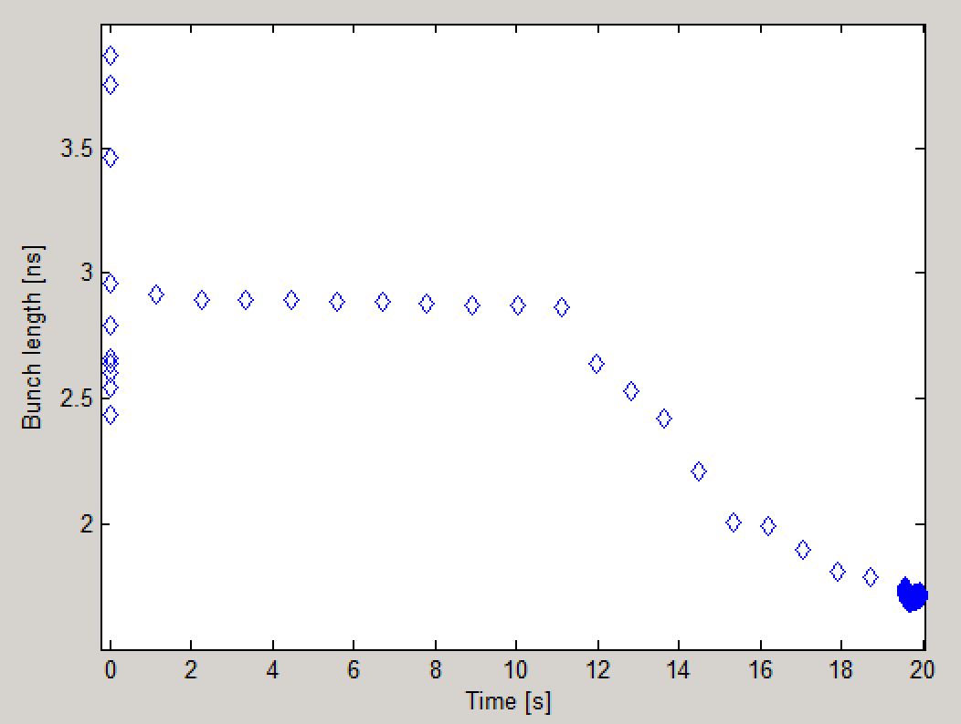
Latest MD results – instability at flat top
Parameters
Q20 nominal acceleration cycle, on 8th of November 2017
BCMS beam (48 bunches)
FB, LD, blow-up on
Intensity ~ $1.75×{10}^{11},$ RF program ~ nominal, 800 MHz at 15%
Acquisition of ~ 20 points per synchrotron period on flat top
Evolution of the bunch length
Controlled emittance blow-up
Beam unstable after arrival at flat top

Slide 4
Measurement of profile oscillations
One acquisition every 9 turns

Slide 5
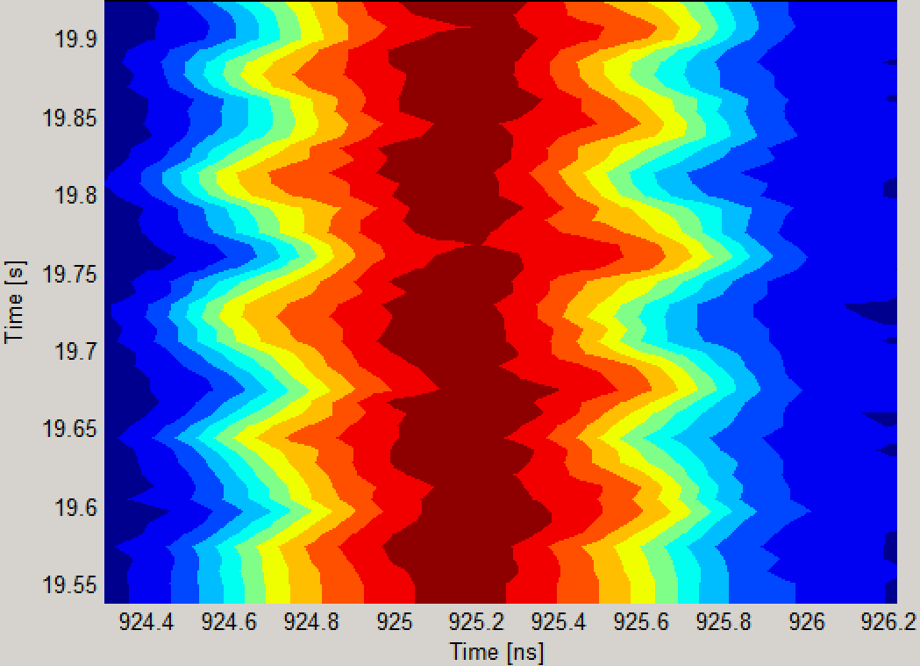
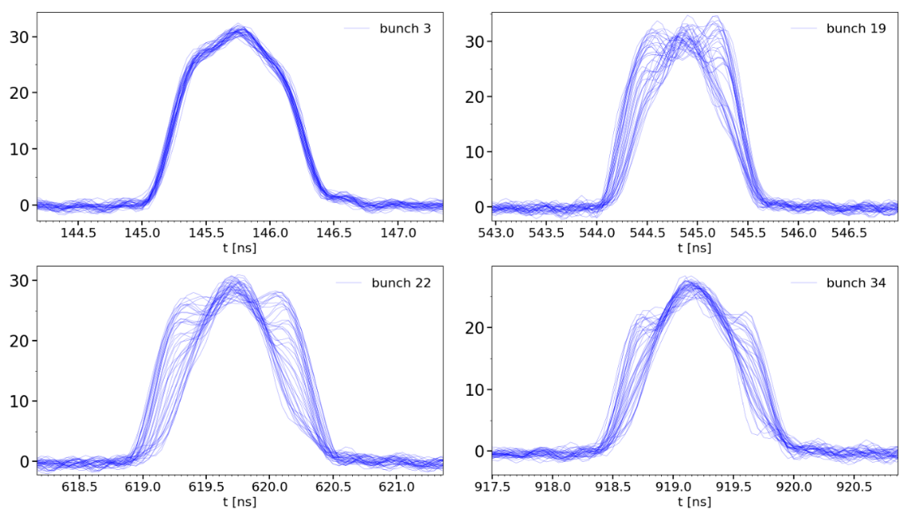
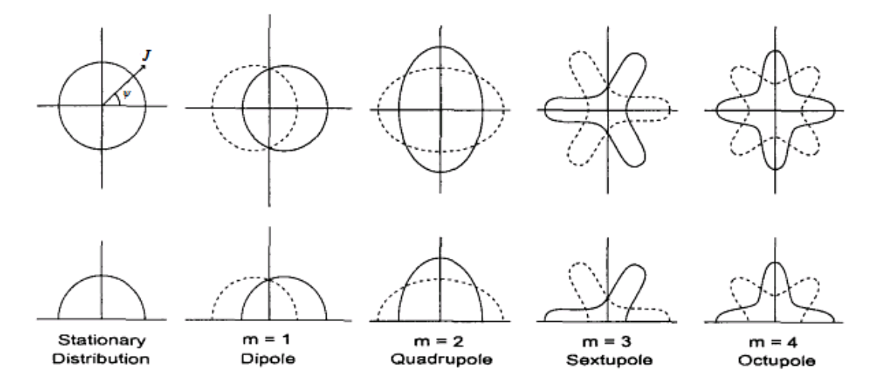
Bunch oscillations and instability mode(s)
Contour plot bunch 34
Profiles superimposed
→ Most likely rigide dipole oscillations and quadrupole

Slide 6
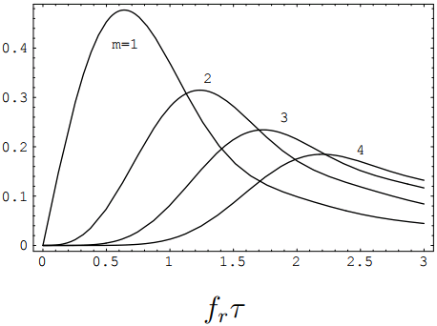
CBI modes and frequencies – estimation
For a given bunch distribution
The growth rate depends on a form factor
→ For given $f_{r}$ (630 MHz) and $τ$ (1.7 ns), the main mode that will grow can be predicted
Courtesy: E. Shaposhnikova
For a given bunch length (1.7 ns) and resonant frequency, m for maximum growth rate can be estimated
$$πf_{r}τ≈m+0.81×m^{1/3}$$
m | 1 | 2 | 2.3 | 3 | 4
fr [MHz] | 340 | 565 | 630 | 790 | 1000
On flat top, 630 MHz HOM excites dipole and quadrupole oscillations

Slide 7
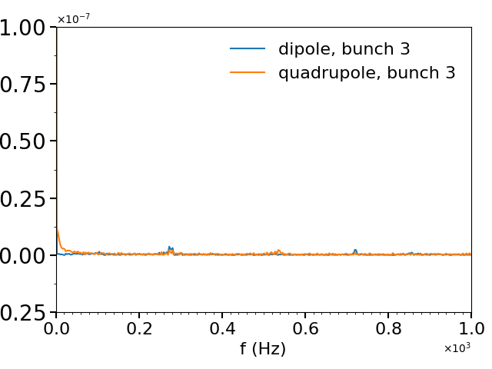
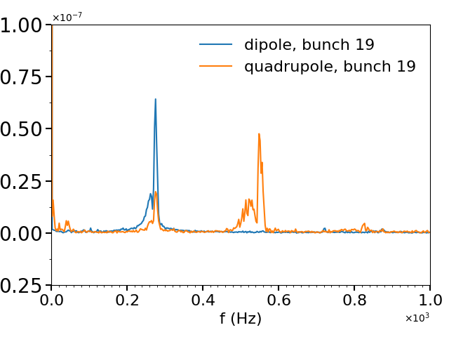
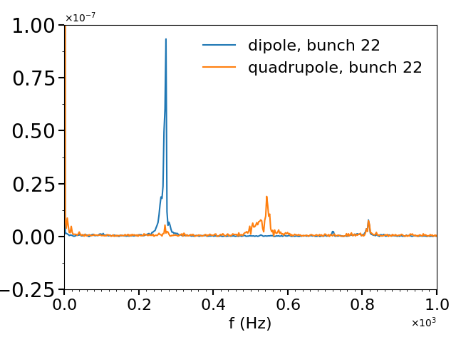
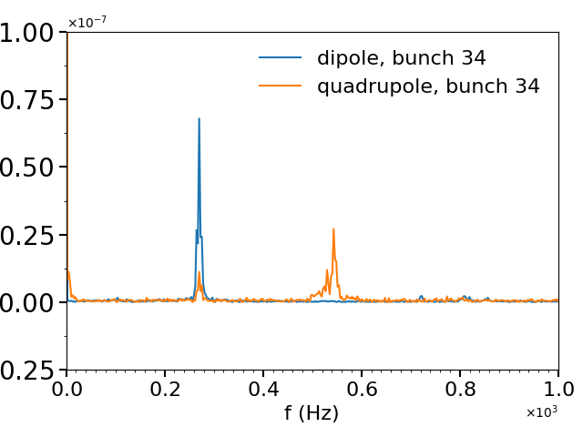
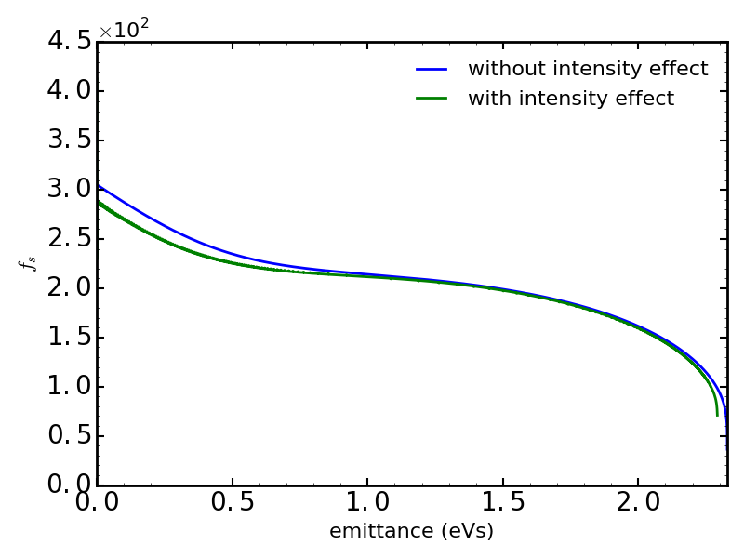
Dipole/quadrupole oscillations on flat top – measurements
Fourier transform of bunch length and position
~ 545 Hz
~ 515 Hz
~ 270 Hz
Synchrotron frequency
~ 543 Hz
$τ=1.7$ ns
Dipole and quadrupole excited
→ Higher order mode?

Slide 8
Tomography on flat top
Special thanks to A. Lasheen

Slide 9
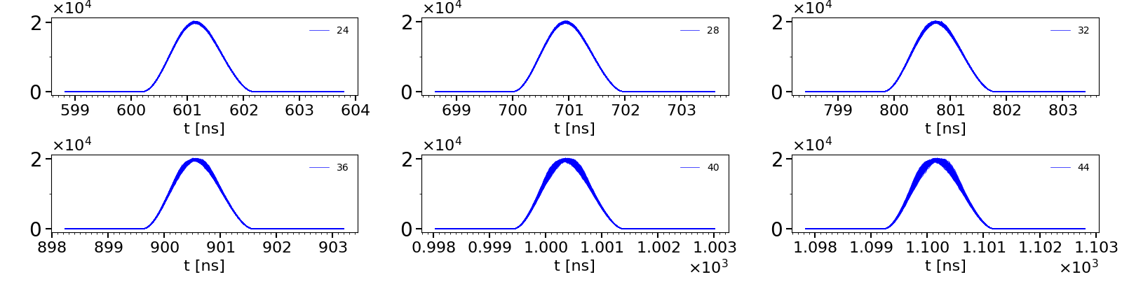
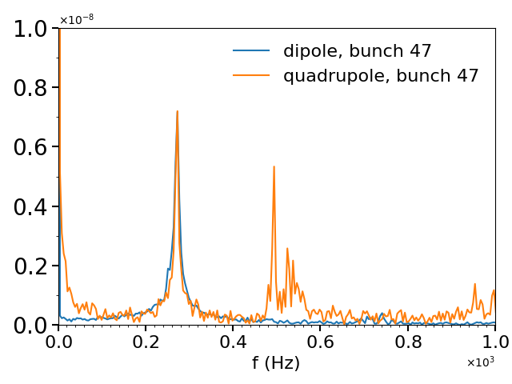
Simulations on flat top
Matched bunches (1.65 ns), 200 ms evolution , full impedance model, $2.2×{10}^{11}$ppb
~ 270 Hz
Modes of oscillations similar to measured one: dipole and quadrupole excited
~ 490 Hz
~ 540 Hz
Peak at $1×f_{s}$ for bunch length oscillations not observed in measurements, probably due to effect of phase loop

Slide 10
Conclusion and future work
Complicated to distinguish the source of the instability
Intensity thresholds of 630 MHz HOM and vacuum flanges close to each other
Bunch length reduction during acceleration excites different harmonics
Theory predicts for the 630 MHz growth of dipole and quadrupole
Both modes observed
Rigide dipole seems to be the leading oscillation
Frequencies of the oscillations are in a good agreement between measurement and simulations
Instability very likely to be caused by the 630 MHz HOM
Future
Measurements should be carried out without controlled emittance blow-up
Simulations with realistic bunch shape are required + ramp
Phase shift between oscillations of each bunch will give the coupled-bunch mode excited

Slide 11
Thank you for your attention

Slide 12
Backup slides

