Slide 1

Reliability of the parallel line HOM coupler with respect to multipactor effect and vacuum related considerations
Nasrin Esfahani

Slide 2
Topics
Comparison between the two HOM couplers (old & new)
Threshold for Vacuum Breakdown
Multipactor effect
Latest status of the four section damping

Slide 3
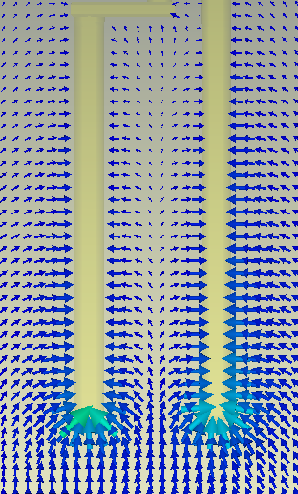
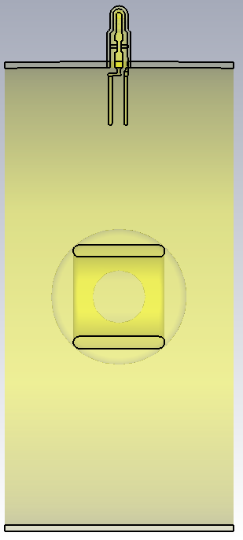
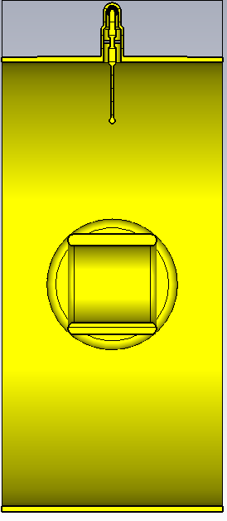
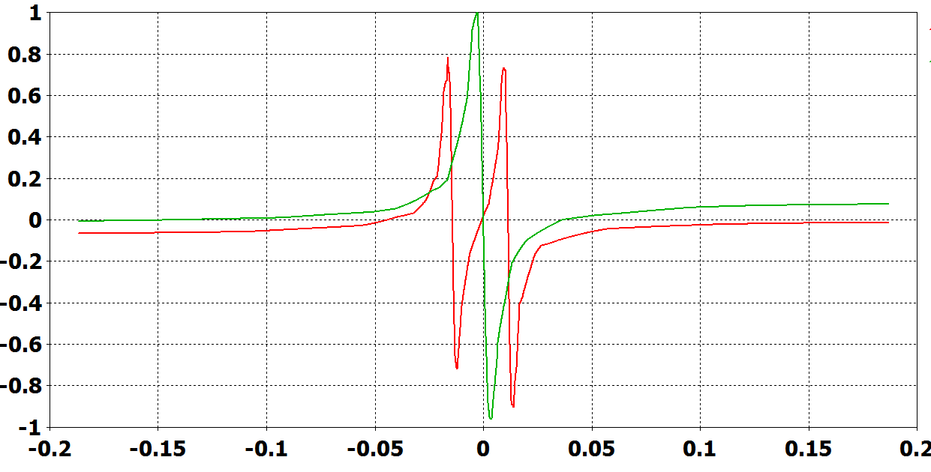
Comparison between the two HOM couplers (FPB)
Ex normalized to the maximum of the field for the original coupler
Normalized Ex (old coupler)
Normalized Ex (new coupler)
y
x

Slide 4
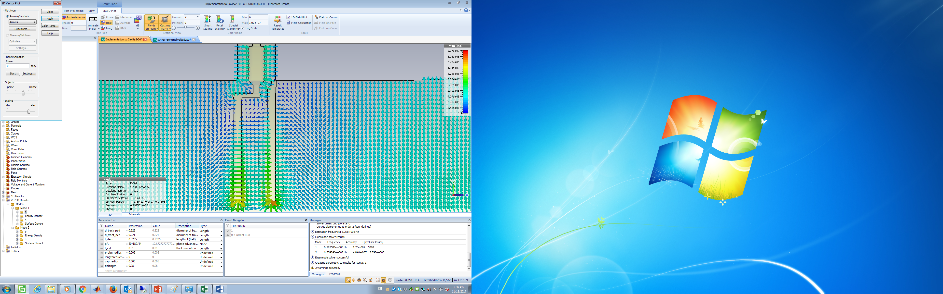
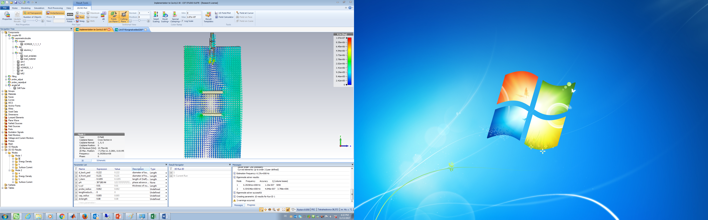
Threshold for Vacuum Breakdown (HOM)
The threshold value of the electric field (for vacuum breakdown)between the two arms of the coupler = 312.5 kV/m
The threshold value for the electric field in the accelerating gap (for the HOM)= 139.5 kV/m
d=2.56 cm
The electric field strength for this higher order mode should be 1.12 larger than the electric filed of the accelerating mode (after LS2) in order to have vacuum breakdown!!!!

Slide 5
Multipactor effect
E-Field pattern for the accelerating mode
E-Field pattern for HOM (30π/44)
E-Field pattern for the accelerating mode is not favourable for initiating a multipactor effect
E-Field pattern for the accelerating mode for the HOM is favourable for initiating a multipactor effect
QUESTION: Which mode (accelerating or HOM) determines the motion of the slow electrons?

Slide 6
Multipactor effect
E-Field pattern for the accelerating mode
E-Field pattern for HOM (30π/44)
When we have up to 8 kW of HOM power the magnitude of the electric field of the HOM is only 10 percent of the magnitude of the electric field of the accelerating mode
The Multipactor effect cannot take place because of the unfavourable field pattern

Slide 7
Multipactor effect, worst case scenario
Neglecting the effect of the accelerating mode

Slide 8
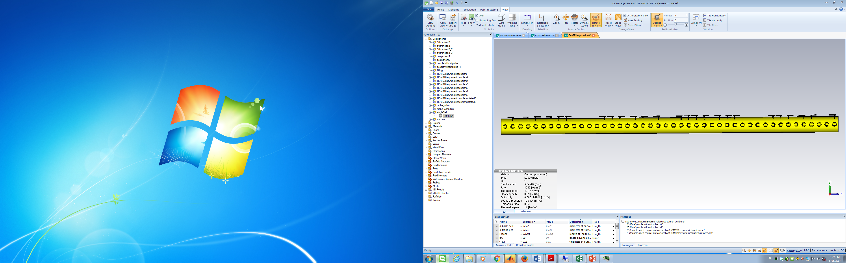
Parallel line-pick up HOM coupler in cavity1
Impedance model (one 4-tank cavity)
with the old couplers
F (MHz) | Rsh (kΩ)
628.9 | 40
629.9 | 110
3.3 reduction
12 kΩ
3.6 reduction
30 kΩ
Impedance is reduced by
a factor of 3.3 using the new coupler.

Slide 9
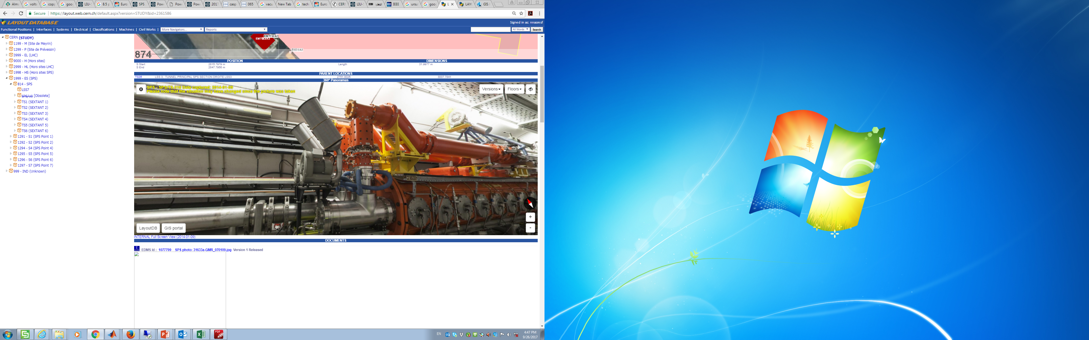
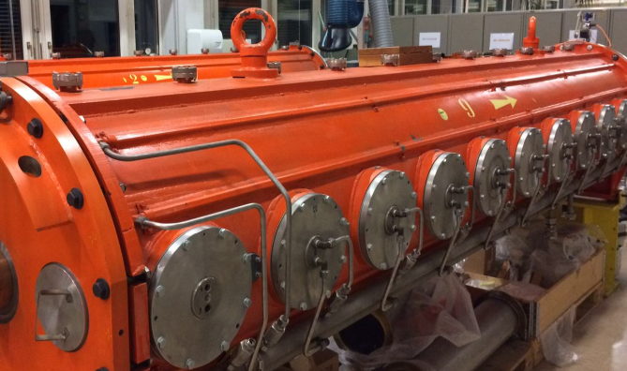

Slide 10
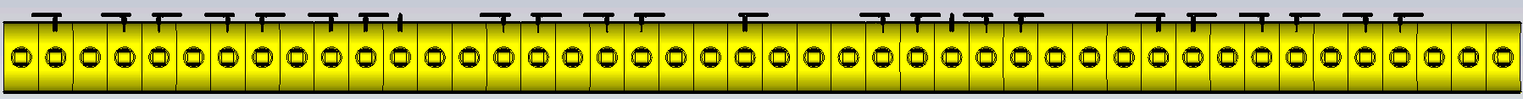
Implementation to Cavity 1
Implementation to Cavity 2
Impedance is reduced by
a factor of 2.9 using
the new coupler.
Implementation to Cavity 2

Slide 11
Conclusions
Worst case scenario examinations show that the conditions are very unfavourable for having vacuum breakdown or multipaction.
The examinations are based on calculation of the required electric field for having vacuum breakdown/multipaction.

Slide 12
Thank you for your attention!

