Slide 1
SPS Impedance Model Update Aaron Farricker

Slide 2
Outline
LSS1 Post LS2 Update
LSS1 Injection Line

Slide 3
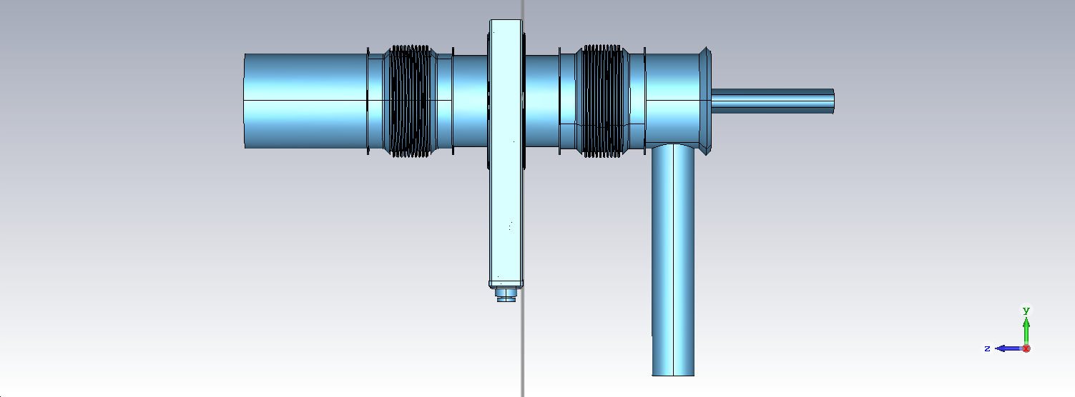
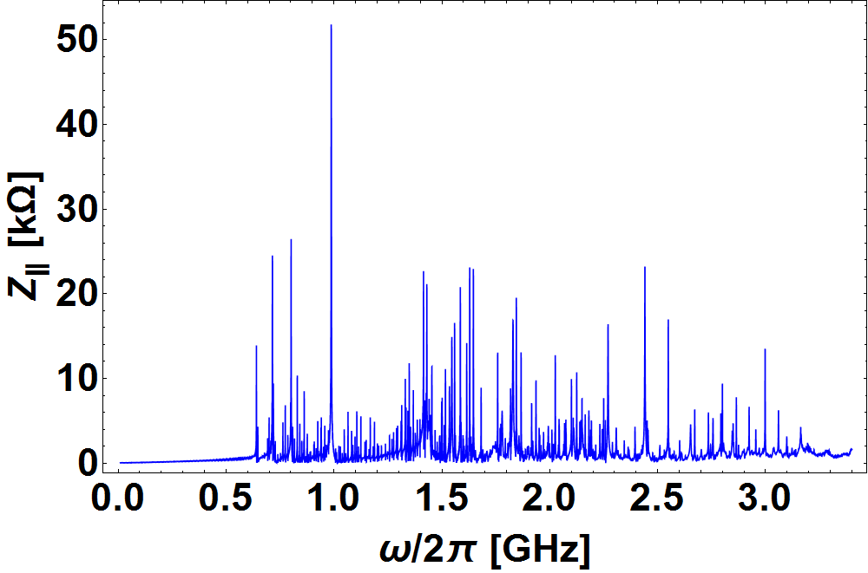
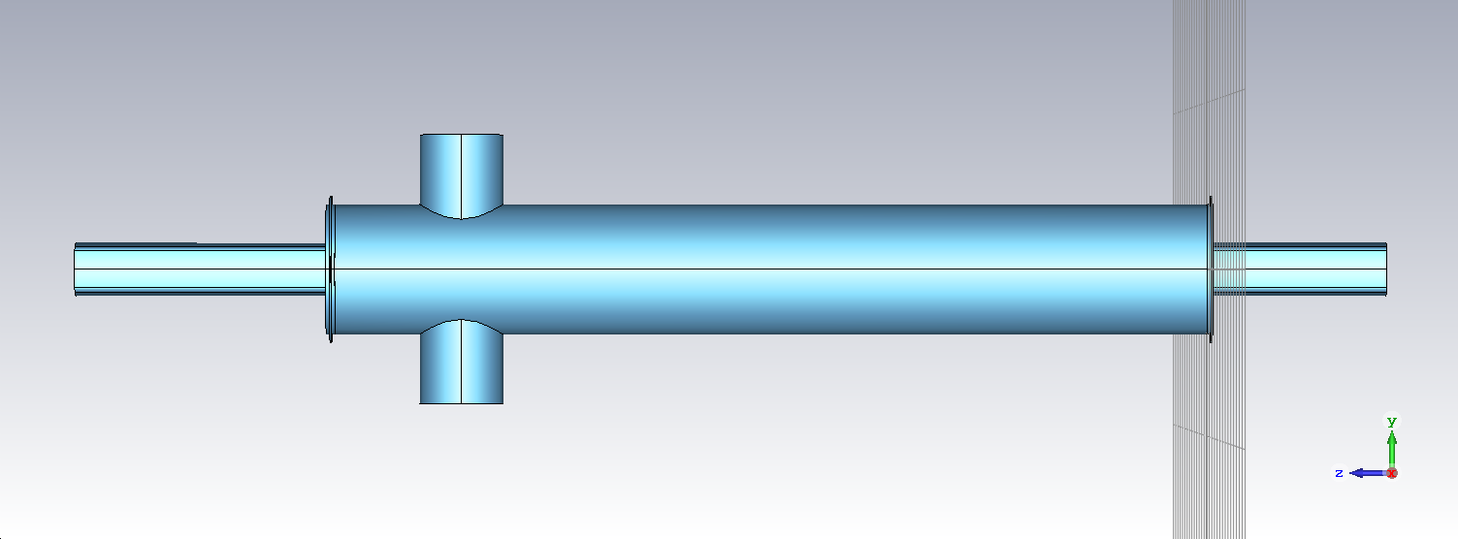
LSS1 Restructuring
LSS1 in the SPS will be restructured to allow the beam dump to be moved to LSS5
This means that LSS1 can be optimized to reduce the impedance profile

Slide 4
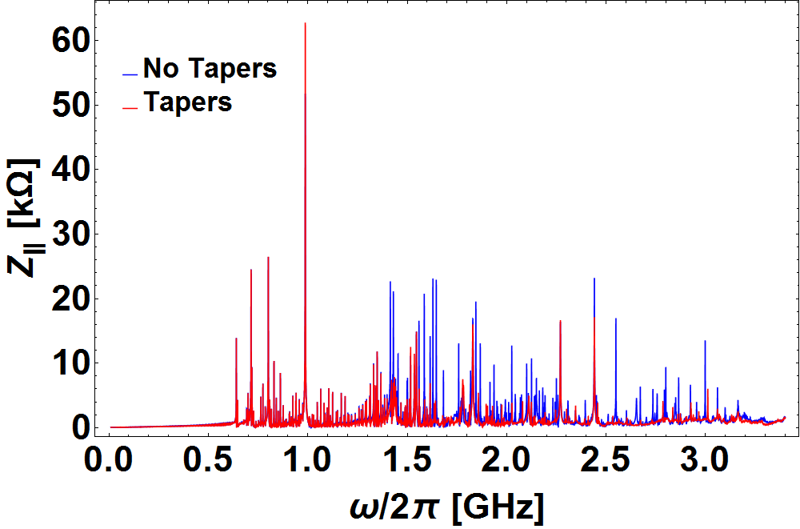
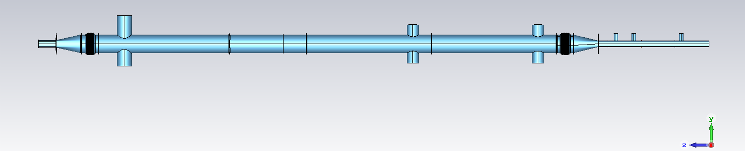
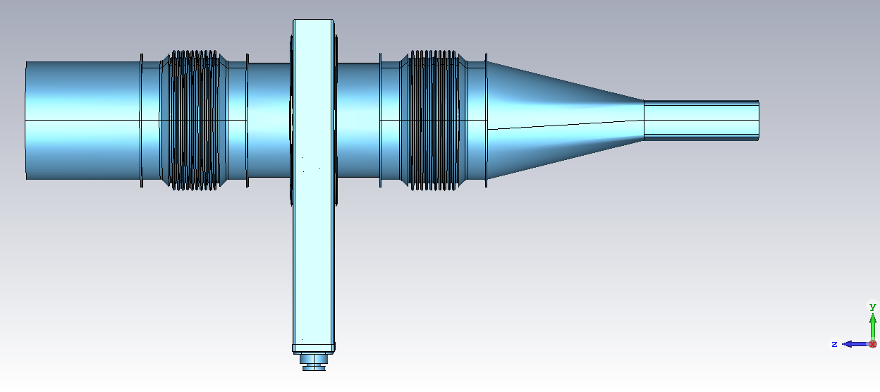
LSS1 Restructuring-Tapers
Introduction of tapers rather than sharp transitions reduces the high frequency impedance
It doesn’t have a massive impact on resonant modes in some of the structures

Slide 5
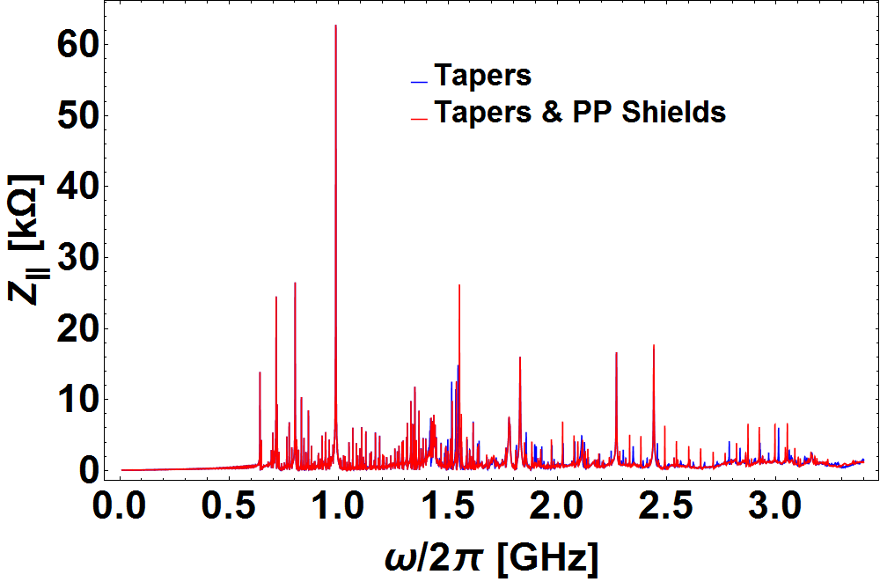
LSS1 Restructuring- PP Shields
Introducing PP shields removes some of the high frequency resonances
There are still however high impedance resonances which need to be removed

Slide 6
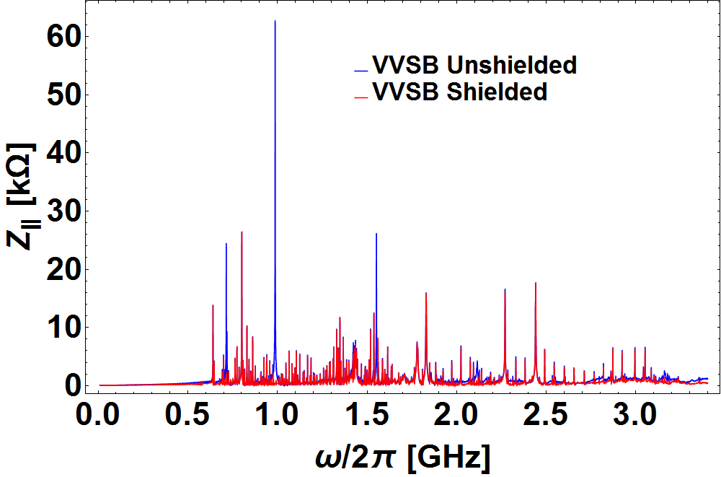
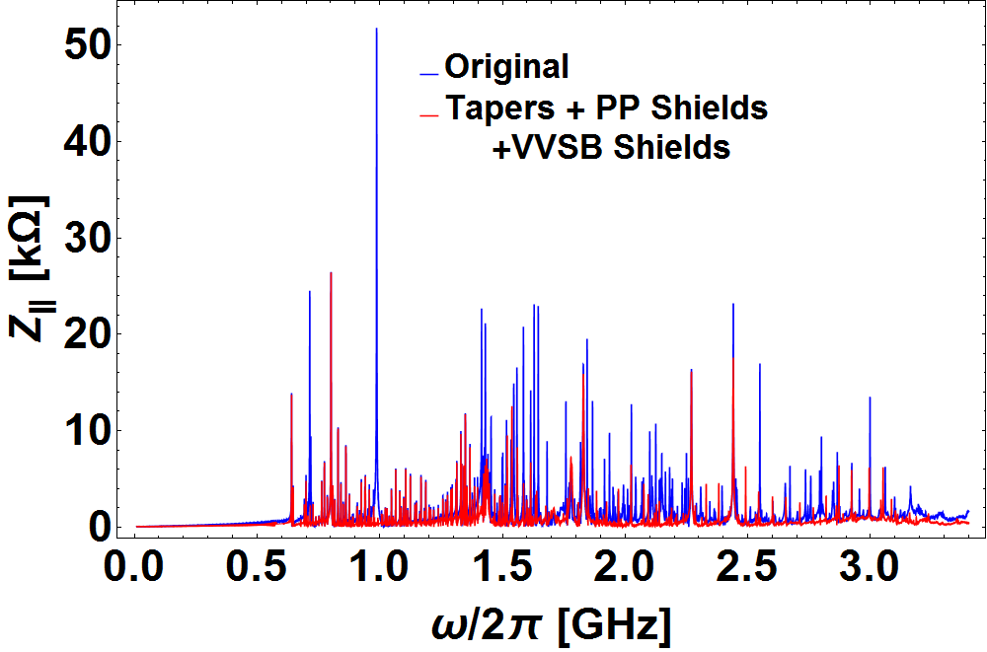
LSS1 Restructuring- Shielded VVSB
Shielding the VVSB removes 3 high shunt impedance peaks having a large impact on the overall spectrum
Overall significant progress has been made in reducing the impedance of LSS1 after LS2

Slide 7
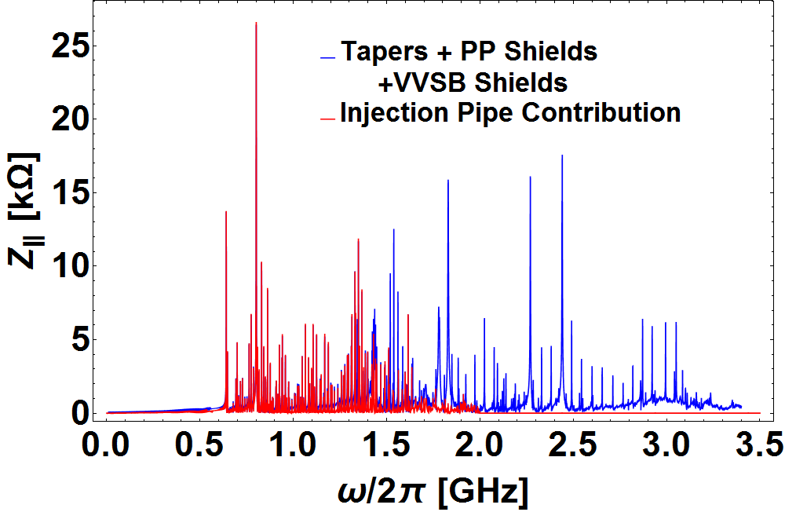
LSS1 Restructuring- Still to Go
MDHW
Note: Zero Padded

Slide 8
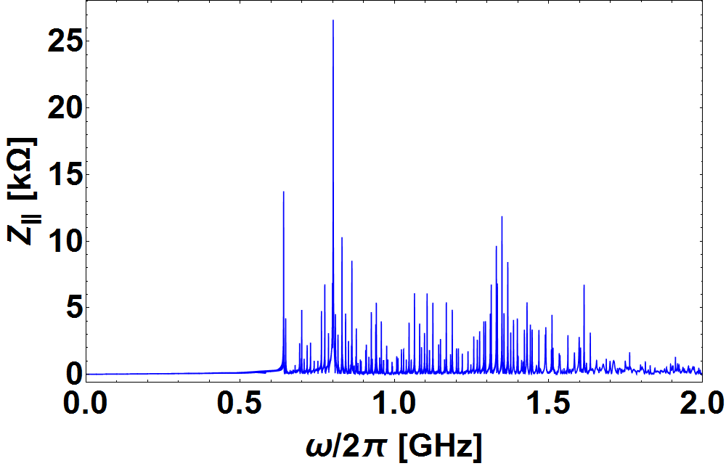
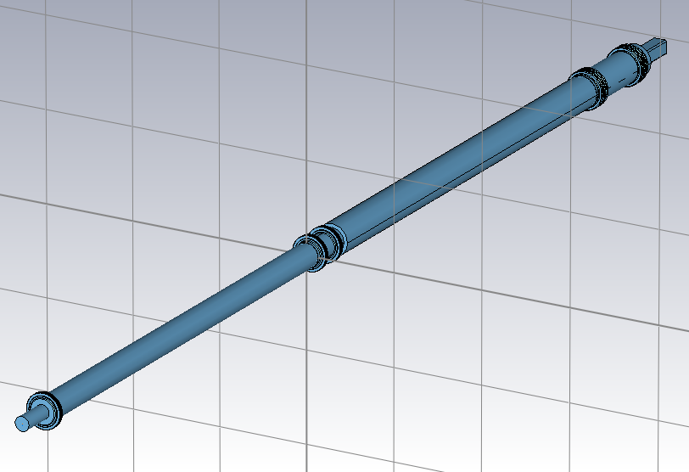
LSS1 Restructuring- Focus on Injection Pipe
2% of 800 MHz Cavities @800MHz
Currently in the Machine
1 three-section
cavity post LS2 @630 MHz
Post LS2
Currently in the machine the impedances are dwarfed by the 200 MHZ cavities
Post LS2 they become significant and changes may be needed
However this section is a unique in the machine and is crucial to injecting beam into the SPS so has many additional constrains

