Slide 1
Update on simulation of capture losses in the SPS
M. Schwarz
Acknowledgements:
A. Lasheen, J. Repond, P. Baudrenghien, E. Shaposhnikova T. Bohl, SPS operator team
BLonD team

Slide 2
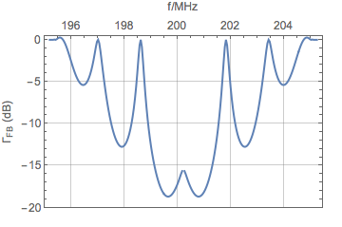
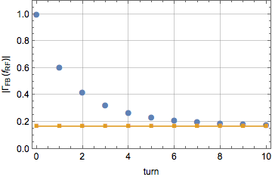
Simulation setup
Model injection by creating 72 bunches (25ns spacing) at the center of SPS RF-bucket
Model feedback by multiplying impedance with FB-reduction factor of P. Baudrenghien (Charmonix X, 2001)
No action of feedback at turn 1
Continuously increase feedback strength after turn 1
Z -> Z x ΓFB
72 bunches
Gaussian bunch profile, sigma=0.9ns
impedance model:
analytic cavity impedance for four 200 MHz TWC
full SPS impedance model
feed-back model:
2MHz single-sided bandwidth, ‘FB time constant: 3 turns’
-15.5 dB at f_RF
(i.e. Z(f_RF) multiplied by factor 0.17)

Slide 3
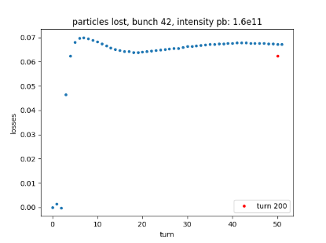
Losses in simulation
At turn 0 (injection), count number of macroparticles inside separatrix N0, for each bunch
At each turn N, count number of macroparticles inside separatrix Nn, for each bunch
Losses = (Nn / N0)-1 , for each bunch

Slide 4
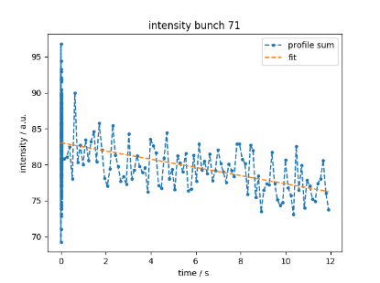
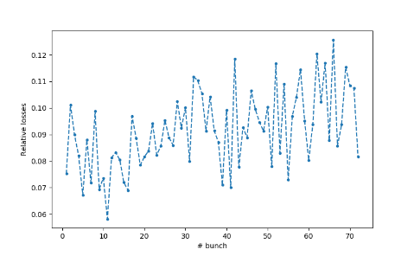
Losses in simulation
Acquire beam profiles along cycle
Intensity of bunch ~ sum of bunch profile
Fit linear function
Losses = (fit(t0) – fit(tend))\fit(t0)
for each bunch
8% losses for bunch 71
8% losses

Slide 5
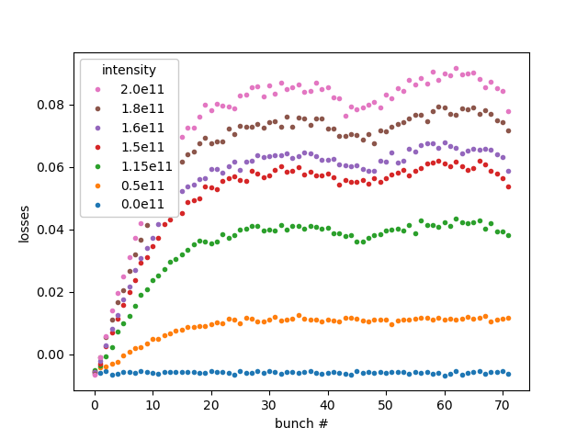
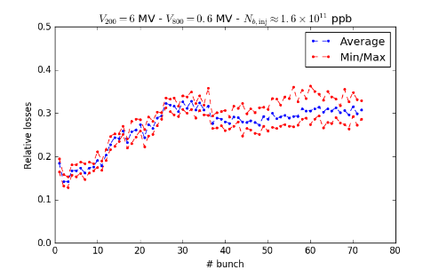
Simulation vs Measurement
Only 200 MHz TWC analytic impedance
curtesy: A. Lasheen
Shape of simulated losses agrees well: increased losses up to ~ bunch 30, ‘dip’ at ~ bunch 45
But: measured losses show offset of about 15 percent

Slide 6
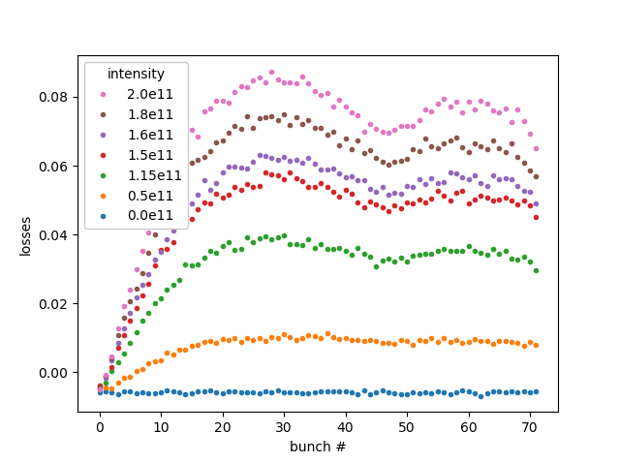
Simulation vs Measurement
Full SPS impedance model
curtesy: A. Lasheen
Maximum of losses now at ~bunch 25
Measured losses show increase of ~15% along batch, but simulations only give ~6%

Slide 7
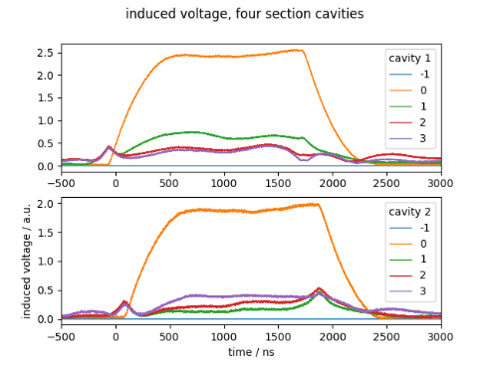
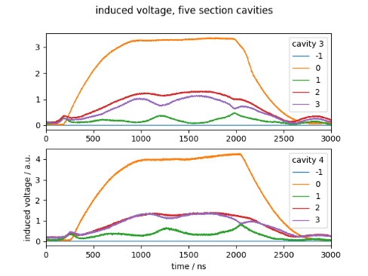
Measurement of induced voltage
MD 2208 (2017-06-07)
FF on, FB delay 100 μs
V200 = 4.5 MV, V800 = 0.45 MV
Intensity per bunch ~ 1.13e11, 72 bunches
Measured cavity voltage at f_RF from I/Q modulator
Scaled with beam intensity for each acquisition
Amplitude = sqrt(I^2+Q^2)
Average amplitude over acquisitions

Slide 8
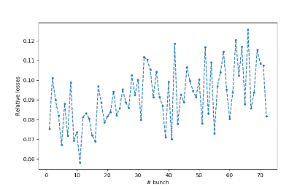
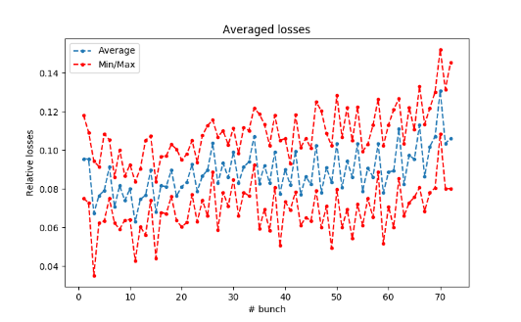
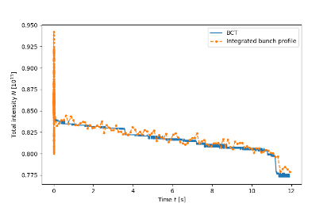
Measured losses
MD 2208 (2017-06-07)
FF on, FB delay 100 μs
V200 = 4.5 MV, V800 = 0.45 MV
Intensity per bunch ~ 1.13e11, 72 bunches
Single acquisition
Averaged over all acquisition
Single acquisition
Losses increase
during ramping

Slide 9
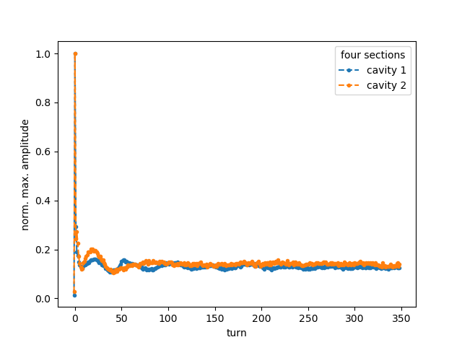
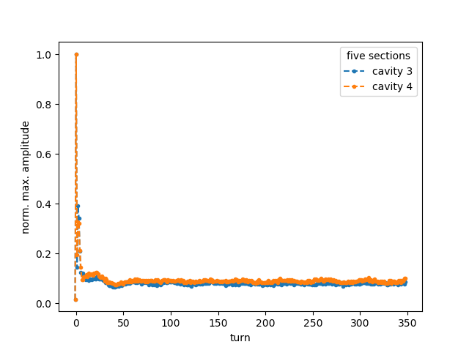
Normalized amplitude

Slide 10
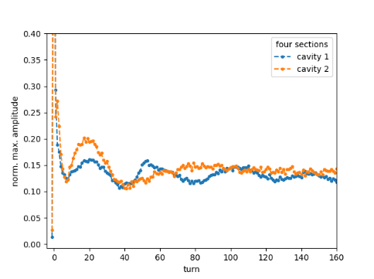
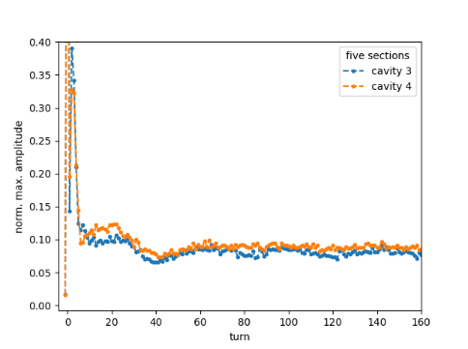
Normalized amplitude

Slide 11
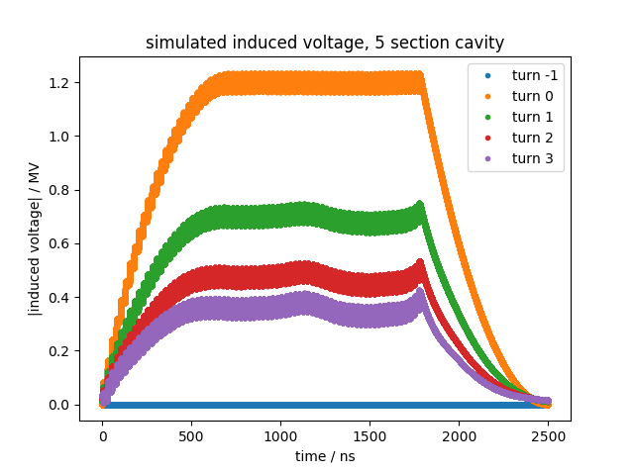
Simulations vs Measurement
No FF,
FB starts after 3 turns
MD 2208 (2017-06-07)
FF starts at turn 1, FB starts after 3 turns
V200 = 4.5 MV, V800 = 0.45 MV
Intensity per bunch ~ 1.13e11, 72 bunches
turns when FB starts

Slide 12
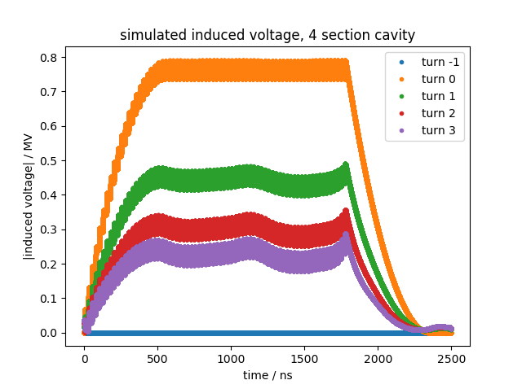
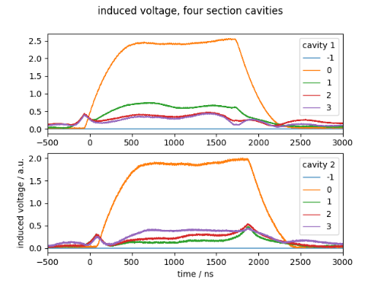
Simulation vs Measurement
MD 2208 (2017-06-07)
FF starts at turn 1, FB starts after 3 turns
V200 = 4.5 MV, V800 = 0.45 MV
Intensity per bunch ~ 1.13e11, 72 bunches
Simulation:
No FF, FB starts after 3 turns

Slide 13
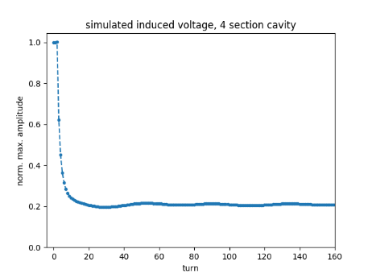
Simulation vs Measurement
Maximum amplitude relative to maximum amplitude at injection
MD 2208 (2017-06-07)
FF starts at turn 1, FB starts after 3 turns
V200 = 4.5 MV, V800 = 0.45 MV
Intensity per bunch ~ 1.13e11, 72 bunches
Simulation:
No FF, FB starts after 3 turns

Slide 14
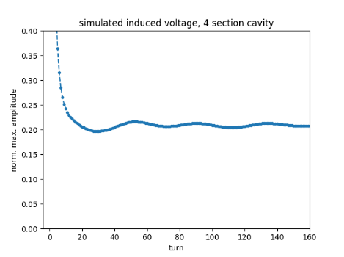
Simulation vs Measurement
Simulation:
No FF, FB starts after 3 turns
MD 2208 (2017-06-07)
FF starts at turn 1, FB starts after 3 turns
V200 = 4.5 MV, V800 = 0.45 MV
Intensity per bunch ~ 1.13e11, 72 bunches

Slide 15
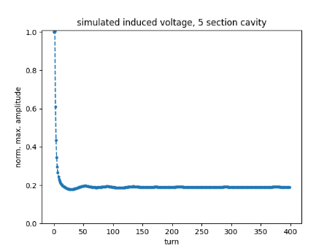
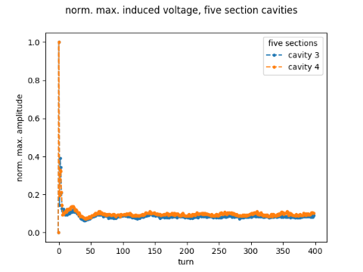
Simulation vs Measurement
No FF,
FB starts after 3 turns
MD 2208 (2017-06-07)
FF starts at turn 1, FB starts after 3 turns
V200 = 4.5 MV, V800 = 0.45 MV
Intensity per bunch ~ 1.13e11, 72 bunches

Slide 16
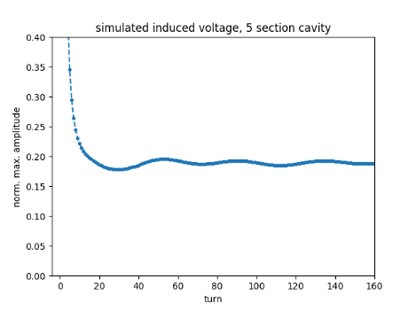
Simulation vs Measurement
No FF,
FB starts after 3 turns
FF starts at turn 1,
FB starts after 3 turns

Slide 17
Next steps: simulation
Summary:
Shape of simulated losses agrees well: increased losses up to ~ bunch 30, ‘dip’ at ~ bunch 45
Reasonable agreement at nominal intensity (1.15e11 ppb)
At high intensity: - measured losses have ‘offset’ of about 15 percent compared to simulation
- measured losses show increase of ~15% along batch, but simulations only give ~6%
Next steps
Use optimized PS bunches
Include FF impedance reduction factor in simulations
Implement method to compute losses in the same way as is used in measurements
Compute phase of simulated induced voltage
Currently, action of feedback in simulation independent of beam properties => implement dynamic feedback in simulation code BLonD

Slide 18
Next steps: measurement
Summary:
Shape of simulated losses agrees well: increased losses up to ~ bunch 30, ‘dip’ at ~ bunch 45
Reasonable agreement at nominal intensity (1.15e11 ppb)
At high intensity: - measured losses have ‘offset’ of about 15 percent compared to simulation
- measured losses show increase of ~15% along batch, but simulations only give ~6%
Next steps
More systematic studies with FF/FB on/off (as was done this week 2017-06-13)
Influence of phase loop
Measure at higher intensities
Study losses with small ramp or ‘cleaning with longitudinal kicker’
Thank you for your attention!

Slide 19
Summary and outlook
Summary:
Shape of simulated losses agrees well: increased losses up to ~ bunch 30, ‘dip’ at ~ bunch 45
But: - measured losses have ‘offset’ of about 15 percent compared to simulation
- simulated losses don’t show ‘dip’ for first bunches
Outlook:
Use optimized simulated bunches from the PS instead of Gaussian ones
Currently, action of feedback in simulation independent of beam properties => implement dynamic feedback in simulation code BLonD

