Slide 1
SPS Impedance Model Wrap Up Thomas Kaltenbacher

Slide 2
Outline
QF/QF closed flanges studies
Shielded QF/MBA; gasket gap filling
SPS pumping ports
DN400 valve
LHC-BGI in the SPS

Slide 3
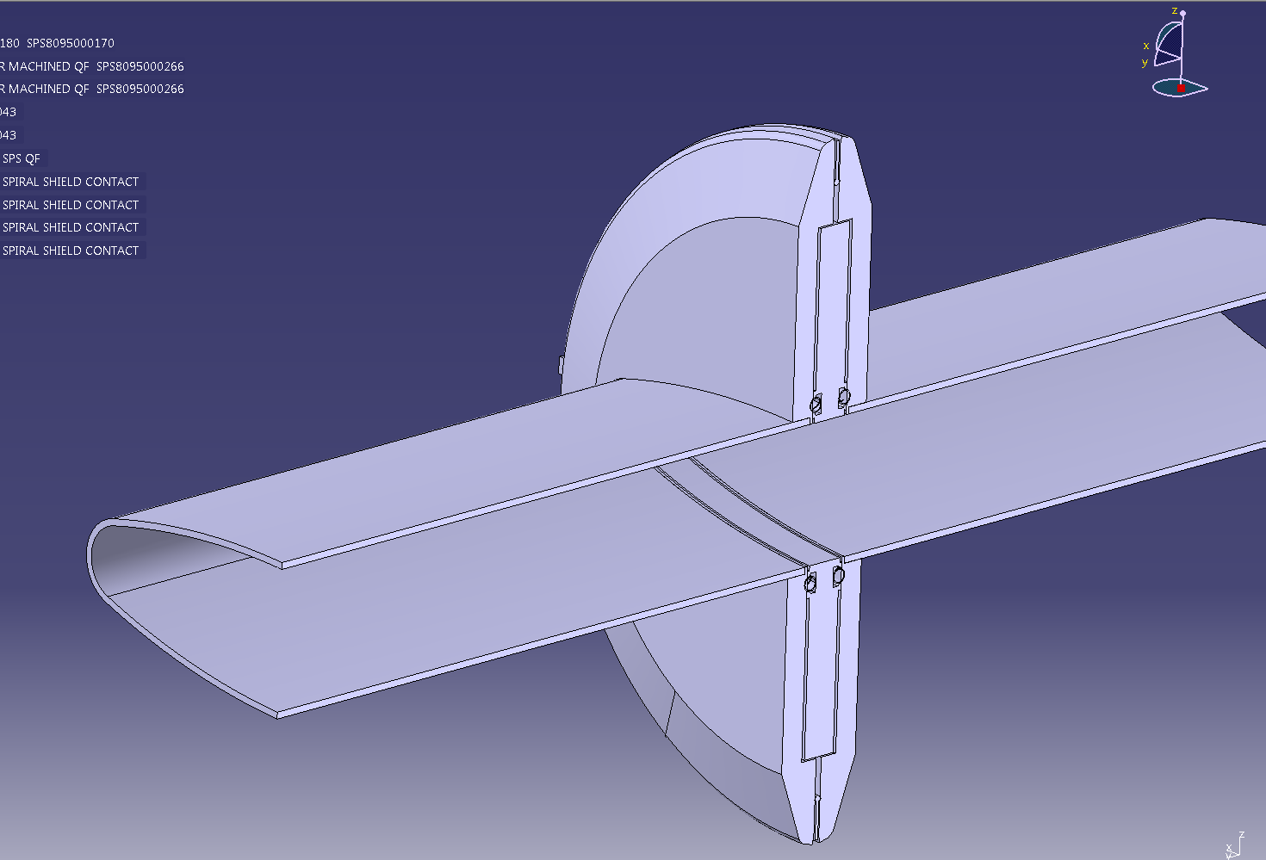
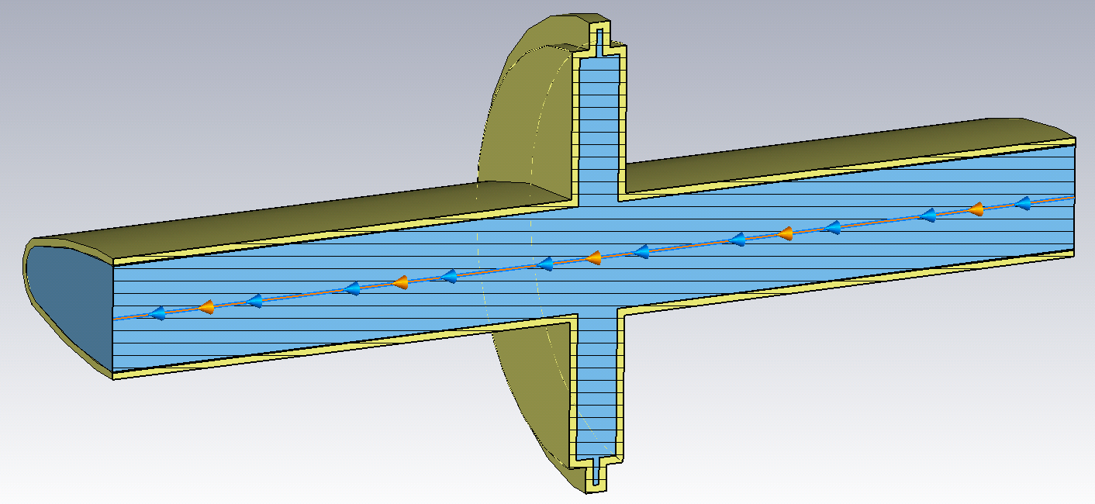
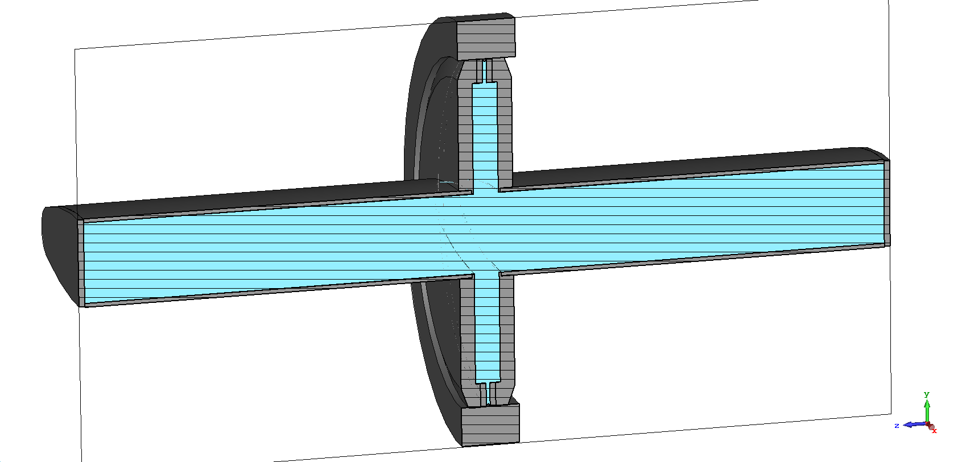
QF/QF VF Simulation Results
ST0779797
J.E. Varela
Impedance model slides 2015
f [GHz] | Z [Ω] | Q | R/Q [Ω]
1.593 | 27000 | 930 | 29
3.19 | 330 | 1500 | 0.22
3.522 | 8700 | 1400 | 6.2
5 | 120 | 10 | 12
EIG results
f [GHz] | Z [Ω] | Q | R/Q [Ω]
1.612 | 19699 | 814 | 24.2
3.216 | 271 | 1068 | 0.3
3.558 | 6987 | 1218 | 5.7
4.001 | 39611 | 2729 | 14.5
Presentation: 24/10/2013 [1]
f [GHz] | Z [Ω] | Q | R/Q [Ω]
1.61 | 29400 | 980 | 30
[1] http://paf-spsu.web.cern.ch/paf-spsu/meetings/2013/m24-10/SPSflanges_meas_sim_24_10.pptx

Slide 4
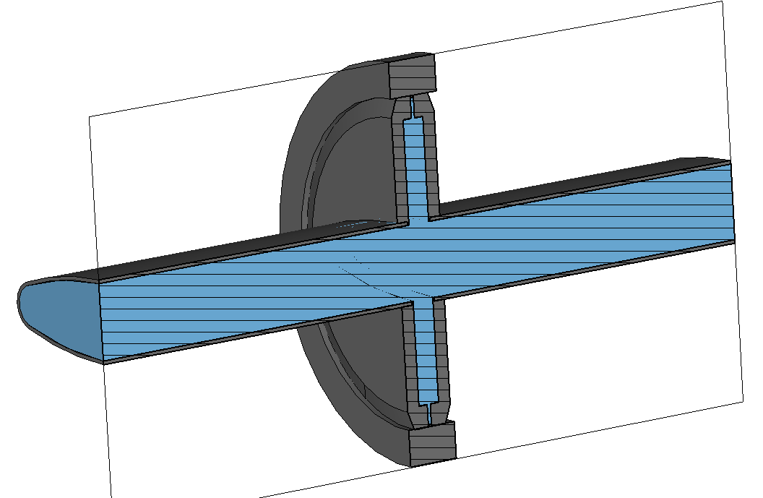
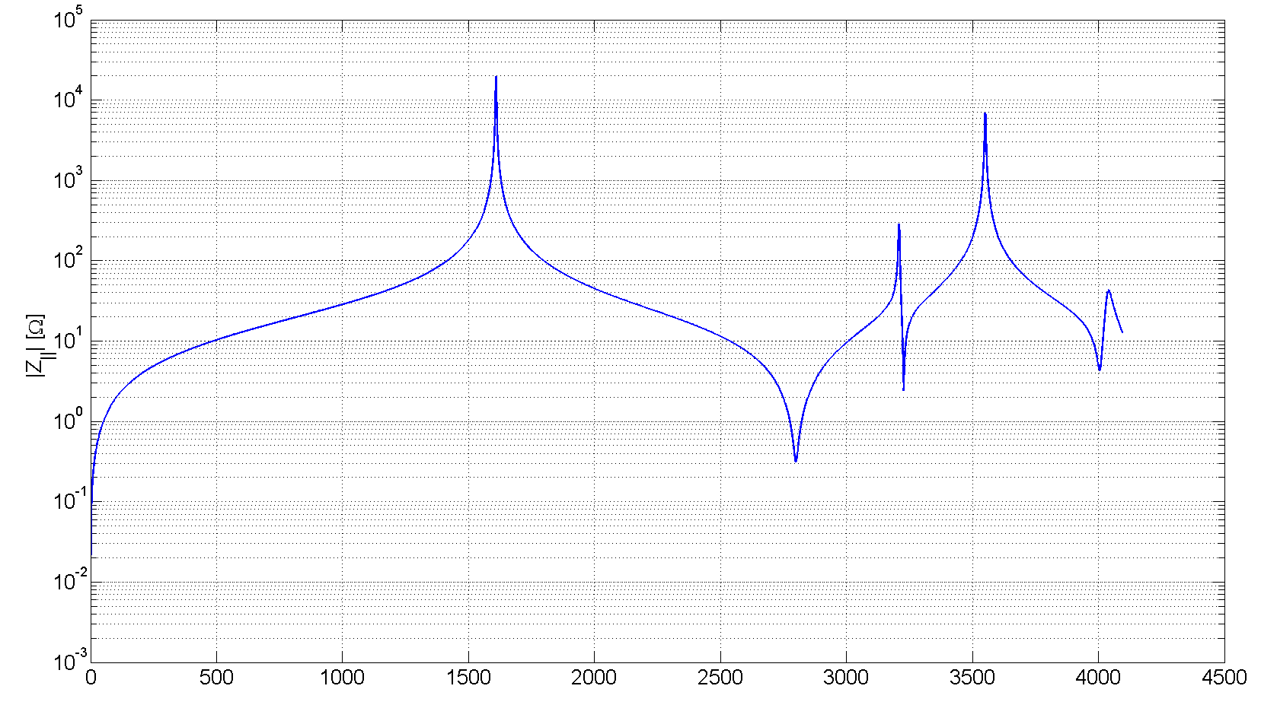
QF/QF VF Simulation Results
EIG results (closed structure)
NL-EIG results (open structure)
WAK results (open structure)
f [GHz] | Z [Ω] | Q | R/Q [Ω]
1.612 | 19699 | 814 | 24.2
3.216 | 271 | 1068 | 0.3
3.558 | 6987 | 1218 | 5.7
4.001 | 39611 | 2729 | 14.5
f [GHz] | Z [Ω] | Q | R/Q [Ω]
1.609 | 19795 | 819 | 24.2
3.209 | 288 | 1048 | 0.3
3.551 | 6962 | 1223 | 5.7
4.042 | 43 | 170 | 0.3
f [GHz] | Z [Ω] | Q | R/Q [Ω]
4.048 | 1122 | 3114 | 0.4
Further studies needed. (i.g. HFSS PML interface, etc.)
Performing EIG and WAK simulations is beneficial, unless the NL-EIG solver is being improved.

Slide 5
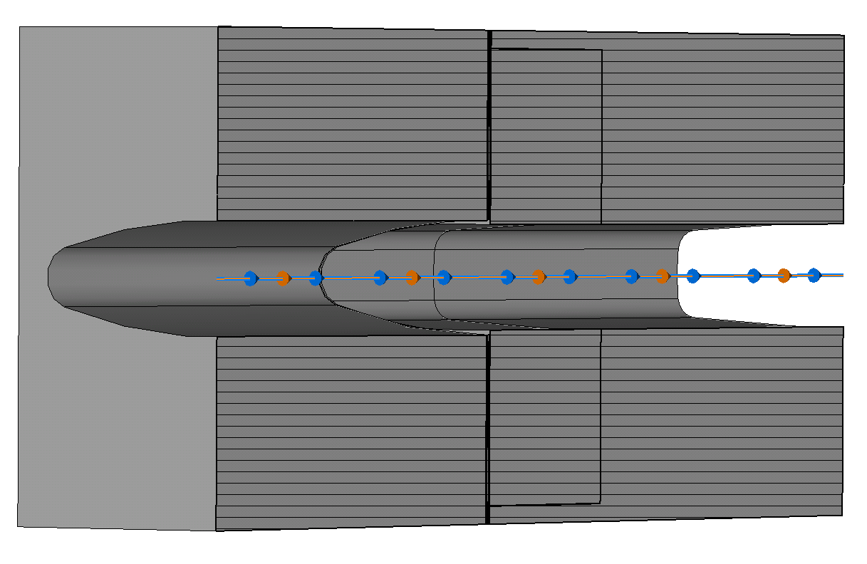
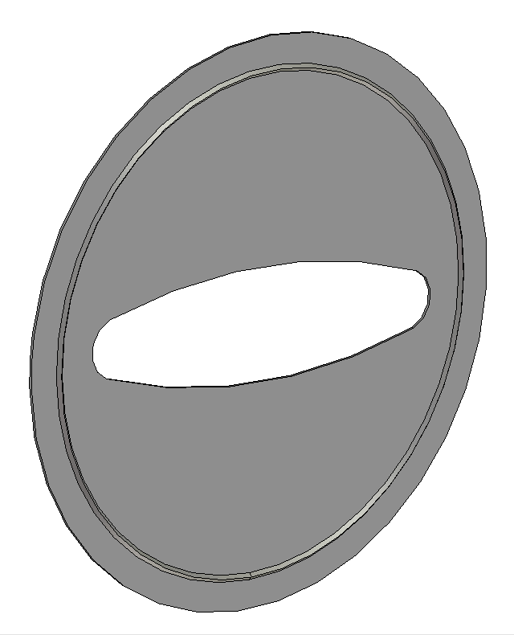
Gasket Gap Filled With Blank Seal
QF
MBA
Blank seal with QF bp

Slide 6
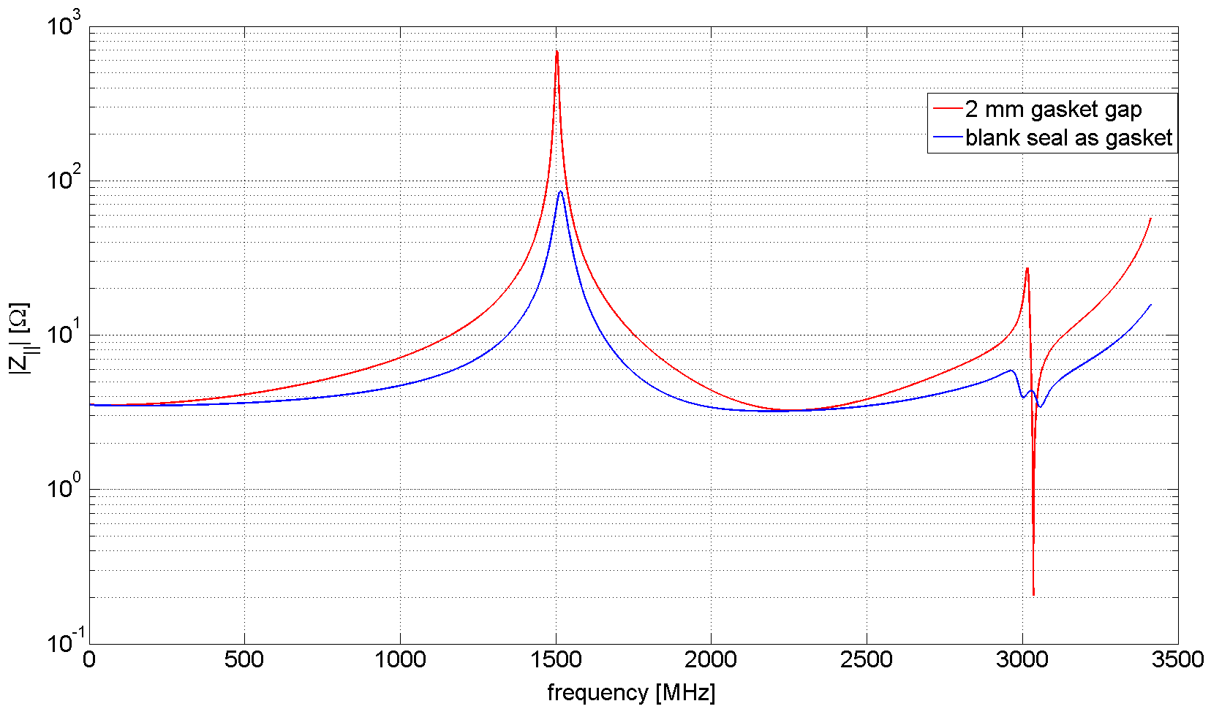
WAK Simulation Results – Gasket Gap Filled
f [GHz] | Z_{s} [Ω] | Q [-] | R/Q [Ω]
1.503 | 695.2 | 178 | 3.9
f [GHz] | Z_{s} [Ω] | Q [-] | R/Q [Ω]
1.515 | 85.4 | 44 | 1.9

Slide 7
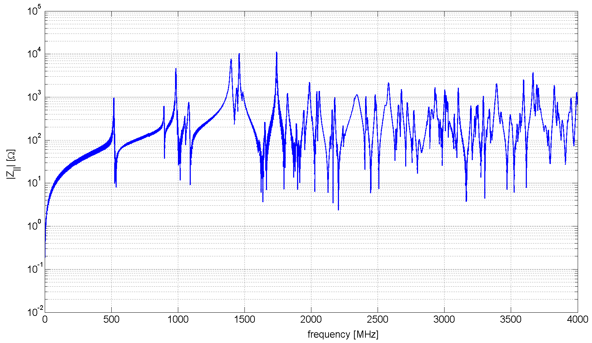
Unshielded PP with VVSB
How many items? → needs to be provided by VSC

Slide 8
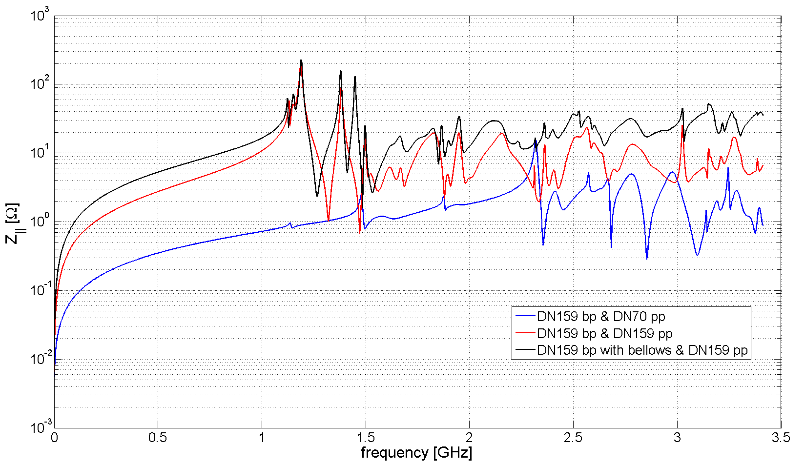
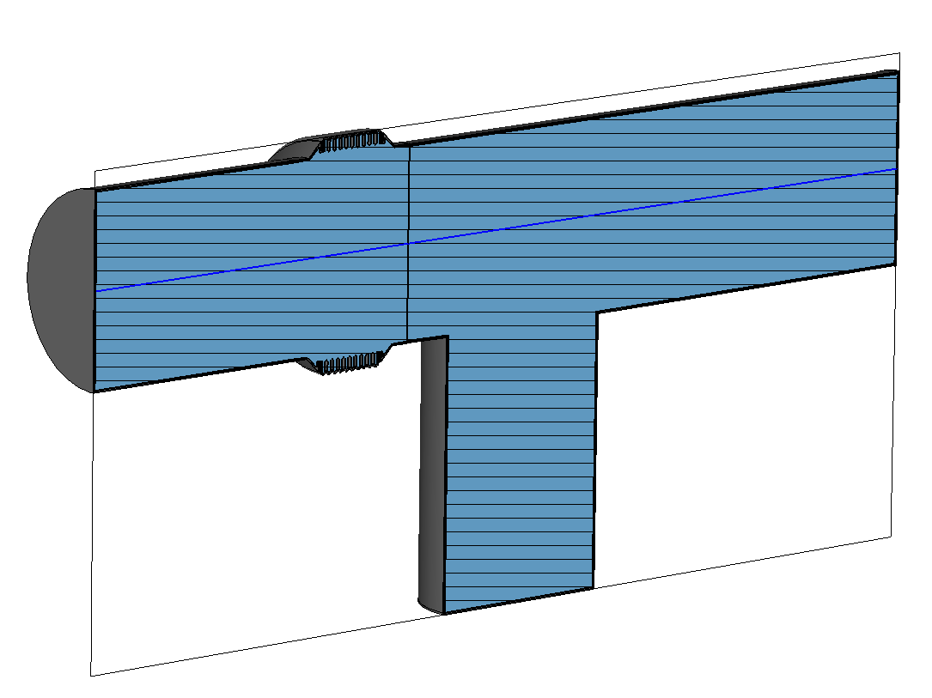
PP without cross sectional change
bellows
DN159
DN159
DN159
DN70
DN159
DN159
How many items? → needs to be provided by VSC

Slide 9
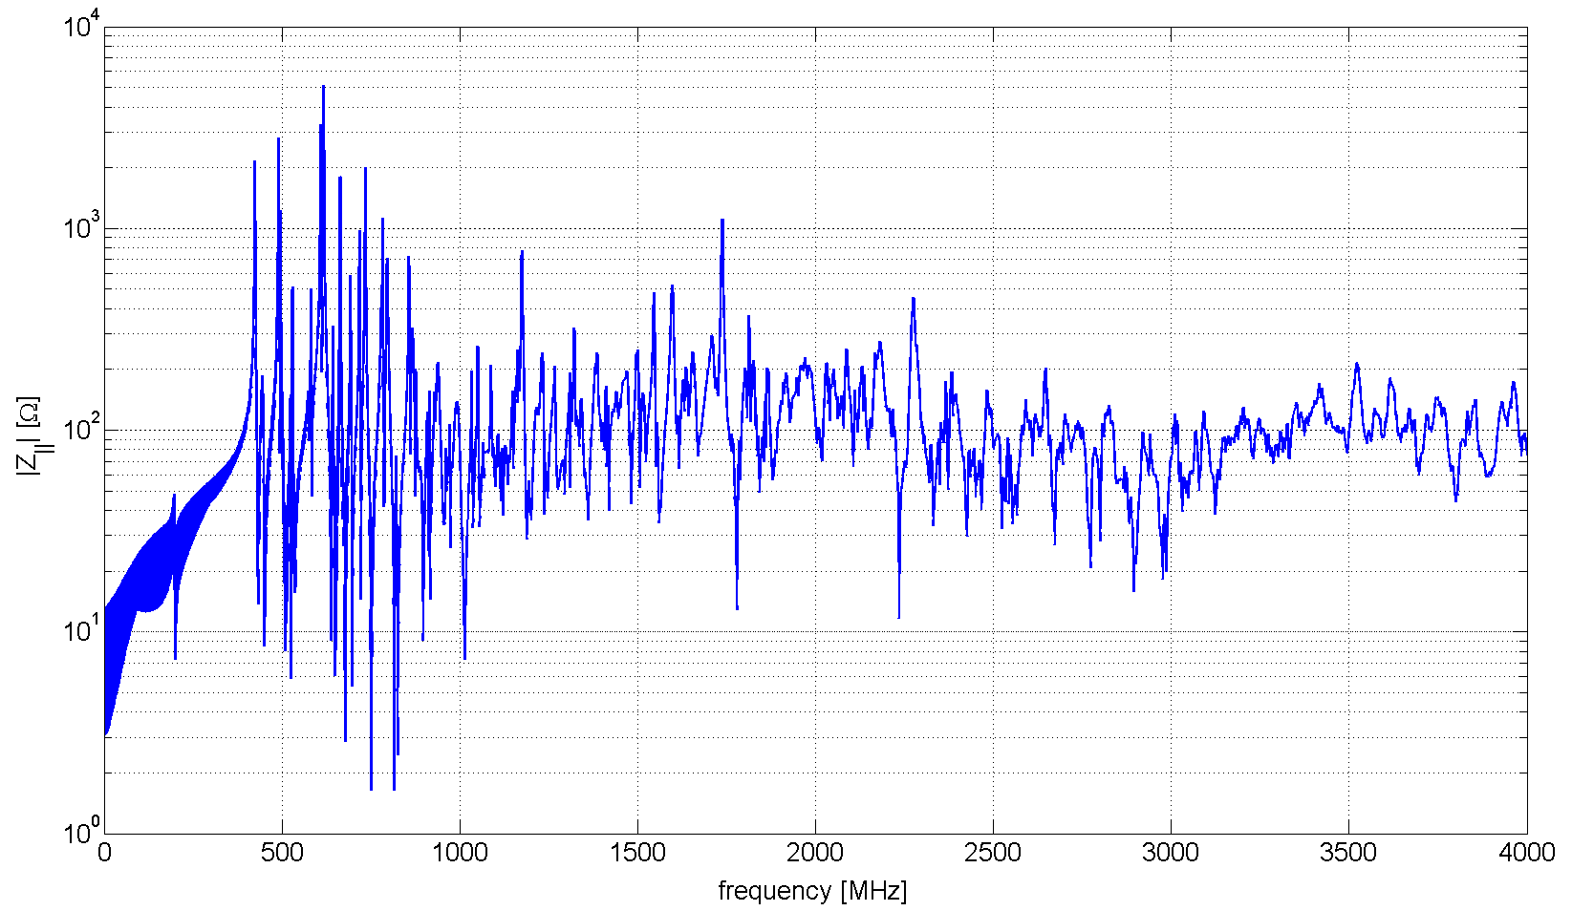
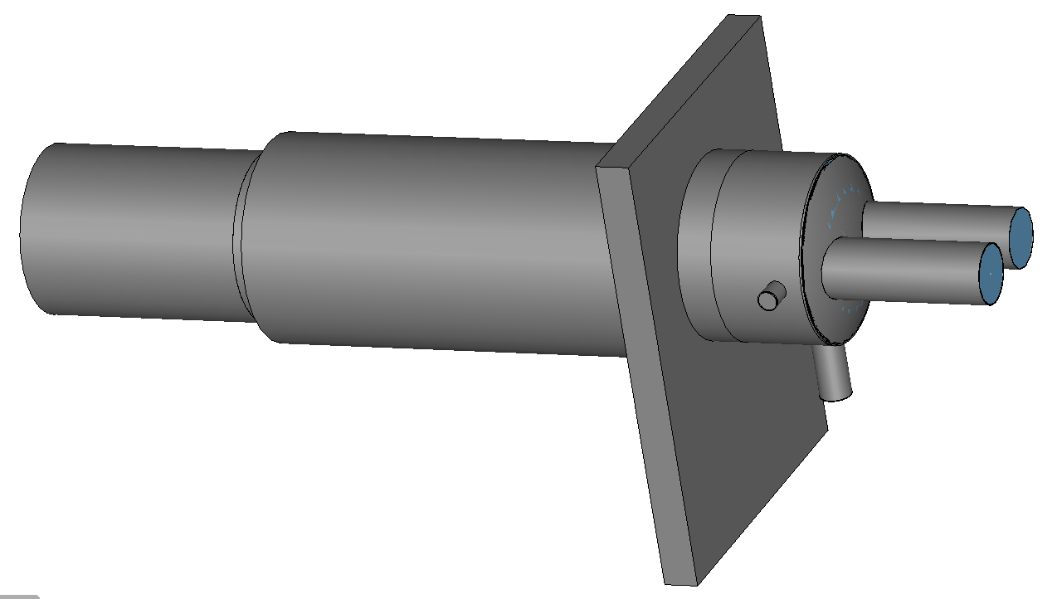
DN400 Valve (VVSF)
Further simulations needed.
VVSF
VECO
VECL
VECM
2 items? → needs to be verified by VSC

Slide 10
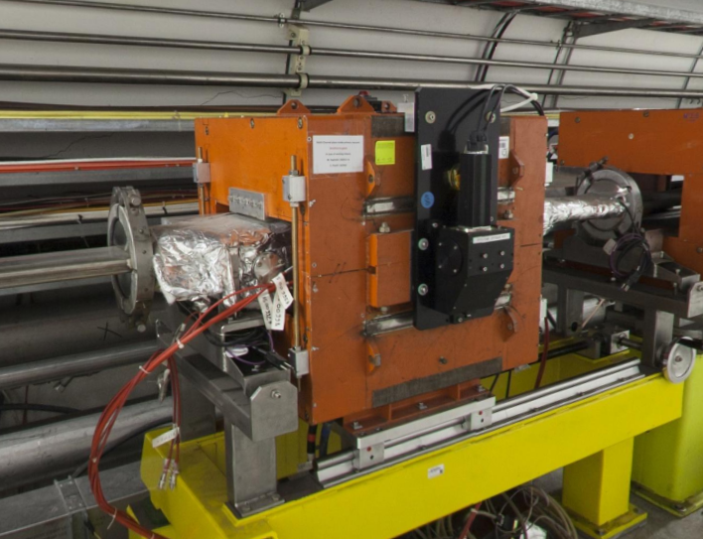
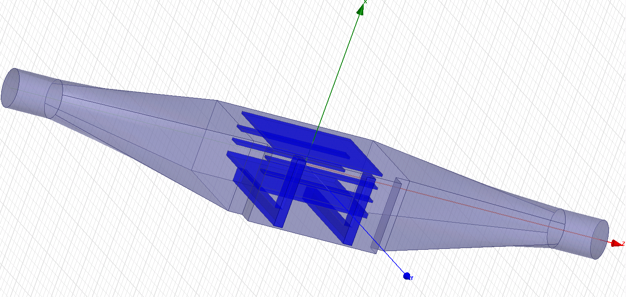
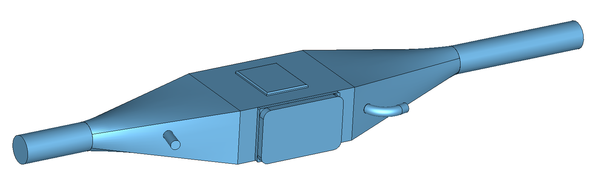
LHC-BGI
HFSS model derived from A. Grudiev
BIPMH.51634
New CST model of empty tank
Beam induced heating issues in the LHC
All 4 devices were removed from the LHC
We have identified the reason: rel. broad band impedance of the device due to
NEG coating
There are 2 devices (BIPMH.51634 & BIPMV.51734) currently in the SPS
Further studies requested by BE-BI

Slide 11
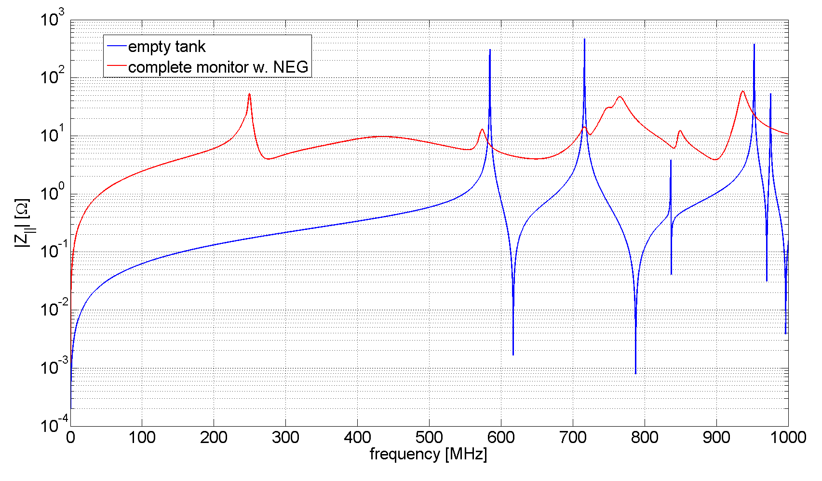
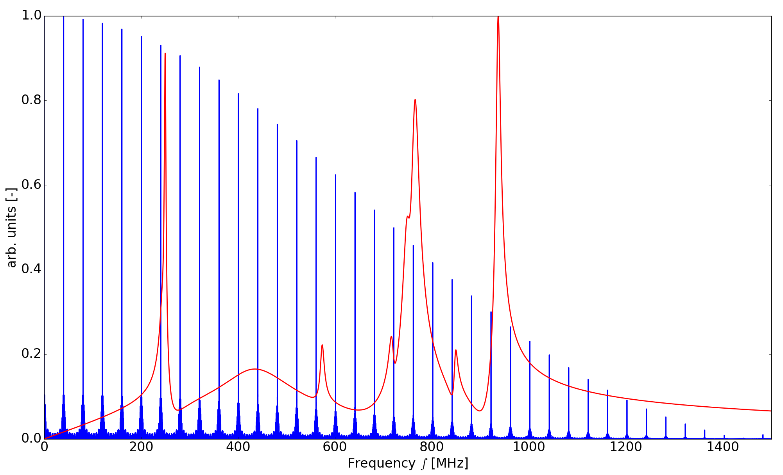
LHC-BGI
NEG coated electrodes power loss: 53.6 W
Imp. Spectr.
Further systematic checks of the current imp. model are advisable.
LHC-BGIs in the SPS could be fitted with temperature probes.
LHC beam spectrum blue; impedance spectrum of the first 20 modes red (from HFSS)
Courtesy A. Lasheen
Empty tank power loss: 123 mW
Simulations performed with 50 Ω/□
Further details: https://indico.cern.ch/event/637413/contributions/2582038/attachments/1457809/2252597/11052017_IWG_nr9_LHC_BGI_v0.pptx

Slide 12
Conclusion
Further systematic checks of the current imp. model are advisable.
LHC-BGIs in the SPS could be fitted with temperature probes.

Slide 13
GOOD LUCK, BE-RF (BR) & LIU/HiLumi LHC

