Slide 1
TMCI and instability studies in Q22
Mario Beck – LIU-SPS BD WG -14.12.2017
Thanks to: Hannes Bartosik, Kevin Li, Giovanni Rumolo, Michael Schenk,
The injectors operator teams

Slide 2
Introduction I
Transverse Mode Coupling Instability (TMCI) is a single bunch instability caused by the transverse wake field.
Theoretically the TMCI threshold can be described as seen below [1]:
$R$ : machine circumference
$ε_{z}$ : longitudinal emittance
$Q_{y}^{′}$ : vertical chromaticity
$η$ : slippage factor
$\left|Z_{y}^{BB}\right|$: Impedance of broad band resonator model
$ω_{r}$ : resonance frequency of broad band resonator model
$ω_{0}$ : revolution frequency of the machine
$β_{y}$ : betatron function of the machine
$$N_{thr}^{TMC}=\frac{16\sqrt{2}}{3π}\frac{R\left|η\right|ε_{z}}{β_{y}eβ^{2}c}\frac{ω_{r}}{\left|Z_{y}^{BB}\right|}\left(1+\frac{Q_{y}^{′}ω_{0}}{ηω_{r}}\right)$$
[1] H. Bartosik - Beam dynamics and optics studies for the LHC injectors upgrade

Slide 3
Introduction II
The influence of the variable factors of the intensity threshold will be investigated.
TMCI has been measured in the SPS in Q20 and Q26 optics before [1].
Now the measurements in the SPS Q22 optic.
TMCI represents an intensity limitation and is thus a potential issue for the LIU.

Slide 4
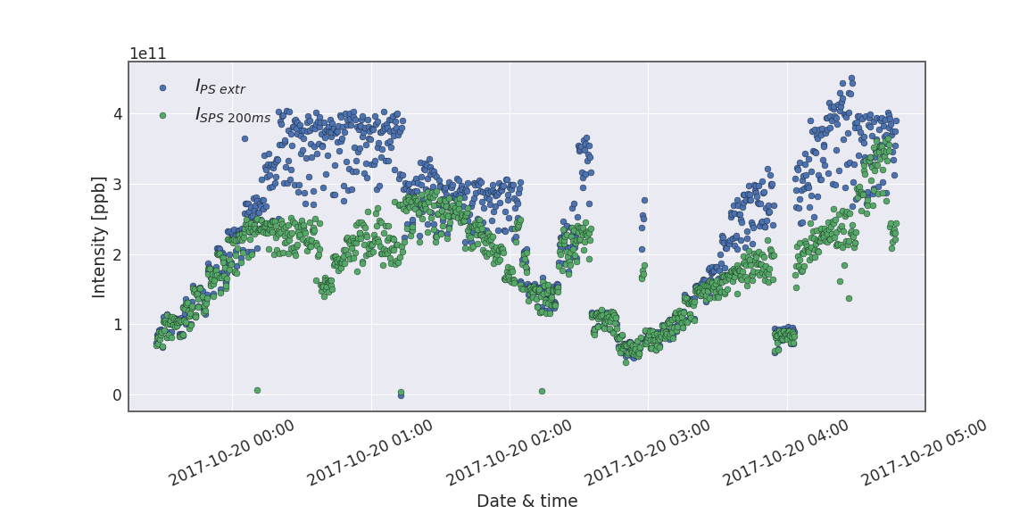
Overview over MD
TMCI MD the 19th to 20th of October 2017.
We observe high losses in the SPS.

Slide 5
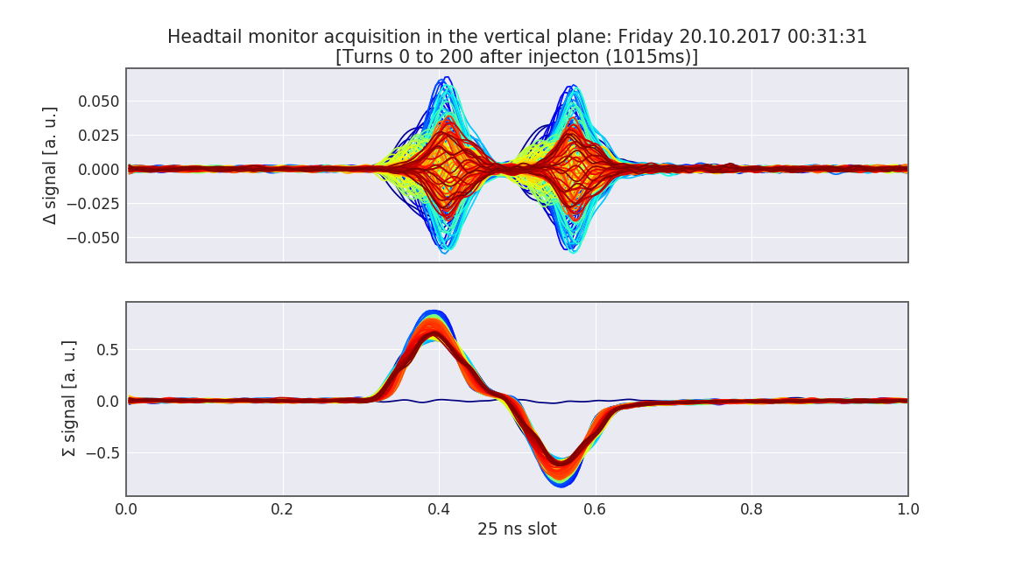
Pattern of the losses
But are the losses we see due to TMCI?
YES! => we observe the traveling wave pattern typical for TMCI.

Slide 6
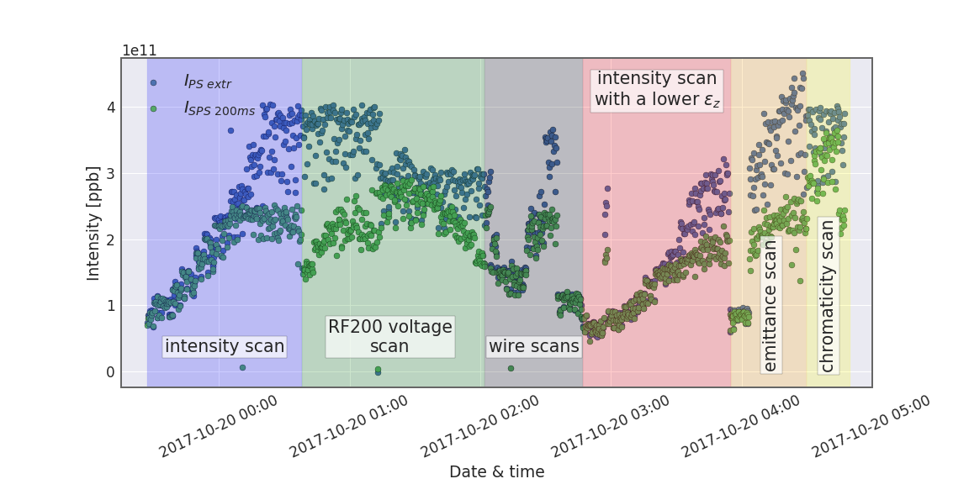
Overview over MD II
To see effects of different parameters on the TMCI threshold, scans were done.

Slide 7
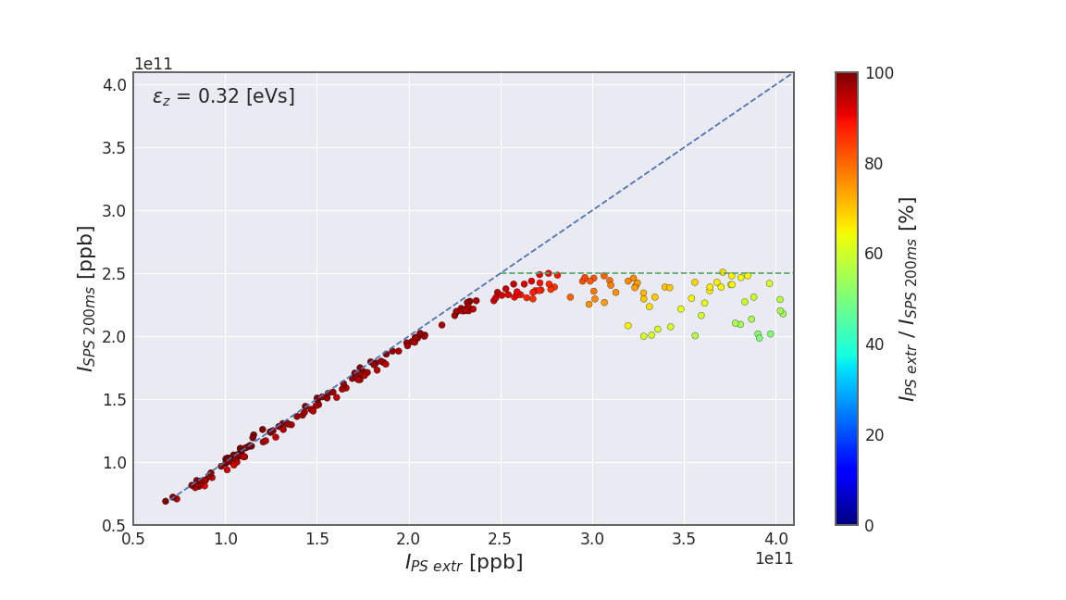
Intensity scan I
RF200 at 2.7 MV
$Q_{y}^{′}$~ 0.7
$ε_{z}$ ~ 0.32 [eVs]
We observed a TMCI threshold of 2.5e11 ppb in the SPS.

Slide 8
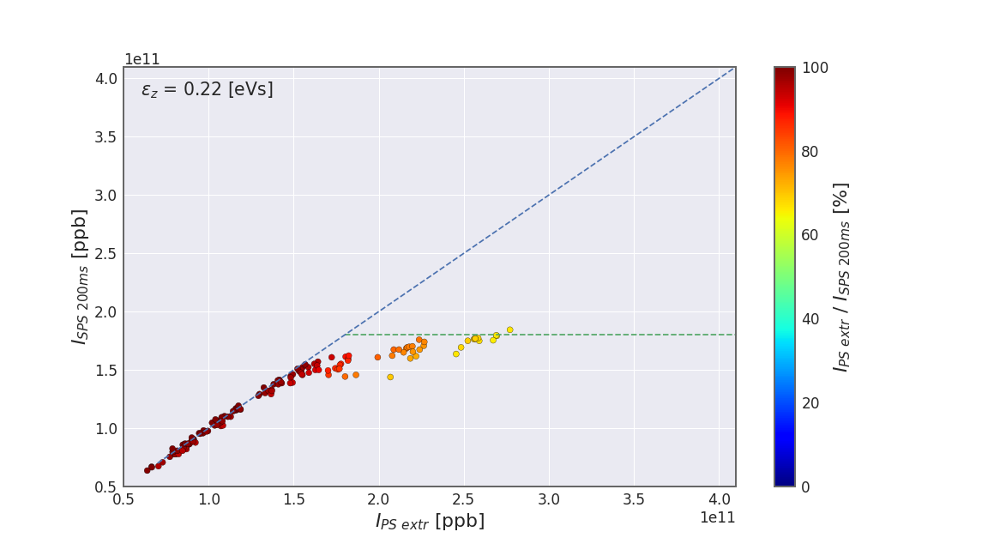
Intensity scan II (smaller $ε_{z}$)
RF200 at 2.7 MV
$Q_{y}^{′}$~ 0.7
$ε_{z}$ ~ 0.22 [eVs]
We observed a lower TMCI threshold of 1.8e11 ppb as expected.

Slide 9
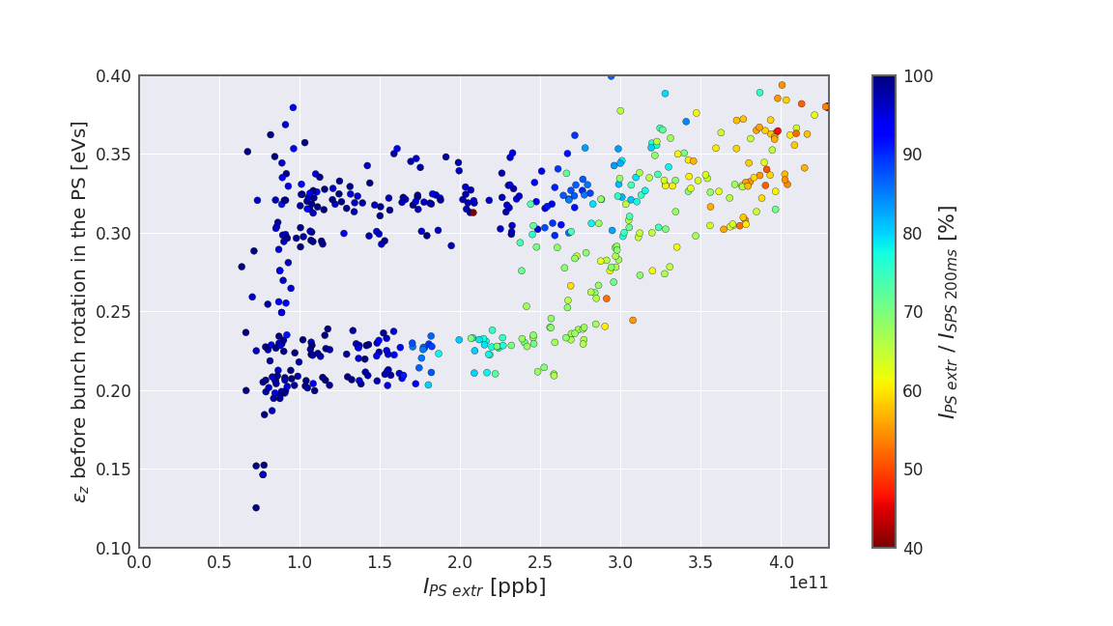
Emittance vs. intensity scan
RF200 at 2.7 MV
$Q_{y}^{′}\sim$0.7
The dependency on intensity and longitudinal emittance are clearly observed.

Slide 10
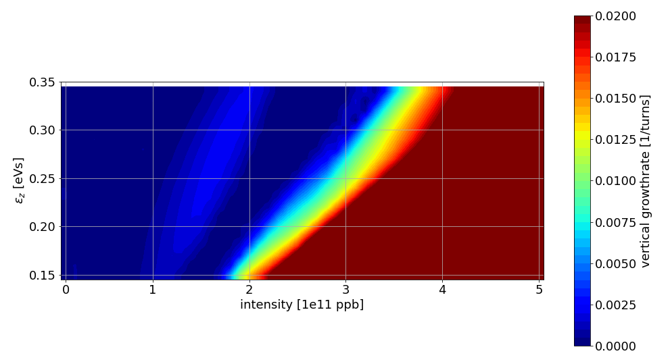
Compare to Simulations
As no turn by turn data of the first turns is available, the growth rate of the measured data is represented by the losses from PS to SPS.
PyHEADTAIL was used for the simulations.

Slide 11
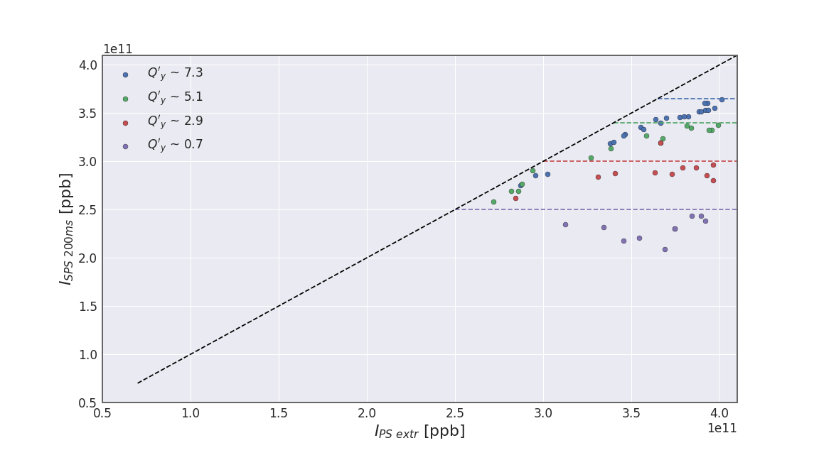
Chromaticity scan
$ε_{z}$ ~ 0.32 [eVs]
RF200 at 2.7 MV
As expected; higher chromaticity leads to a higher TMCI threshold.

Slide 12
Conclusion & outlook
The TMCI has been observed an investigated during measurements in the Q22 optics.
The theoretical dependencies have been shown in measurements.
A good setup of the machines can lead to a TMCI threshold which might just be suffucient for LIU.
Test the effect of the damper and the transverse wideband feedback on LIU intensity TMCI [2].
[2] K. Li - SPS TMCI with the Q22 optics – HSC section meeting – 27.11.2017

Slide 13
Thank you for your attention! Questions?

Slide 14
Backup slides

Slide 15
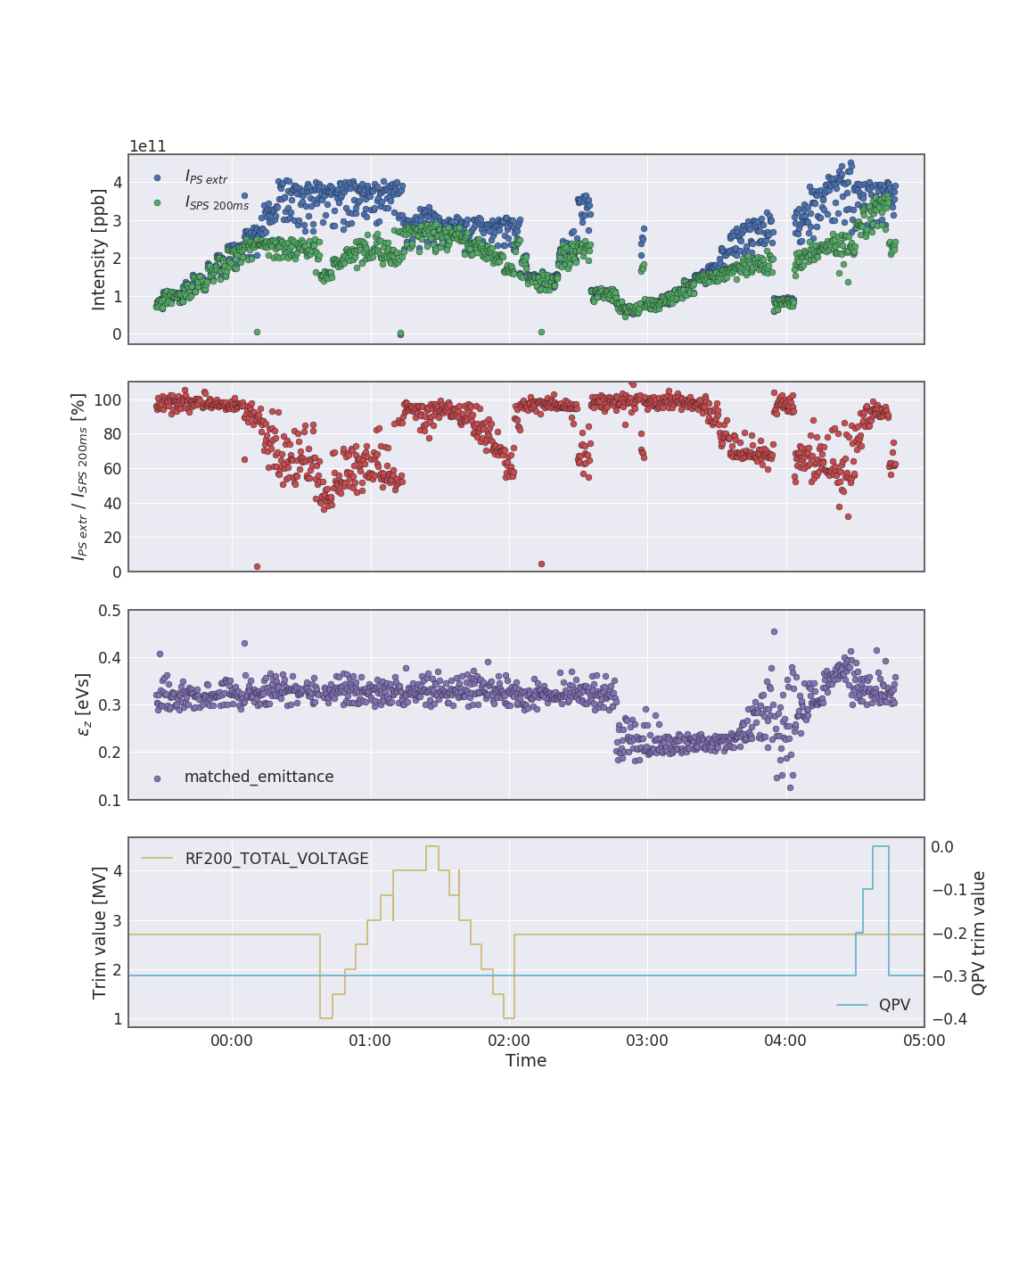
Q22 TMCI MD 19/20 October 2017

Slide 16
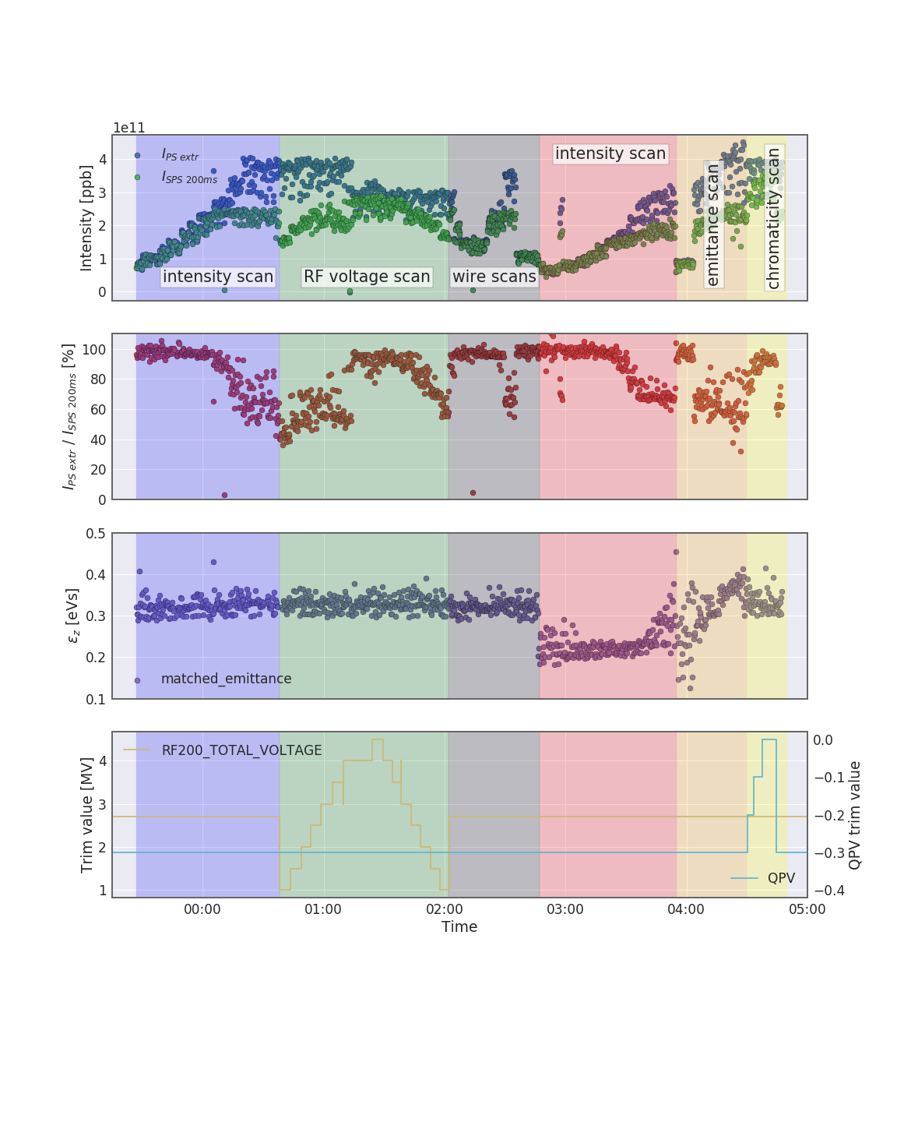
Q22 TMCI MD 19/20 October 2017

Slide 17
Introduction
TMCI (Transverse Mode Coupling Instability) also called fast head tail instability.
Instability created due to the transverse wake.
The leading (transverse offset) particles create a transverse wake which excites the trailing particles.
The particles exchange their positon every half synchrotron period; the faster the synchronous motion is the higher the instability threshold gets.

Slide 18
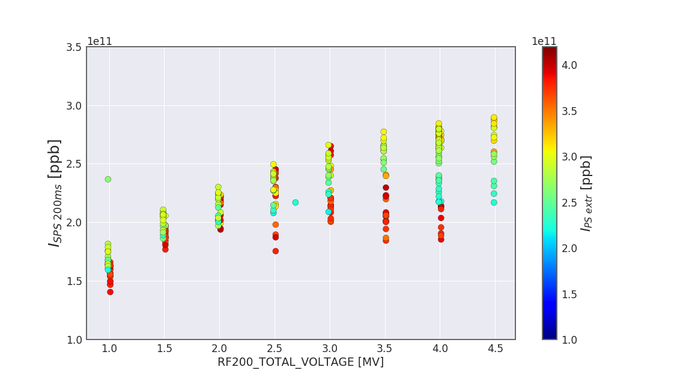
RF200 voltage scan
$$Q_{s}=\frac{ω_{s}}{ω_{0}}=\sqrt{\frac{eVηh}{2πE_{0}β^{2}}}$$
$Q_{s}$: synchrotron tune
$V$ : RF voltage
$E_{0}$: reference energy
$Q_{y}^{′}$~ 0.7
$ε_{z}$ ~ 0.32 [eVs]
Injecting less intensity seems to avoid the fast TMCI losses.
The threshold further seems to be further approached.

Slide 19
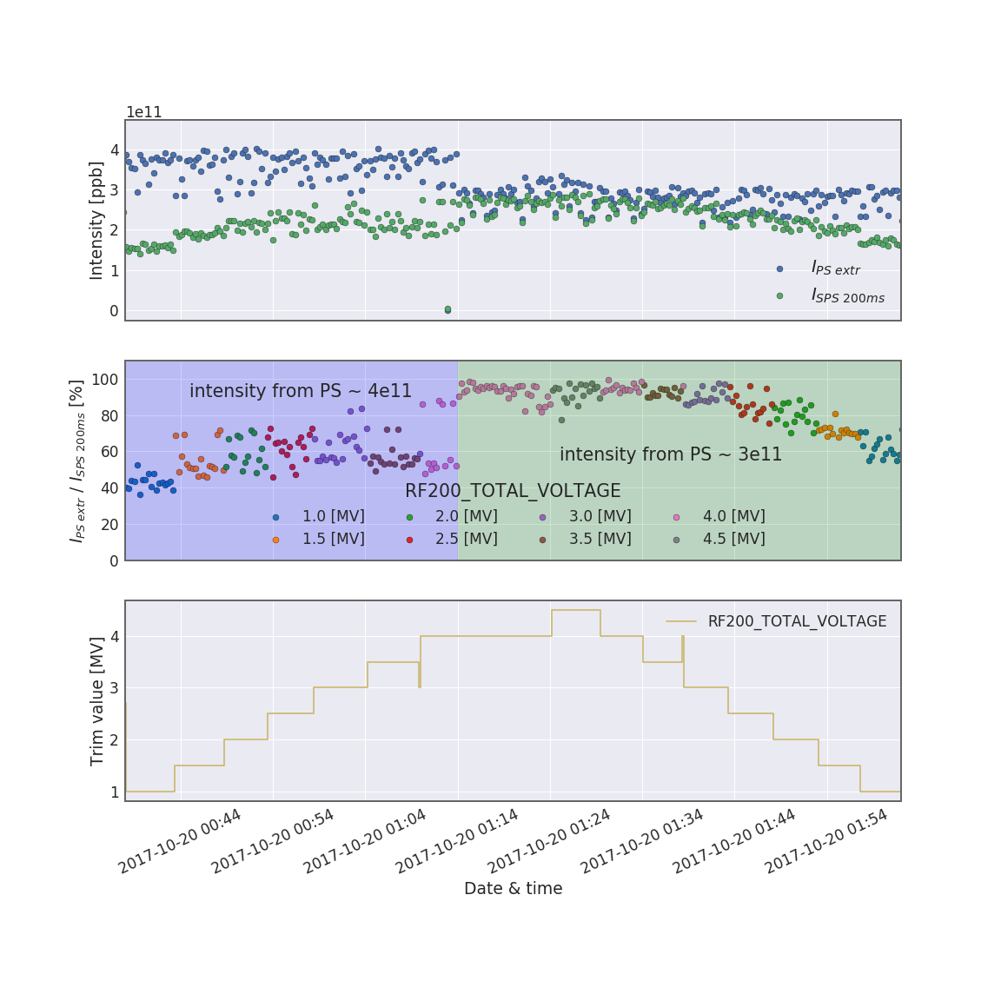
RF200 voltage scan I
$ε_{z}$ ~ 0.32 [eVs]
$Q_{y}^{′}$ ~ 0.7
As the TMCI threshold also depends on $Q_{s}$ we changed the RF200 voltage [3].
$$Q_{s}=\frac{ω_{s}}{ω_{0}}=\sqrt{\frac{eVηh}{2πE_{0}β^{2}}}$$
$Q_{s}$: synchrotron tune
$V$ : RF voltage
$E_{0}$: reference energy
[3] K. Li – USPAS longitudinal beam dynamics - 2015

Slide 20
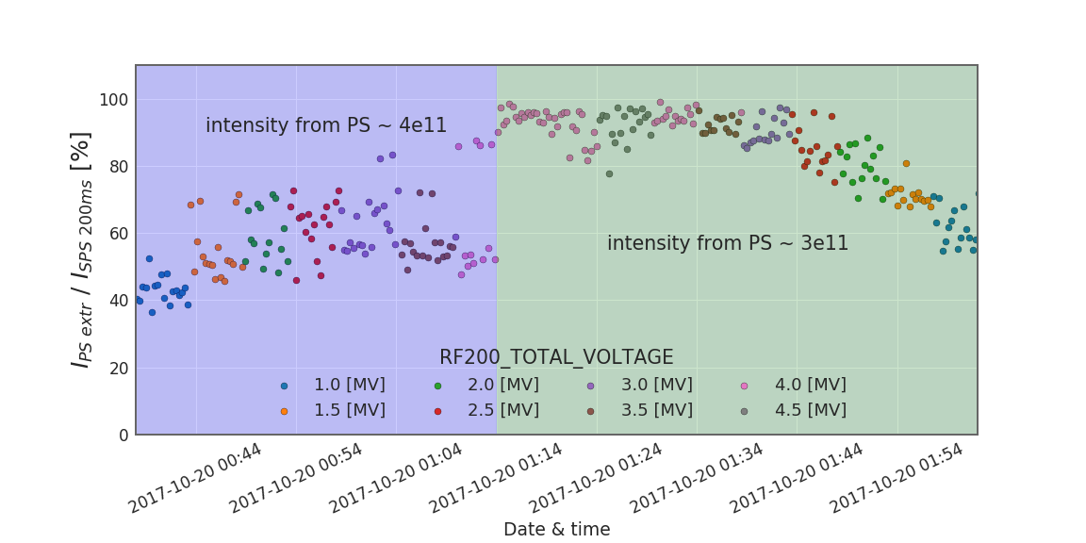
RF200 voltage scan II
$N_{thr}^{TMC}$ should scale
with $\sqrt{V}$: 2e11 with 1.5 MV
for 3MV: $2e11∙\sqrt{\frac{3MV}{1,5MV}}$ $=2.8e11$
Correct!
We observe a principal scaling with the RF voltage.
But also a higher intensity in the SPS when injected less from the PS.

Slide 21
Connecting $Q_{s}$ to $N_{thr}^{TMC}$ [1, 2]
$$Q_{s}=\frac{ω_{s}}{ω_{0}}=\sqrt{\frac{eVηh}{2πE_{0}β^{2}}}$$
$Q_{s}$ : synchrotron tune
$V$ : RF voltage
$E_{0}$ : reference energy
$p_{0}$ : reference momentum
$σ_{z}$ : longitudinal bunch length
$R$ : machine circumference
$ε_{z}$ : longitudinal emittance
$Q_{y}^{′}$ : vertical chromaticity
$η$ : slippage factor
$\left|Z_{y}^{BB}\right|$: Impedance of broad band resonator model
$ω_{r}$ : resonance frequency of broad band resonator model
$ω_{0}$ : revolution frequency of the machine
$β_{y}$ : betatron function of the machine
$$ε_{z}=4π\frac{Q_{s}}{ηR}p_{0}σ_{z}^{2}$$
$$N_{thr}^{TMC}=\frac{16\sqrt{2}}{3π}\frac{R\left|η\right|ε_{z}}{β_{y}eβ^{2}c}\frac{ω_{r}}{\left|Z_{y}^{BB}\right|}\left(1+\frac{Q_{y}^{′}ω_{0}}{ηω_{r}}\right)$$

Slide 22
Overview over MD
TMCI MD the 19th to 20th of October 2017.
In Q22 optics, single bunch, no acceleration.
TMCI threshold for LIU: 2.6e11 ppb [4]
Machine setup:
QPH = -0.05 => Q’ = 1.6
QPV = -0.3 => Q’ = 0.7
RF200 = 2.7 MV
RF800 = 0.27 MV
Beam Setup: PSB: MD4: MD_LHCINDIV_HI_INT_SPS_IMPEDANCE PS : MD7: MD_LHCINDIV_HI_INT_SPS_IMPEDANCE_PS SPS: LHC2: MD_26_L7200_Q22_2017_V1
[4] H. Bartosik – Q22 optics - SPS injection losses review, 30 November 2017

