Slide 1
Transverse beam dynamics and MDs in 2017
H. Bartosik, M. Beck, E. Bjorsvik, M. Carla’, K. Cornelis, W. Höfle, G. Iadarola, V. Kain, K. Li, L. Mether, G. Rumolo, M. Schenk, F. Velotti
in collaboration and with support of
T. Bohl, H. Damerau, B. Goddard, A. Lasheen, G. Papotti,
J. Repond, M. Schwarz, E. Shaposhnikova,
LIU-SPS BD meeting, 14 December 2017

Slide 2
Outline
Main (transverse) LIU SPS MD subjects from 2017
  Injection and flat bottom losses
  High intensity 25 ns run
  Q22
  High brightness and space charge studies
Priorities for 2018

Slide 3
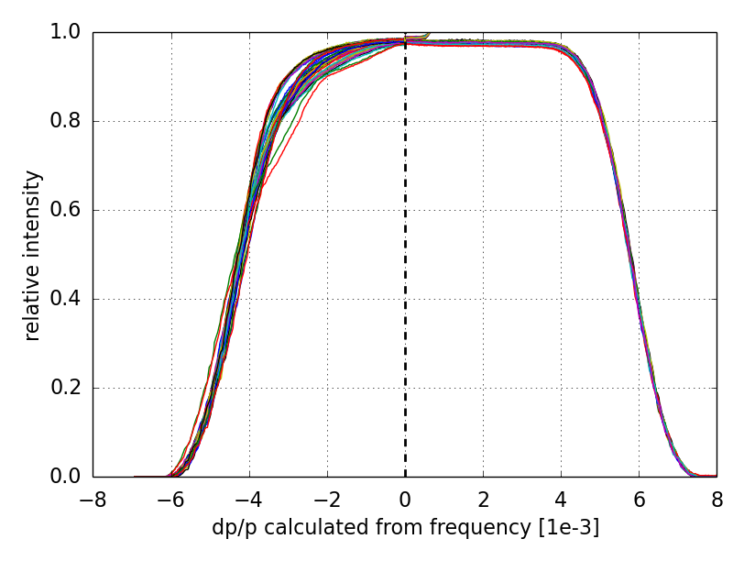
Injection and flat bottom losses
Main subject of MD studies in 2017 (following the efforts from previous years)
Momentum aperture limitation identified
  Asymmetric (smaller towards inside)
immediate losses for dp/p < 0
losses for mean dp/p > 3e-3
loss patterns depend on tune and chromaticity settings, but NOT
on position of
momentum
scraper
Center determined with BPMs

Slide 4
Injection and flat bottom losses
Main subject of MD studies in 2017 (following the efforts from previous years)
Momentum aperture limitation identified
  Asymmetric (smaller towards inside)
  QDs are more critical

Slide 5
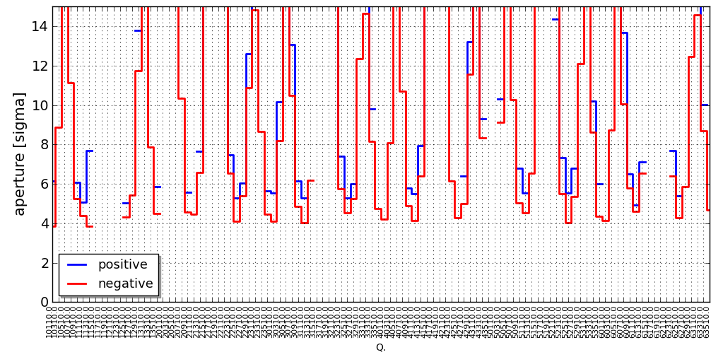
Injection and flat bottom losses
Main subject of MD studies in 2017 (following the efforts from previous years)
Momentum aperture limitation identified
  Asymmetric (smaller towards inside)
  QDs are more critical (design flaw of MBB-QD transitions)

Slide 6
Injection and flat bottom losses
Main subject of MD studies in 2017 (following the efforts from previous years)
Momentum aperture limitation identified
  Asymmetric (smaller towards inside)
  QDs are more critical (design flaw of MBB-QD transitions)
Impact of working point and non-linear chromaticity on losses
  Relatively large chromatic detuning for off momentum particles (due to dipole non-linearities)

Slide 7
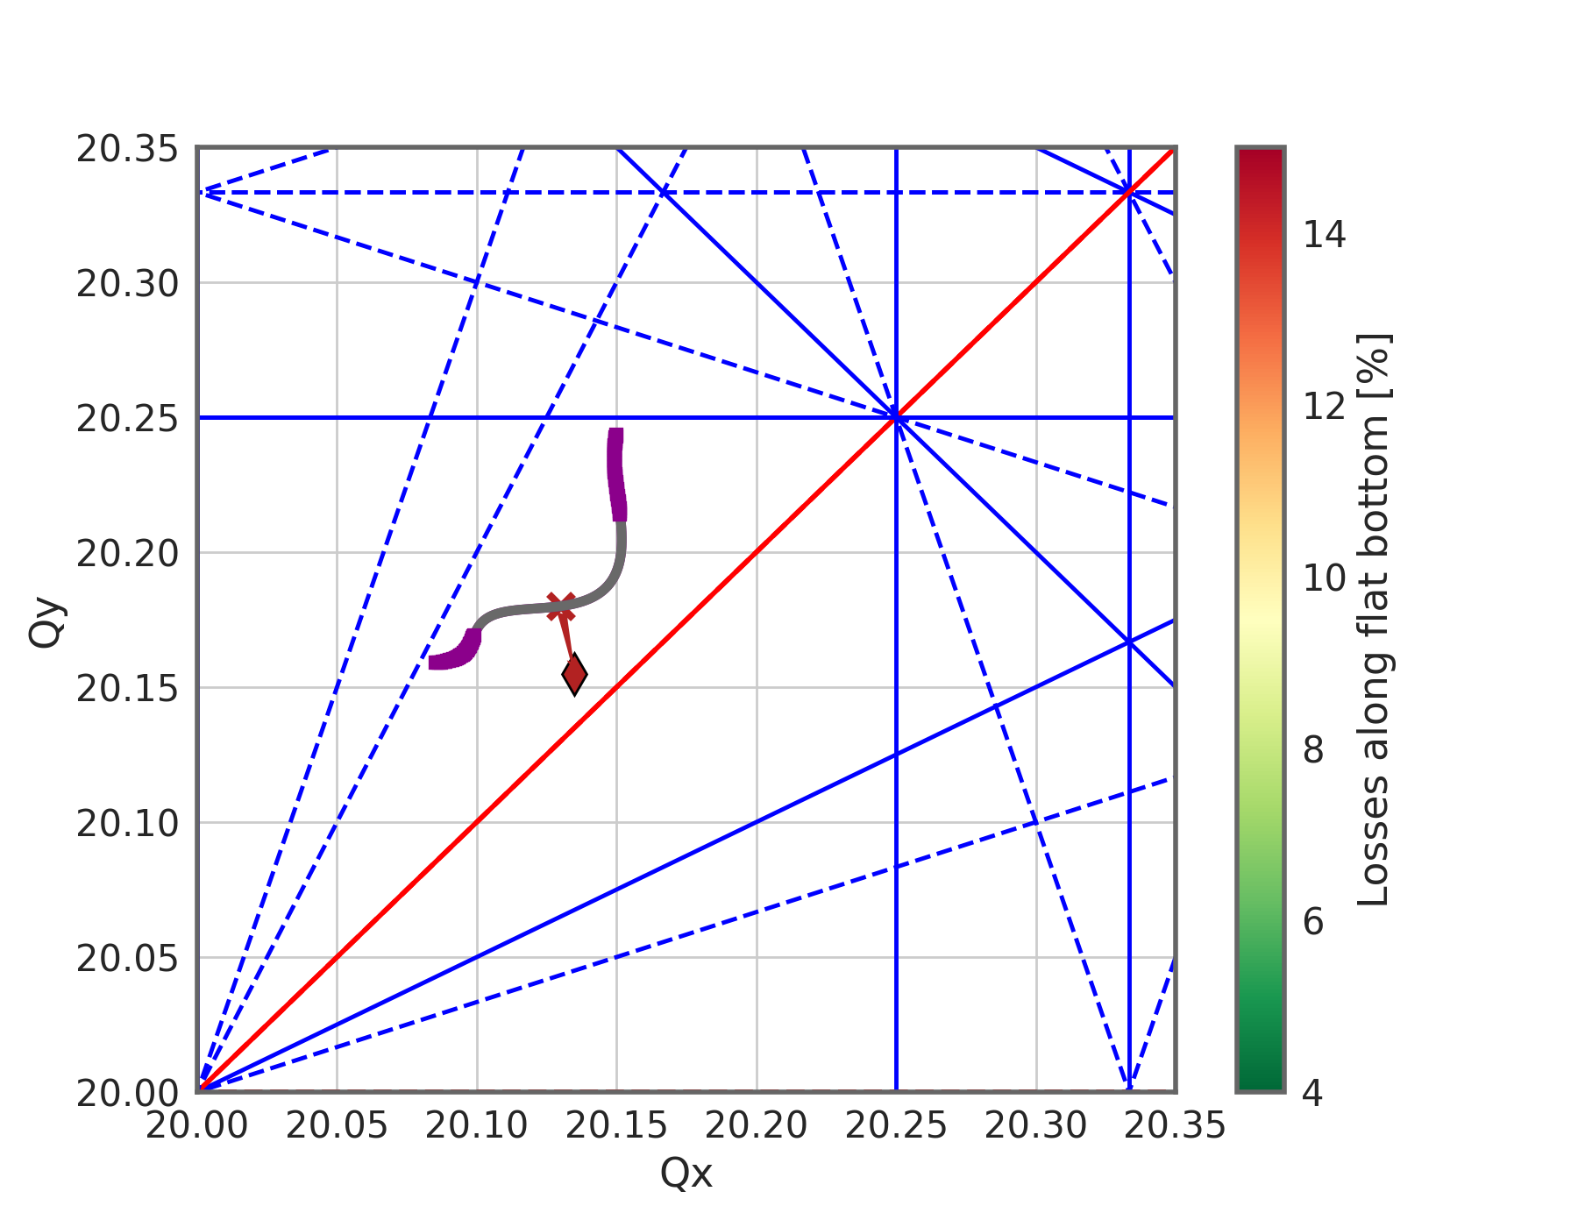
Injection and flat bottom losses
Main subject of MD studies in 2017 (following the efforts from previous years)
Momentum aperture limitation identified
  Asymmetric (smaller towards inside)
  QDs are more critical (design flaw of MBB-QD transitions)
Impact of working point and non-linear chromaticity on losses
  Relatively large chromatic detuning for off momentum particles (due to dipole non-linearities)
  Correction of coherent tune shift moves the incoherent tunes (incoherent tune shifts in addition)

Slide 8
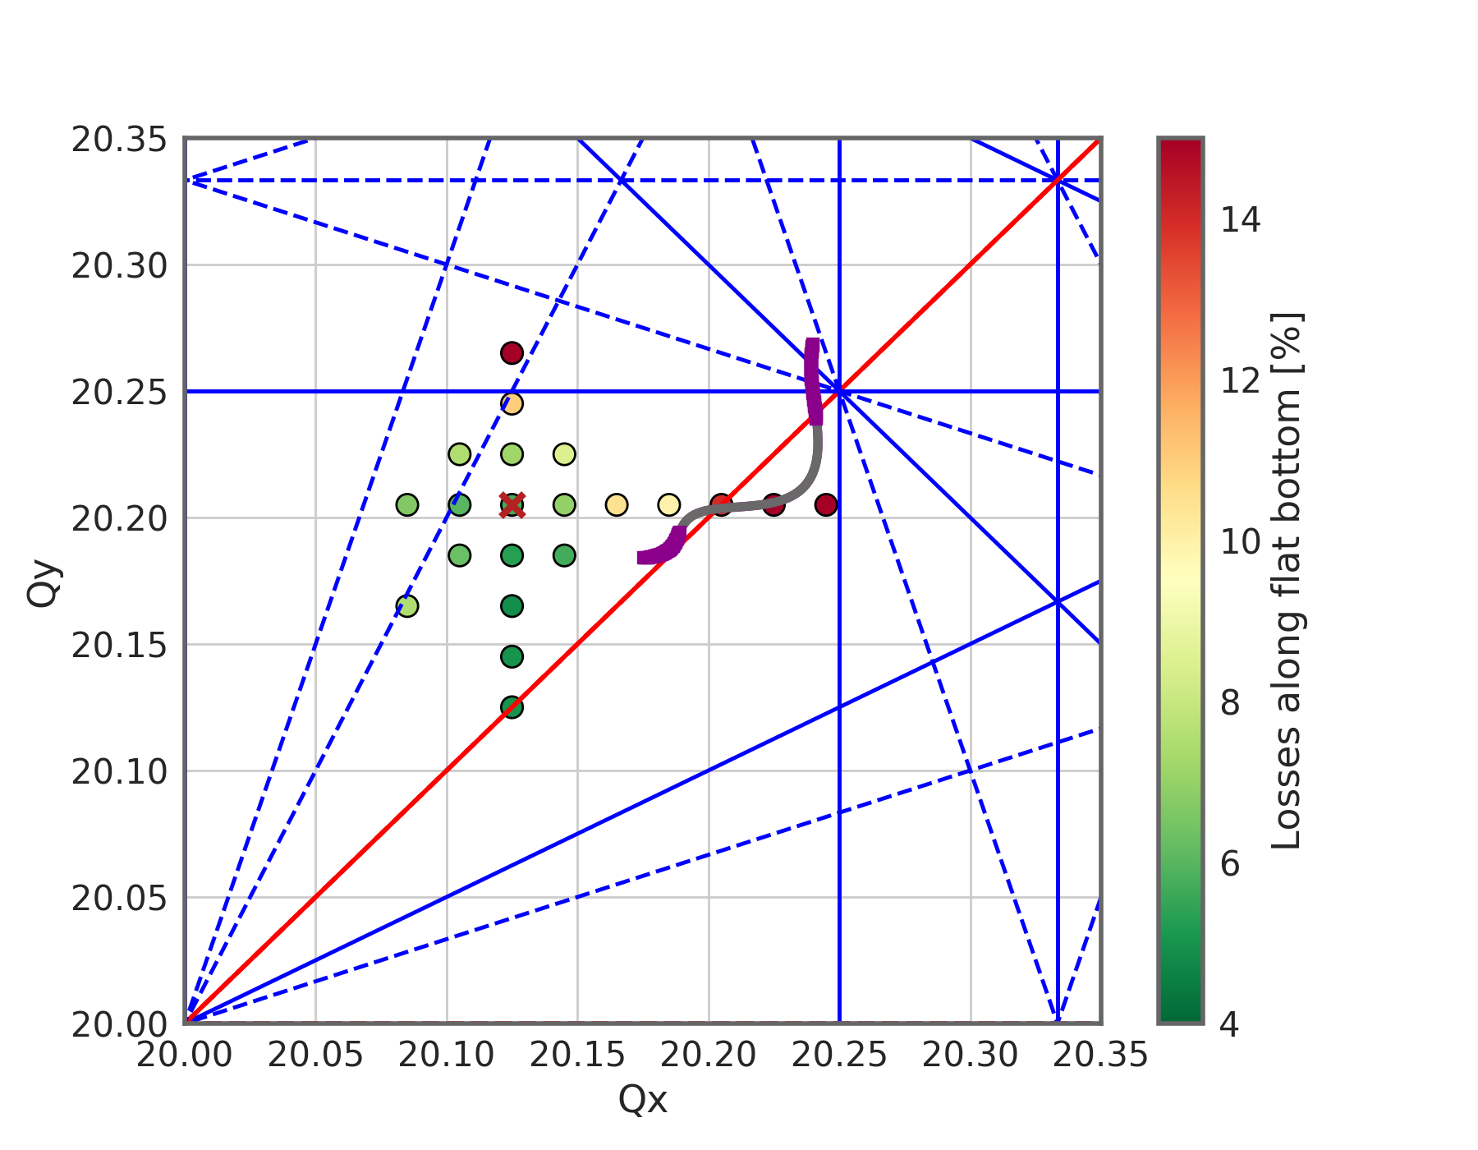
Injection and flat bottom losses
Main subject of MD studies in 2017 (following the efforts from previous years)
Momentum aperture limitation identified
  Asymmetric (smaller towards inside)
  QDs are more critical (design flaw of MBB-QD transitions)
Impact of working point and non-linear chromaticity on losses
  Relatively large chromatic detuning for off momentum particles (due to dipole non-linearities)
  Correction of coherent tune shift moves the incoherent tunes (incoherent tune shifts in addition)
  Present working point close to optimum (i.e. minimum losses)
In this plot the markers indicate where the bare machine working point would be (roughly)

Slide 9
High intensity 25 ns beam studies
Coherent tune shift bunch-by-bunch
  Relatively large tune shift accumulated along the train especially in vertical

Slide 10
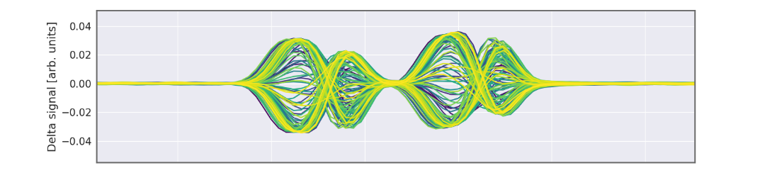
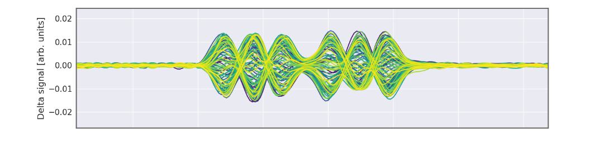
High intensity 25 ns beam studies
Coherent tune shift bunch-by-bunch
  Relatively large tune shift accumulated along the train especially in vertical
Horizontal (single bunch) instability with multiple batches
  ξ_{H} ~ 0.1 – 0.2 → mode 1
  ξ_{H} ~ 0.3 – 0.5 → mode 2
  ξ_{H} > 0.5 → instability mostly suppressed
  Alternatively: Octupoles + ξ_{H}
… transverse damper takes care of coupled bunch modes → clear improvement wrt 2015!
mode 1
mode 2

Slide 11
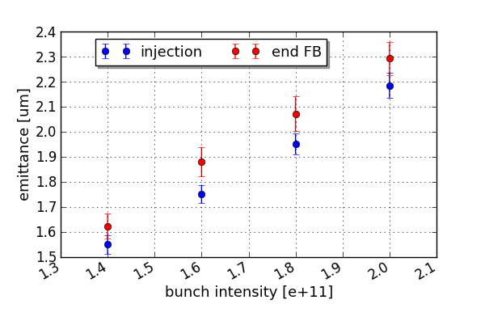
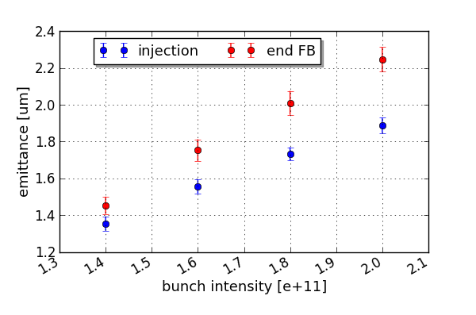
High intensity 25 ns beam studies
Coherent tune shift bunch-by-bunch
  Relatively large tune shift accumulated along the train especially in vertical
Horizontal (single bunch) instability with multiple batches
  ξ_{H} ~ 0.1 – 0.2 → mode 1
  ξ_{H} ~ 0.3 – 0.5 → mode 2
  ξ_{H} > 0.5 → instability mostly suppressed
  Alternatively: Octupoles + ξ_{H}
Emittance growth along flat bottom for higher intensities
  Vertical blow-up significantly increases with intensity
… transverse damper takes care of coupled bunch modes → clear improvement wrt 2015!
horizontal
vertical

Slide 12
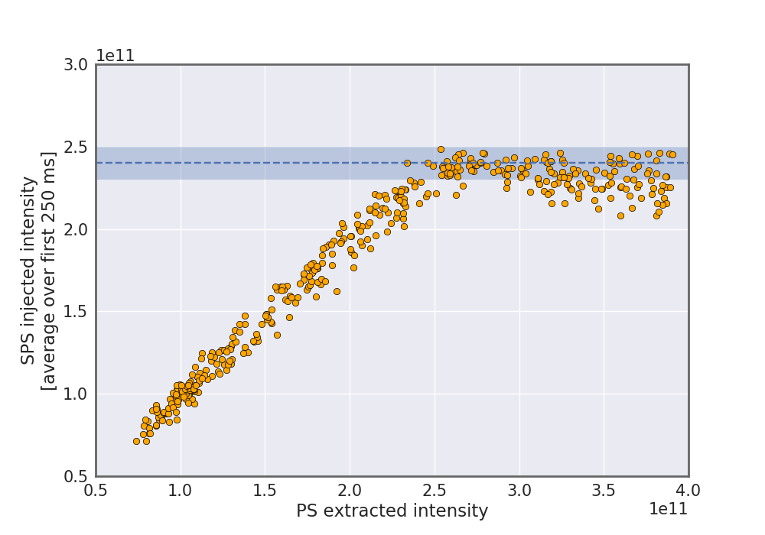
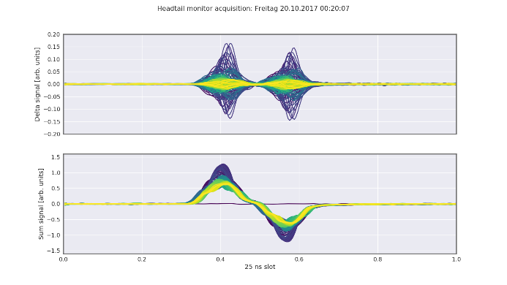
Q22
Main motivation for intermediate transition energy comes from RF power limitations during ramp
TMCI
  Experiments show intensity threshold close to expected values (2.6e11 p/b for nominal longitudinal emittance)

Slide 13
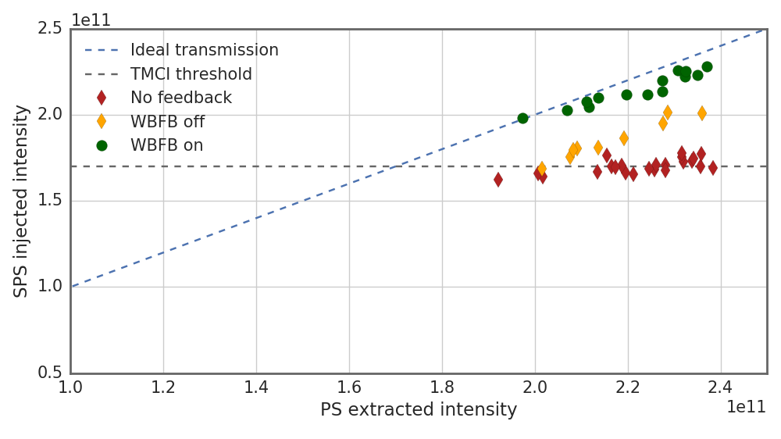
Q22
Main motivation for intermediate transition energy comes from RF power limitations during ramp
TMCI
  Experiments show intensity threshold close to expected values (2.6e11 p/b for nominal longitudinal emittance)
  First successful stabilization of TMCI with WBFB system
  Measurements with reduced RF voltage to provoke instability at lower intensities

Slide 14
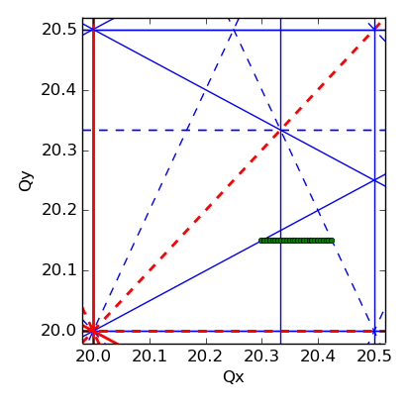
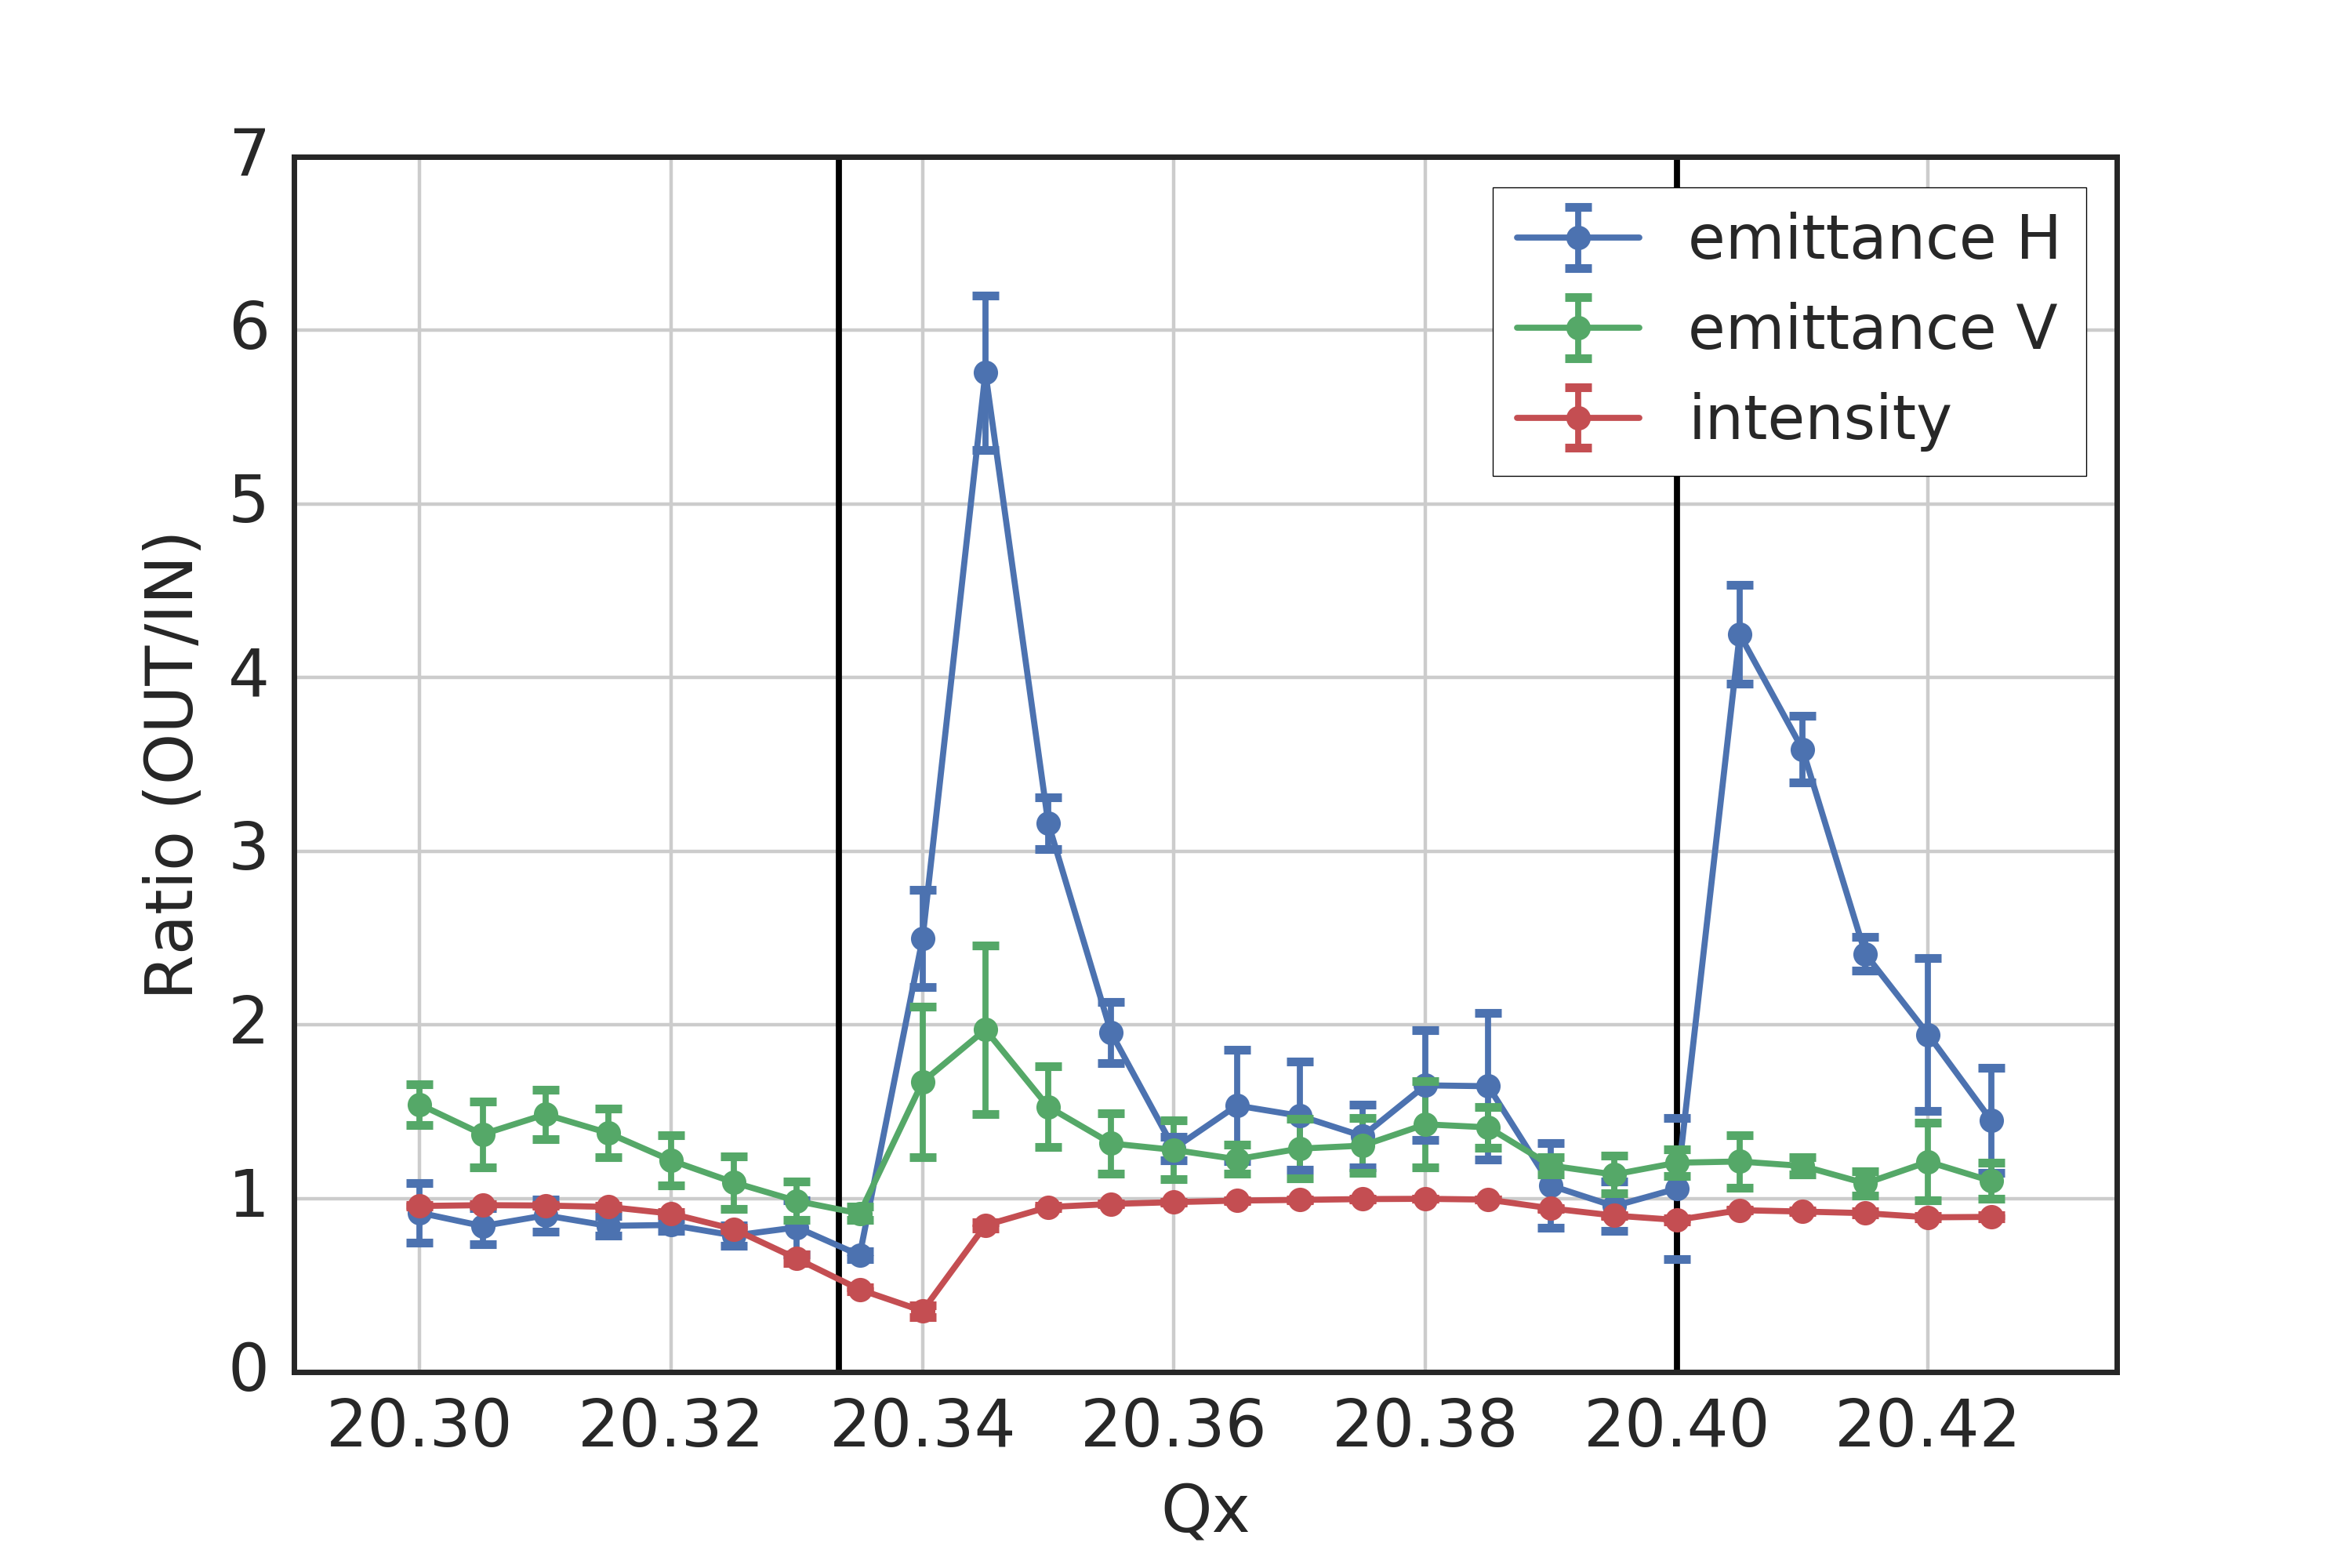
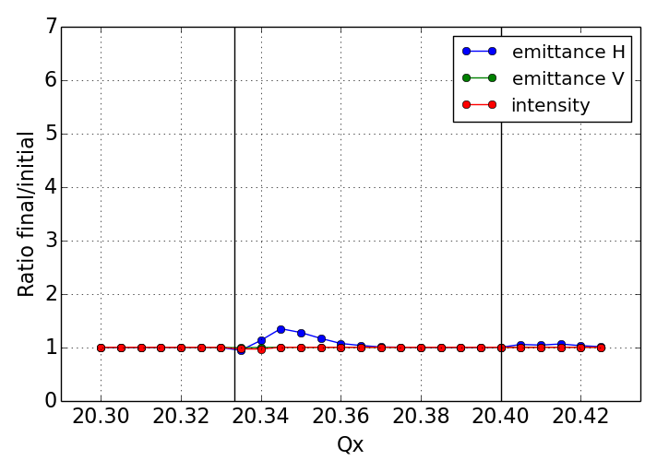
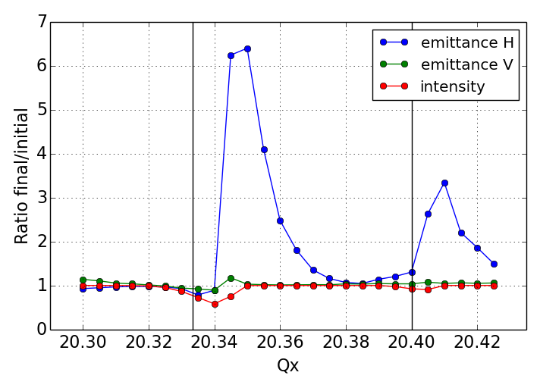
High brightness and space charge studies
Benchmarking of beam response close to betatron resonances
  Identified space charge driven resonance at Qx = 20.4
  Observed beam response not reproduced by space charge itself
  Blow-up and losses seem to be enhanced by quadrupole ripple
measurements
simulations
simulations with Q-ripple
???

Slide 15
Summary & Outlook
Significant progress made on several fronts
  Understanding of capture losses and momentum aperture, working point close to optimum
  High intensity beam studies at flat bottom revealed horizontal single bunch instability (when damper takes care of coupled bunch modes) and vertical emittance growth along flat bottom
  Demonstrated expected TMCI threshold in Q22 and successful suppression with WBFB
  Impact of power converter ripple on high brightness beams
Priorities for 2018
  Flat bottom losses as function of intensity (scraping in high dispersion vs. low dispersion region, further studies of incoherent effects due to chromaticity and working point, flat bottom length, …)
  Transverse emittance growth on flat bottom for high intensity
  Characterization and stabilization of horizontal instability (e.g. octupoles with low Q’’)
  Momentum aperture studies (physical vs. dynamic, improvements after YETS intervention)
  Maximum intensity reach (in Q20 and Q22)
  Reference measurements before LS2
  Pb-ions: last run before HL-LHC era, test Q26 (more aperture, larger momentum acceptance, transition crossing later in the cycle, smaller PC ripple, …)
Changes in MD scheduling (see next slide)

Slide 16
Draft injector schedule 2018 (ver. 0.6)
Dedicated MDs on Wednesdays (mostly needed for crab cavities)
“extended” parallel MDs on Thursdays for LHC beam studies

Slide 17
Thank you for your attention!

