Slide 1
Latest MD results on losses
M. Schwarz
Acknowledgements:
A. Lasheen, J. Repond, P. Baudrenghien, E. Shaposhnikova H. Bartosik, T. Bohl, G. Papotti, SPS & PS operator team

Slide 2
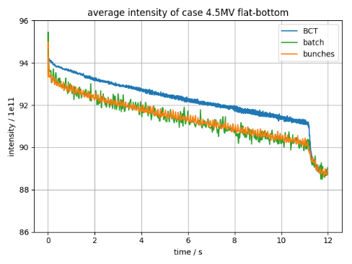
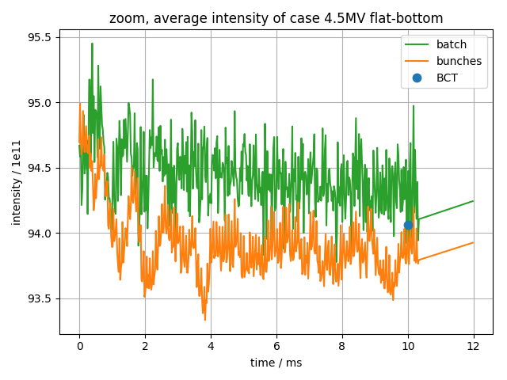
Sources of losses
Losses at injection, possible sources:
Transverse emittance?
Longitudinal effects (bunch shape from PS, uncaptured PS beam,…)
SPS llrf system
Losses at flat-bottom, possible sources:
Momentum aperture and transverse emittance
Full bucket (intensity effects, noise from llrf, magnetic field change,…)
LHC25ns, V₂₀₀=4.5MV

Slide 3
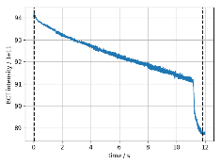
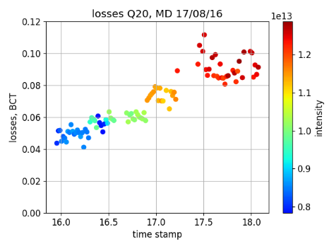
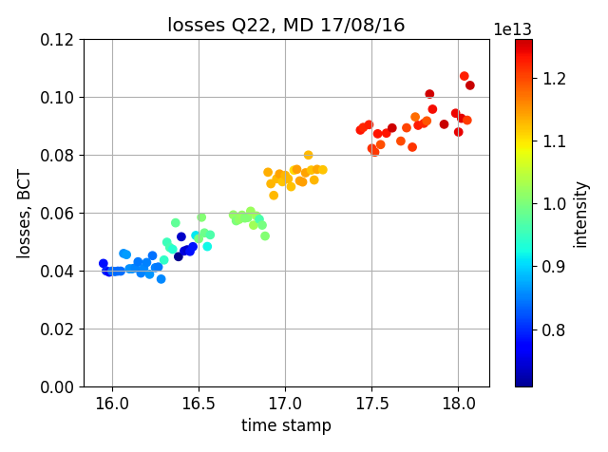
MD 17/08/16: different momentum apertures
Settings:
72 bunches, 25ns spacing, vary intensity
LHC25ns (Q20) and LHC4inj (Q22),
Flat-bottom 0-11.1s, ramp to 450GeV 11.1-19.5s, flat-top 19.5-20s
Here: data from injection to first part of ramp (11.830s ~ 29 GeV)
About 10 acquisitions per data point
V₂₀₀=4.5MV (Q20), V₂₀₀=3.3MV (Q22), (4MV after 17:52), V₈₀₀ = 0.1 V₂₀₀
Momentum aperture δ=6.1e-3 (Q20) and δ=7.7e-3 (Q22) (Curtesy M. Patecki)
LHC25ns, Q20
LHC4inj, Q22
Slightly less losses for Q22

Slide 4
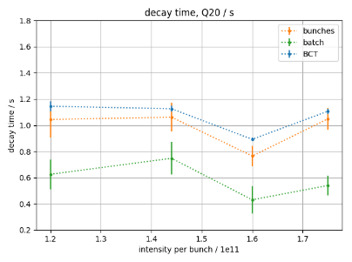
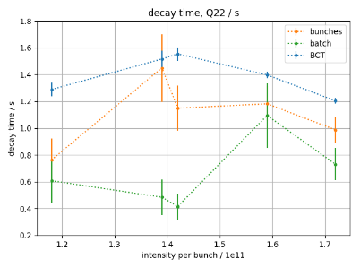
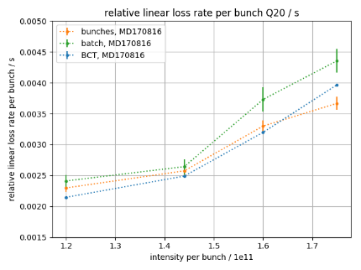
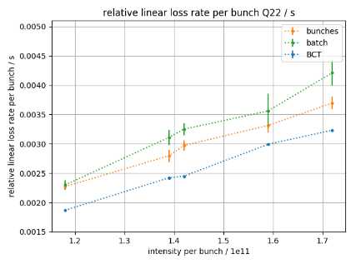
MD 17/08/16: linear loss rate
Fit intensity by $I\left(t\right)=m t+b+A exp\left({−t}/τ\right)$, $m$: linear loss rate, $τ$: decay time
Relative linear loss rate: linear loss rate divided by initial intensity per bunch
$τ$,Q20
$τ$, Q22
rel. lin. loss, Q20
rel. lin. loss, Q22

Slide 5
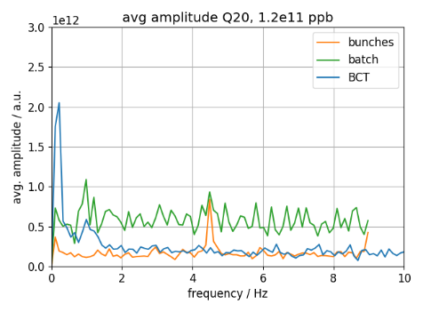
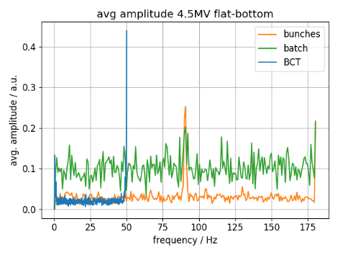
Noise at flat-bottom?
(inspired by F. Capsers)
Take intensity at flat-bottom
Remove linear decrease
FFT
Δt = 55.3ms (2407 turns),
165 points (2s to 11.1s at flat-bottom)
Nyquist frequency 9 Hz
Δt = 2.7ms (120 turns),
450 points (4s to 5.2s)
Nyquist frequency 180 Hz
MD 17/08/16
MD 17/08/23
Under-sampled 50Hz?
Peak at half Nyquist frequency?

Slide 6
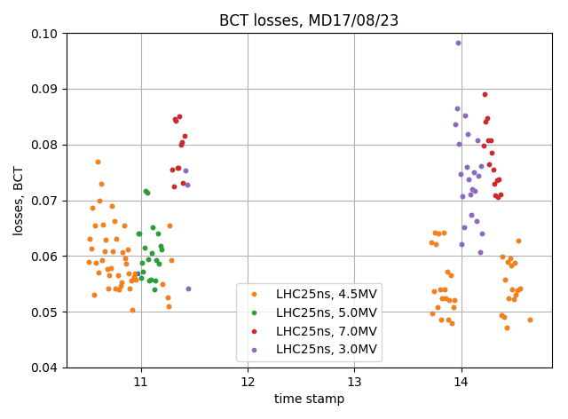
MD 17/08/23: different V₂₀₀
Settings:
72 bunches, 25ns spacing, 1.3e11 particles per bunch
LHC25 (Q20), V₈₀₀ = 0.1 V₂₀₀
Flat-bottom 0-11.1s, ramp to 450GeV 11.1-19.5s, flat-top 19.5-20s
Here: data from injection to first part of ramp (11.830s ~ 29 GeV)
About 10 acquisitions per data point
Inject at V₂₀₀=4.5MV (nominal case), change V₂₀₀ at flat-bottom (ramp 50ms to 100ms after injection and at 10.75s)
For V₂₀₀=3.0MV
more losses at beginning, but
less during FB
For V₂₀₀=7.0MV
less losses at beginning, but
more during FB
Minimal losses for V₂₀₀=4.5MV
MD 17/08/23

Slide 7
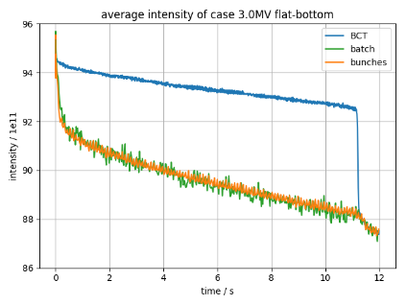
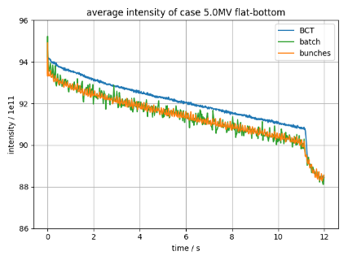
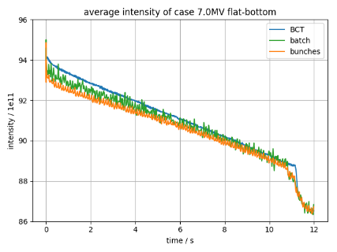
MD 17/08/23: Intensities for different V₂₀₀ at flat-bottom
LHC25ns, V₂₀₀=3.0MV
LHC25ns, V₂₀₀=4.5MV
Uncaptured beam far
away from momentum aperture
LHC25ns, V₂₀₀=5.0 MV
LHC25ns, V₂₀₀=7.0 MV
BCT = batch
-> no uncaptured beam;
Losses from buckets
Bucket height $δbh\sim √V$, V₂₀₀=7MV $\sim$ momentum aperture $δap$-> $δap\sim \sqrt{7/4.5} δbh4.5 \sim 1.25δbh4.5$

Slide 8
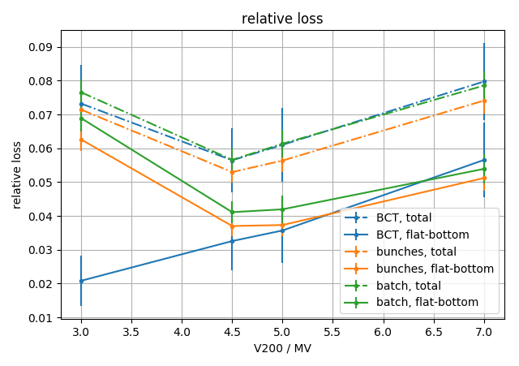
Relative losses MD 17/08/23: different V₂₀₀
Relative loss ${(I\left(20ms\right)−I(t))}/{I(20ms)}$
Flat-bottom: $t$ before ramp $t=11s$ ($t=11.83s$ for BCT, $t=10.71s$ else)
Total: $t$ after ramp ($t=11.83s$)
Bucket touches momentum acceptance -> scraping from bunch
Why more losses
from bunch with smaller bucket area?
Uncaptured beam lost
at beginning of ramp
Uncaptured beam lost at smaller dp/p -> further away from momentum aperture -> can ‘survive’ longer at flat-bottom

Slide 9
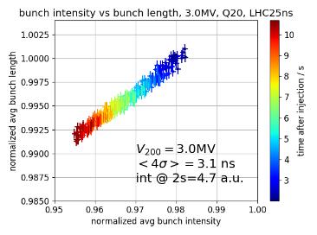
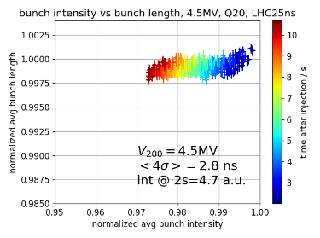
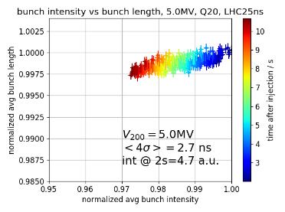
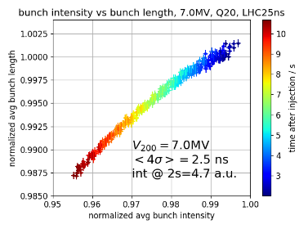
MD 17/08/23: Bunch length vs intensity (Gaussian fit)
Fit Gaussian bunches to profiles at flat-bottom (starting 2s after injection)
Obtain bunch intensity and bunch length
Average bunch intensity normalized by maximum intensity at 2s of all data sets
Average bunch length change normalized bunch length at 2s of data set
Intensity changes, but bunch length does not
-> bucket full

Slide 10
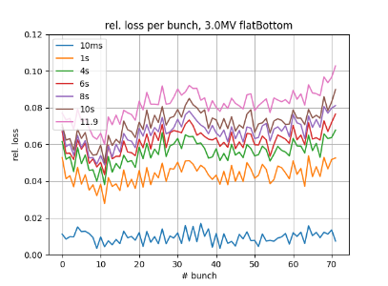
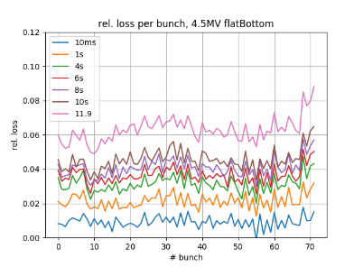
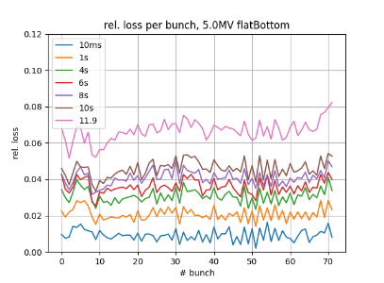
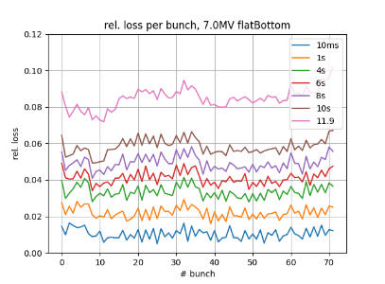
MD 17/08/23: Relative losses per bunch
3.0 MV
4.5 MV
5.0 MV
7.0 MV
‘typical’ pattern for V₂₀₀=3MV, but constant pattern for V₂₀₀=7MV voltage => losses due to scraping at V₂₀₀=7MV

Slide 11
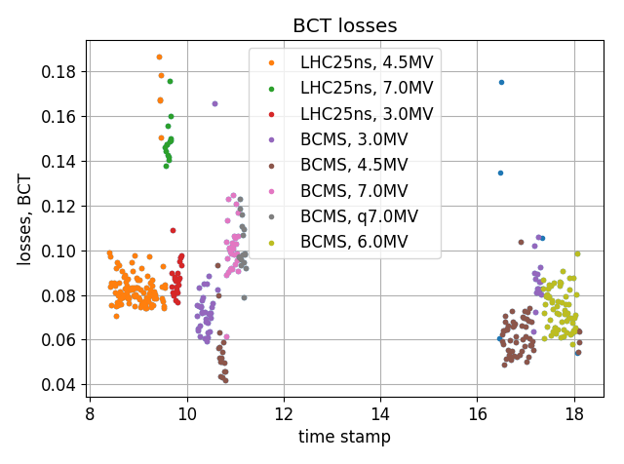
MD 17/08/30: Different transverse emittances
Settings:
48 bunches, 25ns spacing, 1.52e11 particles per bunch
V₈₀₀ = 0.1 V₂₀₀
Flat-bottom 0-11.1s, ramp to 450GeV 11.1-19.5s, flat-top 19.5-20s
Here: data from injection to first part of ramp (11.830s ~ 29 GeV)
About 10 acquisitions per data point
Inject at V₂₀₀=4.5MV (nominal case), change V₂₀₀ at flat-bottom (ramp 50ms to 100ms after injection and at 10.75s to 10.85s)
Compare LHC25ns and BCMS cycle (smaller transverse emittance)
Smaller losses for BCMS
Minimal losses
for V₂₀₀=4.5MV

Slide 12
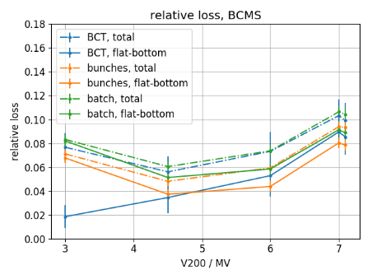
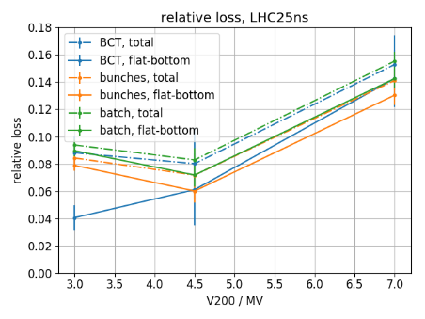
MD 17/08/30: Relative losses
Relative loss ${(I\left(20ms\right)−I(t))}/{I(20ms)}$
Flat-bottom: $t$ before ramp $t=11s$ ($t=11.83s$ for BCT, $t=10.71s$ else)
Total: $t$ after ramp ($t=11.83s$)
Less losses for smaller transverse emittance
BCMS
LHC25ns
MD 17/08/30

Slide 13
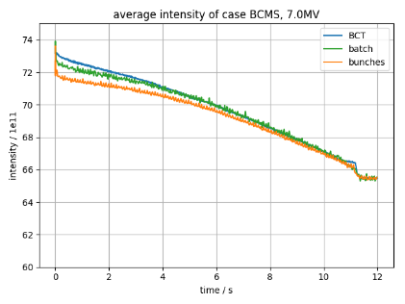
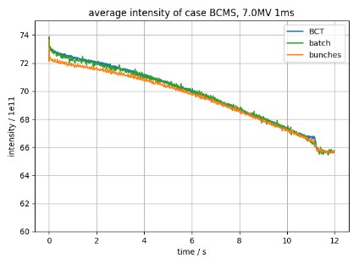
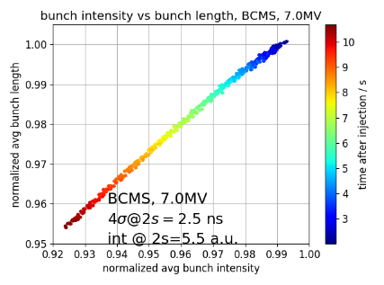
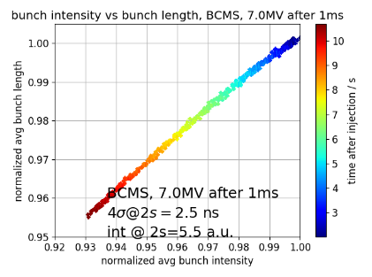
MD 17/08/30: V₂₀₀ increase after at 50ms vs 1ms
BCMS, V₂₀₀=7.0MV
BCMS, V₂₀₀=7.0MV @1ms
Lost particles recaptured earlier ->
BCT and batch intensity equal earlier

Slide 14
Summary
V₂₀₀=4.5MV minimizes overall losses
Reducing V₂₀₀ leads to particles lost at injection
Increasing V₂₀₀ leads to scraping from bucket
momentum aperture $δap\sim 1.25δbh4.5$ for Q20
Reducing transverse emittance lowers losses
BLonD simulations with 72 bunches and Helga’s dynamic feed-back implementation
More systematic studies of uncaptured beam
Next steps
Thank you for your attention!

Slide 15
DETAILS MD 17/08/23: different V₂₀₀
Settings:
72 bunches, 25ns spacing, 1.3e11 particles per bunch
LHC25 (Q20), V₈₀₀ = 0.1 V₂₀₀
Flat-bottom 0-11.1s, ramp to 450GeV 11.1-19.5s, flat-top 19.5-20s
Here: data from injection to first part of ramp (11.830s ~ 29 GeV)
About 10 acquisitions per data point
Inject at V₂₀₀=4.5MV (nominal case), change V₂₀₀ at flat-bottom (ramp 50ms to 100ms after injection and at 10.75s)
For V₂₀₀=3.0MV
More losses at beginning, but
Less during FB
For V₂₀₀=7.0MV
less losses at beginning, but
more during FB
Minimal losses for V₂₀₀=4.5MV
MD 17/08/23

Slide 16
Relative losses MD 17/08/23: different V₂₀₀
Relative loss ${(I\left(20ms\right)−I(t))}/{I(20ms)}$
Flat-bottom: $t$ before ramp $t=11s$ ($t=11.83s$ for BCT, $t=10.71s$ else)
Total: $t$ after ramp ($t=11.83s$)
Bucket touches momentum acceptance -> scraping from bunch
Why more losses
from bunch with smaller bucket area?
Uncaptured beam lost
at beginning of ramp
Uncaptured beam lost at smaller dp/p -> further away from momentum aperture -> can ‘survive’ longer at flat-bottom

Slide 17
MD 17/08/23: Intensities for different V₂₀₀ at flat-bottom
LHC25ns, V₂₀₀=3.0MV
LHC25ns, V₂₀₀=4.5MV
Uncaptured beam far
away from momentum aperture
LHC25ns, V₂₀₀=5.0 MV
LHC25ns, V₂₀₀=7.0 MV
BCT = batch
-> no uncaptured beam;
Losses from buckets
MD 17/08/23

Slide 18
MD 17/08/23: Relative losses per bunch
3.0 MV
4.5 MV
5.0 MV
7.0 MV
‘typical’ pattern for 3MV, but constant pattern for 7MV voltage => losses due to scraping at 7MV

Slide 19
MD 17/08/23: Bunch length vs intensity (Gaussian fit)
Fit Gaussian bunches to profiles at flat-bottom (2s after injection)
Obtain bunch intensity and bunch length
Average bunch intensity normalized by maximum intensity at 2s of all data sets
Average bunch length change normalized bunch length at 2s of data set
Intensity changes, but bunch length does not
-> bucket full

Slide 20
DETAILS MD 17/08/30: Different transverse emittances
Settings:
48 bunches, 25ns spacing, 1.52e11 particles per bunch
V₈₀₀ = 0.1 V₂₀₀
Flat-bottom 0-11.1s, ramp to 450GeV 11.1-19.5s, flat-top 19.5-20s
Here: data from injection to first part of ramp (11.830s ~ 29 GeV)
About 10 acquisitions per data point
Inject at V₂₀₀=4.5MV (nominal case), change V₂₀₀ at flat-bottom (ramp 50ms to 100ms after injection and at 10.75s to 10.85s)
Compare LHC25ns and BCMS cycle (smaller transverse emittance)
Smaller losses for BCMS
Minimal losses
for V₂₀₀=4.5MV

Slide 21
MD 17/08/30: Relative losses
Relative loss ${(I\left(20ms\right)−I(t))}/{I(20ms)}$
Flat-bottom: $t$ before ramp $t=11s$ ($t=11.83s$ for BCT, $t=10.71s$ else)
Total: $t$ after ramp ($t=11.83s$)
Less losses for smaller transverse emittance
BCMS
LHC25ns
MD 17/08/30

Slide 22
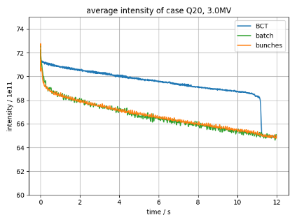
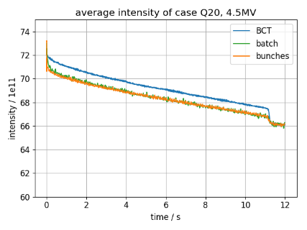
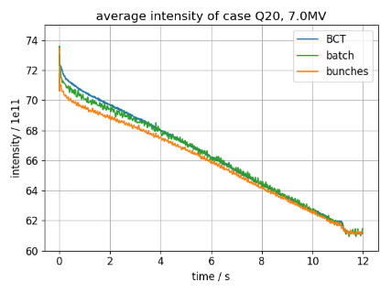
MD 17/08/30:Intensities for different V₂₀₀ at flat-bottom, LHC25ns
LHC25ns, V₂₀₀=3.0MV
LHC25ns, V₂₀₀=4.5MV
Uncaptured beam far
away from momentum aperture
LHC25ns, V₂₀₀=7.0MV
BCT = batch
-> no uncaptured beam;
Losses from buckets

Slide 23
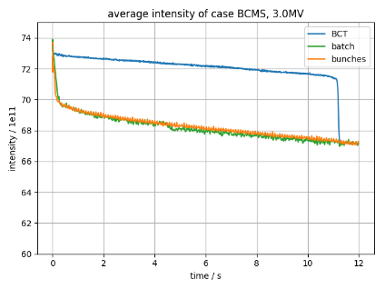
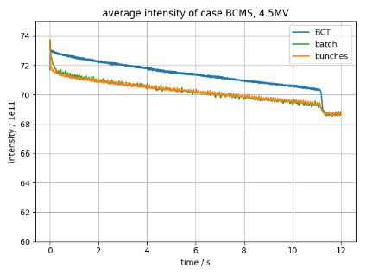
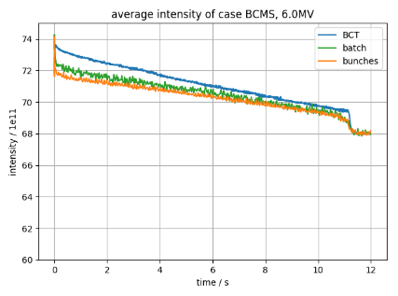
MD 17/08/30:Intensities for different V₂₀₀ at flat-bottom, BCMS
Uncaptured beam far
away from momentum aperture
BCMS, V₂₀₀=3.0MV
BCMS, V₂₀₀=4.5MV
BCT = batch
-> no uncaptured beam;
Losses from buckets
BCMS, V₂₀₀=6.0MV
BCMS, V₂₀₀=7.0MV

Slide 24
MD 17/08/30: V₂₀₀ increase after at 50ms vs 1ms
BCMS, V₂₀₀=7.0MV
BCMS, V₂₀₀=7.0MV @1ms
Lost particles recaptured earlier ->
BCT and batch intensity equal earlier

Slide 25
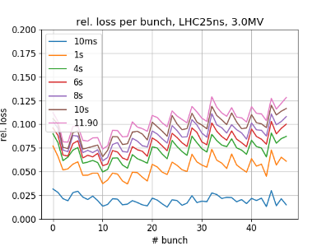
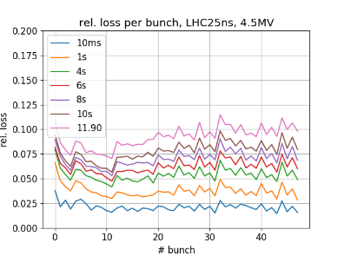
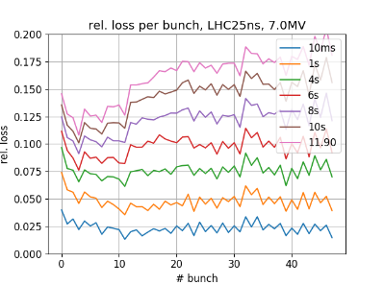
MD 17/08/30: Relative losses per bunch, LHC25ns
LHC25ns, V₂₀₀=3.0MV
LHC25ns, V₂₀₀=4.5MV
LHC25ns, V₂₀₀=7.0MV
MD 17/08/30

Slide 26
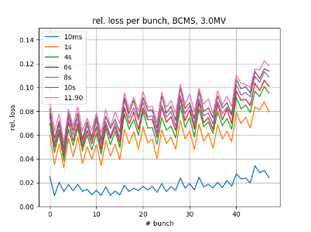
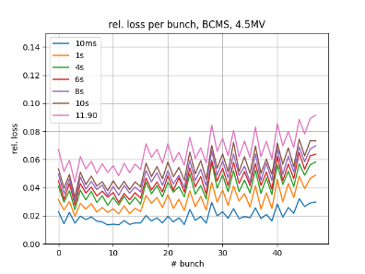
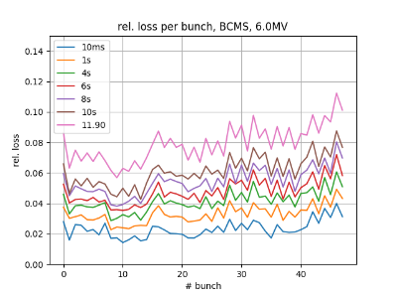
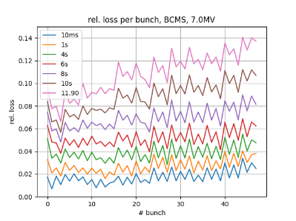
MD 17/08/30: Relative losses per bunch, BCMS
BCMS, V₂₀₀=3.0MV
BCMS, V₂₀₀=4.5MV
BCMS, V₂₀₀=6.0MV
BCMS, V₂₀₀=7.0MV

Slide 27
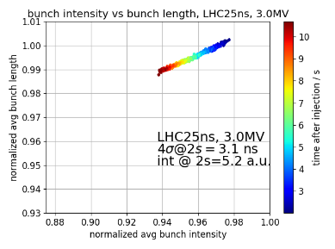
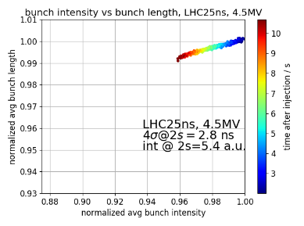
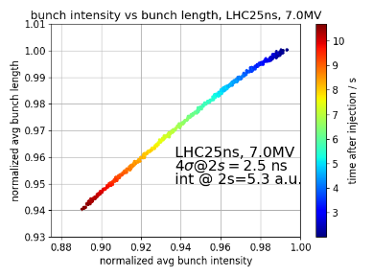
MD 17/08/30: Bunch length vs intensity (Gaussian fit),
LHC25ns
Compared to 1.3ppb, now change in bunch length
MD 17/08/30

Slide 28
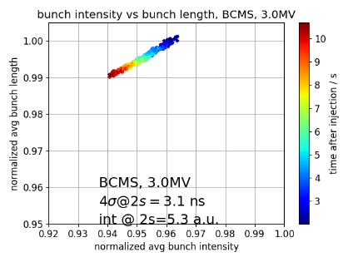
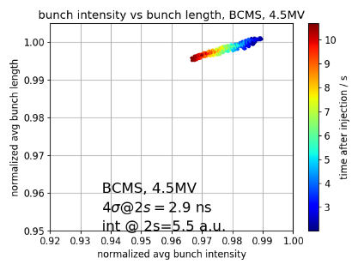
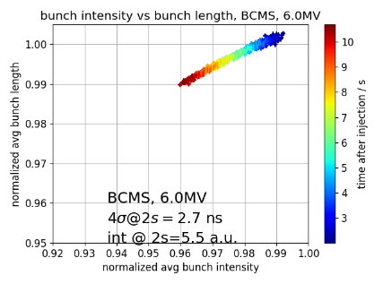
MD 17/08/30: Bunch length vs intensity, (Gaussian fit)
BCMS
MD 17/08/30

Slide 29
DETAILS MD 17/08/16: different momentum apertures
Settings:
72 bunches, 25ns spacing, vary intensity
LHC25ns (Q20) and LHC4inj (Q22),
Flat-bottom 0-11.1s, ramp to 450GeV 11.1-19.5s, flat-top 19.5-20s
Here: data from injection to first part of ramp (11.830s ~ 29 GeV)
About 10 acquisitions per data point
V₂₀₀=4.5MV (Q20), V₂₀₀=3.3MV (Q22), (4MV after 17:52), V₈₀₀ = 0.1 V₂₀₀
Momentum aperture δ=6.1e-3 (Q20) and δ=7.7e-3 (Q22) (Curtesy M. Patecki)
LHC25ns, Q20
LHC4inj, Q22
Slightly less losses for Q22

Slide 30
MD 17/08/16:Intensities Q20
1.2e11ppb, Q20
1.44e11ppb, Q20
1.6e11ppb, Q20
1.75e11ppb, Q20

Slide 31
MD 17/08/16:Intensities Q22
1.18e11ppb, Q22
1.42e11ppb, Q22
1.59e11ppb, Q22
1.72e11ppb, Q22

Slide 32
MD 17/08/16: linear loss rate
Fit intensity by $I\left(t\right)=m t+b+A exp\left({−t}/τ\right)$, $m$: linear loss rate, $τ$: decay time
Relative linear loss rate: linear loss rate divided by initial intensity per bunch
$τ$,Q20
$τ$, Q22
rel. lin. loss, Q20
rel. lin. loss, Q22

Slide 33
MD 17/08/16: Bunch length vs intensity, BCMS (Gaussian fit) Q22
Note: intensities normalized to maximum intensity at each set

Slide 34
MD 17/08/16: Bunch length vs intensity, BCMS (Gaussian fit) Q22
Note: intensities normalized to maximum intensity at each set

Slide 35
MD overview
72 bunches, 25ns spacing, V_{200,Q20} =4.5MV, V_{200,Q22} =3.3MV
LHC25ns(Q20) & LHC4inj(Q22) cycles
Vary intensity
MD 17/08/16
48 bunches, 25ns spacing, 1.52e11 particles per bunch
BCMS & LHC25ns cycles
Vary V₂₀₀ at flat-bottom
MD 17/08/30
72 bunches, 25ns spacing, 1.3e11 particles per bunch
LHC25ns cycles
Vary V₂₀₀ at flat-bottom
MD 17/08/23
72 bunches, 25ns spacing, V_{200,Q20} =4.5MV, V_{200,Q22} =3.3MV
LHC25ns(Q20) & LHC4inj(Q22) cycles
Vary intensity
MD 17/08/02

Slide 36
Linear loss rate $m$
Fit intensity by $I\left(t\right)=m t+b+A exp\left({−t}/τ\right)$
$m$: linear loss rate
$τ$: decay time
MD 17/08/23

Slide 37
Relative losses per bunch
MD 17/08/23

Slide 38
Linear loss rate $m$
Fit intensity by $I\left(t\right)=m t+b+A exp\left({−t}/τ\right)$
$m$: linear loss rate
$τ$: decay time
BCMS
LHC25ns
MD 17/08/30

Slide 39
Relative losses per bunch, BCMS
MD 17/08/30

Slide 40
Relative losses per bunch, LHC25ns
MD 17/08/30

