Slide 1
Tomography of injected bunches in SPS (multi-bunchs)
A. Lasheen

Slide 2
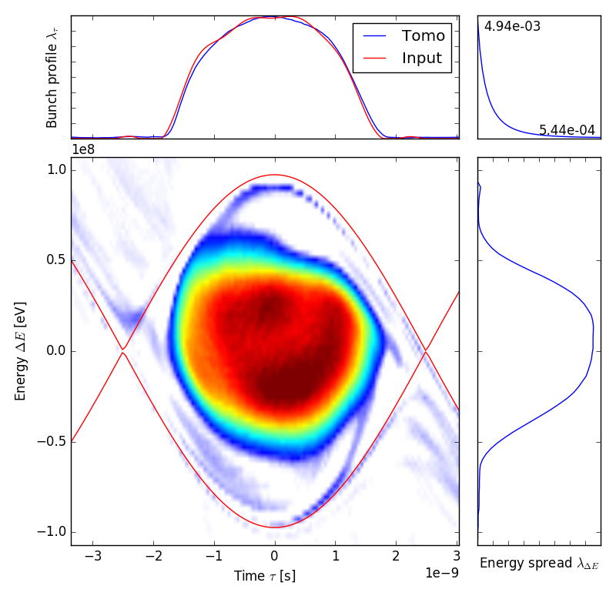
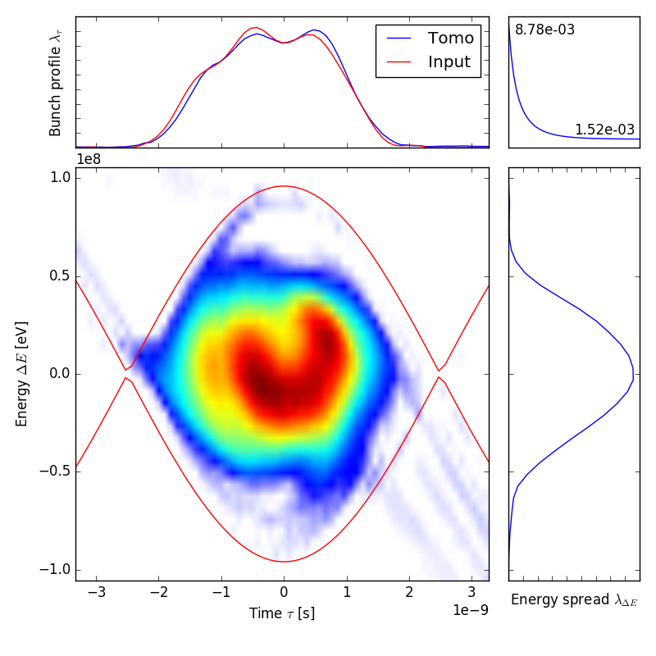
Single vs. multi-bunch
Single bunch: very dense Multi bunch: more tails,
core not very well structured

Slide 3
Evolution of the bunch distribution

Slide 4
Bunch by bunch along the batch (72)
1 bunch every second/frame in video

