Slide 1
Measurements of beam instabilities during ramp with feedback off s 14th of September 2017
J. Repond
Acknowledgement: A. Lasheen, E. Shaposhnikova

Slide 2
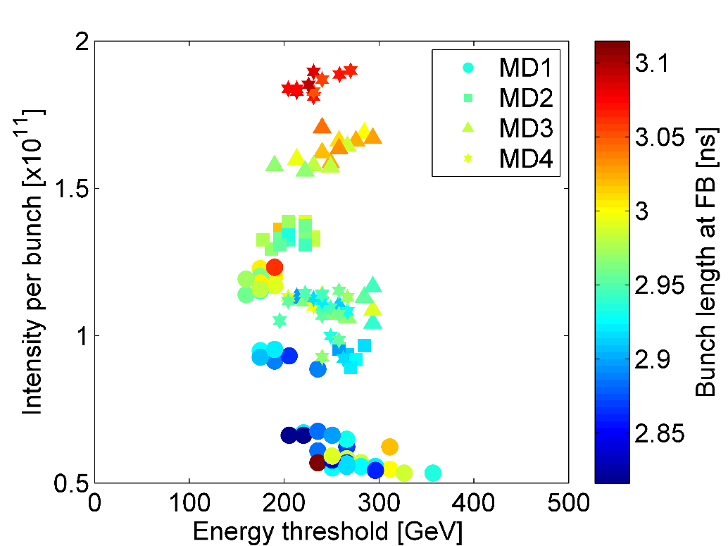
Instability threshold with 12 bunches
Latest results suggest:
Sharp dependence of intensity w.r.t. energy related to the feedback
Feedback more efficient at low energy
Courtesy: T. Argyropoulos
Focus on FB off

Slide 3
MD Parameters
Dedicated MD: 12th of July, 23th of August and 6th of September 2017
LHC 25ns nominal cycle (Q20)
Single RF
Low Level RF:
Phase loop: ON
Longitudinal damper: ON/OFF
Feedforward: OFF
Feedback: OFF
Blow-up: OFF
Batch: 12 bunches
Different emittances and voltage programs
Goals:
Observe effect of LD on stability threshold
Time when the instability is triggered w.r.t. intensity

Slide 4
Intensity threshold 12 bunches – LD effect
Threshold weakly affected by effect of LD
Time when instability starts (~energy) comparable (supported again on next slide)
Without feedback, its effect seems negligible
Threshold~ $0.34×{10}^{11}$ ppb
LD off
Threshold~ $0.39×{10}^{11}$ ppb
Can be neglected in simulation
LD on

Slide 5
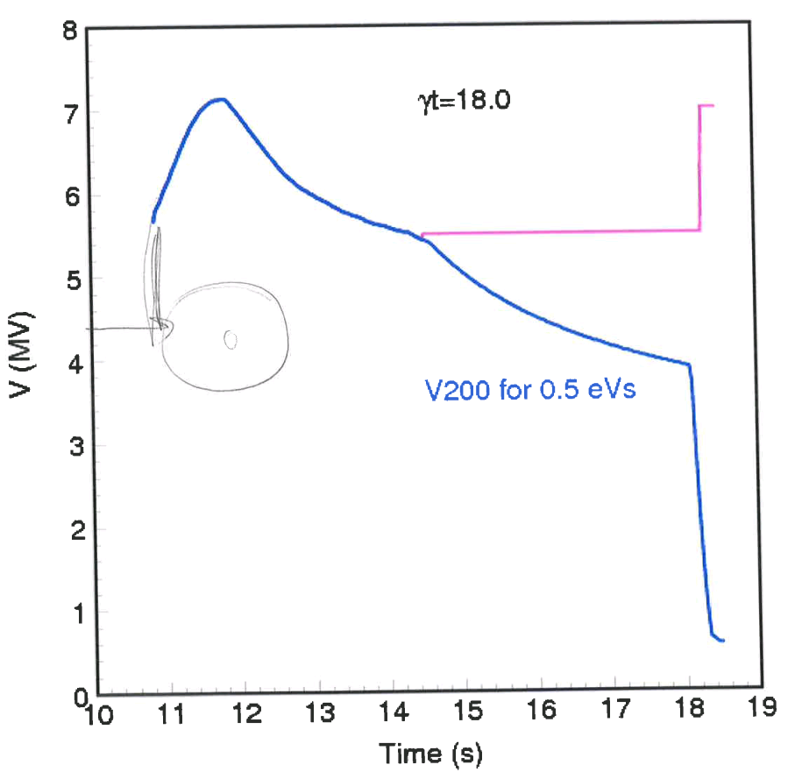
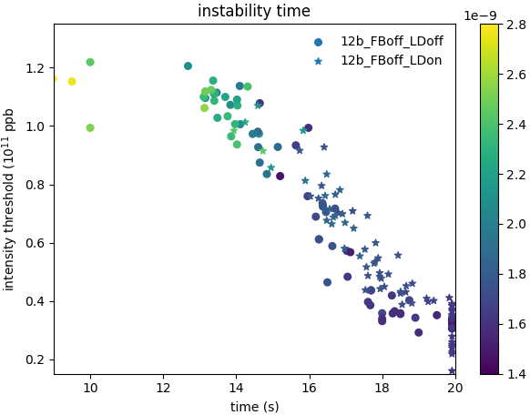
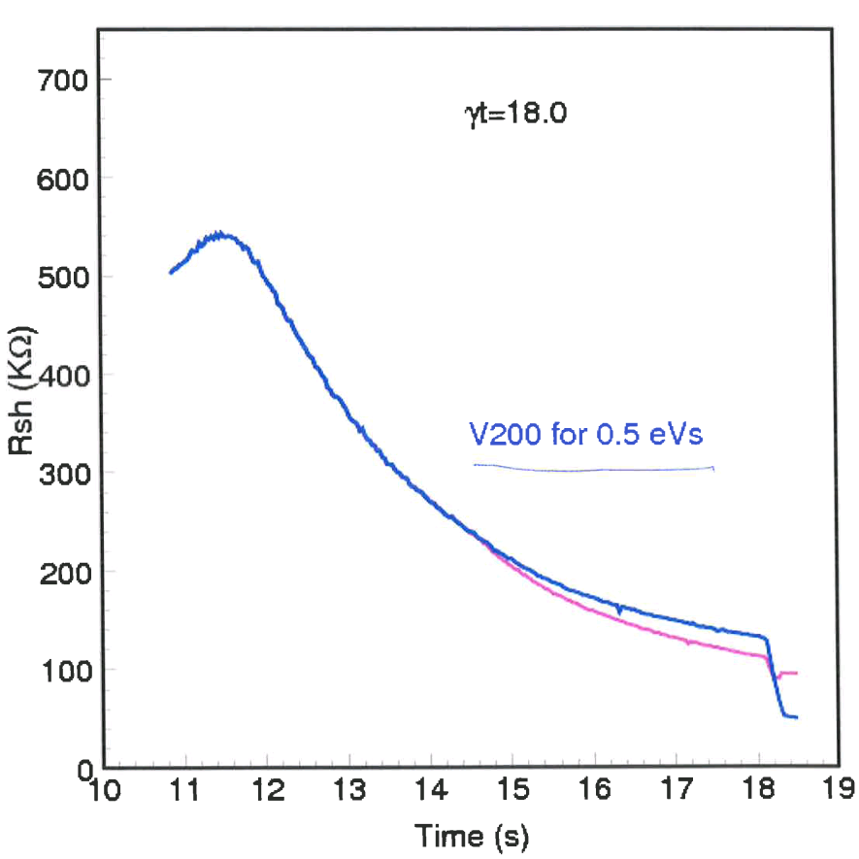
Intensity threshold 12 bunches – time dependence
For given voltage program → Minimum stability threshold during cycle can be estimated
Measured stability threshold is similar to analytical prediction
Constant filling factor
If Rsh=cst → Intensity
Gap
Could be used to find the frequency driving the instability
Courtesy: E. Shaposhnikova

Slide 6
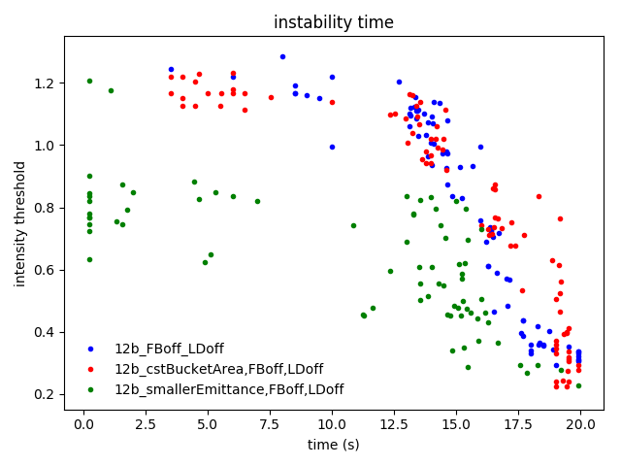
Time dependence – different OP conditions
Analytical estimations show that the threshold:
Decrease when emittance decrease
Changes more weakly with voltage program
Measurements reproduce expectation
Ongoing study to extract, if possible, the leading frequency.
Bad shots, analysis must be refined

Slide 7
Conclusion and future work
Effect of Longitudinal Damper negligeable in simulation
Time dependence of instability threshold similar to analytical estimation
Maybe possible to extract the leading frequency
Ongoing study

Slide 8
Thank you for your attention.

Slide 9
Backup slides

Slide 10
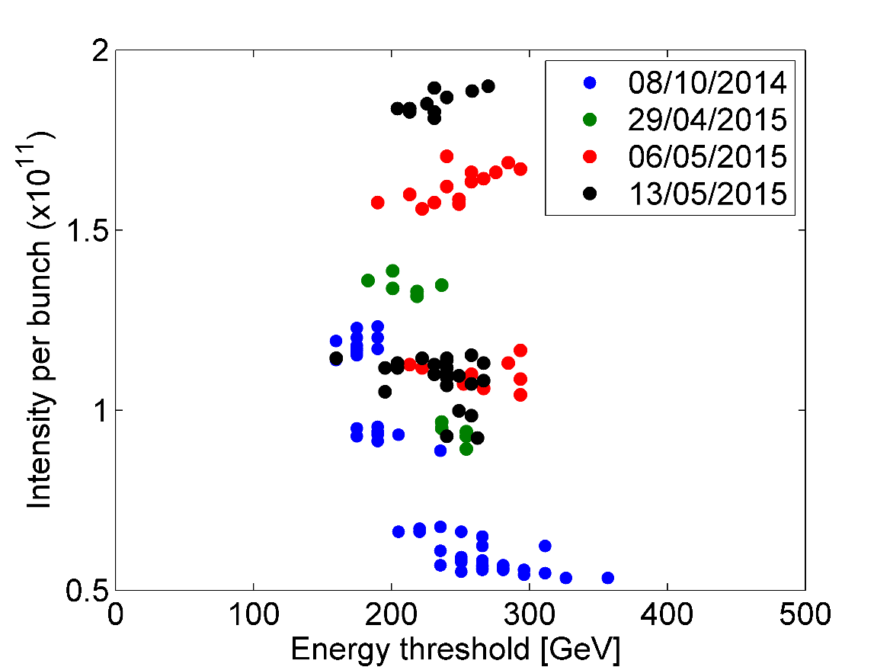
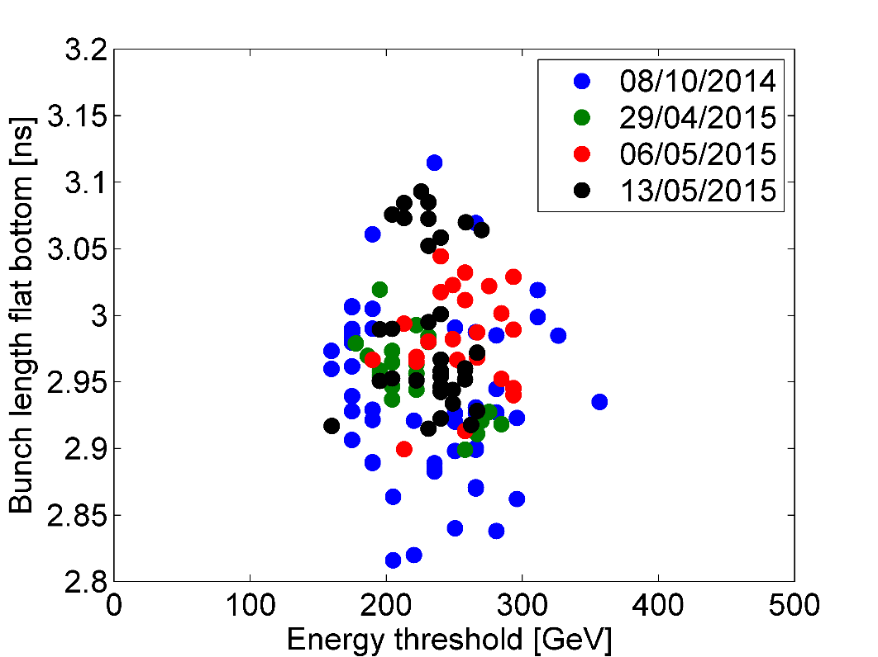
Instability threshold with 12 bunches
Sharp energy threshold with respect to bunch intensity
~6% scatter in bunch length
Courtesy: T. Argyropoulos

Slide 11
Instability threshold with 12 bunches
Courtesy: T. Argyropoulos

