Slide 1
LHC beam losses on SPS flat bottom chroma & octupole scans
H. Bartosik, T. Bohl, S. Cettour Cave, K. Cornelis,
H. Damerau, B. Goddard, V. Kain, A. Lasheen,
G. Rumolo, E. Shaposhnikova, H. Timko
LIU-SPS-BD meeting, 14 September 2017

Slide 2
Chromaticity scan: horizontal
BCMS beam on special MD cycle (6 bp flat bottom + ramp to 28 GeV/c plateau)
  48 bunches, ~1.35e11 p/b injected
  Programmed constant bucket area of 0.6 eVs
ΔQx=QPH*20*δp/p

Slide 3
Chromaticity scan: vertical
BCMS beam on special MD cycle (6 bp flat bottom + ramp to 28 GeV/c plateau)
  48 bunches, ~1.35e11 p/b injected
  Programmed constant bucket area of 0.6 eVs
ΔQy=QPV*20*δp/p

Slide 4
Octupole scan: LOF
BCMS beam on special MD cycle (6 bp flat bottom + ramp to 28 GeV/c plateau)
  48 bunches, ~1.35e11 p/b injected
  Programmed constant bucket area of 0.6 eVs
ΔQx=LOF*3000*(dp/p)²

Slide 5
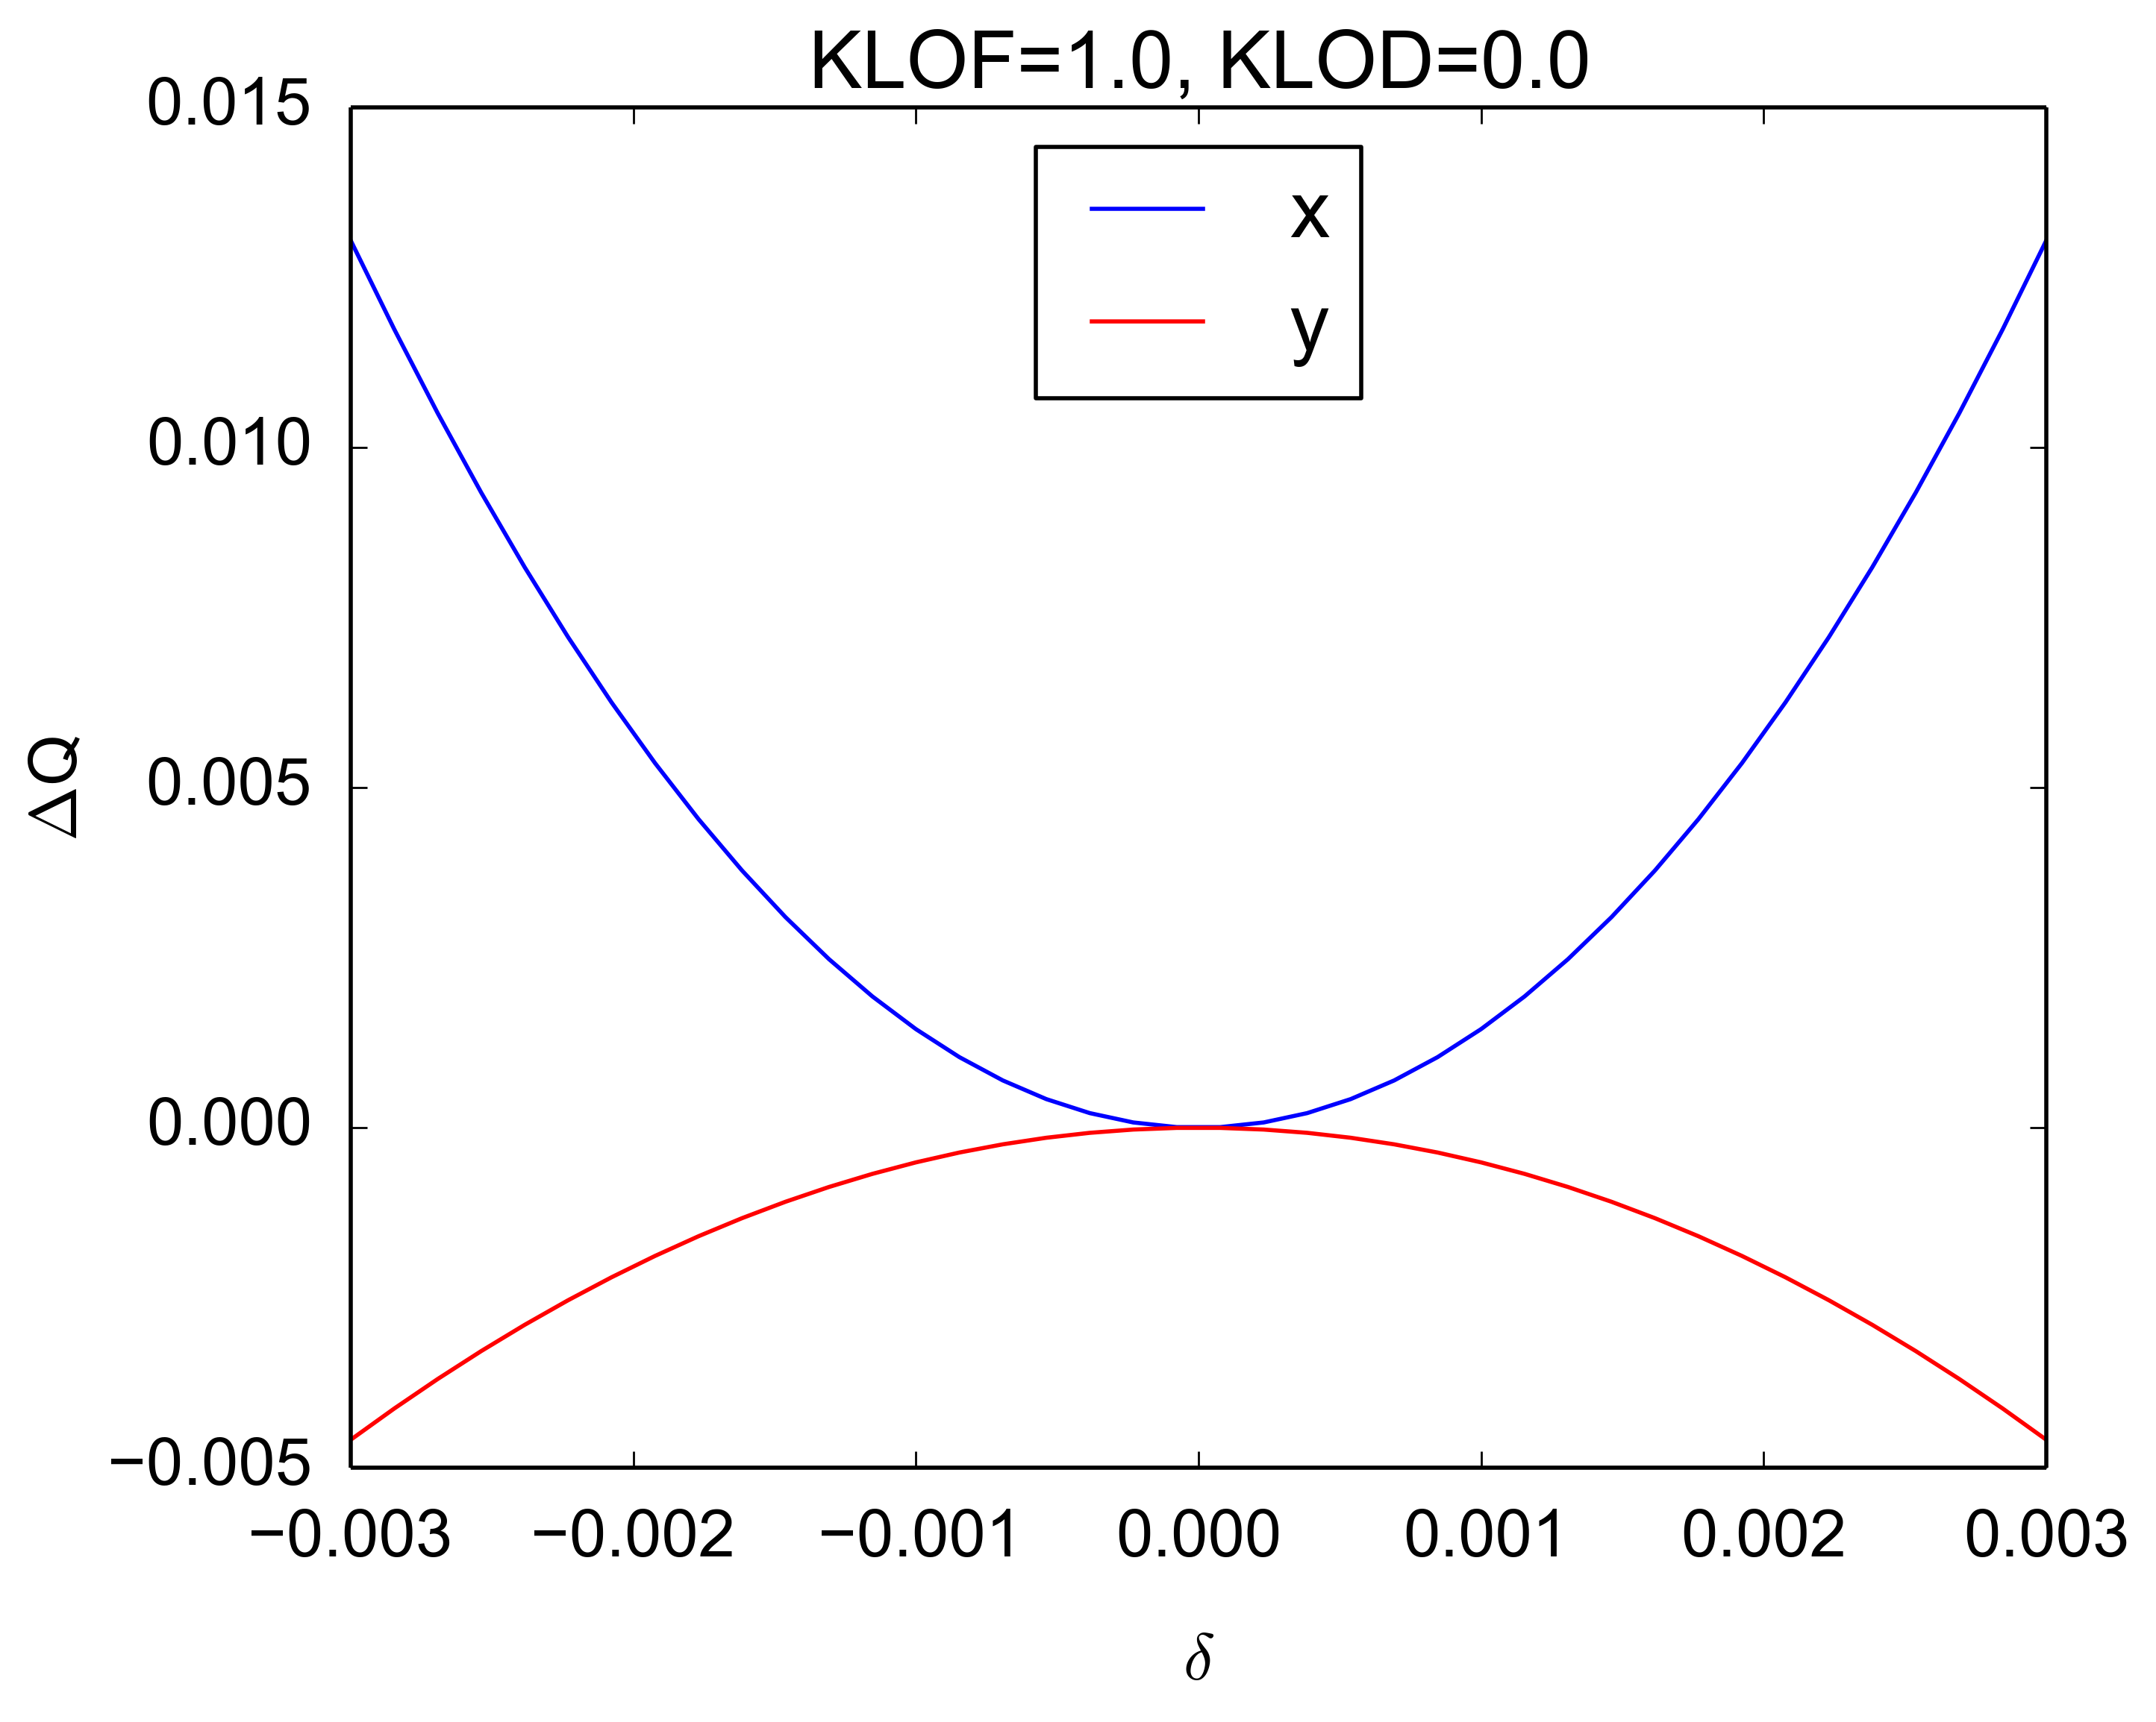
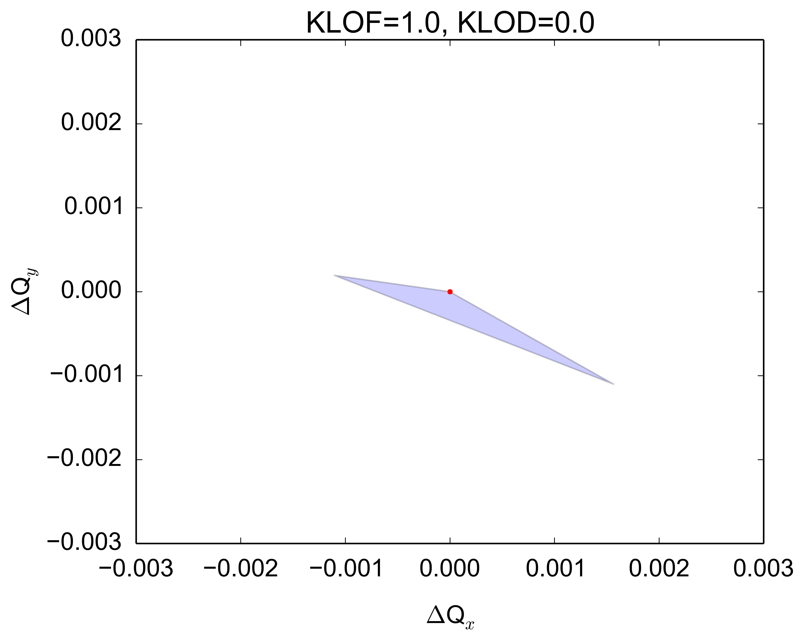
LOF characteristics
Effect of LOF as expected from the SPS optics model
  Tune spread
  Effect on nonlinear chromaticity quite strong (Q’’)
With particles up to 3σ
±1σ

Slide 6
SPS nonlinear chromaticity in Q20

Slide 7
Conclusions
RF bucket height for LHC beams at SPS injection quite large (~3.8e-3)
Increased chromaticity enhances flat bottom losses, but less the total losses
  Up to the point where chromatic detuning pushes even particles in the bucket onto resonances
  Similar behavior for both sextupoles and octupoles (due to impact on Q’’, amplitude detuning much smaller)

Slide 8
Thank you for your attention!

