Slide 1

Systematic Study of the Three and Four-Section Cavities and Examination of the Damping Options
Update on the 628 MHz damping:
Nasrin Esfahani
LIU-SPS BD WG meeting – 13 July 2017

Slide 2
The original design of the HOM Coupler
The original design was based on the single section
Performance of the HOM coupler is very good at around 628.5 MHz and 631.5 MHz.

Slide 3
Impedance of the two four-section cavities
The main contributors to the impedance of the two four-section are two modes :
The highest impedance mode has an almost un damped Q (~30000) and a small R/Q (~ 3)
The next highest one comes from a neighbouring mode with an already damped Q (~ 400) and a large R/Q (~ 180)
Why the HOM coupler does not effectively damp this mode?

Slide 4
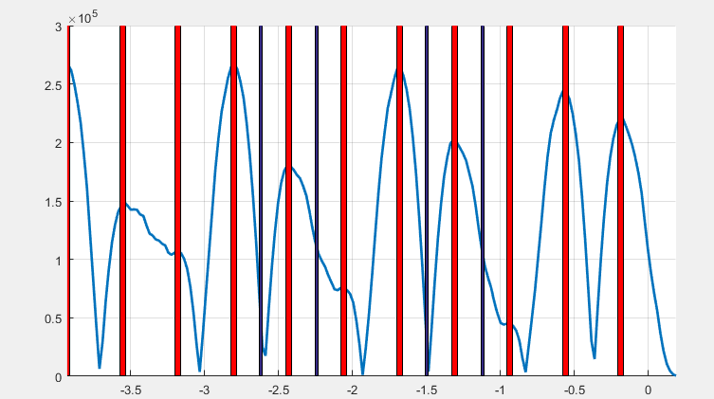
Field profiles for the highest impedance mode (I)
The amplitude of the electric field pointing towards the electric probe of the couplers has been plotted along this line. Examination of the field profiles shows:
Two couplers are totally ineffective
Through optimising the length of the probe the
overall impedance can be reduced by a factor of 1.6.
further Imp. reduction only through changing the
probe length is not possible
The maxima of the electric field amplitude are at the
centre of accelerating gaps
The maxima of the magnetic field lie between
the accelerating gaps and the energy can be extracted
effectively using couplers with magnetic loops

Slide 5
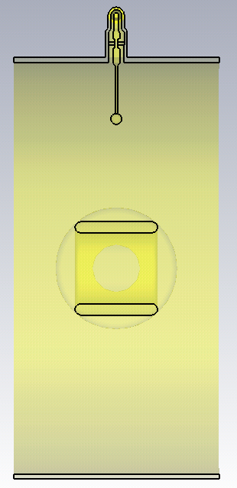
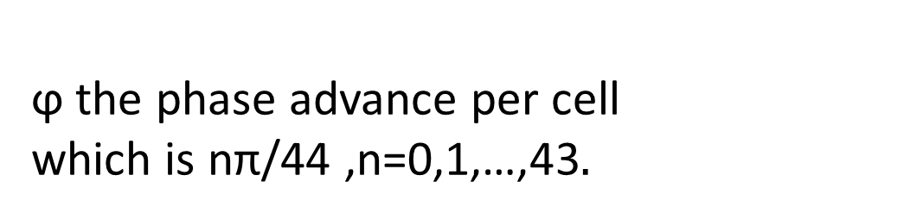
Evaluation of coupler using single cell approach
ϕ the phase advance per cell
which is nπ/44 ,n=0,1,…,43
ϕ
The presence of both un damped modes in the four-section cavities can be predicted using single-cell approximation. The single cell is used for preliminary design and then the result will be evaluated in the four-section or three-section cavities

Slide 6
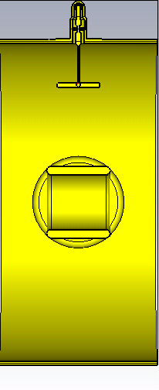
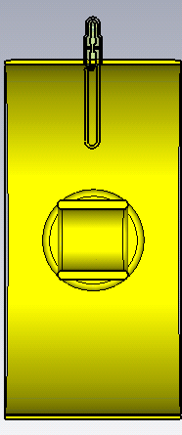
Options currently under consideration
Magnetic loop HOM coupler
Modified Electric HOM coupler
Pros : Magnetic loops are very effective in terms of reducing the impedance of both type of modes (it has already been tested on four section cavities)
Cons: the magnetic field of the fundamental mode can be coupled to this coupler and this limits the area of the loop
Pros: Fundamental mode is less sensitive to this design
Cons: installation difficulties

Slide 7
Impedance of the four three-section cavities
vcv
The most important impedances of the four three-section cavity are:
The two impedances around 629 MHz, because their frequencies are very close to the frequencies of impedance maxima of the four section cavities.
The impedances around 629 are resulted from two modes with an already damped Q (~ 450) and a large R/Q (R/Q > 100)
Other three modes in the freq. range from 623 MHz to 626 MHz are less important because (these modes are all High Q but very low R/Q)
  They do not coincide with the high impedances of the four section cavities
  Considering the Lorenz model for resonators shows that the important modes are around 629

Slide 8
Options currently under consideration
The magnetic loop HOM coupler and the modified electric HOM coupler are also the options for the
three-section cavities, however the dimensions will be different.
Magnetic loop HOM coupler
Modified Electric HOM coupler

Slide 9
Summary and outlook
High Q mode
Two 4-section cavities
A very high Q mode exists in the four section cavity which contributes to the highest impedance in the cavity
The existing coupler cannot effectively damp this mode
One of the high impedance modes of the four-section cavities and both high impedance modes of the three-section cavities are among the already damped modes.
Modified electric and magnetic couplers are going to be examined
four 3-section cavities

