Slide 1
Tomography of the rotated PS bunches in the SPS s LIU-SPS Beam Dynamics Working Group 13/07/2017
A. Lasheen
Acknowledgments: T. Bohl, H. Damerau, S. Hancock

Slide 2
Outline
Motivations and history of tomography in SPS
Correction of the transfer function
First results to evaluate the effect of the linearization of the RF voltage in PS on the rotated bunches

Slide 3
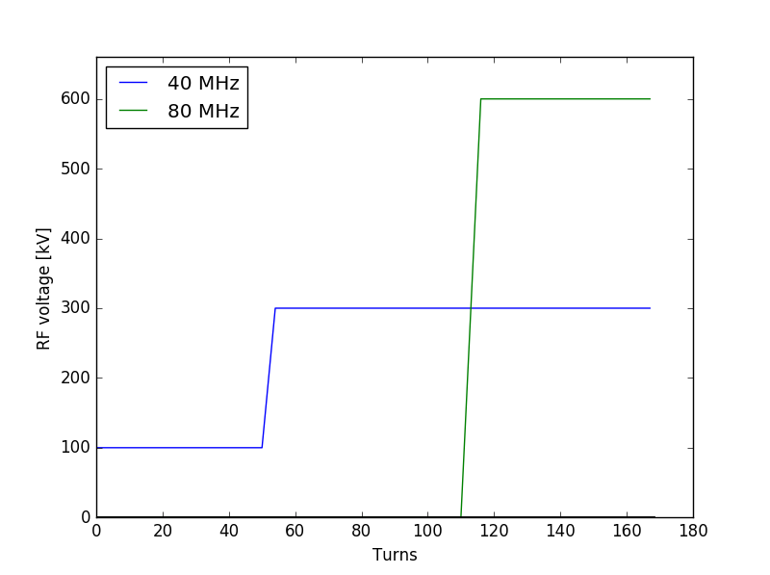
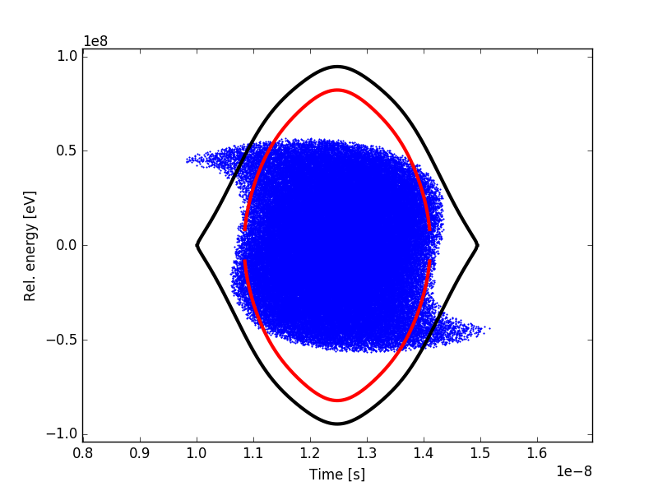
Motivation
Voltage program in PS
Injected bunch distribution in SPS
The transfer of bunches from the PS to the SPS relies on the bunch shortening with fast RF voltage increase (bunch rotation)
Due to the nonlinearities of the RF voltage, some particles take more time to rotate and the injected bunch distribution in SPS is distorted (“S-shape”)

Slide 4
Motivation
Voltage program in PS
Injected bunch distribution in SPS
Studies were done on means to make the bunch distribution better, by linearizing the RF voltage in the PS
The motivation to use tomography was to see whether the effect of the linearization could be evaluated

Slide 5
Tomography in the SPS
The situation of the tomography in the SPS in 2007 is introduced in http://cds.cern.ch/record/1014280/files/ab-note-2007-010.pdf (T. Bohl, H. Damerau, S. Hancock)
The tomography in the SPS was first evaluated in 1997, but the first attempts were not encouraging
It was then studied again in 2006, with the exact same motivation to study rotated bunches from the PS to SPS, one of the conclusions was: “The transfer function correction for the measurement system, especially those for the coaxial cables from the wall current monitors (APWL-10 and WC-2) in the tunnel to the digitizing oscilloscope (Tektronix TDS7254) must be applied. Even after these corrections the signal quality of the bunch profiles still remains at the limit of what is acceptable for tomography.”
In the winter shutdown 2006/2007, the measurement line was improved by replacing the long coaxial cables with a fibre optic link, to reduce the bunch profile distortion (T. Bohl Note-2008-12). A new evaluation of the tomography was done this year.

Slide 6
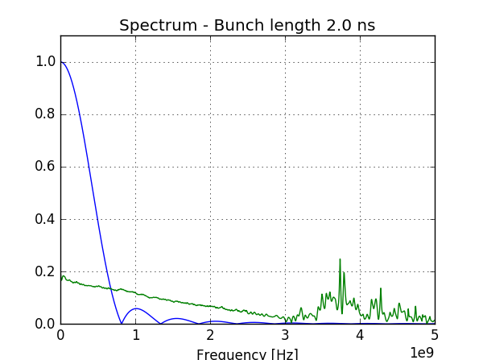
Measurement line transfer function
The measurement line transfer function (TF) is altering the measured longitudinal profile and is composed of:
Longitudinal pick-up
Cables and fiber-optic link up to the BA3 Faraday cage
The TF was obtained from pulse measurements (T. Bohl Note 2011-09, new measurements in 2016)
Data > 3GHz is unphysical and may introduce some corrections errors (mainly for bunch length < 1ns, and for the tails distribution)
$$λ_{meas}= ℱ^{−1}\left[σ_{bunch} 𝒵_{TF}\right]$$

Slide 7
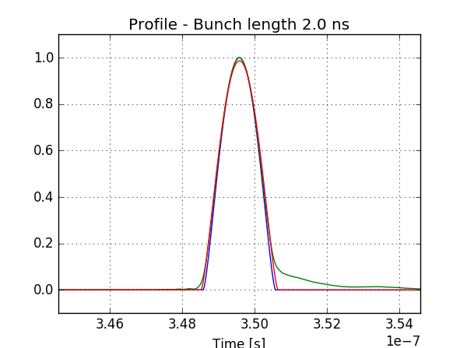
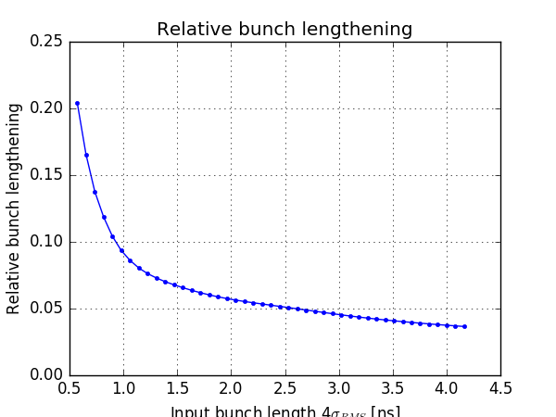
Bunch lengthening from TF
The bunch profile is lengthened due to the TF (blue is original, green is the perturbed profile, red is the fit on perturbed profile)
The tail behind the bunch is unphysical and is the main problem for the tomogram

Slide 8
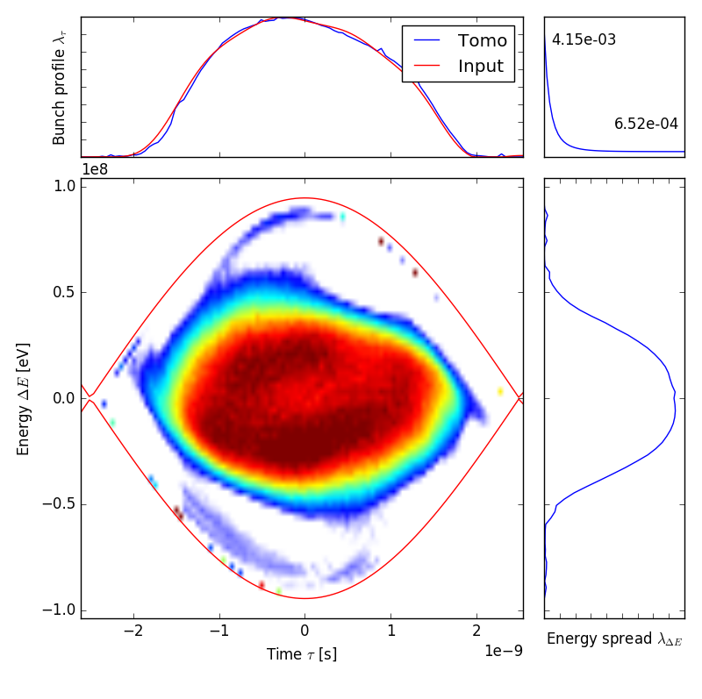
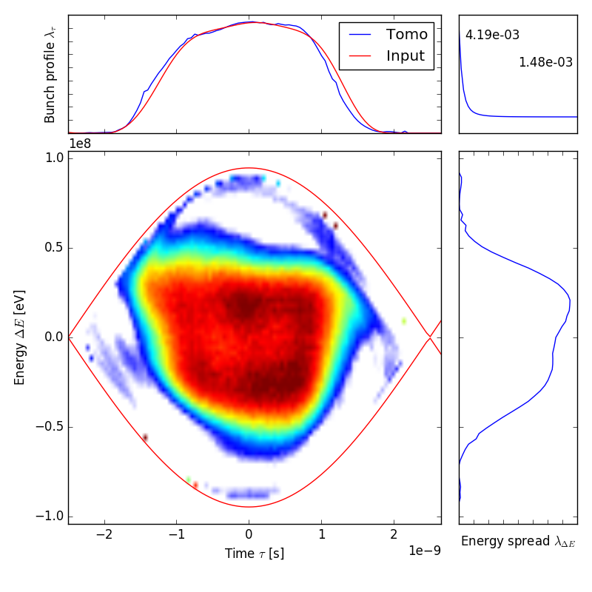
Tomogram at first turn
Without linearization
Small phase error
With linearization
A bunch profile was acquired each turn for 2000 turns in SPS
TF correction was applied on the bunch profiles with a Chebyshev Type II filter at 1.5 GHz
66 turns for reconstruction (1 synchrotron period)
Phase and voltage for tomogram were not optimized

Slide 9
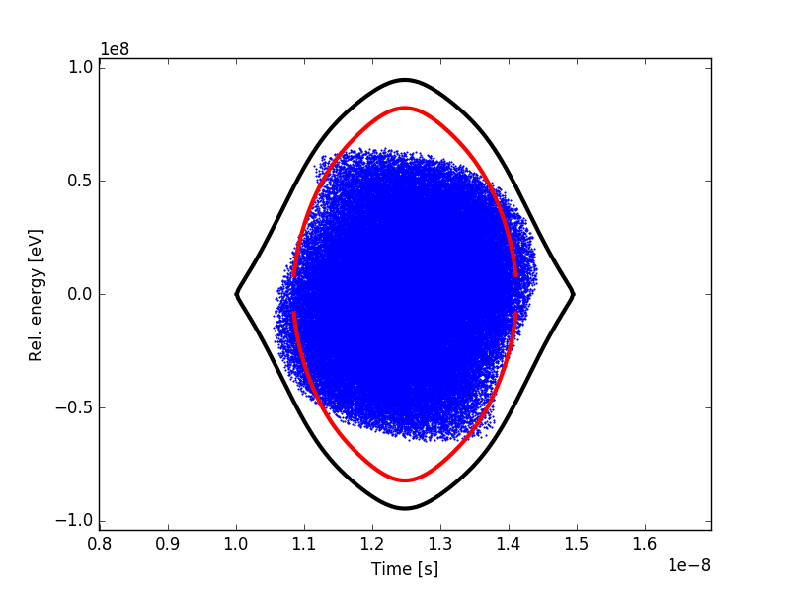
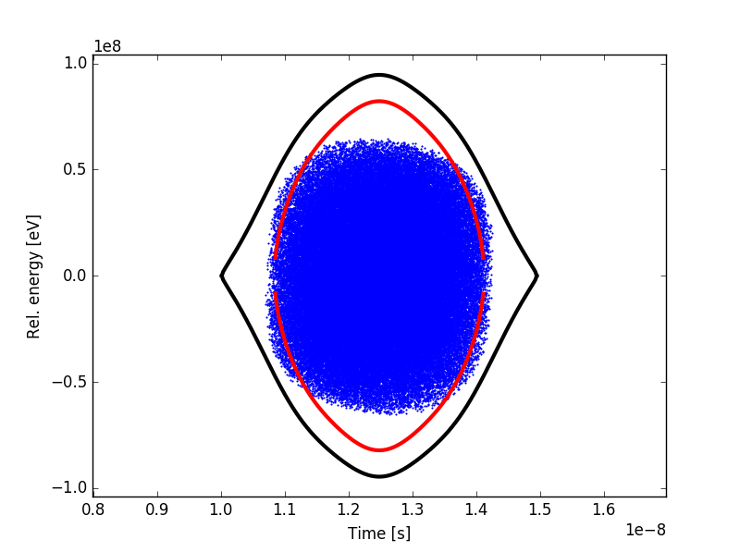
Expectation from simulations
Without linearization
With linearization
The expected bunch distribution with linearization is more square, which corresponds to the observation in the tomogram
Although, the bunch distribution in measurements seem more distorted than expectation
The operation on the 80 MHz RF voltage (fast variations of phase and amplitude seem to distort the bunch distribution) is difficult to control and is certainly idealized in simulations

Slide 10
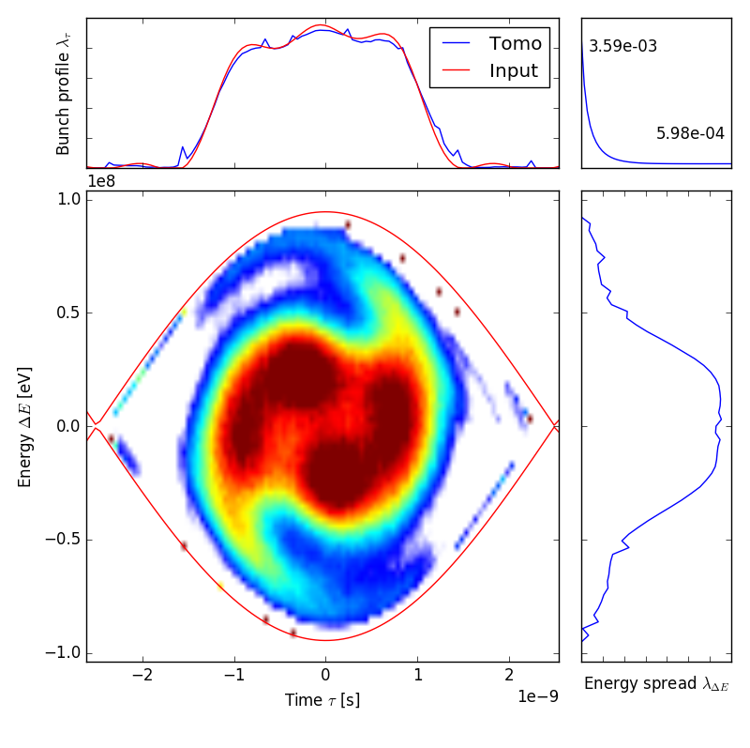
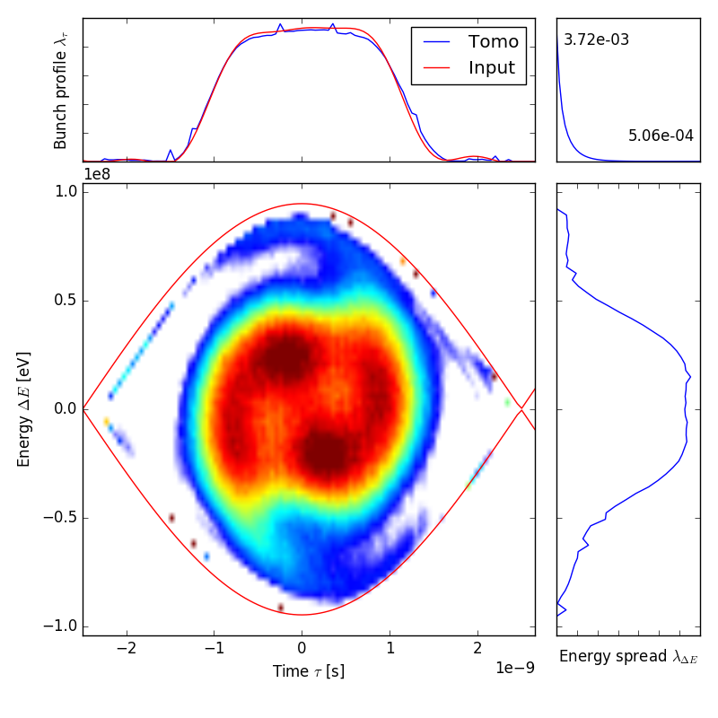
Tomogram during filamentation
Without linearization
With linearization
After 1 thousand turns in the SPS, in the middle of quadrupole oscillations
The SPS voltage is 4.5 MV, the injected PS bunch is not matched for this voltage

Slide 11
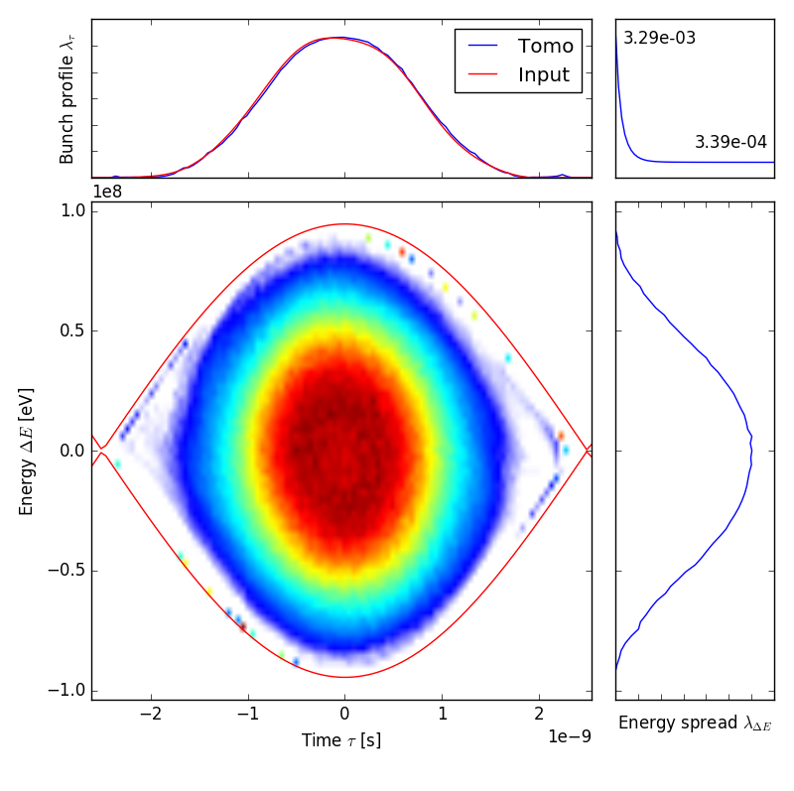
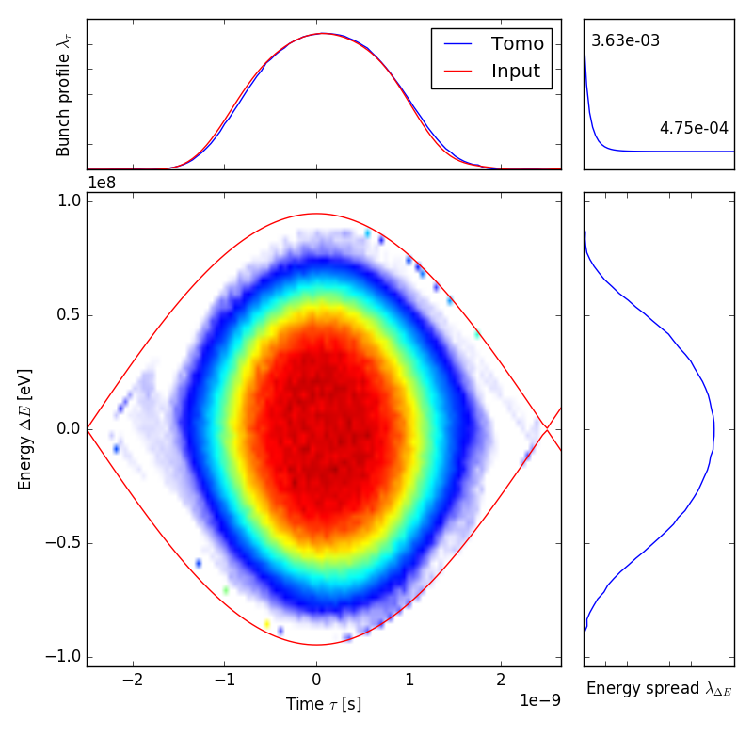
Tomogram after filamentation
Without linearization
With linearization
The bunch distribution after 2000 turns has filamented and is stationary
It is difficult to see tails in the 1st turn reconstruction, but after filamentation it seems that the bunch distribution is more dense with the linearization in PS (to be confirmed in more systematic study)

Slide 12
Animation of tomogram
Tomogram applied each turn, taking as input the 66 next frames
The voltage and phase were not optimized
The glitches corresponds to turn where the input voltage and/or phase is too far from the real value
To be taken in to account: +-10% uncertainty on voltage, phase at injection have damped oscillations due to phase loop, intensity effects…)

Slide 13
Conclusions
The longitudinal tomography for bunches in the SPS relies on the correction of the bunch profiles from the perturbation due to the measurement line transfer function
The results of tomograms including this correction are encouraging, and seem to give reasonable reconstruction of the bunch distribution (qualitative)
The tomogram may not be adapted to measure the distribution of the tails for the injected bunches in the SPS (little number of particles -> very low signal in comparison with the core of the bunch)
Nevertheless, the effect on the core of the bunch distribution can be seen, and results can be further improved by optimizing the tomogram input parameters

