Slide 1
Measurements of the 200 MHz induced voltage and comparison with simulations
M. Schwarz
Acknowledgements:
A. Lasheen, J. Repond, P. Baudrenghien, E. Shaposhnikova T. Bohl, SPS operator team

Slide 2
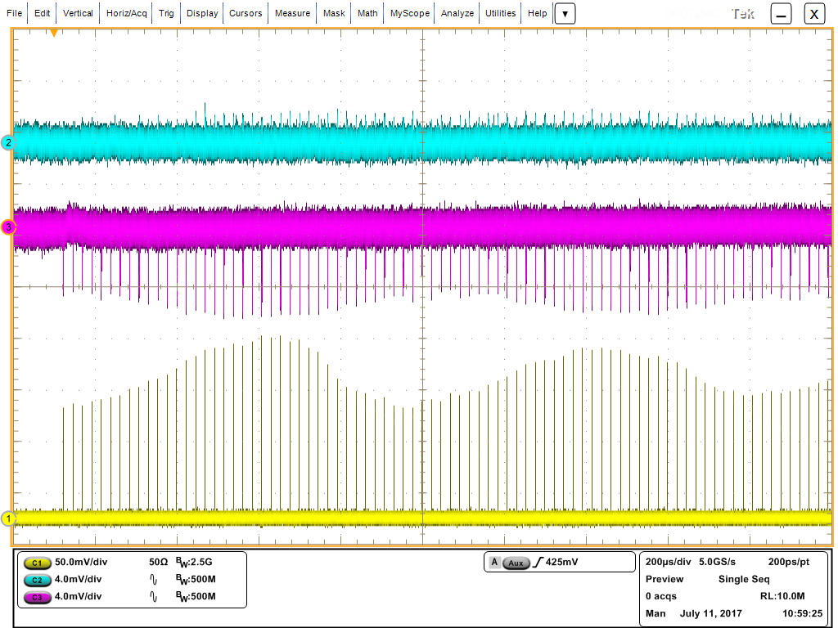
Measured induced voltage
Single bunch
Cavity voltage measured with I/Q demodulator
FF off FB off
I channel
beam
loading
Q channel
1 ms
bunch

Slide 3
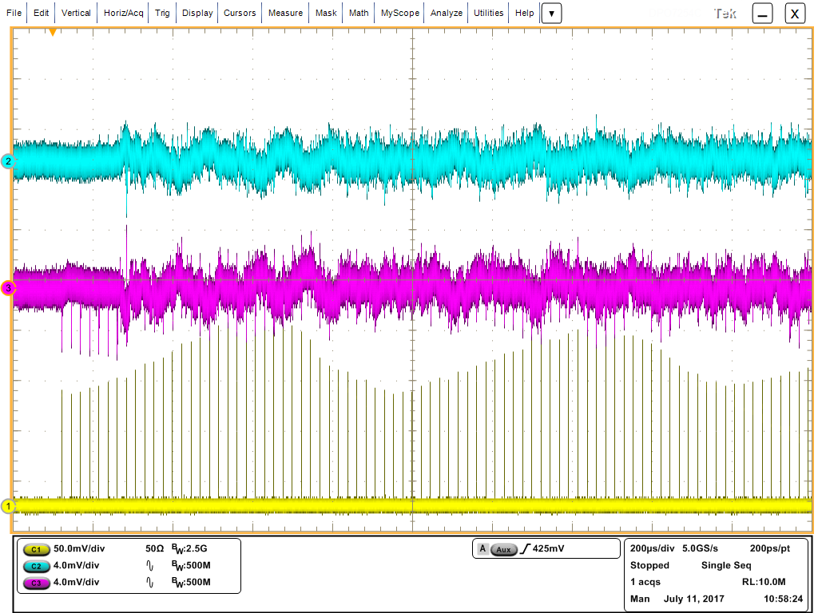
Measured induced voltage
Single bunch
Cavity voltage measured with I/Q demodulator
FB acts
from turn 8
FF off FB on
I channel
Q channel
beam
loading
1 ms
bunch

Slide 4
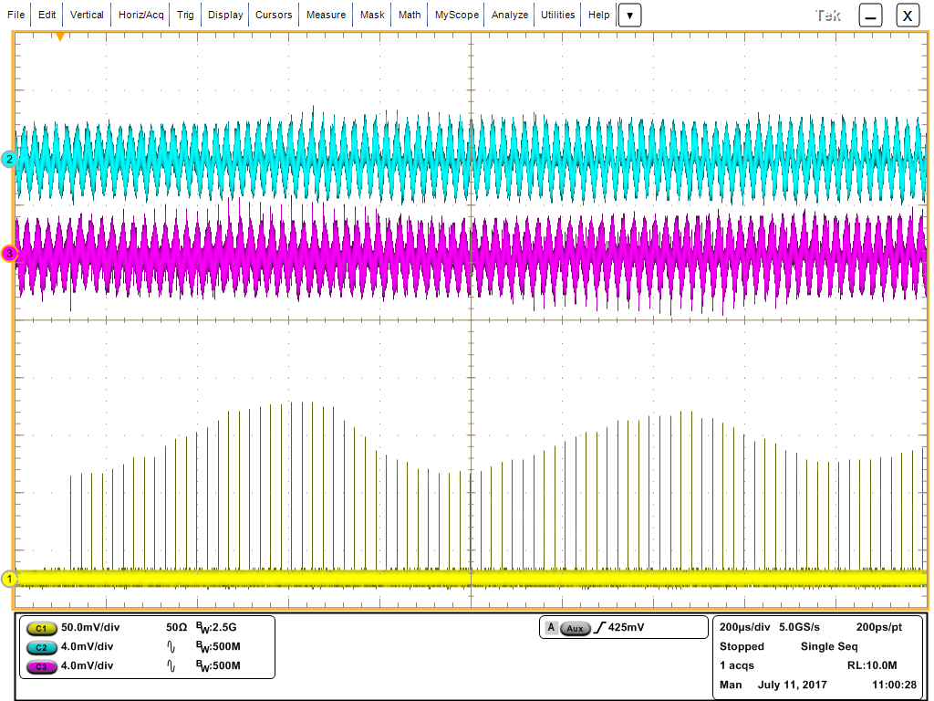
Measured induced voltage
Single bunch
Cavity voltage measured with I/Q demodulator
FF ON FB off
I channel
Q channel
FF acts
from turn 2
1 ms
bunch

Slide 5
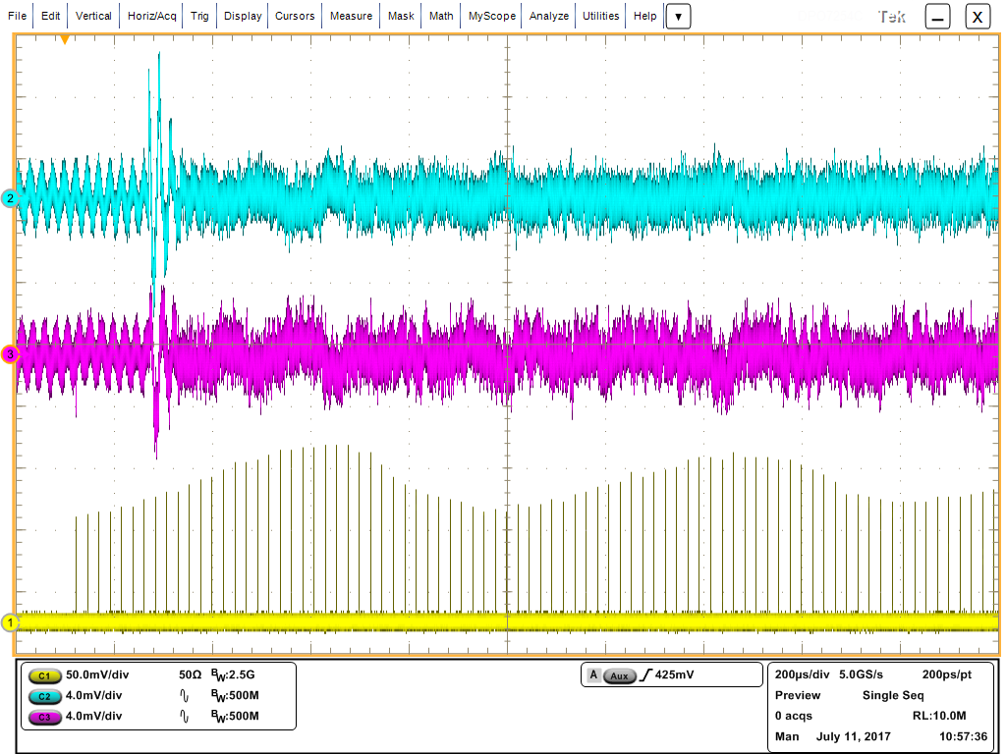
Measured induced voltage
Single bunch
Cavity voltage measured with I/Q demodulator
FF ON FB ON
-FF compensates for voltage x
-when FB turns on, it compensates for voltage x
->overcompensation
I channel
FB acts
from turn 8
Q channel
FF acts
from turn 2
1 ms
bunch

Slide 6
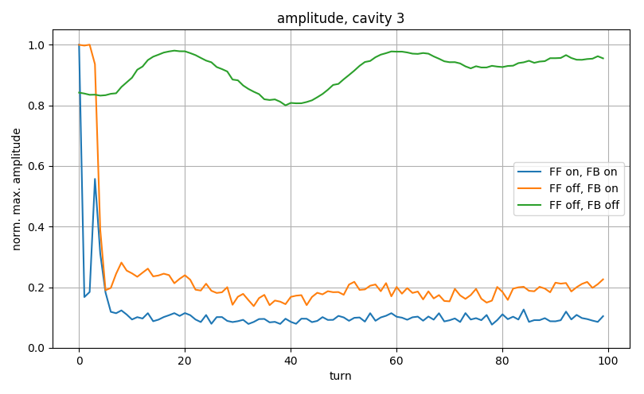
Measured induced voltage
Measured cavity voltage at f_{RF} from I/Q demodulator
Scaled with beam intensity for each acquisition
Amplitude = (I²+Q²)^{1/2}
Average amplitude over acquisitions
Maximum amplitude at each turn divided by total maximum
MD 2294 (2017-06-13)
FF active from turn 1
FB delay 50 μs relative to injection
V200 = 4.5 MV, V800 = 0.45 MV
Intensity per bunch ~ 1.1e11, 72 bunches
FB starts at turn 3
FB active in other cavities
FB over-compensates

Slide 7
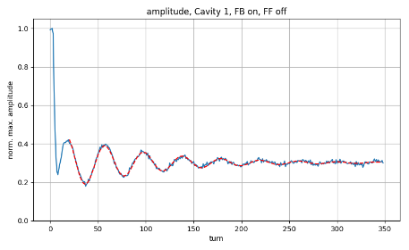
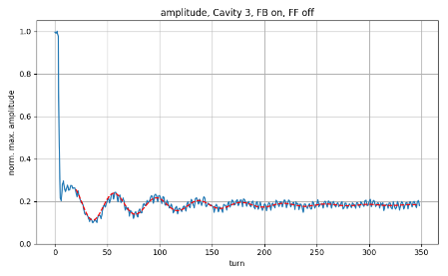
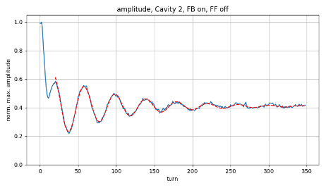
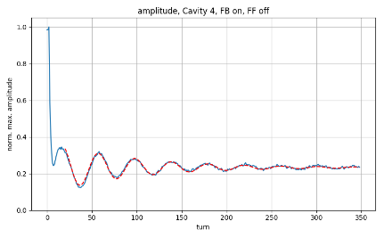
Measured induced voltage: individual cavities
MD 2384 (2017-06-27)
FF off, FB delay 50 μs relative to injection
V200 = 4.5 MV, V800 = 0.45 MV
Intensity per bunch ~ 1.14e11, 72 bunches
Fit function:$f\left(t\right)=A\sin\left(ωt+φ\right)\exp\left(−t/τ\right)+L$
Period ~41 turns agrees with period of FWHM ~39 turns
Reduction different for different cavities
A | T [turn] | $τ$ [turn] | L
0.14 | 41 | 85 | 0.3
A | T [turn] | $τ$ [turn] | L
0.09 | 40 | 83 | 0.19
4 sections cavity
5 sections cavity
A | T [turn] | $τ$ [turn] | L
0.22 | 41 | 83 | 0.41
A | T [turn] | $τ$ [turn] | L
0.12 | 41 | 87 | 0.23
4 sections cavity
5 sections cavity

Slide 8
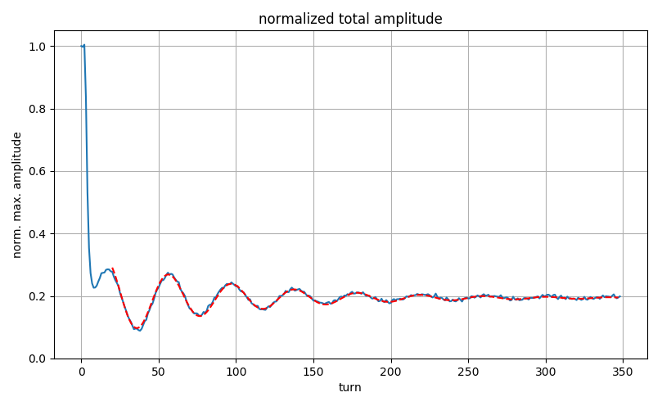
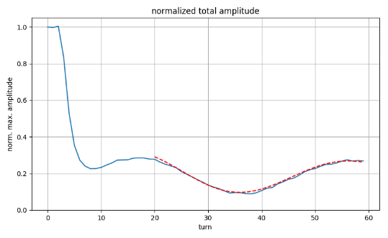
Measured induced voltage: total voltage
Total Voltage = V₁ + V₂ + V₃ + V₄
A | T [turn] | $τ$ [turn] | L
0.12 | 41 | 80 | 0.2

Slide 9
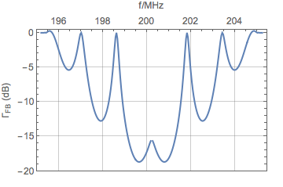
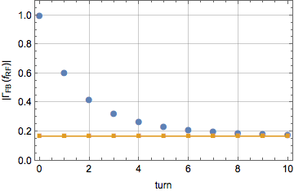
Simulation setup
Model injection by creating 72 bunches (25ns spacing) at the center of SPS RF-bucket
Model feedback by multiplying impedance with FB-reduction factor $Z_{n}=Z_{n−1} Γ_{FB}$ of P. Baudrenghien (Charmonix X, 2001)
No action of feedback at turn 1
Continuously increase feedback strength after turn 1
72 bunches
Nominal PS bunches, FWHM=4.2ns
1.14e11 particles per bunch
impedance model:
full SPS impedance model except in [195,205] MHz
analytic beam loading impedance for 5- and 4 sections cavities in [195,205] MHz
feed-back model:
$Z_{n}=Z_{n−1} {\left(Γ_{FB}\right)}^{S att(t)}$ with $att\left(t\right)=1−e^{−(t−t_{start})/τ}$
‘FB strength $S$’, ‘start time $t_{start}$’, ‘FB time constant $τ$’
Individual parameters for 5- and 4- sections cavities
Computation of beam loading:
Calculate beam loading V(t), using analytic impedance
Filter f_{RF} component VRF(t)
Amplitude = | VRF(t)|
Maximum amplitude at each turn divided by total maximum
$Γ_{FB}=−15.5 dB$ at f_{RF}
(i.e. Z(f_{RF}) multiplied by factor 0.17)
FB strength $S$: 1
$t_{start}$: 0 turns
FB time constant $τ$: 3 turns

Slide 10
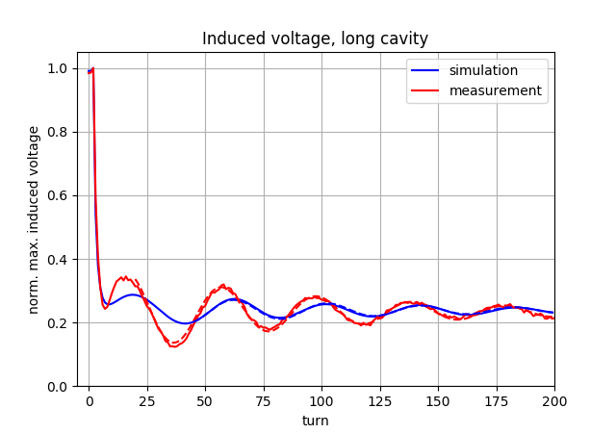
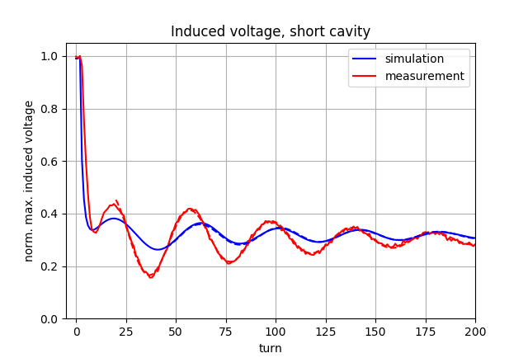
Simulated induced voltage: long/short cavities
Adjust ‘FB strength $S$’, ‘start time $t_{start}$’, and ‘FB time constant $τ$’ such that simulated normalized amplitude agrees with measured one
Measured: average over short cavities
FB strength $S$: 0.85
$t_{start}$: 2 turns
FB time constant $τ$: 2 turns
FB strength $S$: 0.7
$t_{start}$: 2 turns
FB time constant $τ$: 2 turns
Simulated:
Simulated:
A | T [turn] | $τ$ [turn] | L
0.04 | 40 | 110 | 0.24
A | T [turn] | $τ$ [turn] | L
0.05 | 40 | 112 | 0.32
Measured:
Measured:
A | T [turn] | $τ$ [turn] | L
0.12 | 41 | 89 | 0.23
A | T [turn] | $τ$ [turn] | L
0.17 | 41 | 87 | 0.23

Slide 11
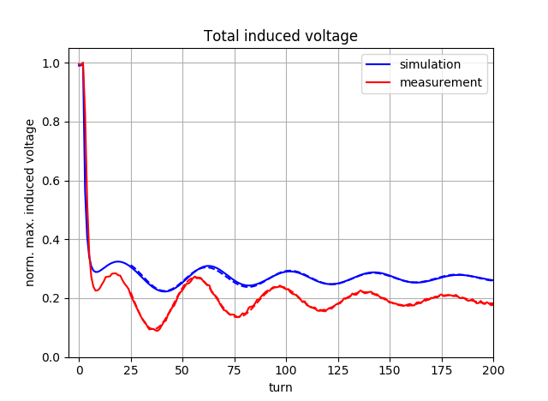
Simulated induced voltage: total
Simulated:
A | T [turn] | $τ$ [turn] | L
0.05 | 40 | 110 | 0.27
Measured:
A | T [turn] | $τ$ [turn] | L
0.12 | 41 | 76 | 0.19
General remarks:
periods of oscillations agree well
oscillation amplitude in simulations systematically smaller compared to measurement

Slide 12
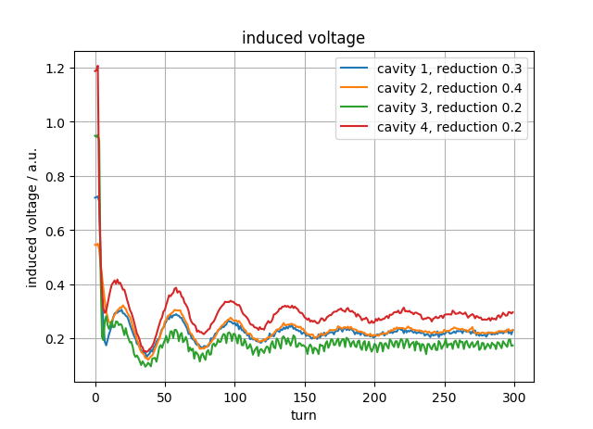
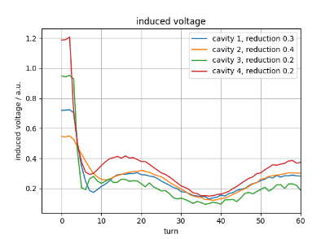
Measurement
Measured voltage in each cavity

Slide 13
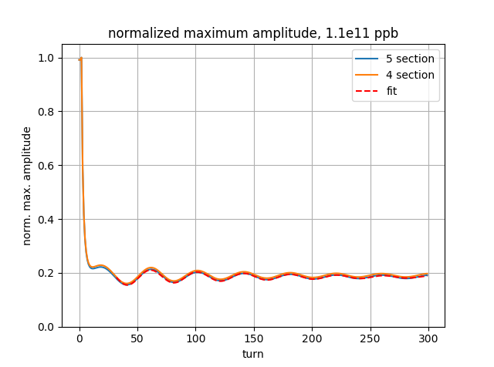
Simulation vs Measurement
Measurement:
- Measure I and Q from I/Q demodulator at 200 MHz
- Amplitude = (I² + Q²)^{1/2}
Simulation:
- Use full impedance model in BLonD
- Calculate induced voltage V(t) in cavity
- Filter 200 MHz component VRF(t)
- Amplitude = | VRF(t) |
~1.14e11 ppb
Simulation:
Period: ~39 turns agrees with oscillation of Period of FWHM oscillations ~38 turns
(synchrotron period ~ 56 turns)
Measurement
Period: ~41 turns agrees with oscillation of Period of FWHM oscillations ~37 turns
(synchrotron period ~ 56 turns)

Slide 14
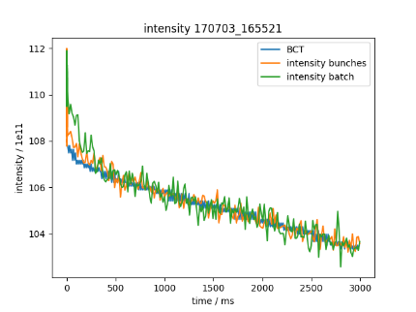
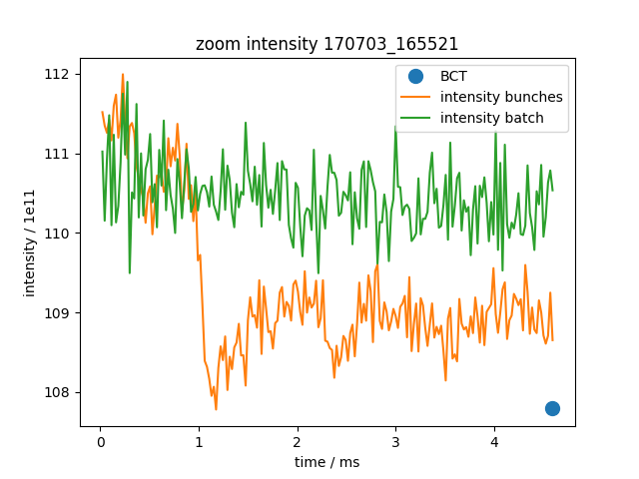
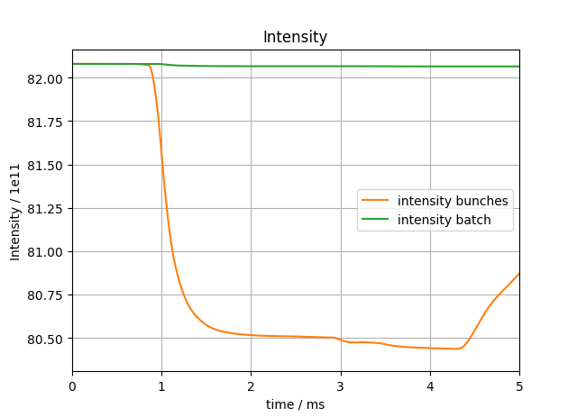
Beam intensity
PRELIMINARY
BCT: intensity of BCT (at 10 ms)
Intensity bunches: intensity obtained by integrating over bunches
Intensity batch: intensity obtained by integrating over batch profile (including ‘empty’ buckets)
1Synchrtron period ~ 1.3ms
Measurement
Not always observed in measurement…
Simulation
intensity of BCT at 10 ms
MD 17/07/03

Slide 15
Summary and next steps
Summary:
Adjusted FB model (impedance reduction) to reproduce measured induced voltage amplitudes
Period length agrees well, but amplitude is off by factor ~3
Next steps simulation:
Include FF impedance reduction factor in simulations
Implement method to compute losses in the same way as is used in measurements
Compute phase of simulated induced voltage
Currently, action of feedback in simulation independent of beam properties => implement dynamic feedback in simulation code BLonD
Next steps measurements:
More systematic studies with FF/FB on/off
Measure at higher intensities
Study losses during flat-bottom with vertical tune kicker (removes particles outside batch) and during ramp
Thank you for your attention!

Slide 16
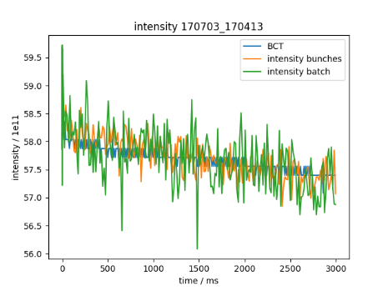
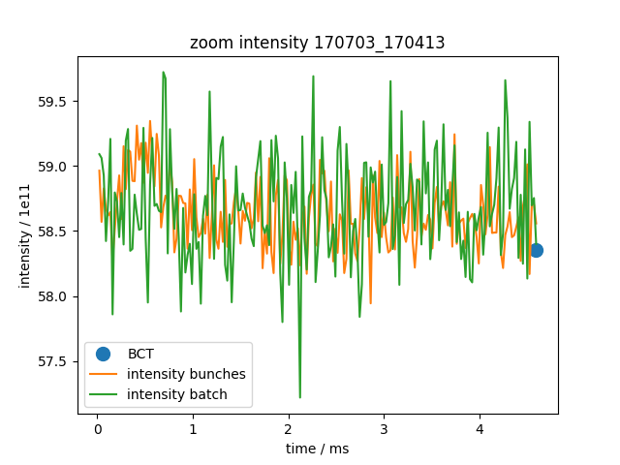
Beam intensity
Measurement
~ 0.8e11 ppb initially
MD 17/07/03

