Slide 1
Transverse Impedance General Considerations and Wake Field Simulations
Nasrin Esfahani
LIU-SPS BD WG – 11 May 2017

Slide 2
Topics
The 900 MHz band HOM
Wake field results

Slide 3
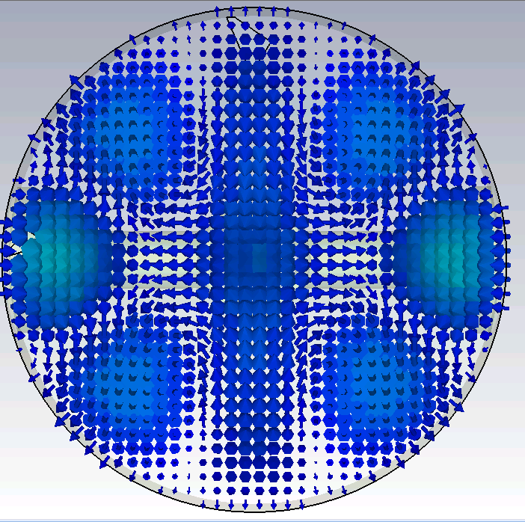
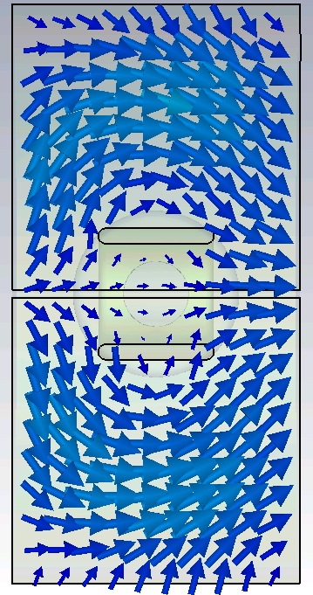
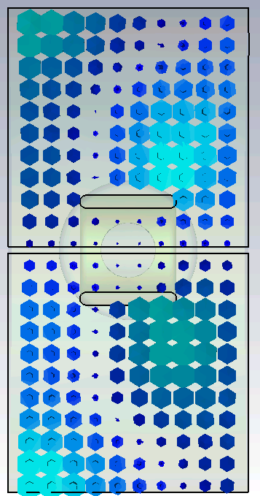
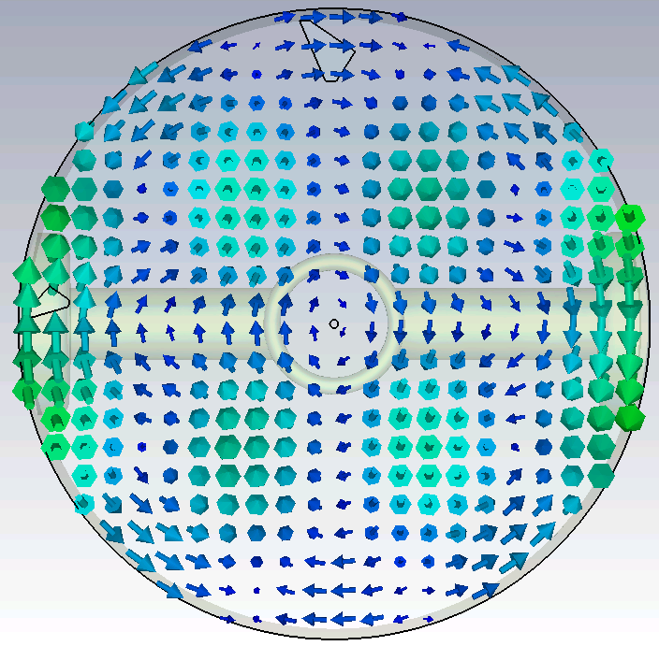
Field profiles of the π/2 mode
ϕ=90
f= 940.8 MHz
Electric Field
Magnetic Field

Slide 4
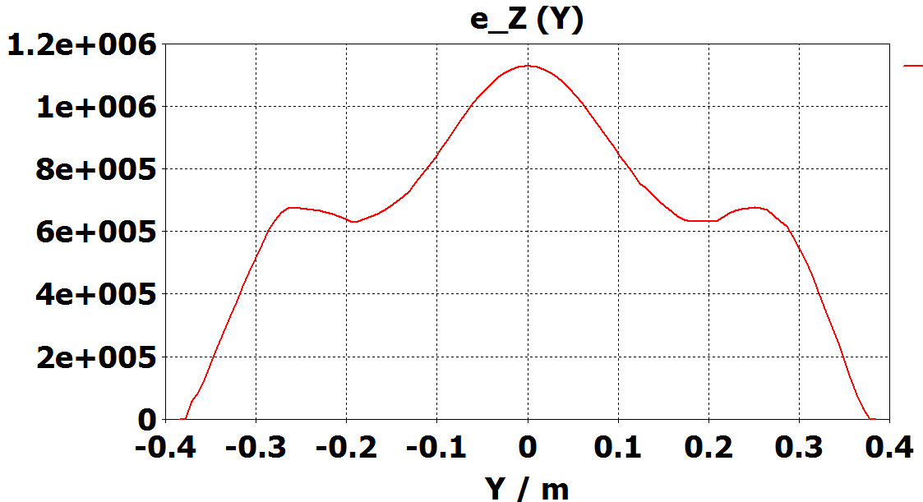

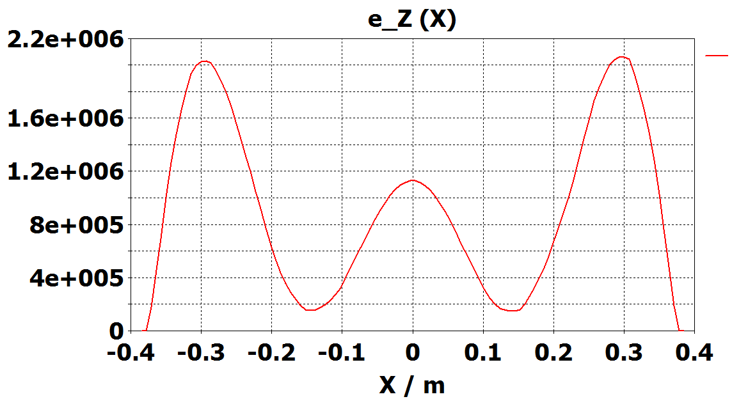
Transverse force
y
x
y
Electric Fields
x
ϕ= π/2 mode is not the disturbing HOM

Slide 5
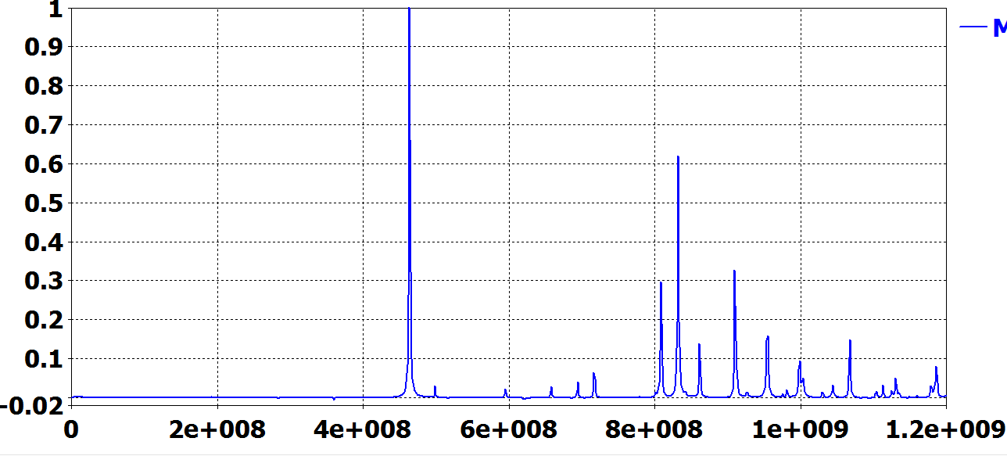

Wake fields on a two-cell unit
909MHz
Normalized Zx
950MHz
920MHz
ϕ= π/2 mode is not the disturbing HOM

Slide 6
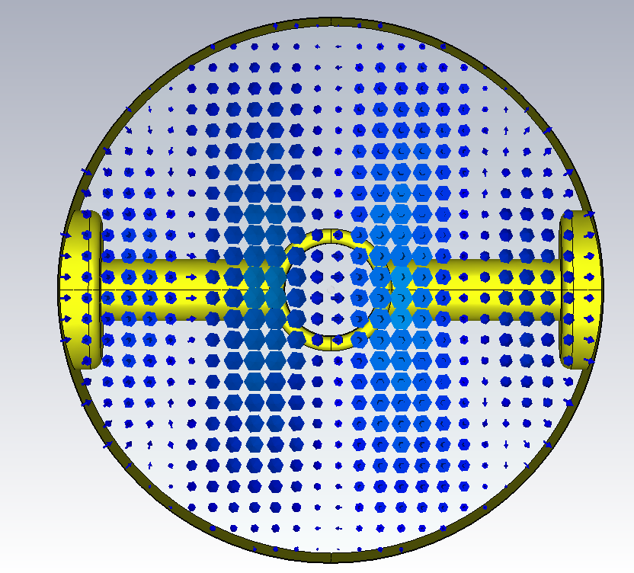
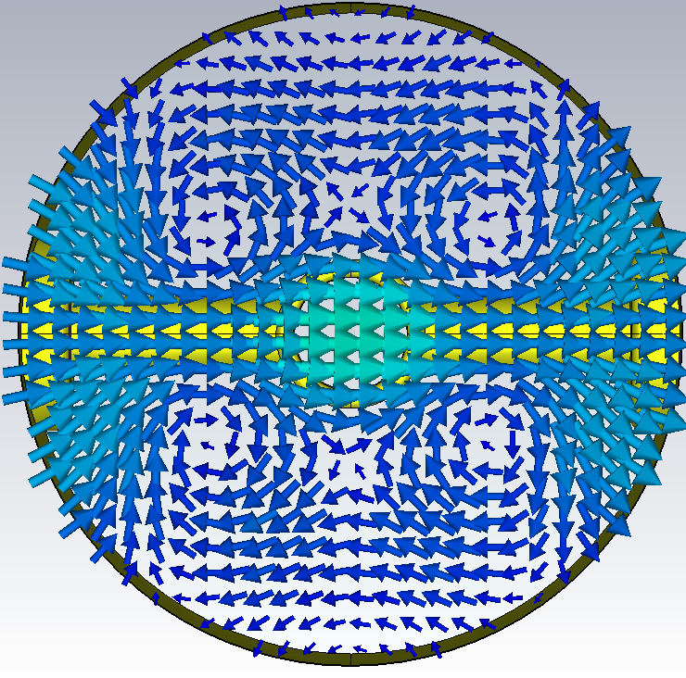
Field profiles of the π/3 mode
ϕ=60
f= 939.6 MHz
Electric Fields
t=0
t=T/4

Slide 7
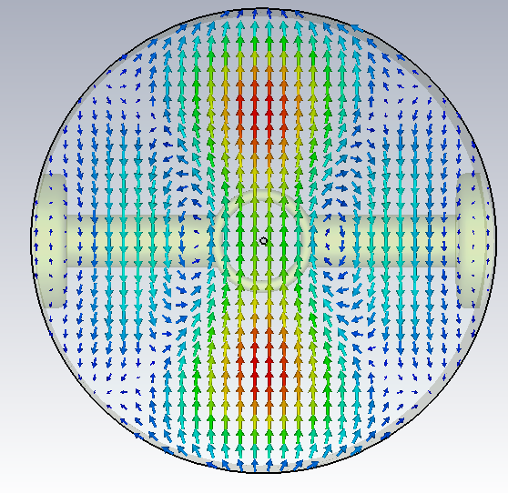
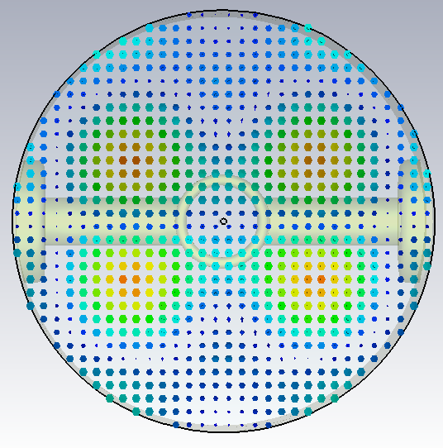
Field profiles of the π/3 mode
ϕ=60
f= 939.6 MHz
Magnetic Fields
t=0
t=T/4

Slide 8
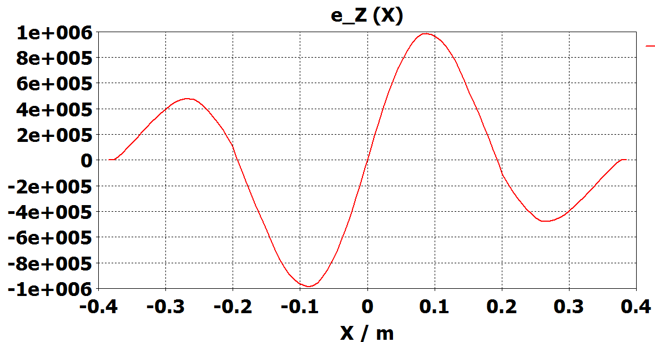
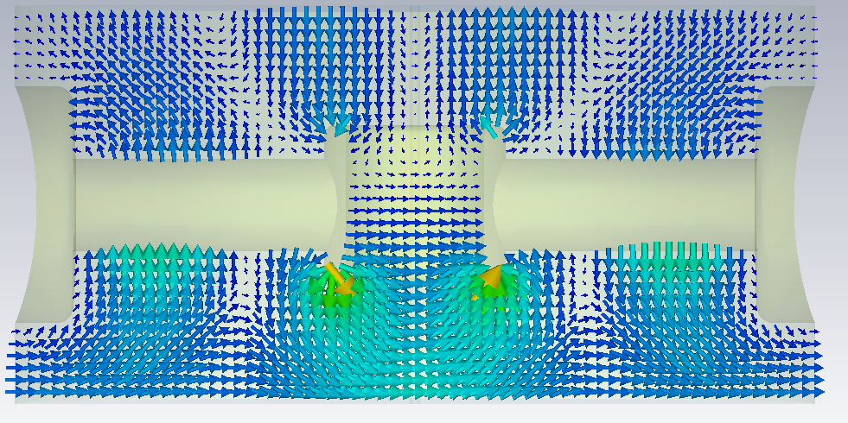
Transverse force
ϕ= 60 ͦMode
y
x

Slide 9
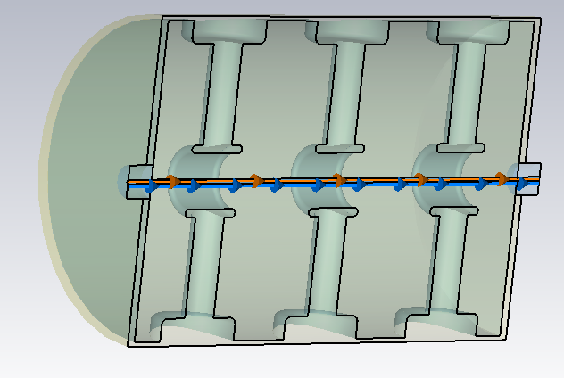
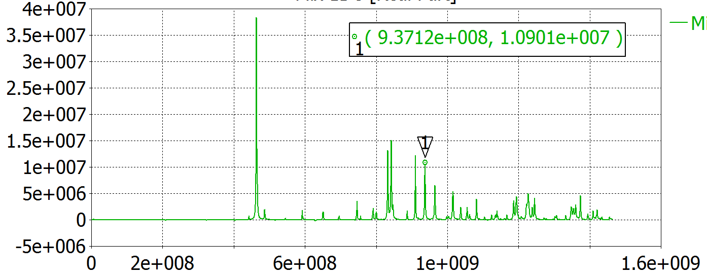
Wake field simulation
x
Zx (Ω/m)
Freq (Hz)

Slide 10
Field profiles of the π/3 mode
ϕ=60
f= 939.6 MHz
Electric Fields
t=0
t=T/4

Slide 11
900 MHz band HOM
Freq (MHz) | Phase shift | Q | Type
939.2 (consistent with [1] and [2] ) | Approximately 60 | 61000 | Hybrid (consistent with [1] and [2])
[1] F. Caspers and G. Dome, “ The 938 MHz resonant damping loops for the 200 MHz SPS travelling wave cavities”, ATS-note-2012-065 (1982).
[2] R. J. Laukner and T. R. P Linnecar, “The transverse coupled bunch mode instability at 940 MHz in the SPS” SPS improvement report No. 186 (1979)

Slide 12
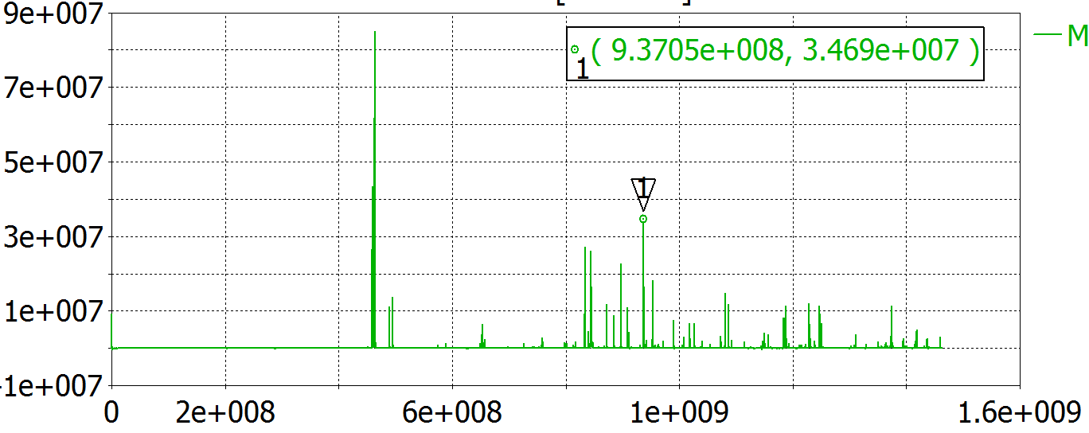
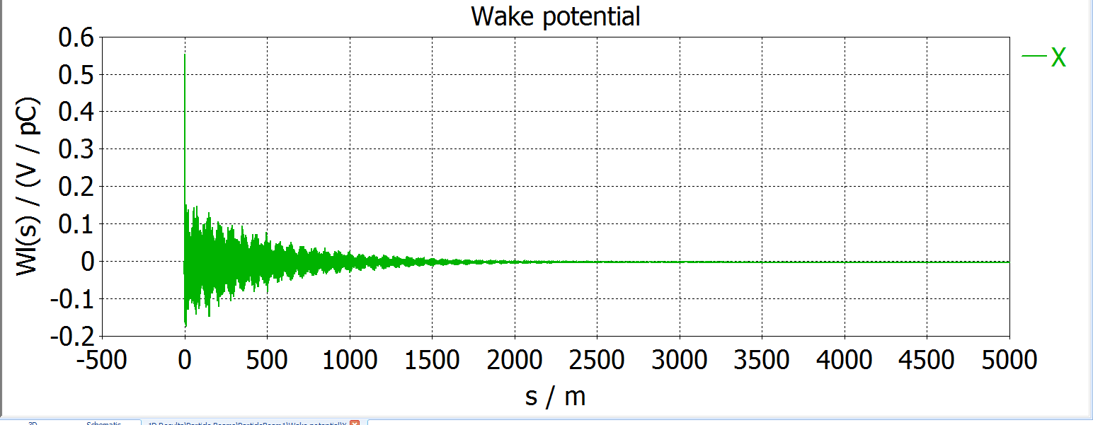
Single section wake
Zx (Ω/m)
Freq
Mode | F (MHz) | Real (Zx (MΩ/m))
1 | 937.04 | 34.7
2 | 937.77 | 16.3

Slide 13
Summary of the wake field results
 | Freq (MHz) | Zx (MΩ/m)
3 Cells | 937.12 | 10
11 Cells (without FPCs) | 937.04 | 34
11 Cells (with FPCS) | 937.45 | 28 (simulations on going)

Slide 14
Measurement and Simulations
 | Freq (MHz) | Zx (4*11 cell)
[1] | 938 | 70 MΩ/m (Q=61000)
Wake field | 937.45 | 4*28=112 MΩ/m
[1] R. J. Laukner and T. R. P Linnecar, “The transverse coupled bunch mode instability at 940 MHz in the SPS” SPS improvement report No. 186 (1979)

Slide 15
Conclusions
The 938 MHz HOM is a π/3 mode
Transverse wake fields on a single section (28 MΩ/m Horizontal mode)

