Slide 1
Update on simulation of capture losses in the SPS
M. Schwarz
Acknowledgements:
A. Lasheen, J. Repond, E. Shaposhnikova
BLonD team

Slide 2
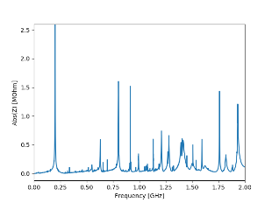
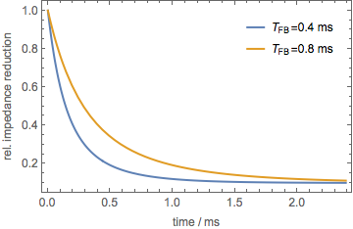
Motivation
Simulate SPS capture losses in full present SPS impedance model
Feedback currently modelled as reduction of TWC impedance at 200 MHz
Previous simulations
72 individual bunches, FB increases step-like (J. Repond)
1 bunch, assumed periodic with T=25 ns, FB strength evolution defined by feedback time constant T_FB (A. Lasheen)
Presented simulation
72 individual bunches, FB strength evolution defined by T_FB

Slide 3
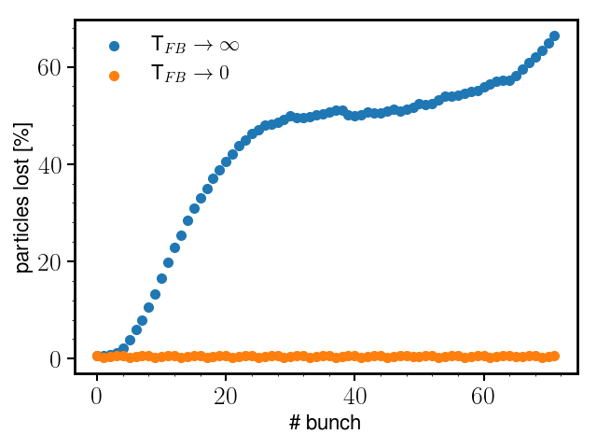
Infinite T_FB: zero attenuation and no impedance reduction Zero T_FB: maximum attenuation and maximum impedance reduction from turn 1
Extreme cases
Without reduction: 60% losses
Instantaneous reduction: <1% losses
V200 = 4.5 MV, V800 = 0.45 MV, 1.2e11 ppb

Slide 4
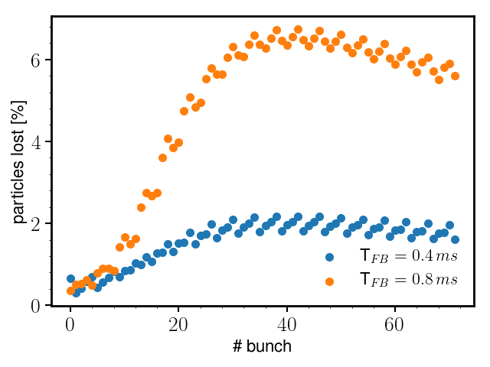
Different FB time constants
T_FB = 0.8 ms: 6% losses
T_FB = 0.4 ms: 2% losses
V200 = 4.5 MV, V800 = 0.45 MV, 1.2e11 ppb

Slide 5
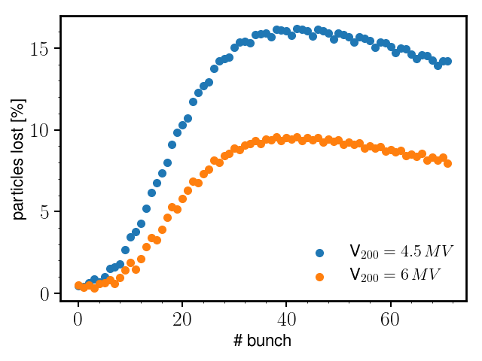
4.5 MV vs 6 MV
V200 = 4.5 MV, V800 = 0.45 MV, 1.6e11 ppb,
T_FB = 0.8 ms
V200 = 6MV, V800 = 0.6MV, 1.6e11 ppb,
T_FB = 0.8 ms

Slide 6
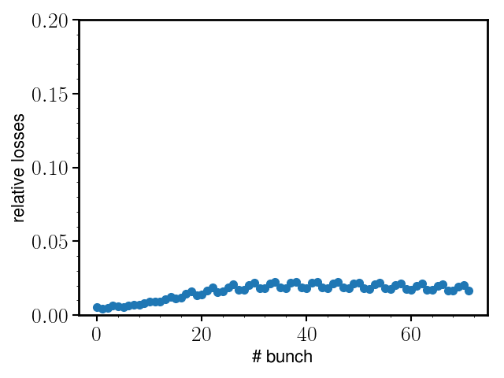
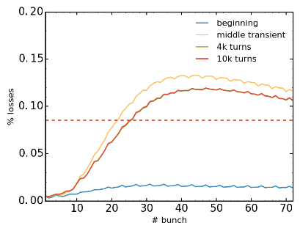
Comparison FB implementations
T_FB = 0.4 ms:
5 dB attenuation at turn 5, 20 dB after turn 100
5 dB attenuation for first 100 turns
20 dB attenuation afterwards
curtesy: J. Repond
V200 = 4.5 MV, V800 = 0.45 MV, 1.2e11 ppb

Slide 7
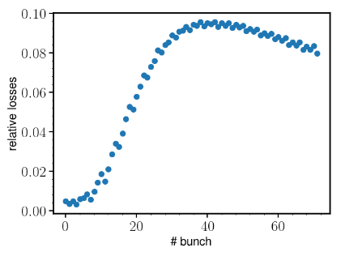
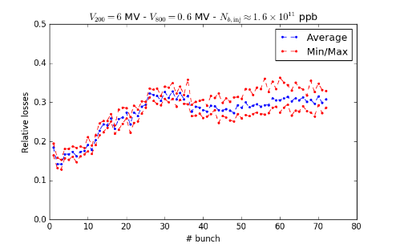
Simulation vs Measurement
V200 = 6MV, V800 = 0.6MV, 1.6e11 ppb,
T_FB = 0.8 ms
Both FB and FF active
curtesy: A. Lasheen
Summary:
Shapes of simulated and measured losses similar
Absolute values different

Slide 8
Summary and outlook
Summary:
Currently, “feedback” simulated by reducing TWC impedance at 200 MHz
Comparison with measurements shows
- qualitative agreement in shape
- quantitative disagreement in absolute value
Outlook:
Currently, action of feedback in simulation independent of beam properties
=> implement dynamic feedback in simulation code BLonD
Investigate transient effects of one-turn feedback

