Slide 1
Synchrotron frequency shift: measurements vs simulations s LIU-SPS Beam Dynamics Working Group 30/06/2015
A. Lasheen, E. Shaposhnikova
Acknowledgments: T. Bohl, S. Hancock, OP team, MD coordinators

Slide 2
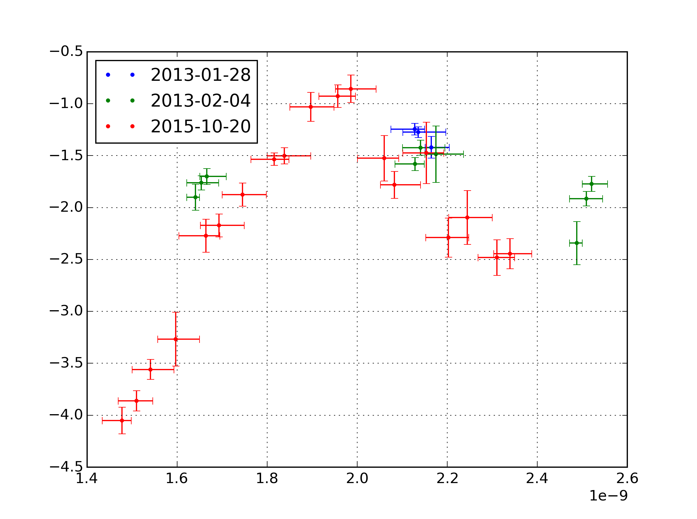
Motivation
Slope b [${10}^{−10}$Hz]
Bunch length [s]
The synchrotron frequency shift, measured from quadrupole oscillations at flat bottom was studied as a probe of the reactive part of the impedance in the SPS.

Slide 3
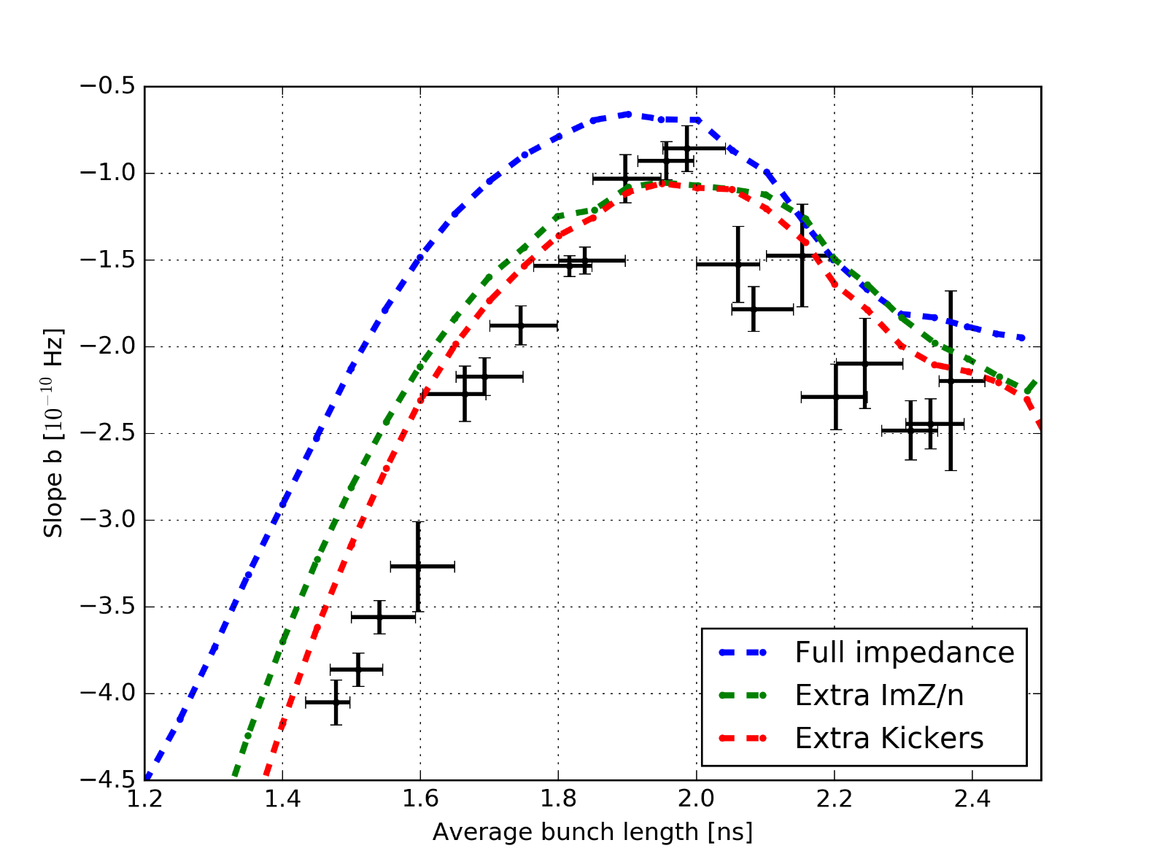
Motivation
From those measurements, an inductive impedance of ImZ/n~1 Ohm (or kickers x 1.5) was estimated to be missing, or the discrepancy may come from the measured bunch length which would be bigger than in reality.
New measurements were needed to confirm this.

Slide 4
Outline
Recap of the method
New measurements results and analysis
Effect of the bunch distribution on the incoherent synchrotron frequency shift

Slide 5
Frequency of the quadrupole oscillations
$$ΔE$$
$$Δt$$
The frequency of the oscillations is $f_{2s}\left(τ,N\right)≈2f_{s0}$
Only the motion of the mismatched particles is seen in measurements.

Slide 6
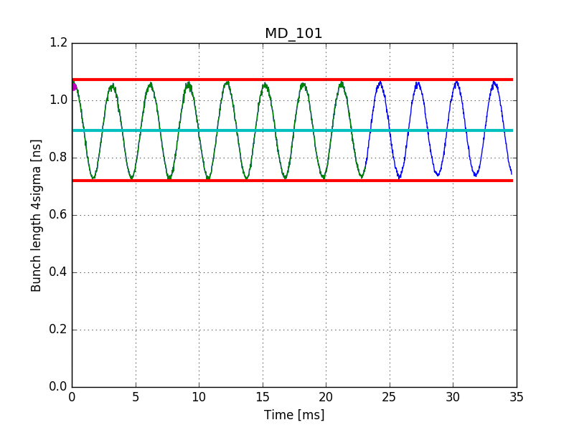
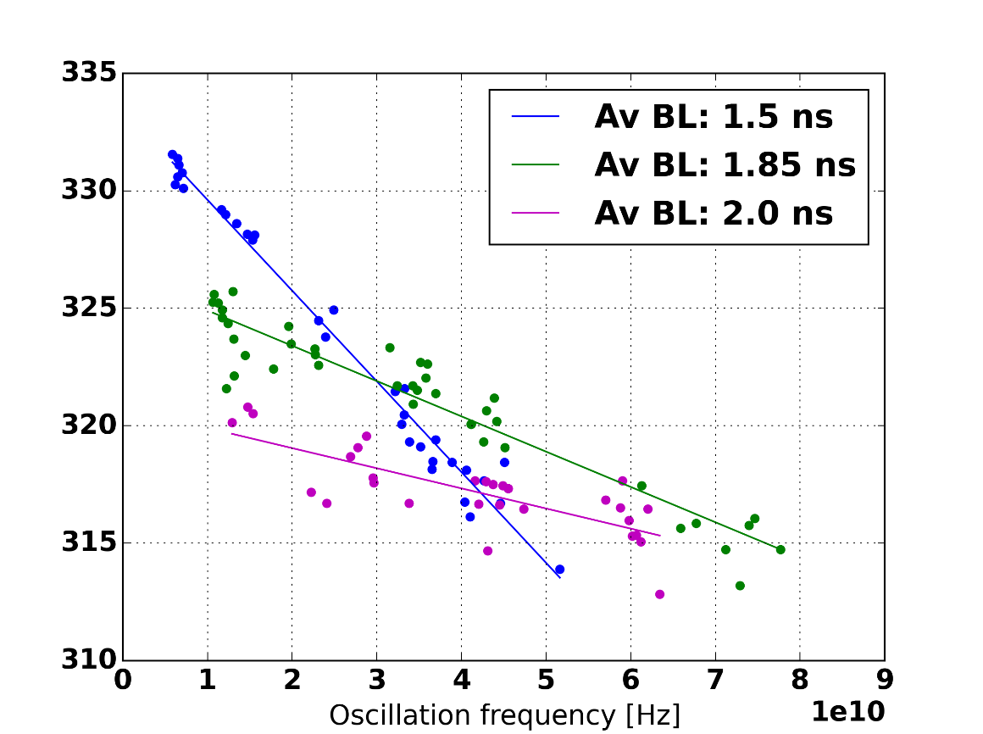
Recap of the method
Frequency $f_{2s}$ [Hz]
Intenstiy [ppb]
Bunch length oscillations are measured at injection.
Assuming a parabolic line density and a constant ImZ/n impedance $f_{2s}\left(τ, N\right)≈f_{2s}^{\left(0\right)}\left(τ\right)−f_{2s}^{\left(0\right)}\left(τ\right)\frac{6e}{hV_{RF}ω_{0}^{2}τ^{3}} \left(\frac{ImZ}{n}\right) N$
a
b

Slide 7
Recap of the method
Frequency $f_{2s}$ [Hz]
Intenstiy [ppb]
Bunch length oscillations are measured at injection.
The frequency of these oscillations are fitted linearly with respect to intensity for different average bunch lengths. $f_{2s}=a−b N$

Slide 8
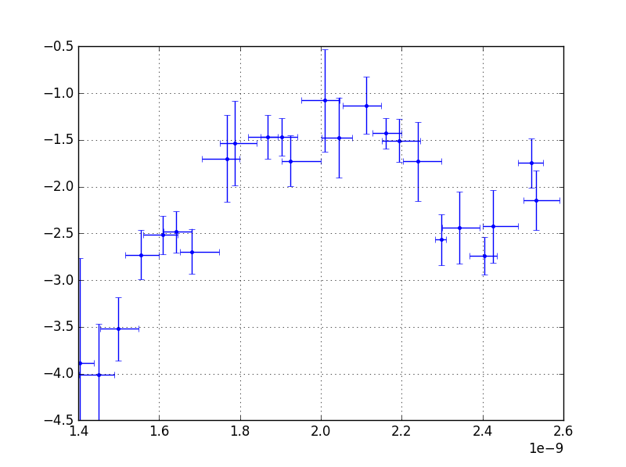
New measurements results
Slope b [${10}^{−10}$Hz]
Slope b [${10}^{−10}$Hz]
Average Bunch length [s]
Average Bunch length [s]
The 2016 measurements are comparable with the 2013 and 2015 measurements

Slide 9
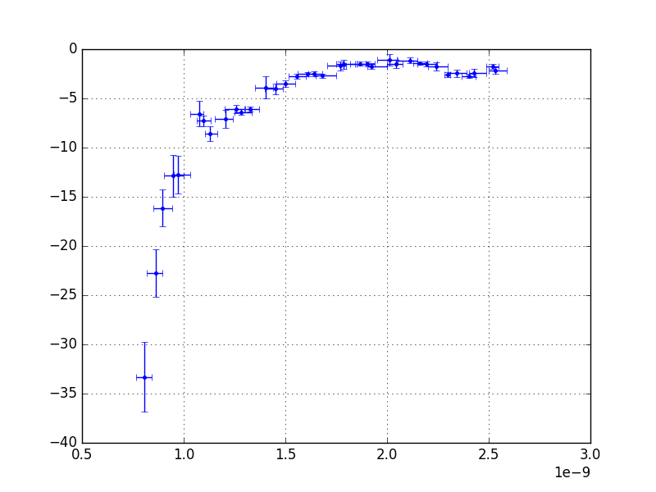
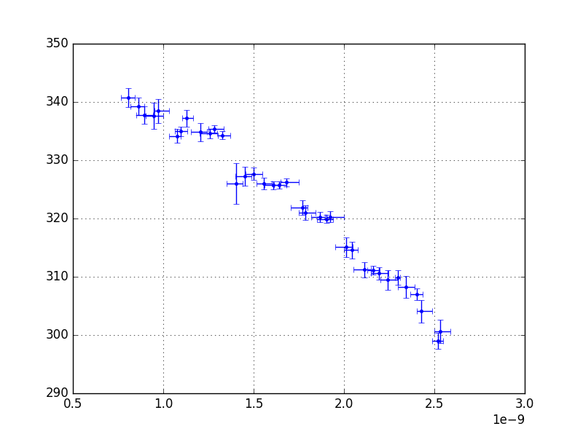
New measurements results
Origin a [Hz]
Slope b [${10}^{−10}$Hz]
Average Bunch length [s]
Average Bunch length [s]
Measurements with very small bunch lengths were achieved
Assuming a parabolic line density and a constant ImZ/n impedance $f_{2s}\left(τ, N\right)≈f_{2s}^{\left(0\right)}\left(τ\right)−f_{2s}^{\left(0\right)}\left(τ\right)\frac{6e}{hV_{RF}ω_{0}^{2}τ^{3}} \left(\frac{ImZ}{n}\right) N$
a
b

Slide 10
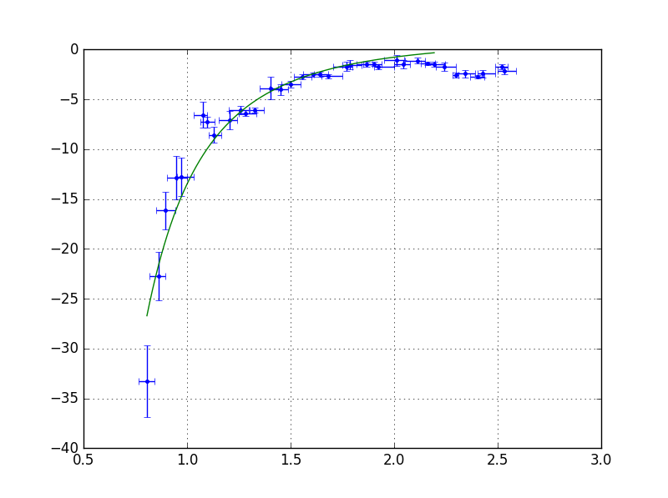
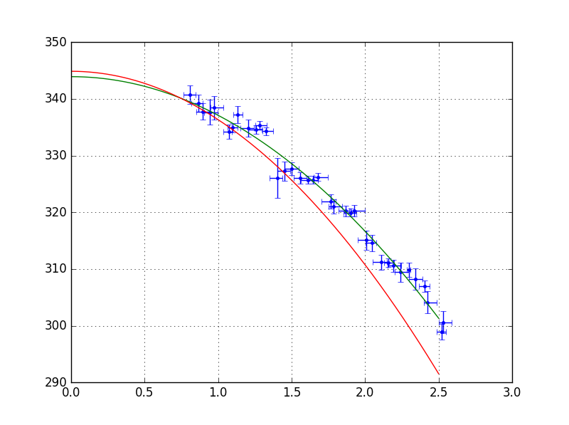
Fit parameters (a,b) dependencies
${2f}_{s0}≈344$ Hz, which is the value expected analytically
Origin a [Hz]
Slope b [${10}^{−10}$Hz]
Average Bunch length [s]
Average Bunch length [s]
The synchrotron frequency shift scales as $b∝\frac{f_{2s}^{\left(0\right)}\left(τ\right)}{τ^{3}}$
The synchrotron frequency without intensity effects scales as $f_{2s}^{\left(0\right)}\left(τ\right)≈2f_{s0}\left(1−\frac{{\left(ω_{RF}τ\right)}^{2}}{64}\right)$

Slide 11
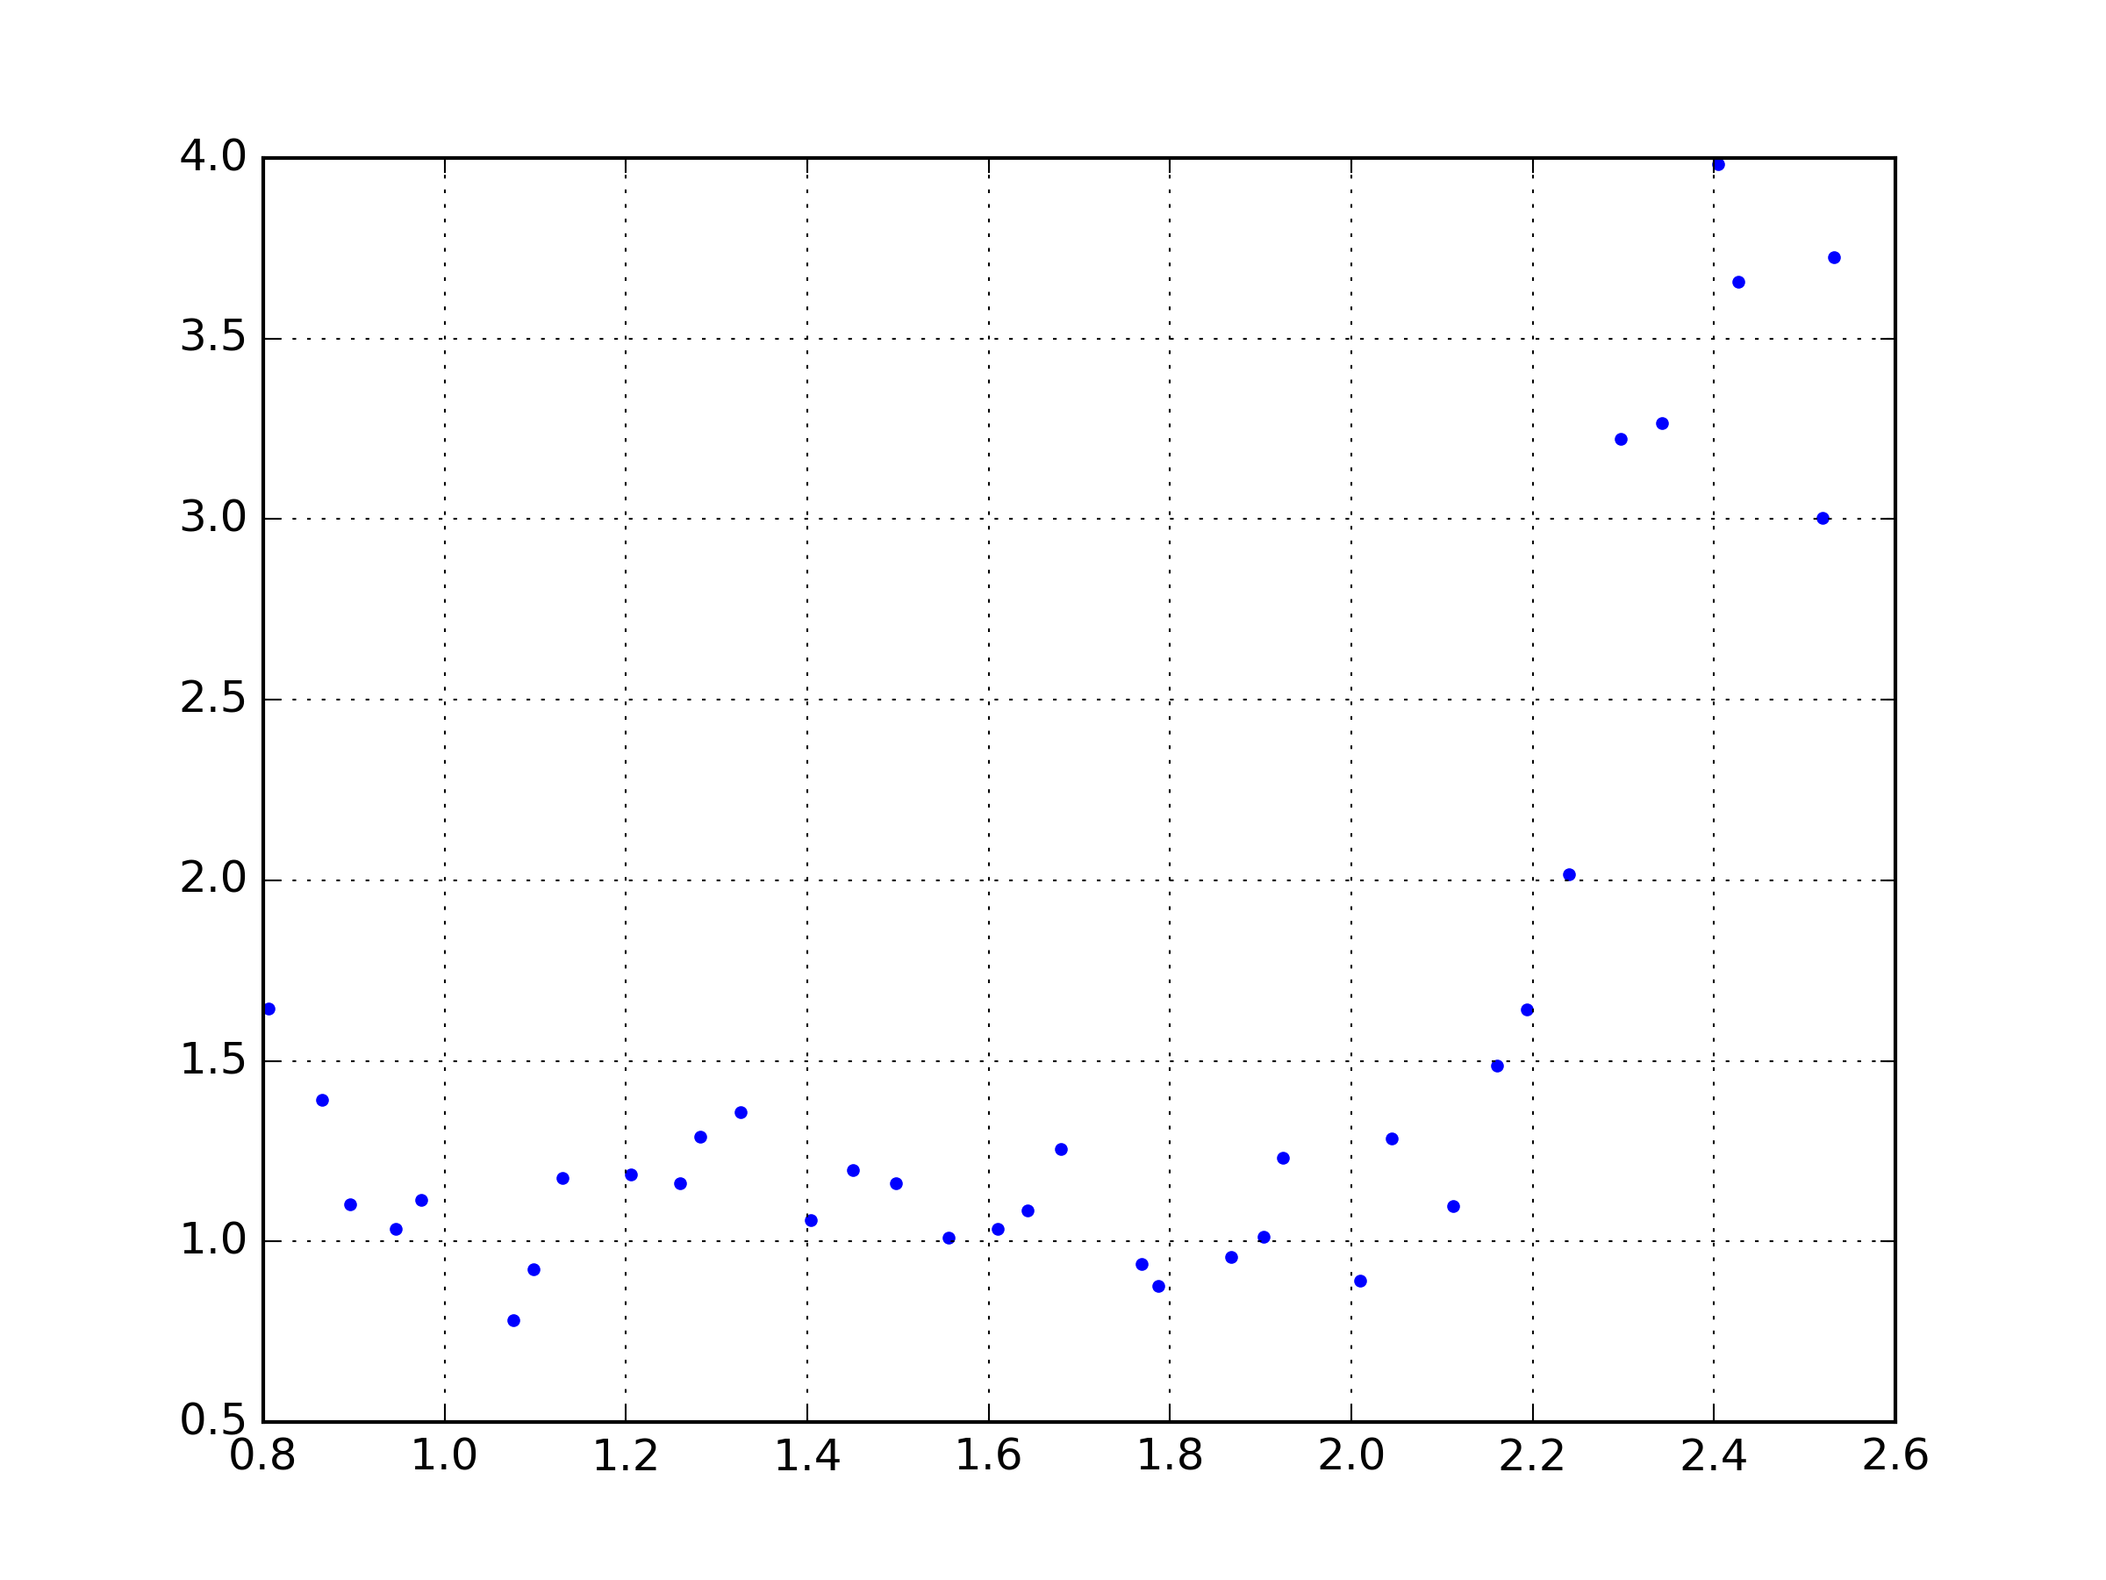
Rescaling of the results
ImZ/n [au]
Average Bunch length [ns]
To reduce the bunch length dependence, we combine a and b from the fit such as: ${\left(\frac{ImZ}{n}\right)}_{fit}=\frac{b}{a}\frac{ω_{0}^{2}τ^{3}V_{RF}h}{6e}$

Slide 12
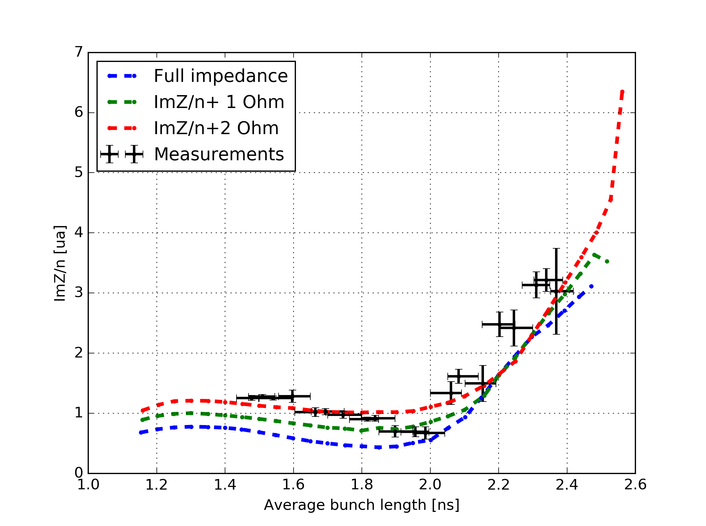
Missing impedance ?
Using the rescaling on the old measurements show that adding ImZ/n~1 Ohm is not enough to reproduce the measurements.

Slide 13
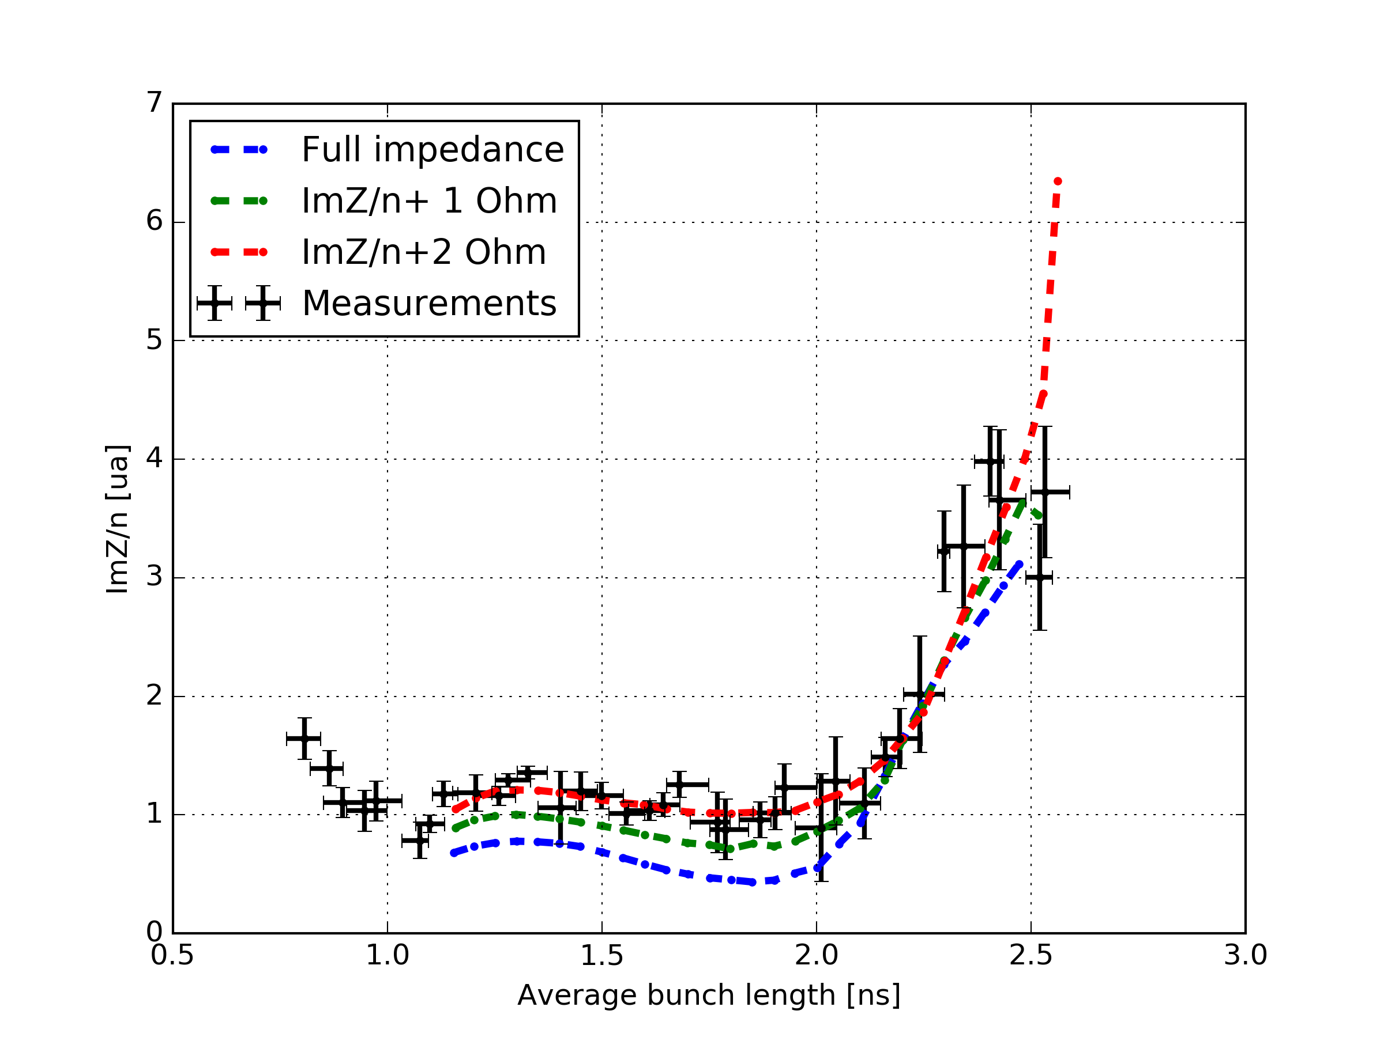
Missing impedance ?
With the new measurements and for very small bunches, it appears more obvious that an addition of ImZ/n~2 Ohm is necessary to reproduce the measurements.

Slide 14
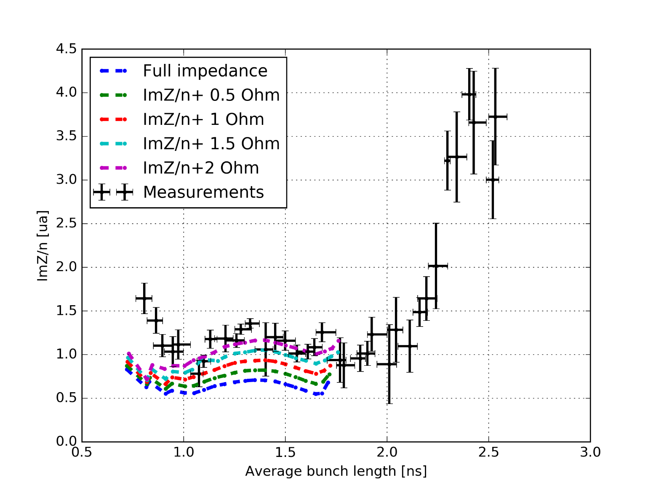
Missing impedance ?
Discrepancies for very small bunch lengths (very low intensities)
More data needed as there are only few measurements are available for the fit
The comparison of simulations and measurements suggest that ImZ/n~2 Ohm is missing from the impedance model… (Space charge in Q26: ImZ/n~ -1.3 Ohm)
Other sources of discrepancies are being evaluated (distribution, etc…)

Slide 15
Frequency of the quadrupole oscillations
$$ΔE$$
$$Δt$$
Only the motion of the mismatched particles is seen in measurements.

Slide 16
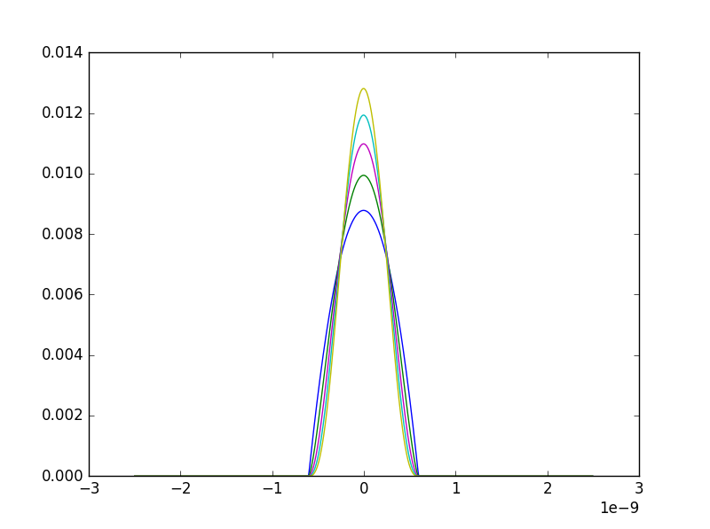
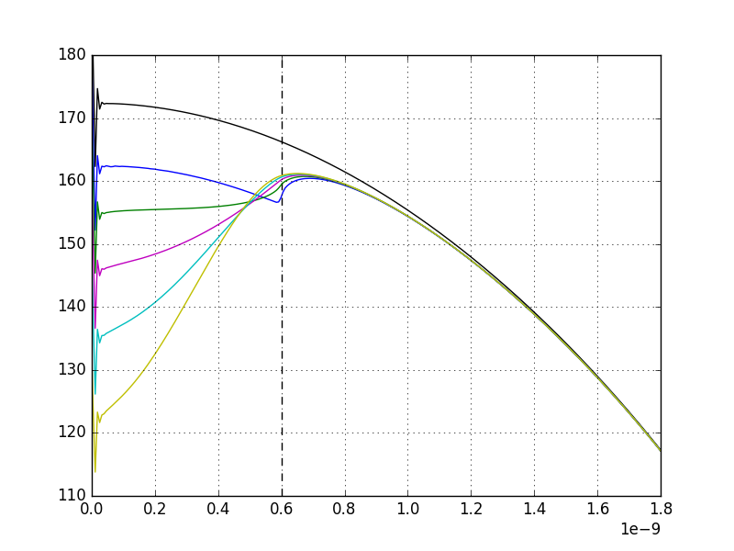
Incoherent shift: effect of the bunch distribution
Mismatched particles
Synchrotron frequency [Hz]
Time [s]
Particle amplitude [s]
Binomial bunch line density: $λ=λ_{0}{\left(1−4{\left(\frac{t}{τ}\right)}^{2}\right)}^{n}$
The incoherent synchrotron frequency shift in the core of the bunch depends much on the distribution, not in the tails (black line is without intensity effects, coloured lines stands for n={1, 1.5, 2 , 2.5, 3}, n=1 is parabolic line density)

Slide 17
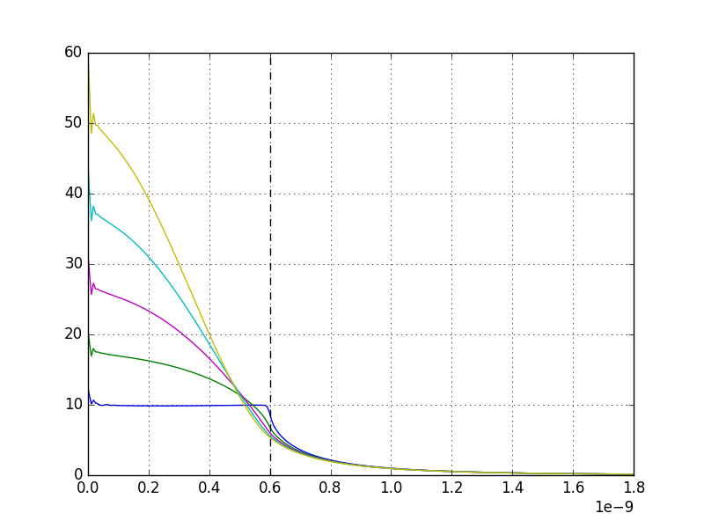
Incoherent shift: effect of the bunch distribution
Synchrotron frequency [Hz]
Synchrotron frequency shift [Hz]
Mismatched particles
Particle amplitude [s]
Particle amplitude [s]
The synchrotron frequency shift is $Δf_{s}\left(\hat{τ},N\right)=f_{s0}\left(\hat{τ}\right)−f_{s}\left(\hat{τ},N\right)$
The synchrotron frequency shift for small amplitudes of oscillations can be expressed easily, but not for higher amplitudes depending on the bunch distribution.
For a parabolic line density and small bunch lengths, the synchrotron frequency shift is constant for all the particles.

Slide 18
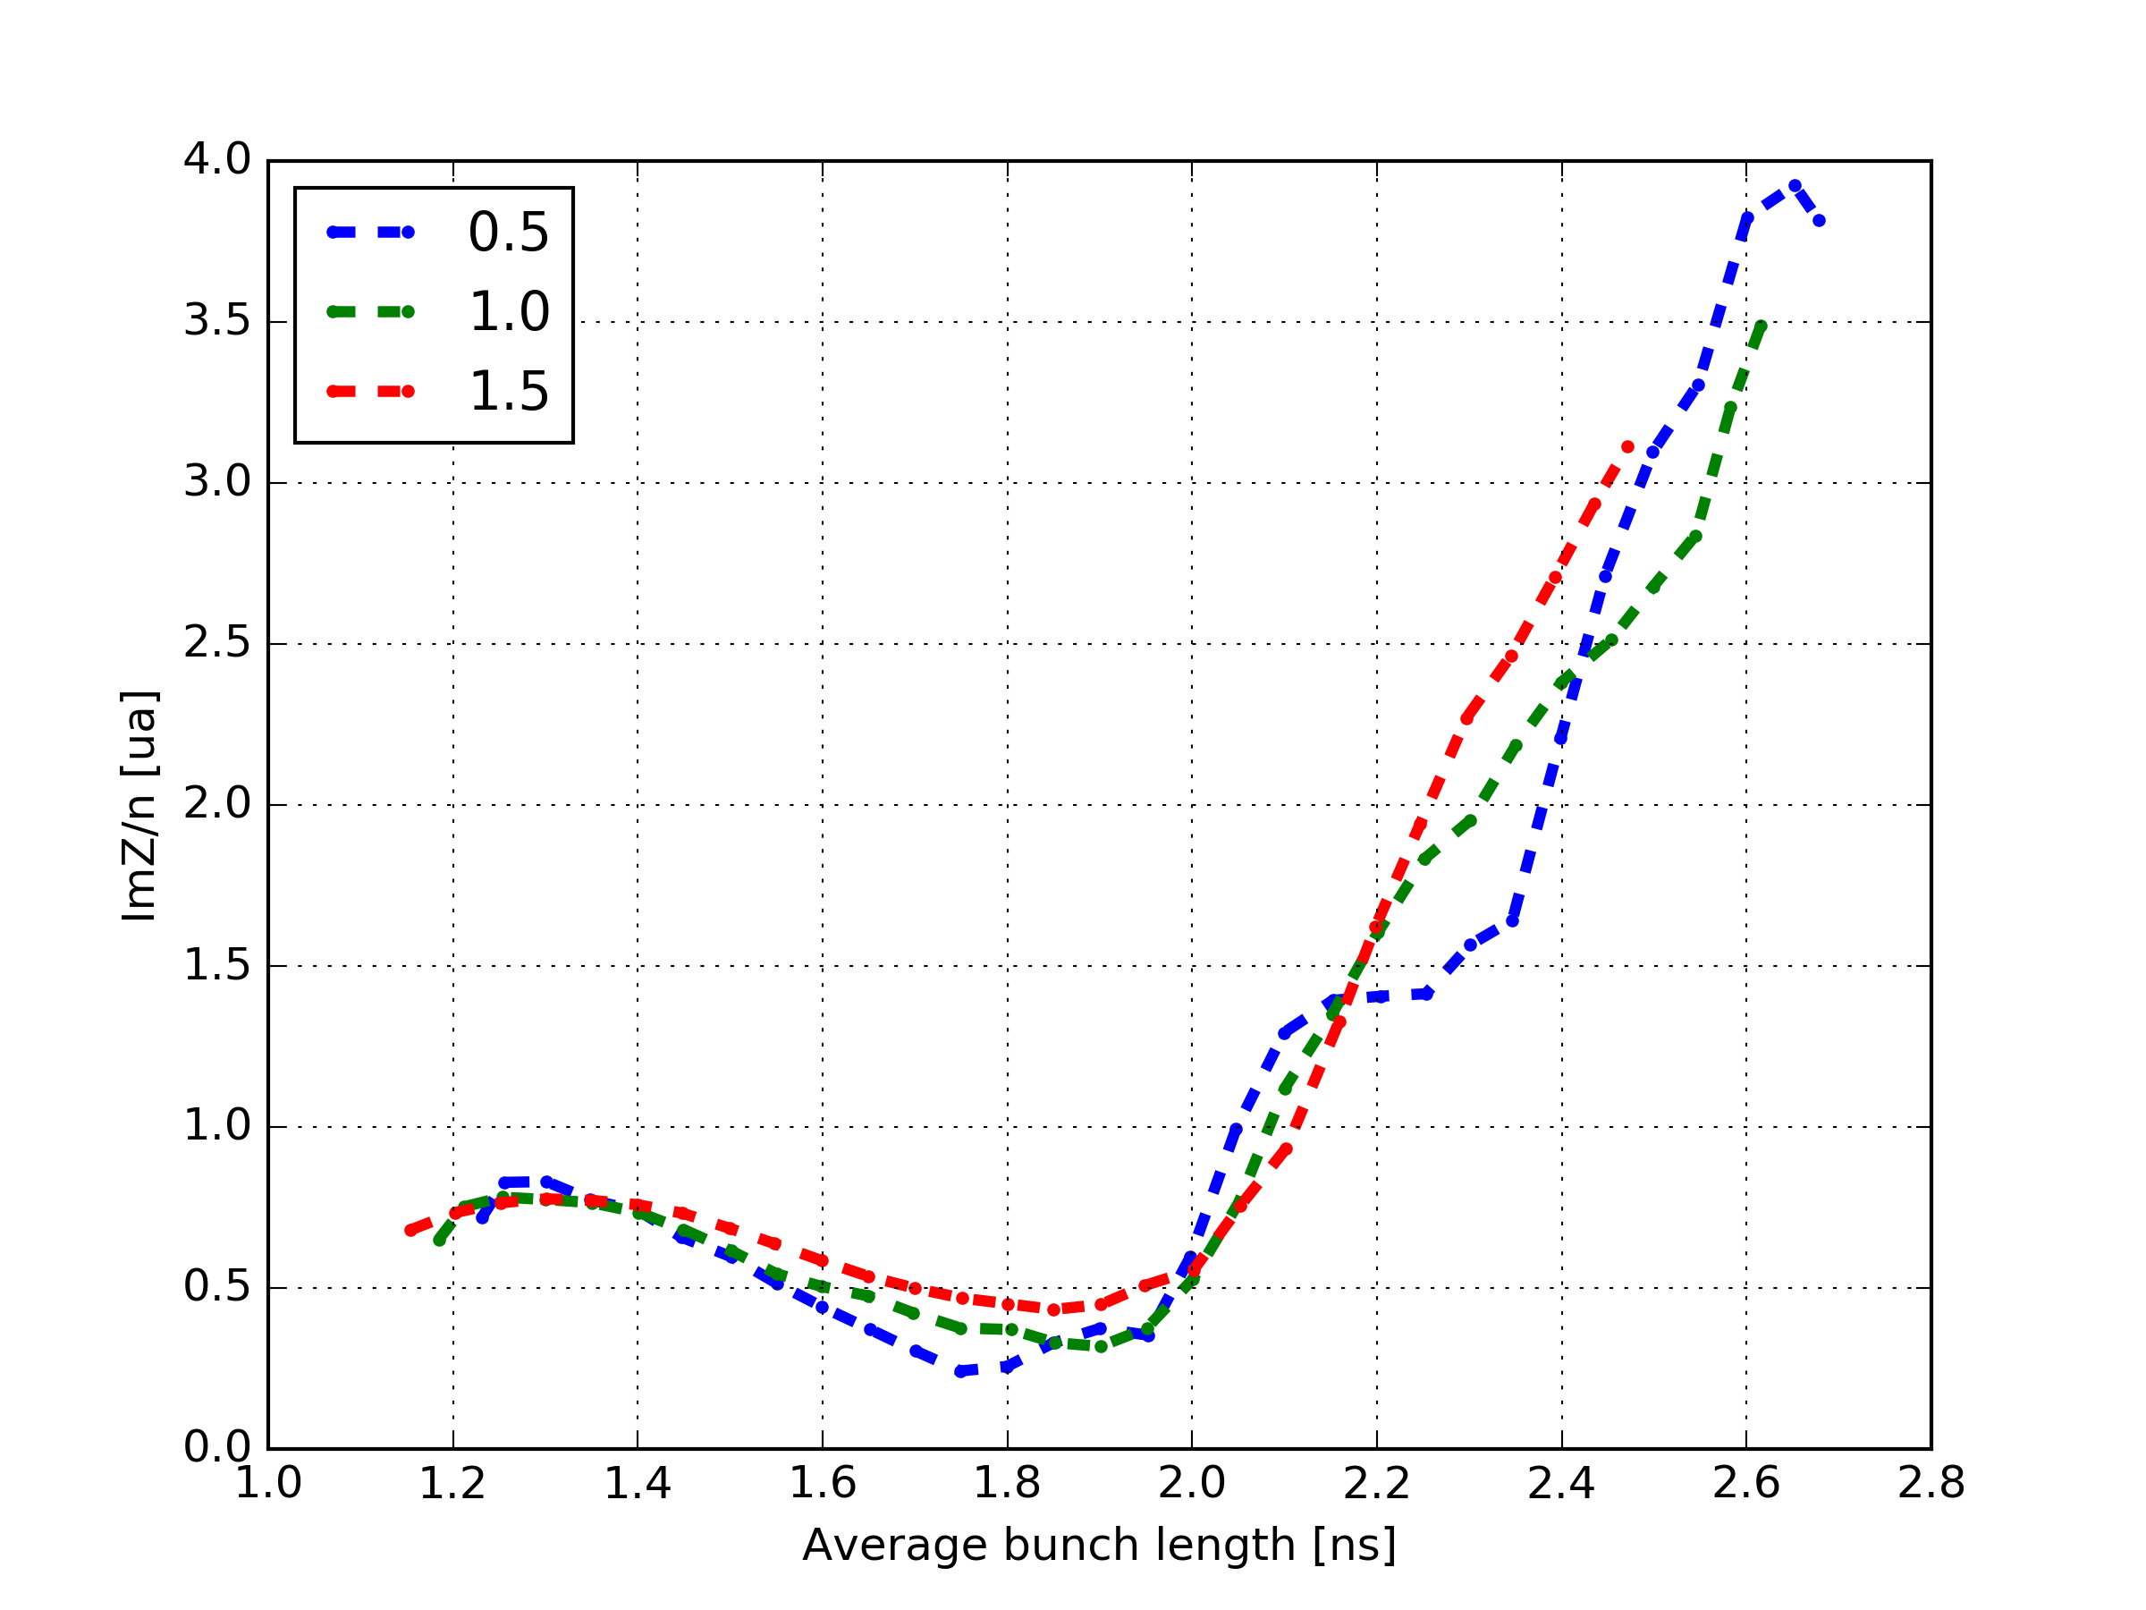
Incoherent shift: effect of the bunch distribution
In simulations, the effect of the bunch distribution is indeed small

Slide 19
Conclusions and future work
New measurements suggest that ImZ/n~2 Ohm may be missing.
As this appears to be very big (equivalent to missing ~half of the kickers…), other sources of discrepancies are studied.
The analysis of the data has been changed to lower the dependence with the average bunch length.
The coherent frequency shift will be estimated to estimate the impact of the mismatch on the results.
New measurements with more data in the flat region are needed to refine the study.
Measurements in Q20 (lower space charge…) are envisioned for cross-checking.
Measurements at high energy could be useful (no space charge, but may be limited by instabilities).

