Slide 1
First results of ramp simulations with 72 bunches s LIU-SPS Beam Dynamics Working Group 30/06/2016
J. Repond

Slide 2
Outline
Motivations
Expected changes through ramp
Our assumptions for the ramp
Stability through ramp
Conclusion and future work

Slide 3
Motivations
Impedance reduction hardly sufficient to reach the HL-LHC goals.

Slide 4
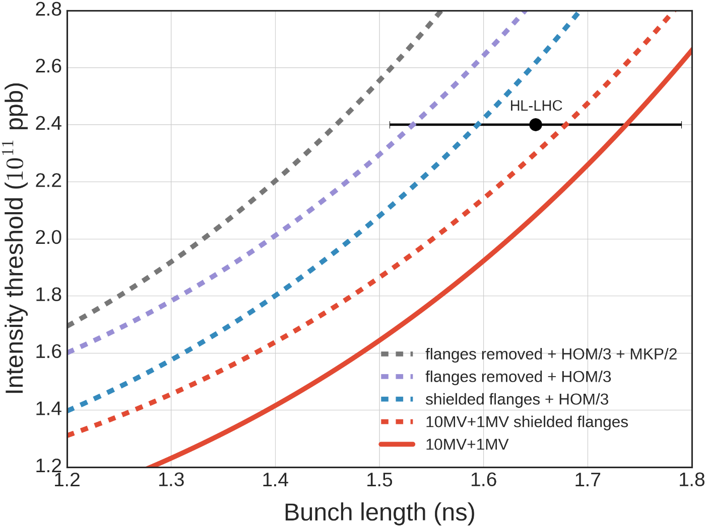
Motivations
Impedance reduction hardly sufficient to reach the HL-LHC goals.

Slide 5
Motivations
Impedance reduction hardly sufficient to reach the HL-LHC goals.
Optimize the fourth harmonic -> another possible way for stability.

Slide 6
Motivations
Impedance reduction hardly sufficient to reach the HL-LHC goals.
Optimize the fourth harmonic -> another possible way for stability.
Simulations increasing the TWC800 power have shown an appreciable increase in the stability threshold at FT.

Slide 7
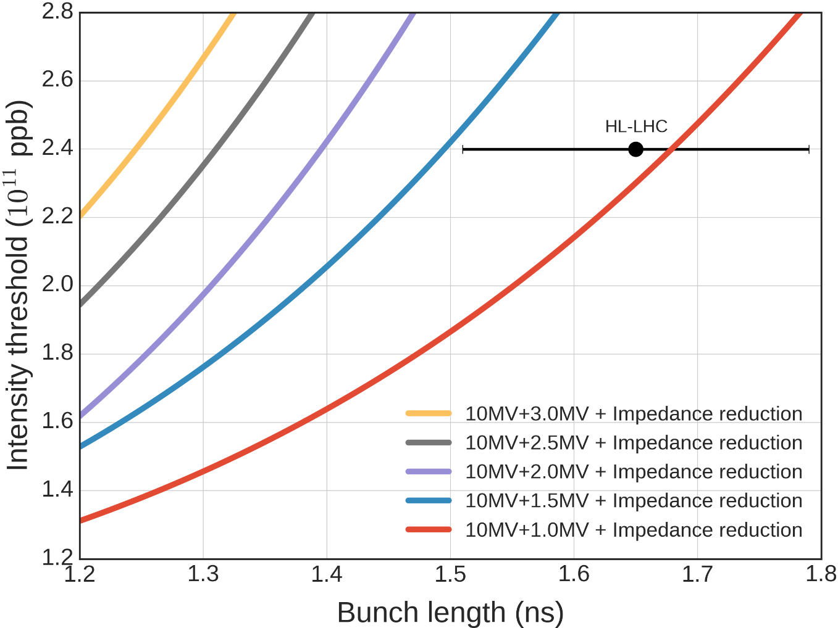
Motivations
FT 450 GeV in the SPS.
72 Bunches.
Reduced impedance model.
Beam loading not taken into account.
TWC800 in BSM.

Slide 8
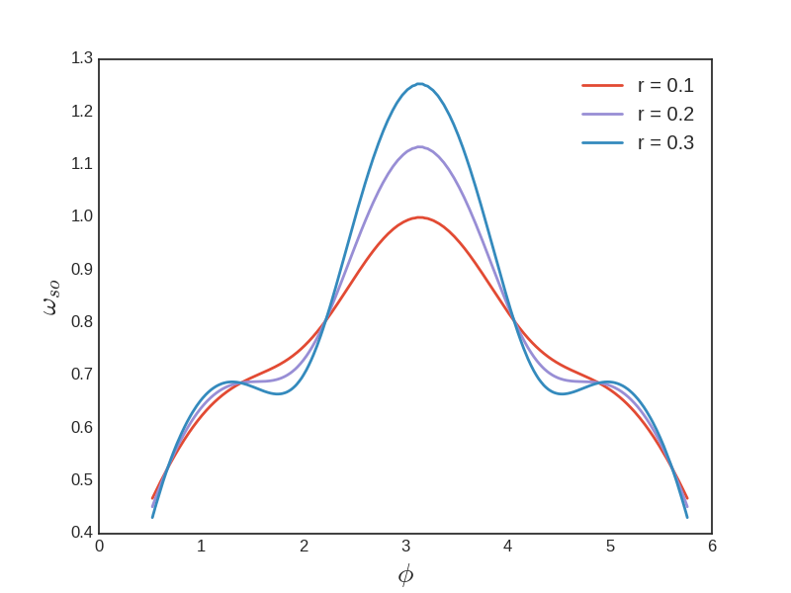
And through ramp ?
High ratio of 4th harmonic -> flat portion in synchrotron frequency -> loss of Landau damping.
No controled emittance blow-up in simulation -> too small bunches unstable.
Acceleration decreases the synchrotron frequency spread (lower amplitude, squeeze the bucket) -> loss of Landau damping.

Slide 9
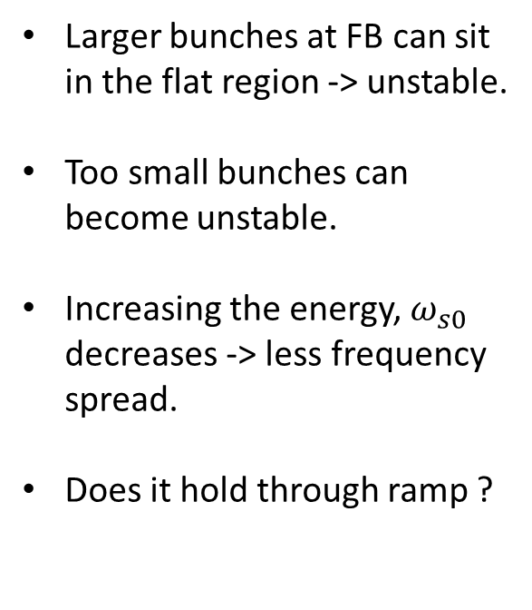
Synchrotron frequency
Larger bunches at FB can sit in the flat region -> unstable.
Too small bunches can become unstable.
Increasing the energy, $ω_{s0}$ decreases -> less frequency spread.
Does it hold through ramp ?

Slide 10
Assumptions for the ramp
Simulations too long, possible workaround
Optimization of BLonD (K. Iliakis)
Work in progress.
Use less macroparticles
Need to check convergence.

Slide 11
Assumptions for the ramp
Simulations too long, possible workaround
Optimization of BLonD (K. Iliakis)
Work in progress.
Use less macroparticles
Need to check convergence.
Need to build a program for the ramp
Operational one assume controled emittance blow-up.

Slide 12
Decrease the computational time
Number of slices -> maximum frequency sampled
Most of the impedance below 4 GHz.
Contributions till 6 GHz in the model.
128 slices -> 12.5GHz (256 before).
Just enough to sample all the impendance.

Slide 13
Decrease the computational time
Number of slices -> maximum frequency sampled
Most of the impedance below 4 GHz.
Contributions till 6 GHz in the model.
128 slices -> 12.5GHz (256 before).
Just enough to sample all the impendance.
N macroparticles / 2 -> keep the same ratio of particles in each box.

Slide 14
Decrease the computational time
Number of slices -> maximum frequency sampled
Most of the impedance below 4 GHz.
Contributions till 6 GHz in the model.
128 slices -> 12.5GHz (256 before).
Just enough to sample all the impendance.
N macroparticles / 2 -> keep the same ratio of particles in each box.
Lowers the threshold up to 5% (simulations performed).

Slide 15
Decrease the computational time
Number of slices -> maximum frequency sampled
Most of the impedance below 4 GHz.
Contributions till 6 GHz in the model.
128 slices -> 12.5GHz (256 before).
Just enough to sample all the impendance.
N macroparticles / 2 -> keep the same ratio of particles in each box.
Lowers the threshold up to 5% (simulations performed).
4 days simulations, sufficient as first overview of stability.

Slide 16
Decrease the computational time
Number of slices -> maximum frequency sampled
Most of the impedance below 4 GHz.
Contributions till 6 GHz in the model.
128 slices -> 12.5GHz (256 before).
Just enough to sample all the impendance.
N macroparticles / 2 -> keep the same ratio of particles in each box.
Lowers the threshold up to 5% (simulations performed).
4 days simulations, sufficient as first overview of stability.
Still need optimization of BLonD to check precisely the convergence (K. Iliakis).

Slide 17
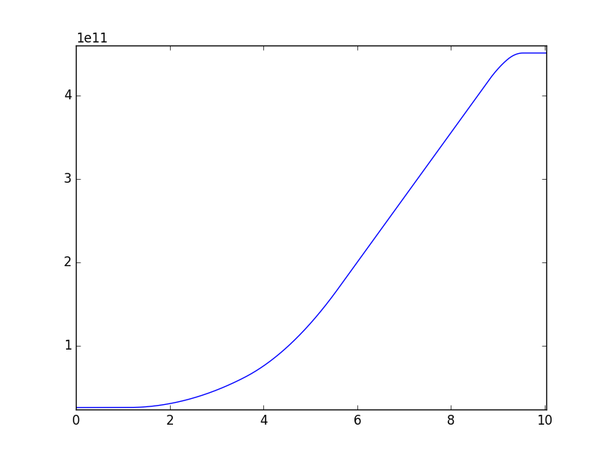
Ramp program
Momentum program
given by operation.

Slide 18
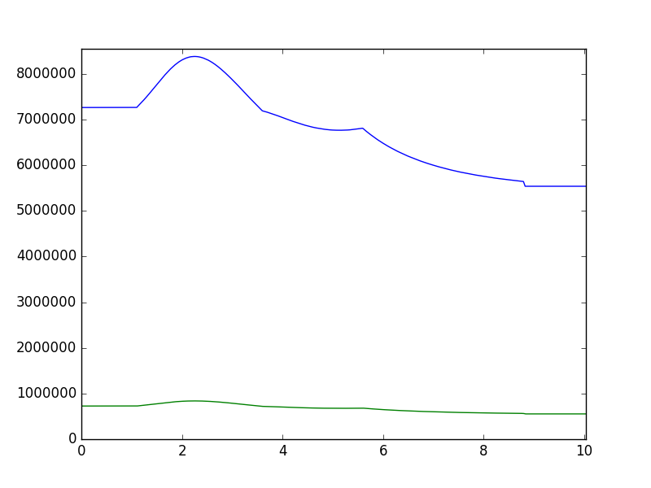
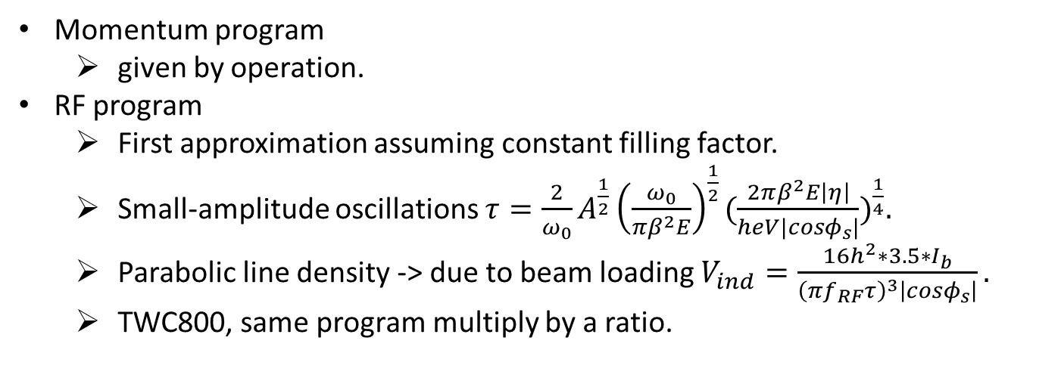
Ramp program
Momentum program
given by operation.
RF program
First approximation assuming constant filling factor.
Small-amplitude oscillations $τ=\frac{2}{ω_{0}}A^{\frac{1}{2}}{\left(\frac{ω_{0}}{πβ^{2}E}\right)}^{\frac{1}{2}}{(\frac{2πβ^{2}E\left|η\right|}{heV|cosφ_{s}|})}^{\frac{1}{4}}.$
Parabolic line density -> due to beam loading $V_{ind}=\frac{16h^{2}∗3.5∗I_{b}}{{\left(πf_{RF}τ\right)}^{3}\left|cosφ_{s}\right|}.$
TWC800, same program multiply by a ratio.

Slide 19
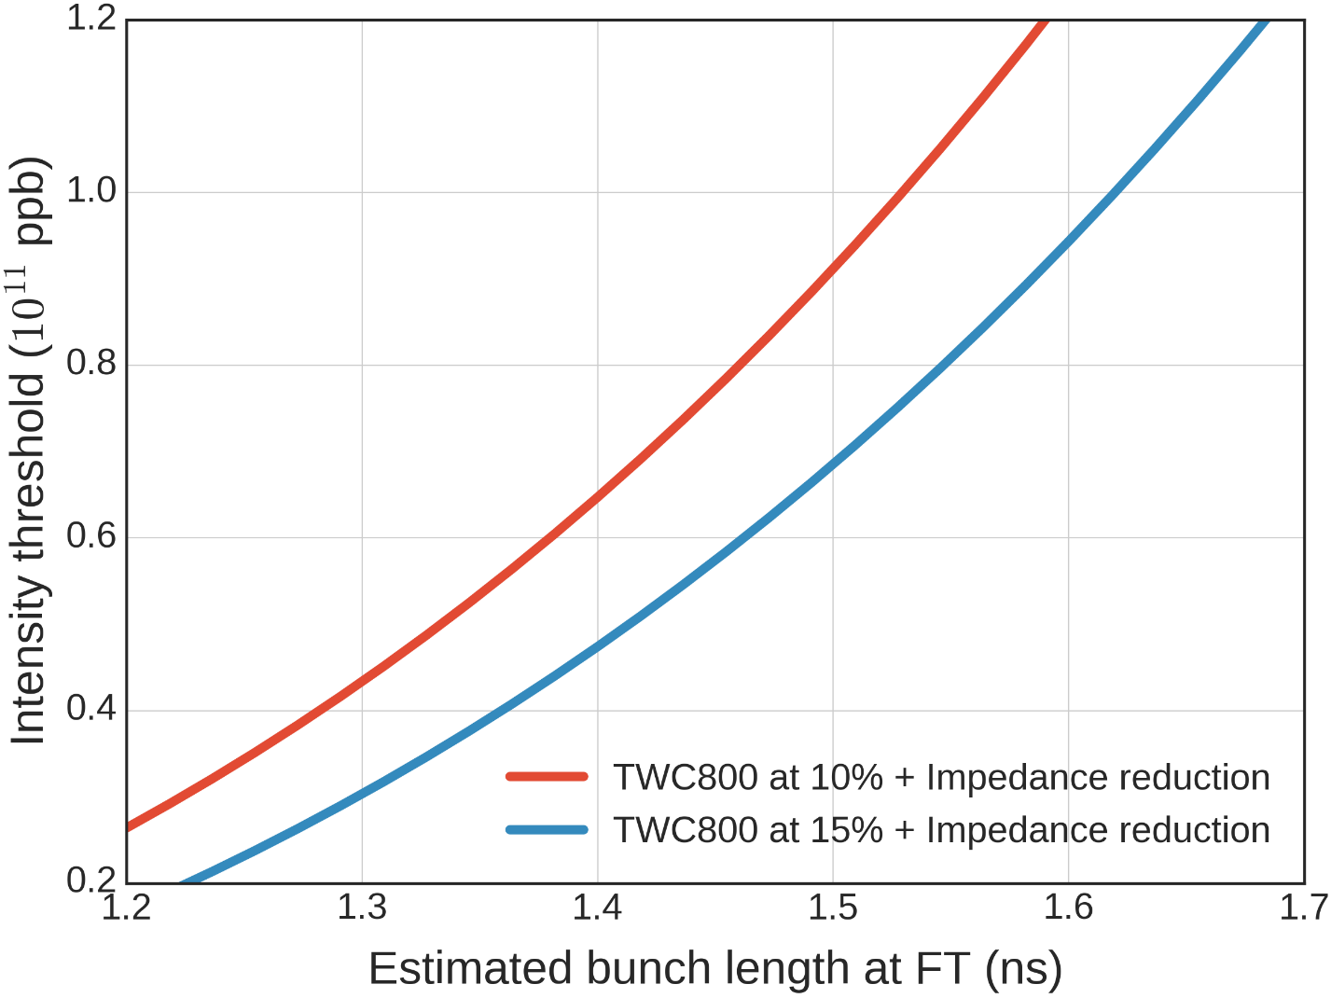
Stability through ramp (preliminary)
25 to 450 GeV ramp.
72 Bunches.
Reduced impedance model.
Beam loading taken into account.
TWC800 BSM.

Slide 20
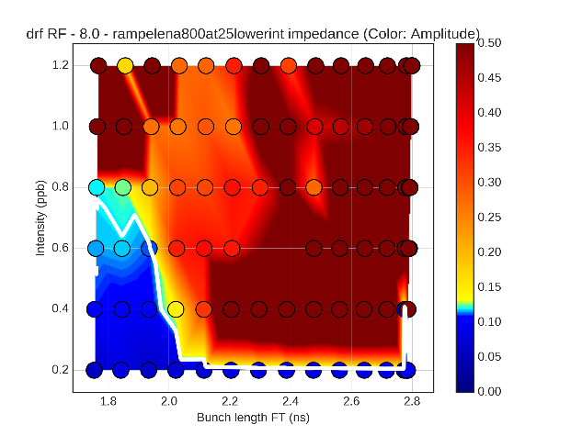
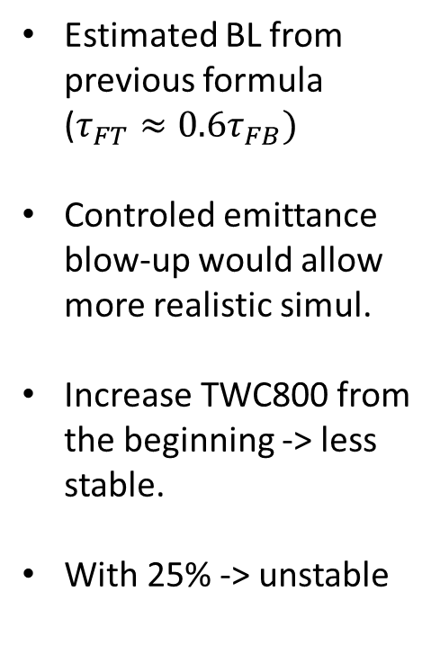
Stability through ramp (preliminary)
Estimated BL from previous formula ($τ_{FT}≈0.6τ_{FB})$
Controled emittance blow-up would allow more realistic simul.
Increase TWC800 from the beginning -> less stable.
With 25% -> unstable

Slide 21
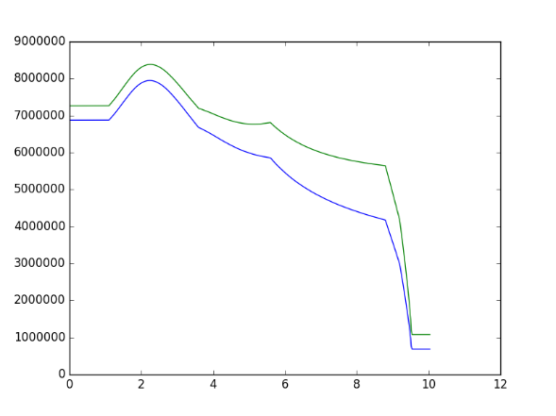
Stability through ramp (preliminary)
More than 10% in the TWC800 makes things worst during ramp.
Controled emittance blow-up -> solution to the instabilities at smaller BL
Would allow us to reproduce operational config.
Ongoing study to adapt the work of S. Albright and D. Quartullo to the SPS simulations.
RF program can still be optimized (where to cut)
TWC800 program can be different.

Slide 22
Conclusions and future work
The RF program of the TWC800 has to be optimize
High ratio of the fourth harmonic from the beginning -> unstable beam during ramp.
At FT -> increase the stability.
Increasing the fourth harmonic only at the end can stabilize the beam.
Studies in progress.
Controled emittance blow-up should be introduce to run more real simulations.
Still need to check convergence through ramp with larger number of macroparticles

