Slide 1
Follow up of Soft clamps production & testing Thomas Kaltenbacher & Christine Vollinger

Slide 2
Open Questions (1/4)
Slide of Thomas from meeting 23/05/2016;
Shows the insulating layer on the beam pipe.
Proposed solution (José):
One strip of the insulation next to the VF is cut so that the copper braid of the clamp makes contact.

Slide 3
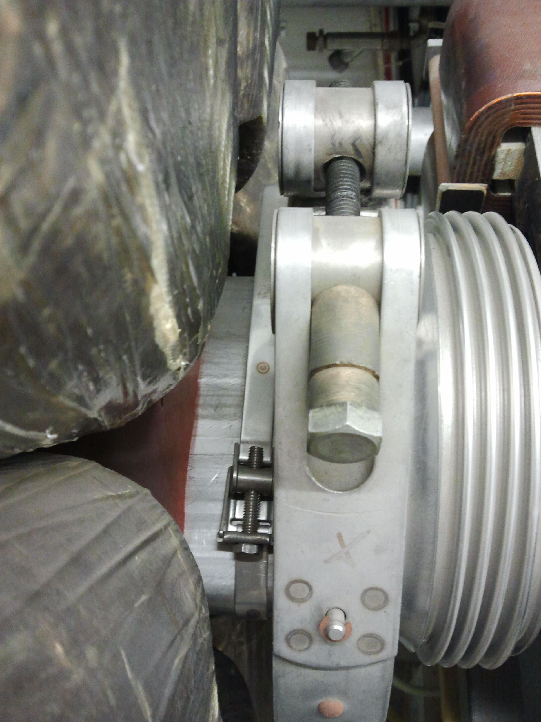
Open Questions (2/4)
From tunnel visit:
Metal band from LEP era is still in place next to the VF.
Proposed solution (1):
Remove the metal band if it is without function.
Proposed solution (2):
Place the copper braid of the clamp more to the left of the VF.
Note: if there is an insulating foil and the metal band, the clamp has to be removed

Slide 4
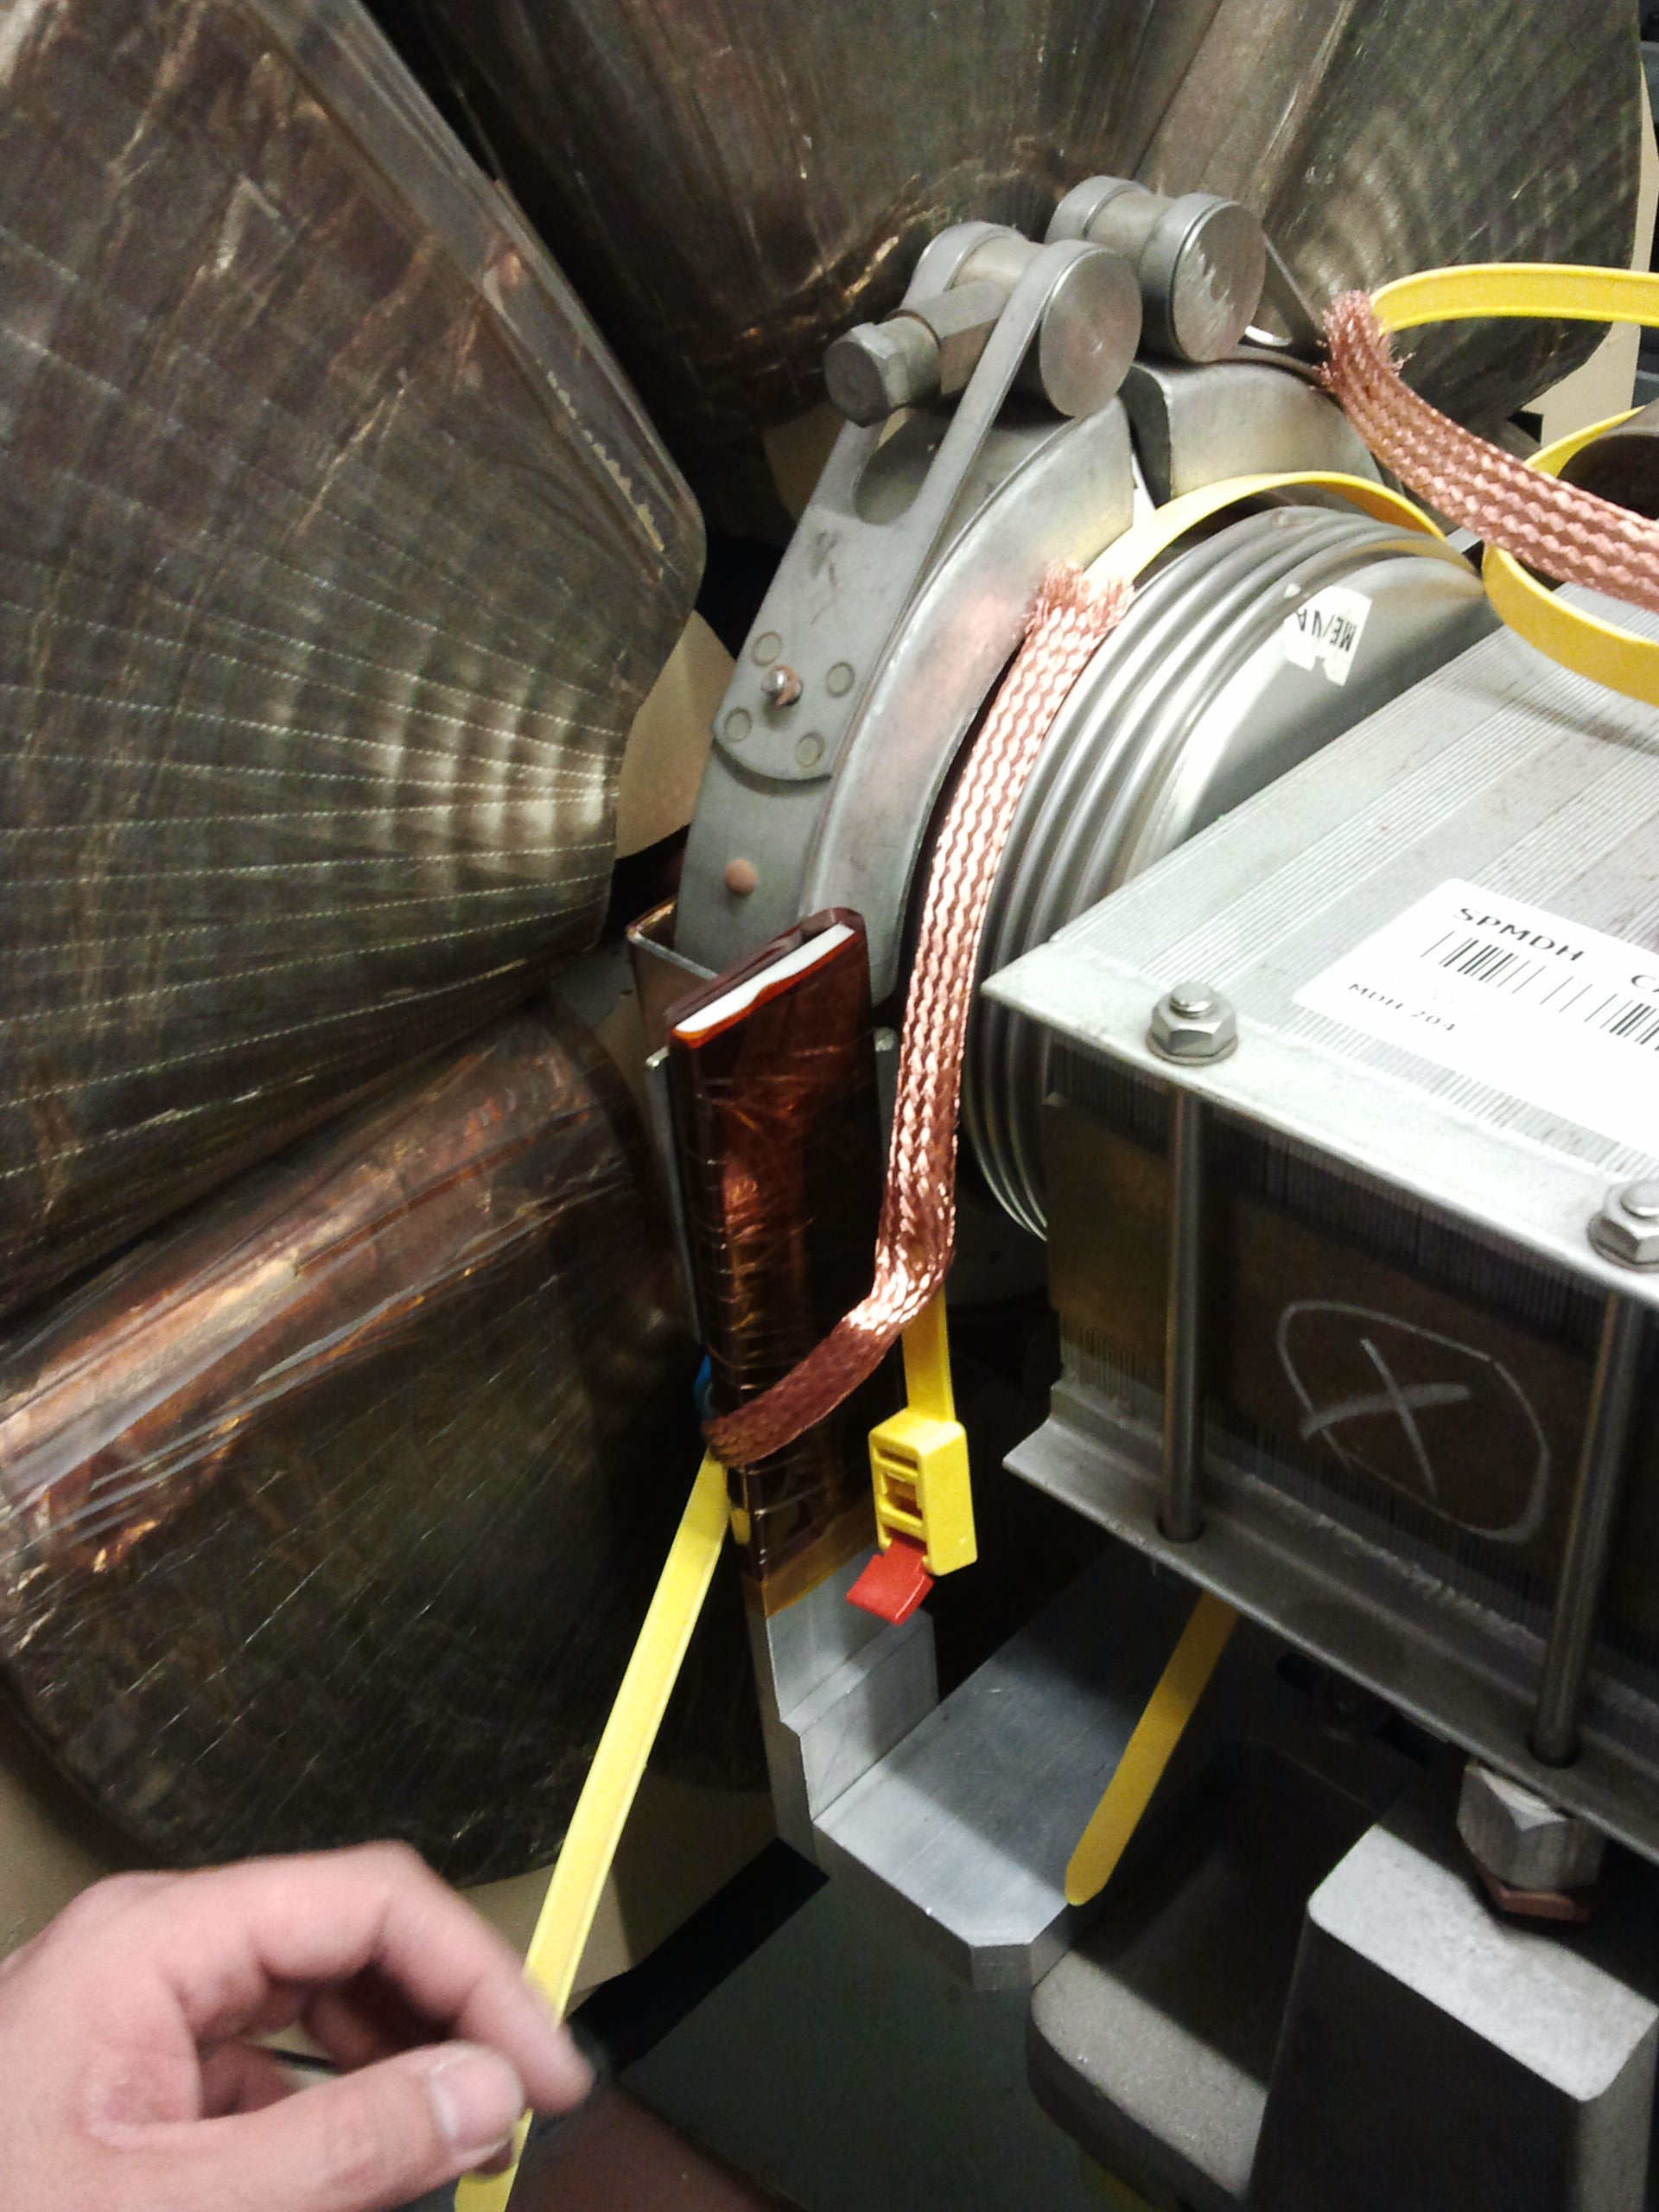
Open Questions (3/4)
From tunnel visit:
VSC equipment “isolating supports” next to the VF.
Proposed solution:
Make the connecting copper bridge (loop) longer so that the “isolating supports” does not pose an obstacle.

Slide 5
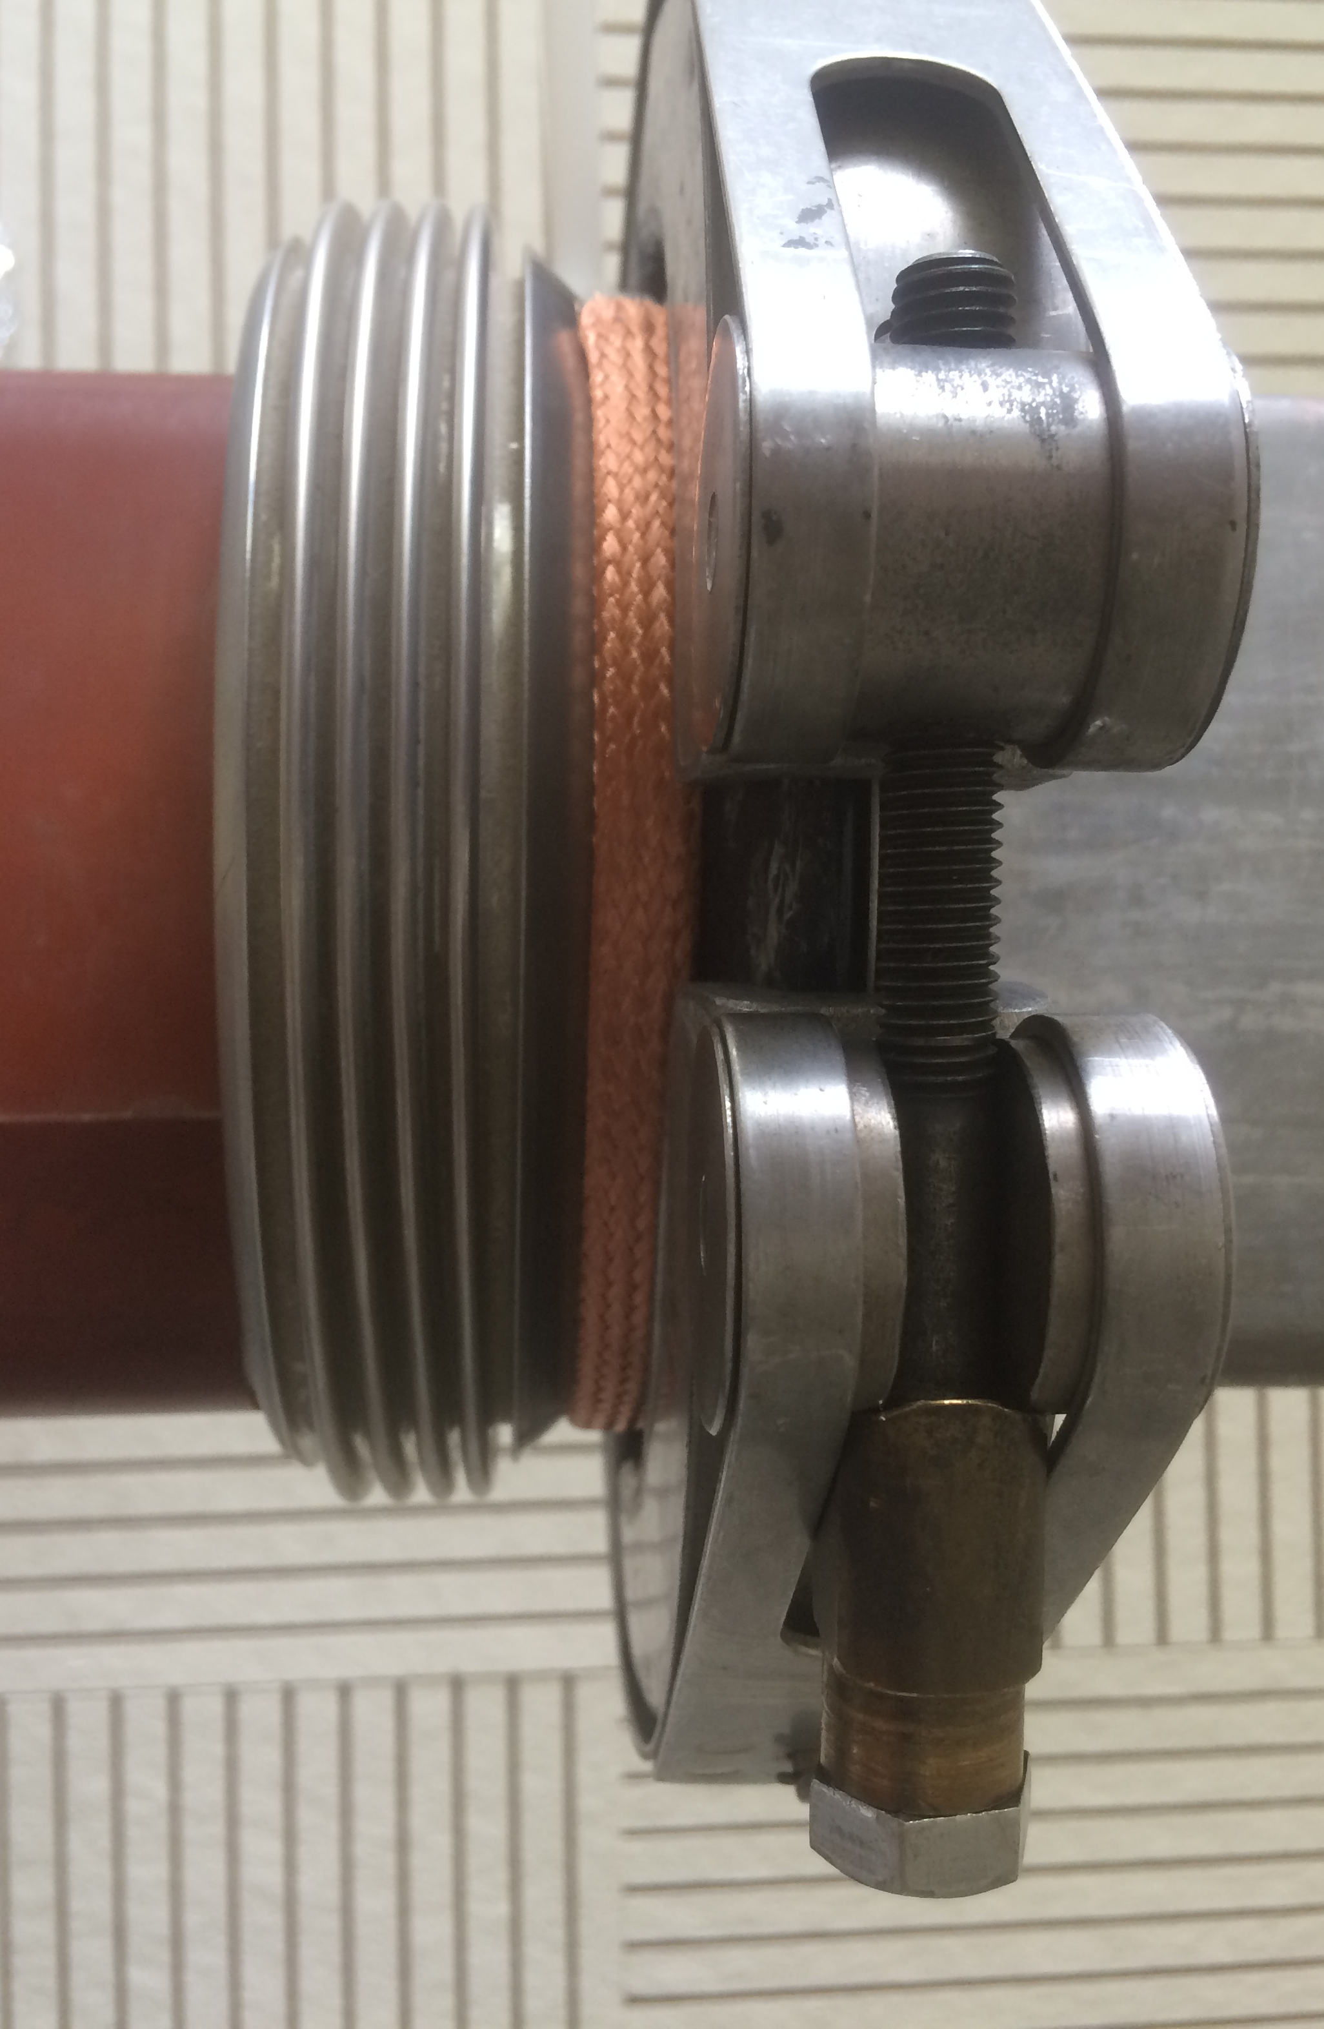
Open Questions (4/4)
From tunnel visit:
The wide copper braid touches the orbital welds
Proposed solution:
Thin upstream clamp (9 mm wide) with slim (white) cable tie

Slide 6
Remaining Open Question
In case we are going to do the test, shall we remove the QF SSS earth connection or not?
Pro removal: + avoid ground loops
Contra removal: + risk of floating sections
+ before LS1 many QF SSS were DC connected → ground loops

