Slide 1
Update on SPS Impedance Model
Thomas Kaltenbacher

Slide 2
VVSB CAD Model
The VVSB is a larger version of the VVSA
The DN150 valve exists also as RF-shielded version
There are currently 33 VVSBs installed in the SPS
150 mm
Standard DN150 all-metal valve with bonnet-flange welded for SPS (VVSB)
RF-shielded DN150 all-metal valve

Slide 3
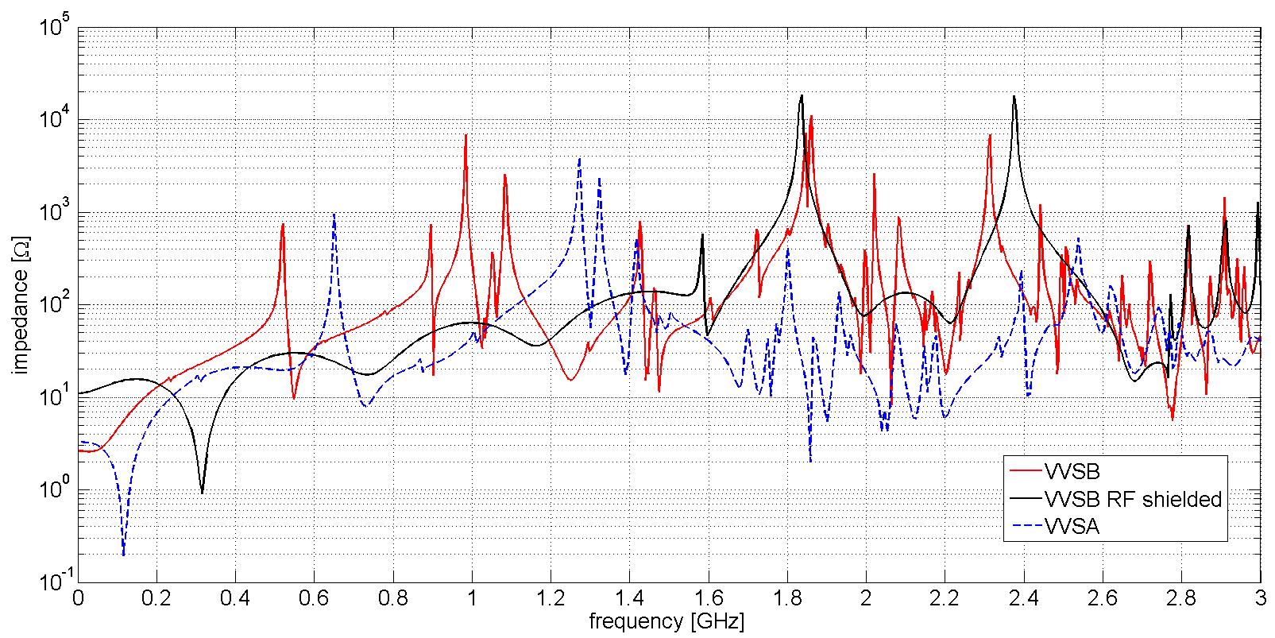
VVSB: Impedance Spectrum (prelim.)
EIG simulation
f [GHz] | Z_{s} [Ω] | Q₀ [-] | R/Q [Ω]
0.517 | 2214.6 | 466 | 4.8
0.992 | 9173.8 | 659 | 13.9
1.185 | 3041.9 | 2685.8 | 1.1
1.471 | 3485.5 | 497.5 | 7.0
1.842 | 10086.3 | 1273.1 | 7.9
2.081 | 999.4 | 452 | 2.2
2.311 | 9505.0 | 1117 | 8.5
… | … | … | …
+ Ongoing simulations & analysis
+ Preliminary data only
Note: data shown for one elements

Slide 4
SPS Machine Elements Focus
Ongoing activity: Register and evaluate machine elements which are not included in the current SPS long. beam coupling impedance model
Current focus:
+ Two SPS Schottky Beam Position Monitors: horizontal BPSH (pos. 12174); vertical BPSV (pos. 12179)
If the BPSH was a pillbox with 3378 mm length and a radius of 136.5 mm:
+ first E₀₁₀ mode at: 841.48 MHz
+ Q₀ = 8786 (for st. steel with s=1.35 x 10⁶ S/m)
+ R/Q = 5.1 Ω

Slide 5
BPSH – Simulation Model
3378 mm
Ø 273 mm
electrode support &
feed-through for
horiz. mov. stage
port & feed-through
for “tuning box” (3 coils)
(pos. of el. connection)
pumping port
10 conv. bellows
pick-up electrode
Impedance evaluation ongoing

Slide 6
Further SPS Machine Elements
Systematic investigation of elements ongoing (current list of RF PUs):
BPSH (1x)
BPSV (1x)
BPCR (12x)
BDV (2x)
AEWA (2x)
BPW (1x)
BPWA (2x)
BPWB (1x)
AERB (1x)
AEW (1x)
AEWB (1x)
AEPC (1x)
AEPA (2)
AEWA (2x)
AEG (1x)
AETA (1x)
APWL (1x)
AEP (1x)
AEPA (2x)
AESA (1x)
AEG … RF pick-up electrode, 1 GHz bandwith
AEP … RF pick-up electrode, for phase detection
AET … RF mode trap
AEW … RF pick-up electrode, wide band
BPS … Beam position, Schottky, horizontal
BPCR … Beam position, directional coupler, chromaticity measurement
BPC … Beam position, directional coupler
BPW … Pick-up station, wide band (RF group), Wide Band Pick-up
BDV … Beam damper vertical
… elements appear not to pose an imp. issue
… elements are being simulated

Slide 7
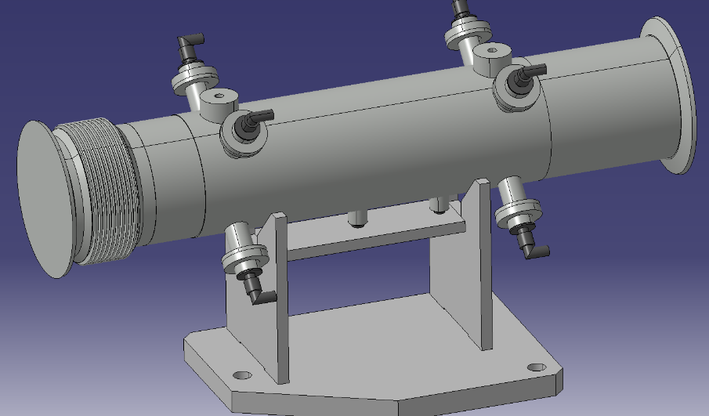
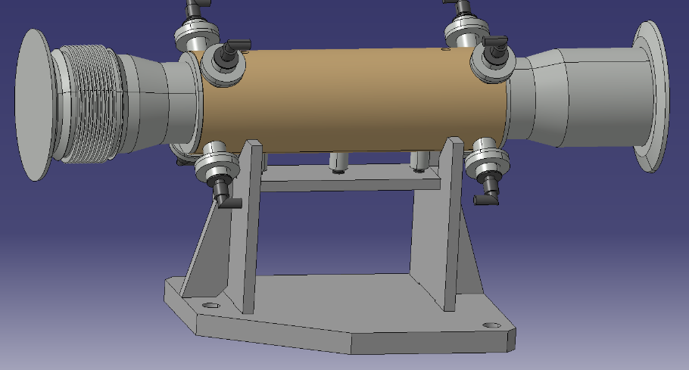
Further SPS Machine Elements – Pick Ups I/II
BPW: Wide Band Pick-up with enamelled flanges; 1 element
Pos.: 31798
BPW: Seems not to pose an impedance issue
BPWA: Wide Band Pick-up with enamelled flanges; 2 elements
Pos.: 31101, 31901
BPWA: Seems not to pose an impedance issue

Slide 8
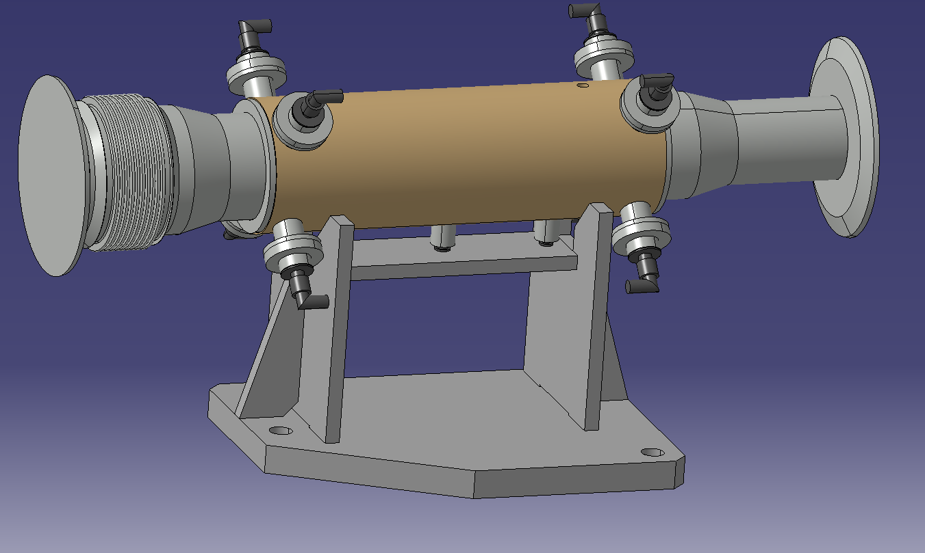
Further SPS Machine Elements – Pick Ups II/II
BPWB: Wide Band Pick-up with enamelled flanges; 1 element
Pos.: 32101
BPW: Seems not to pose an impedance issue

Slide 9
Conclusions
+ VVSB has a similar long. beam coupling impedance (non-negligible)
as the VVSA but with lower frequency components → BD studies
ongoing
+ VVSA and VVSB: Q-reduction (damping) options are being looked into
+ systematic studies of “missing impedances”

