Slide 1
LIU-SPS BD-WG
EM simulations studies for shielded vacuum flanges
Thomas Kaltenbacher with help of Christine Vollinger

Slide 2
Outline
Which shielded VF design is in the current impedance model?
Study of double tube shielding performance
VF gap fill
RF-fingers at (weld) gap
Conclusions

Slide 3
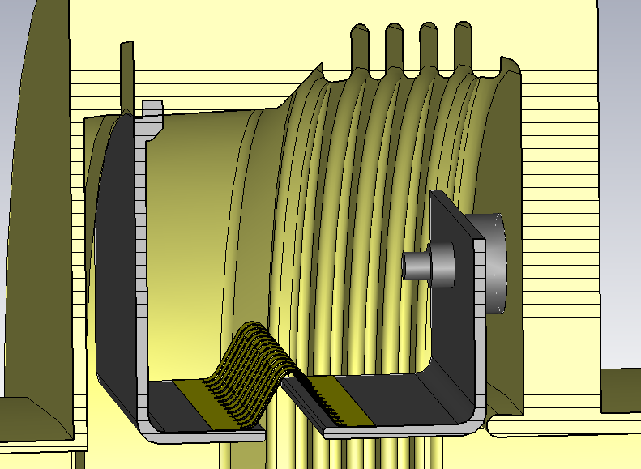
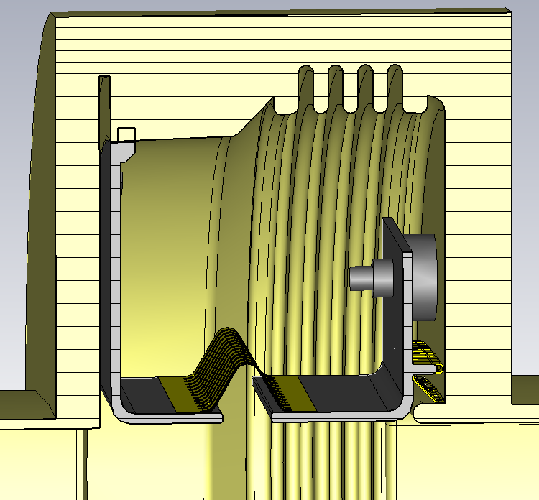
Current Status
Shielding for VF with 4-convolution bellows with MBA & QF beam pipes
The shielded VF with gap fill and RF-fingers is currently in the impedance model (J.E. Varela) and NOT the double tube shield
Shielding was referred to as ”shield II”
Shown values are given per element
w/o VF gap filling
with VF gap filling
f [GHz] | Q₀ | R/Q [Ω]
1.15 | 145 | 4.3
f [GHz] | Q₀ | R/Q [Ω]
1.33 | 350 | 13

Slide 4
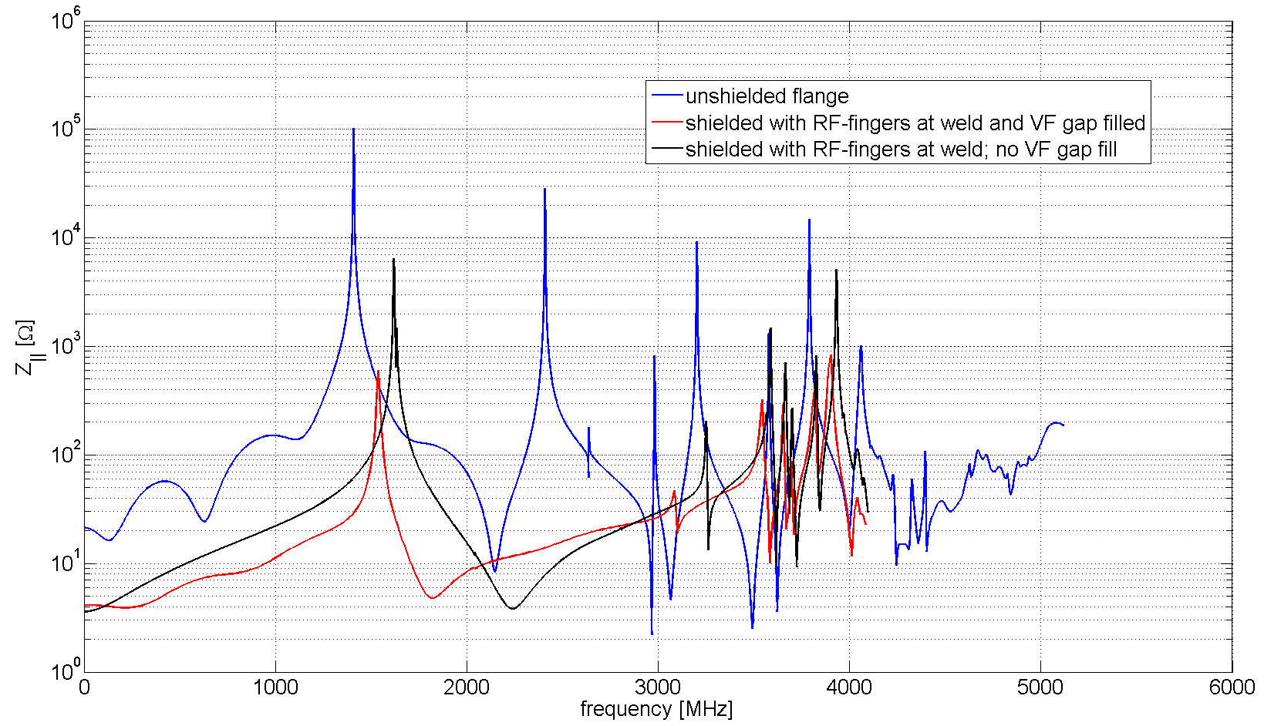
Unshielded Vs. Shielded VF
Unshielded VF
f [GHz] | Q₀ [-] | R/Q [Ω]
1.41 | 1900 | 80.5
Shielded VF & gap filled
f [GHz] | Q₀ [-] | R/Q [Ω]
1.55 | 186 | 4
Shielded VF; no gap fill
f [GHz] | Q₀ [-] | R/Q [Ω]
1.62 | 540 | 13.5

Slide 5
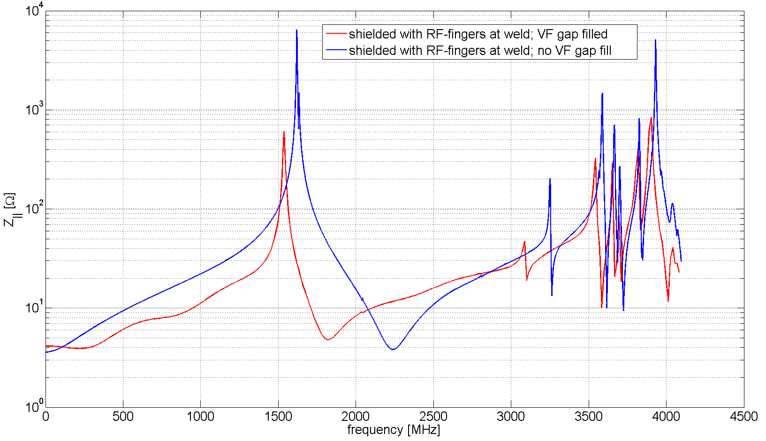
Shielded VF with & w/o gap fill
Shielded VF & gap filled
f [GHz] | Q₀ [-] | R/Q [Ω]
1.55 | 186 | 4
Shielded VF; no gap fill
f [GHz] | Q₀ [-] | R/Q [Ω]
1.62 | 540 | 13.5

Slide 6
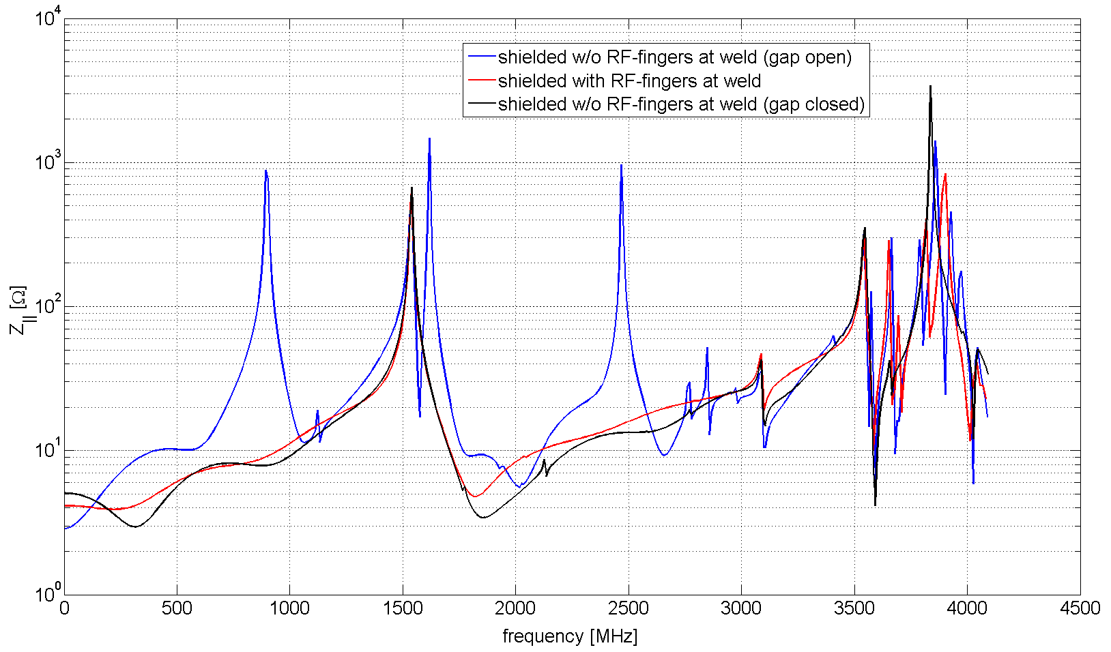
Shielded VF with & w/o RF-fingers

Slide 7
Conclusions
Use RF-fingers or even better to close the gap (weld) structurally
VF gap filling is important to exploit shielding performance (R/Q scaling)
Reliable and robust shielding design needed: gap at weld, RF-fingers fixation and offsets, VF gap filling, etc.

Slide 8
The End
THANK YOU!

