Slide 1
Improved Methods for the Measurement and Simulation of the CERN SPS Non-Linear Optics
H. Bartosik, A. Oeftiger, M. Schenk, F. Schmidt, M. Titze,
21 April, 2016

Slide 2
Introduction
Motivation for developing non-linear model
  Non-linear model of SPS is basic ingredient for studying incoherent (and coherent!) effects for LHC beams
Measurements in the past
  The SPS non-linear chromaticity was observed to depend on the magnetic history of the machine (measurements from 2000-2007)
2006
R. Tomás et al., “Improved Algorithms to determine the Non-Linear Optics Model of the SPS from Non-Linear Chromaticity”, Proceedings of the 22nd Particle Accelerator Conference

Slide 3
Introduction
Motivation for developing non-linear model
  Non-linear model of SPS is basic ingredient for studying incoherent (and coherent!) effects for LHC beams
Measurements in the past
  The SPS non-linear chromaticity was observed to depend on the magnetic history of the machine (measurements from 2000-2007)
Measurements in 2015
  Also at 26 GeV/c but with both optics (Q20 and Q26)
  For maximum machine reproducibility: use same super cycle composition in both optics (SFTPRO + measurement cycle)
  Using BBQ pickup with chirp excitation to measure tune
  Precision of tune measurement significantly improved by averaging over flat bottom
  Spread in vertical tune measurement due to impedance and intensity variation (corrected)
  Very clean results also in vertical when correcting for detuning with intensity (fit up to 5th order)
  NEW: performed combined fit for both optics at the same time

Slide 4
SPS optics
Multipolar components sampled differently due to different dispersion function
Q20
Q26

Slide 5
Correction for detuning due to impedance
data normalized to 4e10 p/b based on SPS impedance model
No correction in horizontal needed

Slide 6
Errors considered in MADX model
Systematic mulitpole errors on SPS main magnets
  These errors are mainly due to remanent fields from ramping to top energy
The model is fitted to the data by
  calculate the response matrix for all multipole errors on the nonlinear chromaticity in MADX-PTC
  apply an SVD algorithm
  SVD can be applied to one measurement set individually, or to multiple sets at the same time (a good non-linear model should be able to predict the chromaticity for all optics)
first allowed multipole error of quadrupoles
allowed multipole errors of dipoles
Remanent fields of main component in sextupoles and octupoels

Slide 7
Individually fitted MADX models
Measured chromaticity can be well reproduced

Slide 8
Individually fitted MADX models
Measured chromaticity can be well reproduced
Model for one optics cannot predict chromaticity in other optics
  especially linear and quadratic terms
Q26 model applied to Q20

Slide 9
Fitting results (each optic individually)
These values create a Q’ between 3 and 10 (depending on optics and plane)
… completely different for the two optics!
consider remanent fields of chromaticity sextupoles!
insufficient agreement
relatively good agreement between the two optics

Slide 10
Result for COMBINED fit of both optics
Fit result as good as for individual fits …

Slide 11
Fitting results summary
Remanent sextupole fields in dipoles even change sign!
Had to allow for different values in the two optics
the remanent fields in sextupoles and octupoles are about 1% of their peak field … does this make sense?

Slide 12
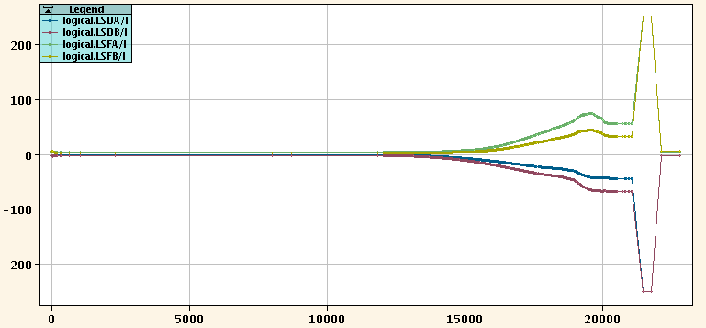
Sextupole currents on LHC Q20 cycle
Ramped to max. current of 250 A after beam extraction on each cycle, but don’t even go to zero …

Slide 13
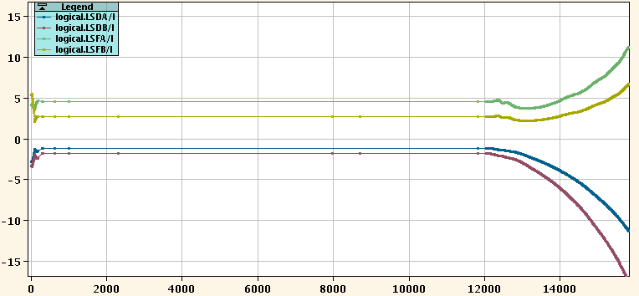
Sextupole currents on LHC Q20 cycle

Slide 14
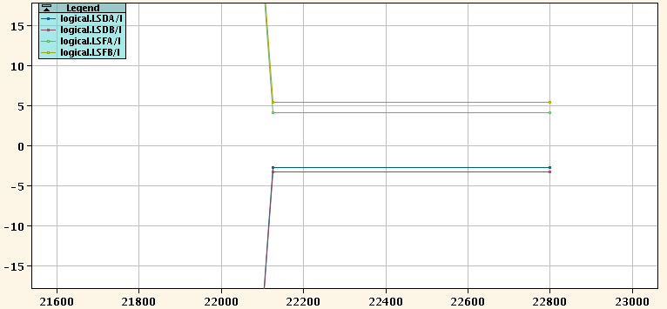
Sextupole currents on LHC Q20 cycle

Slide 15
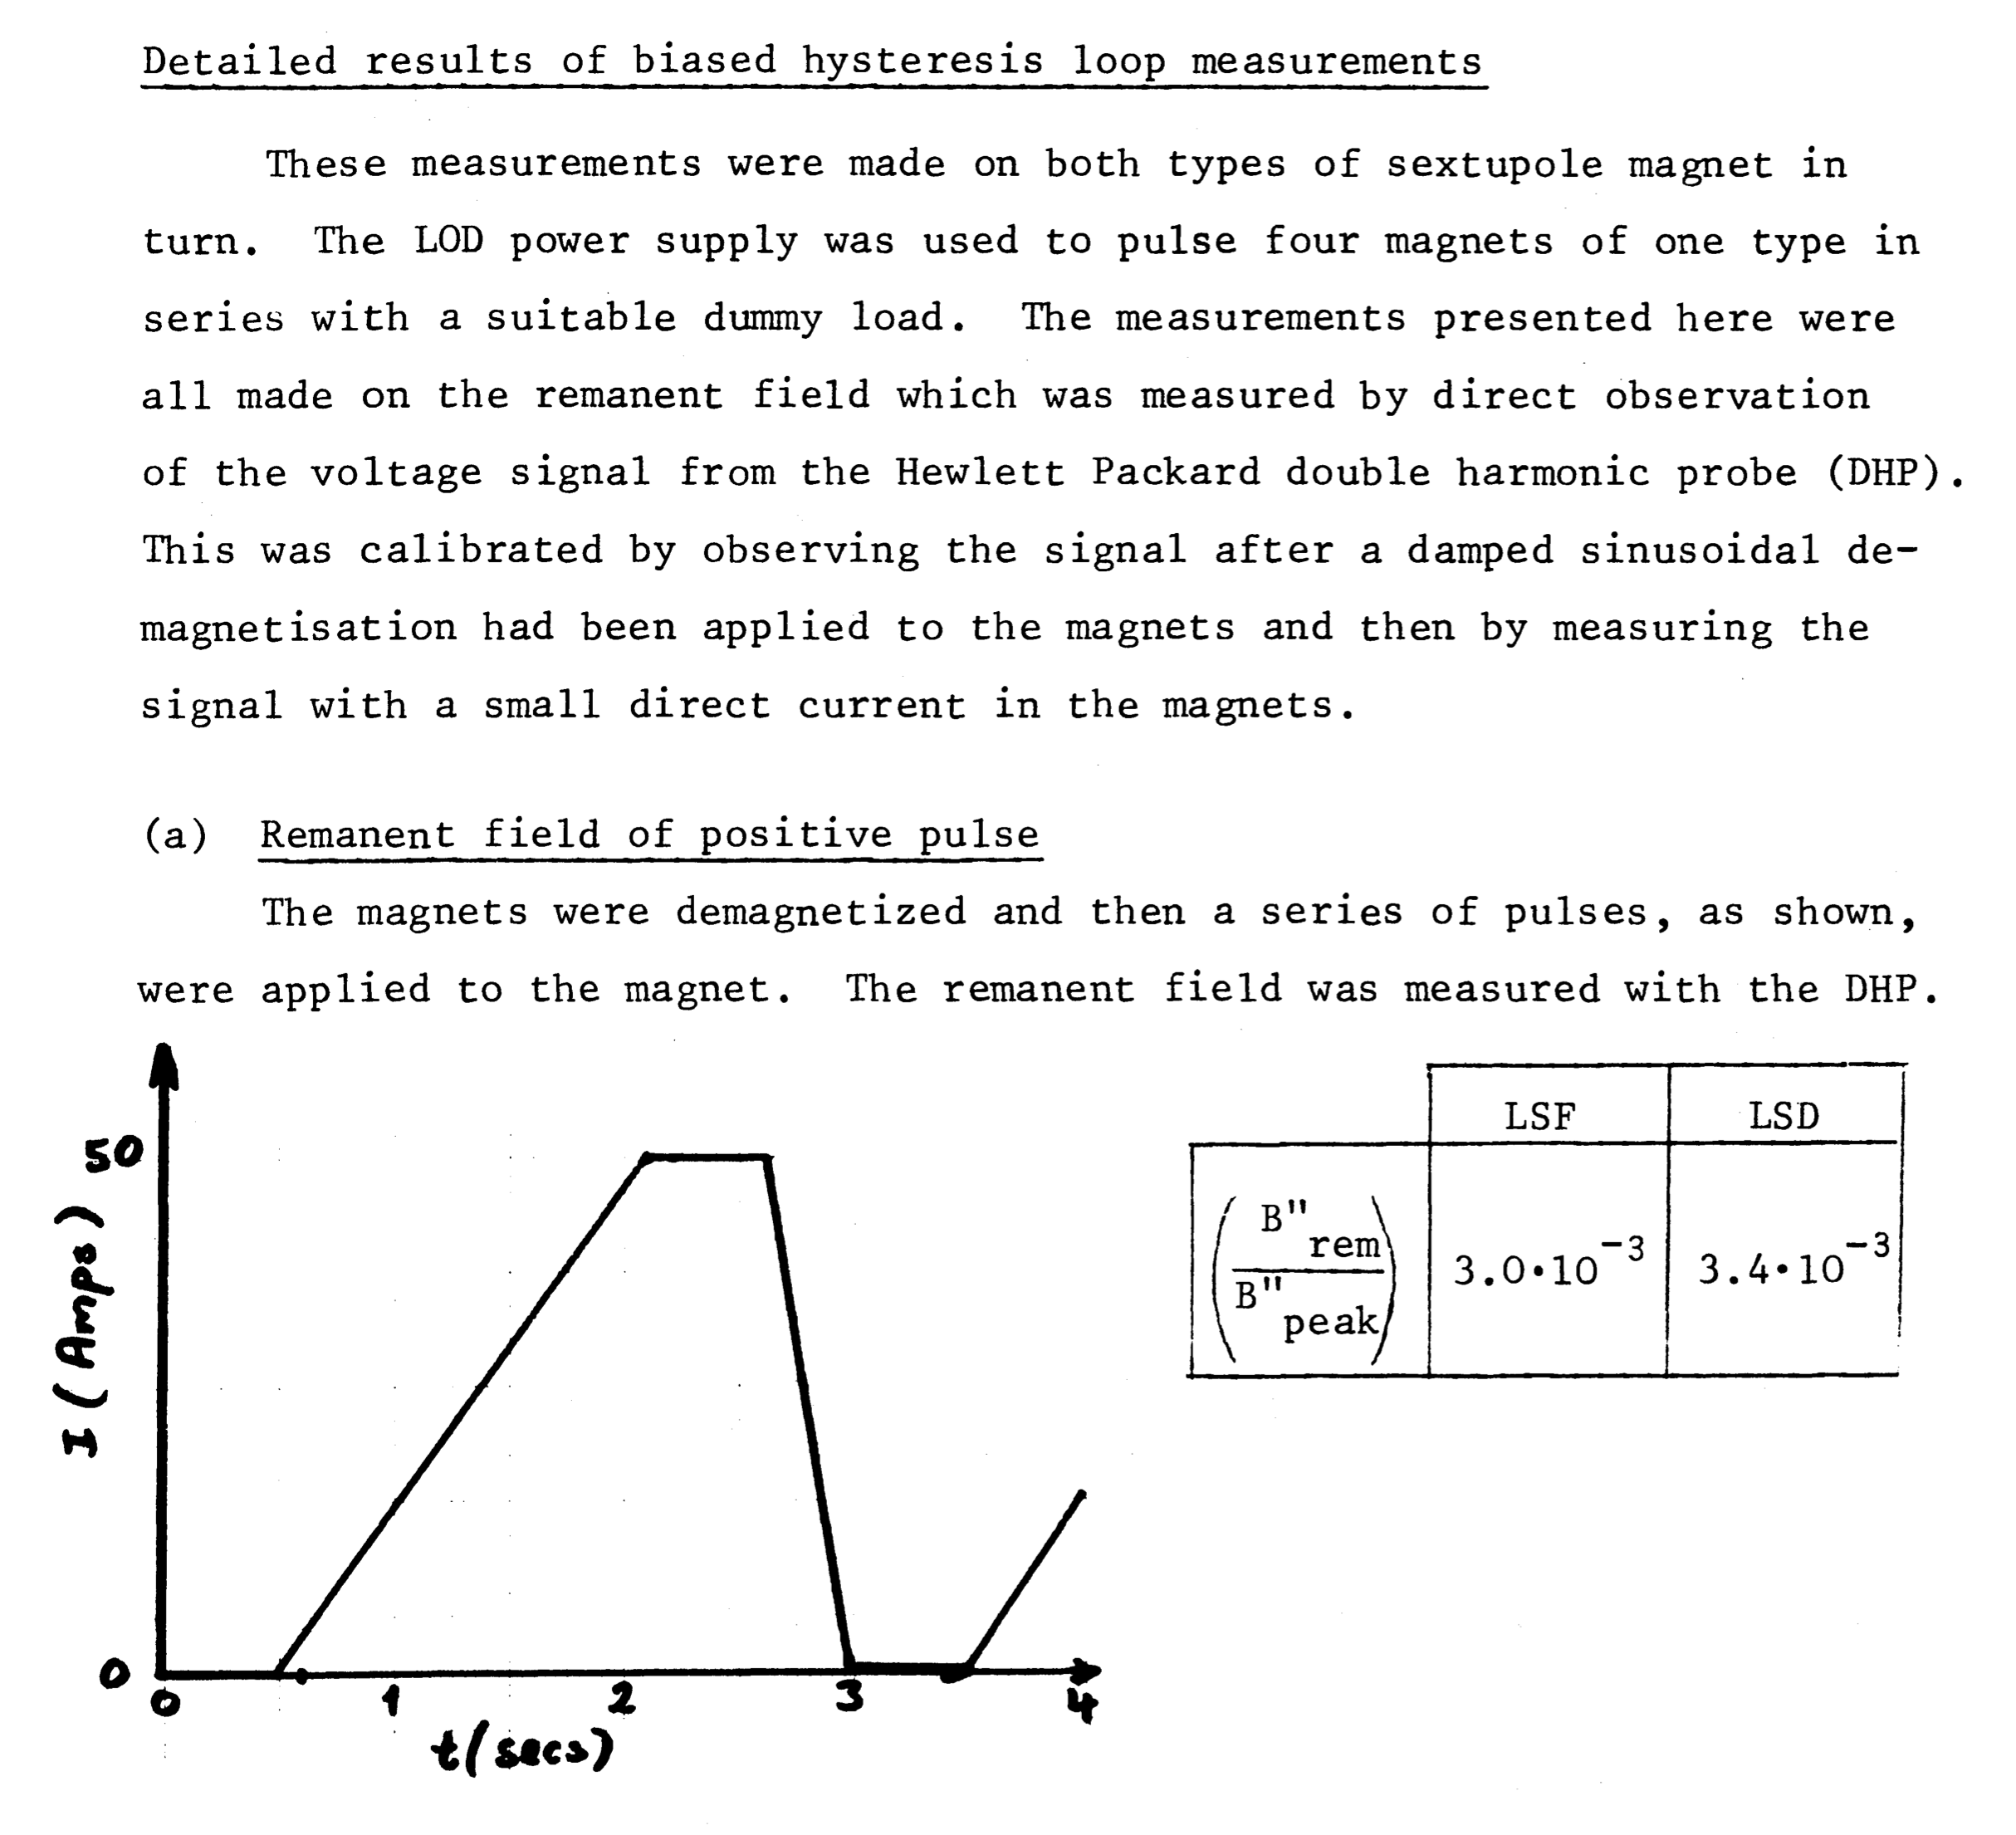
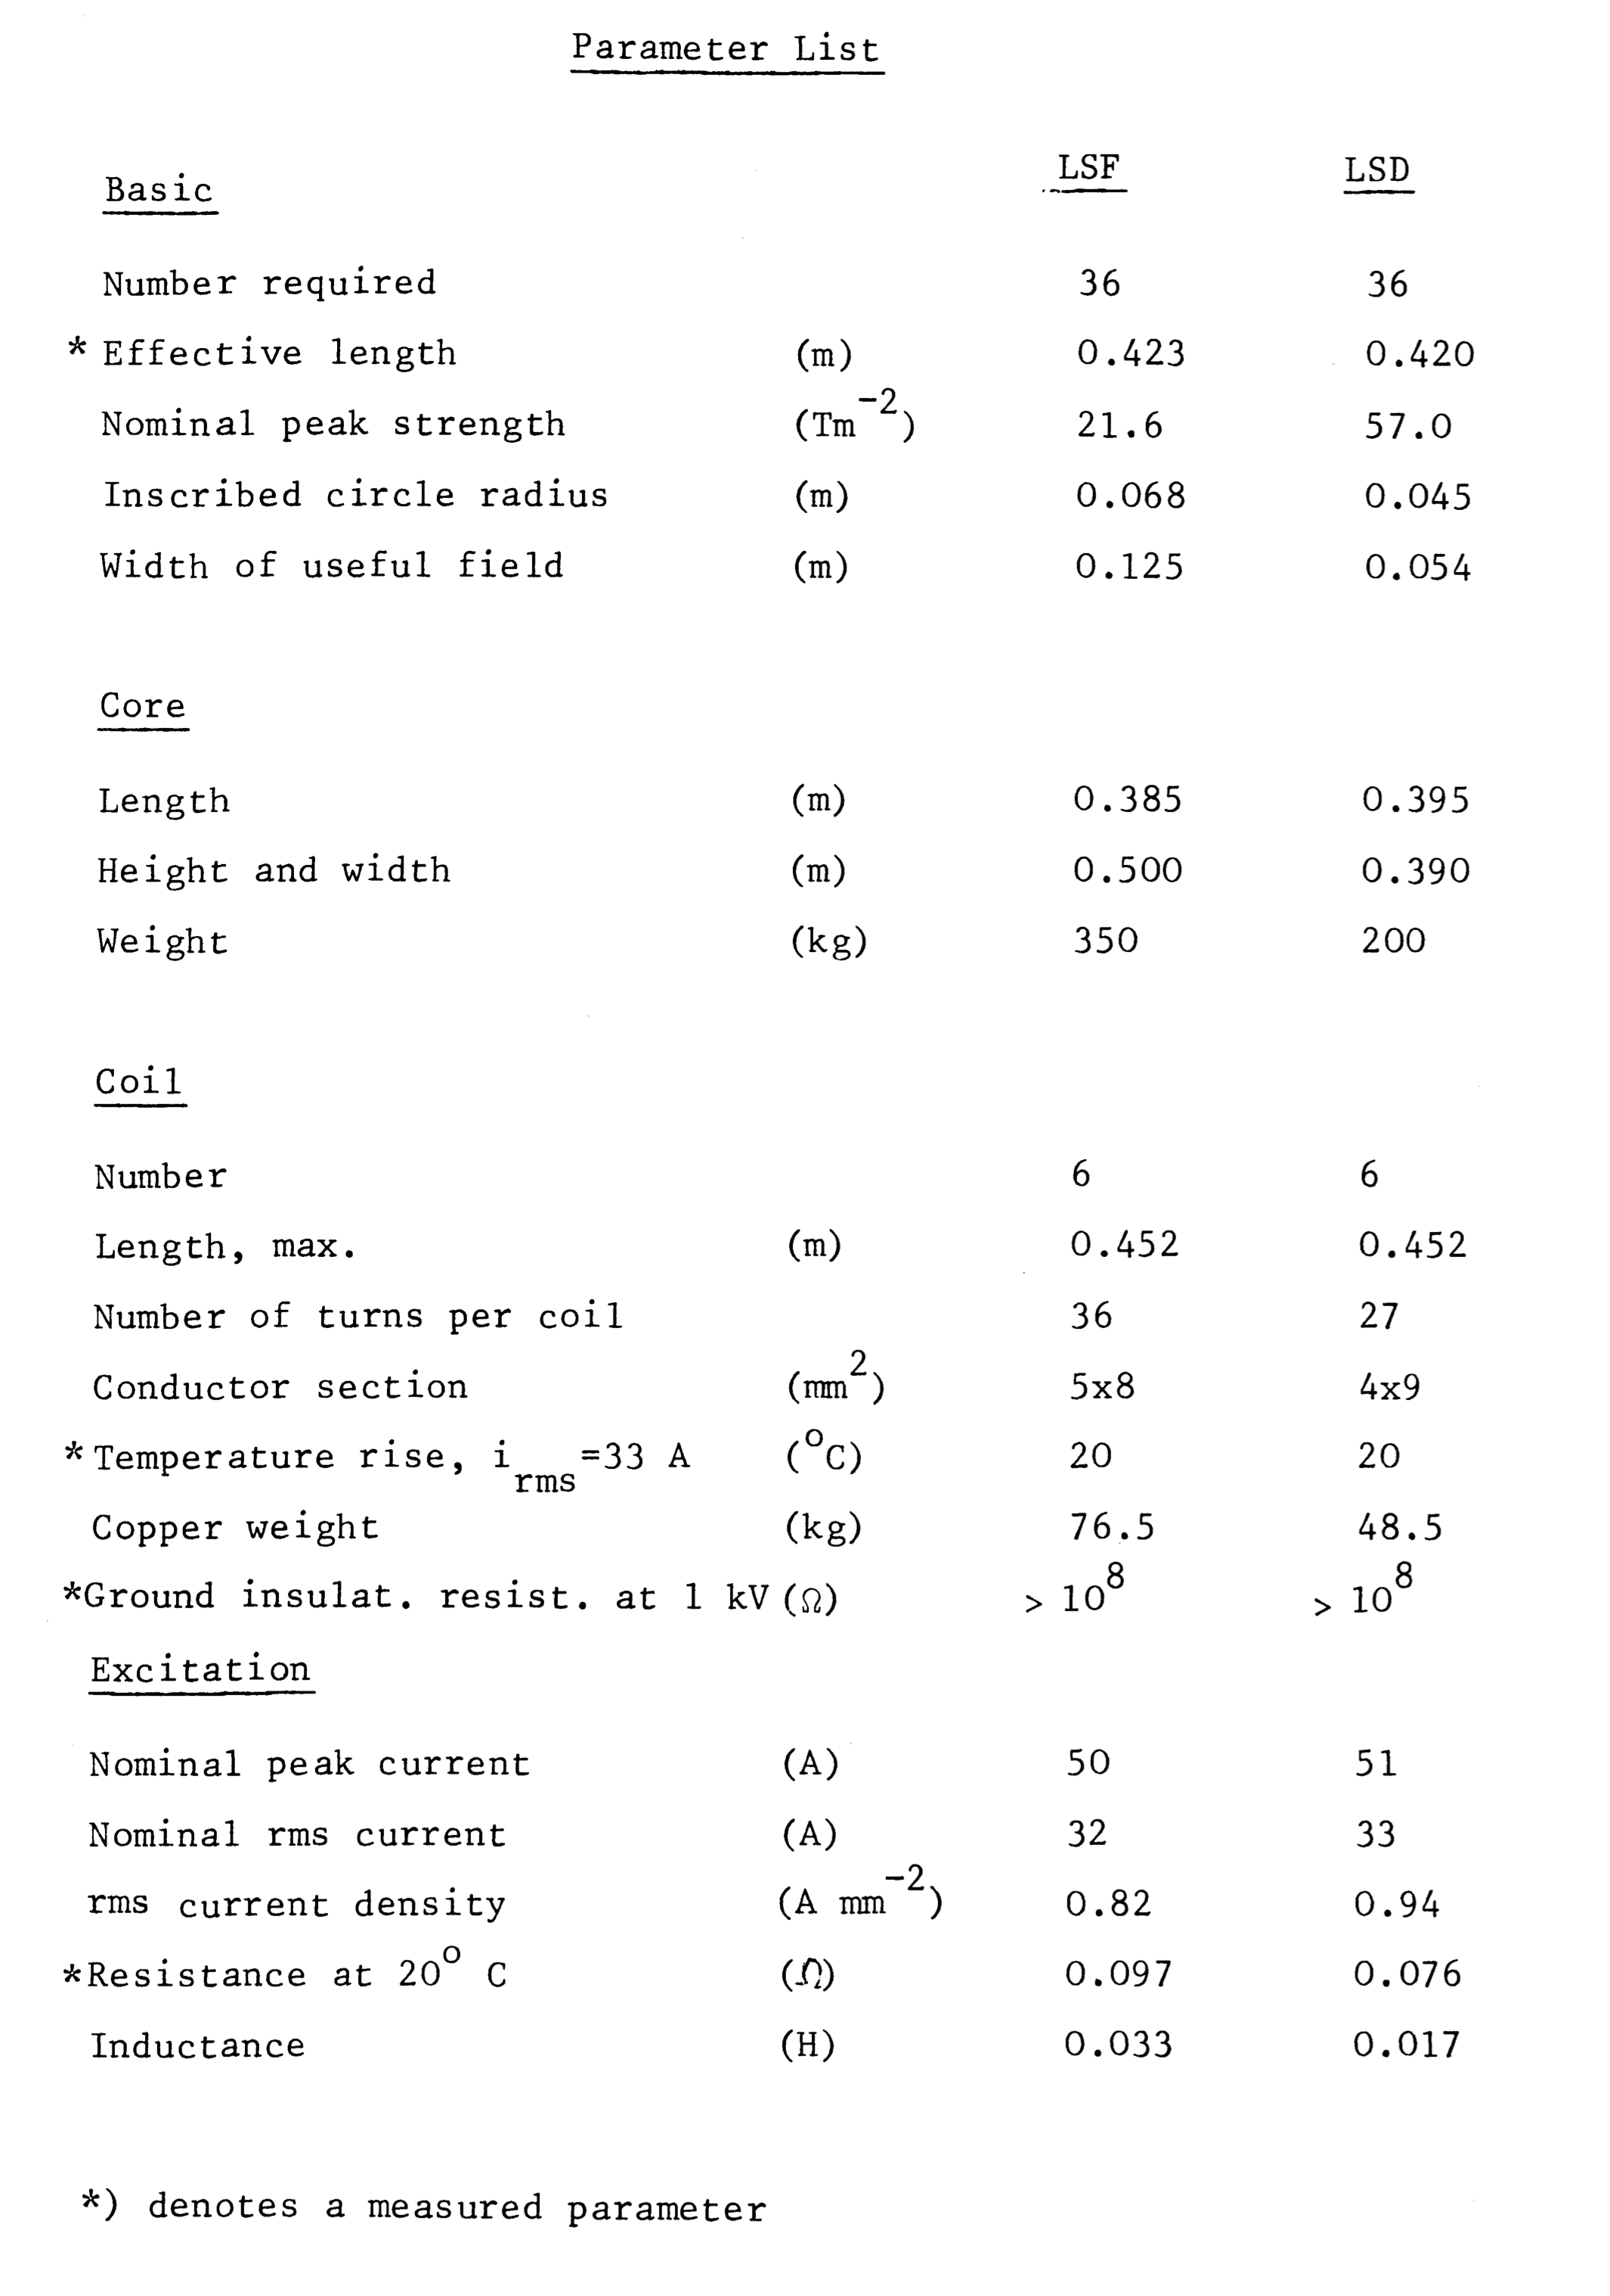
Remanent field measurement OLD sextupoles
R. Lauckner, “The chromaticity sextupoles for the SPS main magnet system”, CERN-LabII-MA-Int-75-6 (1975)

Slide 16
Remanent field measurement OLD sextupoles
Remanent fields in sextupole magnets are expected with a strength of the same order of magnitude as the MADX model
Their impact on linear chromaticity needs to be confirmed in dedicated measurements → try to de-magnetize them
Landau octupoles are not even ramped to a defined field at the end of a cycle → depending on the cycles and changes in the trims, the remanent fields change!
R. Lauckner, “The chromaticity sextupoles for the SPS main magnet system”, CERN-LabII-MA-Int-75-6 (1975)

Slide 17
Summary and conclusions
High precision measurements of non-linear chromaticity at 26 GeV/c
Performed a combined fit of the measurements in both optics
  Leads us to believe that the remanent field components in the chromaticity sextupoles and Landau octupoles are relevant contributions to chromatic behavior at low energy (they are not de-magnetized at the end of a cycle)
  All higher order multipoles (i.e. components that are not actively powered or trimmed by knobs) are consistent between the two optics
Next steps
  Measure impact of sextupole remanent field on linear chromaticity by changing current function to different negative values before injection (or try to de-magnetize them)
  Re-measure non-linear chromaticity once these remanent fields are minimized
  If confirmed, deploy de-magnetization on operational cycles

Slide 18
Thank you for your attention!

