Slide 1
Beam measurements and simulations for the last ion run (longitudinal plane) s LIU-SPS Beam Dynamics Working Group 18/02/2015
A. Lasheen, T. Bohl, E. Shaposhnikova, H. Timko

Slide 2
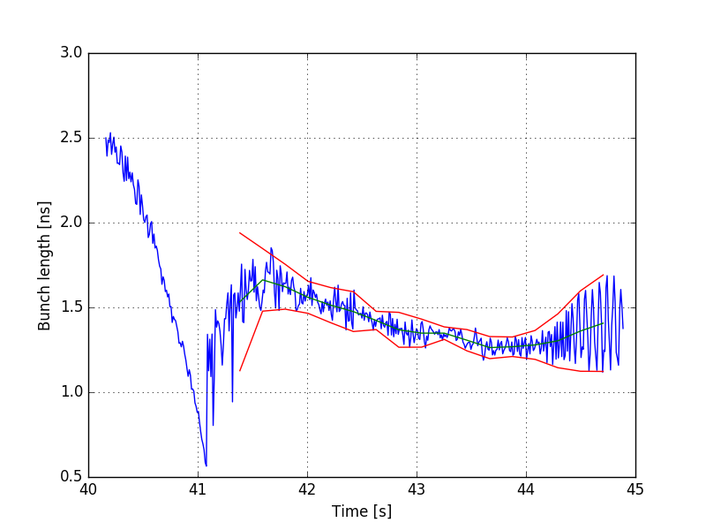
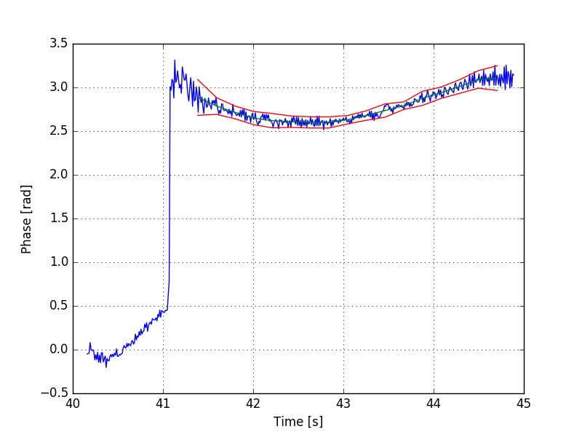
Instability after transition crossing ?
During the ion run in December 2015, instabilities were observed in the longitudinal plane
The motivation to study the dynamics for ions was to test whether our simulations tools were able to reproduce what was observed in measurements (transition crossing + instabilities for ions)

Slide 3
Outline
Measurements
Flat top simulations
Transition crossing simulations

Slide 4
Measurements

Slide 5
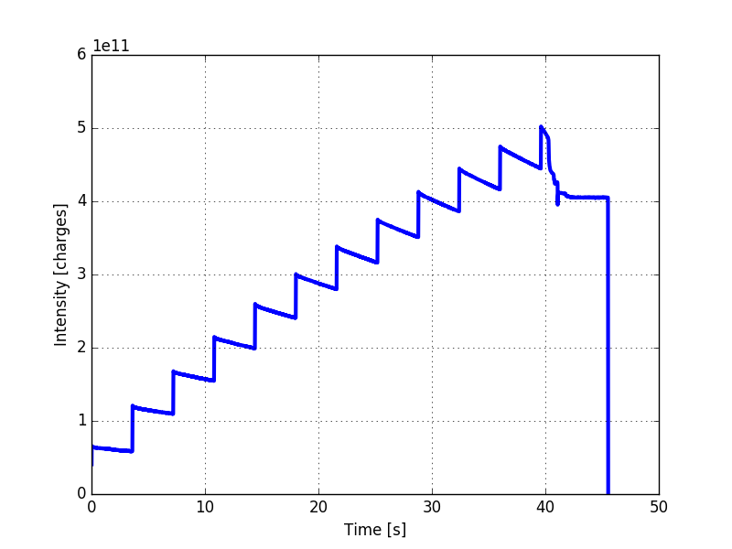
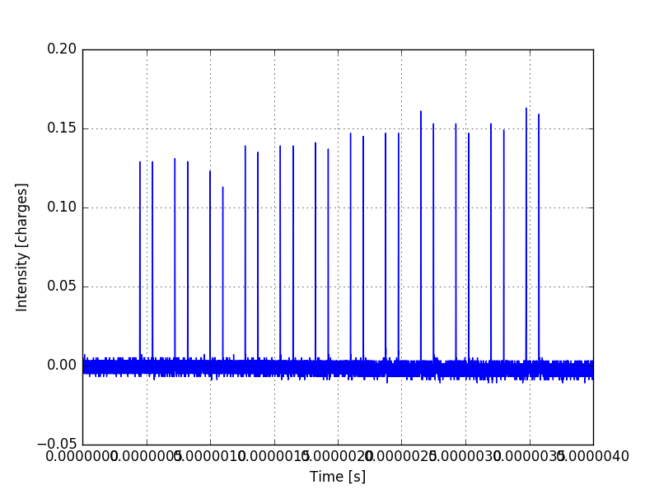
Measurements
Beam charges
Beam profile
Cycle: LHC_ION_12Inj_Q20_2015_V1 (LHCION2) – ${}_{}^{208}{Pb^{82+}}$
Bunch spacing: 100ns – Batch spacing: 175ns (2 bunches per batch)
Important losses during the long flat bottom that leads to bunch-to-bunch variability
Data taken for 20 cycles (more data needed…)

Slide 6
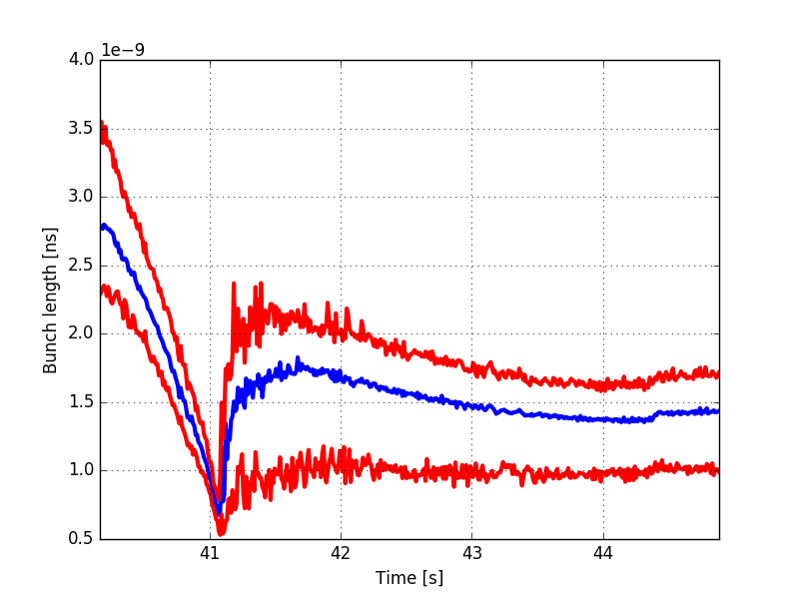
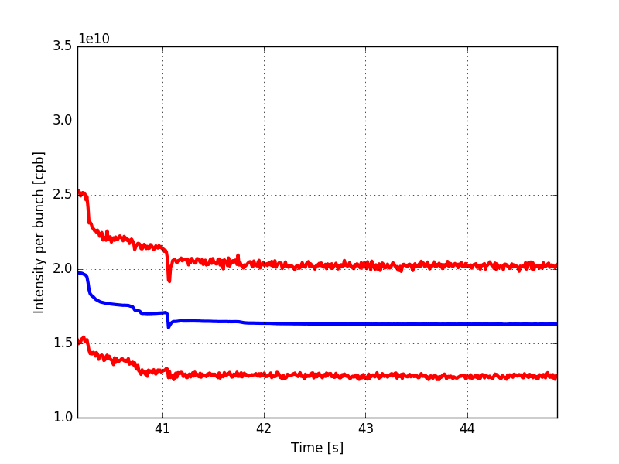
Variability in bunch length / intensity
Bunch length
Bunch intensity
Average
Minimum/Maximum
Average
Minimum/Maximum
Important losses during the long flat bottom that leads to bunch-to-bunch variability
In bunch length and intensity variability through the ramp : $\sim ±25\%$

Slide 7
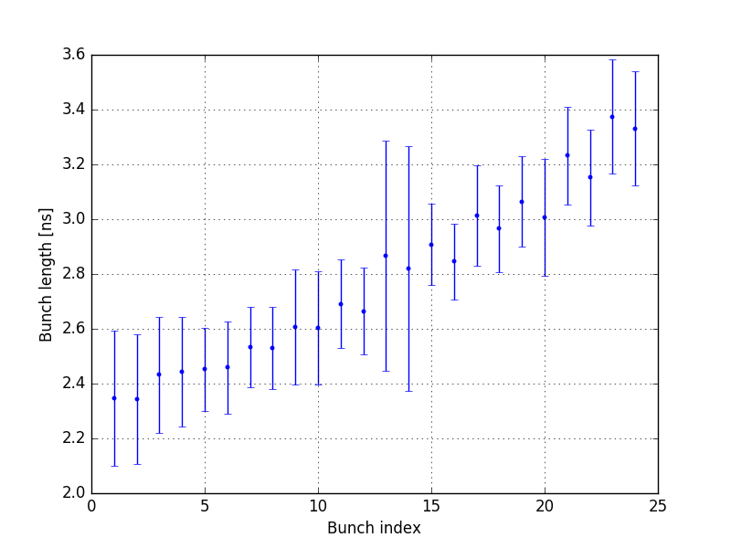
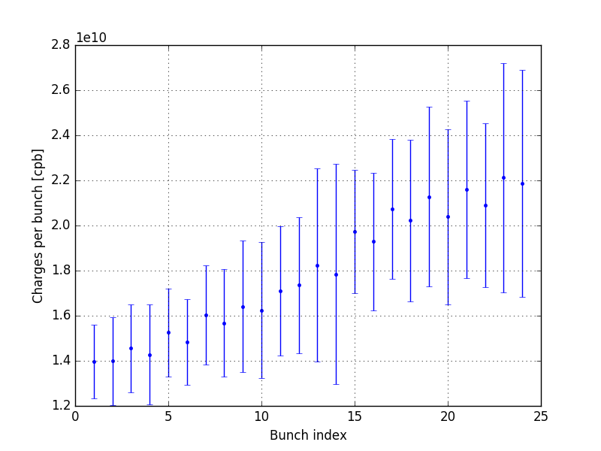
Variability in bunch length / intensity
Bunch length before the ramp
Bunch intensity after losses
Averaged for each bunch over all the acquired data
Bunches that stay longer at flat bottom: shorter and less intense
Error bars : 4$σ$

Slide 8
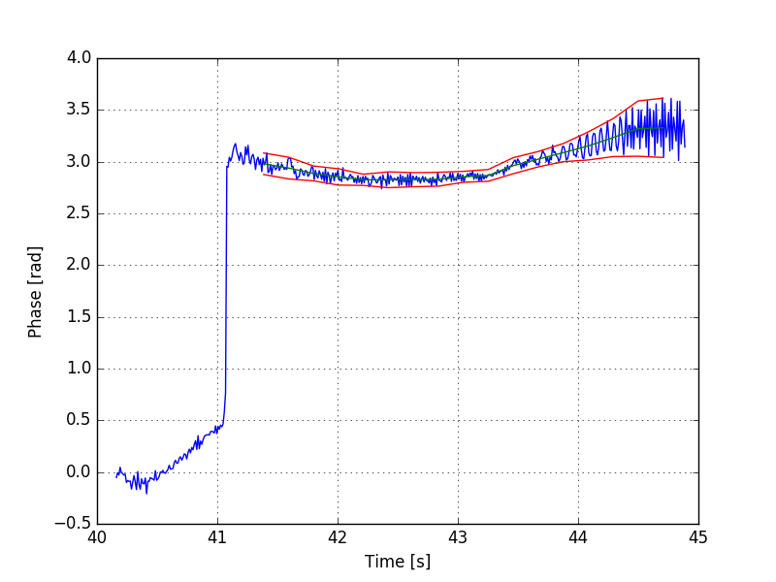
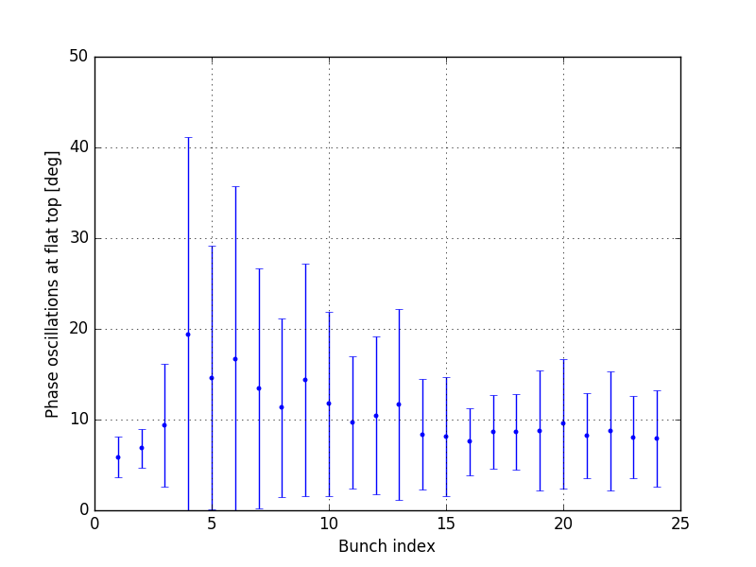
Bunch phase oscillations
Example for Bunch #4
Dipole oscillations for each bunch
The two first bunches are stable (phase loop)
The first half (low intensity, small bunch length) is more unstable than the second (high intensity, long bunch length)

Slide 9
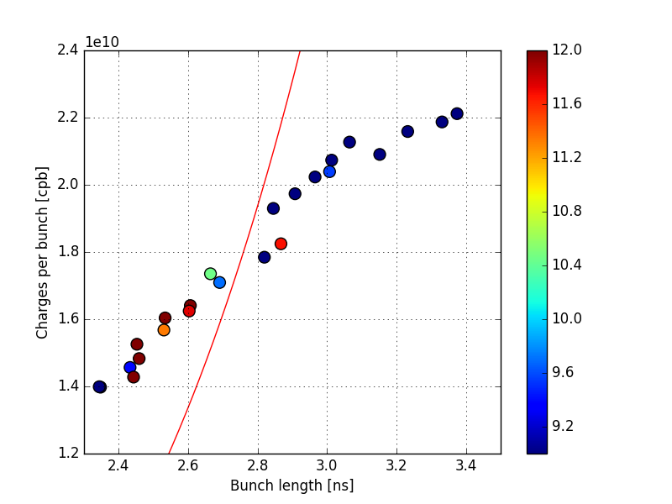
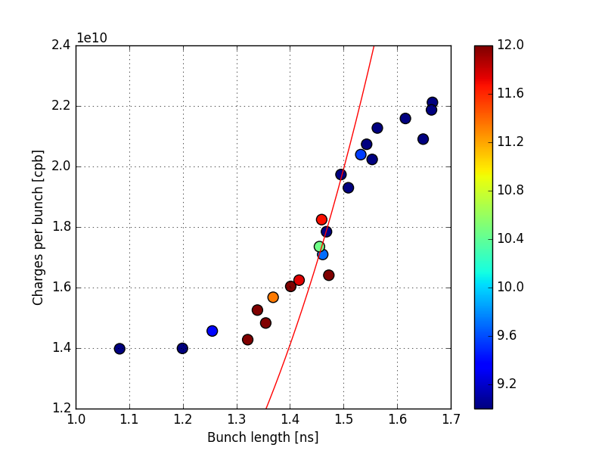
Loss of Landau damping ?
Average bunch length before the ramp
Average bunch length at flat top
Loss of Landau damping threshold for dipole mode in single RF: $N_{th} α τ^{5}$

Slide 10
Flat top simulations

Slide 11
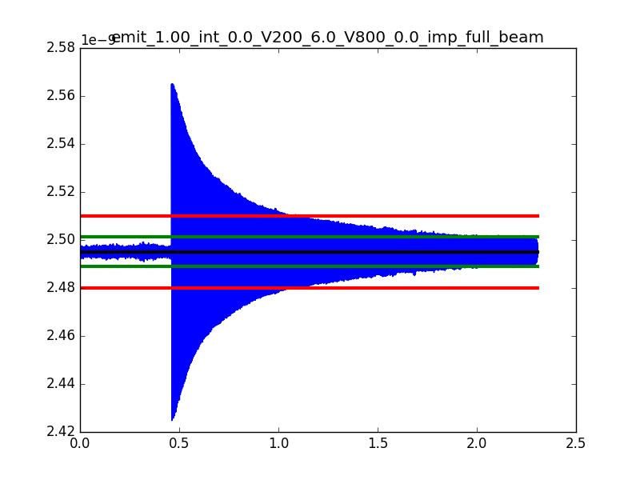
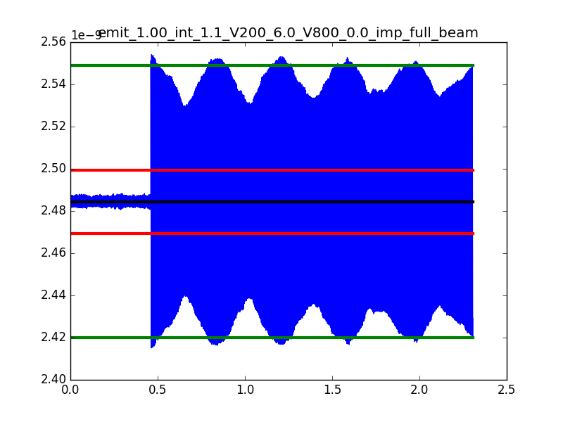
Simulations (BLonD)
No intensity effects
With intensity effects
Bunch position (ns)
Bunch position (ns)
Simulations were done taking flat top parameters (100,000 turns)
Loss of Landau damping was tested by giving a phase kick of +5° to the bunch, and the bunch is considered unstable if oscillations at the end of the simulations are > $±$2°

Slide 12
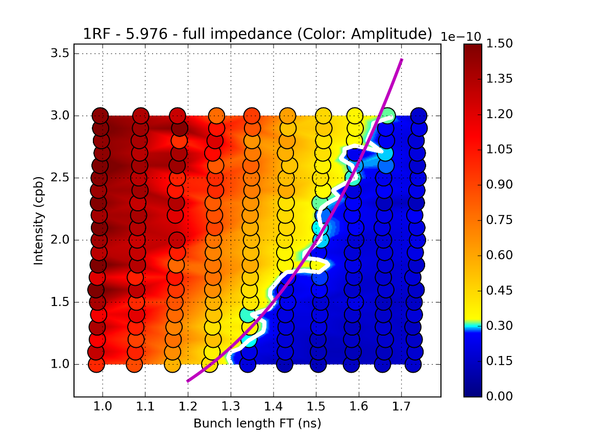
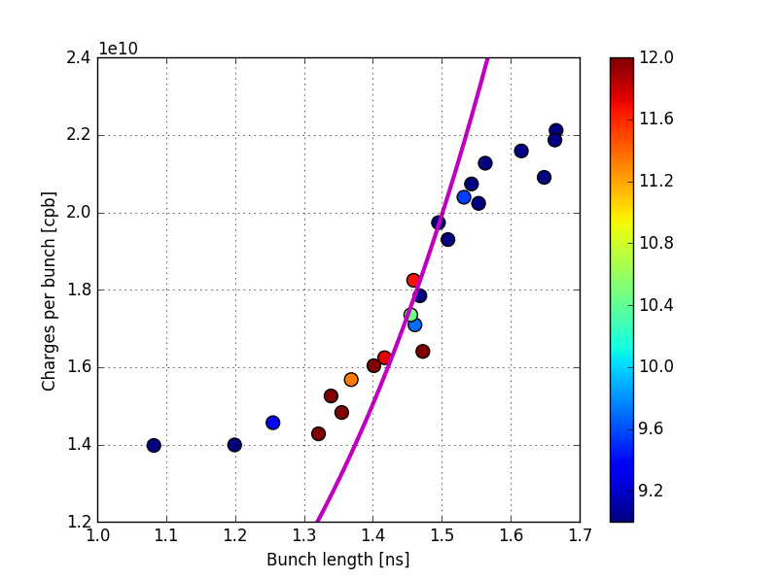
Simulations
The loss of Landau damping scaling fits well with the simulations
There is a good agreement between measurements and simulations concerning the instability threshold (more measurement data needed…)

Slide 13
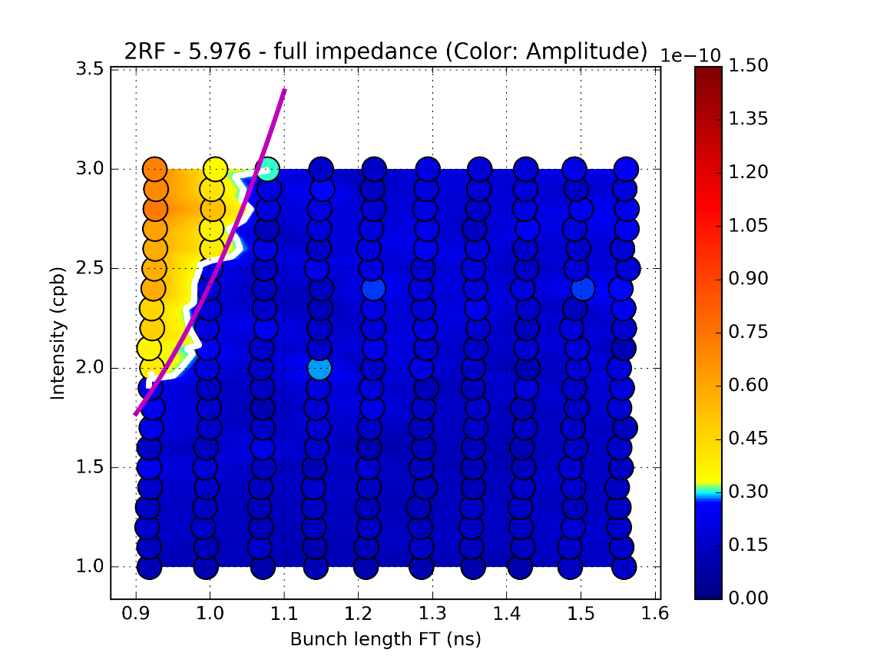
Double RF system for ions
The second RF system in bunch shortening mode would give more synchrotron frequency spread, and lead to a better damping of these oscillations.

Slide 14
Transition crossing simulations

Slide 15
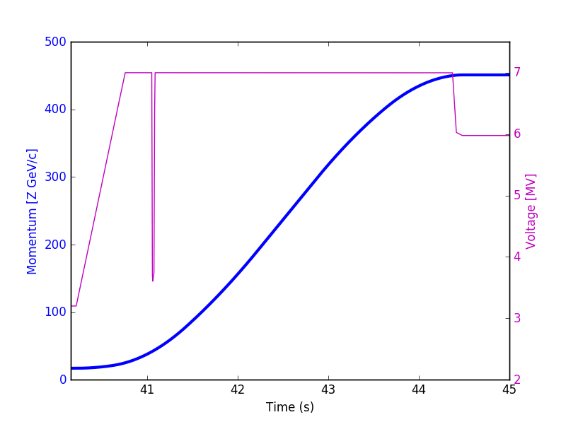
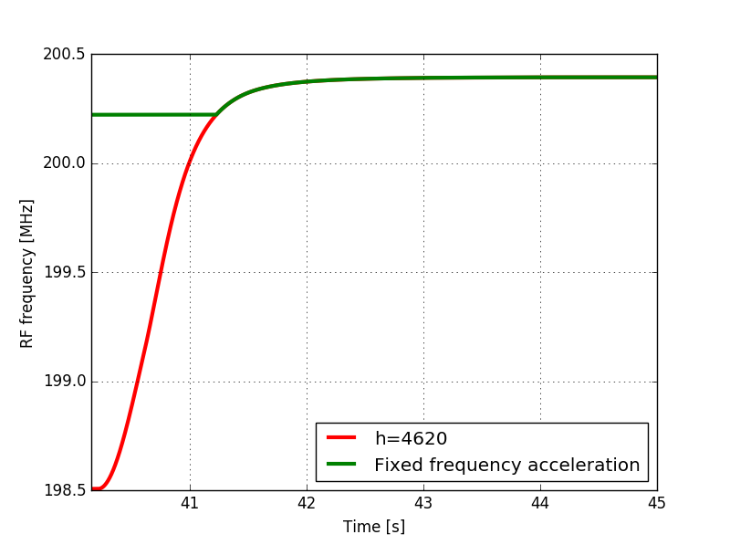
Momentum and RF program
The ramp was simulated using the real momentum program and RF voltage
Fixed frequency acceleration was included in the simulation

Slide 16
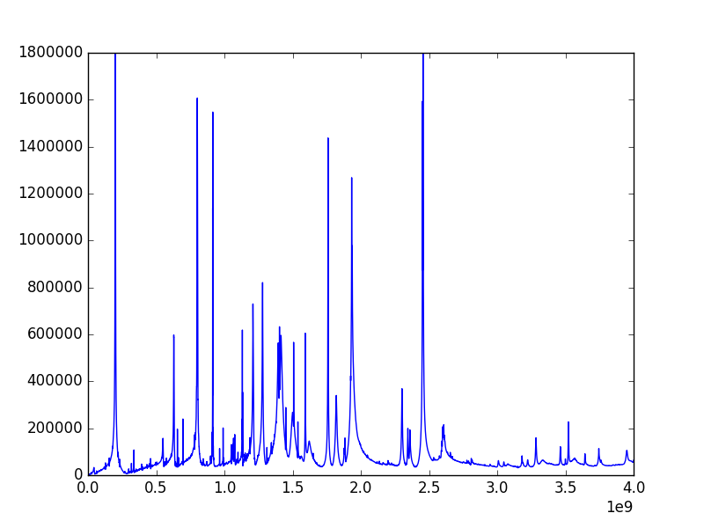
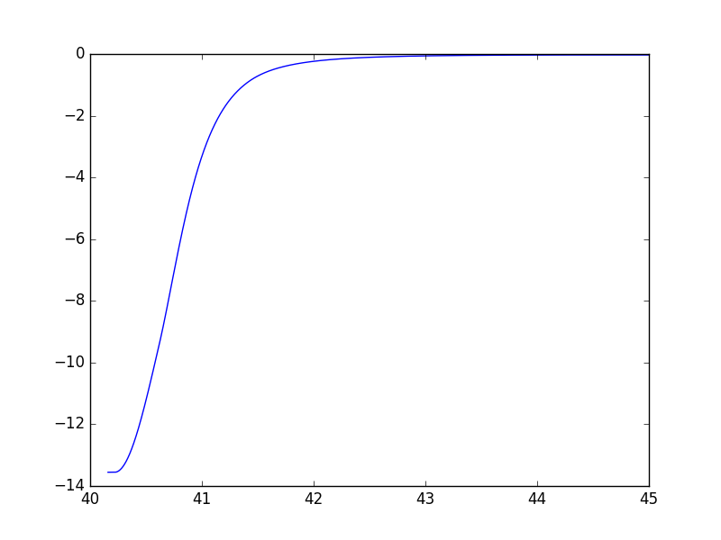
Impedance & Space charge
Abs(Z) (Ohm)
Z/n (Ohm)
$$ε_{x,y (norm)}\sim 1.2μm$$
$$σ_{dp/p}\sim 4.7×{10}^{−4}$$
Freq (Hz)
Time (s)
The latest impedance model was used
The space charge impedance is much higher than for protons at flat bottom (17.07 Z GeV/c, Z/n~factor 10 w.r.t. protons at flat bottom)

Slide 17
Impedance & Space charge
Abs(Z) (Ohm)
Z/n (Ohm)
$$ε_{x,y (norm)}\sim 1.2μm$$
$$σ_{dp/p}\sim 4.7×{10}^{−4}$$
Freq (Hz)
Time (s)
Impedance round uniform beam in rectangular chamber:
$$\frac{Z}{n}=−\sqrt{\frac{μ_{0}}{ε_{0}}} \frac{\frac{1}{4}+\ln\left(\frac{2h}{π\sqrt{2}σ_{x,y}}\tanh\left(\frac{πw}{2h}\right)\right)}{γ^{2}}$$
NB: $σ_{dp/p}$ was considered constant at the time the simulations were done => space charge slightly overestimated, but should be small impact (ln)

Slide 18
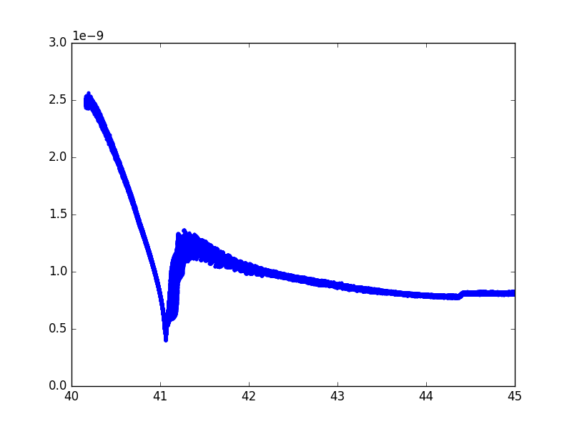
Transition crossing simulations
Bunch length during the ramp
A phase jump is applied on the RF phase, so that the bunch stays on the accelerating $φ_{s}$
Dipole oscillations are observed after transition crossing.

Slide 19
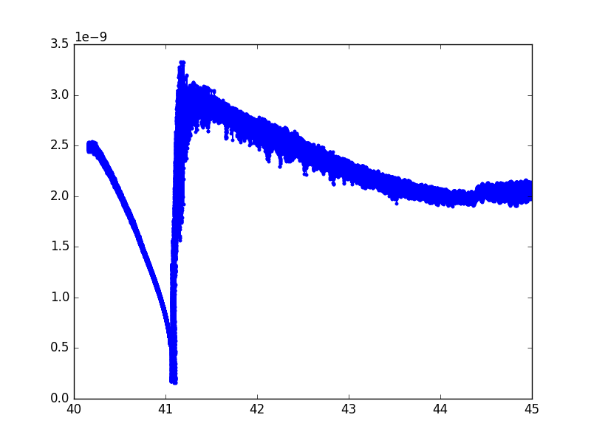
Intensity effects
Bunch length during the ramp
Beam explodes after transition crossing
Very high intensity effects and important dipole oscillations after transition

Slide 20
LLRF implementation in BLonD
Fixed frequency acceleration
$$f_{RF}=h f_{0} but h not integer ⇒ Next turn Δφ_{RF}$$
Phase loop
$$Δφ=φ_{b}−φ_{s}⇒Δf_{RF,PL}=−g_{PL}Δφ \\ ⇒ Next turn Δφ_{PL}$$
Fixed frequency acceleration, RF frequency is adjusted so that $f_{RF}=200.222$ MHz in presence of the beam, but => $Δφ_{RF}=0$
$$g_{PL}=\frac{1}{5T_{0}}$$

Slide 21
LLRF implementation in BLonD
Radial loop, LHC model (note from P. Baudrenghien):
$$Δf_{RF,RL}=z_{2,n}⇒ Next turn Δφ_{RL}$$
${\left(\frac{ΔR}{R}\right)}_{n}$is obtained from the average $ΔE$distribution at each simulation turn (no transverse coordinates in BLonD) from :
$${\left(\frac{ΔR}{R}\right)}_{n}=α\frac{<ΔE>_{n}}{β_{d,n}^{2}E_{d,n}}$$
Machine dependent ? Necessity to implement a model that fits better the SPS implementation ?

Slide 22
LLRF implementation in BLonD
Radial steering (the implementation in BLonD can be adjusted for slip stacking)
${\left(\frac{ΔR}{R}\right)}_{prog}$ is given as an input
$$Δf_{RS}=−f_{RF,d}\left(1−\frac{γ^{2}}{γ_{t}^{2}}\right){\left(\frac{ΔR}{R}\right)}_{prog}$$
$$⇒ Next turn Δφ_{RS}$$

Slide 23
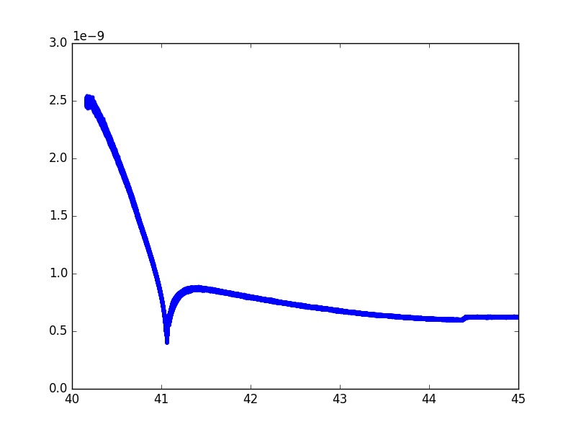
Without intensity effects, with loops
Bunch length during the ramp
The phase loop damps the dipole oscillations generated after transition crossing
Realistic gains are needed

Slide 24
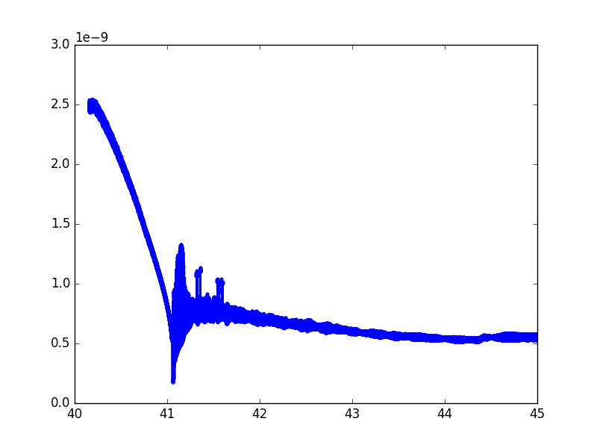
With intensity effects, with loops
Bunch length during the ramp
Radial loop has to be implemented to compensate long term drifts in the RF frequency and phase due to the synchronous phase shift due to intensity effects and for transition crossing
Realistic gains are needed for more realistic simulations

Slide 25
Conclusions and future work
The losses at flat bottom leads to a bunch-to-bunch variability, small bunches then suffer from loss of Landau damping (+ important perturbation due to transition crossing).
Models are ready to be used for future studies (slip stacking, higher intensities, etc.)
Higher orders of momentum compaction factor can be implemented when available
More realistic implementations and values of the gains are needed for the loops
Multibunch simulations through the ramp with intensity effects and loops are possible in a reasonable time (~3 days)

