Slide 1
Preliminary results of simulations with 72 proton bunches s LIU-SPS Beam Dynamics Working Group 18/02/2015
A. Lasheen, J. Repond, E. Shaposhnikova

Slide 2
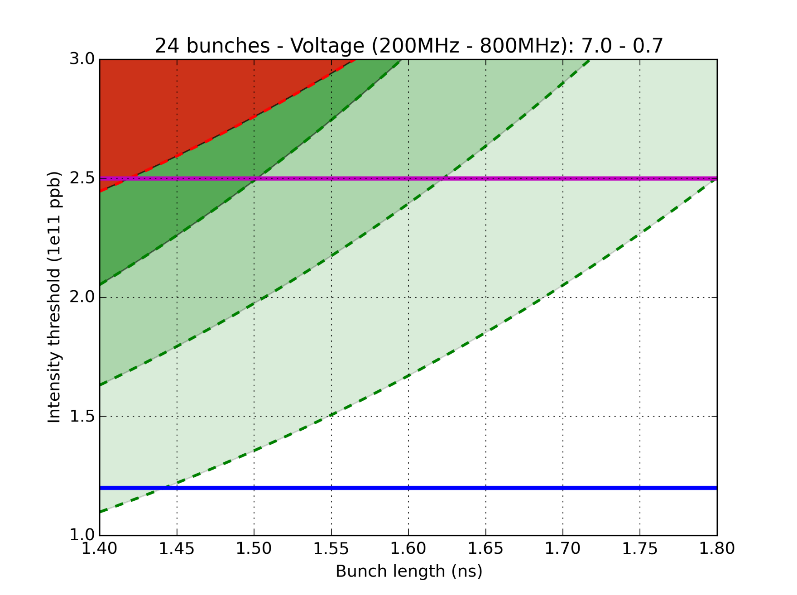
Simulations with 24 bunches – “unrealistic”
Limit after LS2 without impedance reduction (reference point)
SPS goal
(before scraping)
36 bunches measured instability threshold (2015)
3
72 bunches measured instability threshold (2012)
2
Impedance reduction gain (complete removal):
1: Flanges QF-type + HOM 630MHz
2: (1) + MKP
3: (2) + Flanges QD-type + other HOMs
1
Nominal LHC
1
2
3

Slide 3
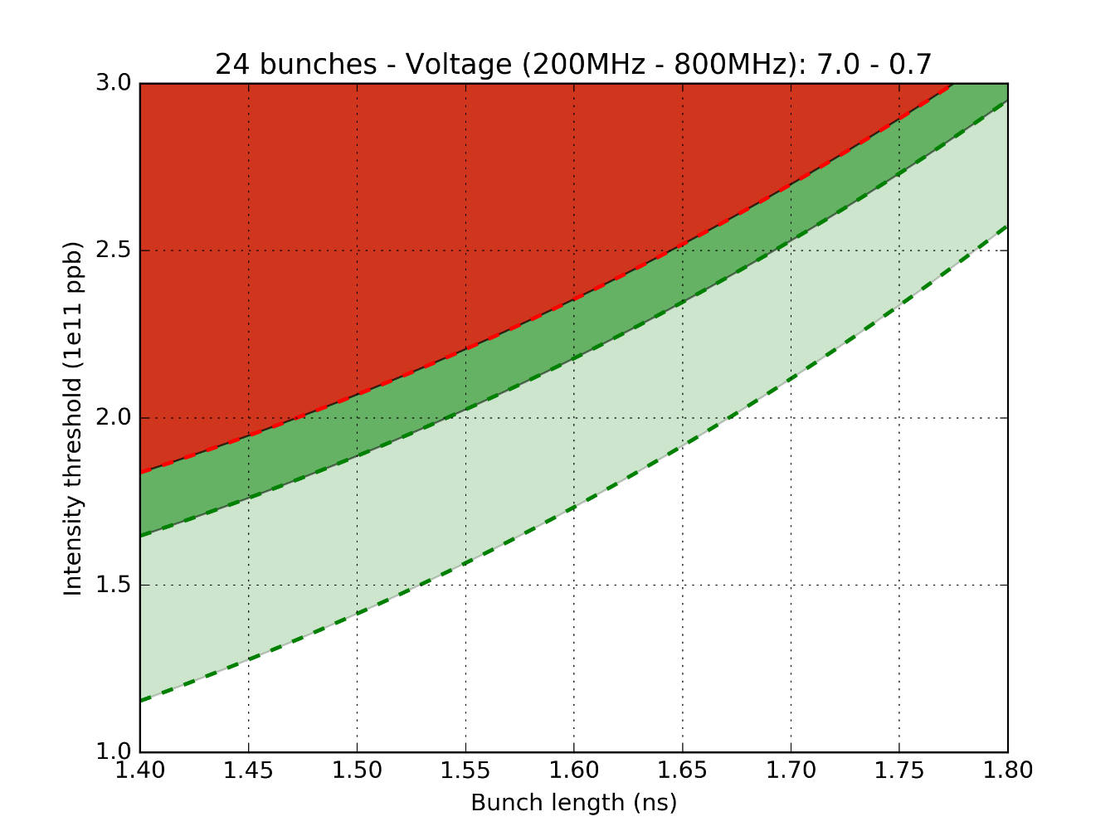
Simulations with 24 bunches – “realistic”
24 bunches at flat-top, bunch shortening mode V_{200MHz} = 7 MV, V_{800MHz} = 0.7 MV
Impedance reduction gain (“realistic” impedance reduction):
No impedance reduction
Impedance reduction
QF flanges
Main cavity higher order mode at 630 MHz divided by 3
Additional reduction of injection kicker (MKP) by 2
Not accessible
4.
HL-LHC
Intensity threshold [10¹¹ ppb]
3.
LIU
2.
1.
Longest bunch for transfer to LHC
Achieved
Bunch length [ns]
In order to have more realistic results for impedance reduction, simulations using 72 bunches were foreseen
Further development in BLonD allowed to lower the simulation time to ~1-3 days for 72 bunches

Slide 4
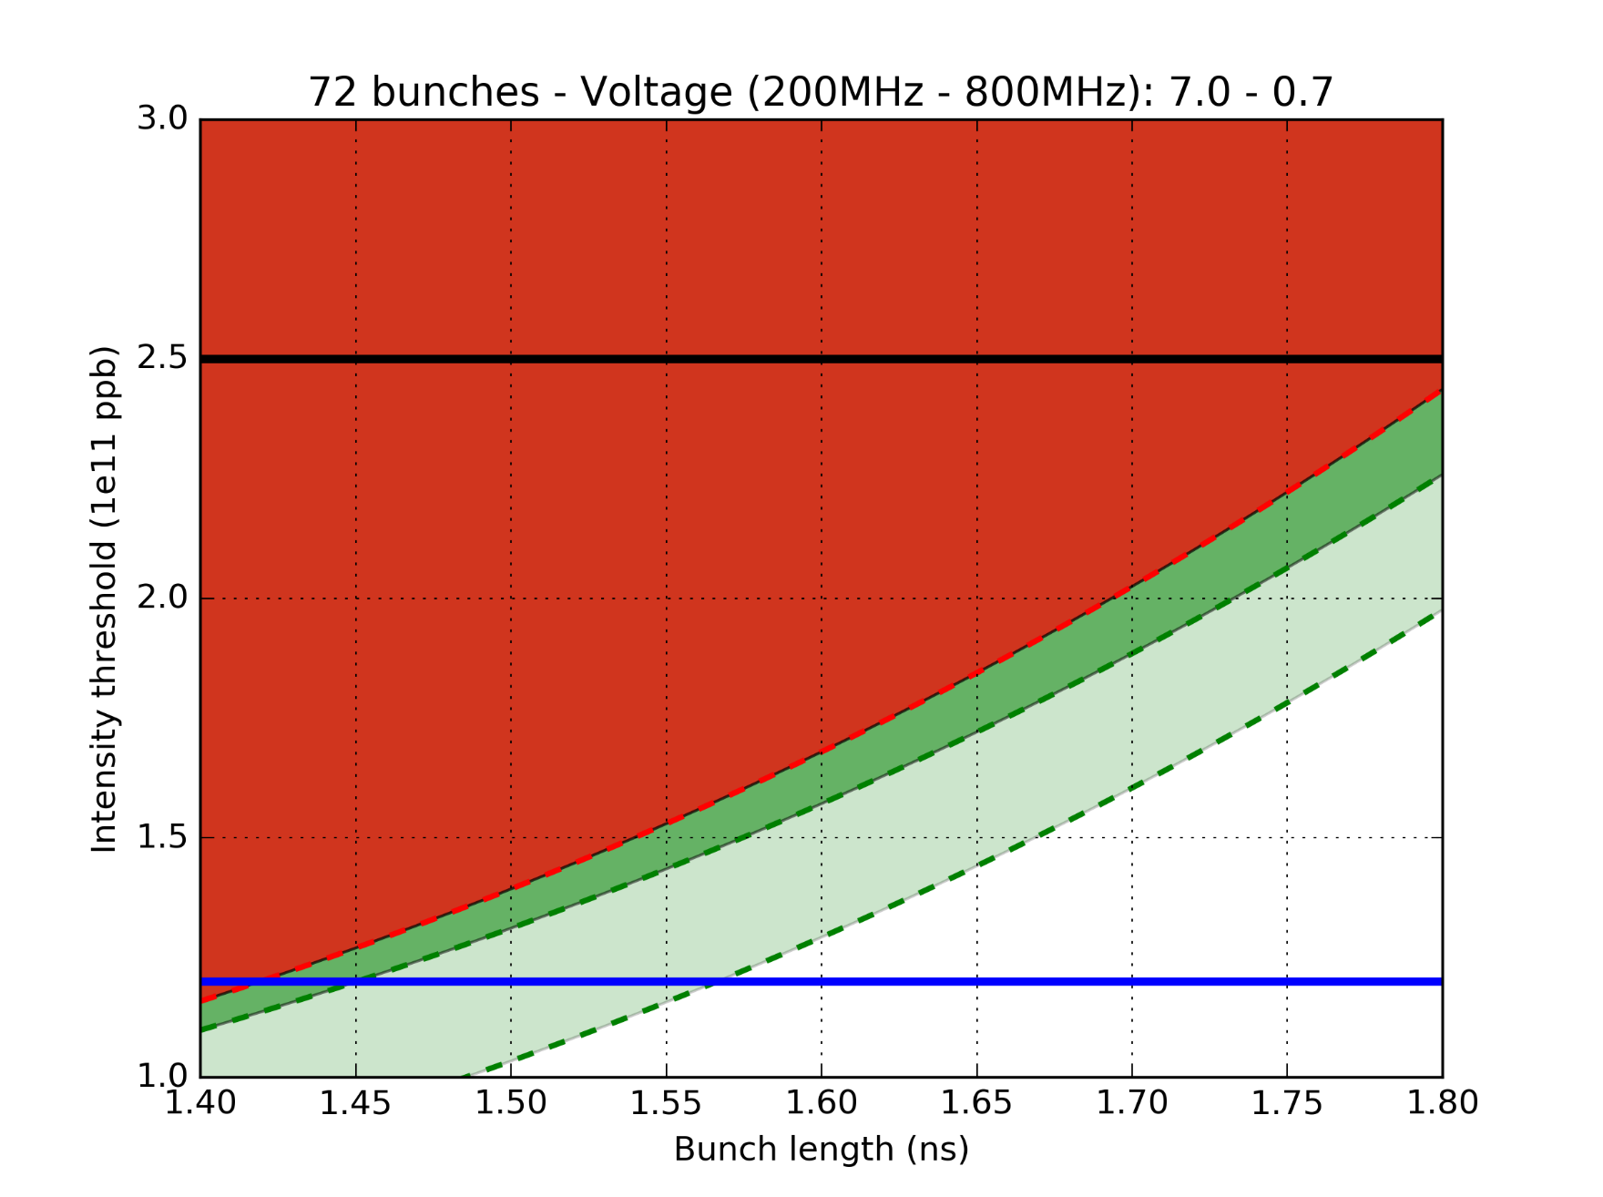
Simulations with 72 bunches
72 bunches measured instability threshold (2012)
SPS goal
(before scraping)
Impedance reduction gain (“realistic” impedance reduction):
1: LIU baseline (Shielded QF type flanges and HOM 630MHz damping by a factor 3)
2: (1) + additional reduction of MKP (R divided by 2)
2
1
1
Nominal LHC
2

Slide 5
Questions after 72 bunches simulations
Is there an impedance in the model that was overlooked, but that is dominant for 72 bunches ?
Is the “realistic” considerations (shielding model for the vacuum flanges, further damping of the HOM 630MHz by a factor 3), while already challenging, not enough to have an important gain in intensity ?
A new round of simulations to test as many assumptions as possible was started.

Slide 6
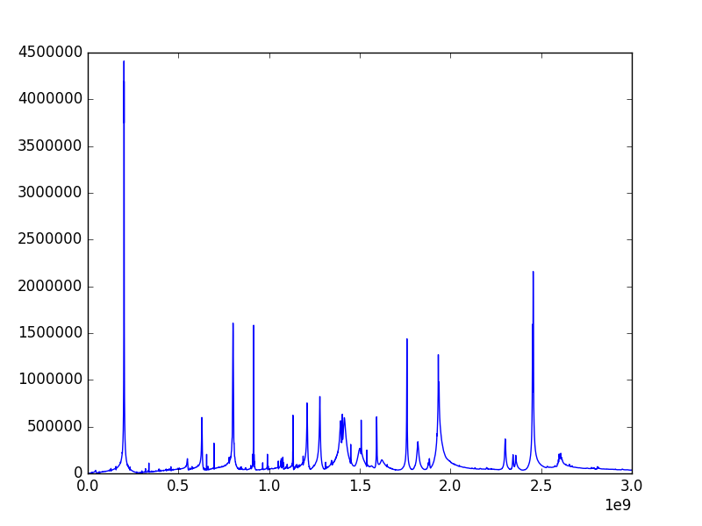
Main contributions to the impedance model
HOM 200MHz cavity
BPV-QD flanges
BPH-QF flanges
MBA-QF & QF-QF closed with bellow
Abs(Z) (Ohm)
Freq (Hz)
Unshielded pumping ports

Slide 7
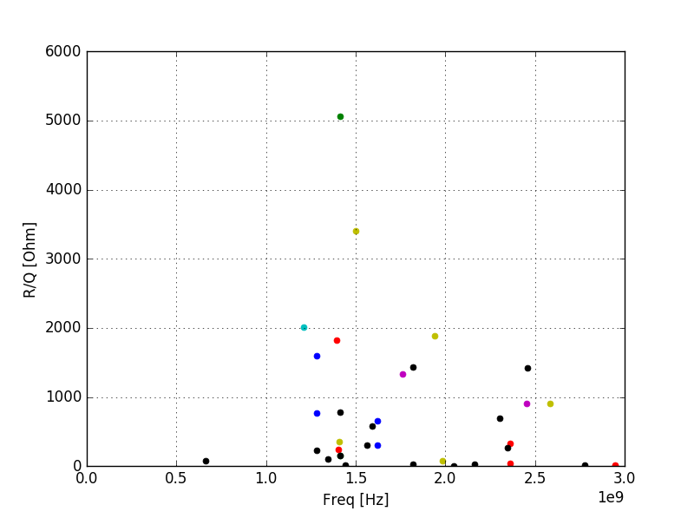
Main impedances at high freq (flanges)
MBA-QF
Unshielded pumping ports
& QF-QF closed with bellow
BPV-QD flanges
BPH-QF flanges

Slide 8
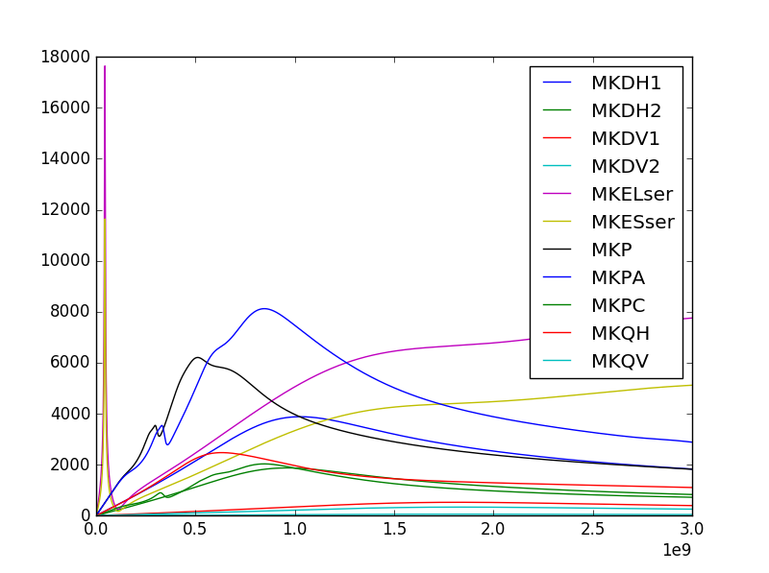
Kickers
Abs(Z) (Ohm)
Freq (Hz)

Slide 9
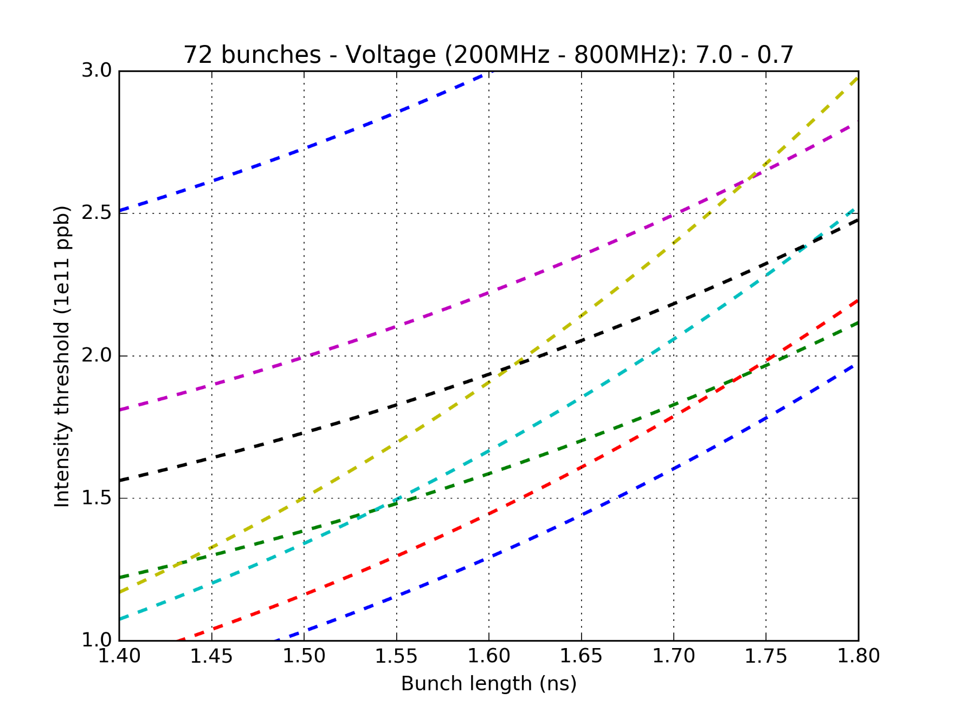
Simulations with 72 bunches
Impedance reduction gain (complete removal):
1: Full
2: All HOMs
3: All Flanges
4: All Kickers
5: 2+3
6: 2+4
7: 3+4
8: 2+3+4

Slide 10
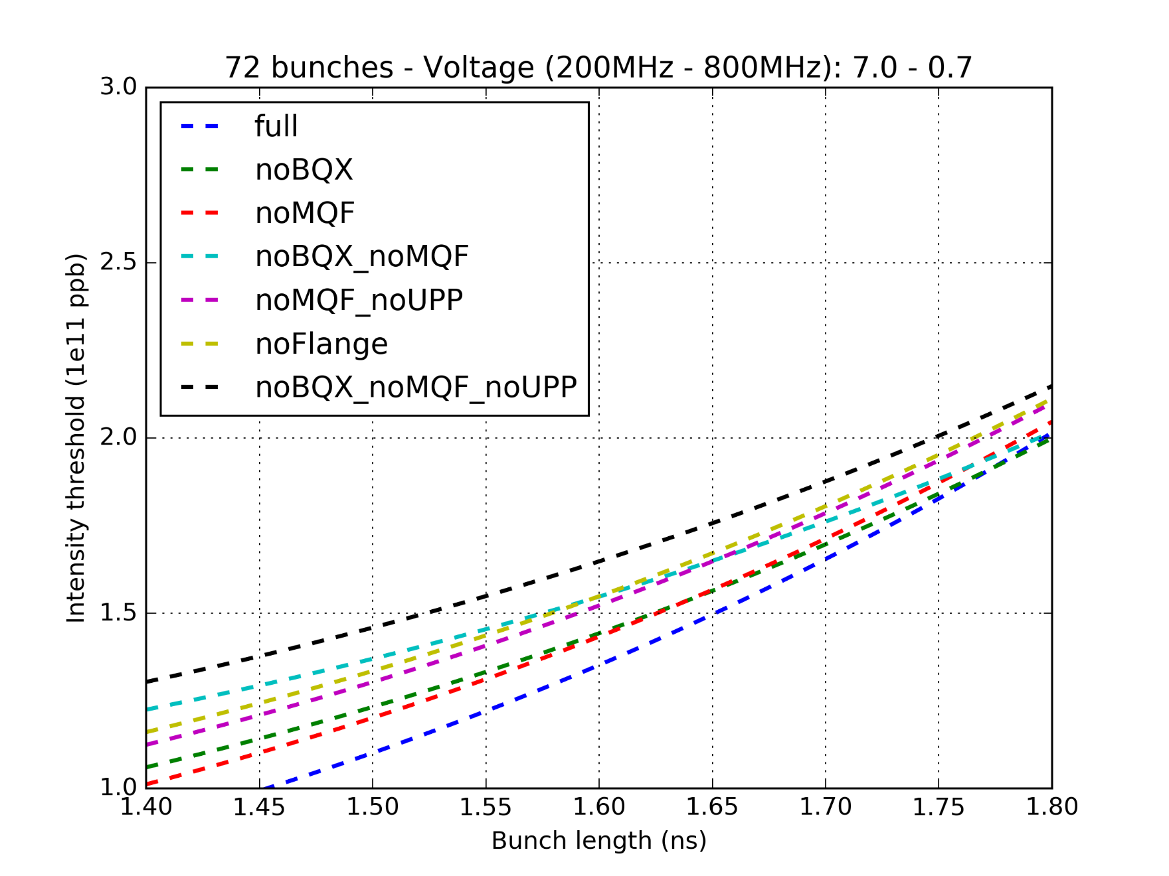
Simulations with 72 bunches – Flanges
PRELIMINARY !!
Impedance reduction gain (complete removal):
BQX = BPV-QD and BPH-QF
MQF = MBA-QF and QF-QF closed with bellow
UPP = Unshielded pumping ports
=> All those flanges has to be taken into account

Slide 11
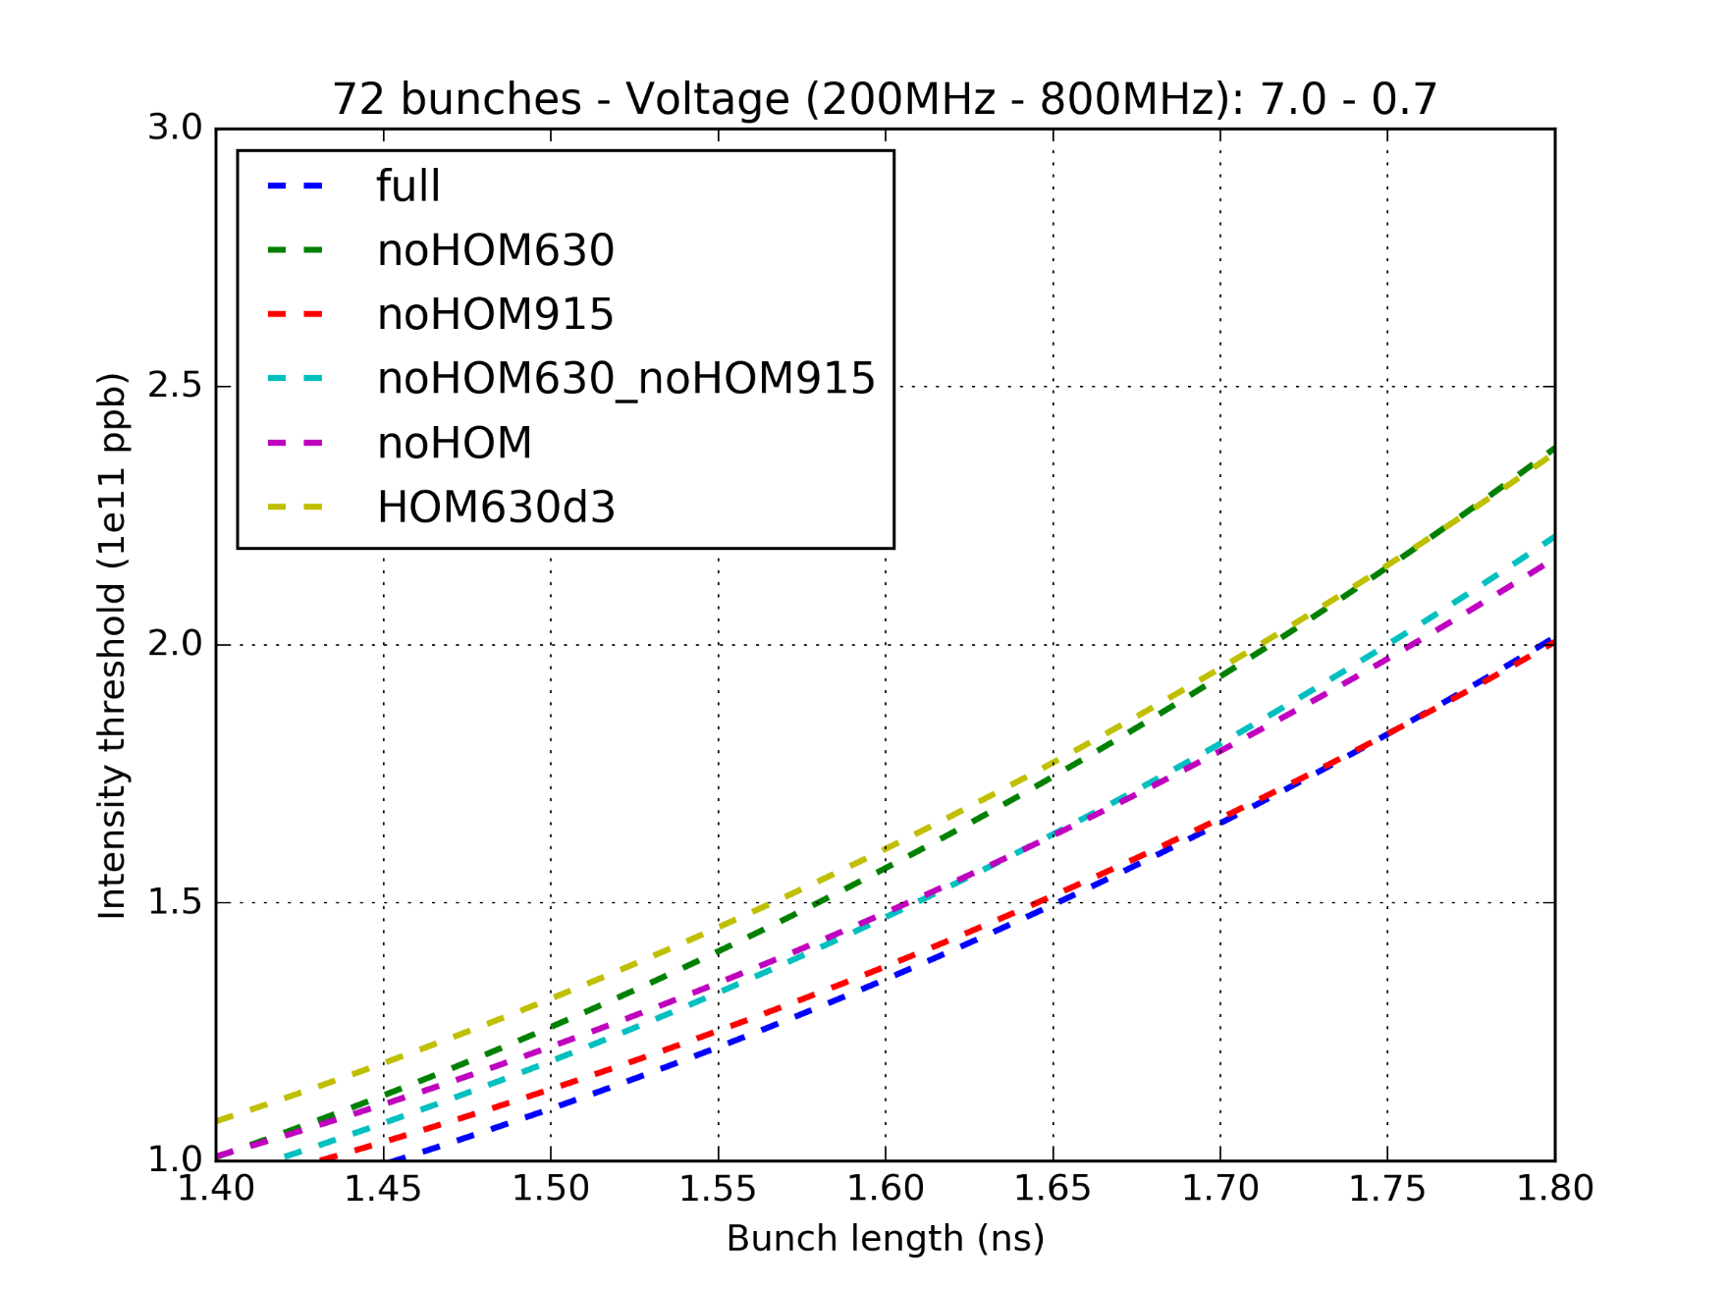
Simulations with 72 bunches – HOMs
PRELIMINARY !!
Impedance reduction gain:
HOM630d3 = damping the 630MHz HOM by a factor 3
noHOM = removing ALL HOMs (200MHz and 800MHz)
=> The 630MHz HOM seems to be the most important one

Slide 12
Conclusions and future work
Further simulations to check for the combinations of removing the HOM 630MHz, the different flanges (BPV-QD, BPH-QF, MBA-QF, QF-QF closed with bellow) and the unshielded pumping ports.
Specifications will be defined for the impedance reduction for the different type of flanges to have an acceptable gain in intensity. (but due to the high number of configurations, another strategy for simulations needs to be taken)
Simulations will be ran for 10MV and for the cavity configuration after LS2 (4 cavities of 3 sections + 2 cavities of 4 sections, vs 2 cavities of 4 sections + 2 cavities of 5 sections).
Simulations will be ran for 5MV to check the expected intensity gain if we do bunch rotation at flat top with the reduced impedance.

