Slide 1
Update on Studies of the 200 MHz HOMs
R. Calaga, F. Caspers, A. Grudiev, T. Kaltenbacher, A. Lasheen,
E. Montesinos, T. Roggen, E. Shaposhnikova,
Ya. Shashkov, C. Völlinger
LIU-SPS -BD-WG 18/02/2016

Slide 2
Outline
Study purpose
Measurement based verifications
HOM impedance reduction
Conclusions & outlook

Slide 3
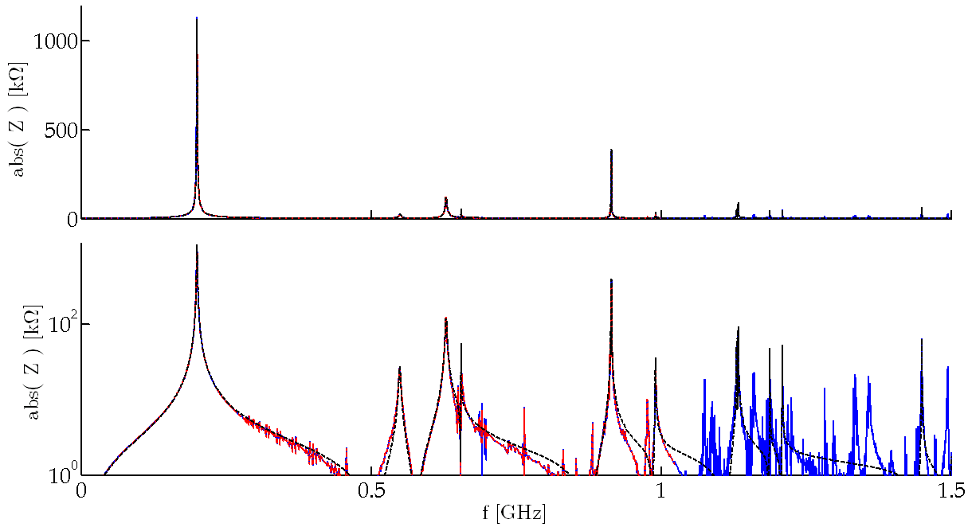
Study purpose
Impedance model for 200 MHz TWC (J.E. Varela)
Available for 4 and 5 section cavities
Based on simulations, used: resonator model
Goal 1: Measurement based verification
simulation model vs. prototype vs. tunnel
measurements with beam
Goal 2: Further reduction of HOM impedance
4-section cavity
(J.E. Varela)
f [GHz] | Z [kΩ] | Q | R/Q [Ω]
0.1997 | 850 | 450 | 1889
0.2003 | 2060 | 400 | 5150
0.201 | 850 | 425 | 2000
0.5499 | 55.2 | 200 | 276
0.6289 | 80 | 700 | 114
0.629.9 | 220 | 250 | 880
0.6554 | 108 | 2500 | 43
0.914 | 770 | 5000 | 154
0.9148 | 772 | 5000 | 154
0.9907 | 72 | 1500 | 48
1.1306 | 110 | 4000 | 27
1.1319 | 132 | 4000 | 33
1.1331 | 156 | 5000 | 31
1.1335 | 160 | 5000 | 32
1.1878 | 96 | 7500 | 13
1.2093 | 106 | 6000 | 18
1.450 | 130 | 5500 | 24
1.5073 | 174 | 8000 | 22
1.5076 | 236 | 8000 | 29
lin. scale
4-section cavity
log. scale

Slide 4
Goal 1: Measurement based verification
For comparison sim. model vs. prototype vs. tunnel
Measurements on 4-section & 5-section in tunnel
HOM-HOM
HOM-P
P-P
Feeder line
FPC-Load…
Measurements:
T. Kaltenbacher, T. Roggen,
R. Calaga
Ideas and suggestions:
F. Caspers, R. Calaga
S1
S2
S3
S4
HOM1
HOM2
HOM3
HOM4
P1
P2
P3
P4
P5
P6
P7
P8
P9
P10

Slide 5
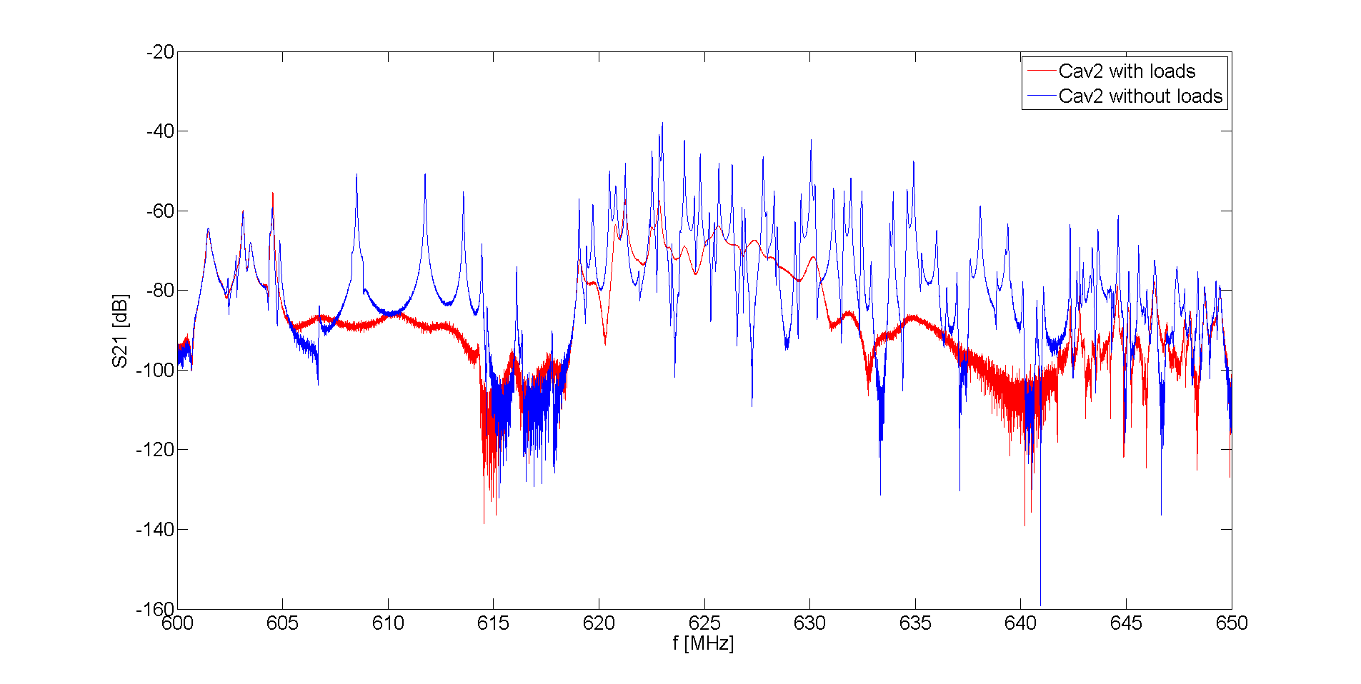
Goal 1: Measurement based verification
Highlights
628 MHz HOM dampers work very well
Q = 955
-30 dB
S1
S2
S3
S4

Slide 6
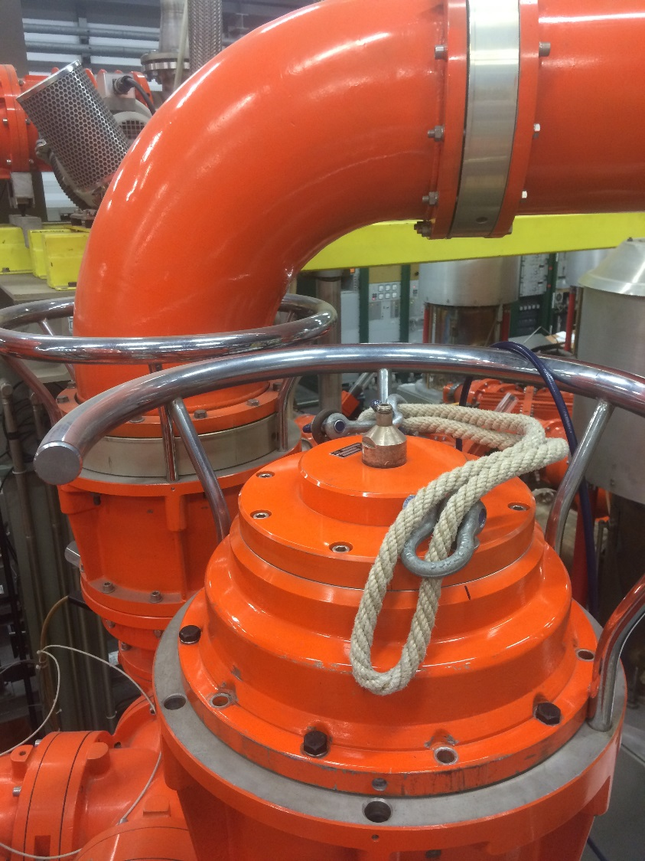
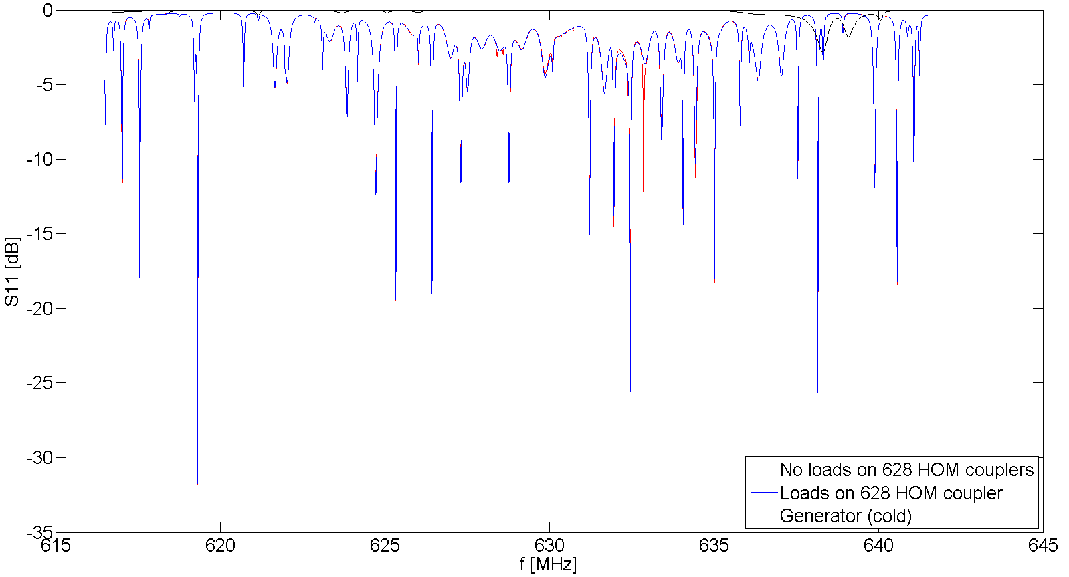
Goal 1: Measurement based verification
Highlights
Feeder line & fundamental power coupler
-1 dB
-2 dB
Idea and suggestions:
F. Caspers
Generator: Full reflection
Feeder line contribution to damping is limited
Generator: Full reflection
No difference with installed 628MHz loads

Slide 7
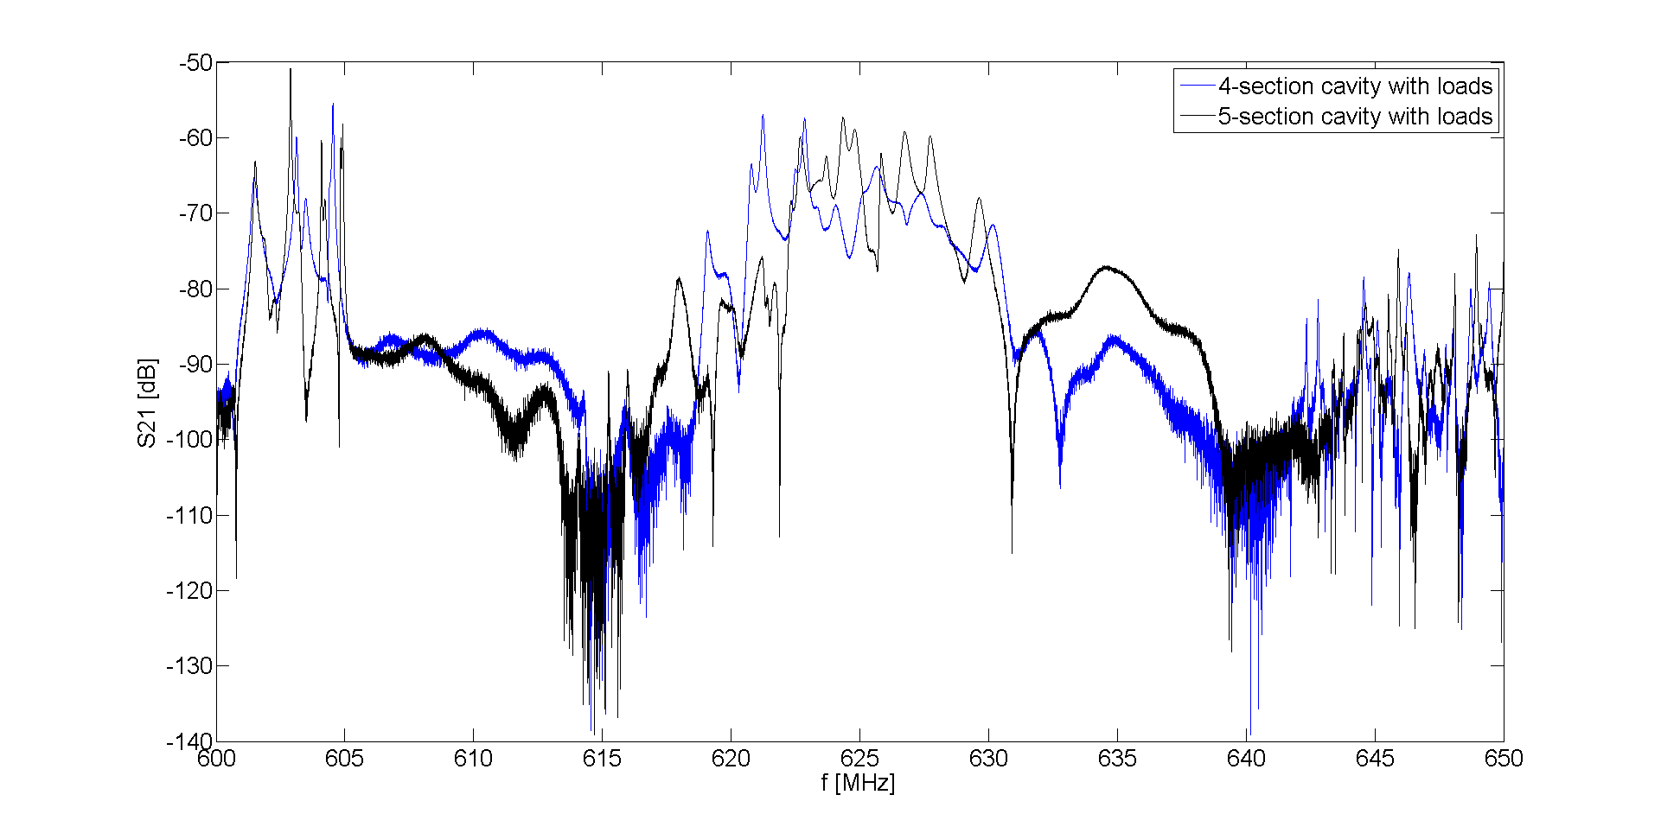
Goal 1: Measurement based verification
Highlights
4-section cavity vs. 5-section cavity
Less damping in 5-section for some modes
632-638 MHz region better damped?

Slide 8
Goal 1: Measurement based verification
Measurements with beam
4 cables available (Tunnel → Faraday cage) (R. Calaga)
1 central LLRF field pickup loop per cavity
(Usage: TBD with T. Bohl)
Measurement program: in preparation

Slide 9
Goal 2: Further reduction of HOM impedance
Currently installed 628 MHz HOM dampers work very well
Damper location in the cavity already optimal
Some solutions were tried to reduce impedance:
Complex load instead of 50 Ω load
Installing more HOM couplers
→ Improvement 10-30 %
More elaborate solutions are being looked into
In collaboration with MEPhI, Russia (Ya. Shashkov)

Slide 10
Conclusions & Outlook
Goal 1: Measurement based verification
Large measurement set available for 4 & 5-section cavities as installed in tunnel
628 MHz HOM dampers work very well
Feeder line limited contribution to damping
→ Simulate a subset of measurements
→ Prepare measurement program with beam
Goal 2: Further reduction of HOM impedance
→ Studies ongoing

Slide 12
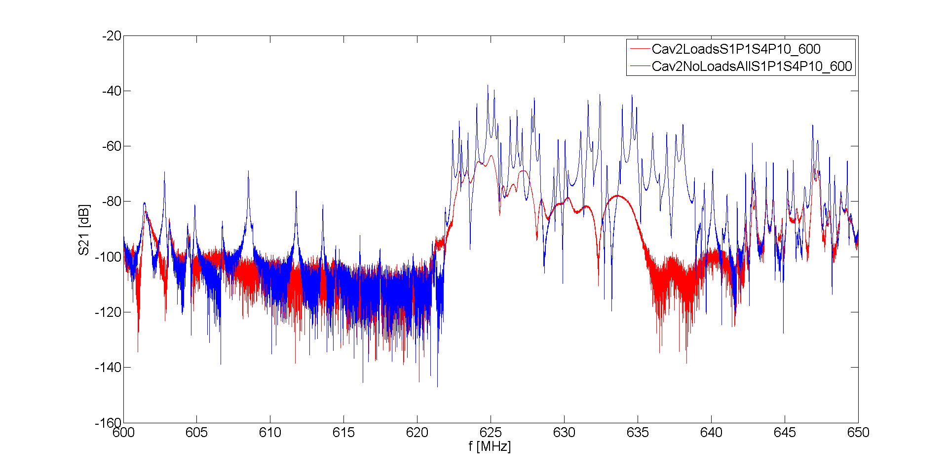
Goal 1: Measurement based verification
Highlights
628 MHz HOM dampers work very well
S1
S2
S3
S4

Slide 13
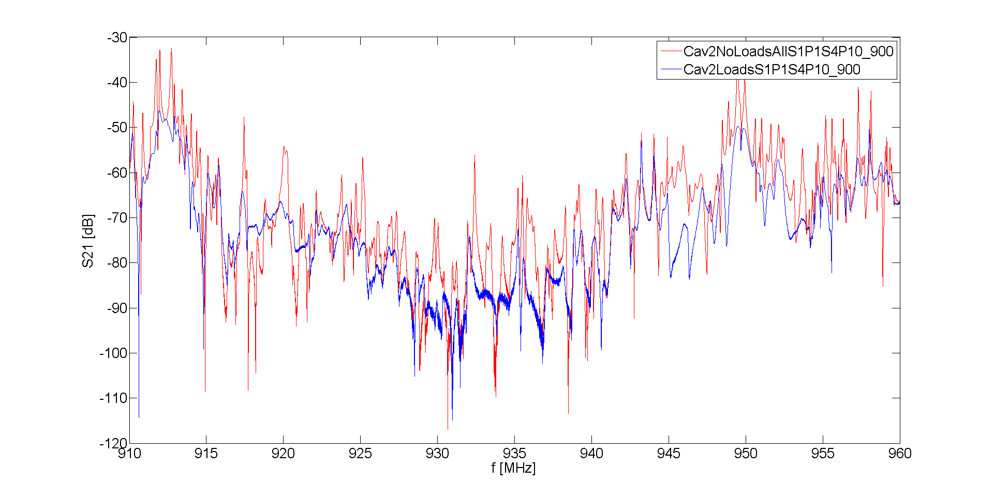
Goal 1: Measurement based verification
628 MHz dampers: Effect on 938 MHz
S1
S2
S3
S4

Slide 14
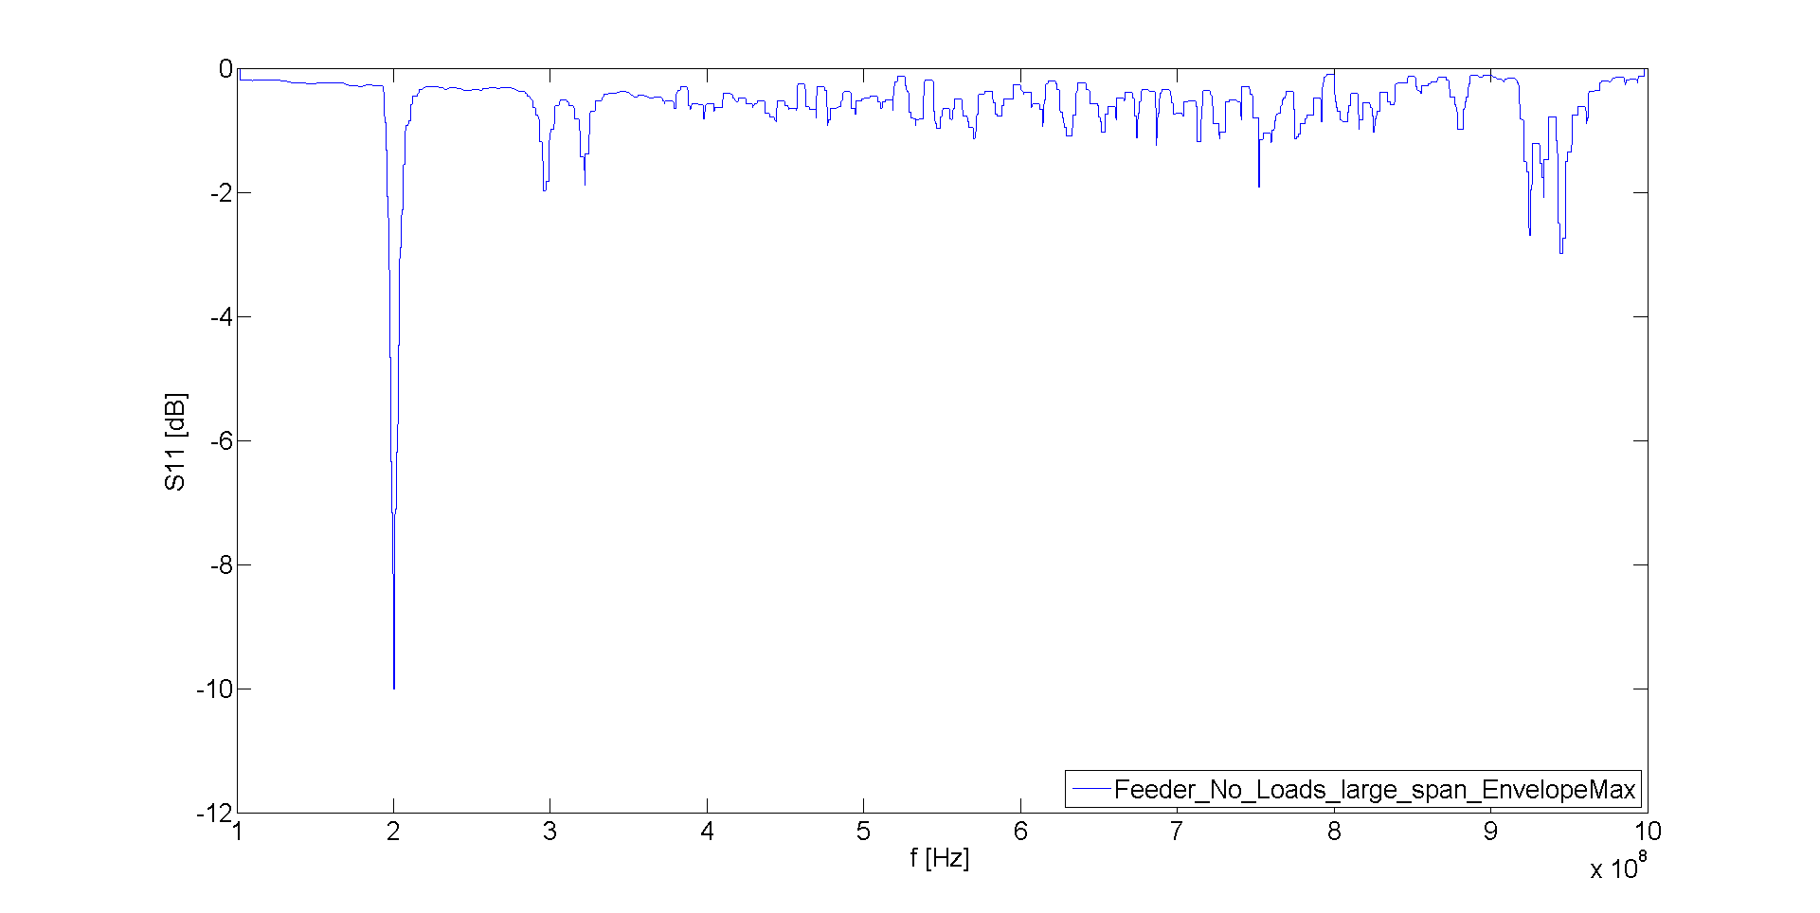
S11 on the feeder line: Cavity side
100 MHz
1000 MHz
2nd passband
628 MHz
FPC @ 200 MHz
938 MHz: Some dB loss

Slide 15
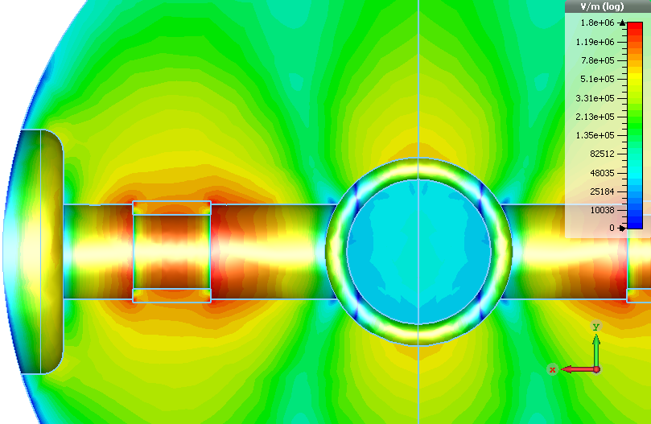
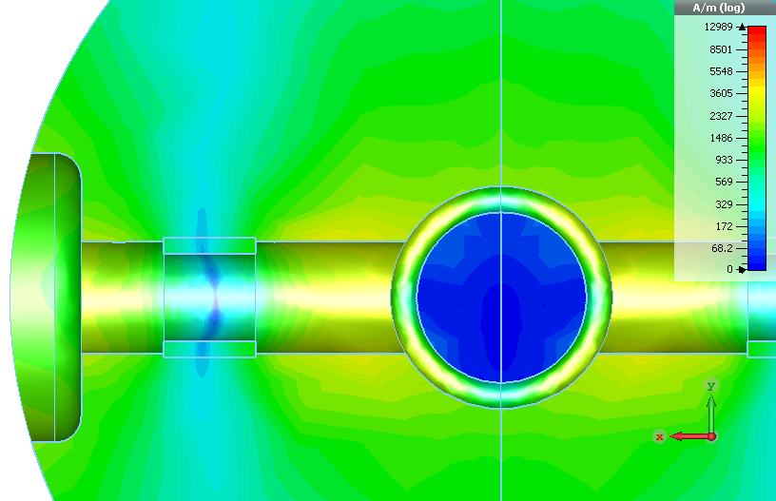
Alternatives for improved HOM damping (Ya. Shashkov)
Coax line in beampipe
with ferrite absorber
Specific ferrite
TT2-111R
HOM f-shift to reduce R/Q:
Antenna length / trimming the stems
Electric field
Magnetic field

