Slide 1
Beam simulations for situation after the RF upgrade s LIU-SPS Beam Dynamics Working Group 17/03/2015
A. Lasheen, J. Repond, E. Shaposhnikova

Slide 2
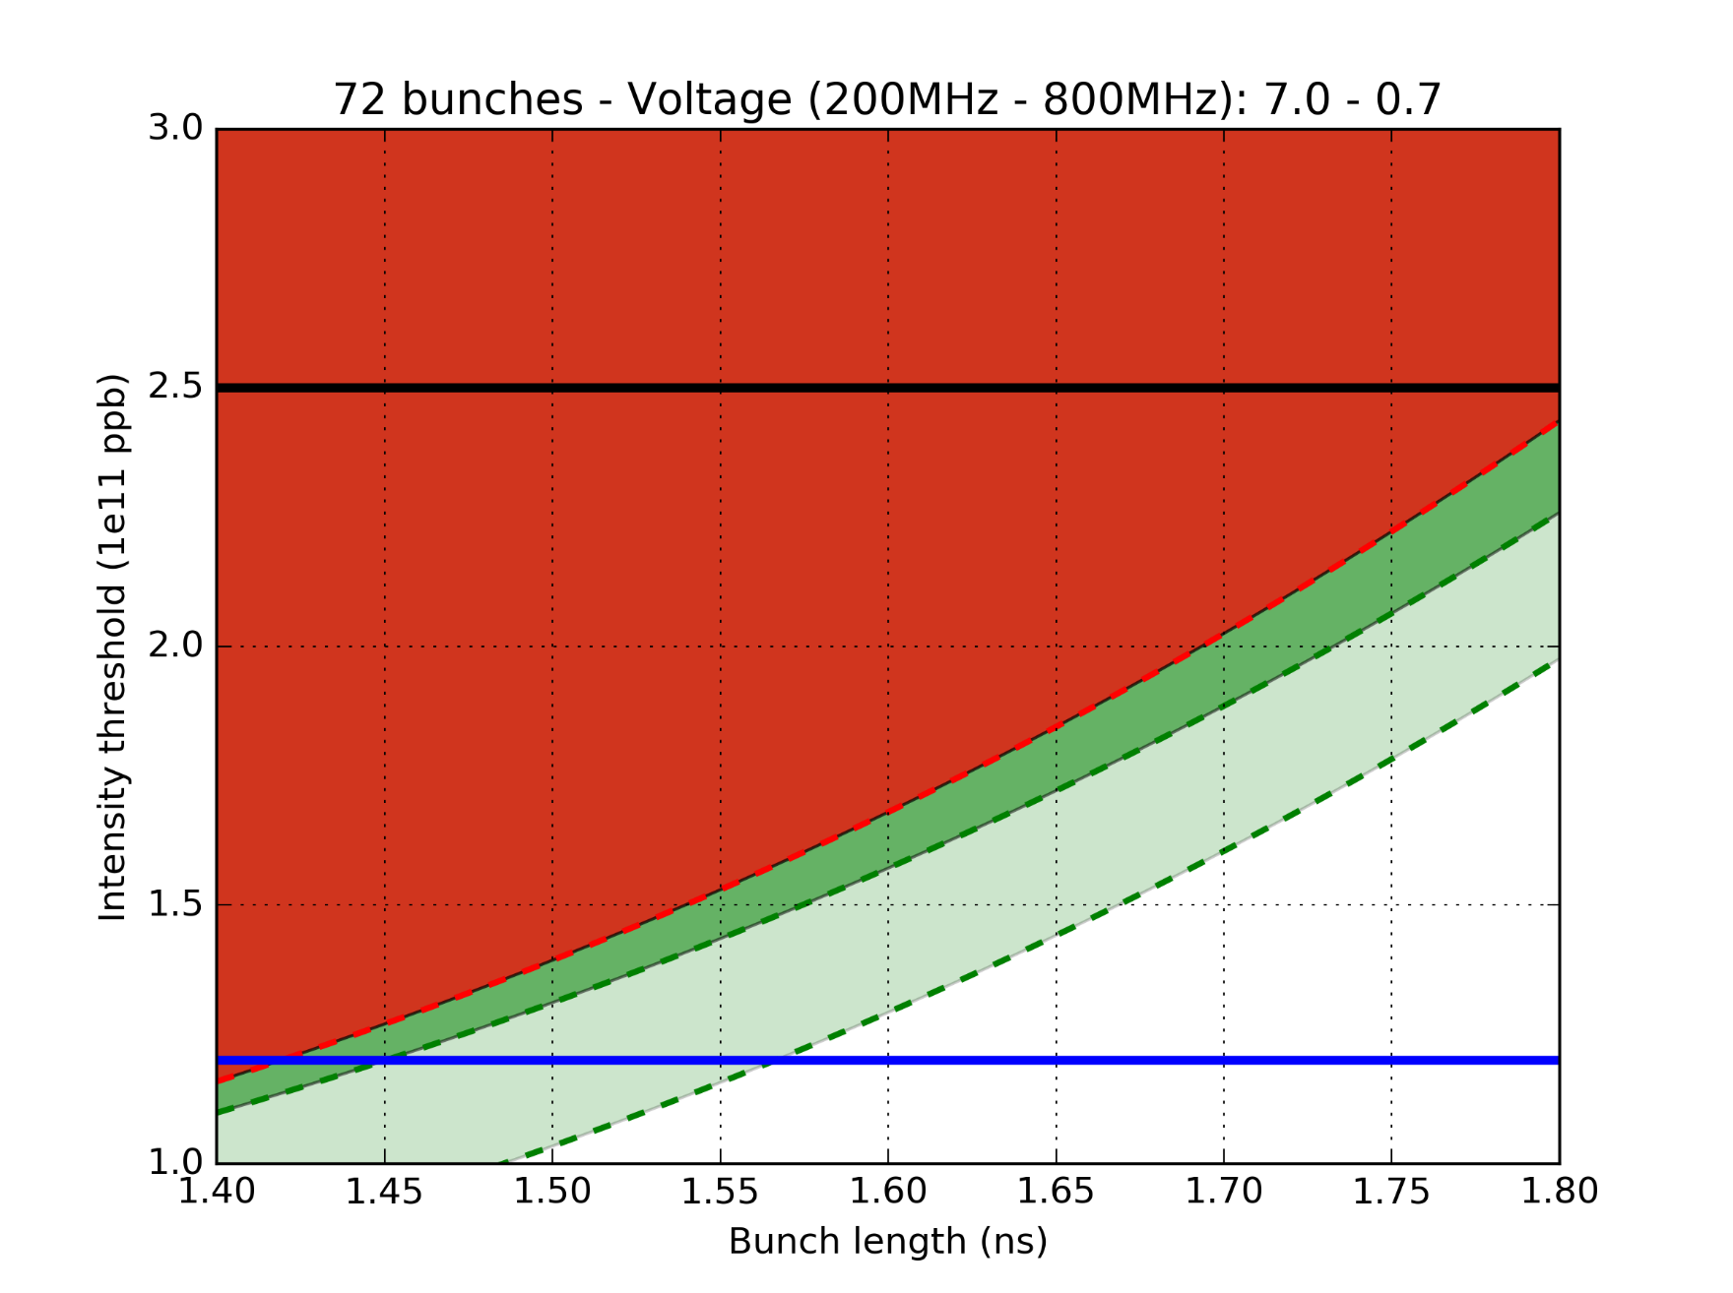
Simulations with 72 bunches
72 bunches measured instability threshold (2012)
SPS goal
(before scraping)
Impedance reduction gain (“realistic” impedance reduction):
1: LIU baseline (Shielded QF type flanges and HOM 630MHz damping by a factor 3)
2: (1) + additional reduction of MKP (R divided by 2)
2
1
1
Nominal LHC
2

Slide 3
Questions after 72 bunches simulations
Is there an impedance in the model that was overlooked, but that is dominant for 72 bunches ?
How different would the beam stability be after the RF upgrade ? What about the impedance reduction gain ?
What would happen for realistic impedance reduction cases ?

Slide 4
Outline
Impedance model
Main contributions
Assumptions made to compute the 3 sections TWC200 impedance
Assumptions made to evaluate the flanges impedance reduction for more realistic cases
72 bunches simulations at 10 MV
Ideal case with complete removal of impedance contributions
Realistic cases with further HOM damping
Realistic cases without further HOM damping

Slide 5
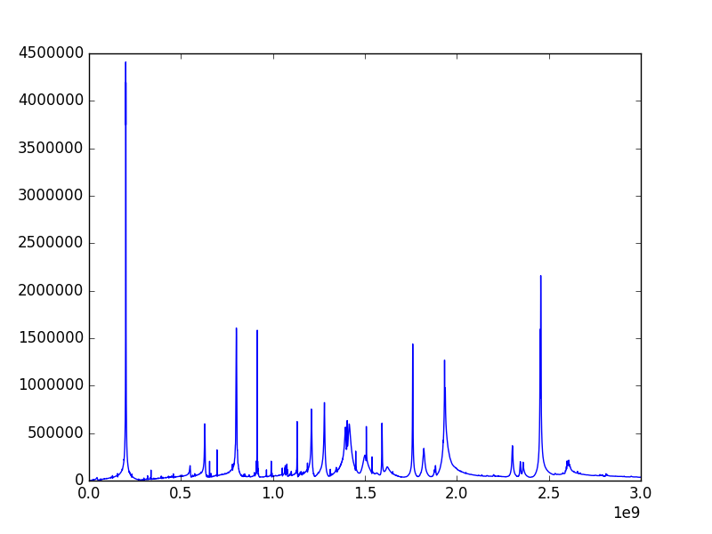
Main contributions to the impedance model
HOM 200MHz cavity
BPV-QD flanges
BPH-QF flanges
MBA-QF & QF-QF closed with bellow
Abs(Z) (Ohm)
Freq (Hz)
Unshielded pumping ports

Slide 6
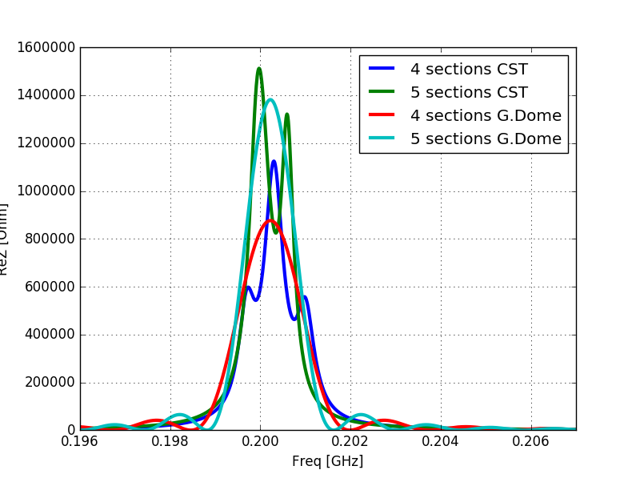
TWC200 impedance after upgrade
The TWC200 impedance was computed from:
Wakefield CST simulations
G. Dôme (CERN-SPS/ARF/77-11, 1977)
See previous talks from J. Varela and H. Timko

Slide 7
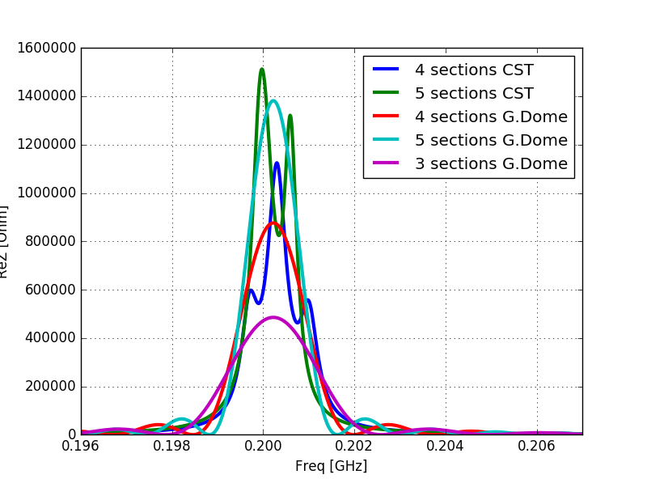
TWC200 impedance after upgrade
The 3 sections TWC impedance was estimated following the same reasoning (CST simulations and studies ongoing, see T. Roggen’s slides)

Slide 8
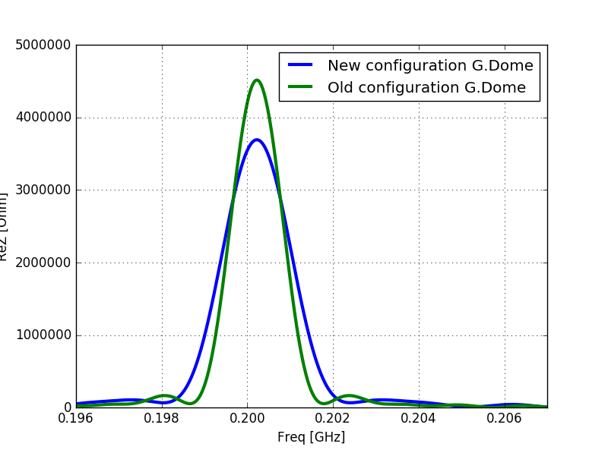
TWC200 impedance after upgrade

Slide 9
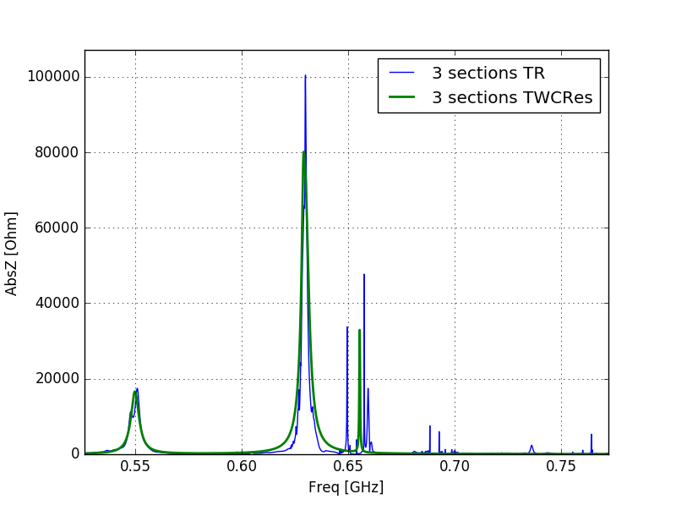
TWC200 impedance after upgrade – HOM
!! PRELIMINARY !!
Assumptions made to scale down the HOM from 4 to 3 sections cavity (result in green):
- Keeping R/Q constant
Reducing R by ~40% (ratio for the main harmonic)
This was compared with T. Roggen’s early simulations for 3 sections (in blue) to check if the assumption was not too bad, but this still needs to be refined.

Slide 10
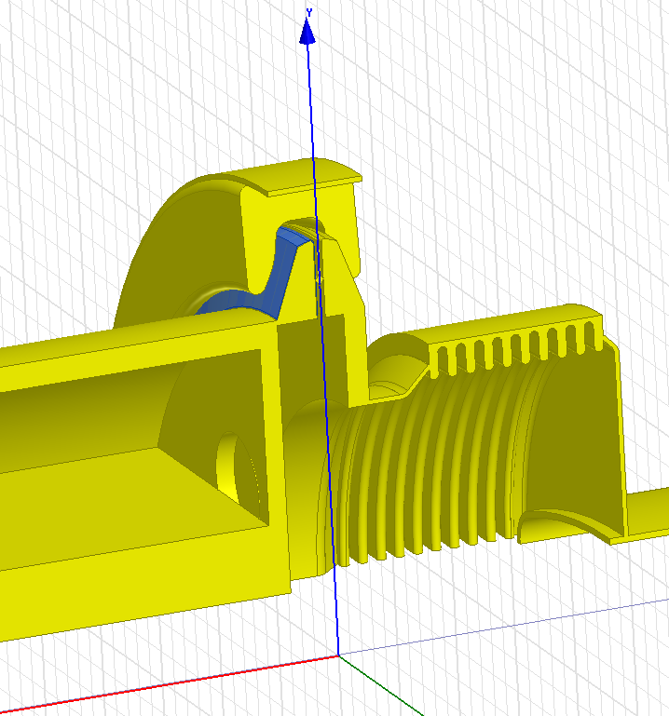
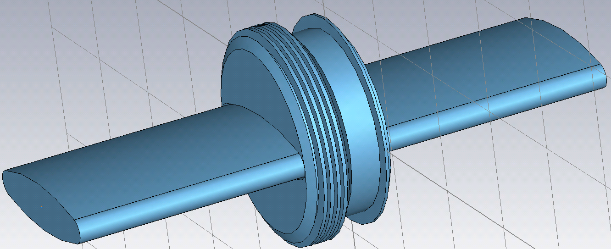
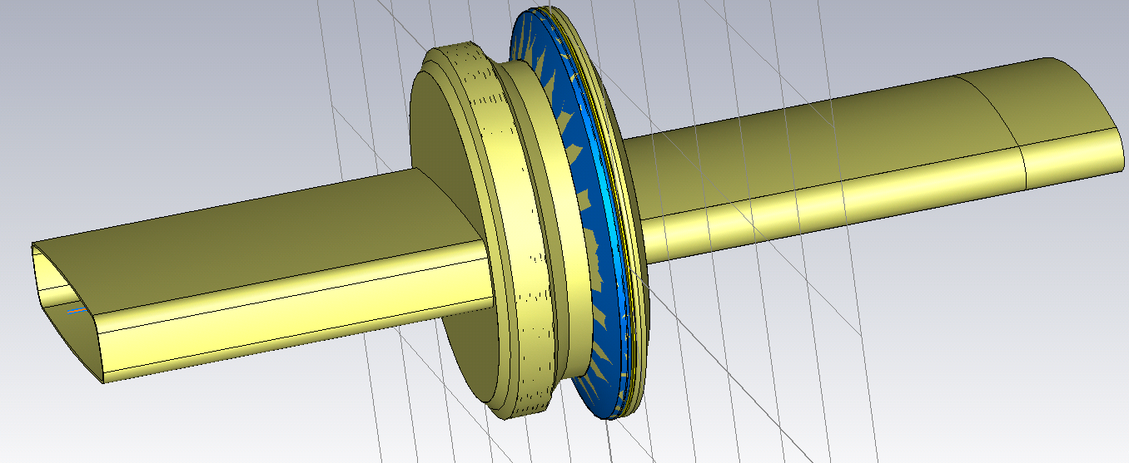
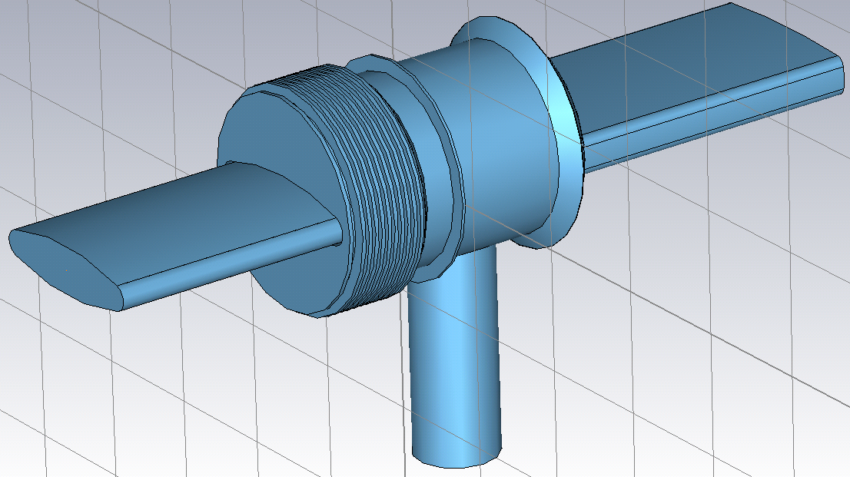
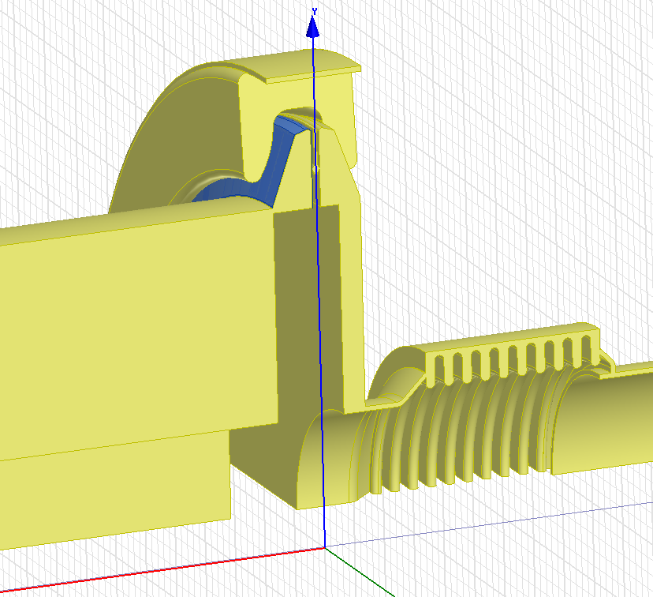
More realistic assumptions for impedance reduction
Baseline
Non-enameled QF - QF => 27
(No bellows => 21 )
Enamelled QF - MBA => 82
MBA - MBA => 14
Non-shielded, enameled BPH - QF => 40
+ 64 already shielded
Non-baseline
Non enameled Unshielded pumping ports => 17
(+ special locations)
Enamelled BPV - QD ≈ 90

Slide 11
Flanges impedance reduction design
Used in beam dynamics simulations as “shielded model”
J. Varela
SPS upgrade meeting
21/05/2015

Slide 12
More realistic assumptions for impedance reduction
The following arguments were used to narrow down the number of cases to simulate
Enamelled flanges:
In case they should remain insulated, a shielded design should be simulated
Non enamelled flanges and pumping ports:
Short-circuited, impedance should be close to 0
BPH-QF:
~2/3 were already shielded, the remaining may be shielded in the same way and reduce impedance close to 0
BPV-QD:
Not in the baseline, but the impact was evaluated in beam dynamics simulations to see if anything should be done about them

Slide 13
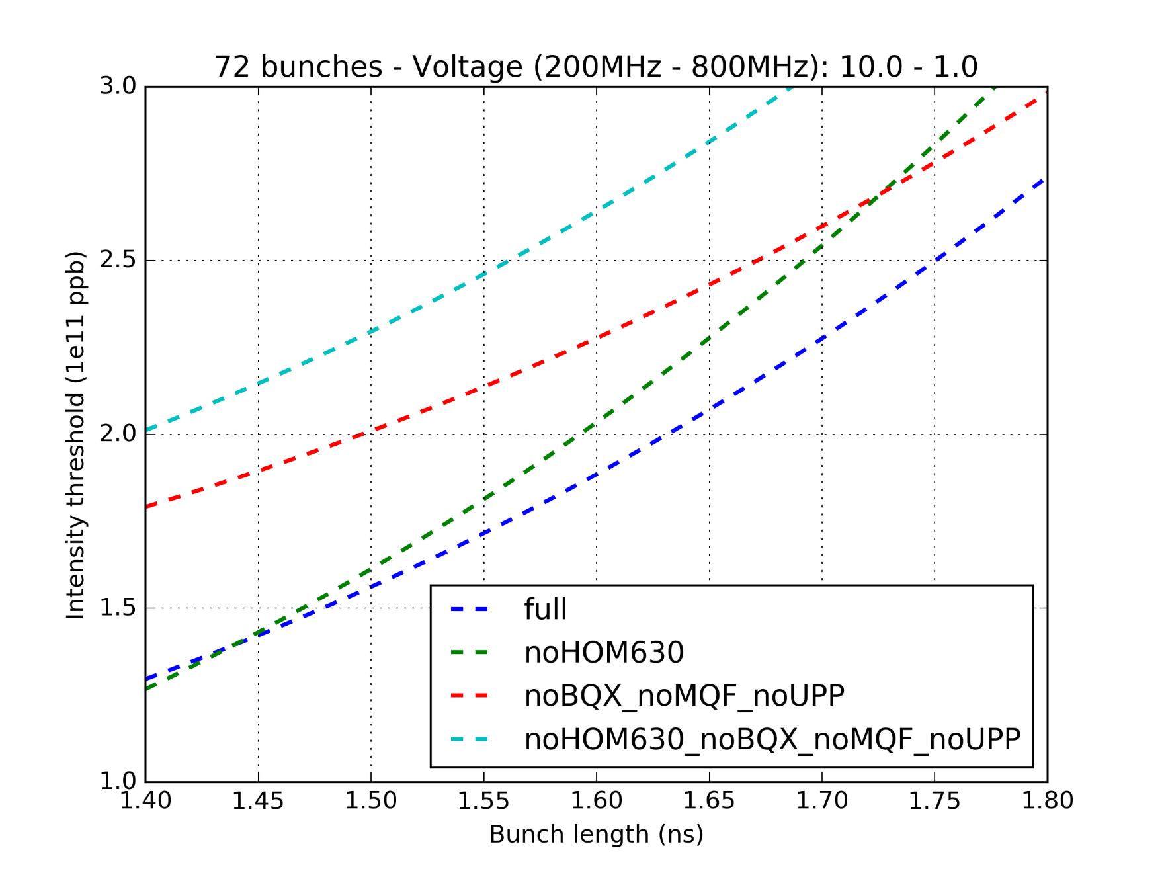
Simulations with 72 bunches – 10 MV
Voltage : 10 MV
Expected with beam loading after RF upgrade (a more accurate evaluation depending on intensity will be included in the future)
LIU

Slide 14
Simulations with 72 bunches – 10 MV
Impedance reduction gain (complete removal, baseline):
BQX = BPV-QD and BPH-QF
MQF = MBA-QF and QF-QF closed with bellow
UPP = Unshielded pumping ports (17/42 will be shielded, other are special positions)
LIU

Slide 15
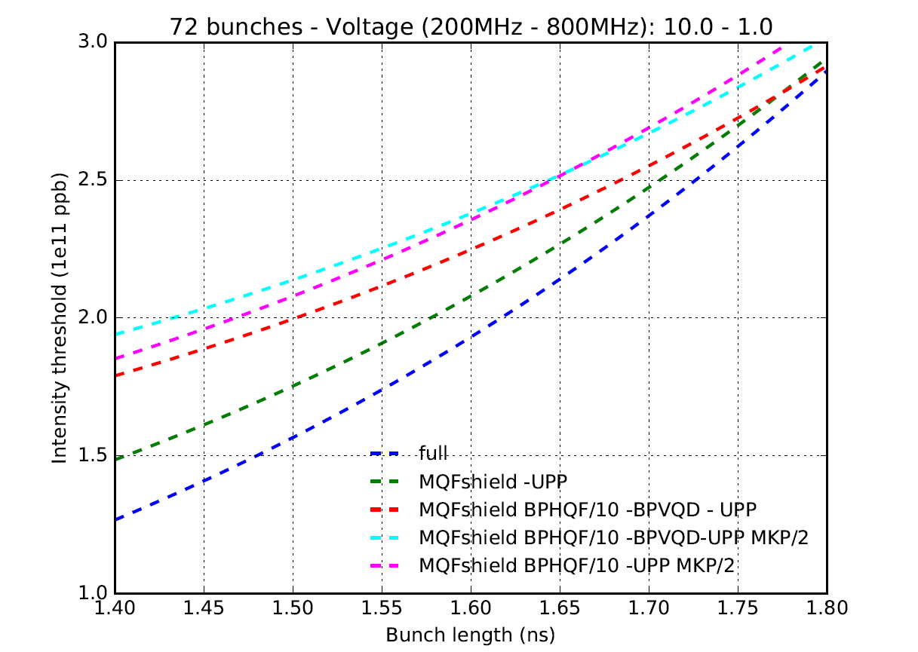
Simulations with 72 bunches – 10 MV
LIU

Slide 16
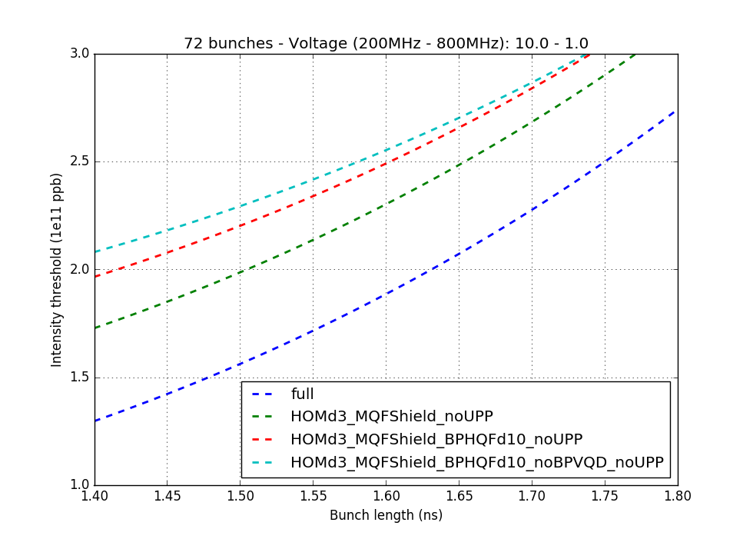
Simulations with 72 bunches – 10 MV
LIU

Slide 17
Conclusions and future work
Simulations were ran at 10 MV and showed that, to our current knowledge, the gain from impedance reduction would allow us to reach the LIU baseline, but with a very thin margin.
The impact of a more realistic beam distribution and simulations through the ramp should be studied (not possible yet with the current simulation time)
The future updates of the impedance model will be gradually implemented and tested (more realistic TWC model, better model for the HOMs and damping possibilities, better estimations of Q from the measurements for the flanges impedance,…)
A better implementation of how the beam loading is compensated in operation is of concern (feedback, power limitation, cavity controller…)

