Slide 1
LIU-SPS BD-WG Measurements and EM simulations for vacuum flanges Thomas Kaltenbacher with help of Christine Vollinger and Fritz Caspers

Slide 2
Outline
Simulation Models – New Strategy
Simulation Vs. Measurements – Problems and Verification
Further Steps

Slide 3
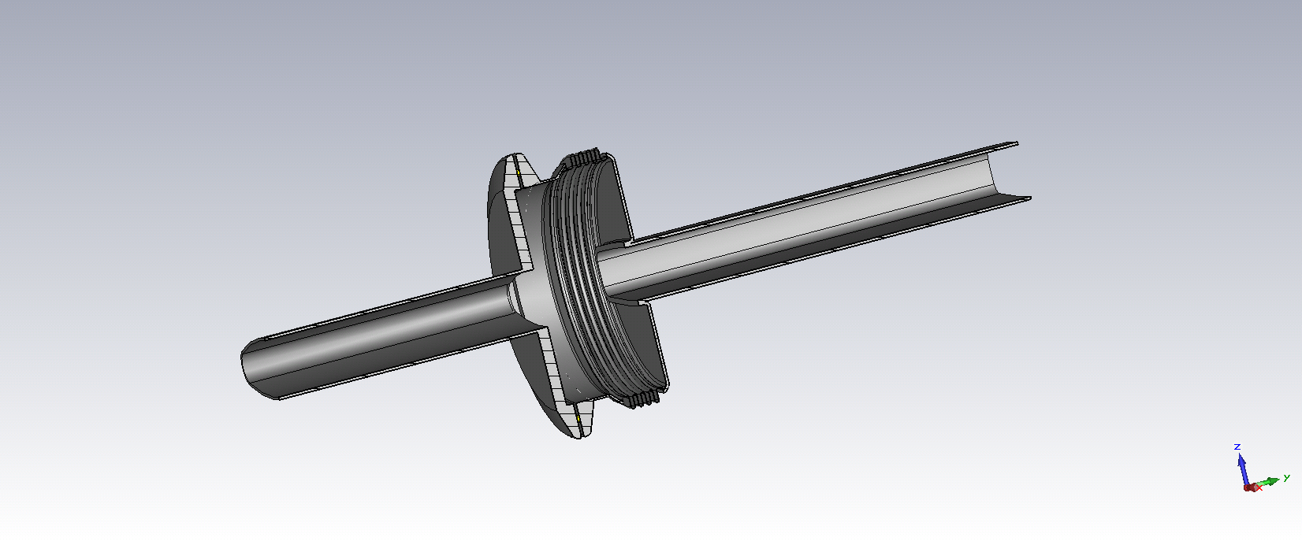
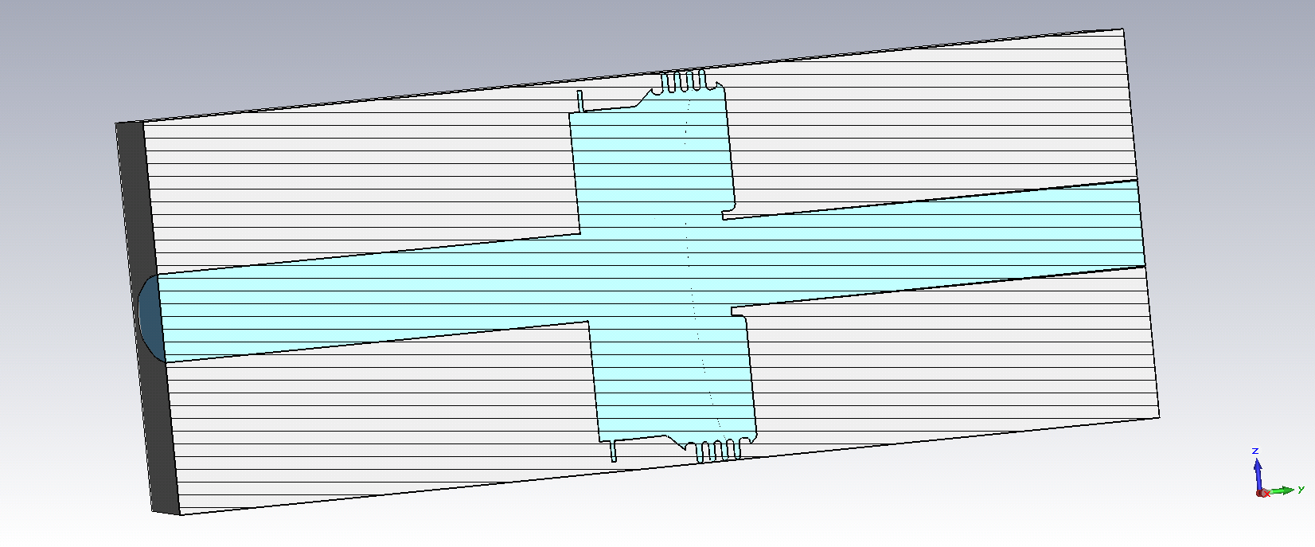
Simulation Models
Change in strategy: simulation models are no longer built by ourselves but directly imported from CATIA (if available);
Complexity of the model reduced, if necessary;
Traceability will be ensured; creation of simulation model database of SPS devices (EDMS).

Slide 4
Some Confirmed Assumptions
Assumptions in the current impedance model:
MBA/QF and QF/QF are identical
Enamelled QF/MBA and MBA/MBA are identical
Flanges with 4 convolution bellows were investigated.
Note: Non-Enamelled flanges were checked so far.
Interface | Mode [GHz] | R/Q [Ω] | Q0 [-]
QF/QF | 1.406 2.402 | 79.10 13.75 | 1977 1787
MBA/QF | 1.409 2.408 | 80.45 13.80 | 1998 1823
MBA/MBA | 1.401 2.349 | 81.55 14.60 | 1909 1677
R/Q [Ω]
79.10 13.75
80.45 13.80
81.55 14.60
Note: Simulated values.

Slide 5
Simulation Vs. Measurements I/II
Current impedance model requires verification
f [GHz] | Q
1.400 | 1750
The measured Q0 values are systematically smaller than the simulated ones (approx. factor of 3)
In simulation: Inputs were cross checked (e.g. conductivity of stainless steel)
In measurement: Methods and material is investigated
QF/MBA 4 conv. Bellow (non-enamelled) | Res. Freq. [GHz] | Q0 [-]
Measured | 1.398 | 710
Simulated | 1.407 | 1977

Slide 6
Simulation Vs. Measurements II/II
Device | QF/MBA 4 conv. Bellow (non-enamelled) | Res. Freq. [GHz] | Q0 [-]
MBA 4 conv. Bellow QF no bellow | Simulated | 1.390 1.576 | 1987 527
MBA 4 conv. Bellow QF no bellow | Measured | 1.376 1.506 | 516 130
Scaling factor
3.77
3.98
The discrepancy is mainly attributed to contact resistances and RF leakage (gasket and welds)
To reduce complexity, devices were closed with a blind flange.
Further investigation is needed; better material is requested

Slide 7
Further Steps
Identify missing impedances in the current model (e.g. cross section changes/devices which have not yet been included)
Continue verification of the existing model.

Slide 8
The End
THANK YOU!

