Slide 1
The SPS Transverse Damper
Performance during 2015 Ions Operation
G. Kotzian
BE-RF-FB, 07. January 2016 LIU-SPS BD WG
http://paf-spsu.web.cern.ch/paf-spsu/

Slide 2
Outline
Objective:
Show how the damper was used in 2015 with Ions,
illustrate the intricacies due the ion specific RF modulation (FSK),
and sketch the performance obtained for the 2015 configuration.
Structure:
Damper configuration for Ions in 2015
Fixed Frequency Acceleration in the SPS
Rough summary of damper performance in 2015

Slide 3
Recap: Transverse Feedback System
The transverse damper is a feedback system: it measures the bunch-by-bunch oscillations and damps them by fast electrostatic kickers.
BPM
Kicker
5ns Bunches
Active closed loop feedback
Analog
Front
End
Signal
Processing
BBQ
SUM
ADC
DAC
Power Amp
transverse
position
pre-processed
sampled
position
calculated
correction data
correction
signal
drive signal

Slide 4
SPS Damper Loops
pLHC
RF Frontend
200 MHz
ADC1
BeamPos1
DSPU1
DAC1
Switch M1
Damper Signal Selector
pLHC
BeamPos2
DSPU2
Switch M2
ADC2
DAC2
pLHC
cfv-ba2-alltrdamp[hv]1
SPS Damper Loops
pFT
Baseband Frontend
ADC1
BeamPos1
DSPU1
DAC1
pFT
ADC2
BeamPos2
DSPU2
DAC2
pFT
from BBQ
SPS Damper Loops
Ions
RF Frontend
200 MHz FSK
ADC1
BeamPos1
DSPU1
DAC1
Ions
ADC2
BeamPos2
DSPU2
DAC2
Ions
cfv-ba2-alltrdamp[hv]2
from VNA
SPS Damper Loops
Scrub
Baseband Frontend
(40 MHz)
ADC1
BeamPos1
DSPU1
DAC1
Scrub
from VNA
ADC2
BeamPos2
DSPU2
DAC2
Scrub
Stripline pickup
processing
BPM
Proc.
BPM
Proc.
pLHC,
Scrub
Ions
PLC1
PLC2
200 W
Driver
200 W
Driver
SURFACE BA2
TUNNEL LSS2
2015 SETUP:
- pLHC Module
- at injection
- 1 Damper in H
pFT
Damper Power System
Electrostatic PU processing
BW ~100MHz
BPM
Proc.
BPM
Proc.
Final
Stage
Final
Stage
BEAM
PU1
PU2
KICKER1
KICKER2

Slide 5

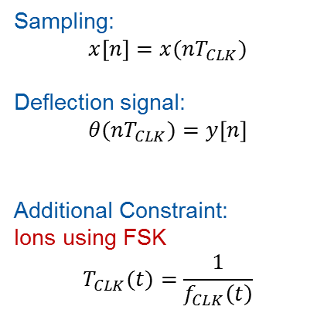




Key Parameters for Ions operation
Key Parameters:
  PU sampling delay (analogue to digital conversion)
  Kicker output delay (digital to analog conversion)
Fiber Link
In 2015: common clocks for ADCs and DACs
Clock Gen.
TX
RX
BA3
BA2
$$x[n]$$
Controller
$$y[n]$$
Transport delay ~9.535 us
Sampling:
$$x\left[n\right]=x(nT_{CLK})$$
Deflection signal:
$$θ(nT_{CLK})=y\left[n\right]$$
Additional Constraint:
Ions using FSK
$$T_{CLK}(t)=\frac{1}{f_{CLK}\left(t\right)}$$
Sensor
$$T_{CLK}$$
Actuator
Discrete-time
SAMPLING DELAY
OUTPUT DELAY
Continuous-time
Beam
$$x\left(t\right)$$
$$θ(t)$$
  In other words: discrete-time samples are not equally spaced due to RF modulation (FSK)

Slide 6



















RF Modulation: FSK (Frequency Shift Keying)
$$\frac{n}{4620}$$
$$1.0$$
Proton Beam
NB: FSK technique is a result of
Fixed Frequency Acceleration (FFA)
Ions (BA3)
$$0.9$$
Ions (BA2)
$$0.8$$
FSK in BA2 shifted w.r.t. BA3 by transport delay ~9.535 us (Fiber Link)
$$0.7$$
$$0.6$$
Worst case slippage (50 % delay):
$$\left(\frac{4653}{4620}−1\right)T_{REV}=166 \text{ns}$$
➔ More than 6x 25ns periods
$$0.5$$
Signal Processing Time (normalized)
$$0.4$$
$$0.3$$
$$0.2$$
SOLUTION:
Additional delay by means
of local fibers in BA2 (~10us)
$$0.1$$
NB: NOT IN SCALE!
$$\frac{t_{BEAM}}{T_{REV}}$$
$$0.0$$
$$0.1$$
$$0.2$$
$$0.3$$
$$0.4$$
$$0.5$$
$$0.6$$
$$0.7$$
$$0.8$$
$$0.9$$
$$1.0$$
Beam Revolution Time (normalized)

Slide 7
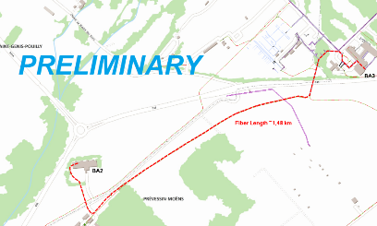
Ions (for implementation
in 2016):
4 different delays for
pick-up and kicker (ADC/DAC) clocks
200 MHz LO
200 MHz RF
Protons
120 MHz
ADC/DAC
BPCR.221
f_{rev}
10 MHz ref

Slide 8
Example: Damping Performance 2015
Damping times:
HORIZONTAL→ roughly 1ms
VERTICAL → roughly 1ms

Slide 9
Observations / Damper Performance 2015
  Proton dampers successfully operated with ions!
  → operation problematic due to inherent FSK
  Beam position sampling: shifted
    “Sliding” → bunches assigned to wrong bucket in the signal processing
    Due to shifting a correct tagging not possible
    → the signal processing “sees” more than 2x12 bunches
  Feedback correction signal: shifting for subsequent injections
    Degraded injection damping for batches [5, 6] as well as [11, 12]
  For most of the Ion run damper was deactivated after 11th injection
    Active damping only at flat bottom (no feedback during ramp)
  One horizontal damper used
    Feedback phase arbitrarily detuned by +20 deg
    → erratic beam losses during acceleration when using optimum feedback phase (although damper off)

Slide 10
THANK YOU
Questions?

