Slide 1
Latest results of ramp simulations for 72 bunches s LIU-SPS Beam Dynamics Working Group 04/08/2016
J. Repond

Slide 2
Outline
Motivations
High frequency noise
Blow-up implementation
Conclusion and future work

Slide 3
Motivations
Ramp simulation important to reproduce measurement.

Slide 4
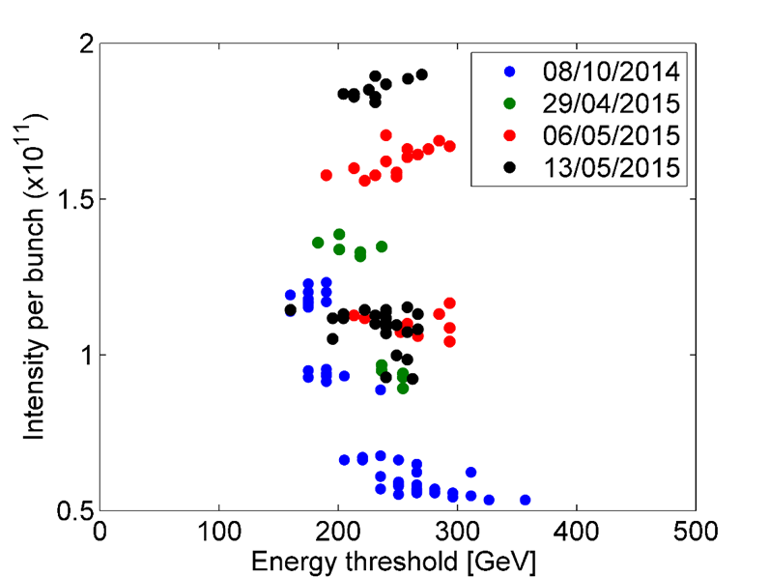
Motivations
Ramp simulation important to reproduce measurement.
Theoretically $I_{th}∼\frac{1}{E}$.
Here, sharp energy threshold w.r.t. intensity.
Still not fully understood.
SPSU meeting, T. Argyropoulos 21 May 2015

Slide 5
Motivations
Ramp simulation important to reproduce measurement.
Possible optimisation of the RF program.

Slide 6
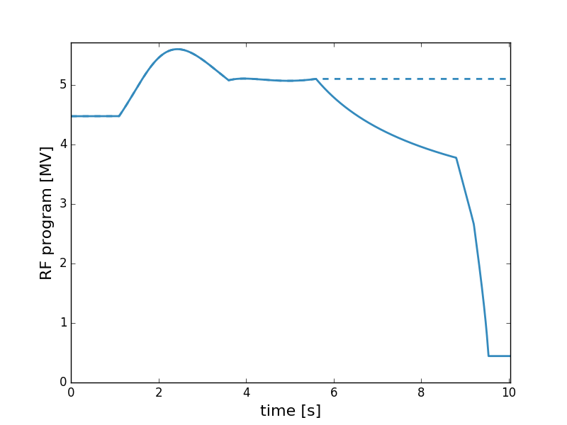
Motivations
Ramp simulation important to reproduce measurement.
Possible optimisation of the RF program.

Slide 7
Motivations
Ramp simulation important to reproduce measurement.
Possible optimisation of the RF program.
Preliminary results exhibit two issues
Blow-up needed to explore larger emittance

Slide 8
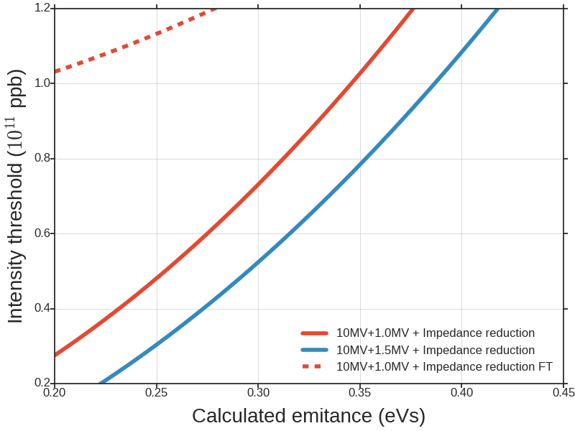
Motivations
Ramp simulation important to reproduce measurement.
Possible optimisation of the RF program.
Preliminary results exhibit two issues
Blow-up needed to explore larger emittance.
$A≈0.6 eVs$ at flat bottom.
Emittance conserved if stable.

Slide 9
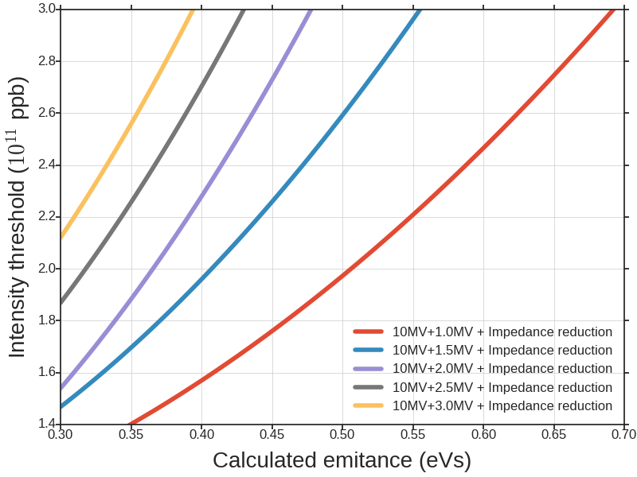
Motivations
$I_{thr}$ at FT should be the limiting factor ($I_{thr}∼1/E).$
FT 450 GeV
72 bunches
Ramp 450
72 bunches

Slide 10
Motivations
$I_{thr}$ at FT should be the limiting factor ($I_{thr}∼1/E).$
FT and ramp simulations do not overlap.
FT 450 GeV
72 bunches
Ramp 450
72 bunches

Slide 11
Motivations
$I_{thr}$ at FT should be the limiting factor ($I_{thr}∼1/E).$
FT and ramp simulations do not overlap.
Too short bunches unstable during ramp -> broad band inductive impedance of the SPS.
FT 450 GeV
72 bunches
Ramp 450
72 bunches

Slide 12
Motivations
$I_{thr}$ at FT should be the limiting factor ($I_{thr}∼1/E).$
FT and ramp simulations do not overlap.
Too short bunches unstable during ramp -> broad band inductive impedance of the SPS.
High ratio for the TWC800 does not stabilize during ramp.
FT 450 GeV
72 bunches
Ramp 450
72 bunches

Slide 13
Motivations
$I_{thr}$ at FT should be the limiting factor ($I_{thr}∼1/E).$
FT and ramp simulations do not overlap.
Too short bunches unstable during ramp -> broad band inductive impedance of the SPS.
High ratio for the TWC800 does not stabilize during ramp.
Number of slices and macroparticles reduced -> numerical issues ?
FT 450 GeV
72 bunches
Ramp 450
72 bunches

Slide 14
Motivations
Ramp simulation important to reproduce measurement.
Possible optimisation of the RF program.
Preliminary results exhibit two issues
Blow-up needed to explore larger emittance.
What is the noise’s effect on the stability threshold?

Slide 15
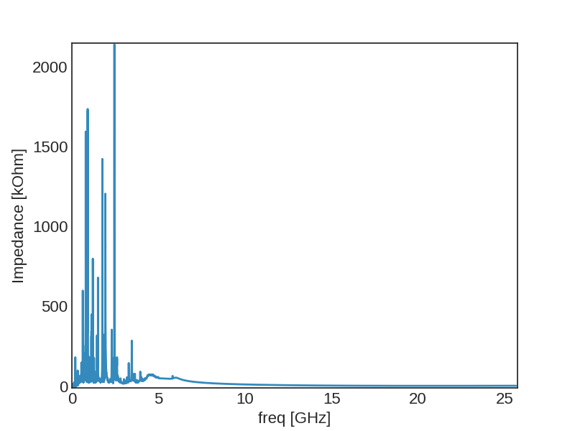
High frequency noise
No knowledge of impedance at high frequency (>5GHz).

Slide 16
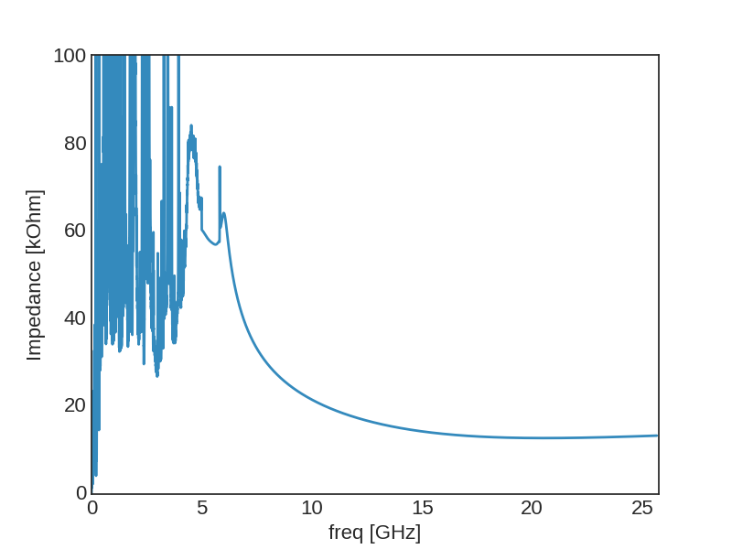
High frequency noise
No knowledge of impedance at high frequency (>5GHz)
Does not fall to 0 at high frequency because of kickers fit and broad-band inductive impedance.
$$∼ω^{−3/2}$$

Slide 17
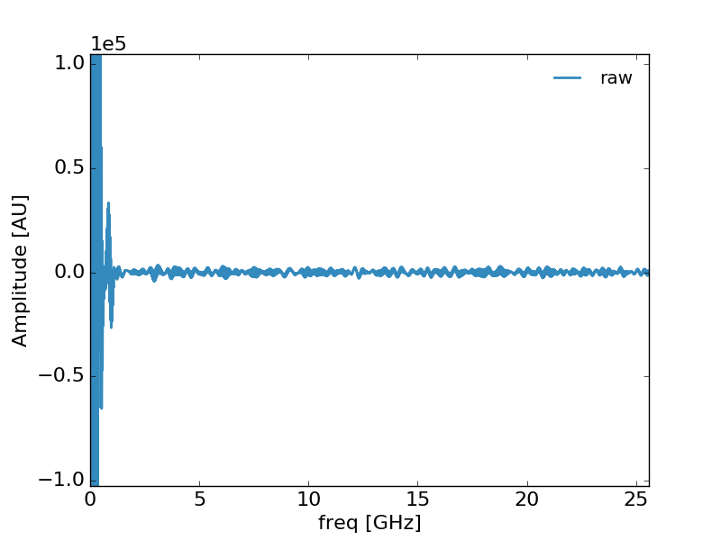
High frequency noise
No knowledge of impedance at high frequency (>5GHz)
Does not fall to 0 at high frequency because of kickers fit and broad-band inductive impedance.
Numerical noise on beam spectrum can be amplified

Slide 18
High frequency noise
Observation of the HF noise’s contribution by

Slide 19
High frequency noise
Observation of the HF noise’s contribution by
Setting manually to 0 the impedance after 5 GHz.

Slide 20
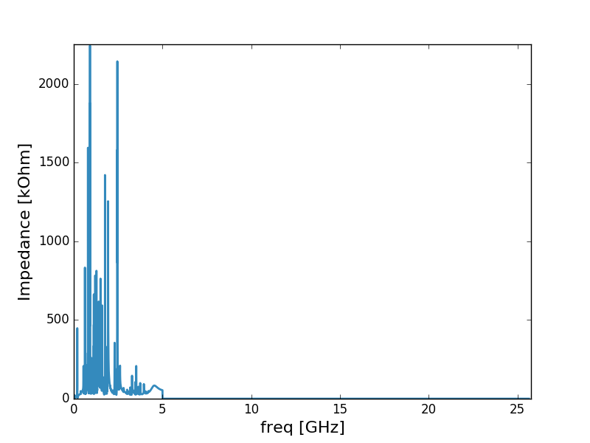
High frequency noise
Observation of the HF noise’s contribution by
Setting manually to 0 the impedance after 5 GHz.

Slide 21
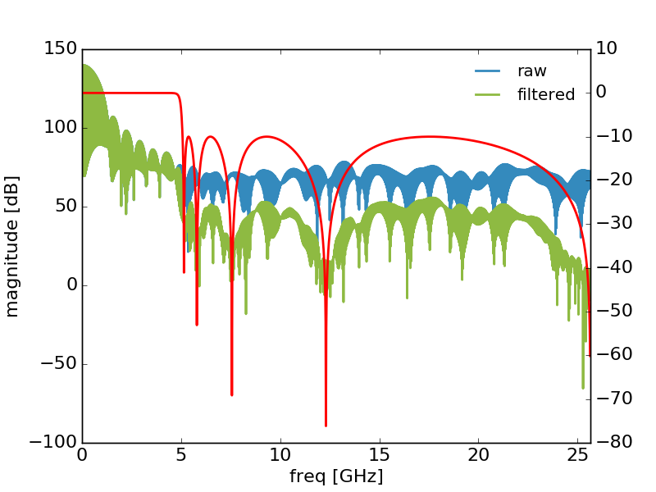
High frequency noise
Observation of the HF noise’s contribution by
Setting manually to 0 the impedance after 5 GHz.
Applying a filter on the beam spectrum.

Slide 22
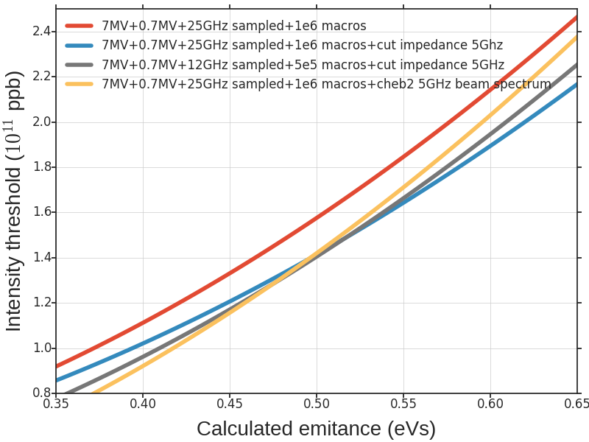
High frequency noise
High frequency noise stabilize the beam.

Slide 23
High frequency noise
High frequency noise stabilize the beam.
Different simulation’s parameters gives comparable results
Not a problem of convergence

Slide 24
High frequency noise
High frequency noise stabilize the beam.
Different simulation’s parameters gives comparable results
Not a problem of convergence
Cut and filter give also comparable results.

Slide 25
High frequency noise
High frequency noise stabilize the beam.
Different simulation’s parameters gives comparable results
Not a problem of convergence
Cut and filter give also comparable results.
Ongoing studies to determine the impact of the noise.
More macroparticles minimize the noise.

Slide 26
Blow-up implementation
Why blow-up in simulation?

Slide 27
Blow-up implementation
Why blow-up in simulation?
Compare to operation.

Slide 28
Blow-up implementation
Why blow-up in simulation?
Compare to operation.
Explore larger emittance.
FB 4.5MV, $A≈0.6eVs$.
FT 7MV, $A≈2.3eVs$.
If stable, emittance conserved.

Slide 29
Blow-up implementation
Based on operational values for reproduction purpose.

Slide 30
Blow-up implementation
Based on operational values for reproduction purpose
Band-limited noise added to the phase of the TWC200

Slide 31
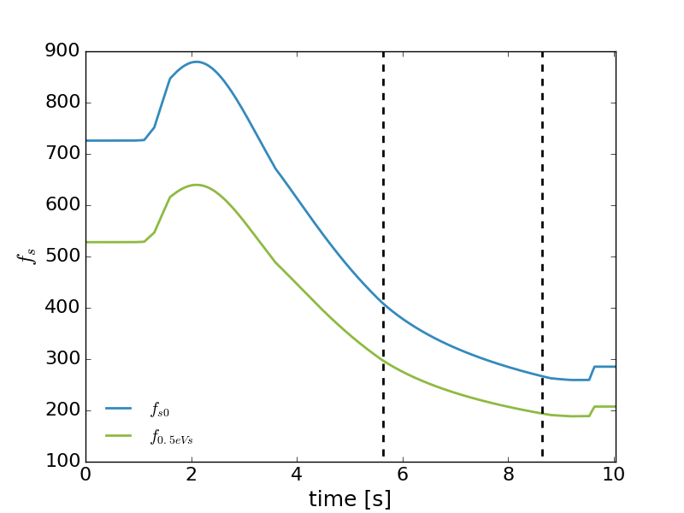
Blow-up implementation
Based on operational values for reproduction purpose
Band-limited added to the phase of the TWC200
Follows the synchrotron frequency.
${f_{s}}_{0}$evolution
during ramp

Slide 32
Blow-up implementation
Based on operational values for reproduction purpose
Band-limited noise added to the phase of the TWC200
Follows the synchrotron frequency.
Switched on during ramp as in operation.
$$t_{start}$$
$$t_{end}$$

Slide 33
Blow-up implementation
Based on operational values for reproduction purpose
Band-limited noise added to the phase of the TWC200
Follows the synchrotron frequency.
Switched on during ramp as in operation.
Pass-band in frequency to target the bunch’s core.
$${{f_{max}=f}_{s}}_{0}$$
$$f_{min}=f_{0.5eVs}$$

Slide 34
Blow-up implementation
Based on operational values for reproduction purpose
Band-limited noise added to the phase of the TWC200
Follows the synchrotron frequency.
Switched on during ramp as in operation.
Pass-band in frequency to target the bunch’s core.
Triangular spectrum with maximum frequency $f_{s0}$ and minimum $f_{s_{0.5eVs}}$.

Slide 35
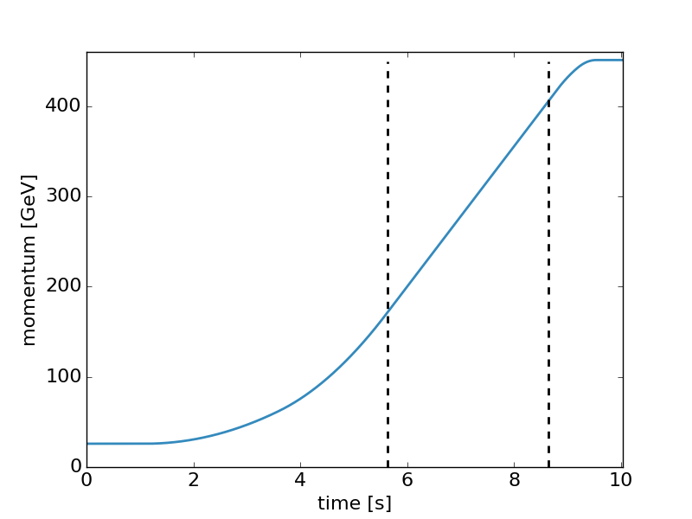
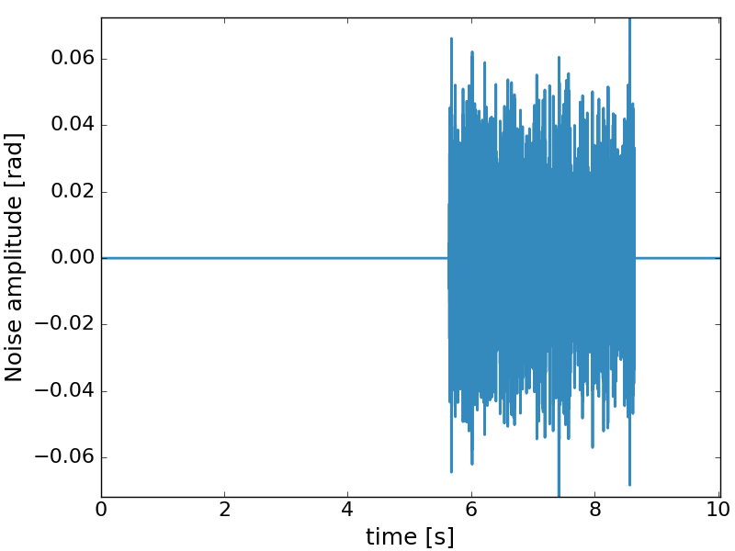
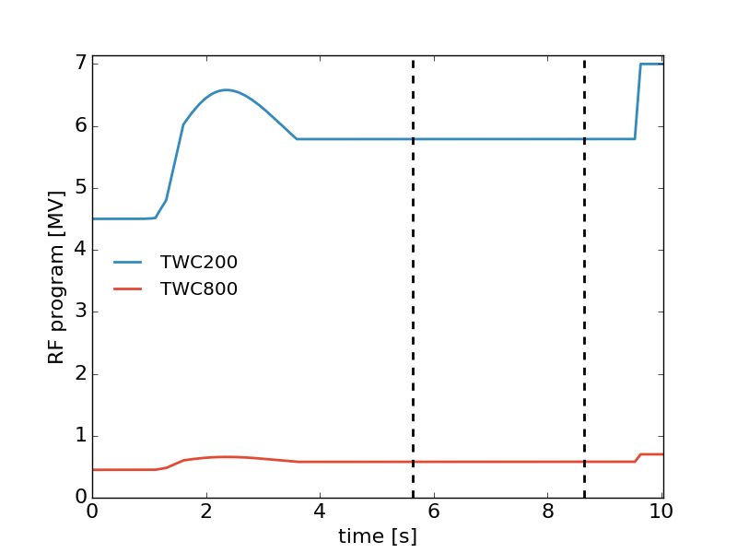
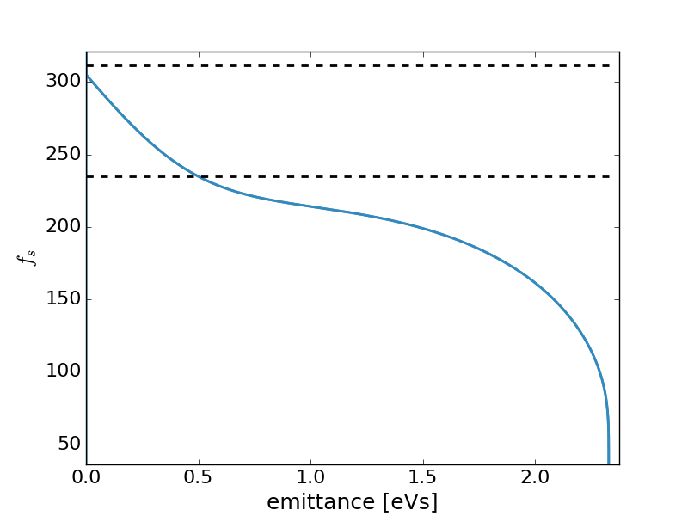
Blow-up implementation

Slide 36
Blow-up implementation
For the moment only tested through ramp with 12 bunches and an arbitrary amplitude of the noise with a flat spectrum (too high)

Slide 37
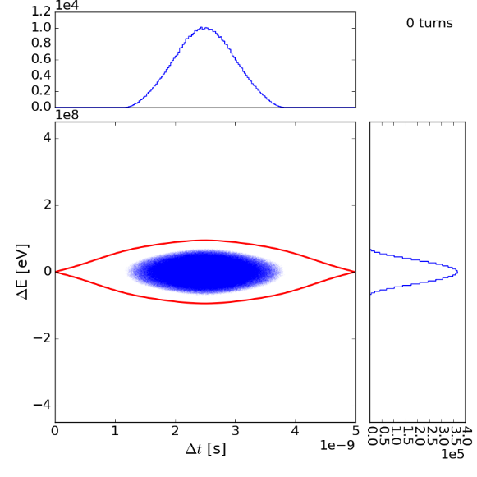
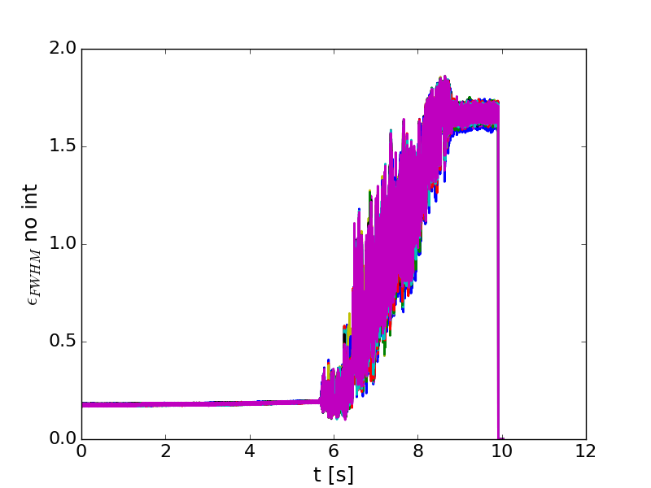
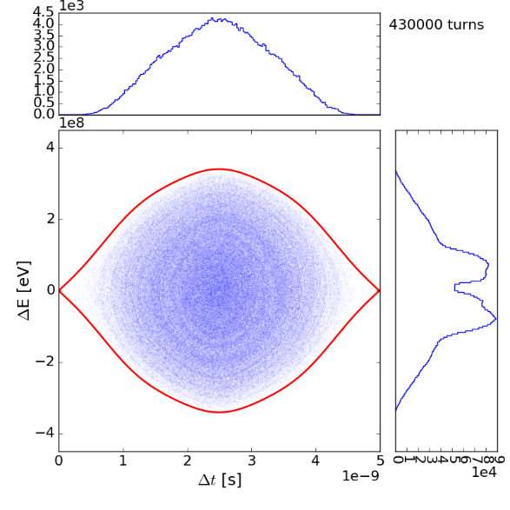
Blow-up implementation
For the moment only tested through ramp with 12 bunches and an arbitrary amplitude of the noise with a flat spectrum (too high)

Slide 38
Conclusions and future work
HF noise issues
Increase stability threshold
Where and how apply a filter to keep all physical effects ?
Simulations with more macroparticles would decrease noise effects -> require more computational time
Ongoing studies to quantify the effects of the noise.

Slide 39
Conclusions and future work
HF noise issues
Increase stability threshold
Where and how apply a filter to keep all physical effects ?
Simulations with more macroparticles would decrease noise effects -> require more computational time
Ongoing studies to quantify the effects of the noise.
Blow-up now possible in simulation
Allow to reach larger value of emittance during ramp
Based on values used in operation -> next step, compared with measurement.

Slide 40
Thank you for your attention !
Acknowledgement
Thank to H. Timko and D. Quartullo for the implementation of the noise generation.
Thank to J.E. Müller for the filter’s implementation.
Many thanks to the BLonD team for countless fruitful discussions.

