Slide 1
Missing impedance from synchrotron frequency shift s LIU-SPS Beam Dynamics Working Group 04/08/2016
A. Lasheen, T. Bohl, E. Shaposhnikova
Acknowledgments: BR section, OP team, MD coordinators

Slide 2
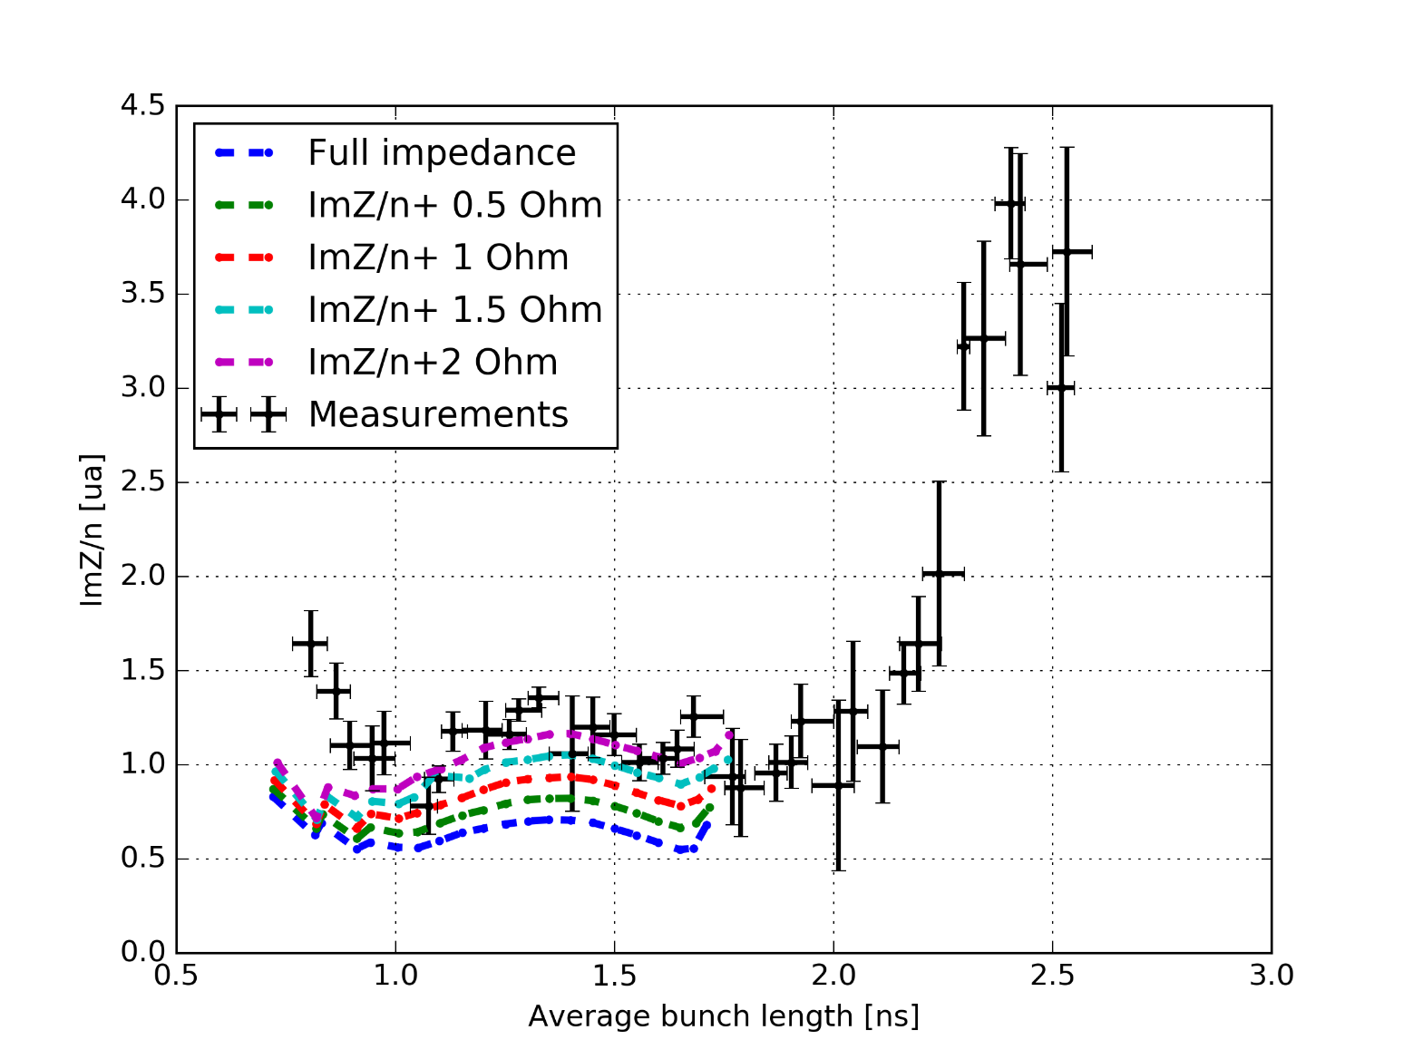
Missing impedance ?
The comparison of simulations and measurements suggest that ImZ/n~2 Ohm is missing from the impedance model… (Space charge in Q26: ImZ/n~ -1.3 Ohm)
Other sources of discrepancies are being evaluated (distribution, etc…)

Slide 3
Outline
Correction of the measurement line transfer function
New measurements results and analysis in the Q20 optics
Estimation of the missing impedance in Q26 and Q20

Slide 4
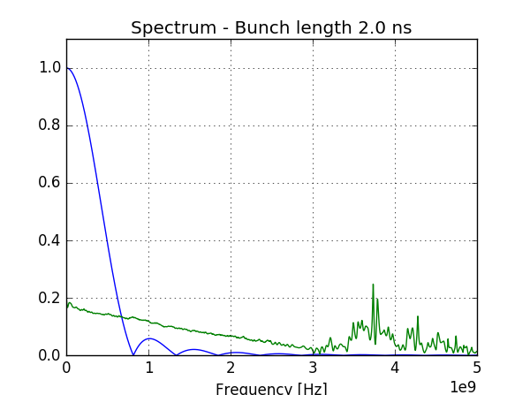
Measurement line transfer function
The measurement line transfer function (TF) is altering the measured longitudinal profile and is composed of:
Longitudinal pick-up
Cables and fiber-optic link up to the BA3 Faraday cage
The TF was obtained from pulse measurements (deconvolution of a perturbed pulse w.r.t. a reference one)
Data > 3GHz is unphysical and may introduce some corrections errors (mainly for bunch length < 1ns, and for the tails distribution)
$$λ_{meas}= ℱ^{−1}\left[σ_{bunch} 𝒵_{TF}\right]$$

Slide 5
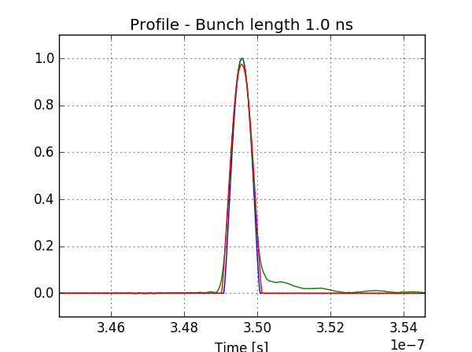
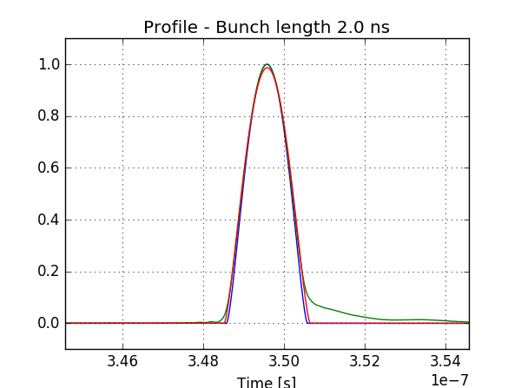
Measurement line transfer function
Blue: the original bunch profile => $λ=λ_{0}{\left(1−4{\left(\frac{t}{τ_{full}}\right)}^{2}\right)}^{\frac{3}{2}}$
Green: the perturbed profile
Red: the fitted profile from the perturbed one
The perturbation is small, the bunch is slightly lengthened (+ some extra tails)

Slide 6
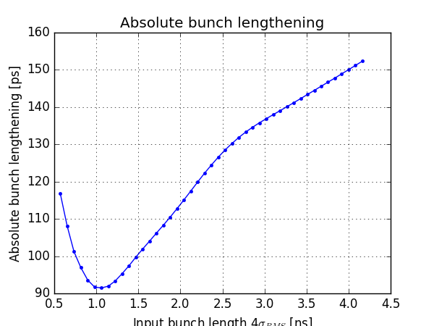
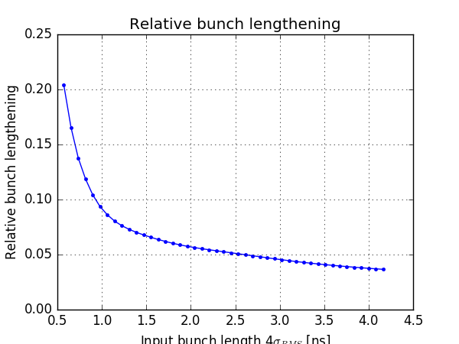
Bunch lengthening from TF
The bunch length is defined as $τ_{4σ}=4σ_{RMS}$ (computed from the fitted profile)
The bunch lengthening is around 100-150ps depending on the input bunch length which corresponds to 5% to 10% lengthening (results are uncertain bellow 1ns due to the TF noisy data above 3GHz)

Slide 7
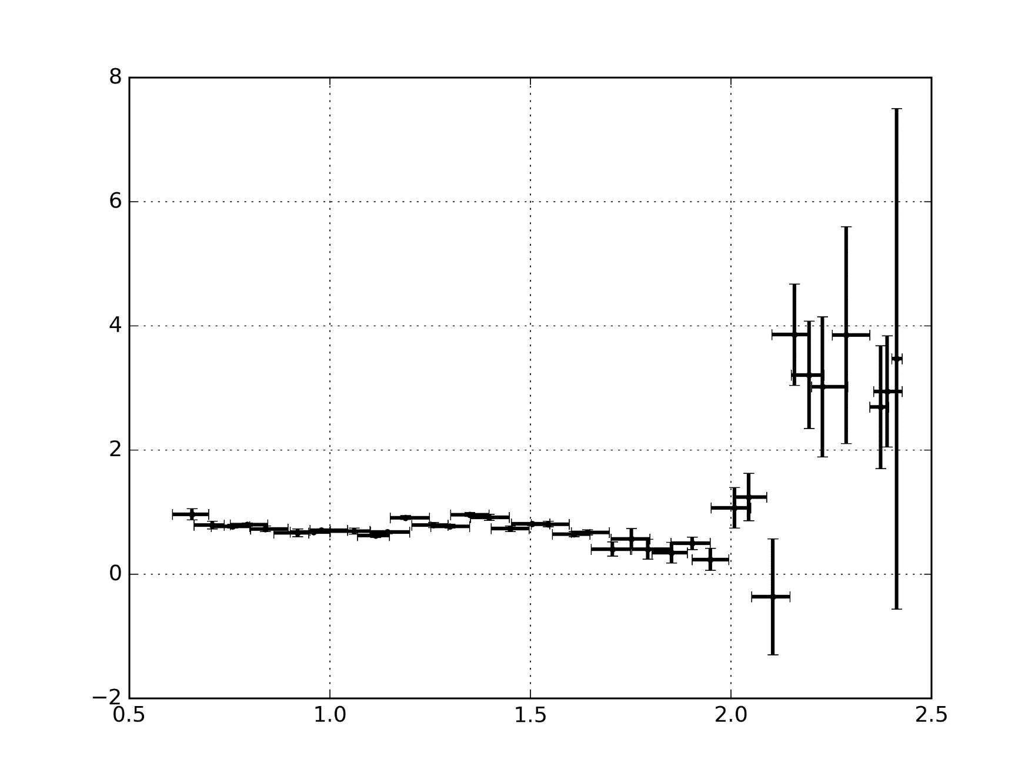
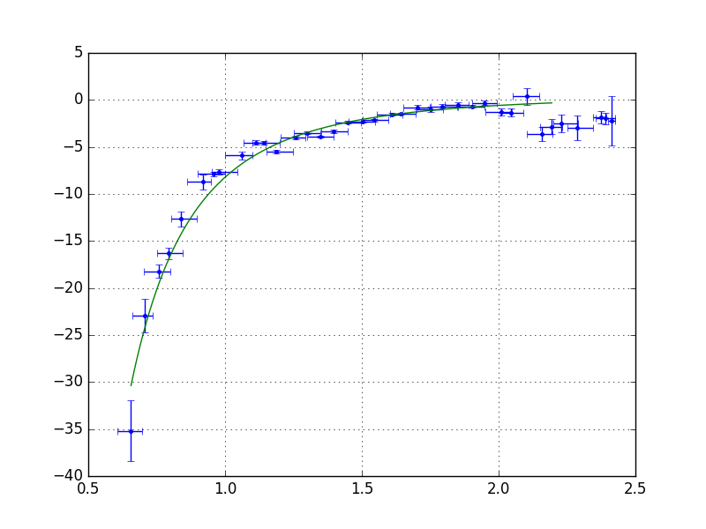
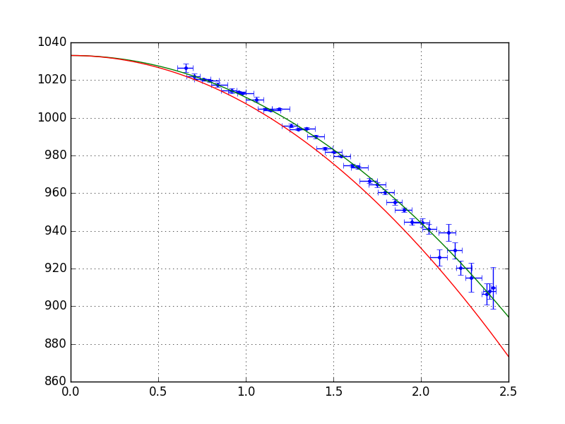
Measurements in Q20
Slope b [${10}^{−10}$Hz]
ImZ/n [au]
Average Bunch length [ns]
Average Bunch length [ns]
Measurements done in Q20 with V = 2.6 MV (same acceptance as for Q26 studies A~0.46eVs), after data analysis the actual RF voltage appeared to be V=2.8MV
Results are very similar to Q26 after rescaling with: ${\left(\frac{ImZ}{n}\right)}_{fit}=\frac{b}{a}\frac{ω_{0}^{2}τ^{3}V_{RF}h}{6e}$
$2f_{s0}$ corresponding to V=2.8MV
Origin a [Hz]
$$f_{2s}^{\left(0\right)}\left(τ\right)≈2f_{s0}\left(1−\frac{{\left(ω_{RF}τ\right)}^{2}}{64}\right)$$
Average Bunch length [ns]

Slide 8
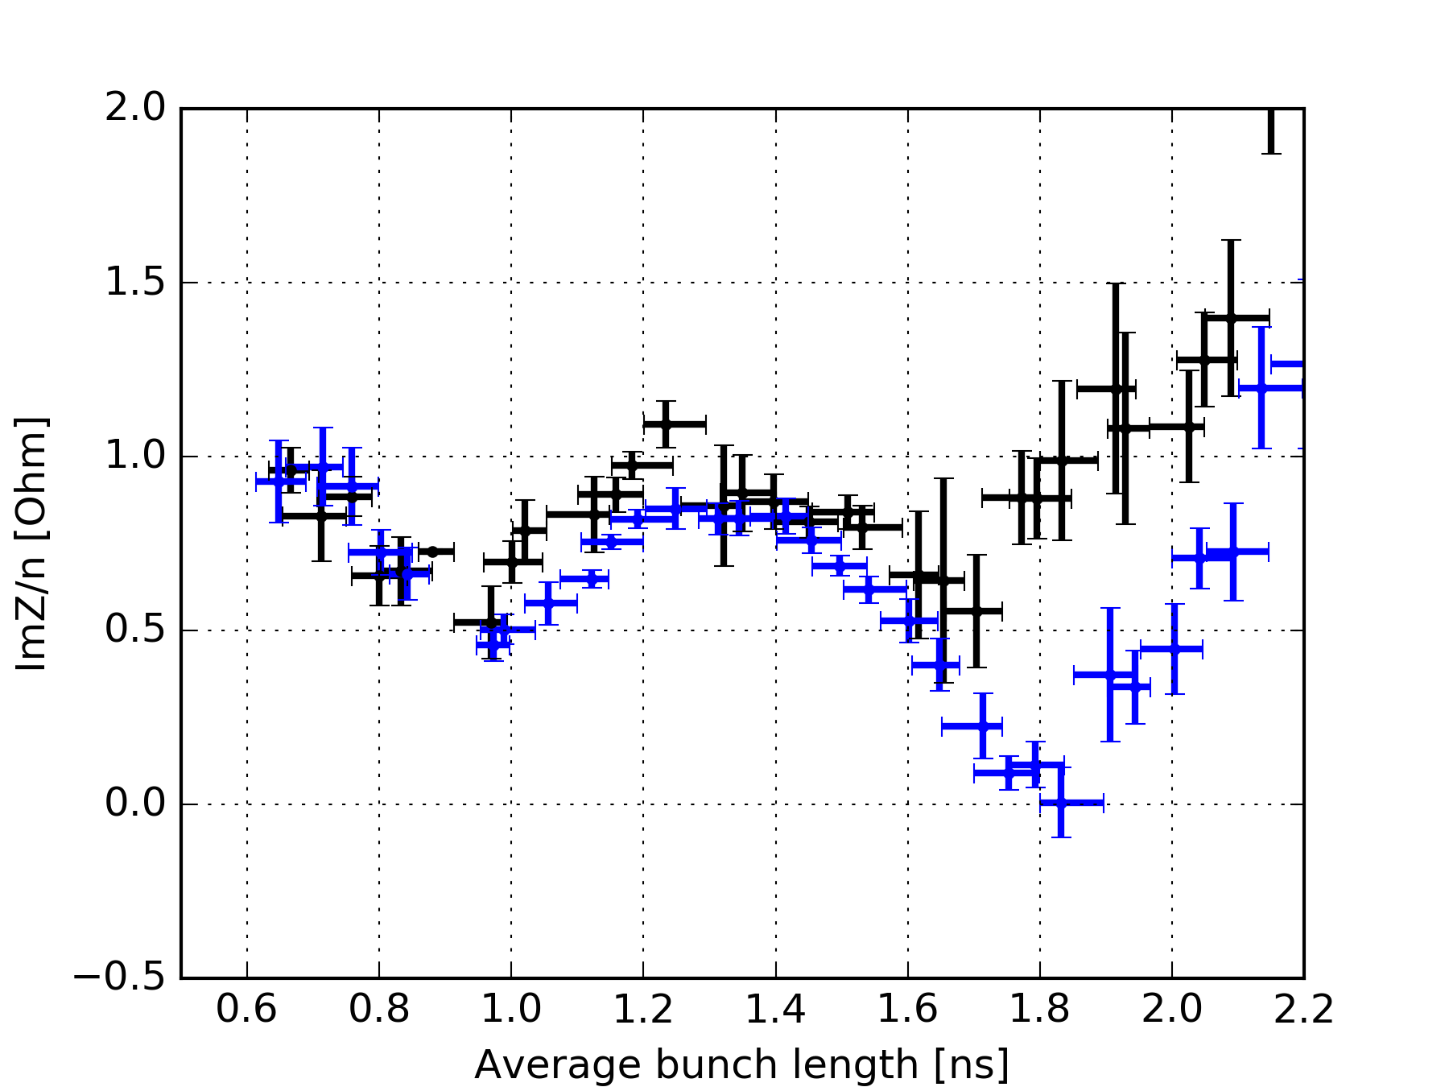
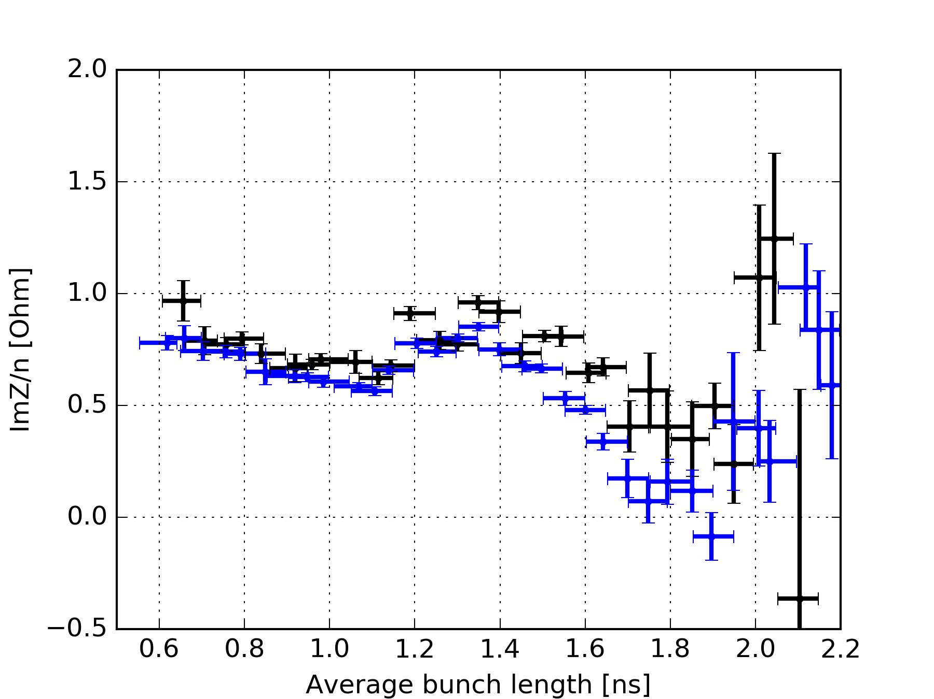
Comparison with simulations
Q26
Q20
The data analysis is including the corrections of the TF.
Simulations were done by taking each acquisition and using the exact same line density, and generating a mismatched bunch to have the same peak-to-peak bunch length oscillations.
Measurements in Q20 and Q26 give very similar results/pattern, except at 1.8 ns (may be more sensitive to the bunch distribution and coherent effects for bigger bunch lengths)
In both cases, comparing measurements (black) with simulations (blue) show that some little impedance is missing.

Slide 9
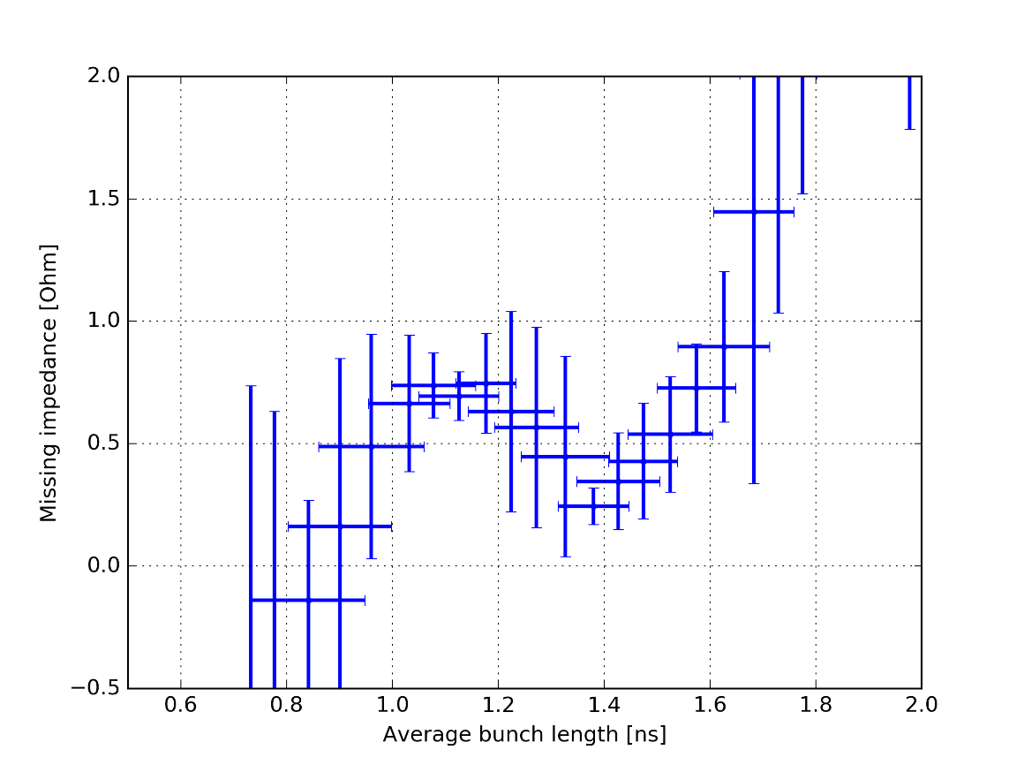
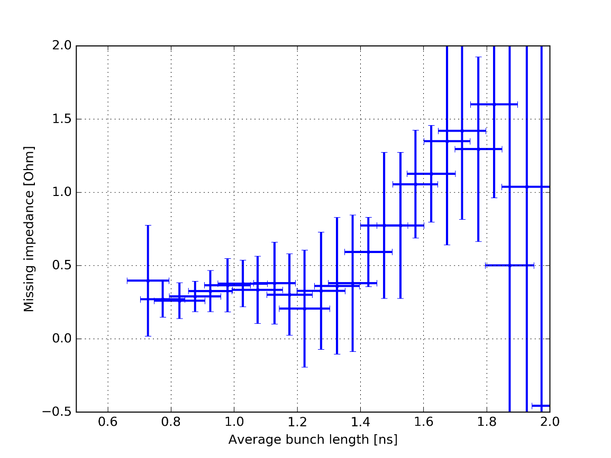
Evaluation of the missing impedance
Q26
Q20
Simulations were done by adding a pure inductive impedance and scanning ImZ/n from -0.5 to 2 Ohm.
For each bunch length, the necessary ImZ/n to add to have a perfect agreement was estimated.
The missing impedance is around 0.3-0.5 Ohm for bunch length <1.4ns, for bunch length > 1.4ns an increasing inductive impedance is missing (resonator at low frequency)

Slide 10
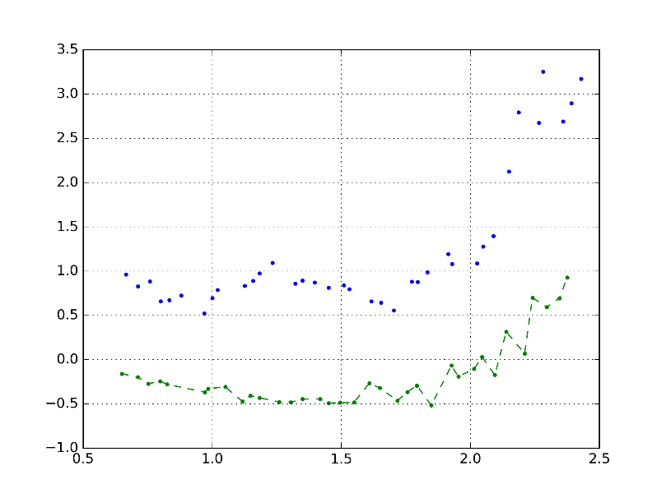
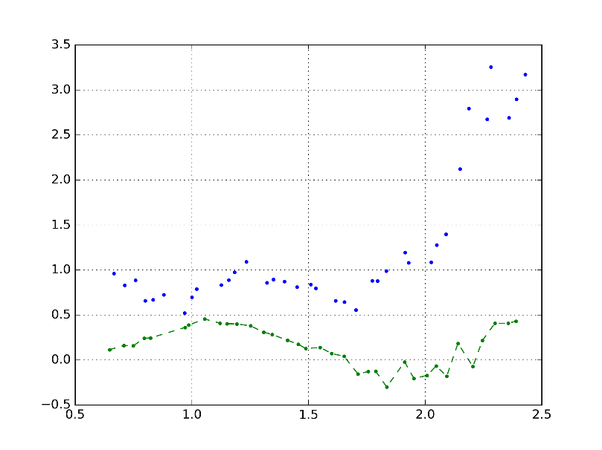
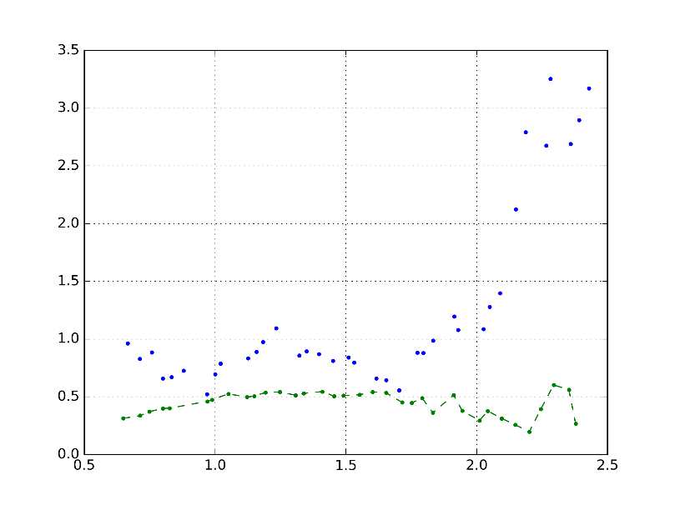
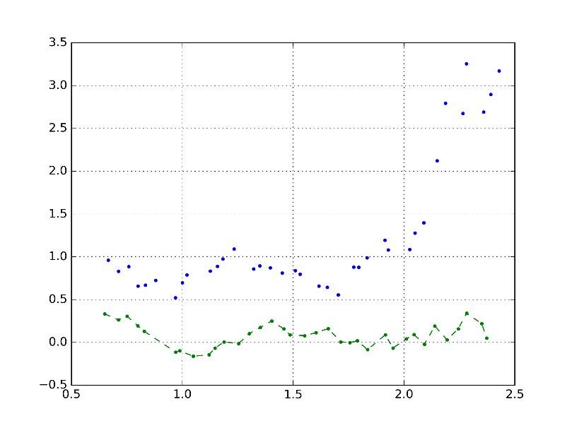
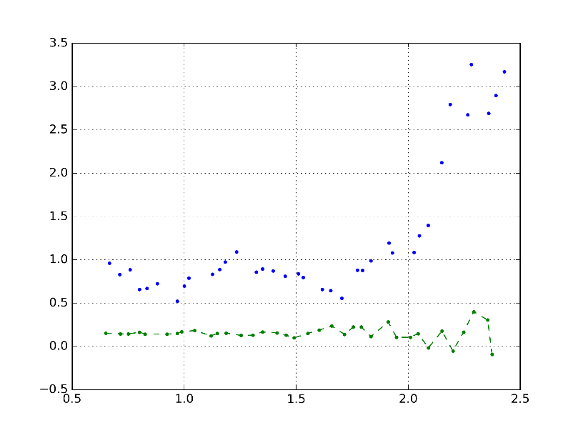
Impact of the various impedance sources
TWC200
TWC800
Kickers
ImZ/n [au]
Average Bunch length [ns]
Average Bunch length [ns]
Average Bunch length [ns]
Flanges (1.4GHz)
Remaining impedances
ImZ/n [au]
Average Bunch length [ns]
Average Bunch length [ns]
The influence of each impedance group was tested one by one to better evaluate the frequency dependence of the missing impedance

Slide 11
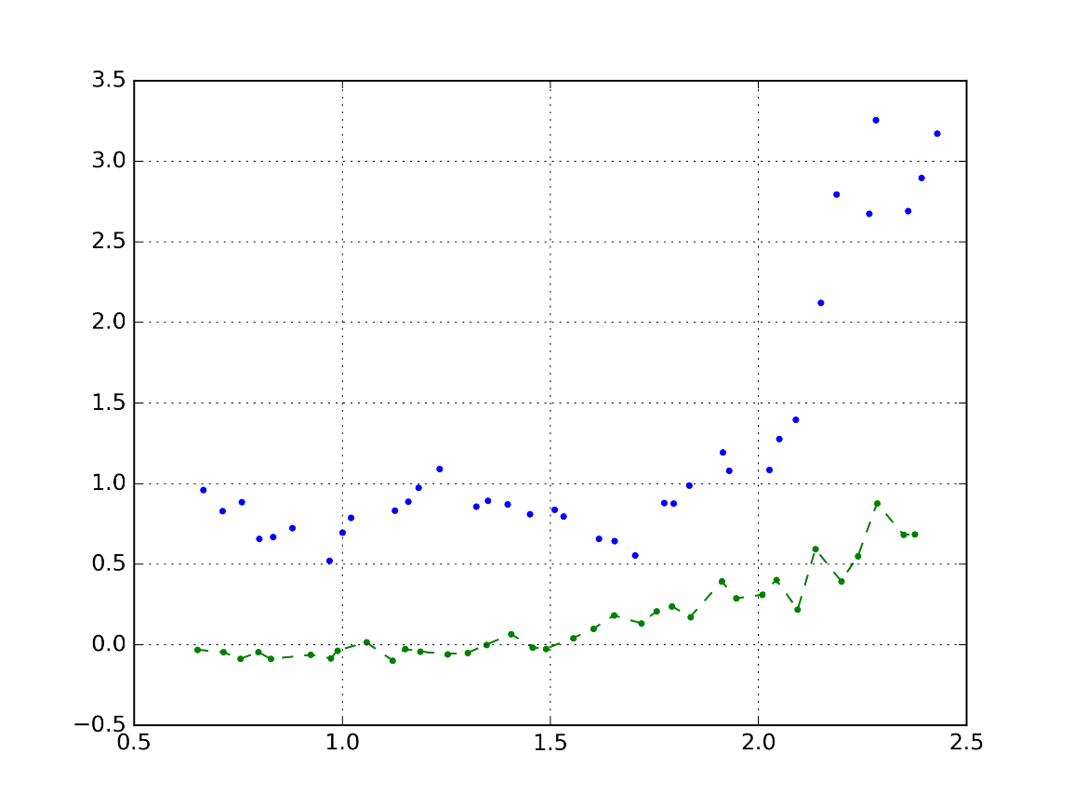
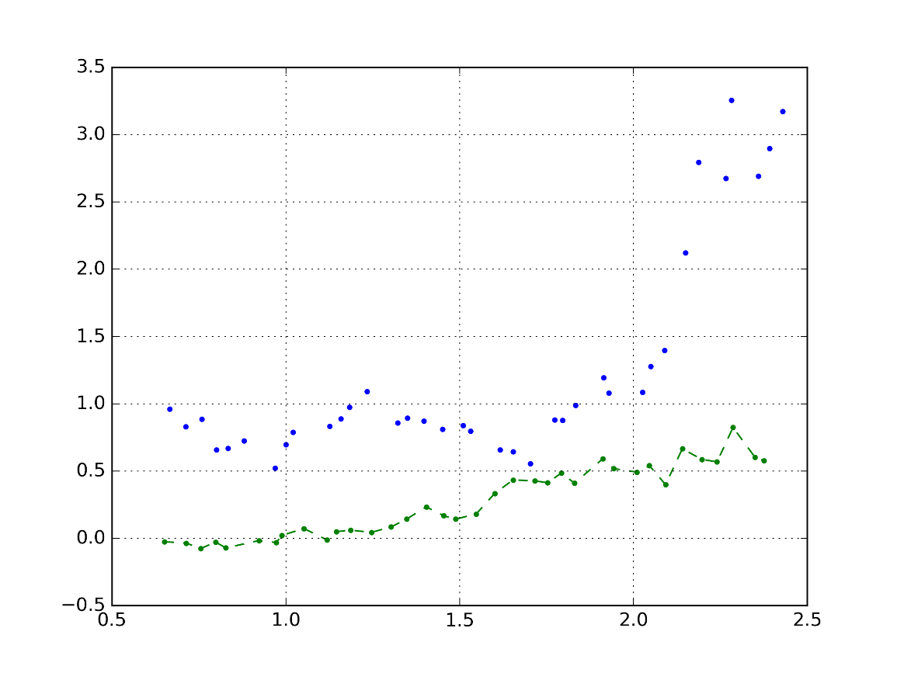
Impact of the various impedance sources
Q26 – 1 resonator 300MHz
Q26 – 1 resonator 400 MHz
ImZ/n [au]
ImZ/n [au]
Average Bunch length [ns]
Average Bunch length [ns]
A single resonator is used for the simulations and its parameters $f_{r}$ and $R/Q$ were scanned (the results are independent with Q)
To obtain the expected missing impedance pattern, the range of $f_{r}$ is around 300-400MHz

Slide 12
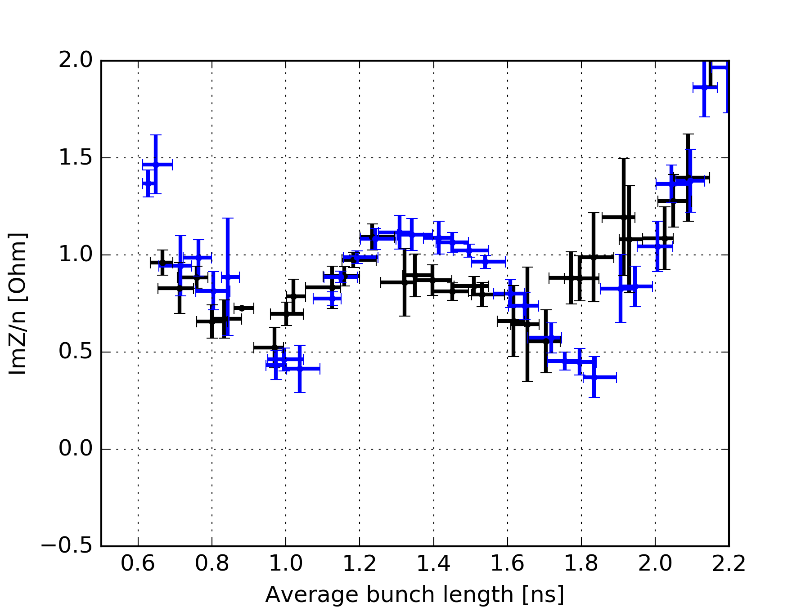
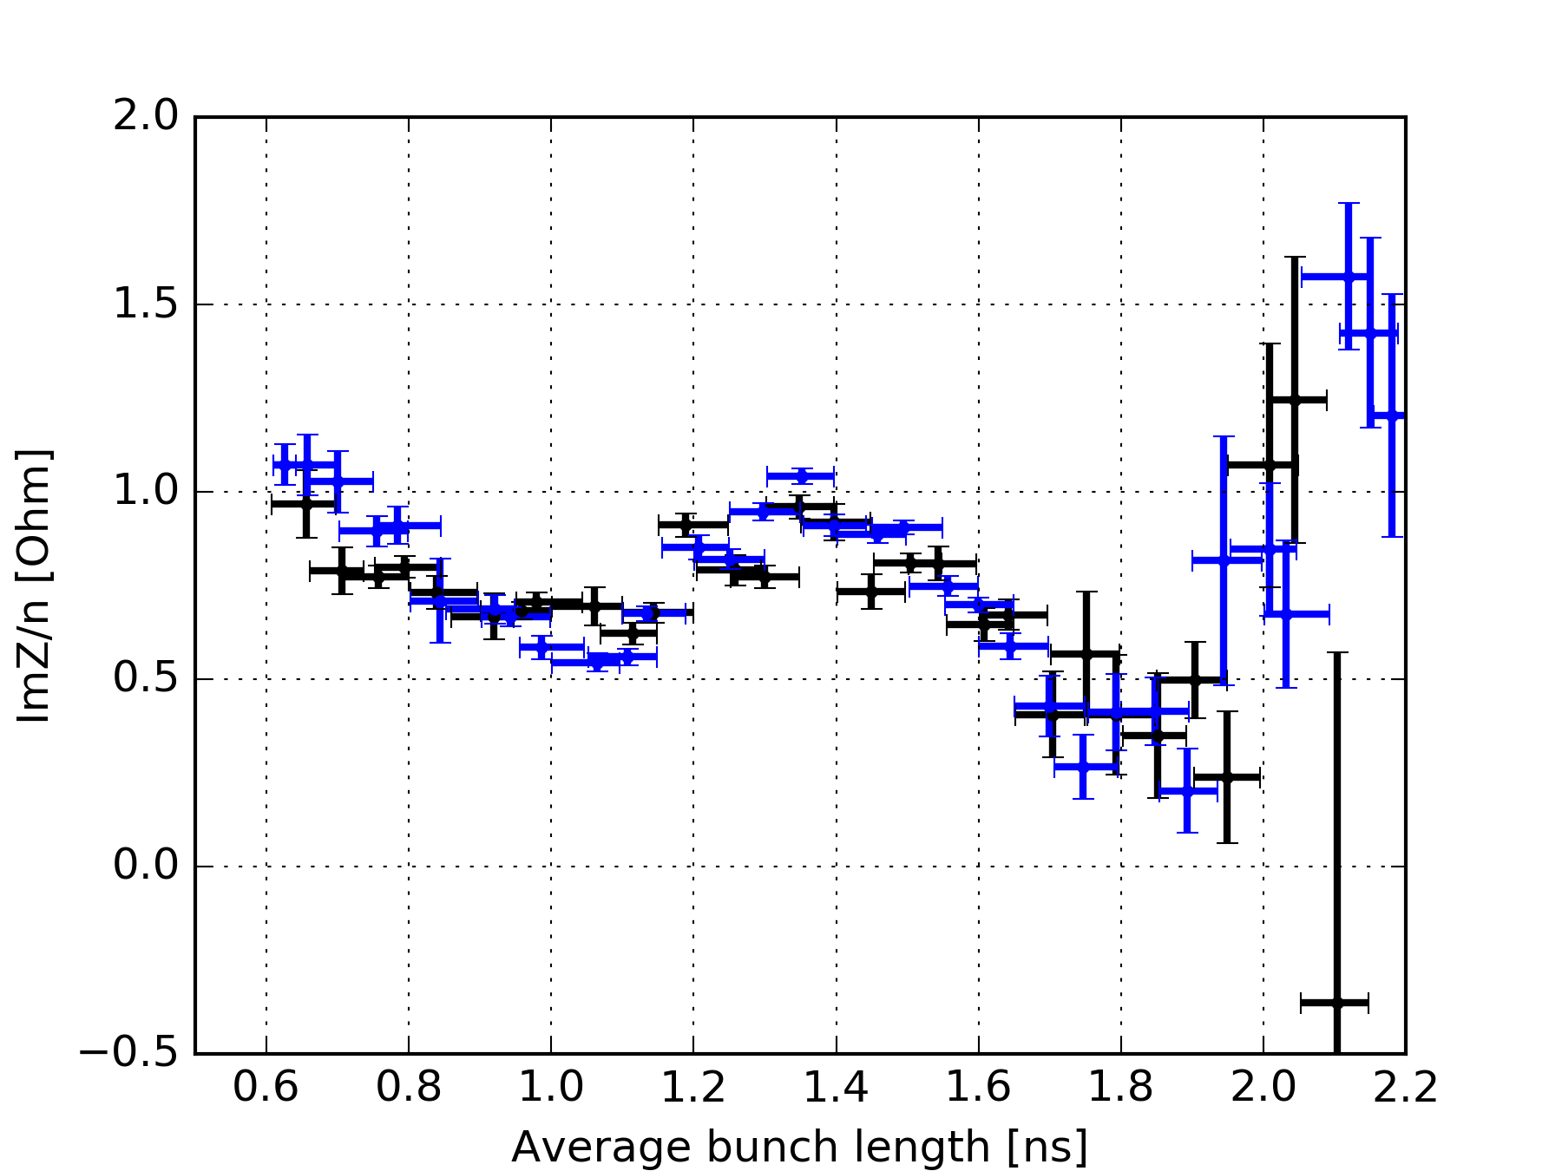
Adding a single resonator
Q26
Q20
A better agreement can be found by adding to the full impedance model a resonator with $f_{r}=350$ MHz ($±100$MHz) and $R/Q=3 kΩ$ ($±1 kΩ$)
Q was set to 10

Slide 13
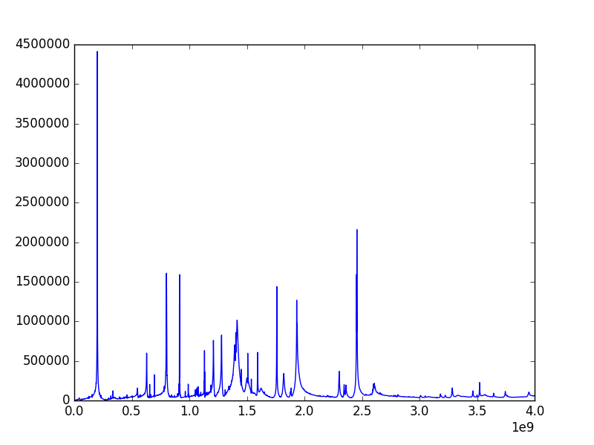
Adding a single resonator
The extra resonator is this small bump
Z [Ohm]
f [Hz]

Slide 14
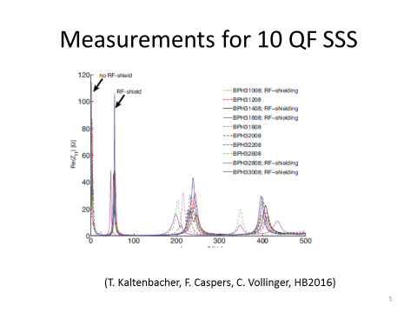
Possible candidates ?
E. Shaposhnikova – LIU-SPS Coordination meeting 03/08/2016
Low freq resonances flanges
Beam dump gaps
T. Roggen – LIU-SPS Beam Dynamics Working Group meeting 16/04/2015
TWC200 HOM
Non conform pumping ports

Slide 15
Conclusions
In overall, some impedance seem still to be missing.
Including the corrections of the measurement line transfer function, around ImZ/n~0.3-0.5 Ohm (instead of ImZ/n~2 Ohm without the correction)
The measurements uncertainty and the high amount of parameters to control lead to big error bars, making difficult to estimate the missing impedance.
Nevertheless, the bunch length dependence of the missing impedance indicates that to reach a better agreement a resonance sitting around in the range of 300-400MHz would be required.

